Slide 1

Building RESTful APIs with Node and Express
Full stack Skills Bootcamp

Slide 2
Building RESTful APIs with Node and Express
Lesson Overview:
In this lesson, we will be introduced to:
What is RESTful and CRUD
Setting up Express and Express routes
Working with JSON
.gitignore
Deploying a Node/Express application

Slide 3
What is RESTful?
REST (Representational State Transfer) is an architectural style for designing APIs.
Key principles:
Stateless
Client-Server
Cacheable
Uniform Interface
Example: A REST API for a Notes Application

Slide 4
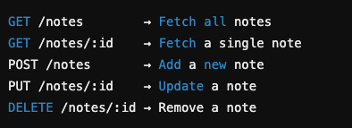
What is CRUD?
CRUD Operations:
Read (GET) – Retrieve existing data
Create (POST) – Add new data
Update (PUT/PATCH) – Modify existing data
Delete (DELETE) – Remove data

Slide 5

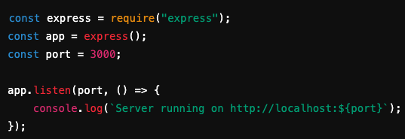
Setting Up a Simple Express Server
Install Node.js and Express
Create server.js

Slide 6


Express Routes & Wildcards
Defining routes in Express
Using route parameters (wildcards)

Slide 7

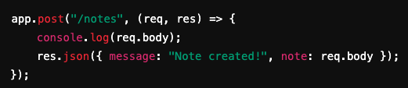
Real World Applications for TDD
Handling JSON Data in Express Middleware for handling JSON requests
Example POST request

Slide 8

Serving Static Files in Express
Serving Static Files in Express
Serving static frontend files such as HTML, CSS, and JavaScript.
Setting up Express to serve static files
Access frontend files by visiting http://localhost:3000/.

Slide 9

GitIgnore: How to Exclude Files and Folders from a Repository
Purpose of .gitignore: Prevent certain files or folders from being tracked by Git.
Typical Example

Slide 10
Real World Examples of .gitignore
Common Scenarios: Node.js projects: Exclude node_modules/. Environment files: Exclude .env to protect sensitive information. Log files: Prevent log files from cluttering the repository.

Slide 11

Deploying to Render.com
Why Render.com? Free hosting for Node.js applications Easy deployment from GitHub
Steps to deploy:
Push project to GitHub
Create a Render account
Click New Web Service and connect the repository
Set the Start Command to

Slide 12
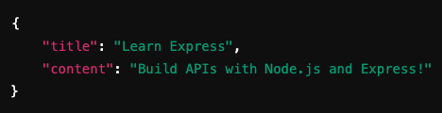
Testing the API with Postman
Testing the API with Postman Install and open Postman. Send a GET request to http://localhost:3000/notes. Send a POST request with JSON data

Slide 13
Conclusion
Building RESTful APIs with Express is a crucial skill for full-stack development. Mastering these concepts will allow you to create scalable, efficient, and deployable applications. Keep practicing, experimenting, and improving your API development skills!

Slide 14
Questions?

