Slide 1

Introducing Python
Full stack Skills Bootcamp

Slide 2
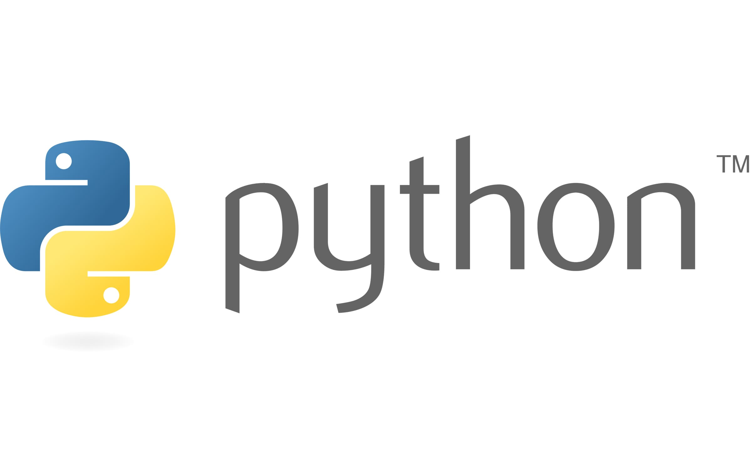
Introducing Python
Lesson Overview:
In this lesson, we will be introduced to:
Installing Python & Running in VSCode
Virtual Environments
Debugging in VSCode
Variables, Loops, and Functions

Slide 3
A Short History of Python
Created by Guido van Rossum in 1991
Designed for readability and simplicity
Common uses
Web Development (Django, Flask)
Data Science & AI (Pandas, NumPy, TensorFlow)
Automation & Scripting
Game Development & Cybersecurity
Artificial Intelligence

Slide 4
Why learn Python?
More readable and concise than JavaScript
Used heavily in AI, ML, and automation
Strong community and vast ecosystem

Slide 5
Installing Python & Running in VSCode
Installation: Download Python from python.org Add Python to system PATH during installation
Setting up VSCode: Install the Python extension Open a .py file and select the Python interpreter).
Running Python Code in VSCode: Run a script: python script.py Use the VSCode terminal or built-in debugger

Slide 6
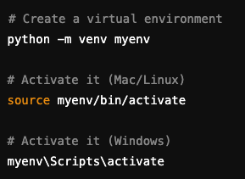
Virtual Environments
Why use Virtual Environments? 1. Keeps dependencies isolated 2. Prevents version conflicts 3. Best practice for Python projects
Creating & Activating a Virtual Environment: demo…

Slide 7
Debugging Functions in VSCode
What is Debugging?
Debugging is the process of identifying and fixing errors in your code.
Helps you understand how your program executes step by step.

Slide 8
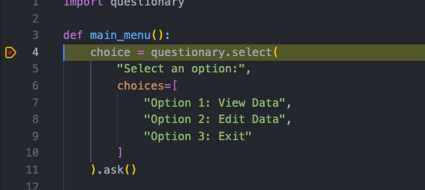
Why Use a Debugger in VSCode?
See variable values at each step
Pause code execution at breakpoints
Find and fix logical errors efficiently

Slide 9
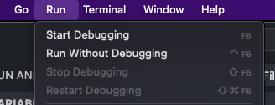
Setting Up Debugging in VSCode
Open your Python file in VSCode
Add breakpoints (Click left of the line number)
Run the debugger (Click Run → Start Debugging or press F5)
Step through the code using Step Over (F10), Step Into (F11)

Slide 10

Common Debugging Features
Breakpoints – Stops execution at a specific line
Step Over – Executes the next line without stepping into functions
Step Into – Steps inside function calls
Watch Variables – Observe how values change
Call Stack – See the function execution order demo…

Slide 11

Variables, Loops & Functions
What are Variables? Variables store values in memory. No need to declare types (dynamic typing like JavaScript).

Slide 12

Python Loops – for Loop
Python for loop Used to iterate over sequences like lists or strings.

Slide 13
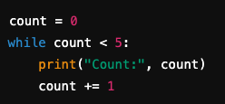
Python Loops – while Loop
Python while loop Executes as long as a condition is True.

Slide 14
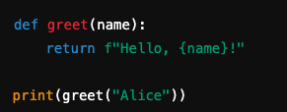
Defining Functions in Python
Python functions Like JavaScript, Functions help organize reusable code.

Slide 15
Conclusion
Debugging in VSCode helps find errors easily.
Variables store data dynamically in Python.
Loops (for, while) help automate repetitive tasks.
Functions make code reusable and organised.

Slide 16
Questions?

