Slide 1

SQL ORM and JWT Authentication
Full stack Skills Bootcamp

Slide 2
SQL ORM and JWT Authentication
Lesson Overview:
In this lesson, we will be introduced to:
What is JWT
Creating and signing tokens
Middleware
Using tokens client-side
Session Authentication

Slide 3
What is a JWT?
JWT stands for JSON Web Token.
A compact, URL-safe way to represent claims between two parties.
Typically used for authentication and authorization.
Consists of three parts: Header, Payload, and Signature.

Slide 4
Real-World Use Cases for JWT
Secure API authentication.
User session management.
Single Sign-On (SSO) implementations.
Data exchange between services without requiring a database lookup

Slide 5
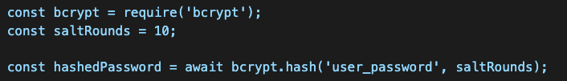
Handling Password Encryption in Sequelize with bcrypt
Why Hash Passwords?
Protects user credentials.
Prevents plaintext password storage. Using bcrypt to Hash Passwords:

Slide 6
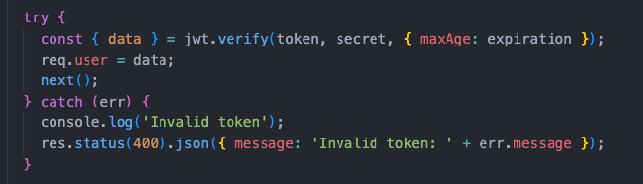
Handling Password Encryption in Sequelize with bcrypt
Verifying Passwords:

Slide 7
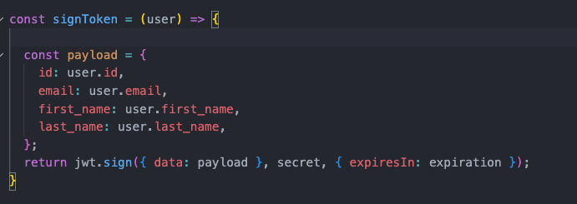
Signing a JWT
Generating a Token:
Tokens are created using a signing process

Slide 8
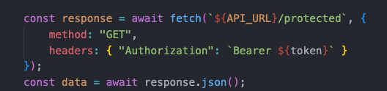
Using a JWT Client-Side with JavaScript
Store the JWT in localStorage or sessionStorage.
Include the JWT in API requests via headers

Slide 9
Session Authentication
JWT vs. Session-based authentication.
Sessions require server-side storage.
JWT authentication is stateless and scalable.

Slide 10
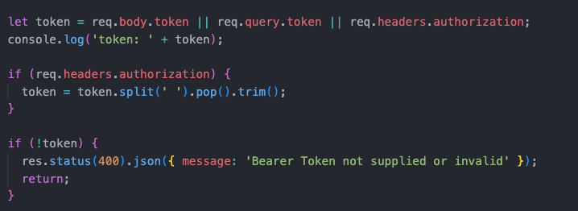
Auth Middleware
Middleware to protect routes using JWT authentication.
It intercepts a request and checks for a valid token before passing control to the route

Slide 11

Protecting Routes Using Middleware
Protecting routes The auth middleware function can be added as a parameter to the route
The ensures the middleware function runs first
The middleware function checks the JWT and allows the route to run or not

Slide 12
Review: The Auth Lifecycle
User signs up with a password (hashed using bcrypt).
User logs in and receives a JWT.
The client stores and uses the JWT for authentication.
Protected routes validate JWT via middleware.
JWT expires or user logs out, requiring re-authentication.

Slide 13
Useful resources
JWT Official Docs
Sequelize Documentation
bcrypt Documentation
Node.js Documentation

Slide 14
Conclusion & Questions
JWT enables secure, scalable authentication.
Sequelize and bcrypt enhance user security.
Implementing authentication properly is crucial.

Slide 15
Questions?

