Slide 1
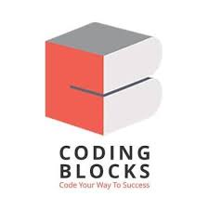
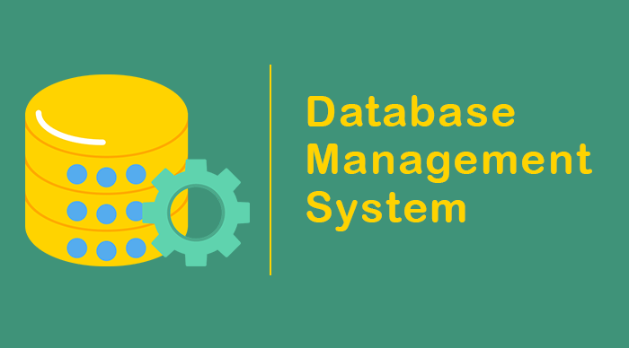
.

Slide 2
What is Data And Database ? Data is different types of information usually formatted in a particular manner. Database is an organized collection of structured information, or data, typically stored electronically in a computer system.

Slide 3
What is DBMS ? A DBMS Consists of collection of set of application programs used to access, update and manage that data. A software system that allows users to store, manage, and manipulate vast amounts of data in a structured and organized manner. DBMS provides an interface between the users or applications and the underlying database, facilitating efficient data storage, retrieval, modification, and deletion.

Slide 4
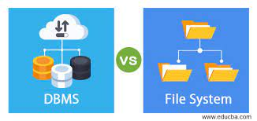
File System to DBMS

Slide 5
Advantages of DBMS .Data Sharing .Data searching .Data Security .Backup .Maintenance

Slide 6
Disadvantages of DBMS . Comlex Structure of DBMS . High Maintenance . Compatibility . Cost of Hardware and Software

Slide 7
Characteristics of Database approach The database approach, also known as the database management system (DBMS) approach, is a method for storing, managing, and organizing data in a structured manner. It involves the use of a database management system to create, manipulate, and maintain databases.

Slide 8
1. Data Independence 2. Data Integrity 3. Data Security 4. Data Sharing and Concurrency Control 5. Data Querying and Manipulation 6. Data Scalability and Performance 7. Data Durability and Recovery

Slide 9
Database Architectures 1. Relational Database Management System (RDBMS) 2. NRDBMS/NoSQL 3. Distributed Databases

Slide 10
Database Languages 1. SQL (Structured Query Language) 2. MQL (MongoDB Query Language)

Slide 11
Popular DBMS Software 1. Oracle Database 2. MySQL 3. Microsoft SQL Server 4. PostgreSQL 5. MongoDB

Slide 12
Database Administrator and its Responsibility 1. Database Installation and Configuration 2. Database Design and Schema Management 3. Data Security and Access Control 4. Performance Monitoring and Tuning 5. Backup and Recovery 6. Database Maintenance and Upgrades 7. Data Replication and High Availability 8. Capacity Planning and Scalability

Slide 13
Schema ,Instance and Schema Architecture Schema: A schema represents the overall design and layout of the database objects, such as tables, views, indexes, and constraints. Instance: It represents the actual data stored in the database system, including the content of tables, indexes, and other database objects. Schema Architecture: Schema architecture refers to the design and organization of schemas within a database system. 1. Single-schema architecture 2. Three-schema architecture

Slide 14
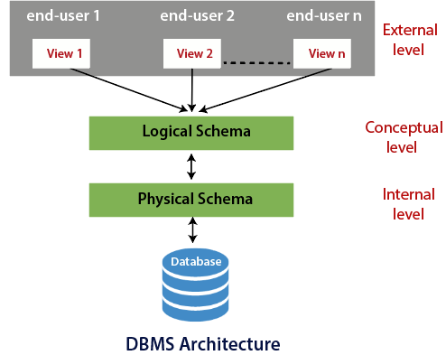
Three-schema architecture

Slide 15
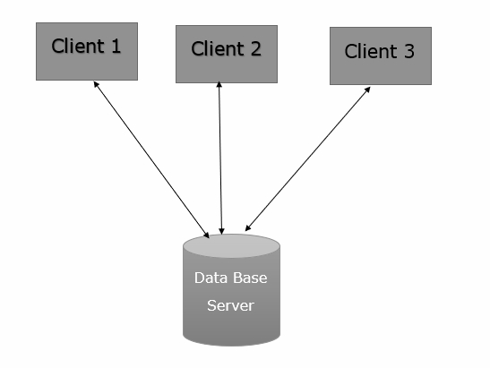
Database System Architecture 1. Two-tier Architecture: The two-tier architecture, also known as the client-server architecture, consists of two layers: the client layer and the server layer. In this architecture, the client layer directly communicates with the database server.

Slide 16
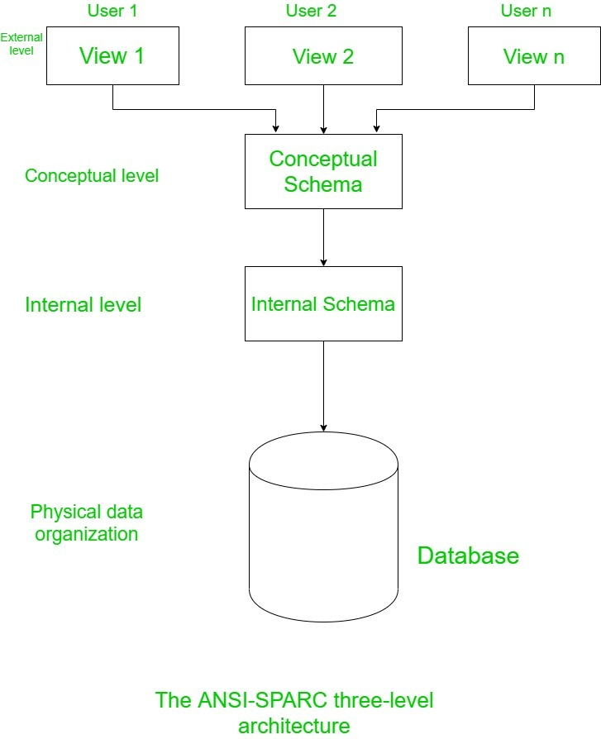
2. Three Level ANSI-SPARC Architecture

