Slide 1
Anchor Tag (<a>)
<a> creates hyperlinks
Can link to websites, email, phone, file, downloads
Key attributes: href, target, title, download
<a href="URL“ >Link Text</a>

Slide 2
Media Tags
<img> – Images (Embeds an image)
Attributes: src, alt, width, height
<video> – Videos (Plays video files)
Attributes: src, controls, autoplay, loop, muted
<audio> – Audio(Plays audio files)
Attributes: controls, autoplay, loop, muted
<iframe> – Inline Frame(Embeds another webpage, video, or map)
Attributes: src, width, height, allowfullscreen

Slide 3
Form Tags
<form> → Form container (action, method)
🔹 <input> → Text, password, radio, checkbox, email, number, file, etc.
🔹 <label> → Label for input fields
🔹 <textarea> → Multi-line text input
🔹 <button> → Submit / Reset / Normal button
🔹 <select> & <option> → Dropdown menu
🔹 <datalist> → Predefined suggestions for input fields
🔹 <fieldset> → Groups related form elements 🔹 <legend> → Title/Caption for a fieldset

Slide 4
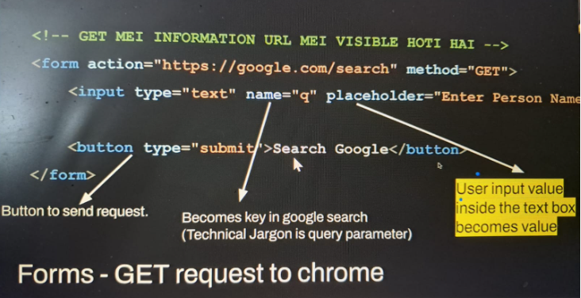
Form Working

Slide 5
Reference
https://www.w3schools.com/
https://developer.mozilla.org/en-US/

