Slide 1
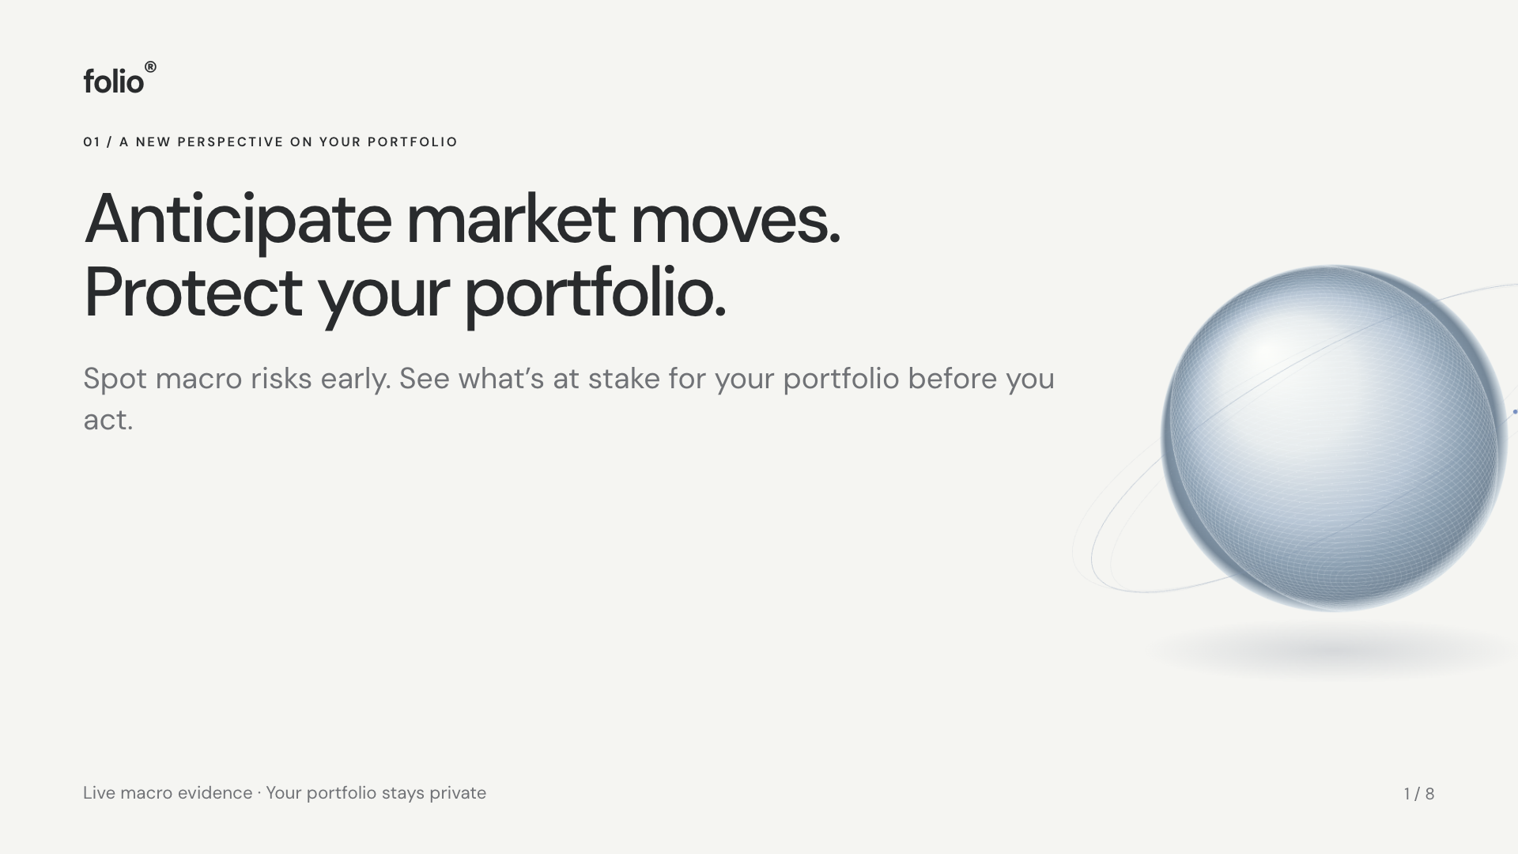
Notes:
Anticipate market moves. Protect your portfolio.
{"label":"A new perspective on your portfolio","title":"Anticipate market moves. Protect your portfolio.","body":["Spot macro risks early. See what’s at stake for your portfolio before you act."],"note":"Live macro evidence · Your portfolio stays private"}
Visual export of the HTML deck at https://folio-macro-companion.vercel.app/pitch.html. Edit shared content in public/pitch-data.js. Bayesian news updating and identified causal effects are future work; current portfolio returns are assumptions. Revenue is an illustrative annual subscription scenario.

Slide 2
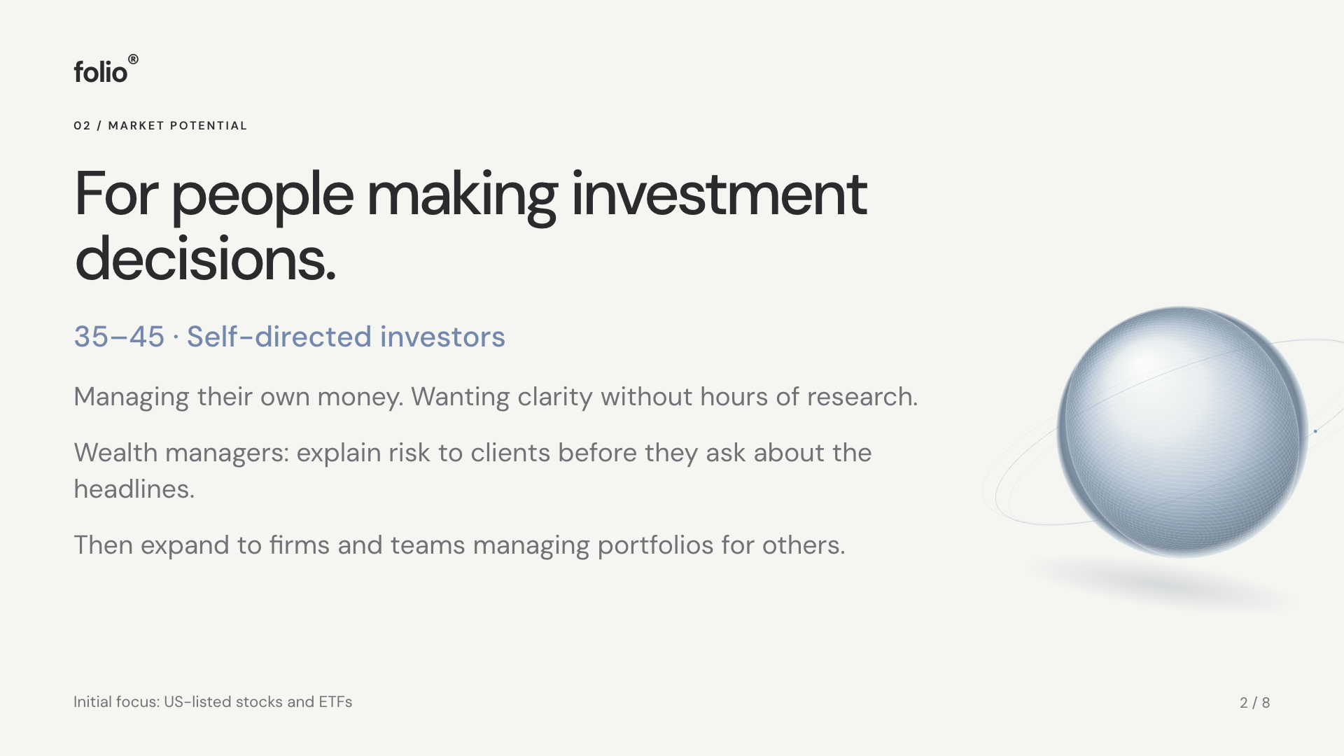
Notes:
For people making investment decisions.
{"label":"Market potential","title":"For people making investment decisions.","accent":"35–45 · Self-directed investors","body":["Managing their own money. Wanting clarity without hours of research.","Wealth managers: explain risk to clients before they ask about the headlines.","Then expand to firms and teams managing portfolios for others."],"note":"Initial focus: US-listed stocks and ETFs"}
Visual export of the HTML deck at https://folio-macro-companion.vercel.app/pitch.html. Edit shared content in public/pitch-data.js. Bayesian news updating and identified causal effects are future work; current portfolio returns are assumptions. Revenue is an illustrative annual subscription scenario.

Slide 3
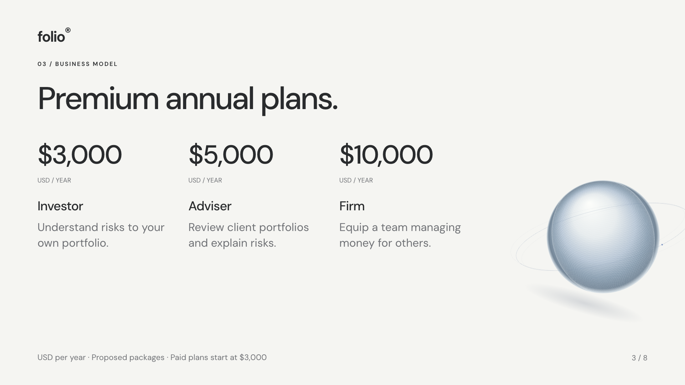
Notes:
Premium annual plans.
{"label":"Business model","title":"Premium annual plans.","prices":[["$3,000","Investor","Understand risks to your own portfolio."],["$5,000","Adviser","Review client portfolios and explain risks."],["$10,000","Firm","Equip a team managing money for others."]],"note":"USD per year · Proposed packages · Paid plans start at $3,000"}
Visual export of the HTML deck at https://folio-macro-companion.vercel.app/pitch.html. Edit shared content in public/pitch-data.js. Bayesian news updating and identified causal effects are future work; current portfolio returns are assumptions. Revenue is an illustrative annual subscription scenario.

Slide 4
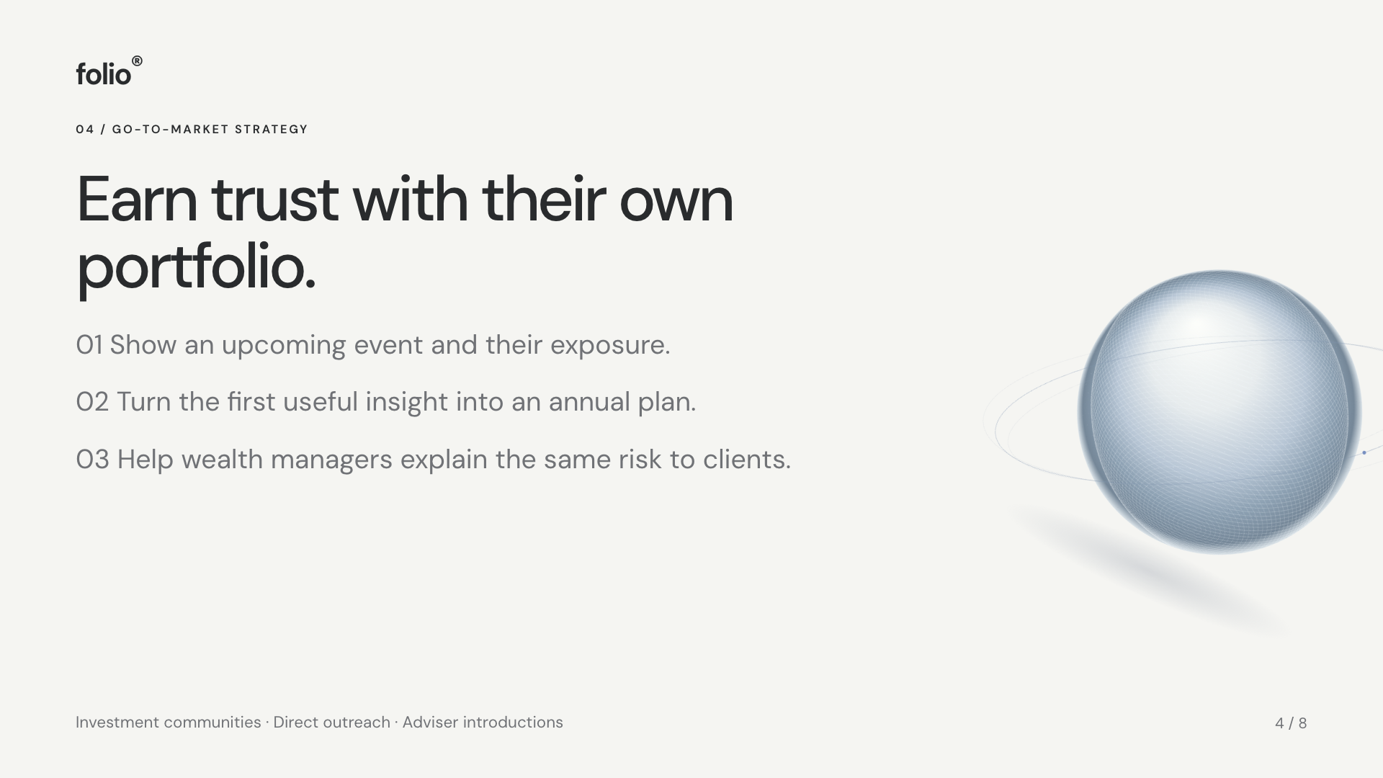
Notes:
Earn trust with their own portfolio.
{"label":"Go-to-market strategy","title":"Earn trust with their own portfolio.","body":["01 Show an upcoming event and their exposure.","02 Turn the first useful insight into an annual plan.","03 Help wealth managers explain the same risk to clients."],"note":"Investment communities · Direct outreach · Adviser introductions"}
Visual export of the HTML deck at https://folio-macro-companion.vercel.app/pitch.html. Edit shared content in public/pitch-data.js. Bayesian news updating and identified causal effects are future work; current portfolio returns are assumptions. Revenue is an illustrative annual subscription scenario.

Slide 5
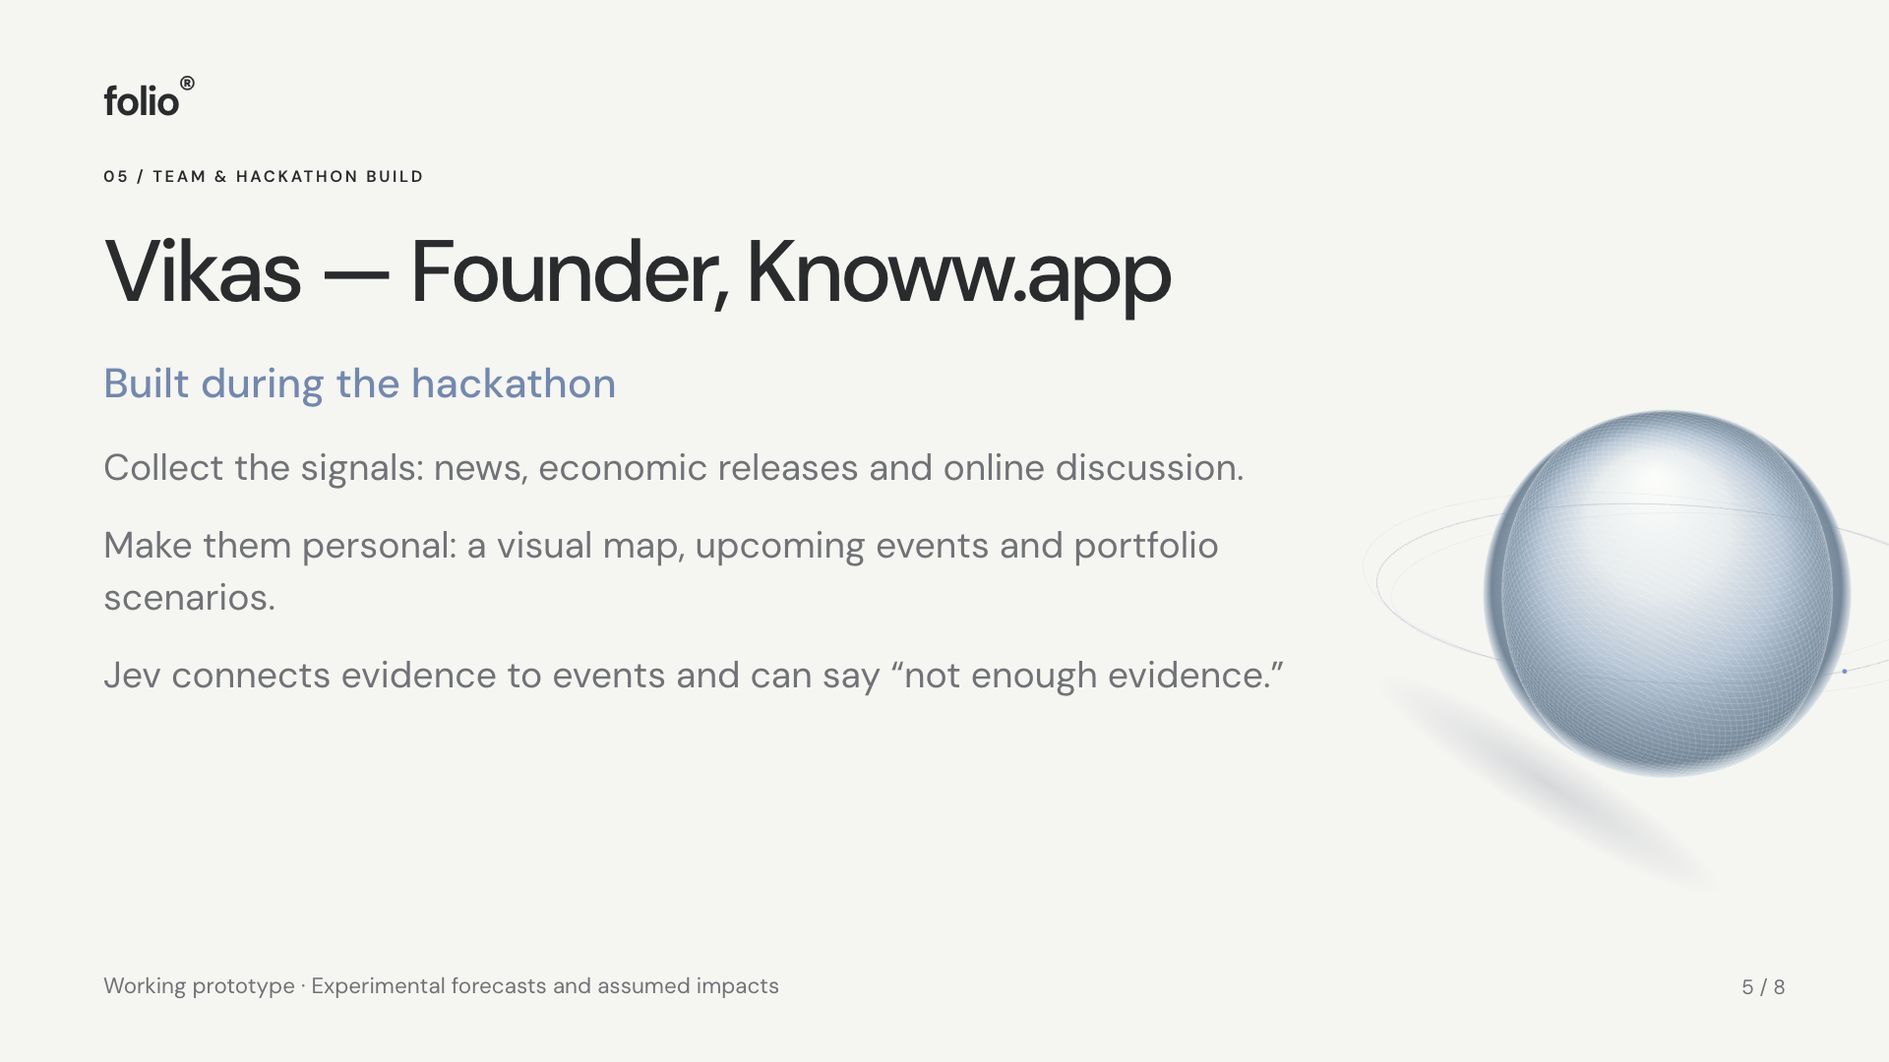
Notes:
Vikas — Founder, Knoww.app
{"label":"Team & hackathon build","title":"Vikas — Founder, Knoww.app","accent":"Built during the hackathon","body":["Collect the signals: news, economic releases and online discussion.","Make them personal: a visual map, upcoming events and portfolio scenarios.","Jev connects evidence to events and can say “not enough evidence.”"],"note":"Working prototype · Experimental forecasts and assumed impacts"}
Visual export of the HTML deck at https://folio-macro-companion.vercel.app/pitch.html. Edit shared content in public/pitch-data.js. Bayesian news updating and identified causal effects are future work; current portfolio returns are assumptions. Revenue is an illustrative annual subscription scenario.

Slide 6
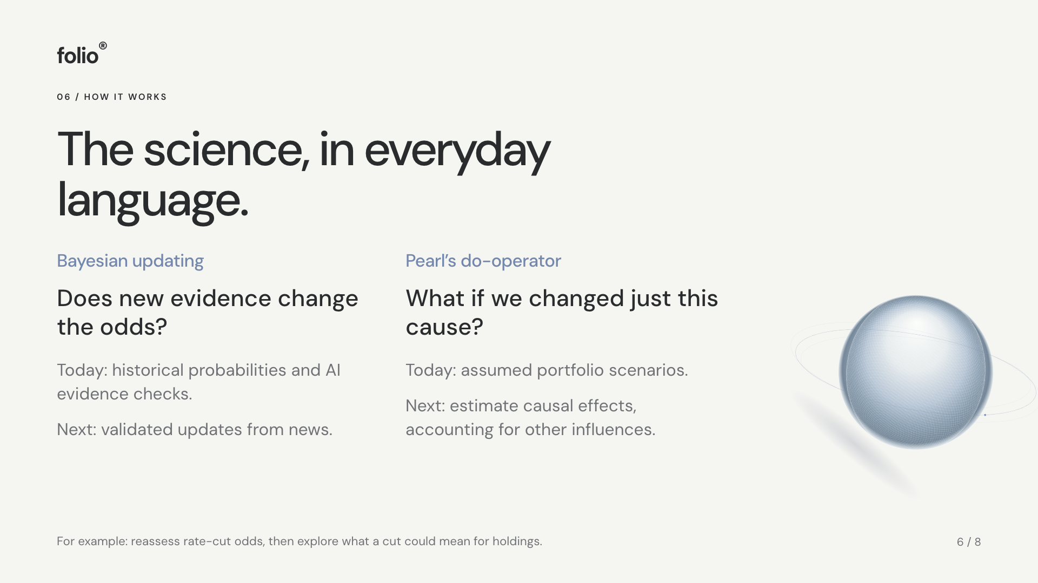
Notes:
The science, in everyday language.
{"label":"How it works","title":"The science, in everyday language.","science":[["Bayesian updating","Does new evidence change the odds?","Today: historical probabilities and AI evidence checks.","Next: validated updates from news."],["Pearl’s do-operator","What if we changed just this cause?","Today: assumed portfolio scenarios.","Next: estimate causal effects, accounting for other influences."]],"note":"For example: reassess rate-cut odds, then explore what a cut could mean for holdings."}
Visual export of the HTML deck at https://folio-macro-companion.vercel.app/pitch.html. Edit shared content in public/pitch-data.js. Bayesian news updating and identified causal effects are future work; current portfolio returns are assumptions. Revenue is an illustrative annual subscription scenario.

Slide 7
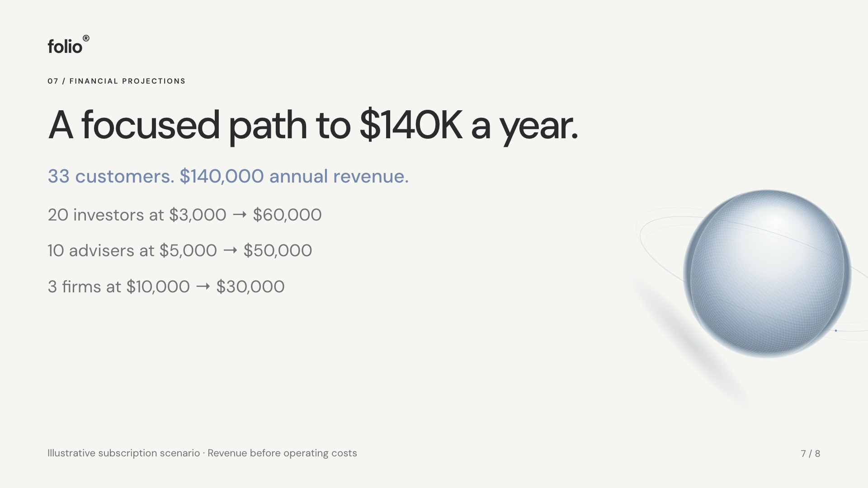
Notes:
A focused path to $140K a year.
{"label":"Financial projections","title":"A focused path to $140K a year.","body":["20 investors at $3,000 → $60,000","10 advisers at $5,000 → $50,000","3 firms at $10,000 → $30,000"],"accent":"33 customers. $140,000 annual revenue.","note":"Illustrative subscription scenario · Revenue before operating costs"}
Visual export of the HTML deck at https://folio-macro-companion.vercel.app/pitch.html. Edit shared content in public/pitch-data.js. Bayesian news updating and identified causal effects are future work; current portfolio returns are assumptions. Revenue is an illustrative annual subscription scenario.

Slide 8
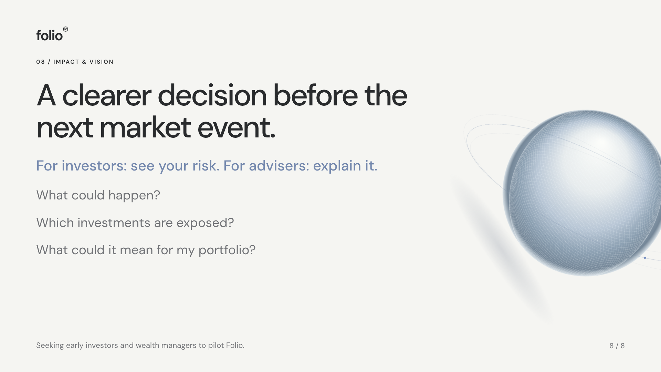
Notes:
A clearer decision before the next market event.
{"label":"Impact & vision","title":"A clearer decision before the next market event.","body":["What could happen?","Which investments are exposed?","What could it mean for my portfolio?"],"accent":"For investors: see your risk. For advisers: explain it.","note":"Seeking early investors and wealth managers to pilot Folio."}
Visual export of the HTML deck at https://folio-macro-companion.vercel.app/pitch.html. Edit shared content in public/pitch-data.js. Bayesian news updating and identified causal effects are future work; current portfolio returns are assumptions. Revenue is an illustrative annual subscription scenario.

