Slide 1

Prediction of the bike availability and uneven distribution of BSS using Machine Learning
Group – 08 Sheth Pal 40196640 Safavi Sohi Seyedmohammadhossein 40199128 Prajapati Jay 40227110 Vikas Vipulbhai Vaghasiya 40219501 Sheth Rajvi Maheshbhai 40211702
_{Big Data Analytics - CIVI6731}
_{Pro. Mazdak Nik-Bakht}

Slide 2
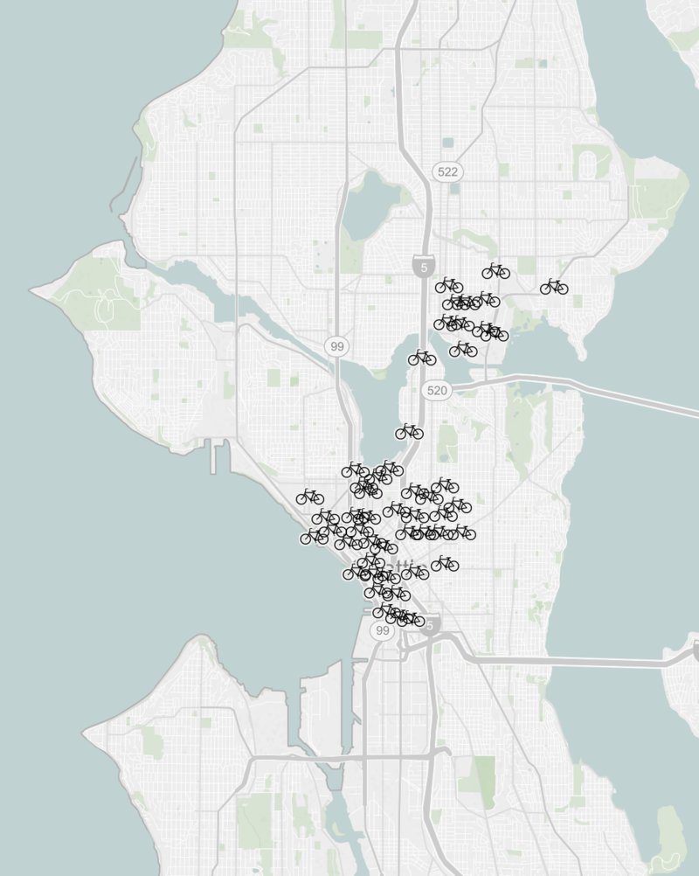
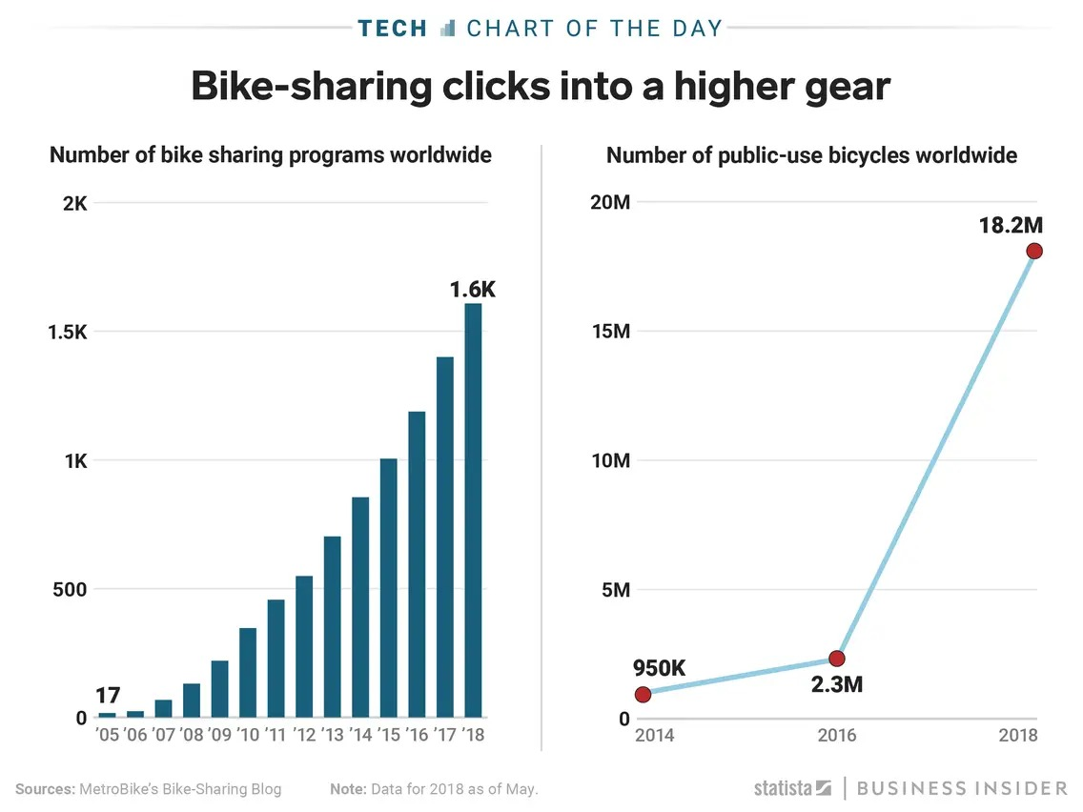
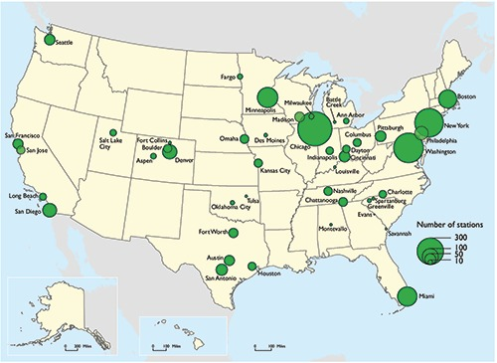
Background
Around 2.4 million trips in 2012 Worldwide 1950 bike-sharing programs
Approximate 1.5 million bikes in 2022.
Pronto launched on October 13, 2014, with 500 bikes in 50 stations.
Use of the Pronto system was based on either annual memberships ($85) or short-term passes of either 24 hours ($8) or three days ($16).
Primary sponsorship for the system was provided by Seattle-based Alaska Airlines, who paid $2.5 million for a 5-year sponsorship that includes their logo on the bikes themselves.
Source: https://en.wikipedia.org/wiki/Pronto_Cycle_Share

Slide 3
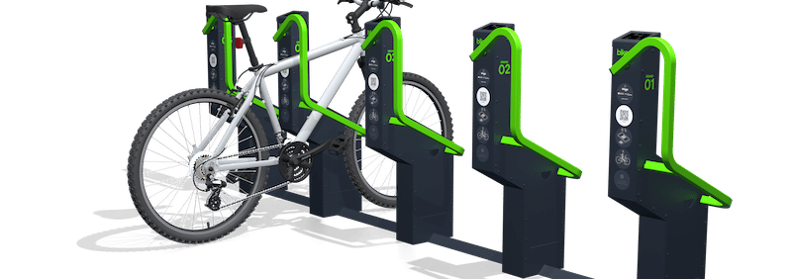


Motivation
Unavailability's of bikes
Trucks used for the bike distribution
User dissatisfaction
Revenue generation and revenue management

Slide 4
Problem statement
The BSS company aims to use machine learning to predict the number of bikes that will be added or reduced in a specified station in particular time, to efficiently manage their equipment and resources to ensure availability of bikes for users.

Slide 5
Literature Review
Author | Year | Research Location | Data | Title | Research description
Elzbieta Macioszek and Maria Ciesla | 2022 | Poland | Factors Data | External Environmental Analysis for Sustainable Bike-Sharing System Development | Modeling the effect of different factors on BSS system
Huthaifa I. Ashqar | 2021 | San Francisco, USA | Two bike trip dataset | Network and station-level bike-sharing system prediction: a San Francisco bay area case study | Modeling the number of available bikes at the station level
El Arbi Abdellaoui Alaoui | 2021 | London, United Kingdom | Data from BSSs | Intelligent management of bike sharing in smart cities using machine learning and Internet of Things | BSS management using machine learning and IoT
Sathishkumar V E and Yongyun Cho | 2020 | South Korea | Open Data Source | In the prediction of hourly rental bike demand, the hour of the day, and temperature are the most influential variables. | A rule-based regression predictive model for BSS demand prediction.
Daniele Gammelli, Yihua Wang, Dennis Prak, Filipe Rodrigues,Stefan Minner, Francisco Camara Pereira | 2022 | New York, Usa | Science Direct | Predictive and prescriptive performance of bike-sharing demand forecasts for inventory management | To determine the optimal starting inventory level of a station for a given day, a User Dissatisfaction Function (UDF) models

Slide 6
Objectives
Exploring the correlation between the different relevant attributes.
01
Predicting a number of departure at a particular time based on correlated attributes, using different machine learning algorithms.
02
Predicting a number of arrival at a particular time based on correlated attributes, using different machine learning algorithms.
03

Slide 7



Dataset
Station data
Trip data
Weather data
Seattle Open Data
https://data.seattle.gov/Community/Pronto-Cycle-Share-Trip-Data/tw7j-dfaw
https://www.kaggle.com/datasets/pronto/cycle-share-dataset?resource=download

Slide 8







Data Preparation
Exploring the correlation between the different relevant attributes.
Data warehouse
Attribute Reduction
Data merging
RapidMiner & Excel
Data Cleansing
Exploratory
Data
Analysis (EDA)

Slide 9
Pre-processing steps
Removed irrelevant data
3 wrong station names and ID were removed from the data set, also night trip data has been removed.
Removed missing value
The station without any trips for particular hours
Replaced missing values
Missing temperature value replaced by average temperature value Replace unknown data in events with sunny. Replace unknown data in trips by zero.
Anomaly detection
Removed trips of more than 15 in one hour has been considered an outlier.
Attribute reduction
Gender types and ages for the non-members were unavailable; hence entire attributes were removed.
Correlation analysis
Pearson correlation analysis is performed after normalization

Slide 10
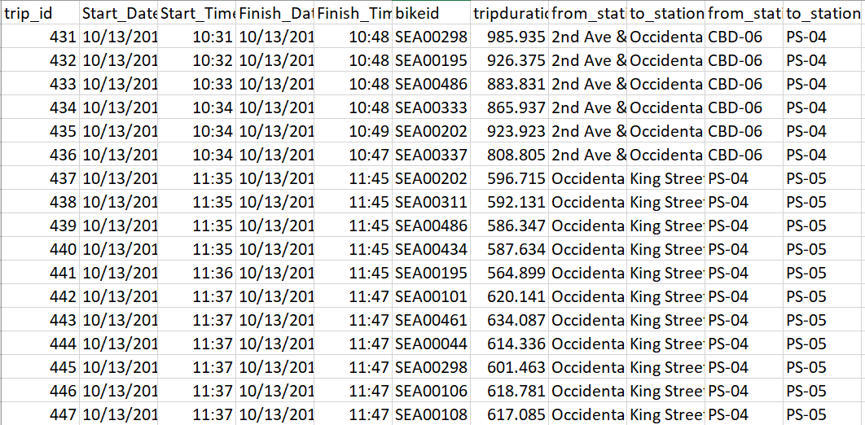
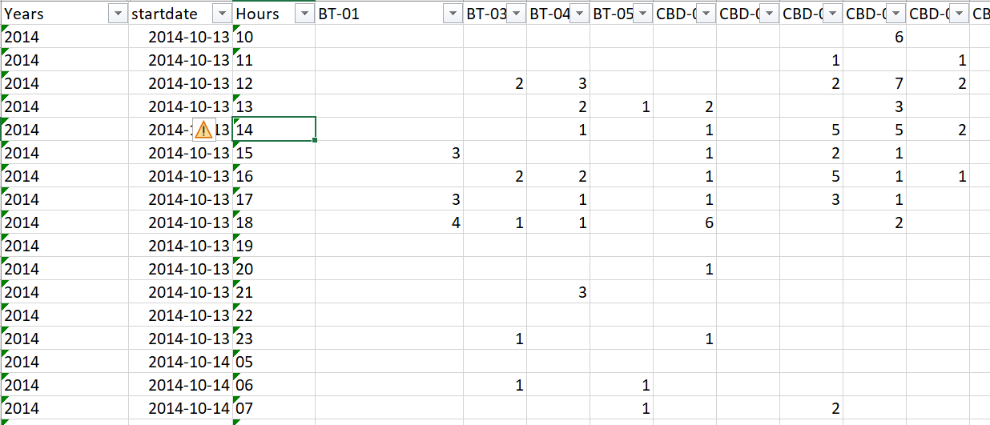
Data information
Exploratory Data Analysis
Data Preparation
Excel preparation using pivot table
Removing mission data
Trip data for individual station ID
Missing events with Sunny days
Temperature with an average temperature
Data type conversion from nominal to numerical using dummy coding
Final Data

Slide 11
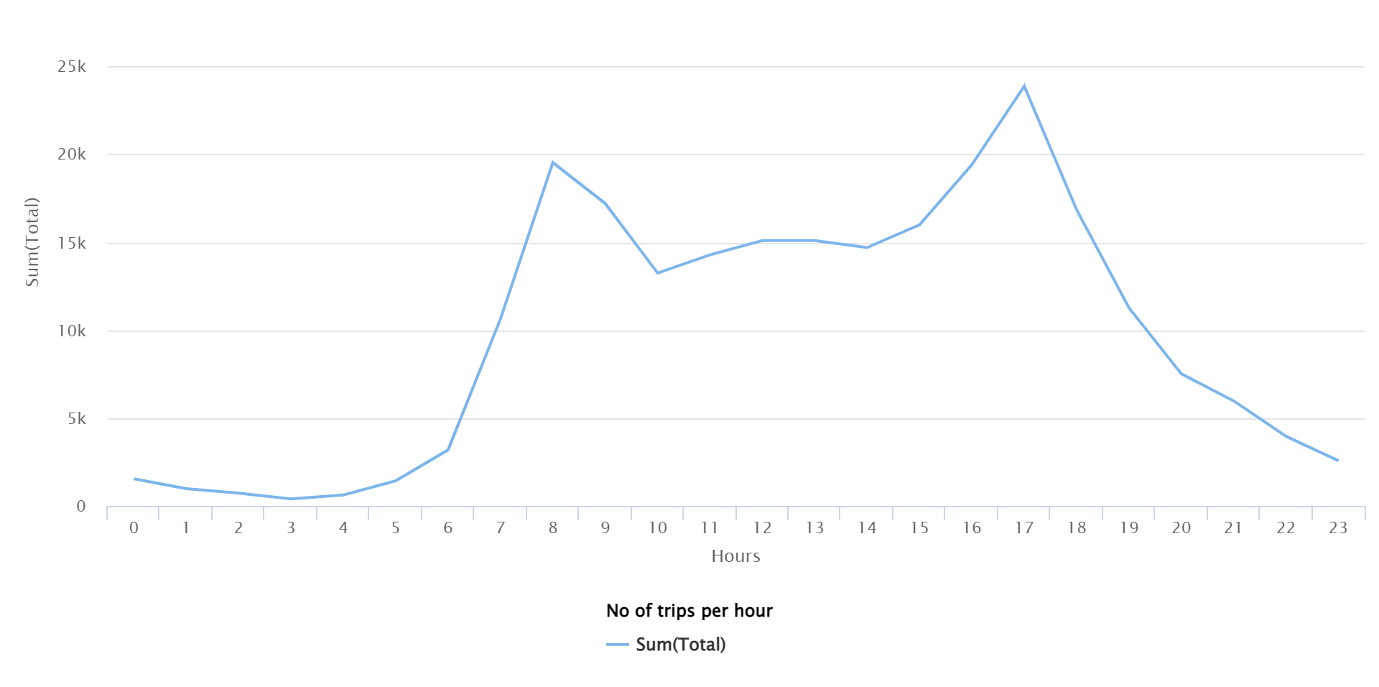
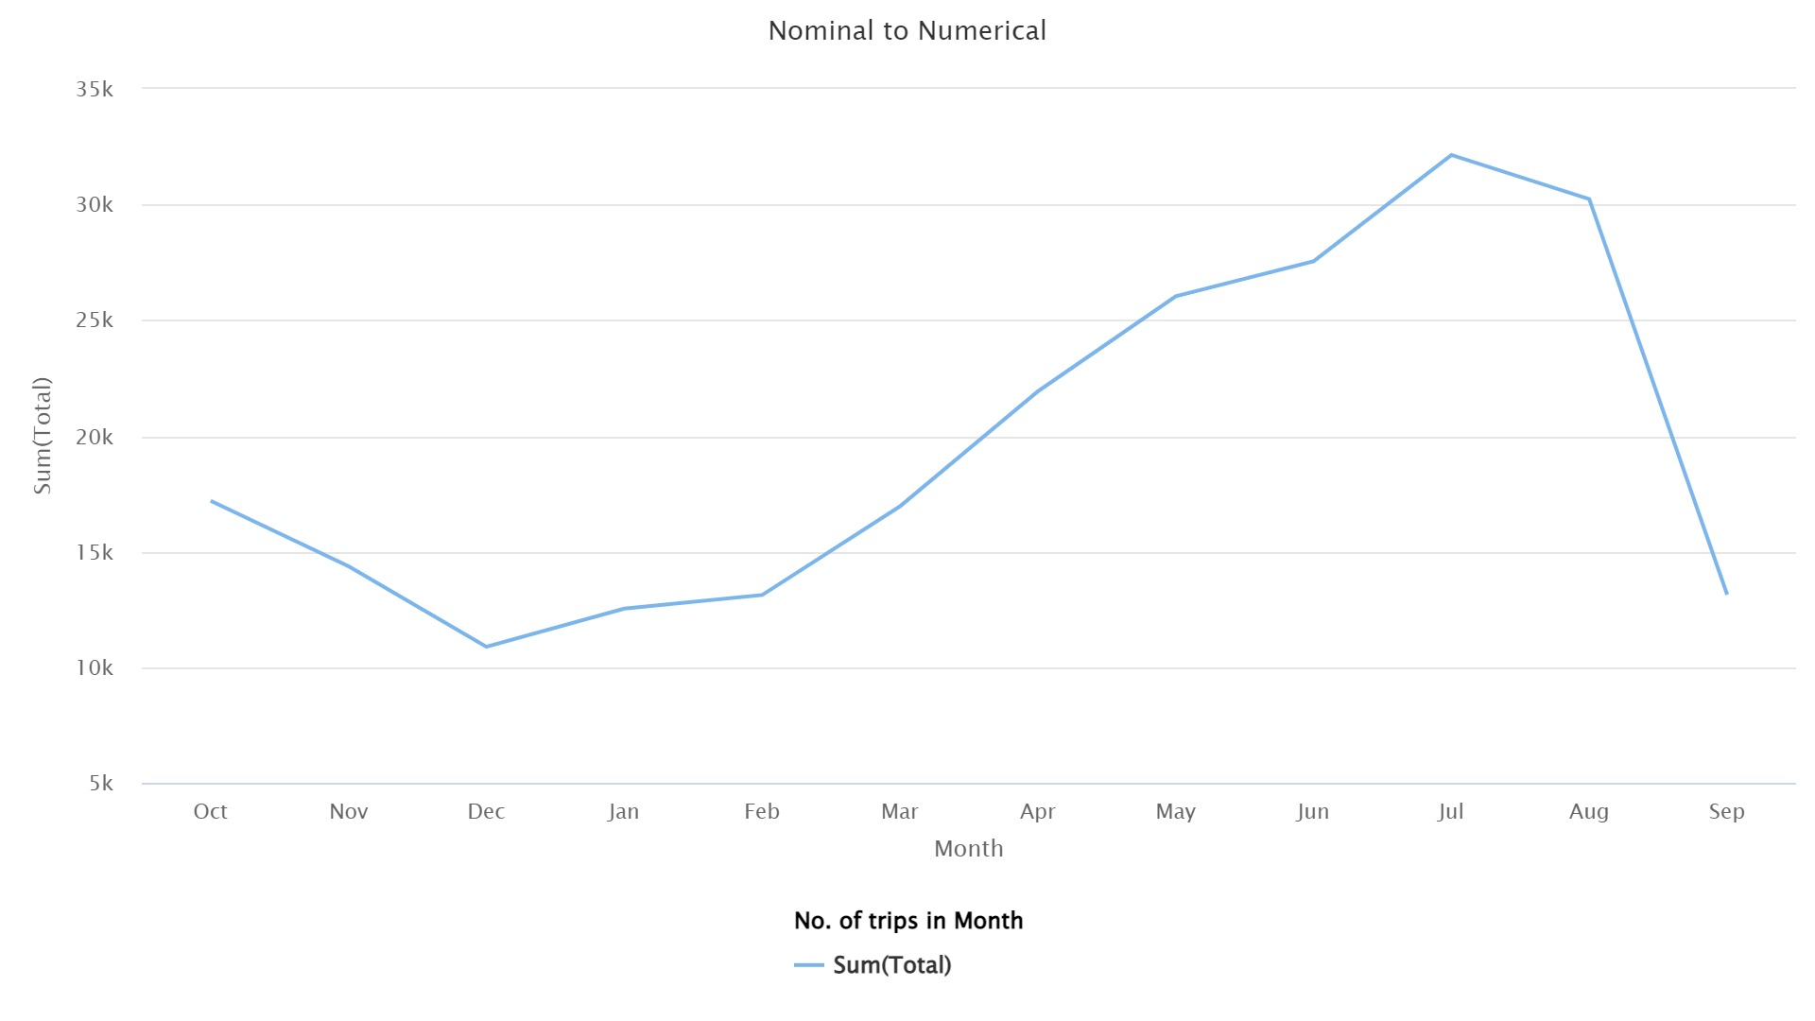
Exploratory Data Analysis

Slide 12
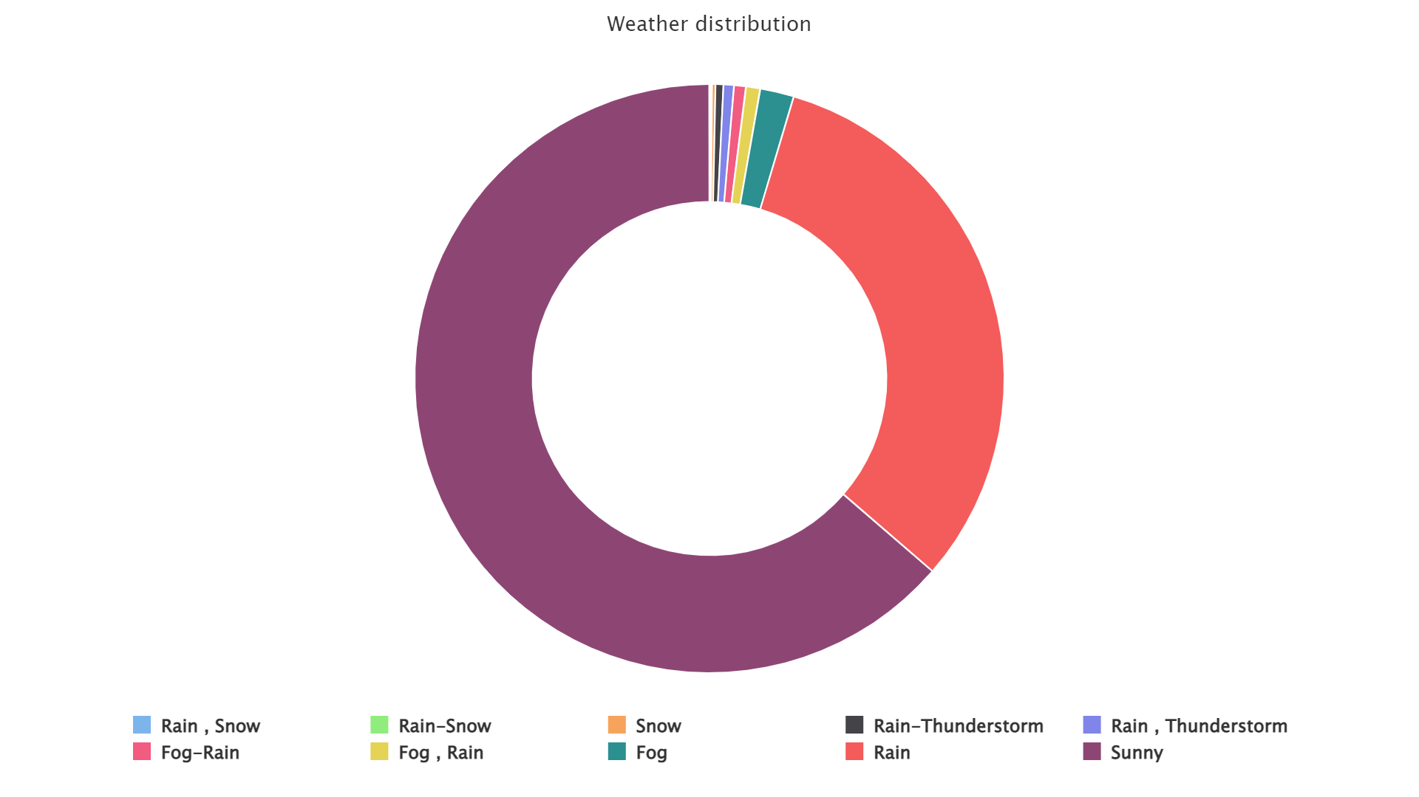

Slide 13
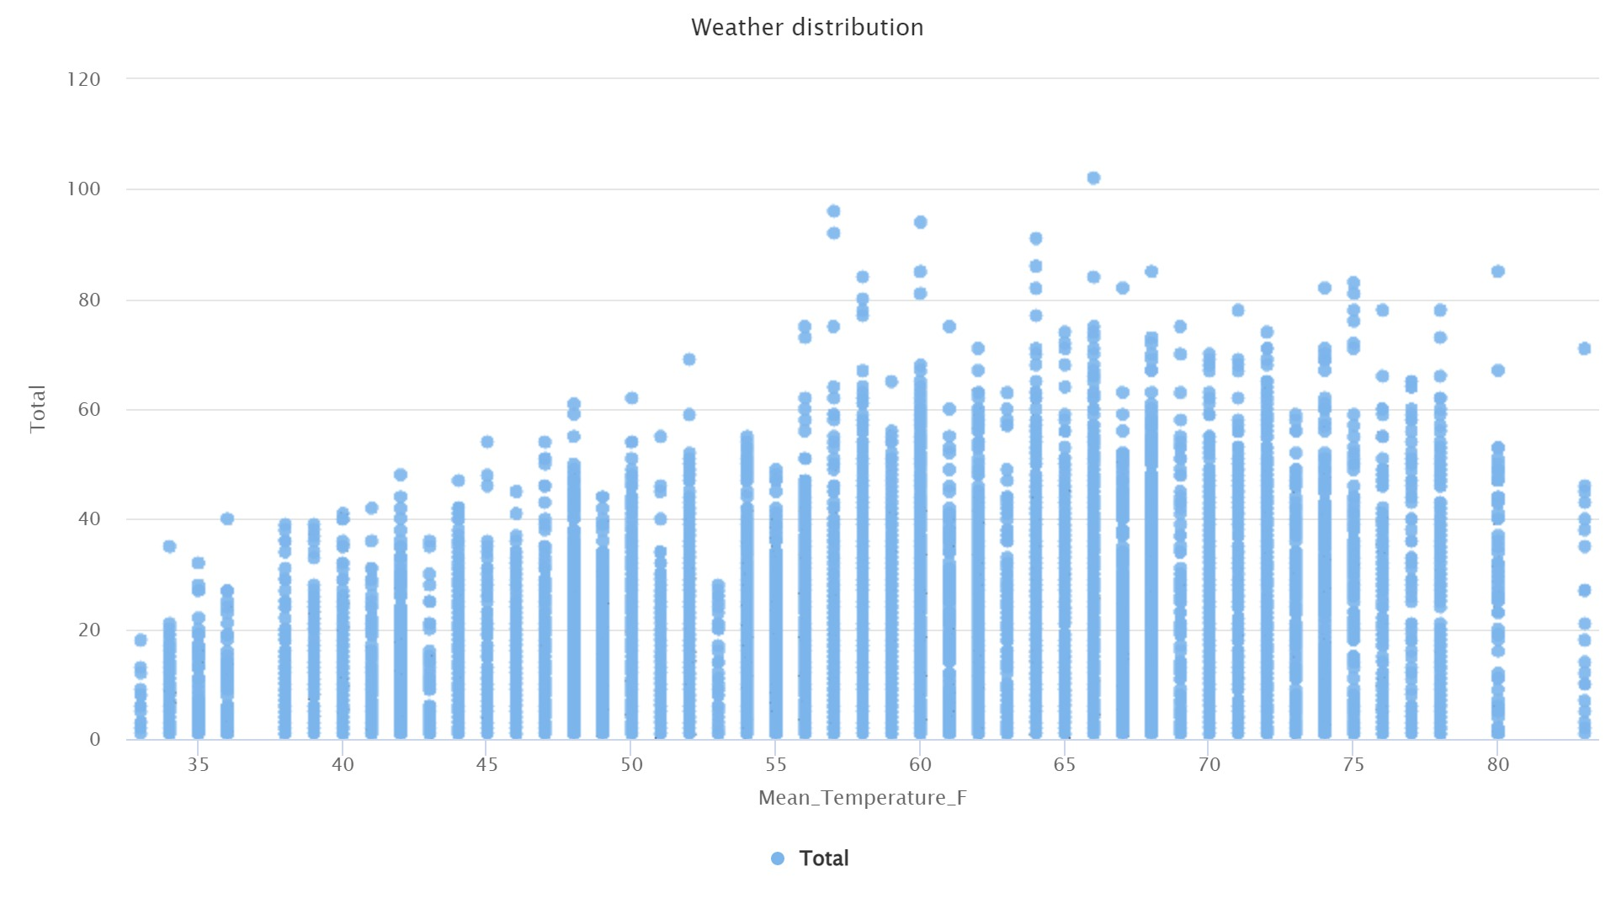

Slide 14
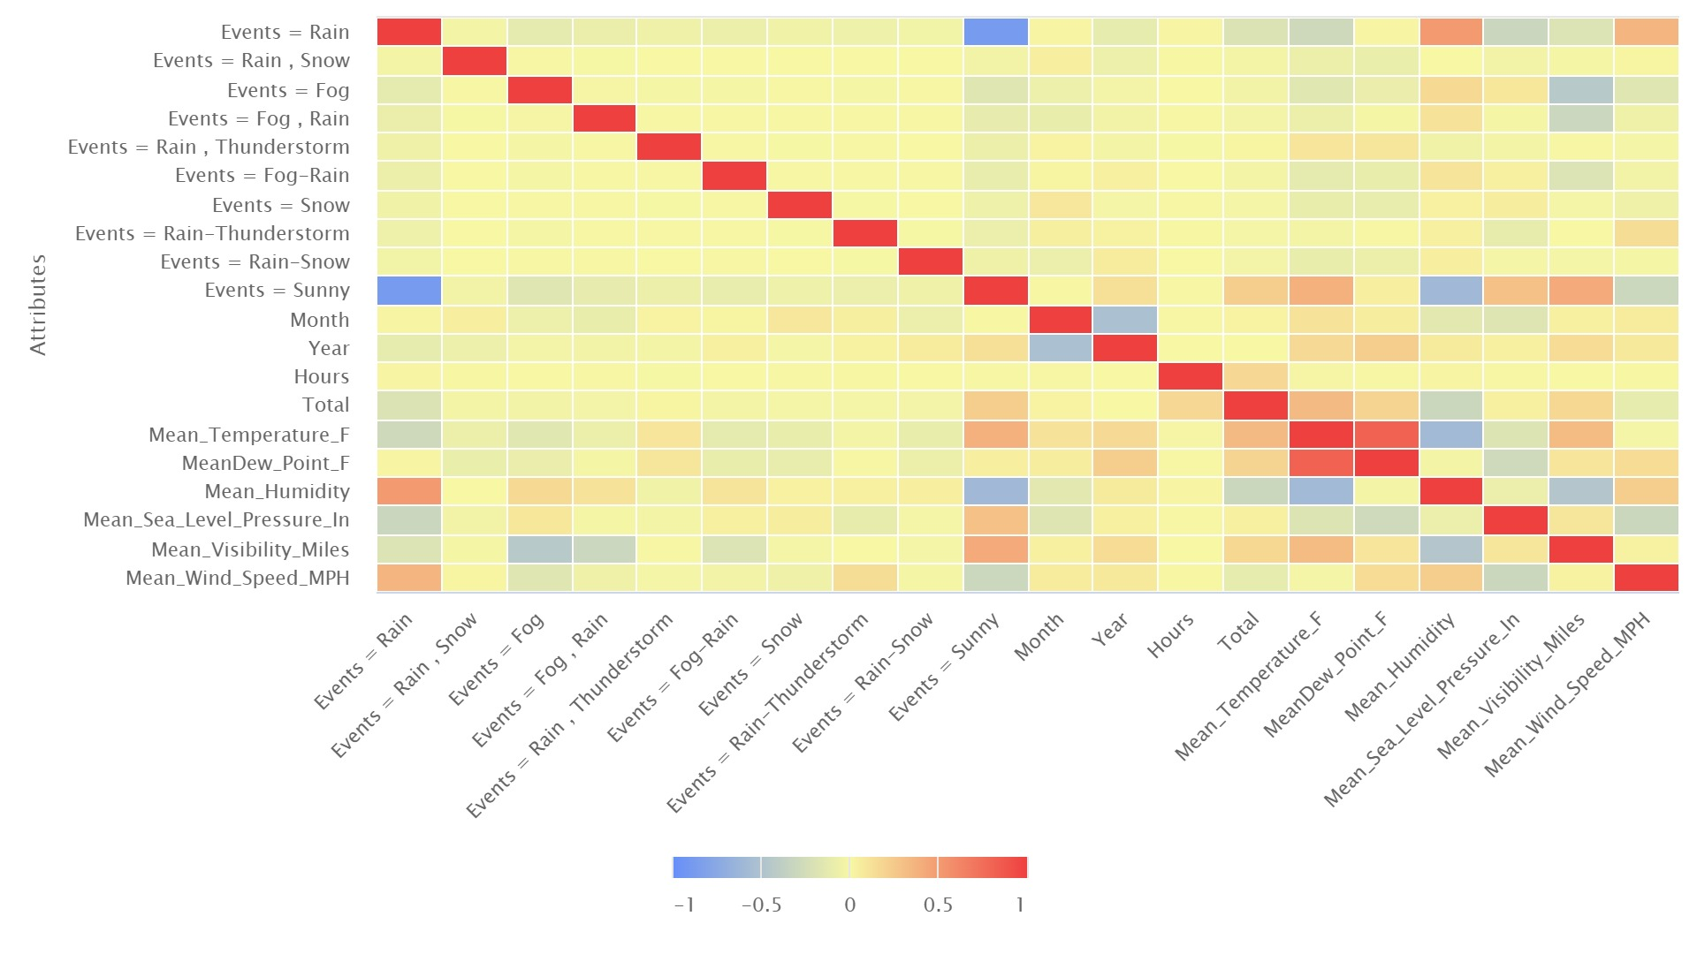
Heat Map

Slide 15
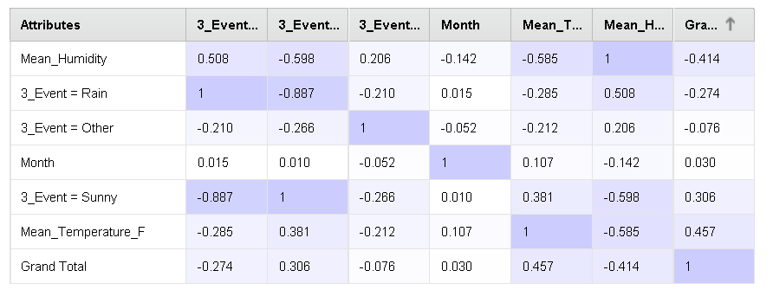
Pearson Correlation Matrix

Slide 16
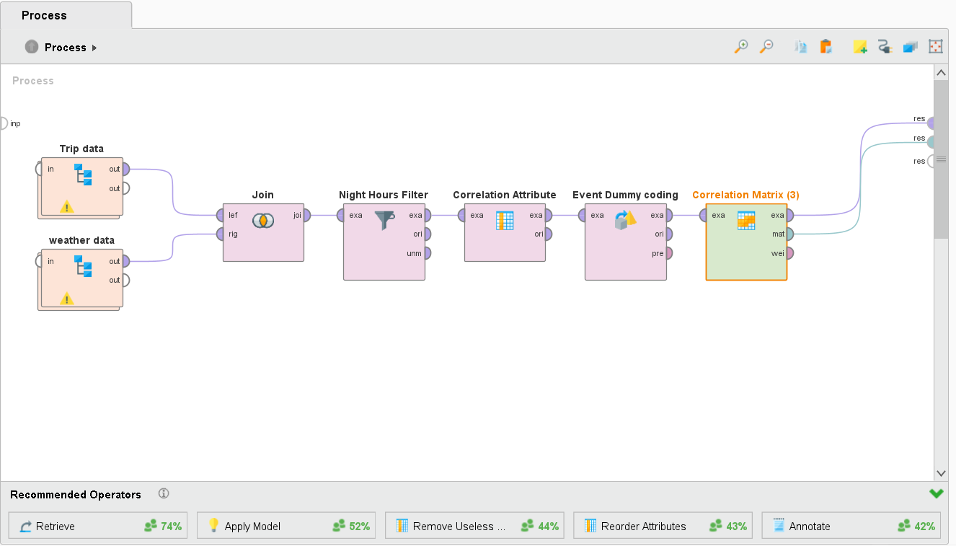
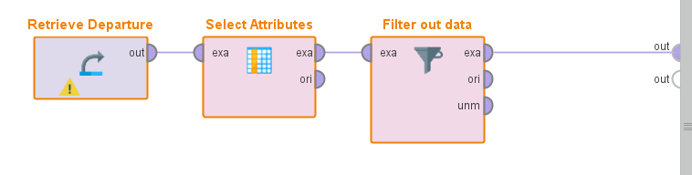
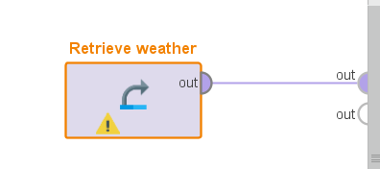

Correlation Model

Slide 17
Model
Description our target and predictors variables
Target attribute:
Number of departure in station x
Number of arrivals in station x
Predictors:
Month
date
Year
Hour
Weather condition
Temperature
Humidity

Slide 18
Model
Algorithm selection:
Algorithms
Logistic regression
KNN
Decision Tree

Slide 19
Model Flow Diagram
Trip
Join
Data Processing
Filtering
Label Attribute
Weather
Optimization
Cross Validation
Algorithm
Performance

Slide 20
Model Range Prediction
Range
1
2
3
1,2 → 1
0 → 0
1..9 → 1..9
3,…,13 → 2
1,…,13 → 1
10..13 → 10

Slide 21
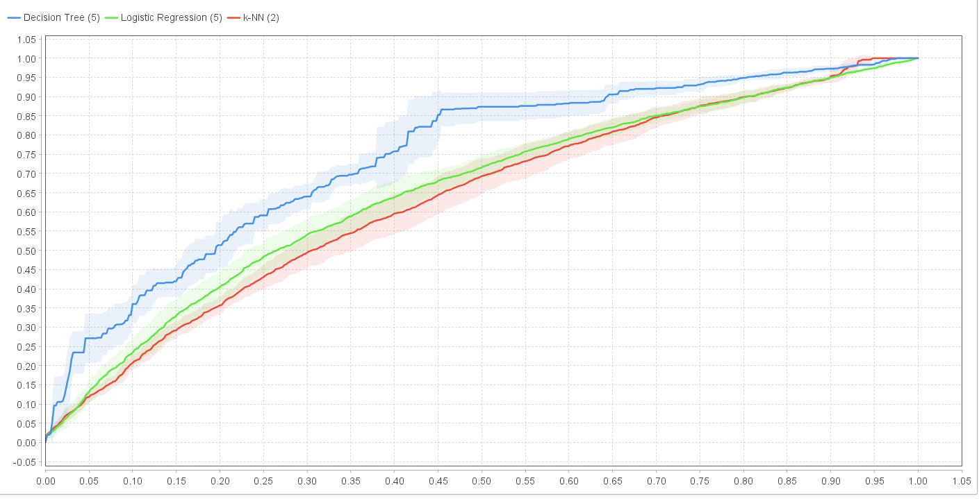
Modeling
ROC curve

Slide 22

Departure

Slide 23
Departure Model
Logistic regression
Accuracy: 64.12% +/- 1.74% (micro average: 64.12%) F1 score: 60.68%
 | true 0 | true 1 | class precision
pred. 0 | 4402 | 2307 | 65.61%
pred. 1 | 817 | 1180 | 59.09%
class recall | 84.35% | 33.84%

Slide 24
Departure Model
Decision Tree
accuracy: 69.57% +/- 3.70% (micro average: 69.57%) F1 score: 55.69%
 | true 2 | true 1 | class precision
pred. 2 | 297 | 549 | 35.11%
pred. 1 | 832 | 2861 | 77.47%
class recall | 26.31% | 83.90%

Slide 25
Departure Model
kNN
accuracy: 71.06% +/- 0.50% (micro average: 71.06%) F1 score: 72%
 | true 3 | true 4 | true 2 | true 1 | true 5 | true 6 | true 8 | true 7 | true 10 | true 9 | class precision
pred. 3 | 1138 | 95 | 185 | 236 | 63 | 39 | 23 | 12 | 9 | 1 | 63.19%
pred. 4 | 118 | 1216 | 109 | 141 | 48 | 34 | 13 | 14 | 13 | 1 | 71.24%
pred. 2 | 223 | 164 | 969 | 523 | 119 | 62 | 25 | 63 | 11 | 17 | 44.53%
pred. 1 | 422 | 349 | 696 | 1130 | 199 | 166 | 49 | 43 | 14 | 29 | 36.49%
pred. 5 | 70 | 52 | 68 | 60 | 1504 | 23 | 8 | 10 | 2 | 8 | 83.32%
pred. 6 | 52 | 52 | 49 | 33 | 69 | 1580 | 4 | 6 | 0 | 3 | 85.50%
pred. 8 | 30 | 76 | 32 | 27 | 35 | 67 | 1995 | 68 | 0 | 0 | 85.62%
pred. 7 | 51 | 63 | 31 | 18 | 36 | 94 | 7 | 1819 | 3 | 1 | 85.68%
pred. 10 | 47 | 72 | 27 | 12 | 61 | 59 | 29 | 104 | 2071 | 9 | 83.14%
pred. 9 | 36 | 48 | 21 | 7 | 53 | 63 | 34 | 48 | 64 | 2118 | 84.99%
class recall | 52.03% | 55.60% | 44.31% | 51.67% | 68.77% | 72.25% | 91.22% | 83.17% | 94.70% | 96.84%

Slide 26
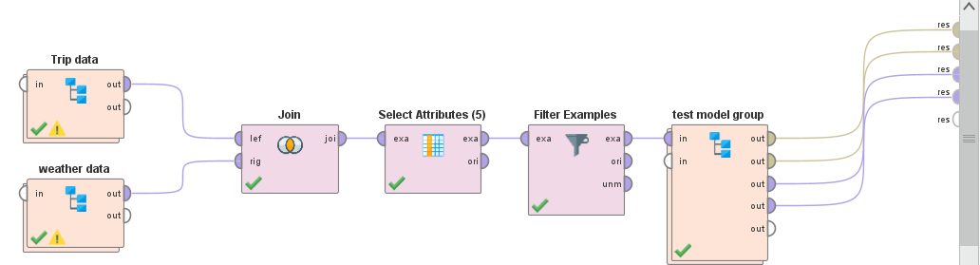
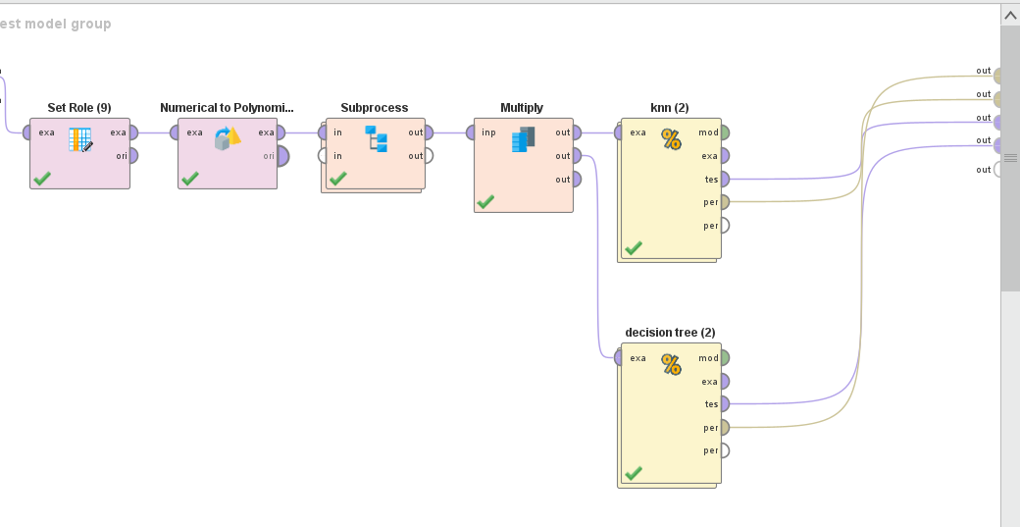

Slide 27
Arrival

Slide 28
Arrival Model
Logistic regression
Accuracy: 65.06% +/- 1.12% (micro average: 65.06%) F1 score: 62.68%
 | true 0 | true 1 | class precision
pred. 0 | 4167 | 2079 | 66.71%
pred. 1 | 970 | 1510 | 60.89%
class recall | 81.12% | 42.07%

Slide 29
Arrival Model
Decision Tree
Accuracy: 74.42% +/- 0.85% (micro average: 74.42%) F1 score: 57.56%
 | true 1 | true 2 | class precision
pred. 1 | 3195 | 865 | 78.69%
pred. 2 | 306 | 212 | 40.93%
class recall | 91.26% | 19.68%

Slide 30
Arrival Model
kNN
Accuracy: 74.33% +/- 0.83% (micro average: 74.33%) F1 score: 75%
 | true 1 | true 4 | true 2 | true 3 | true 6 | true 5 | true 7 | true 9 | true 8 | true 10 | class precision
pred. 1 | 1481 | 335 | 818 | 495 | 112 | 245 | 57 | 32 | 16 | 8 | 41.15%
pred. 4 | 113 | 1382 | 100 | 71 | 32 | 26 | 21 | 13 | 9 | 8 | 77.86%
pred. 2 | 390 | 149 | 1037 | 195 | 61 | 86 | 27 | 13 | 19 | 3 | 52.37%
pred. 3 | 138 | 49 | 120 | 1176 | 31 | 34 | 8 | 5 | 26 | 12 | 73.55%
pred. 6 | 42 | 74 | 46 | 77 | 1794 | 41 | 9 | 9 | 0 | 1 | 85.71%
pred. 5 | 73 | 64 | 65 | 80 | 17 | 1691 | 15 | 9 | 3 | 3 | 83.71%
pred. 7 | 25 | 68 | 46 | 49 | 101 | 52 | 2028 | 5 | 3 | 0 | 85.32%
pred. 9 | 24 | 59 | 34 | 55 | 70 | 49 | 49 | 2172 | 45 | 2 | 84.88%
pred. 8 | 16 | 54 | 28 | 65 | 54 | 44 | 23 | 9 | 2116 | 5 | 87.66%
pred. 10 | 4 | 72 | 12 | 43 | 34 | 38 | 69 | 39 | 69 | 2264 | 85.63%
class recall | 64.22% | 59.93% | 44.97% | 51.00% | 77.80% | 73.33% | 87.94% | 94.19% | 91.76% | 98.18%

Slide 31
Conclusion
Zero number of trips from the rest is separated using Logistic regression having an accuracy 65%.
Further, Trips are subclass into three groups, 1, 2 and rest all will be in class 3. The best accuracy received in decision tree is 72%.
Oversampling using SMOTE is done for the 3rd model for the even distribution of the data set. Departure and arrival prediction is done using kNN.

Slide 32
Model Deployment
Resource allocation
Demand prediction
( User Engagement )
Decision-making
Bike-sharing system professionals could integrate the method into their existing system to deploy it. This would entail creating an interface that takes weather data and predicts the number of arrivals and departures at each station.
This information could then be used by professionals to plan the allocation of bikes and docking stations and other decision-making processes. To ensure the accuracy of the predictions, the data used to train the model must be updated regularly.

Slide 33
Thank You.

