Slide 1
IMAGE CLASSIFICATION
Reorganized By :
Jwan M Aldoski
Department of Civil Engineering , Faculty of Engineering,
Universiti Putra Malaysia, 43400 UPM Serdang, Selangor Darul Ehsan. Malaysia.

Slide 2
Why classify?
Make sense of a landscape
  Place landscape into categories (classes)
    Forest, Agriculture, Water, etc
Classification scheme = structure of classes
  Depends on needs of users

Slide 3
Example Uses
Provide context
  Landscape planning or assessment
  Research projects
Drive models
  Global carbon budgets
  Meteorology
  Biodiversity

Slide 4
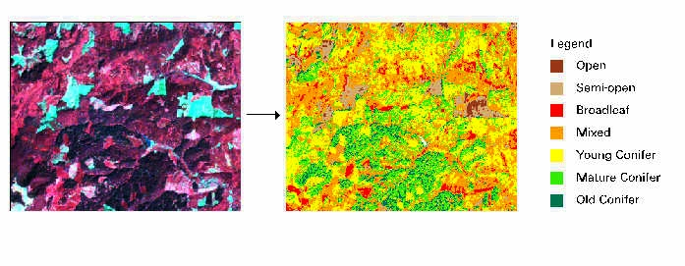
Example: Near Mary’s Peak
Derived from a 1988 Landsat TM image
Distinguish types of forest

Slide 5
Classification: Critical Point
LAND COVER not necessarily equivalent to LAND USE
  We focus on what’s there: LAND COVER
  Many users are interested in how what’s there is being used: LAND USE
Example
  Grass is land cover; pasture and recreational parks are land uses of grass

Slide 6
Classification
TODAY’S PLAN
Basic strategy for classifying remotely-sensed images using spectral information
Supervised Classification
Unsupervised Classification
Lab 4
Next class: Important considerations when classifying; improving classifications; assessing accuracy of classified maps

Slide 7
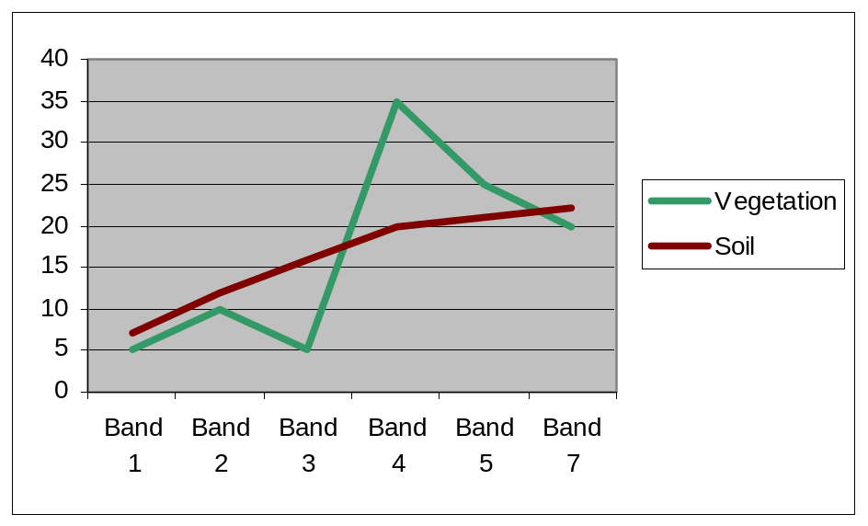
Basic Strategy: How do you do it?
Use radiometric properties of remote sensor
Different objects have different spectral signatures

Slide 8
Basic Strategy: How do you do it?
In an easy world, all “Vegetation” pixels would have exactly the same spectral signature
Then we could just say that any pixel in an image with that signature was vegetation
We’d do the same for soil, etc. and end up with a map of classes

Slide 9
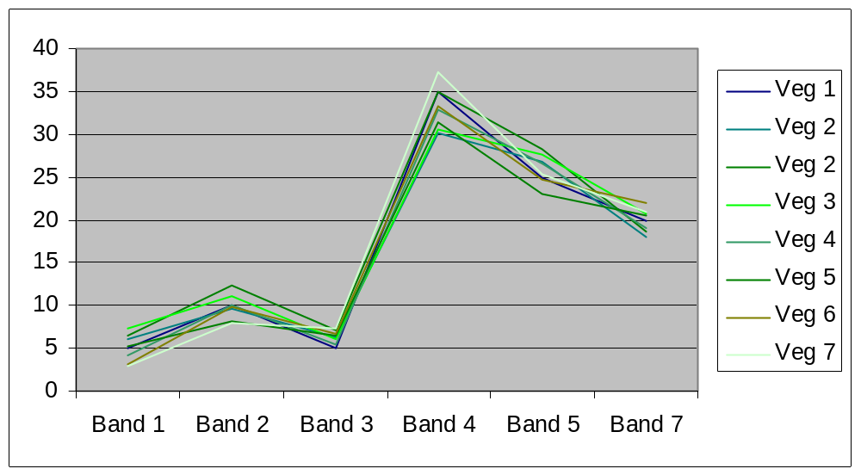
Basic Strategy: How do you do it?
But in reality, that isn’t the case. Looking at several pixels with vegetation, you’d see variety in spectral signatures.
The same would happen for other types of pixels, as well.

Slide 10
The Classification Trick:
Deal with variability
Different ways of dealing with the variability lead to different ways of classifying images
To talk about this, we need to look at spectral signatures a little differently

Slide 11
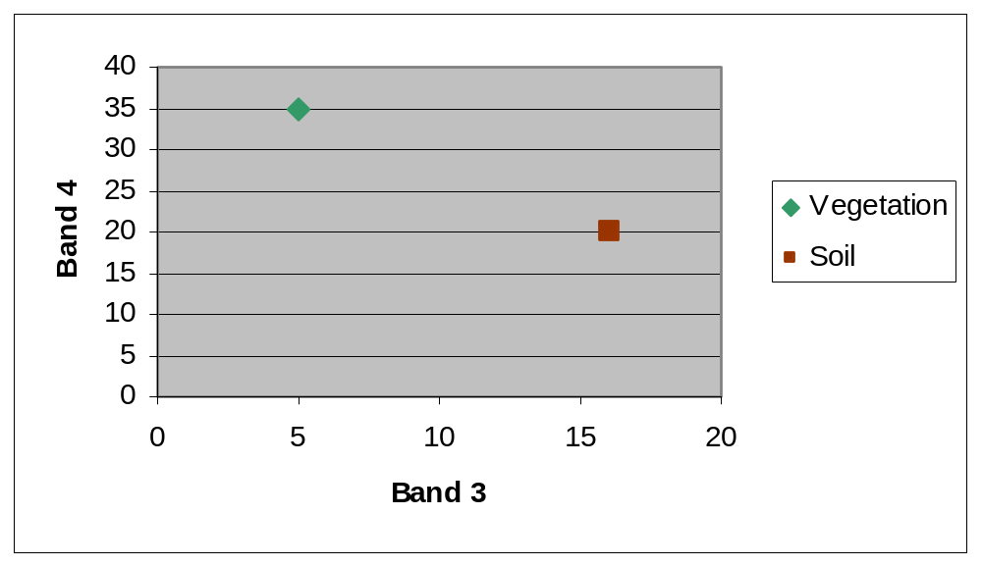
Think of a pixel’s reflectance in 2-dimensional space. The pixel occupies a point in that space.
The vegetation pixel and the soil pixels occupy different points in 2-d space

Slide 12
In a Landsat scene, instead of two dimensions, we have six spectral dimensions
Each pixel represents a point in 6-dimensional space
To be generic to any sensor, we say “n-dimensional” space
For examples that follow, we use 2-d space to illustrate, but principles apply to any n-dimensional space

Slide 13
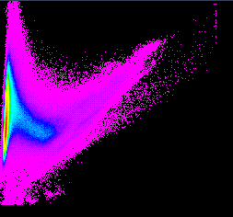
Feature space image
A graphical representation of the pixels by plotting 2 bands vs. each other
For a 6-band Landsat image, there are 15 feature space images
Band 4
Band 3

Slide 14
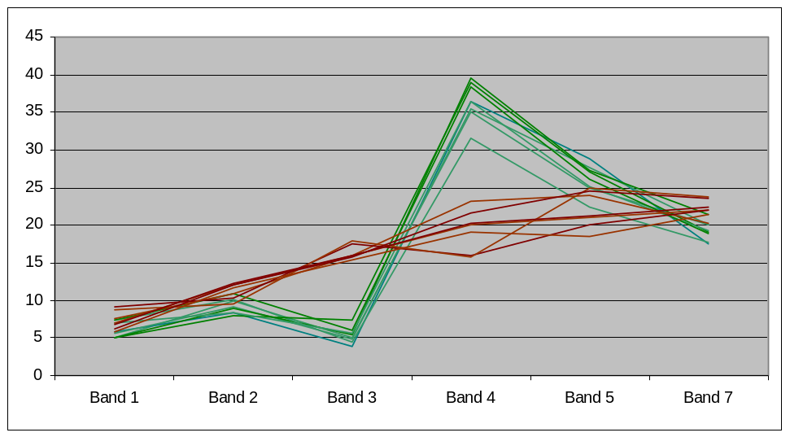
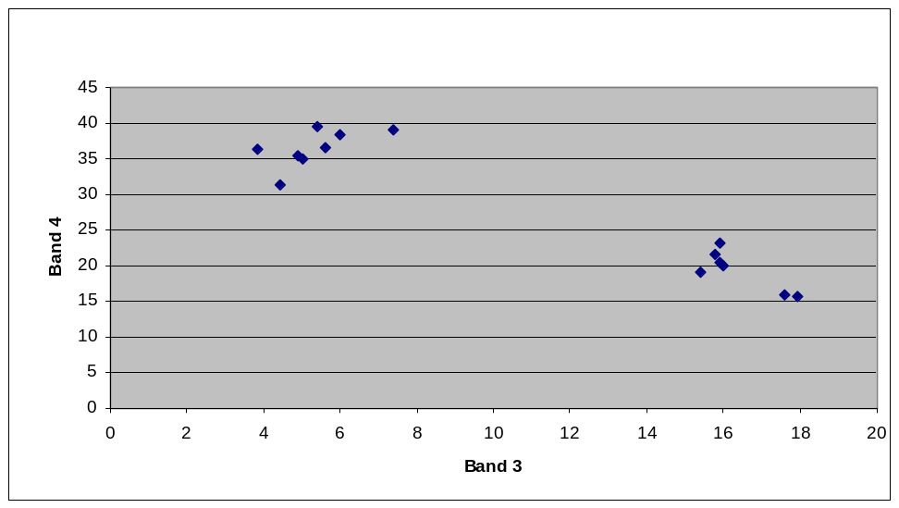
Basic Strategy: Dealing with variability
With variability, the vegetation pixels now occupy a region, not a point, of n-dimensional space
Soil pixels occupy a different region of n-dimensional space

Slide 15
Basic strategy: Dealing with variability
Classification:
  Delineate boundaries of classes in n-dimensional space
  Assign class names to pixels using those boundaries

Slide 16
Classification Strategies
Two basic strategies
  Supervised classification
    We impose our perceptions on the spectral data
  Unsupervised classification
    Spectral data imposes constraints on our interpretation

Slide 17
Supervised Classification
Supervised classification requires the analyst to select training areas where he/she knows what is on the ground and then digitize a polygon within that area…
Mean Spectral Signatures
The computer then creates...
Conifer
Known Conifer Area
Water
Known Water Area
Deciduous
Known Deciduous Area
Digital Image

Slide 18
Supervised Classification
Mean Spectral Signatures
Information
Multispectral Image
(Classified Image)
Conifer
Deciduous
Water
Unknown
Spectral Signature of Next Pixel to be Classified

Slide 19
The Result is Information--in this case a Land Cover map...
Land Cover Map
Legend:
Water
Conifer
Deciduous

Slide 20
Supervised Classification
Common Classifiers:
  Parallelpiped
  Minimum distance to mean
  Maximum likelihood

Slide 21
Supervised Classification
Parallelepiped Approach
Pros:
  Simple
  Makes few assumptions about character of the classes

Slide 22
Supervised Classification
Cons: When we look at all the pixels in image, we find that they cover a continuous region in n-dimensional space: the parallelepiped approach may not be able to classify those regions
Band 4
Band 3

Slide 23
Supervised Classification
Cons: Parallelepipeds are rectangular, but spectral space is “diagonal,” so classes may overlap
Band 4
Band 3

Slide 24
Supervised Classification: Statistical Approaches
Minimum distance to mean
  Find mean value of pixels of training sets in n-dimensional space
  All pixels in image classified according to the class mean to which they are closest

Slide 25
Supervised Classification: Minimum Distance
All pixels below line called soil
Band 4
Band 3

Slide 26
Supervised Classification: Minimum Distance
Minimum distance
  Pros:
    All regions of n-dimensional space are classified
    Allows for diagonal boundaries (and hence no overlap of classes)

Slide 27
Supervised Classification
Minimum distance
  Con:
    Assumes that spectral variability is same in all directions, which is not the case
Band 4
Band 3
For most pixels, Band 4 is much more variable than Band 3

Slide 28
Supervised Classification: Maximum Likelihood
Maximum likelihood classification: another statistical approach
Assume multivariate normal distributions of pixels within classes
For each class, build a discriminant function
  For each pixel in the image, this function calculates the probability that the pixel is a member of that class
  Takes into account mean and covariance of training set
Each pixel is assigned to the class for which it has the highest probability of membership

Slide 29
Maximum Likelihood Classifier
Mean Signature 1
Candidate Pixel
Relative Reflectance
Mean Signature 2
It appears that the candidate pixel is closest to Signature 1. However, when we consider the variance around the signatures…
Blue
Green
Red
Near-IR
Mid-IR

Slide 30
Maximum Likelihood Classifier
Mean Signature 1
Candidate Pixel
Relative Reflectance
Mean Signature 2
The candidate pixel clearly belongs to the signature 2 group.
Blue
Green
Red
Near-IR
Mid-IR

Slide 31
Supervised Classification
Maximum likelihood
  Pro:
    Most sophisticated; achieves good separation of classes
  Con:
    Requires strong training set to accurately describe mean and covariance structure of classes

Slide 32
Supervised Classification
In addition to classified image, you can construct a “distance” image
  For each pixel, calculate the distance between its position in n-dimensional space and the center of class in which it is placed
  Regions poorly represented in the training dataset will likely be relatively far from class center points
    May give an indication of how well your training set samples the landscape

Slide 33
Supervised Classification
Some advanced techniques
  Neural networks
    Use flexible, not-necessarily-linear functions to partition spectral space
  Contextual classifiers
    Incorporate spatial or temporal conditions
  Linear regression
    Instead of discrete classes, apply proportional values of classes to each pixel; ie. 30% forest + 70% grass

Slide 34
Unsupervised Classification
Recall: In unsupervised classification, the spectral data imposes constraints on our interpretation
How? Rather than defining training sets and carving out pieces of n-dimensional space, we define no classes beforehand and instead use statistical approaches to divide the n-dimensional space into clusters with the best separation
After the fact, we assign class names to those clusters

Slide 35
Unsupervised Classification
The analyst requests the computer to examine the image and extract a number of spectrally distinct clusters…
Spectrally Distinct Clusters
Cluster 3
Cluster 6
Cluster 5
Cluster 2
Cluster 1
Cluster 4
Digital Image

Slide 36
Unsupervised Classification
Output Classified Image
Saved Clusters
Cluster 3
Cluster 6
Next Pixel to be Classified
Cluster 5
Cluster 2
Cluster 1
Cluster 4
Unknown

Slide 37
Unsupervised Classification
The result of the unsupervised classification is not yet information until…
The analyst determines the ground cover for each of the clusters…
???
Water
???
Water
???
Conifer
???
Conifer
???
Hardwood
???
Hardwood

Slide 38
Unsupervised Classification
It is a simple process to regroup (recode) the clusters into meaningful information classes (the legend).
The result is essentially the same as that of the supervised classification:
Land Cover Map
Legend
Labels
Water
Water
Water
Conif.
Conifer
Hardw.
Conifer
Hardwood
Hardwood

Slide 39
Unsupervised Classification
Pros
  Takes maximum advantage of spectral variability in an image
Cons
  The maximally-separable clusters in spectral space may not match our perception of the important classes on the landscape

Slide 40
ISODATA -- A Special Case of
Minimum Distance Clustering
“Iterative Self-Organizing Data Analysis Technique”
Parameters you must enter include:
  N - the maximum number of clusters that you want
  T - a convergence threshold and
  M - the maximum number of iterations to be performed.

Slide 41
ISODATA Procedure
N arbitrary cluster means are established,
The image is classified using a minimum distance classifier
A new mean for each cluster is calculated
The image is classified again using the new cluster means
Another new mean for each cluster is calculated
The image is classified again...

Slide 42
ISODATA Procedure
After each iteration, the algorithm calculates the percentage of pixels that remained in the same cluster between iterations
When this percentage exceeds T (convergence threshold), the program stops or…
If the convergence threshold is never met, the program will continue for M iterations and then stop.

Slide 43
ISODATA Pros and Cons
Not biased to the top pixels in the image (as sequential clustering can be)
Non-parametric--data does not need to be normally distributed
Very successful at finding the “true” clusters within the data if enough iterations are allowed
Cluster signatures saved from ISODATA are easily incorporated and manipulated along with (supervised) spectral signatures
Slowest (by far) of the clustering procedures.

Slide 44
Unsupervised Classification
Critical issue: where to place initial k cluster centers
Along diagonal axis
Along principal axis

Slide 45
Unsupervised Classification
Important issue: How to distribute cluster centers along axis
Distribute normally
Distribute at tails of distribution

Slide 46
Unsupervised Classification
After iterations finish, you’re left with a map of distributions of pixels in the clusters
How do you assign class names to clusters?
  Requires some knowledge of the landscape
  Ancillary data useful, if not critical (aerial photos, personal knowledge, etc.)
  Covered in more depth in the Lab 4

Slide 47
Unsupervised Classification
Alternatives to ISODATA approach
  K-means algorithm
    assumes that the number of clusters is known a priori, while ISODATA allows for different number of clusters
  Non-iterative
    Identify areas with “smooth” texture
    Define cluster centers according to first occurrence in image of smooth areas
  Agglomerative hierarchical
    Group two pixels closest together in spectral space
    Recalculate position as mean of those two; group
    Group next two closest pixels/groups
    Repeat until each pixel grouped

Slide 48
Classification: Summary
Use spectral (radiometric) differences to distinguish objects
Land cover not necessarily equivalent to land use
Supervised classification
  Training areas characterize spectral properties of classes
  Assign other pixels to classes by matching with spectral properties of training sets
Unsupervised classification
  Maximize separability of clusters
  Assign class names to clusters after classification

Slide 49
Spectral Clusters and Spectral Signatures
Recall that clusters are spectrally distinct and signatures are informationally distinct
When using the supervised procedure, the analyst must ensure that the informationally distinct signatures are spectrally distinct
When using the unsupervised procedure, the analyst must supply the spectrally distinct clusters with information (label the clusters).

Slide 50
Spectrally Distinct Signatures
Most image processing software have a set of programs which allow you to:
  Graphically view the spectral signatures
  Compute a distance matrix (measuring the spectral distance between all pairs of signature means)
  Analyze statistics and histograms etc...
After you analyze the signatures, the software should allow you to:
  Modify merge or delete any signatures
  Remember--they must be spectrally distinct!
Finally, you can then classify the imagery (using a maximum likelihood classifier).

Slide 51
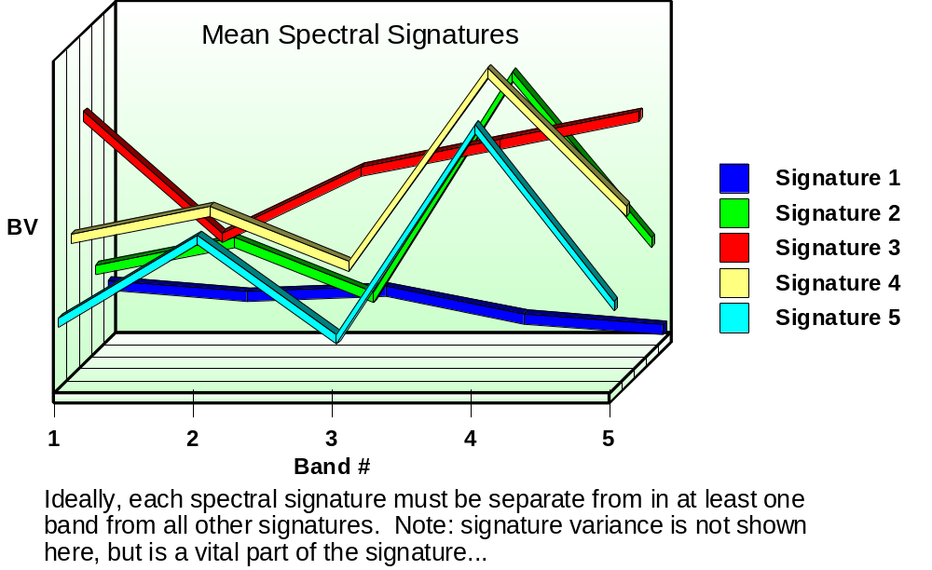
Evaluating Signatures--Signature Plots

Slide 52
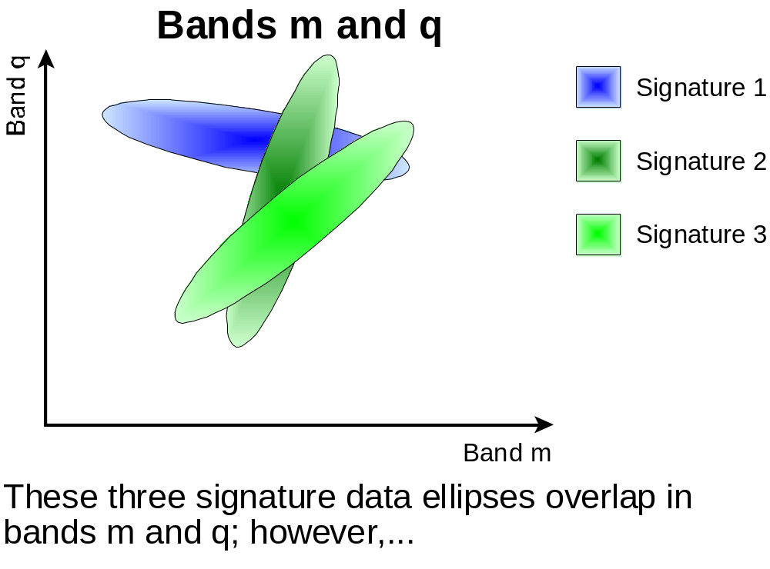
Evaluating Signatures--Signature Ellipses

Slide 53
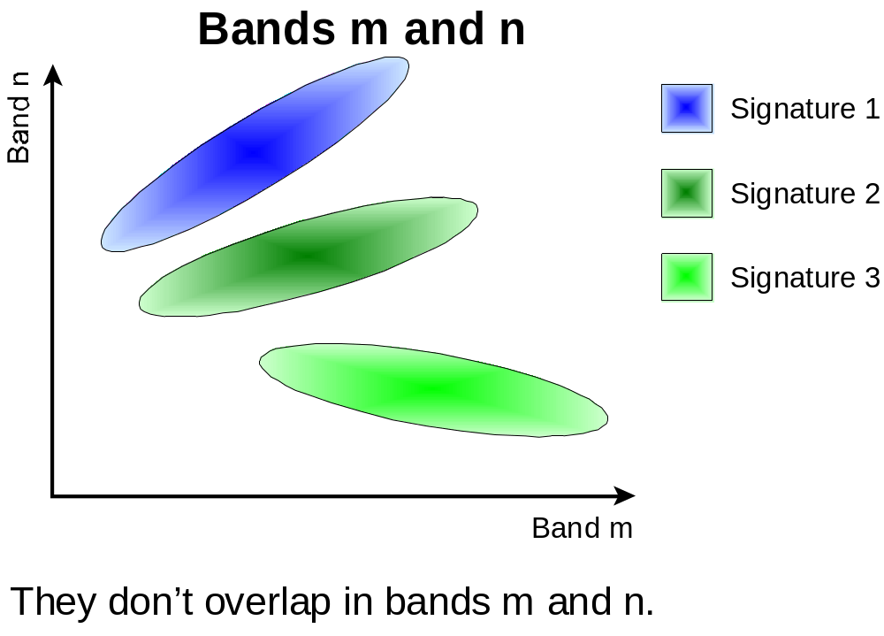
Evaluating Signatures--Signature Ellipses

Slide 54
Classification -- Final Thoughts
Classifications are never complete -- they end when time and money run out
Classification is iterative -- it’s tough to get it right the first few iterations
Consider a hybrid classification -- part supervised, part unsupervised
Manual Classification and/or Editing is not cheating!

Slide 55
Classification
References:
  ERDAS Online Help
  Lillesand and Kiefer (at SLC): Chapter 7
  Richards, John. Remote Sensing Digital Image Analysis: An introduction. 2nd Edition. 1993. Spring-Verlag, Berlin: Chapters 8 and 9

Slide 56

Thank you

