Slide 1
Data Generation - Sales
By Abhishek Das & Vikas Yadav

Slide 2
Abstract
We worked on generation of sales data from a given set of features. Objective for that can be:
To detect changes in sales from expected
To detect effects on sales, if some changes occurs in features used

Slide 3
Dataset
Dataset based on transaction daypart alongwith part of the week i.e., Breakfast_Weekday, Dinner_Weekend, Lunch_Weekday etc. was considered
Dayparts were observed as: Weekpart as:
-> 00:00 to 12:00 - Breakfast -> Monday to Friday - Weekday
-> 12:00 to 18:00 - Lunch -> Saturday, Sunday - Weekend
-> 18:00 to 00:00 - Dinner
Only transaction type M were considered
M - Menu ; T - Tender ; D - Discount
Transaction keys were made unique

Slide 4
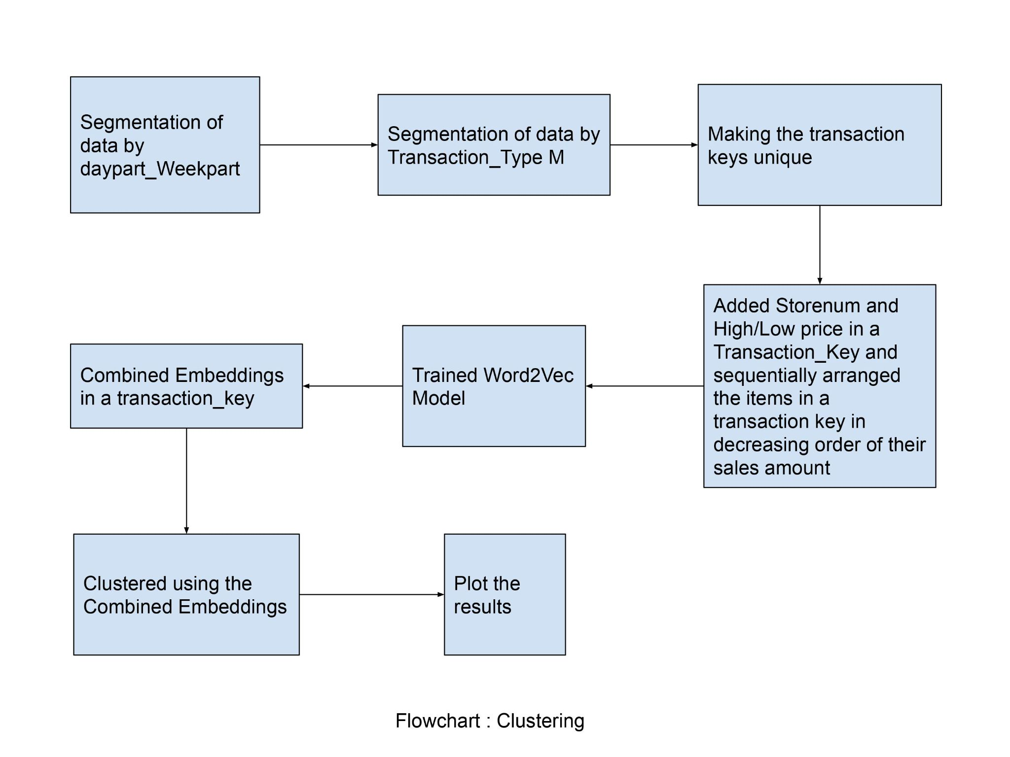
Methodology
Features used:
Storenum
Sales amount
Date and time
Transaction type
Product description
Sales channel

Slide 5
Methodology
Trained Word2Vec model with text file having storenum, High/Low price along with product descriptions space-separated ended with ‘\n’
Combined Embeddings of product combination obtained after Wod2Vec training corresponding to each transaction_key
K-means clustering was used to cluster the embeddings

Slide 6
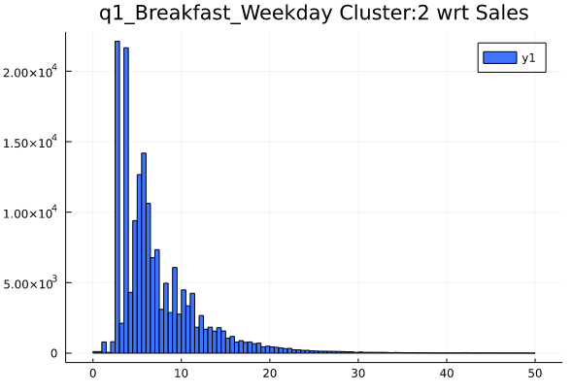
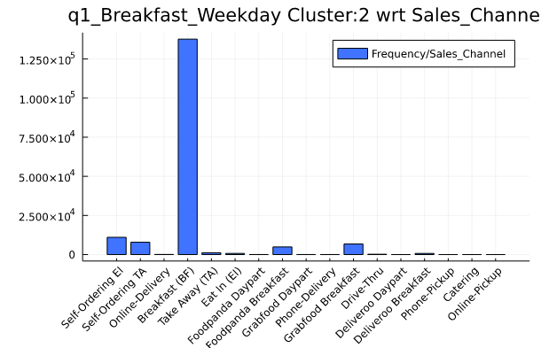
Results

Slide 7
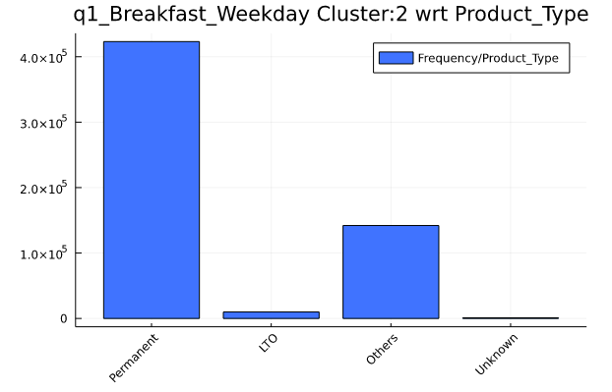
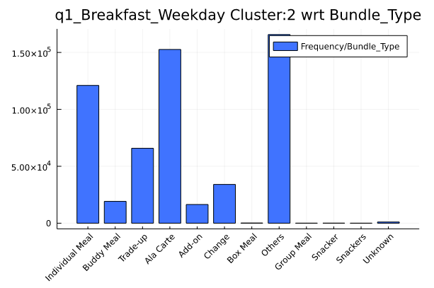
Results

Slide 8
Internship Experience !

Slide 9
Data Generation

Slide 10
Data
Found a way to represent each transaction before feeding it to the model
Created Transaction-Wise Embeddings
Each Transaction was a combination of different features :
Store Number
Sales Amount ( 7 Divisions )
Sales Channel
Combination of Items

Slide 11
Model
Modified GANs
Learnt to Generate Real Like Sales Data
Learn the Context of the given Input

Slide 12
Input / Output
Input :
Output :
Segment
Store_Num
Sales Channel
Sales_Amount Div
Input
Item Combination

Slide 13
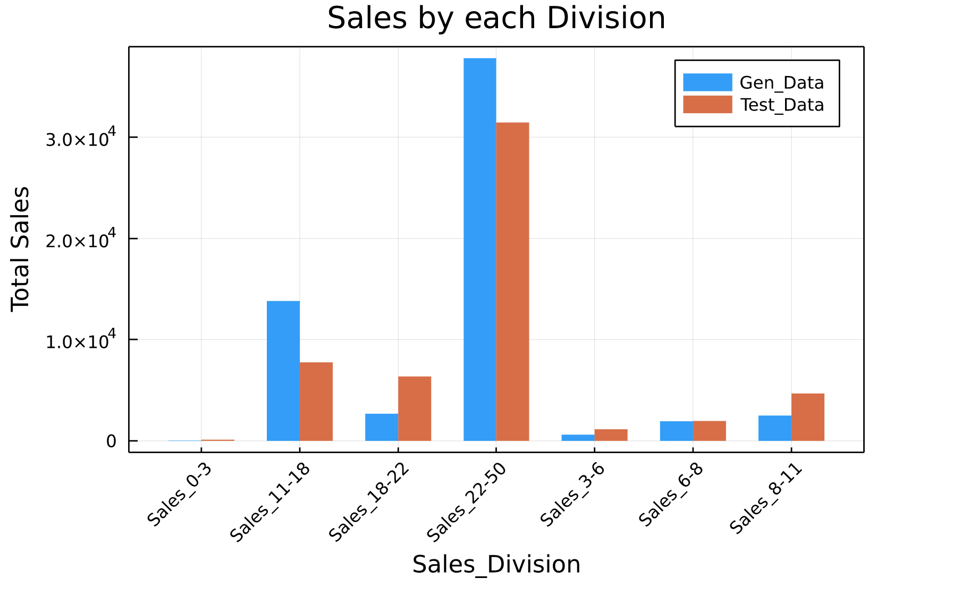
Results

Slide 14
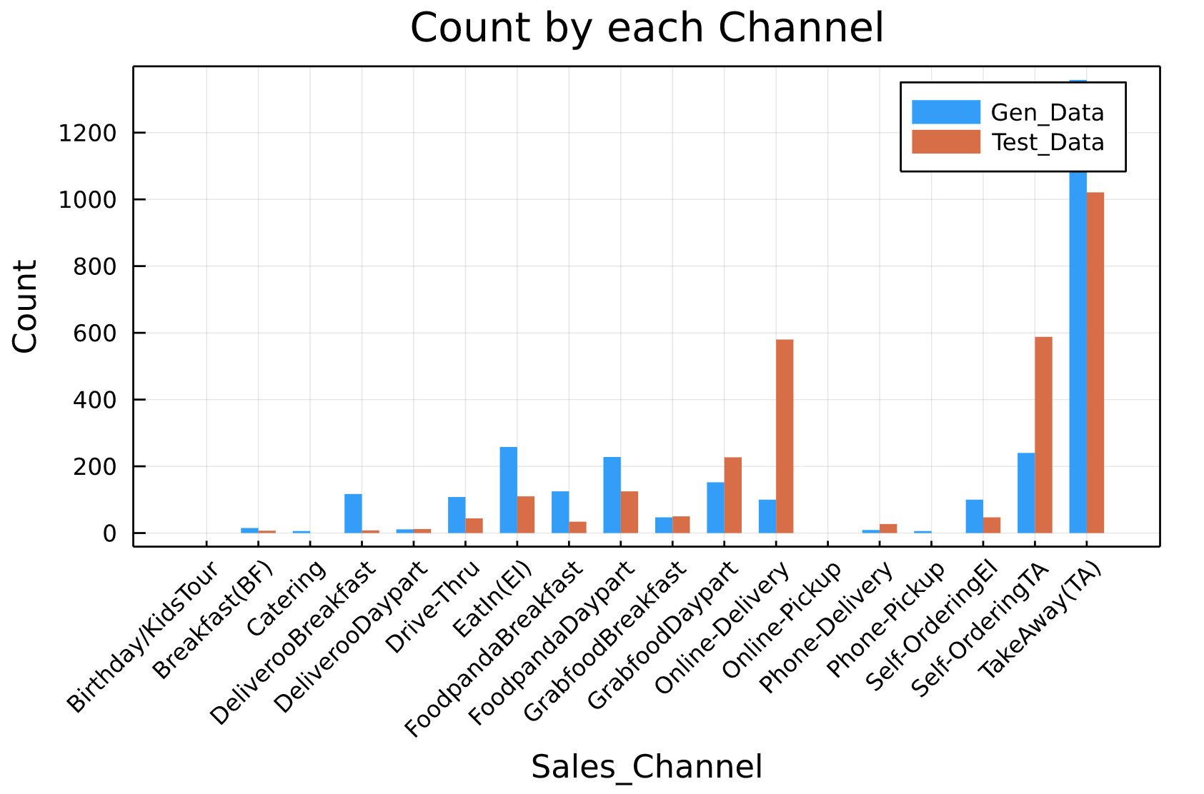
Results

Slide 15
Thank You !

