Slide 1

AstroSage Analysis
Vikas Chandrakar
18-October-2025

Slide 2
About AtstroSage
Company overview - AstroSage
Industry: Digital astrology and spiritual services
Headquarters: Noida, India
Ownership: Operated by Ojas Softech Pvt. Ltd.
Founded: Mid-2000s (public sources indicate the portal launched in the 2000s)
Website: www.astrosage.com
What the company does
Provides Vedic astrology tools and content: daily/weekly/monthly/yearly horoscopes, personalized Kundli (birth charts), Panchang, Muhurat, compatibility/matchmaking.
Offers consultations with astrologers via its marketplace (AstroSage Varta) and detailed paid reports (e.g., Brihat Kundli).
Runs popular mobile apps (AstroSage Kundli) with a very large user base in India and the global diaspora.
Publishes educational content and magazines/blogs on astrology, numerology, tarot, and related topics.
Sells spiritual products and remedies through its e-commerce arm (e.g., gemstones, yantras, puja-related items).

Slide 3
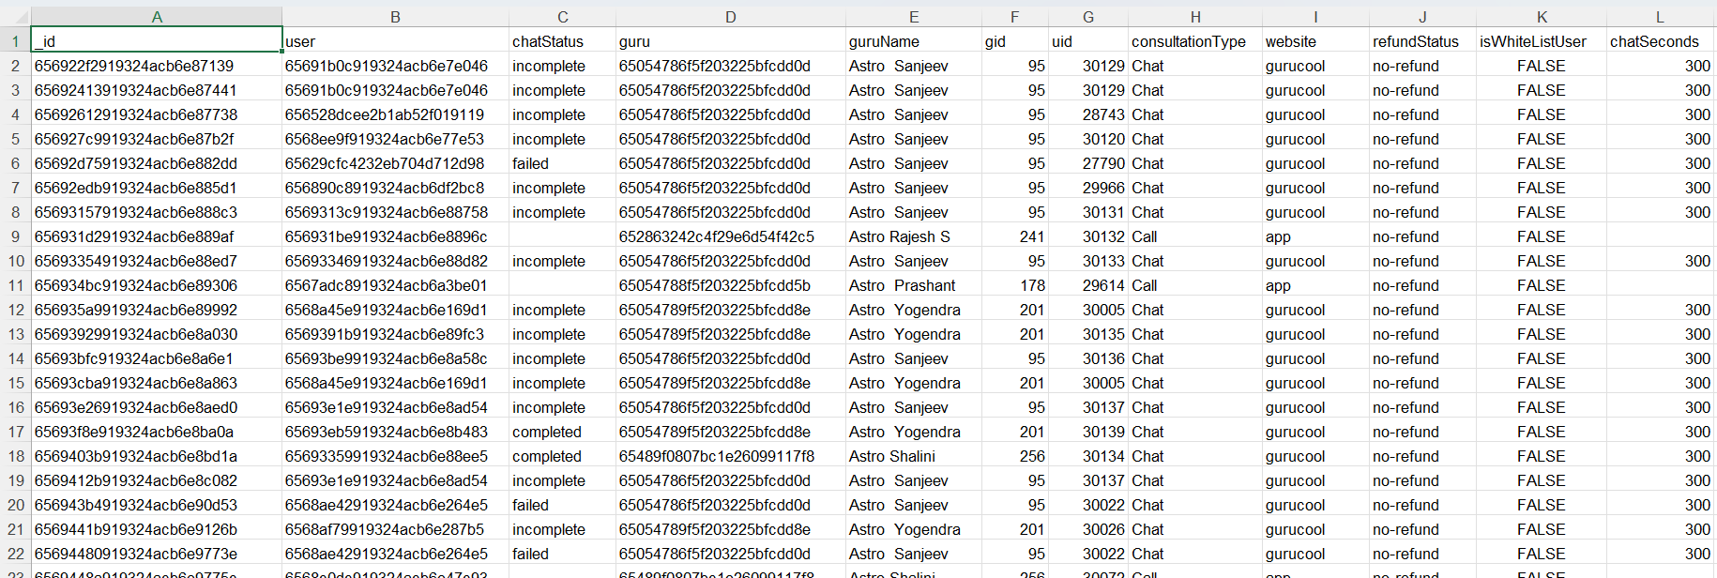
Problem Statement
AstroSage has received a 1 crore investment and aims to optimize its call center operations. The goal is to determine how to allocate this investment to maximize operational efficiency, customer satisfaction, and profitability. The analysis will consider historical call data, performance metrics, and market trends to make informed decisions.

Slide 4
Summary of the dataset
_id: Unique identifier for each record.
user: User ID associated with the record.
chatStatus: Status of the chat (e.g., incomplete, failed, completed).
guru: Unique identifier for the guru.
guruName: Name of the guru.
gid: Guru ID.
uid: User ID.
consultation Type: Type of consultation (e.g., Chat, Call).
website: Source of the consultation (e.g., gurucool).
Refund Status: Indicates if the session is refundable or not (e.g., no-refund).
is WhiteList User: Boolean indicating if the user is whitelisted.
chat Seconds: Duration of the chat in seconds.
queue: Boolean indicating if the session was queued.
FreeCall: Boolean indicating if the call was free.
Free Chat: Boolean indicating if the chat was free.
CreatedAT: Original creation date and time.
updatedAt: Original update date and time.
__v: Version key.
statementEntryId: Identifier for the statement entry.
chatStartTime: Start time of the chat.
chatEndTime: End time of the chat.
timeDuration: Undefined, some technical data as per app. (Don’t use it as the duration of chat/call)
callChannel: Channel used for the call.
calIvrType: IVR type used during the call.
callStatus: Status of the call.
CallSid: Unique identifier for the call session.
amount: Amount charged for the session.
astrologerCallStatus: Status of the astrologer during the call.
astrologerOnCallDuration: Duration of the astrologer's call.
astrologersEarnings: Earnings of the astrologer from the session.
netAmount: Net amount after deductions.
region: Region of the user.
userCallStatus: Status of the user's call.
userOnCallDuration: Duration of the user's call.
rating: Rating assigned based on the session's status.

Slide 5

There are 4 different consultation service that Astrosage offers.
In total 149 Consultants are available.
Data Cleaning and Preprocessing
Handle missing values and blank data cells across the dataset.
Normalized date values in day, month and year for daily, monthly and yearly reports.
This dataset allows for an in- depth understanding of AstroSage market presence and operational scope.
A good dataset is important to understand the operational cost , customer satisfaction and trend in the sales of call center.
This dataset enable us to predict and suggest future investments to grow the sales Turnover.

Slide 6

Methodology
Data Cleaning - Used spreadsheets functions like trim and Removing duplicates for data cleaning.
Data Enrichment - Added new variables using Date functions for better analysis .
Customer Segmentation - Used Sorting and Filtering to classify customers based on consultation type and summarizing key metrics and Identifying connection patterns across different metrics and product categories.
Used Pivot tables to analyze the performance of consultants over different category type and ratings received on basis of consultations from users.
Visualization -:Created interactive dashboard using different charts for detailed view of dataset.

Slide 7
Analytical Approach AstroSage Call Center
Objective: maximize revenue, user satisfaction, and efficiency across call/chat.
Data: interaction logs, revenue, guru roster, website/app source, timestamps, status, rating, country.
Preparation: dedupe and standardize statuses/ratings, unify timezone, link revenue to interactions, handle missing values.
KPIs: Total Revenue, Calls, Chats, Active Gurus, Avg Rating; completion/failure/no‑answer rates; revenue per interaction/guru; channel and website mix.
Time analysis: daywise and hourly volumes to find peaks/troughs and seasonality for planning.
Quality/funnel: status breakdown by channel/website/guru; rating distribution; drivers of failure and low ratings.
Opportunity sizing: quantify revenue lost to failed/incomplete interactions; what‑if uplift from +5pp completion or shifting traffic to higher‑yield sources.
Staffing: convert hourly demand to staffing via AHT and SLA, propose peak‑hour shifts and cross‑skill coverage for call vs chat.
Actions: callback/retry flows for busy/no‑answer, routing to high‑performing gurus, training for low‑rating segments, prioritize high‑ROI websites/channels.
Governance: reconcile revenue with finance, monitor anomaly alerts, metric glossary and data‑quality checks, privacy compliance.

Slide 8
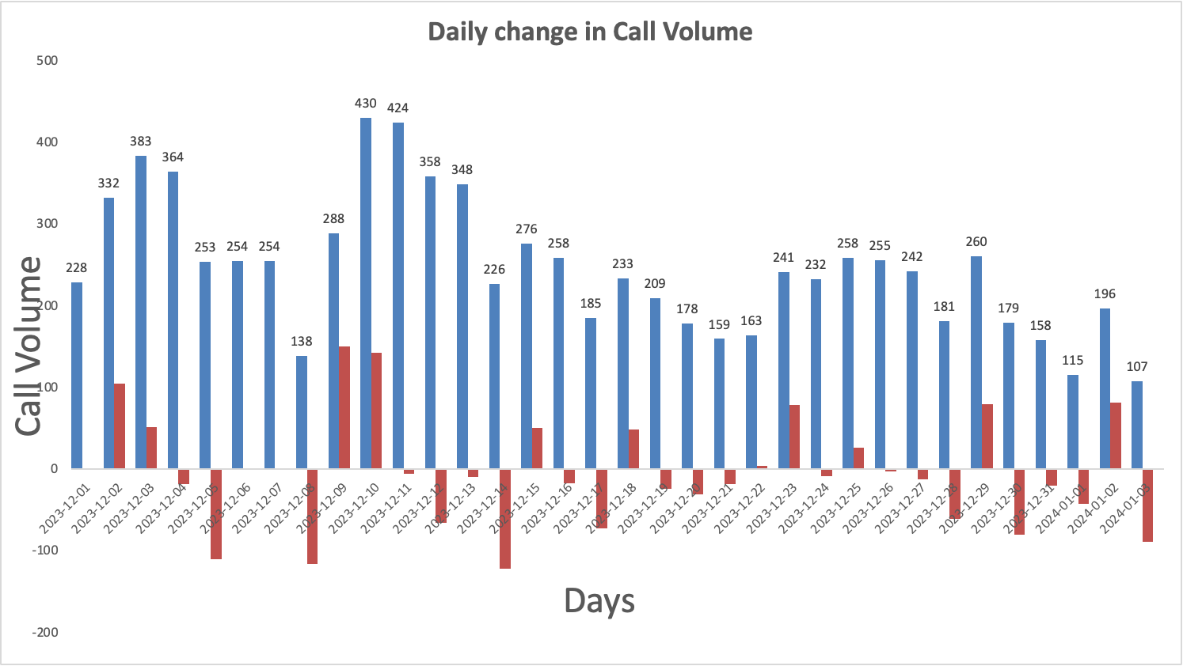
Day Wise Change in Call Volume
The column chart shows the Day-wise call distribution.
430 calls is the maximum amount of call received on a single day.
On an average the call center receives around 250 calls on a daily basis.
It also shows the change in call volume day by day.

Slide 9
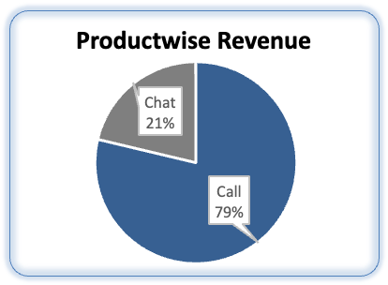
Revenue Generated By Each Category
Product-wise revenue Pie Chart , presents a detailed insight about the revenue generated by different consultation-types as per the percentage of total revenue.
The majority of sales occur through call segments, with a smaller share coming from chat interactions.
AstroSage should consider adopting advanced technologies and hiring skilled agents to boost the share of complementary and public live calls.

Slide 10
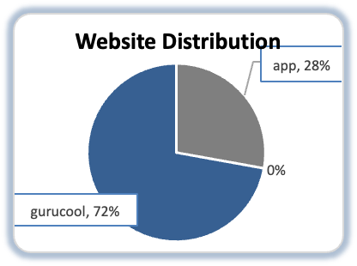
Website Distribution
The website distribution pie chart is presented with the different websites showing count consultations through different website channels.
The least amount of consultations appear from dashboard.
The most amount consultations are from gurucool.

Slide 11
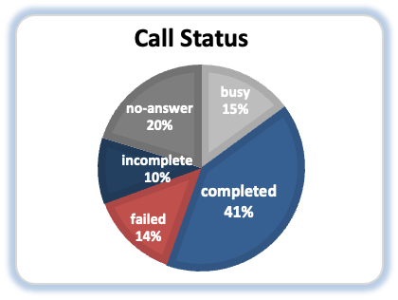
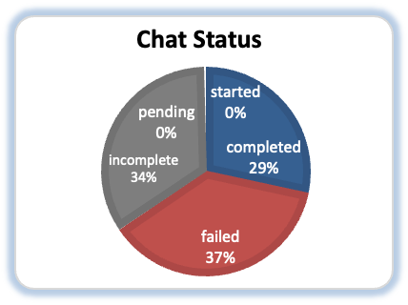
Call Status and Chat Status Distribution
The call-status pie chart is presented with the different responses by the user i.e. the end result of consultation.
The completed calls are 25% and there are the most amount of failed calls.
The NA represents the consultations done on any other consultation-type than calls.
The chat-status pie chart is presented with the different responses by the user i.e. the end result of consultation.
The completed chats are 20% and most amount of failed chats 37%.
The On call represents the consultations done on any other consultation-type than calls.

Slide 12
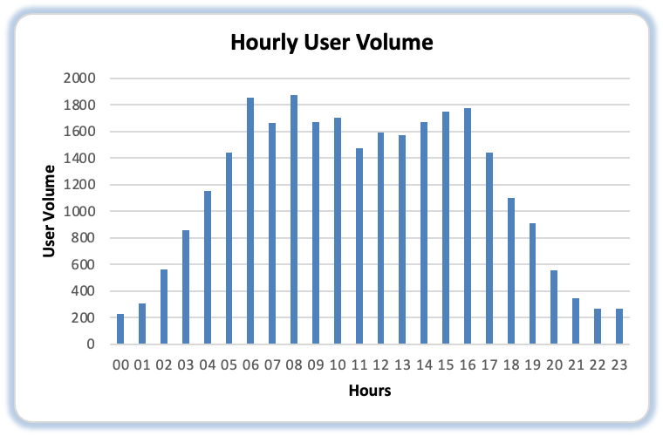
Hourly User Volume
Given column chart shows hourly call distribution ,according to chart we can see that highest call peak hours starts from 6AM to 4PM.
More investment can be done in hiring skilled agents and also on implementing Ai-powered chat-bots and CRM technology.
Also a well-designed and systematic feedback system and automatic call routing system will attract more users for calls and overall engagements.

Slide 13
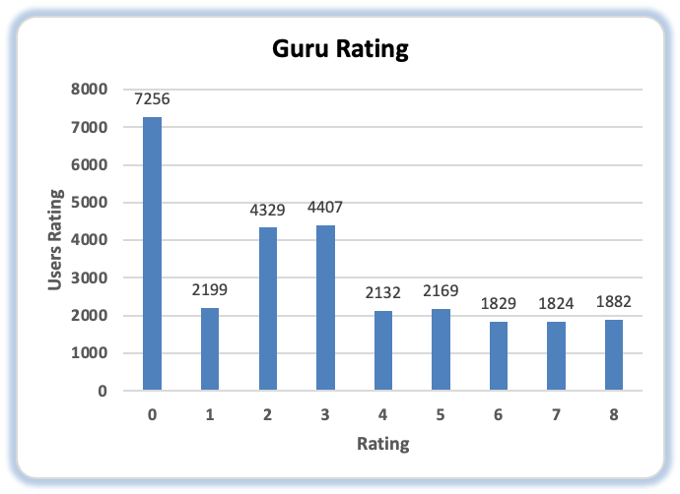
Guru Rating on the scale of 8
The column chart represents the rating-wise guru distribution.
The calls consultation needs to be worked on and improve to increase the quality of consultation.
The ratings of Gurus that consulted on chats is better than on calls.

Slide 14


Strategic Recommendations
Upgrade Technology Infrastructure
Reason: High call (59%) and chat (71%) failure rates indicate unreliable systems.
Action: Implement a cloud-based omnichannel platform with smart routing and callback options.
Impact: Improved reliability, higher customer satisfaction, and reduced missed interactions.
Implement Advanced Workforce Management (WFM)
Reason: Peak hours (6 AM–5 PM) cause workload imbalance and agent fatigue.
Action: Use data-driven scheduling and dynamic staffing tools.
Impact: Better workload balance, reduced burnout, and improved efficiency.

Slide 15


Strategic Recommendations
Introduce Targeted Training Programs
Reason: Low average rating (2.93/8) indicates skill gaps and poor service quality.
Action: Provide regular training on communication, technology usage, and customer engagement.
Impact: Improved resolution rates and higher customer satisfaction.
Optimize Channel Strategy for Revenue Growth
Reason: Calls generate 79% of total revenue, while chats underperform with high failure rates.
Action: Focus on improving call handling and enhancing chat reliability.
Impact: Increased conversion rates and revenue growth.

Slide 16


Strategic Recommendations
Adopt AI-Powered Chatbots and Analytics Tools
Reason: Manual inefficiencies in chat and call handling.
Action: Deploy AI for initial interactions and sentiment analysis.
Impact: Faster response times and deeper customer insights.
Implement Performance-Based Incentives
Reason: Top 10 gurus handle 44% of total calls, showing workload imbalance.
Action: Introduce incentives tied to satisfaction and efficiency metrics.
Impact: Balanced performance and motivated workforce.

Slide 17

Strategic Recommendations
Overall Expected Impact:
📈 Higher customer satisfaction
⚙️ Increased operational efficiency
💰 Boosted profitability
🛅 Improved employee retention
Strengthen Data Monitoring and Reporting
Reason: Continuous tracking enables proactive issue resolution.
Action: Use dashboards to monitor KPIs like completion rates and ratings.
Impact: Data-driven decisions and continuous improvement.

Slide 18
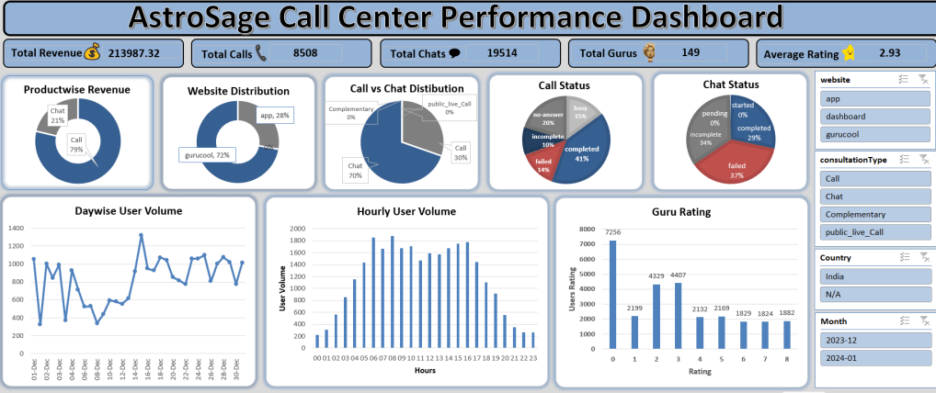

Slide 19
The DashBoard Consists of Following Metrics
Total Revenue
Total Calls
Total Chats
Total Gurus
Average Rating
Call Revenue (%)
Chat Revenue (%)
Website Distribution (app, dashboard, gurucool)
Consultation Type Distribution (Call, Chat, Complementary, public_live_Call)
Call Status (Completed, Incomplete, Failed, No Answer, Busy)
Chat Status (Completed, Incomplete, Failed, Pending/Started)
Daywise User Volume
Hourly User Volume
Guru Rating Distribution
Filters: Website, Consultation Type, Country, Month

Slide 20
Conclusion
Summary of Findings
High system failure rates and workload imbalances were key operational challenges.
Average customer satisfaction (2.93/8) indicates an urgent need for service quality improvement.
Calls remain the primary revenue driver (79%), but chat performance lags behind.
Strategic Takeaways
Technology upgrade is essential to fix foundational inefficiencies.
Training and AI integration will empower agents to deliver consistent, high-quality service.
Data-driven workforce management ensures optimal performance during peak hours.
Incentive-based motivation will balance workloads and enhance productivity.

Slide 21
Conclusion
Final Outlook
By implementing these strategic actions, AstroSage’s call center can:
🚀 Achieve higher customer satisfaction and loyalty.
⚙️ Operate more efficiently with smarter scheduling and automation.
💰 Boost profitability through improved completion rates and revenue optimization.
👥 Foster a motivated and balanced team culture focused on quality service.

Slide 22

References
Newton School – Learning resources and guidance
Raw Data – Dataset used for analysis
AstroSage Website – www.astrosage.com
ChatGPT – AI-based assistance and explanations

Slide 23

Vikas Chandrakar
18-10-2024

