Slide 1

AstroSage Analysis
Vikas Chandrakar
18-October-2025

Slide 2
About AtstroSage
Company overview - AstroSage
Industry: Digital astrology and spiritual services
Headquarters: Noida, India
Ownership: Operated by Ojas Softech Pvt. Ltd.
Founded: Mid-2000s (public sources indicate the portal launched in the 2000s)
Website: www.astrosage.com
What the company does
Provides Vedic astrology tools and content.
Offers consultations with astrologers via its marketplace (AstroSage Varta) and detailed paid reports (e.g., Brihat Kundli).
Sells spiritual products and remedies.

Slide 3
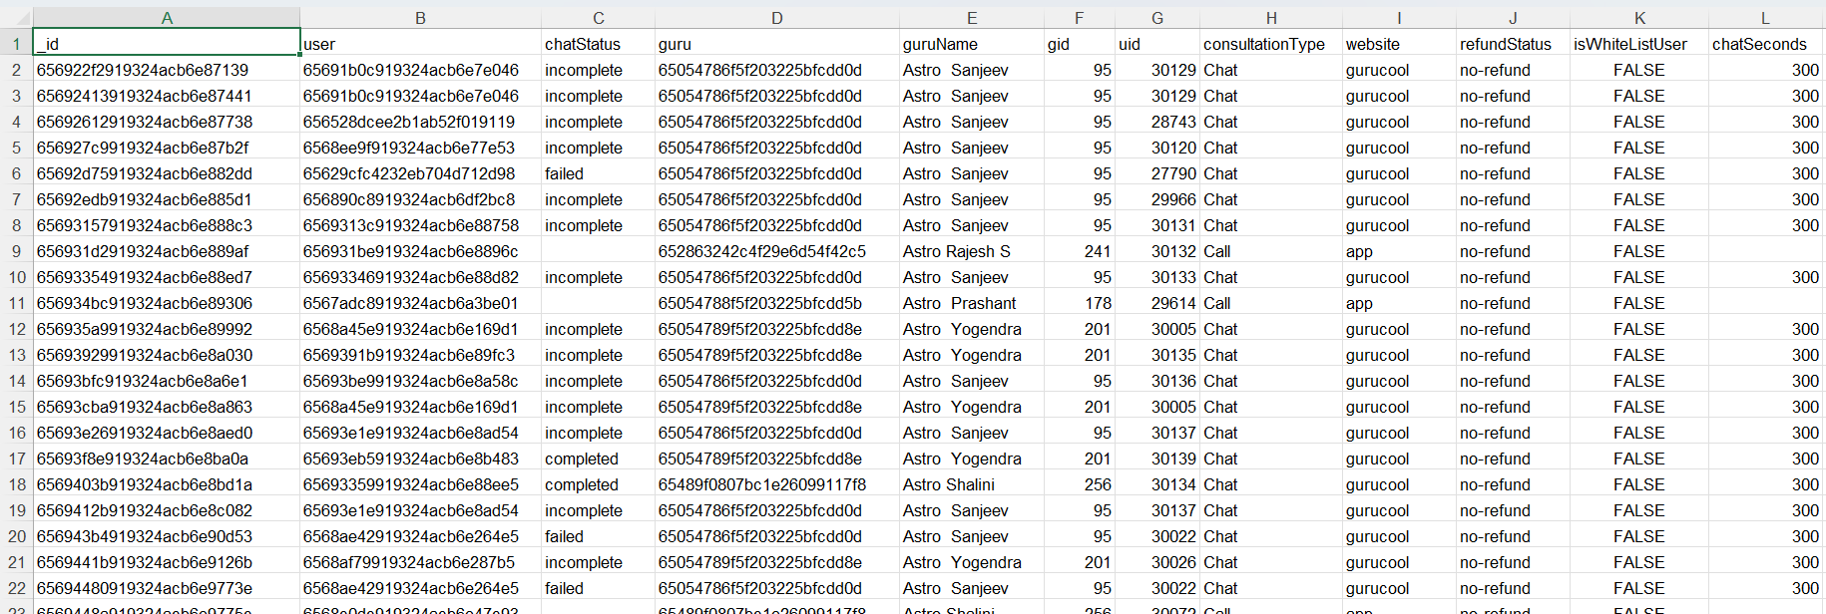
Problem Statement
AstroSage has received a 1 crore investment and aims to optimize its call center operations. The goal is to determine how to allocate this investment to maximize operational efficiency, customer satisfaction, and profitability. The analysis will consider historical call data, performance metrics, and market trends to make informed decisions.

Slide 4

Data Overview
2,790 unique users served by 305 gurus.
Covers 34 days of data from India.
8,512 total calls (41% completed, 14% failed, 10% incomplete).
Data used to analyze customer trends and optimize operations.

Slide 5

Data Cleaning and Pre-processing
Handle missing values and blank data cells across the dataset.
Normalized date values in day, month and year for daily, monthly and yearly reports.
This dataset allows for an in- depth understanding of AstroSage market presence and operational scope.
A good dataset is important to understand the operational cost , customer satisfaction and trend in the sales of call center.
This dataset enable us to predict and suggest future investments to grow the sales Turnover.

Slide 6

Analytical Approach
Data Cleaning - Used spreadsheets functions like trim and Removing duplicates for data cleaning.
Data Enrichment - Added new variables using Date functions for better analysis .
Customer Segmentation - Used Sorting and Filtering to classify customers based on consultation type and summarizing key metrics and Identifying connection patterns across different metrics and product categories.
Visualization -:Created interactive dashboard using different charts for detailed view of dataset.

Slide 7
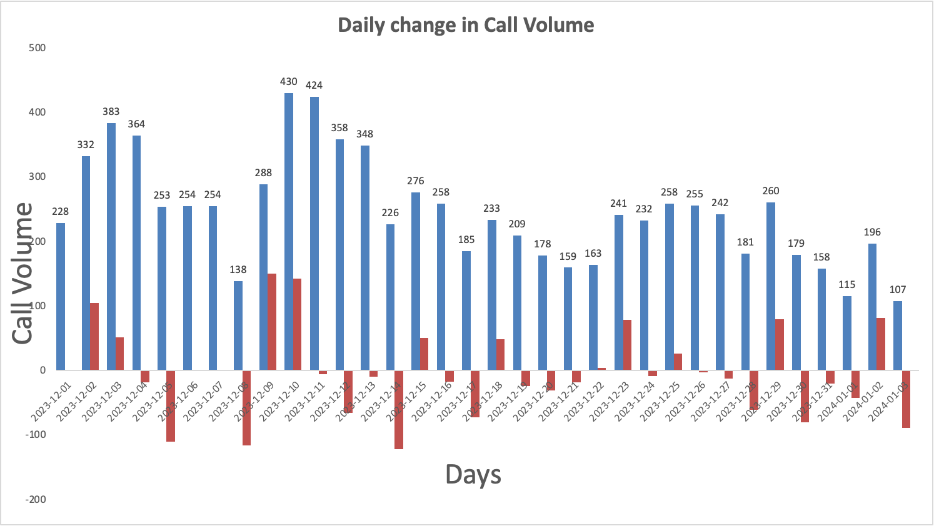
Day Wise Change in Call Volume
The column chart shows the Day-wise call distribution.
430 calls is the maximum amount of call received on a single day.
On an average the call center receives around 250 calls on a daily basis.
It also shows the change in call volume day by day.

Slide 8
Revenue Generated By Each Category
Product-wise revenue Pie Chart , presents a detailed insight about the revenue generated by different consultation-types as per the percentage of total revenue.
The majority of sales occur through call segments, with a smaller share coming from chat interactions.
AstroSage should consider adopting advanced technologies and hiring skilled agents to boost the share of complementary and public live calls.

Slide 9
Website Distribution
The website distribution pie chart is presented with the different websites showing count consultations through different website channels.
The least amount of consultations appear from dashboard.
The most amount consultations are from gurucool.

Slide 10
Call Status Distribution
The call-status pie chart is presented with the different responses by the user i.e. the end result of consultation.
The completed calls are 25% and there are the most amount of failed calls.
The NA represents the consultations done on any other consultation-type than calls.

Slide 11
Chat Status Distribution
The chat-status pie chart is presented with the different responses by the user i.e. the end result of consultation.
The completed chats are 20% and most amount of failed chats 37%.
The On call represents the consultations done on any other consultation-type than calls.

Slide 12
Hourly User Volume
Given column chart shows hourly call distribution ,according to chart we can see that highest call peak hours starts from 6AM to 4PM.
More investment can be done in hiring skilled agents and also on implementing Ai-powered chat-bots and CRM technology.
Also a well-designed and systematic feedback system and automatic call routing system will attract more users for calls and overall engagements.

Slide 13
Guru Rating on the scale of 8
The column chart represents the rating-wise user distribution.
The calls consultation needs to be worked on and improve to increase the quality of consultation.
The ratings given by users that consulted on chats is better than on calls.

Slide 14

Strategic Recommendations
Upgrade Technology Infrastructure
Reason: High call (59%) and chat (71%) failure rates indicate unreliable systems.
Action: Implement a cloud-based omnichannel platform with smart routing and callback options.
Impact: Improved reliability, higher customer satisfaction, and reduced missed interactions.

Slide 15

Strategic Recommendations
Implement Advanced Workforce Management (WFM)
Reason: Peak hours (6 AM–5 PM) cause workload imbalance and agent fatigue.
Action: Use data-driven scheduling and dynamic staffing tools.
Impact: Better workload balance, reduced burnout, and improved efficiency.

Slide 16

Strategic Recommendations
Introduce Targeted Training Programs
Reason: Low average rating (2.93/8) indicates skill gaps and poor service quality.
Action: Provide regular training on communication, technology usage, and customer engagement.
Impact: Improved resolution rates and higher customer satisfaction.

Slide 17
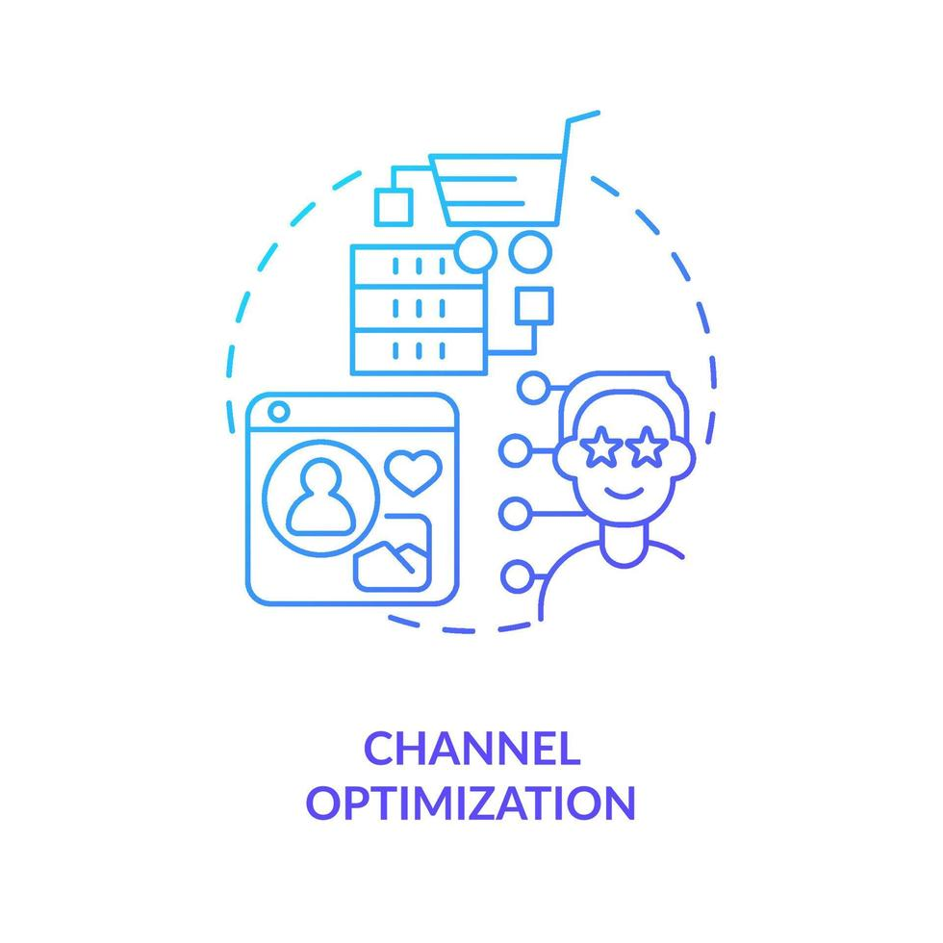
Strategic Recommendations
Optimize Channel Strategy for Revenue Growth
Reason: Calls generate 79% of total revenue, while chats underperform with high failure rates.
Action: Focus on improving call handling and enhancing chat reliability.
Impact: Increased conversion rates and revenue growth.

Slide 18

Strategic Recommendations
Adopt AI-Powered Chatbots and Analytics Tools
Reason: Manual inefficiencies in chat and call handling.
Action: Deploy AI for initial interactions and sentiment analysis.
Impact: Faster response times and deeper customer insights.

Slide 19

Strategic Recommendations
Implement Performance-Based Incentives
Reason: Top 10 gurus handle 44% of total calls, showing workload imbalance.
Action: Introduce incentives tied to satisfaction and efficiency metrics.
Impact: Balanced performance and motivated workforce.

Slide 20

Strategic Recommendations
Strengthen Data Monitoring and Reporting
Reason: Continuous tracking enables proactive issue resolution.
Action: Use dashboards to monitor KPIs like completion rates and ratings.
Impact: Data-driven decisions and continuous improvement.

Slide 21

Overall Expected Impact
📈 Higher customer satisfaction
⚙️ Increased operational efficiency
💰 Boosted profitability
🛅 Improved employee retention

Slide 22
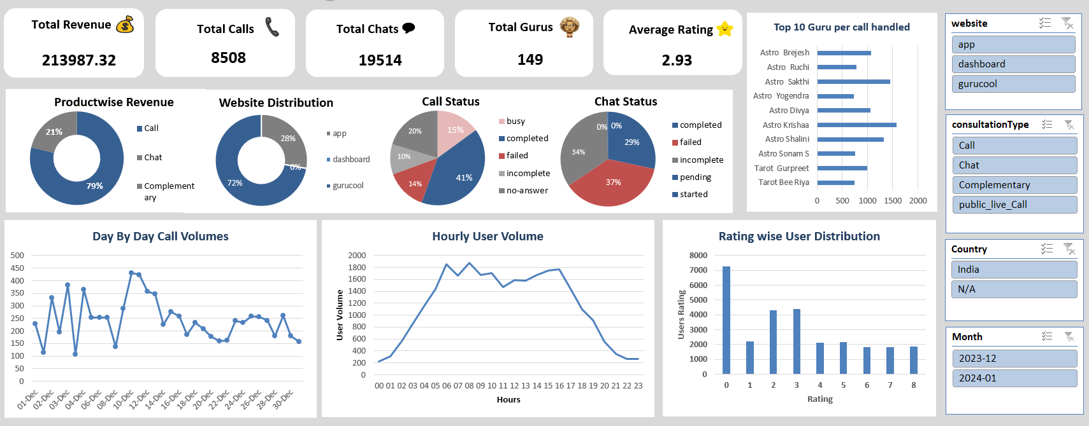
AstroSage Call Center Performance Dashboard

Slide 23
Conclusion
Summary of Findings
High system failure rates and workload imbalances were key operational challenges.
Average customer satisfaction (2.93/8) indicates an urgent need for service quality improvement.
Calls remain the primary revenue driver (79%), but chat performance lags behind.

Slide 24
Conclusion
Strategic Takeaways
Technology upgrade is essential to fix foundational inefficiencies.
Training and AI integration will empower agents to deliver consistent, high-quality service.
Data-driven workforce management ensures optimal performance during peak hours.
Incentive-based motivation will balance workloads and enhance productivity.

Slide 25
Final Outlook
By implementing these strategic actions, AstroSage’s call center can:
🚀 Achieve higher customer satisfaction and loyalty.
⚙️ Operate more efficiently with smarter scheduling and automation.
💰 Boost profitability through improved completion rates and revenue optimization.
👥 Foster a motivated and balanced team culture focused on quality service.

Slide 26

Newton School – Learning resources and guidance
Raw Data – Dataset used for analysis
AstroSage Website – www.astrosage.com
ChatGPT – AI-based assistance and explanations

Slide 27

Vikas Chandrakar
18-10-2024

