Slide 1


Slide 2
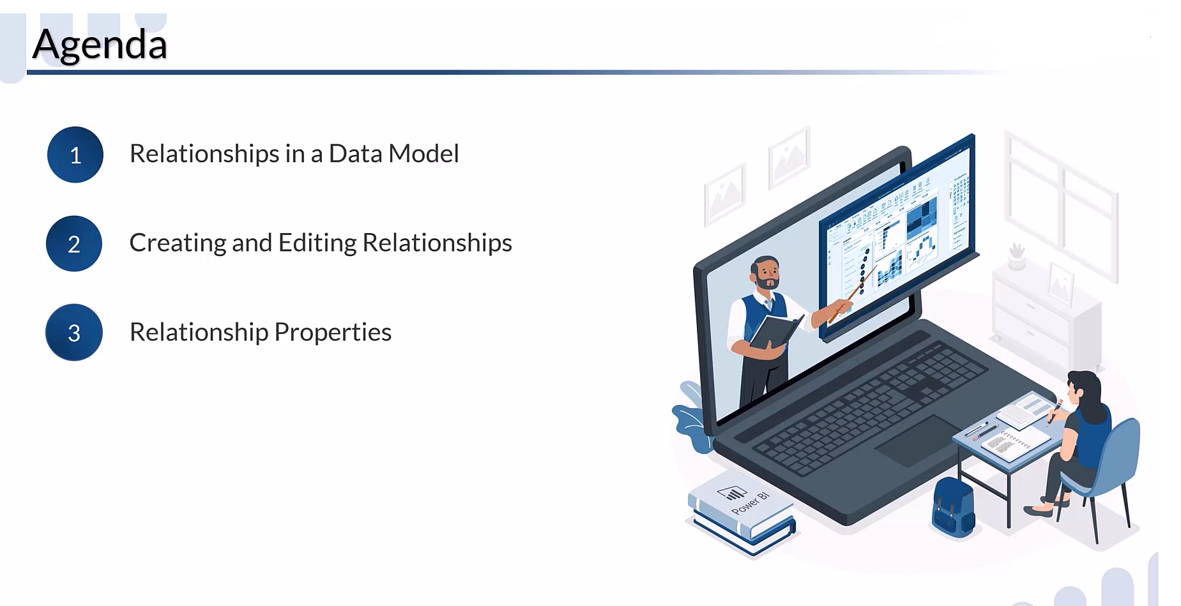

Slide 3
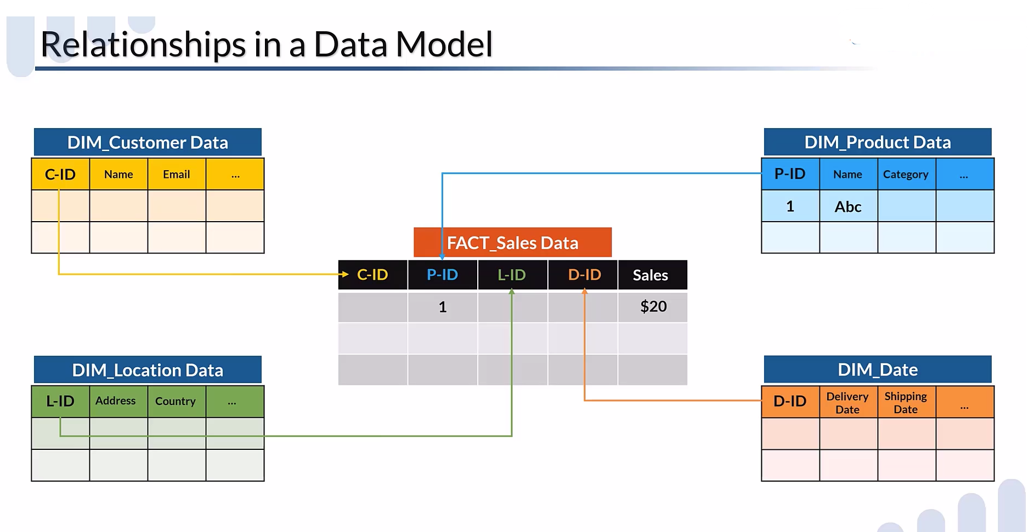

Slide 4
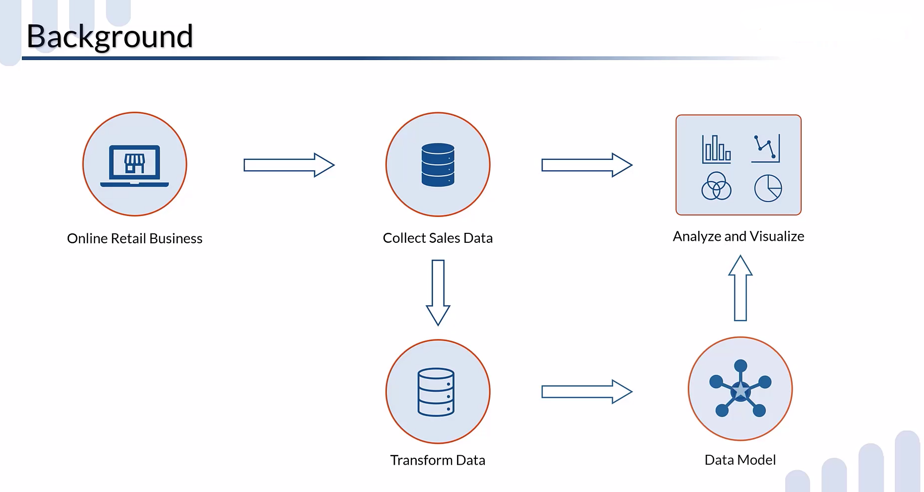
Already Transform Data

Slide 5
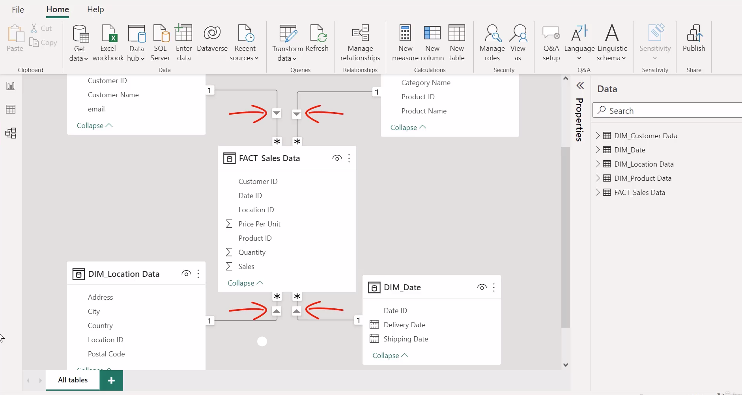
As you know Power Bi is a intelligent tool & its automatically auto detect & auto create
the relationship between the table according to column Id’s

Slide 6
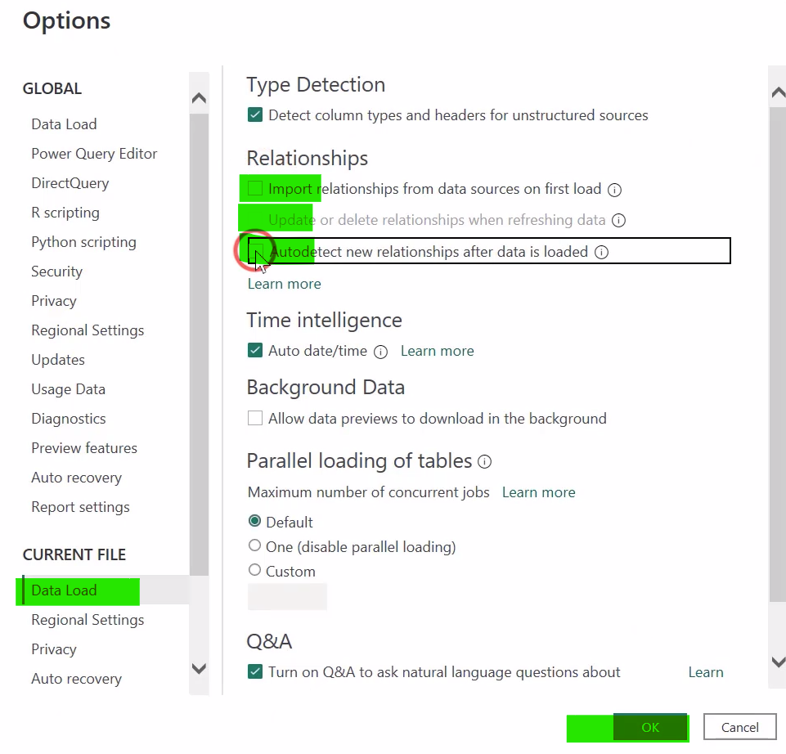
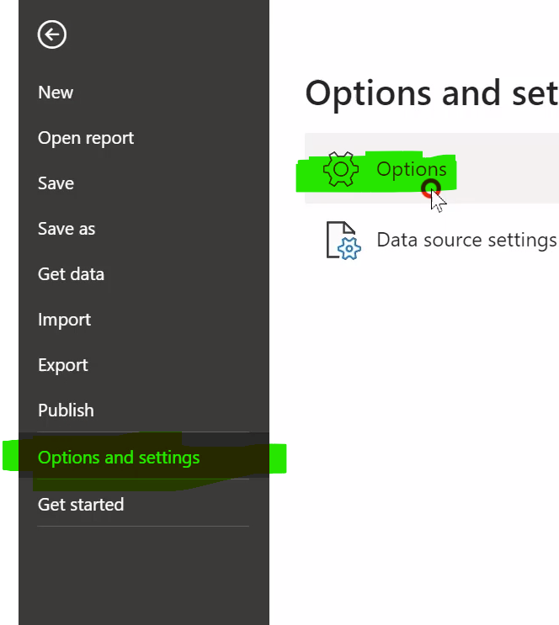



Now if you to disable this auto detect & auto create the relationship between the table to customize the
Relationship according to your own just follow the following steps.
Uncheck Three
Options

Slide 7
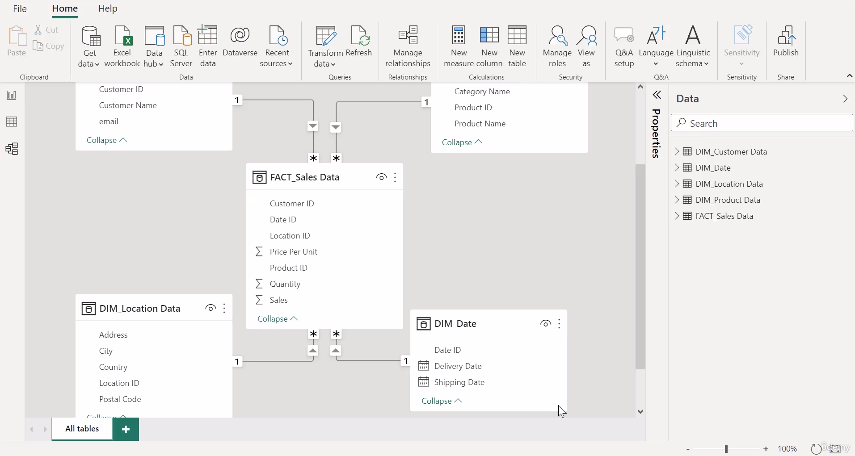
As you see there is no changes after uncheck the relationship, because data is previously loaded
So to remove the relationship between dataset we have to unload or load the data again using
POWER QUERY EDITOR

Slide 8
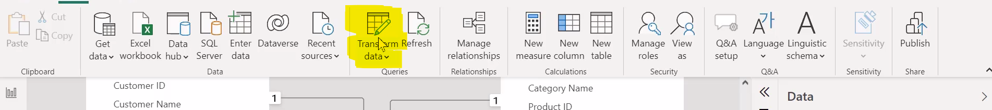
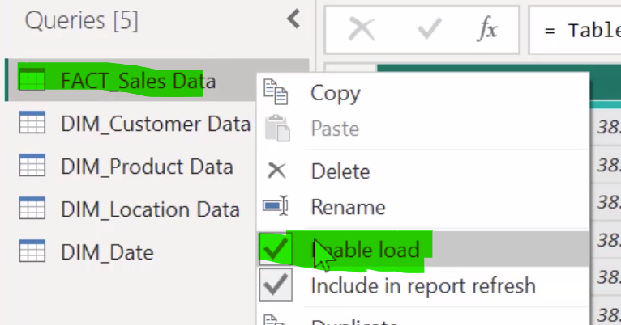
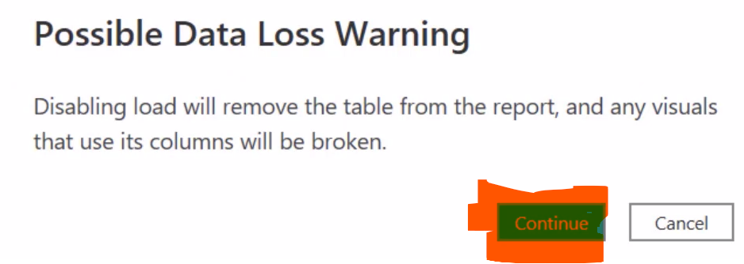
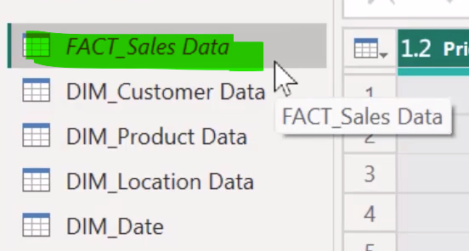



Now use following steps to unload the data
Click Transform Data & open PBI editor
As u see data which unloaded show in Italic while
Other data show in normal format
Follow same process on each data set
Then choose CLOSE & APPLY

Slide 9
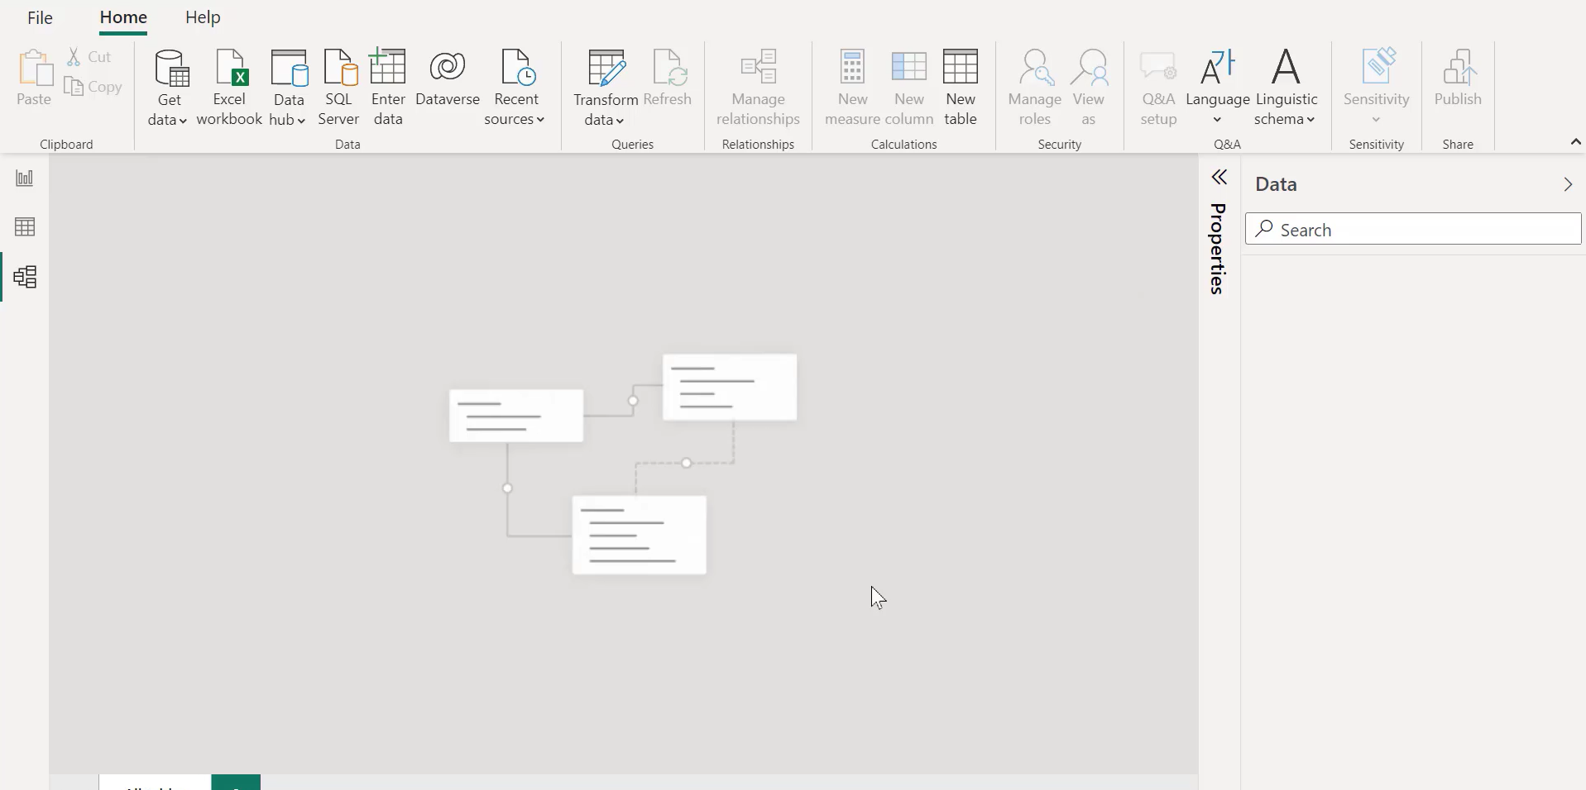
Now you can see model view contains no table

Slide 10
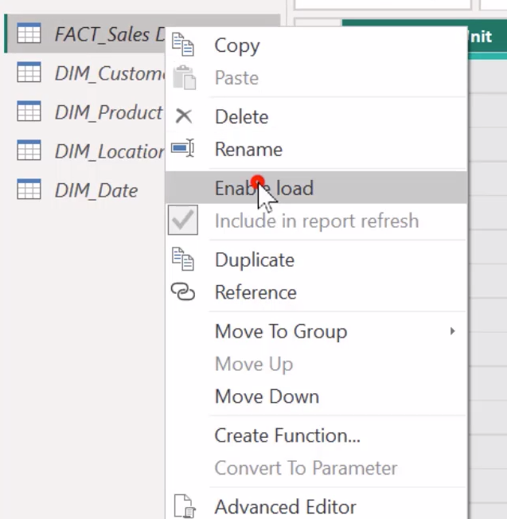
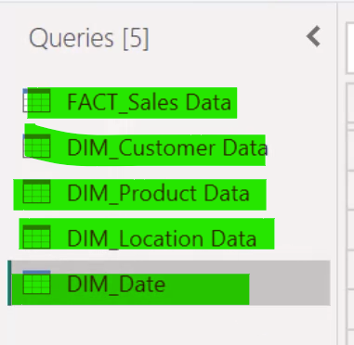
Now you can load the table again in data model using PBI query editor
Click the Transform Data Option & load the Dataset again using following steps
See all dataset are loaded as u see fonts are in
normal format.
Load all the data set
& choose close & apply to reload the models

Slide 11
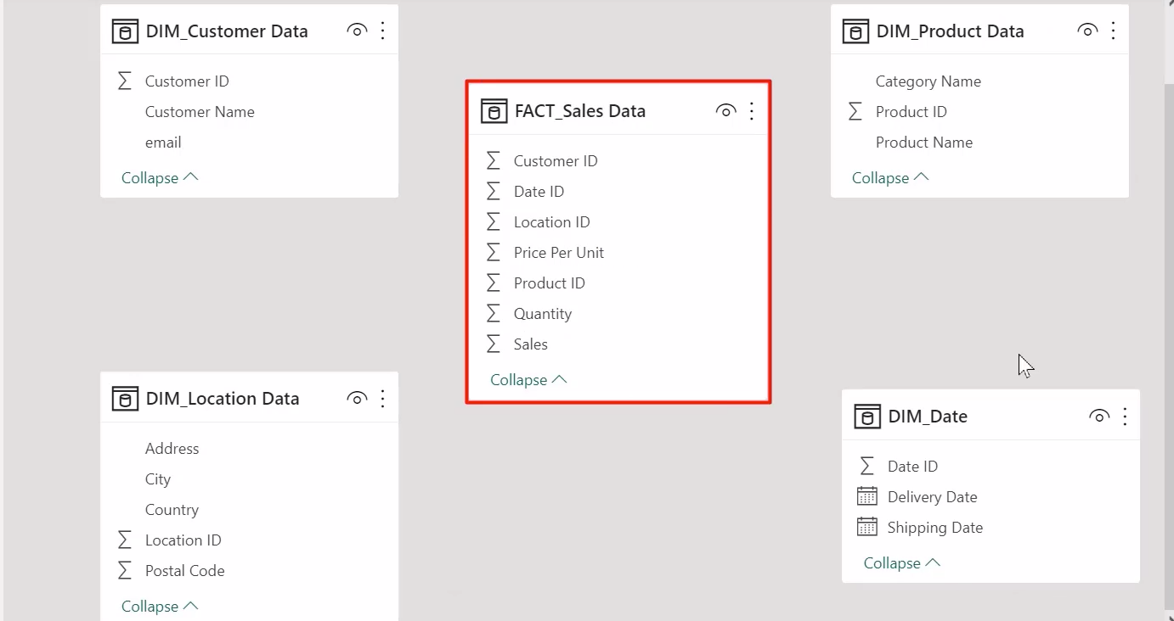
As you see, now there is no relationship between the tables

Slide 12
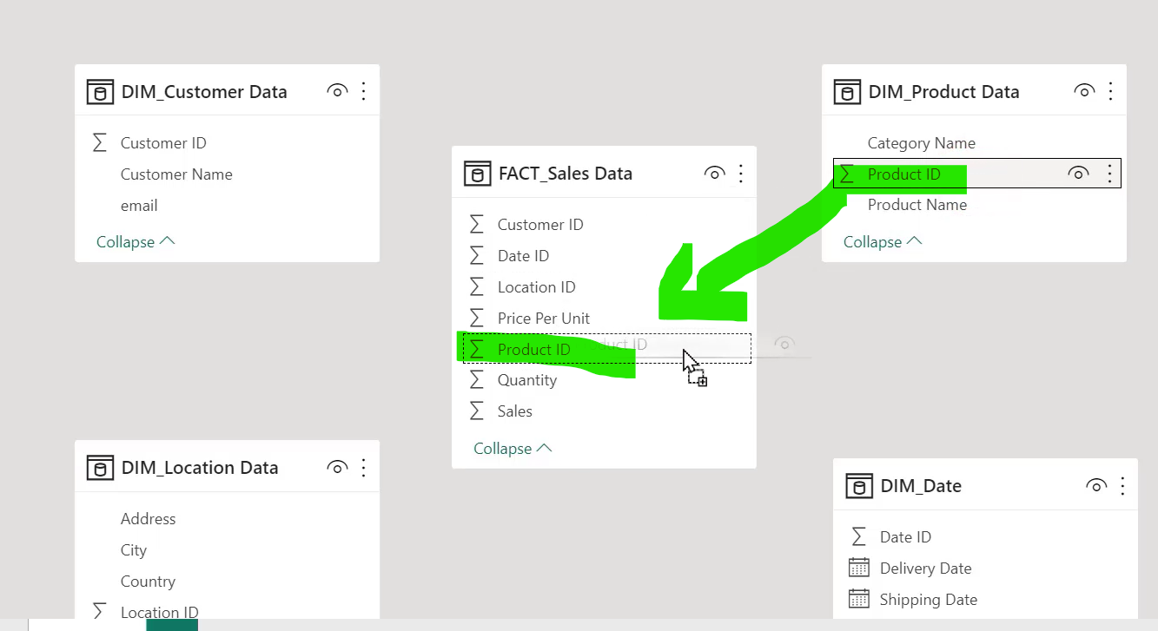
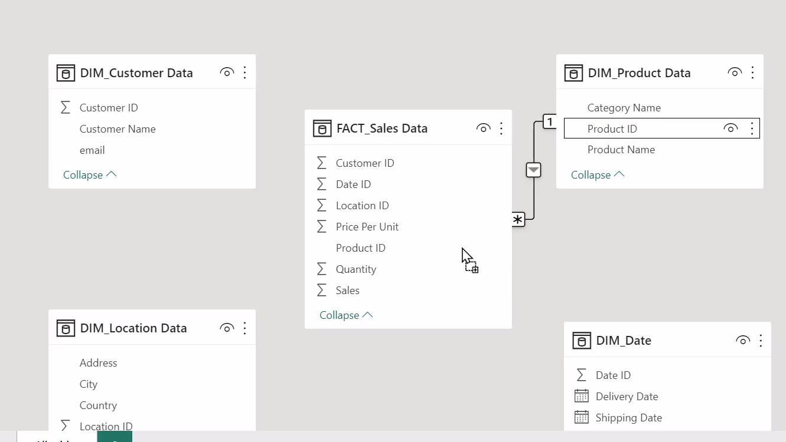
To set the relationship just drag the productid and drop it on Fact sale Data productid
This will set the correct relation ship between products

Slide 13
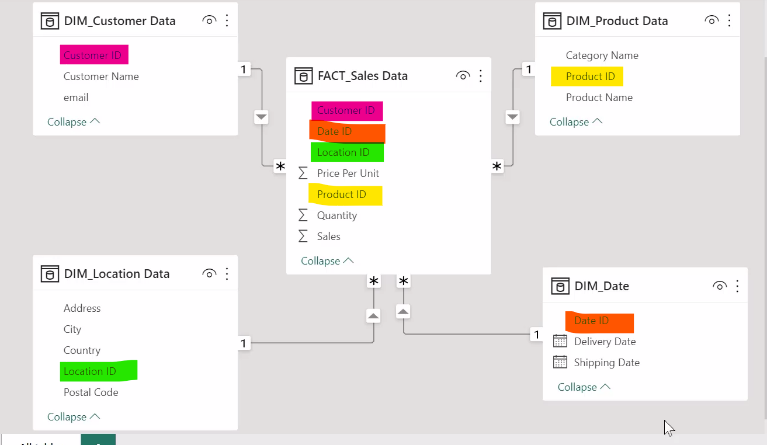
Follow same step on other keys , this will set the relationship according to your requirements

Slide 14
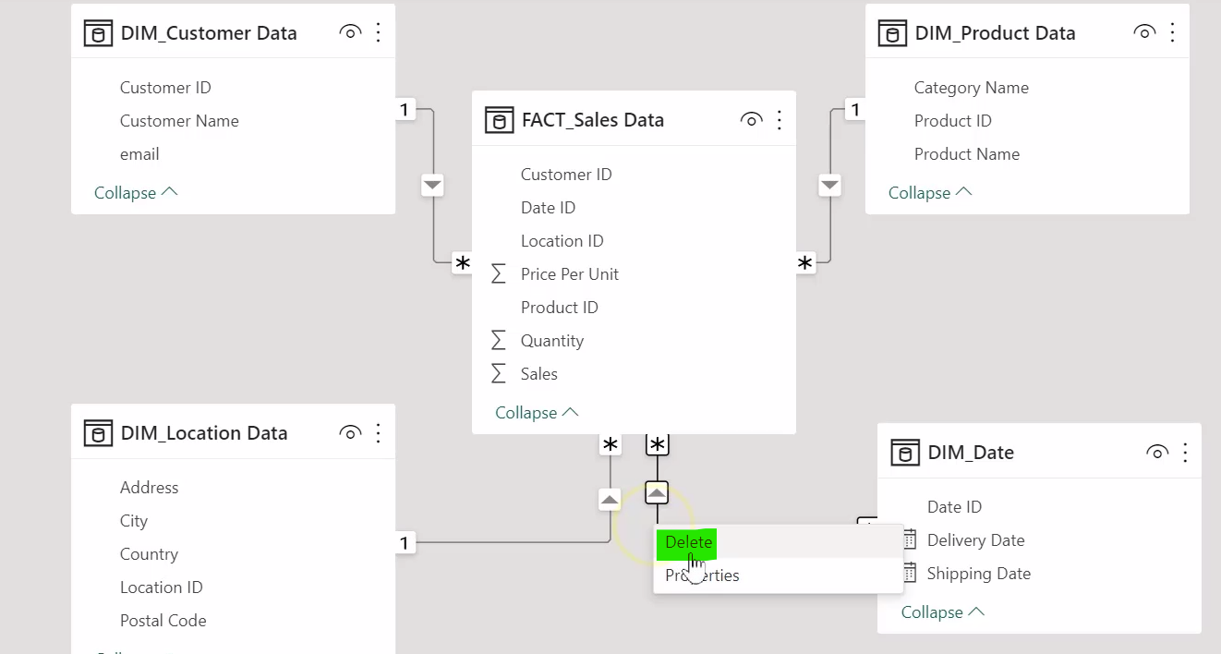
To delete the relationship just right click on relationship line & delete it

Slide 15
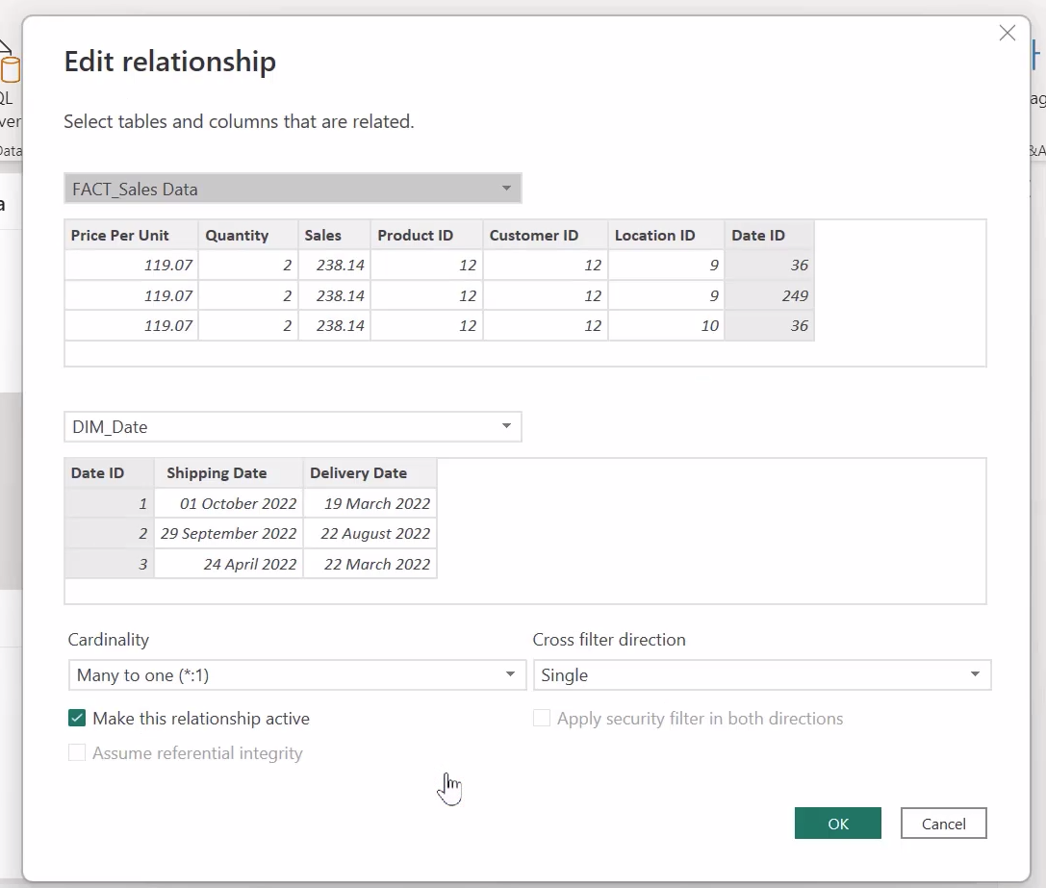
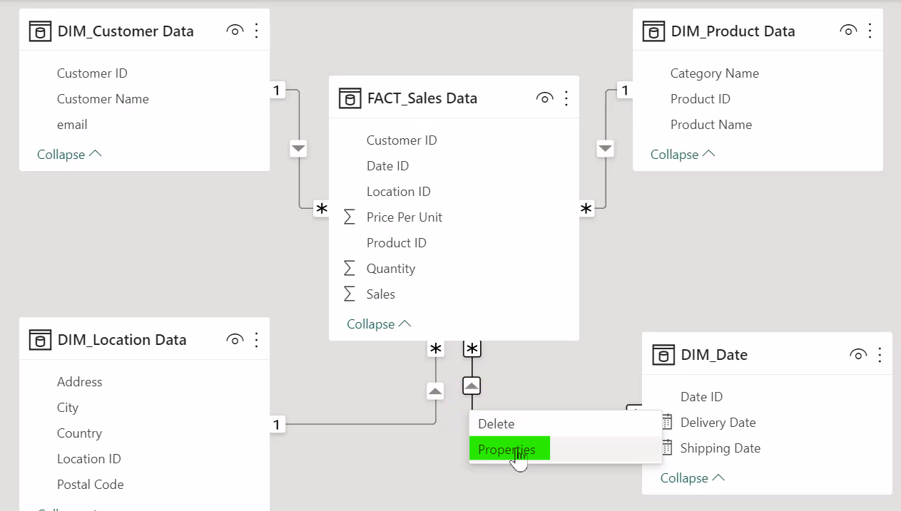
To Edit the relationship just right click on relationship & choose properties option, this will open
Edit relationship dialog, now you can change the relationship and press ok

Slide 16
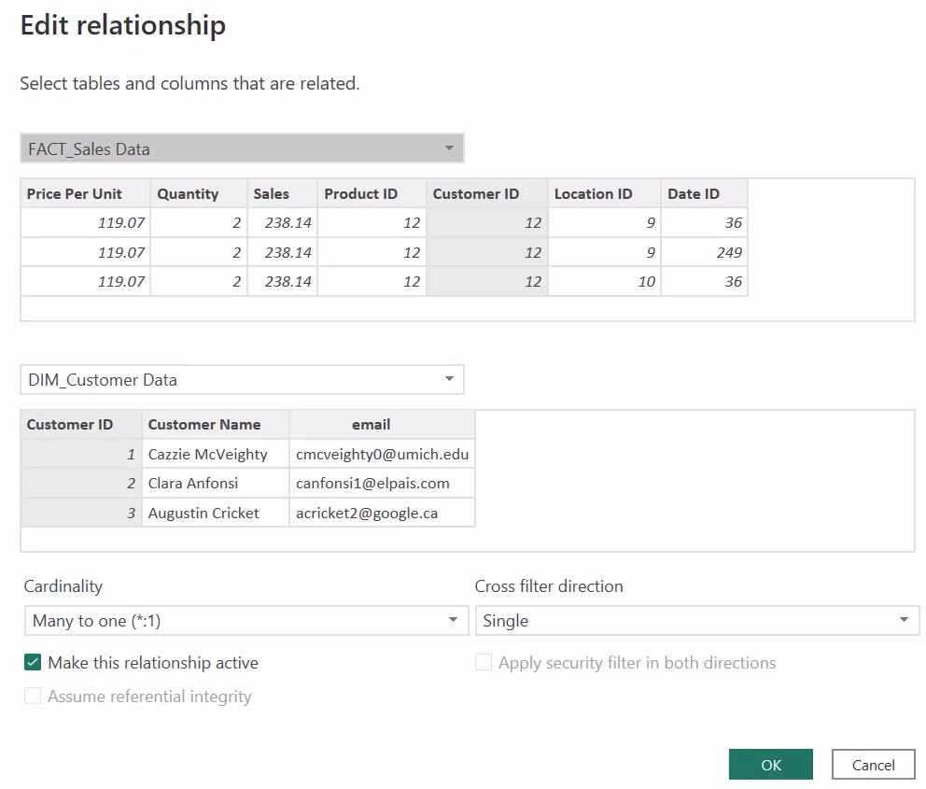
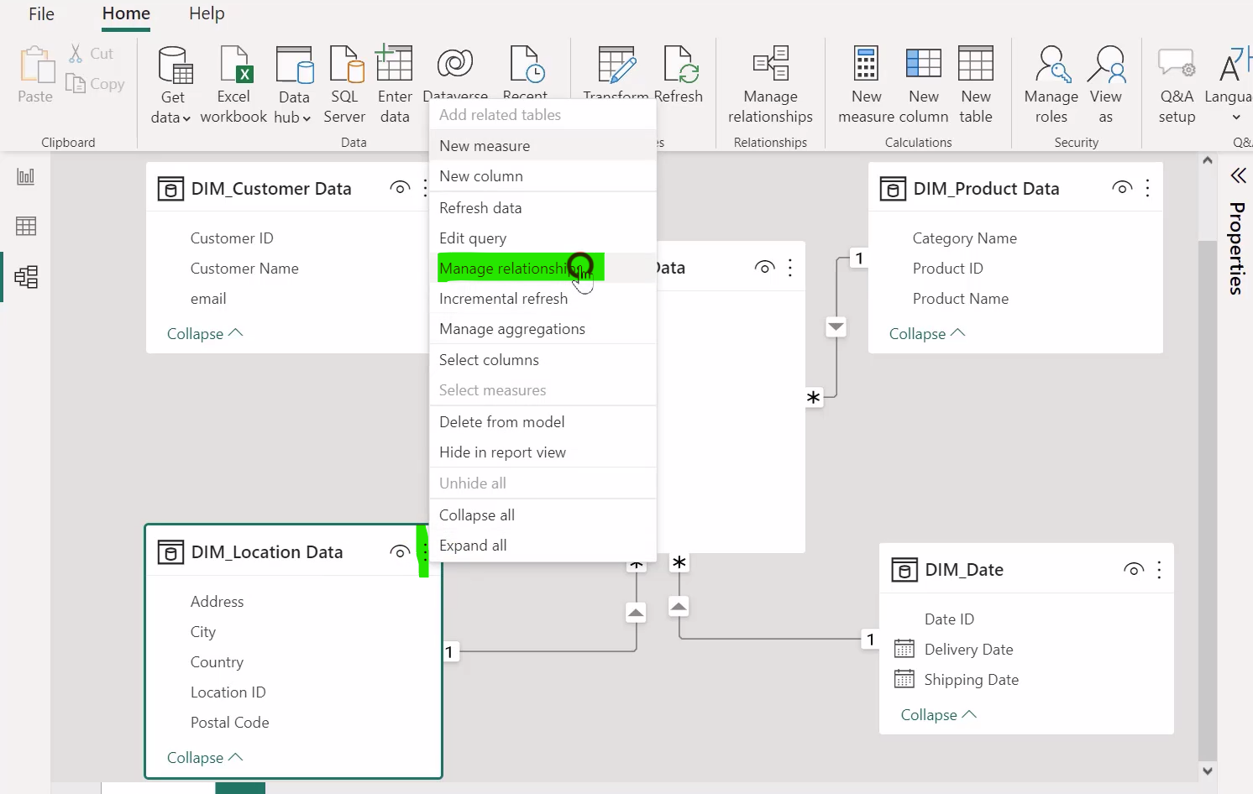
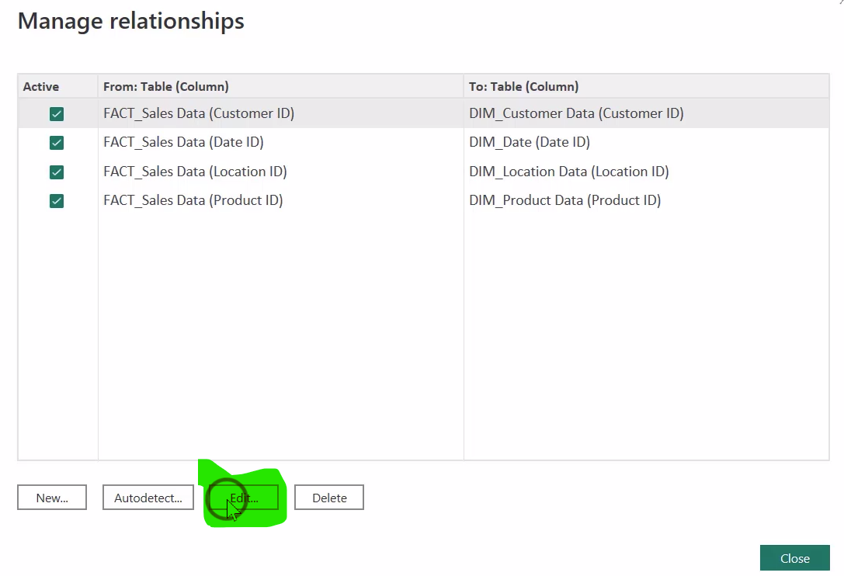
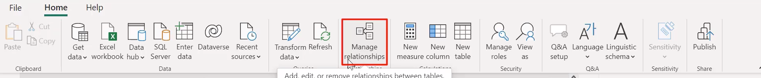
There is another way to edit the relationship
You can also manage it using manage
relationship from home tab

Slide 17
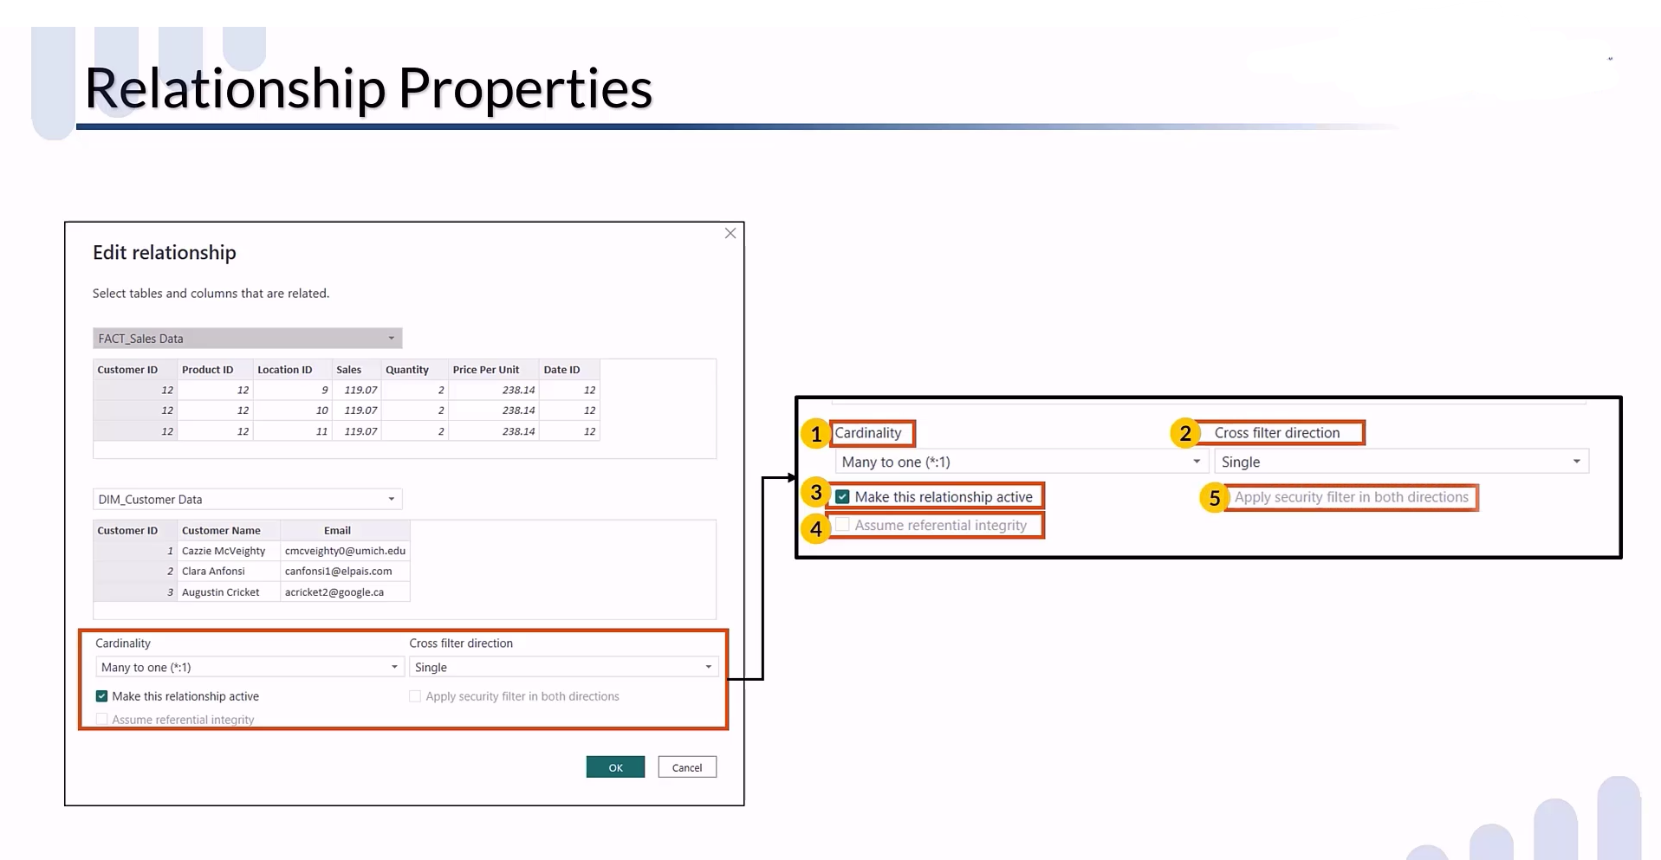

Slide 18
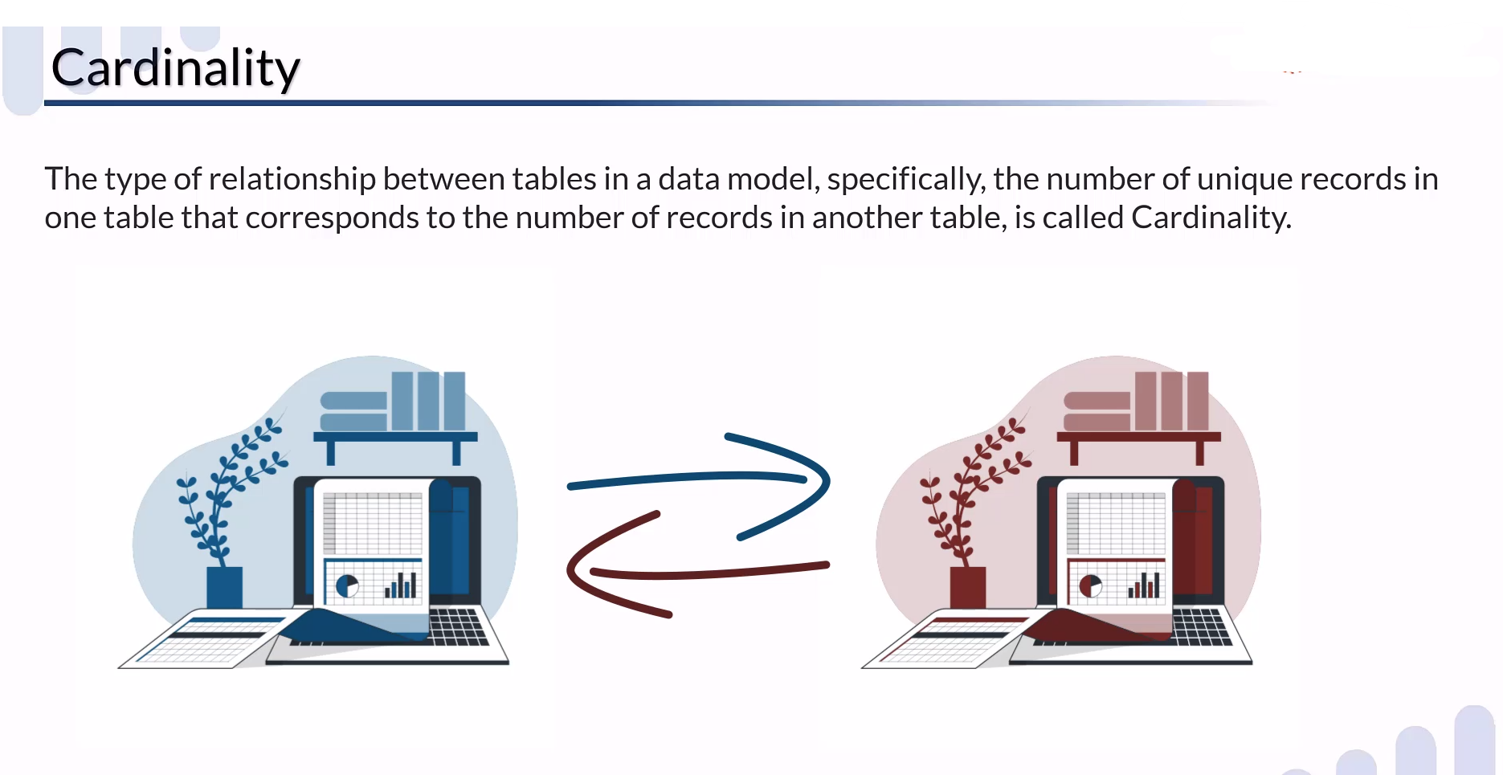

Slide 19
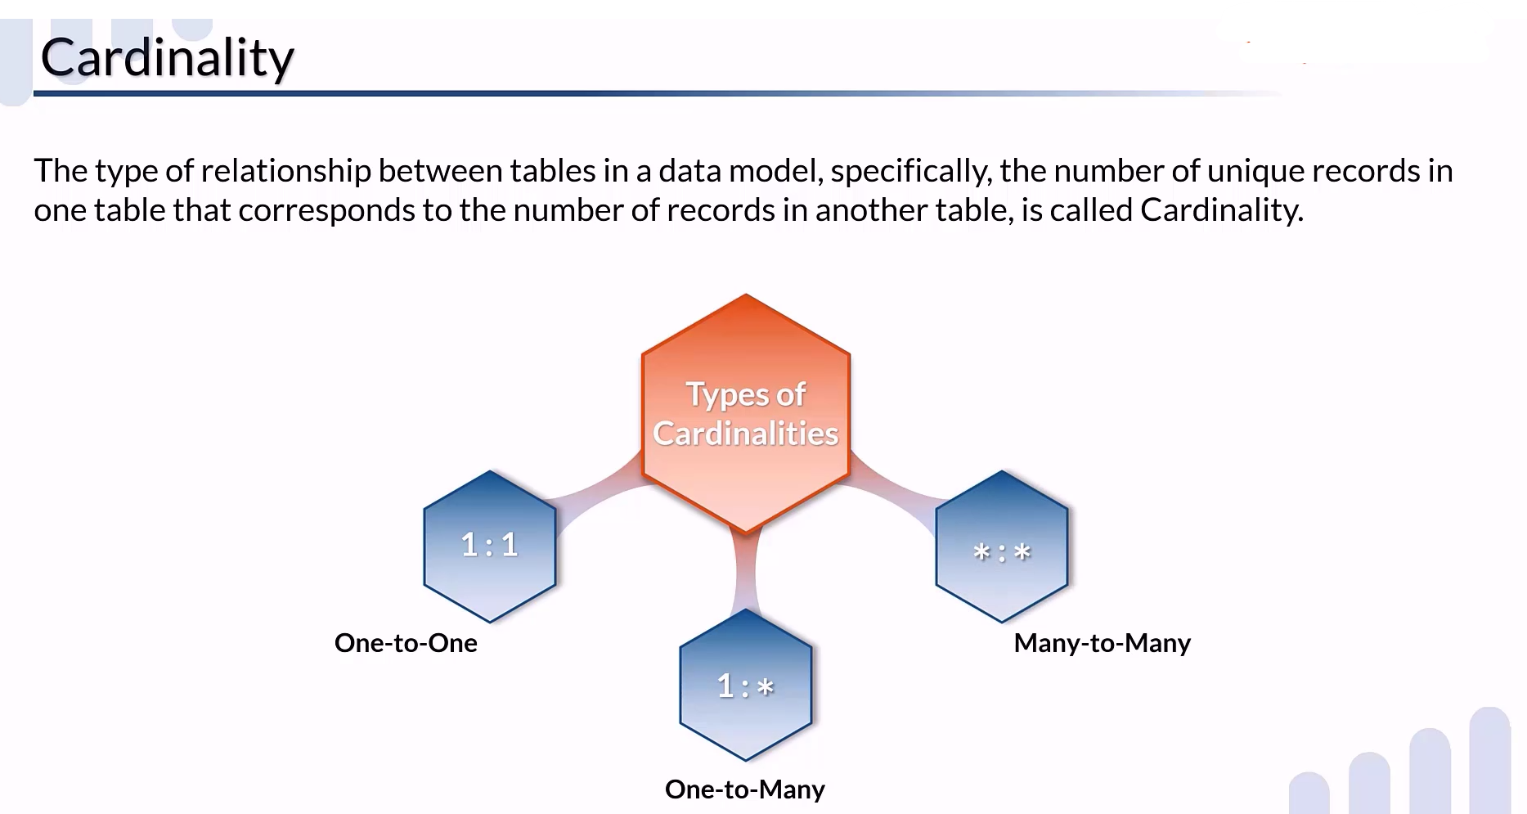

Slide 20
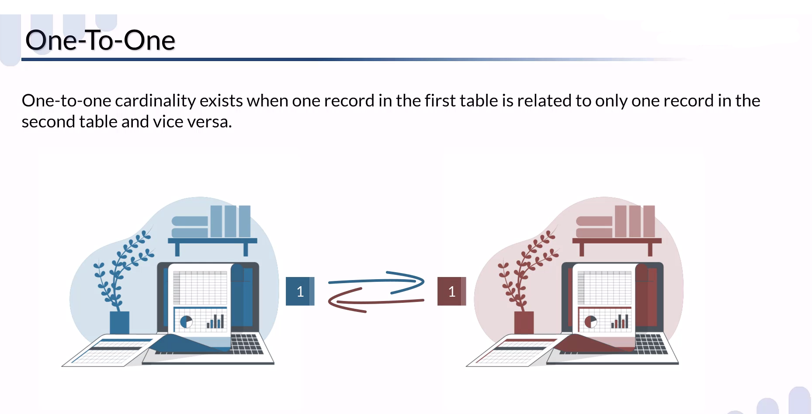
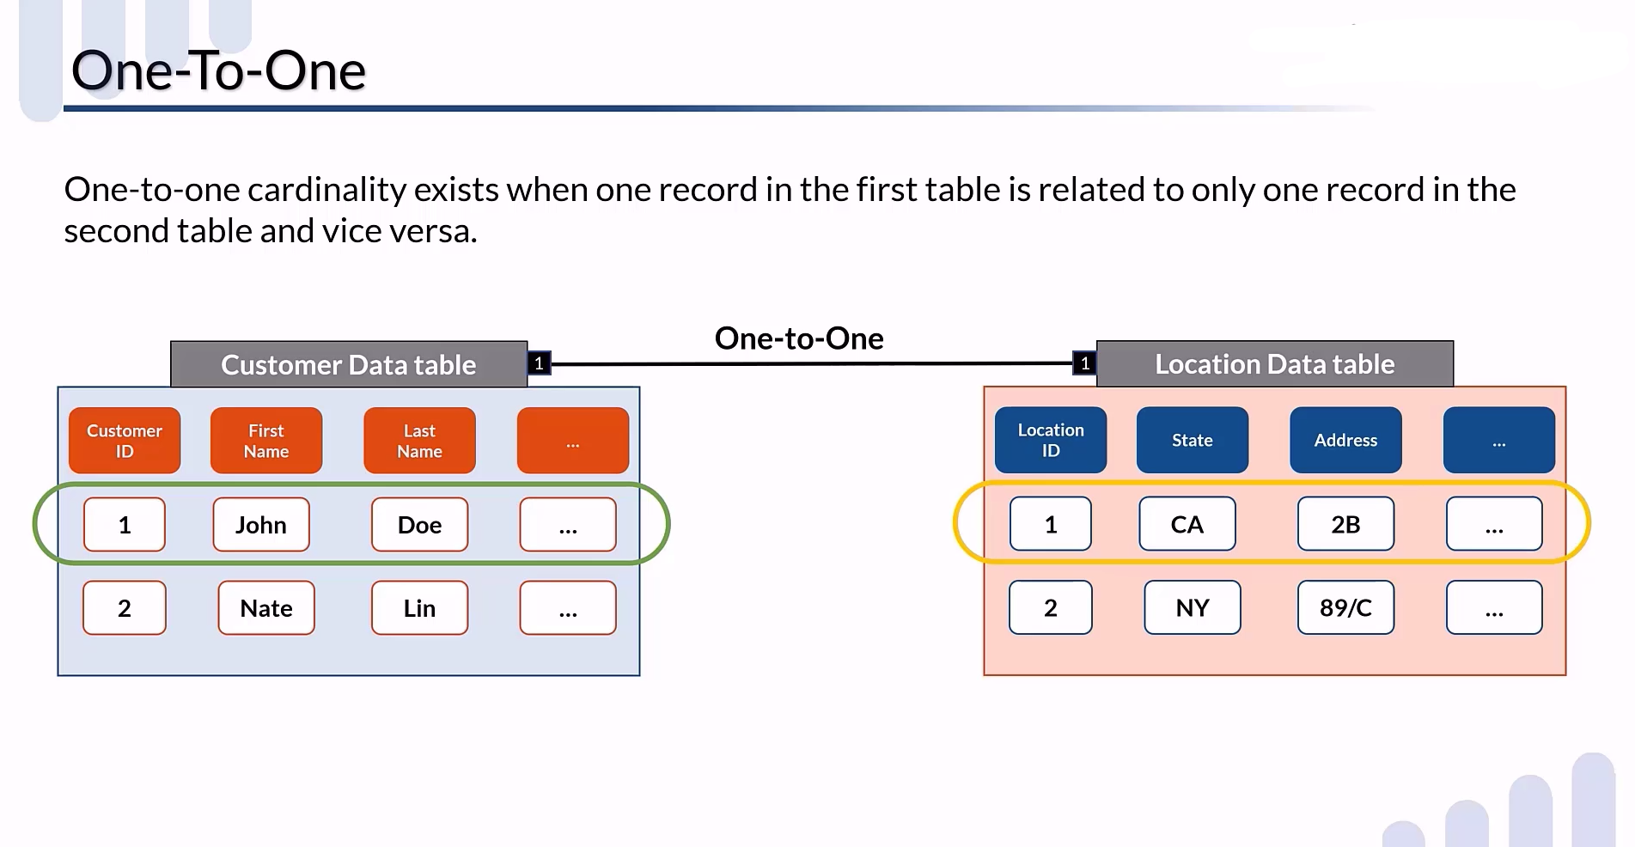

Slide 21
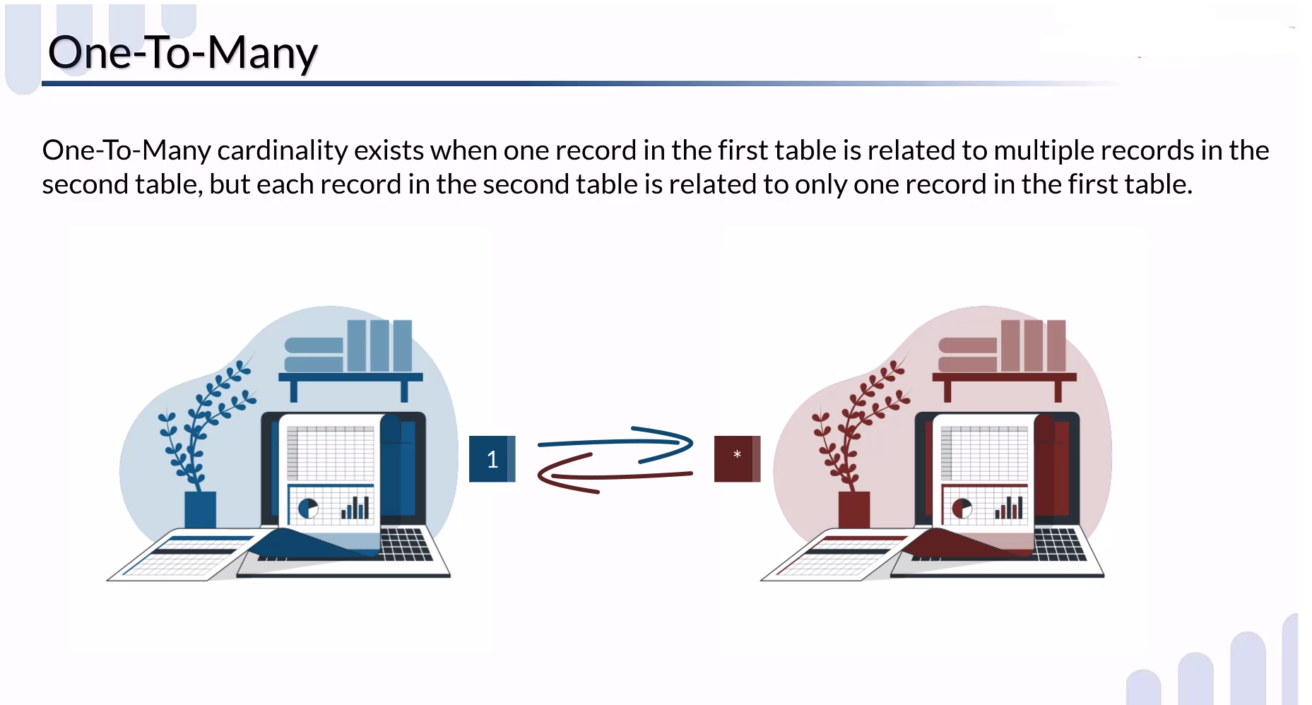

Slide 22
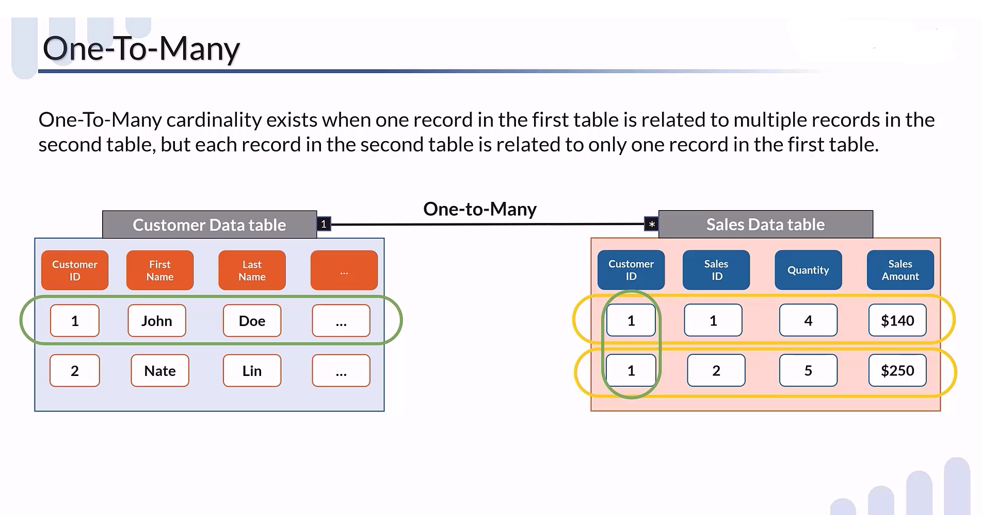

Slide 23
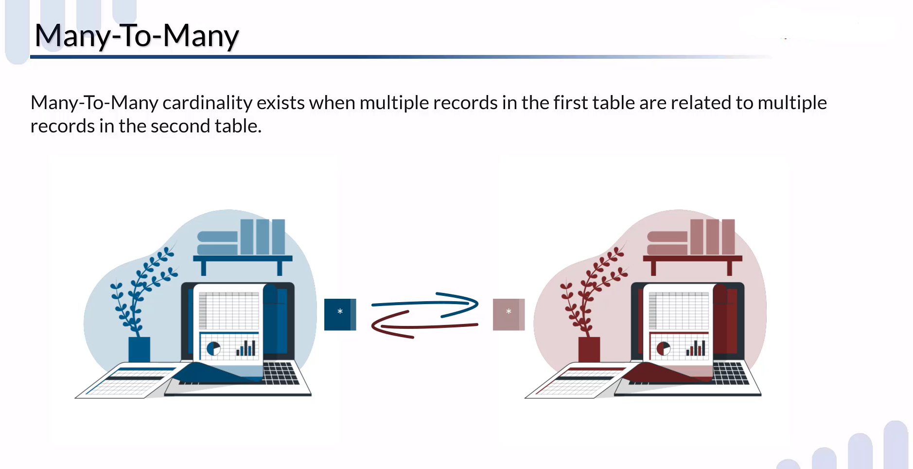

Slide 24
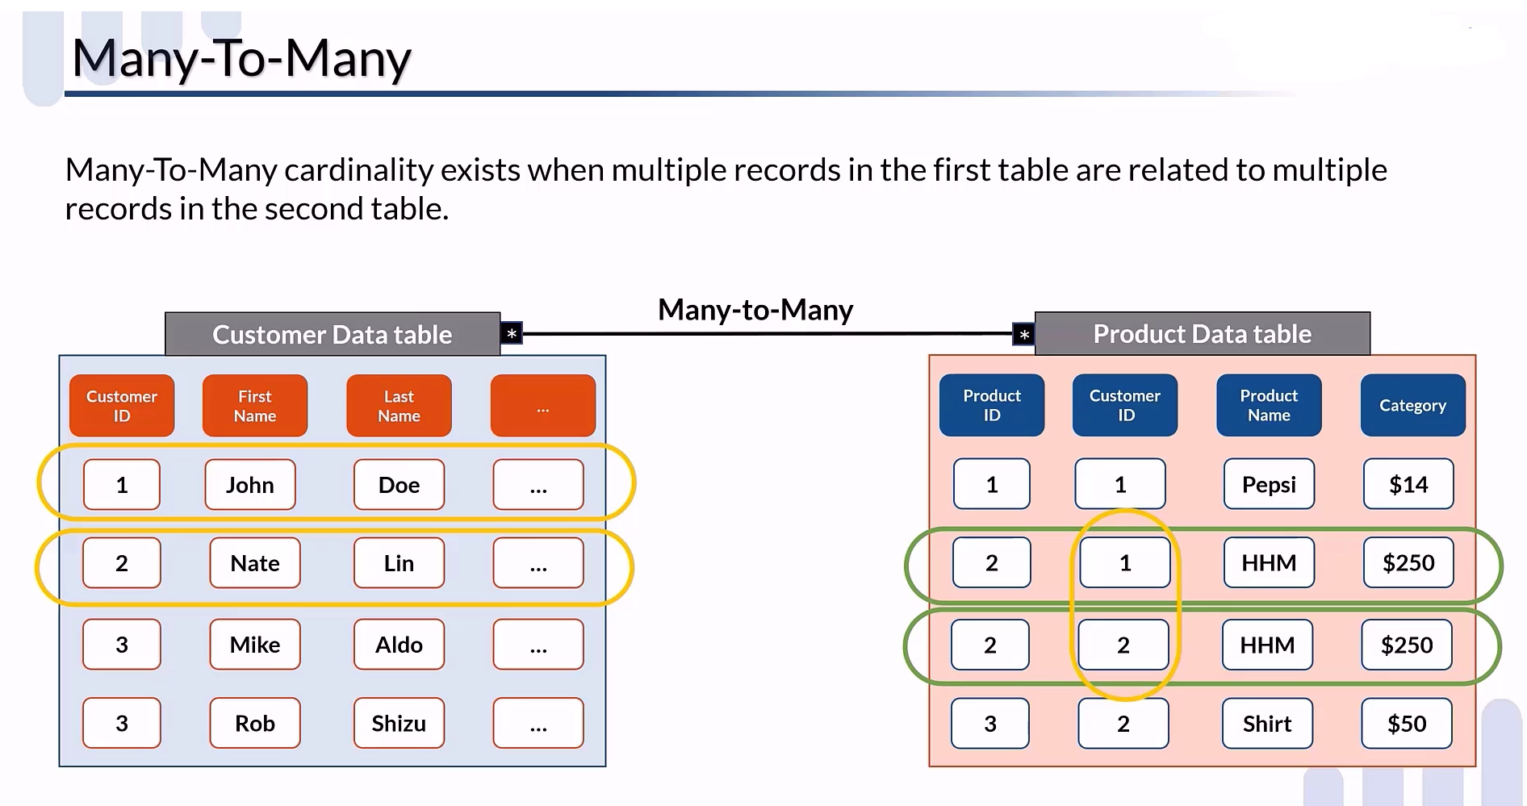

Slide 25
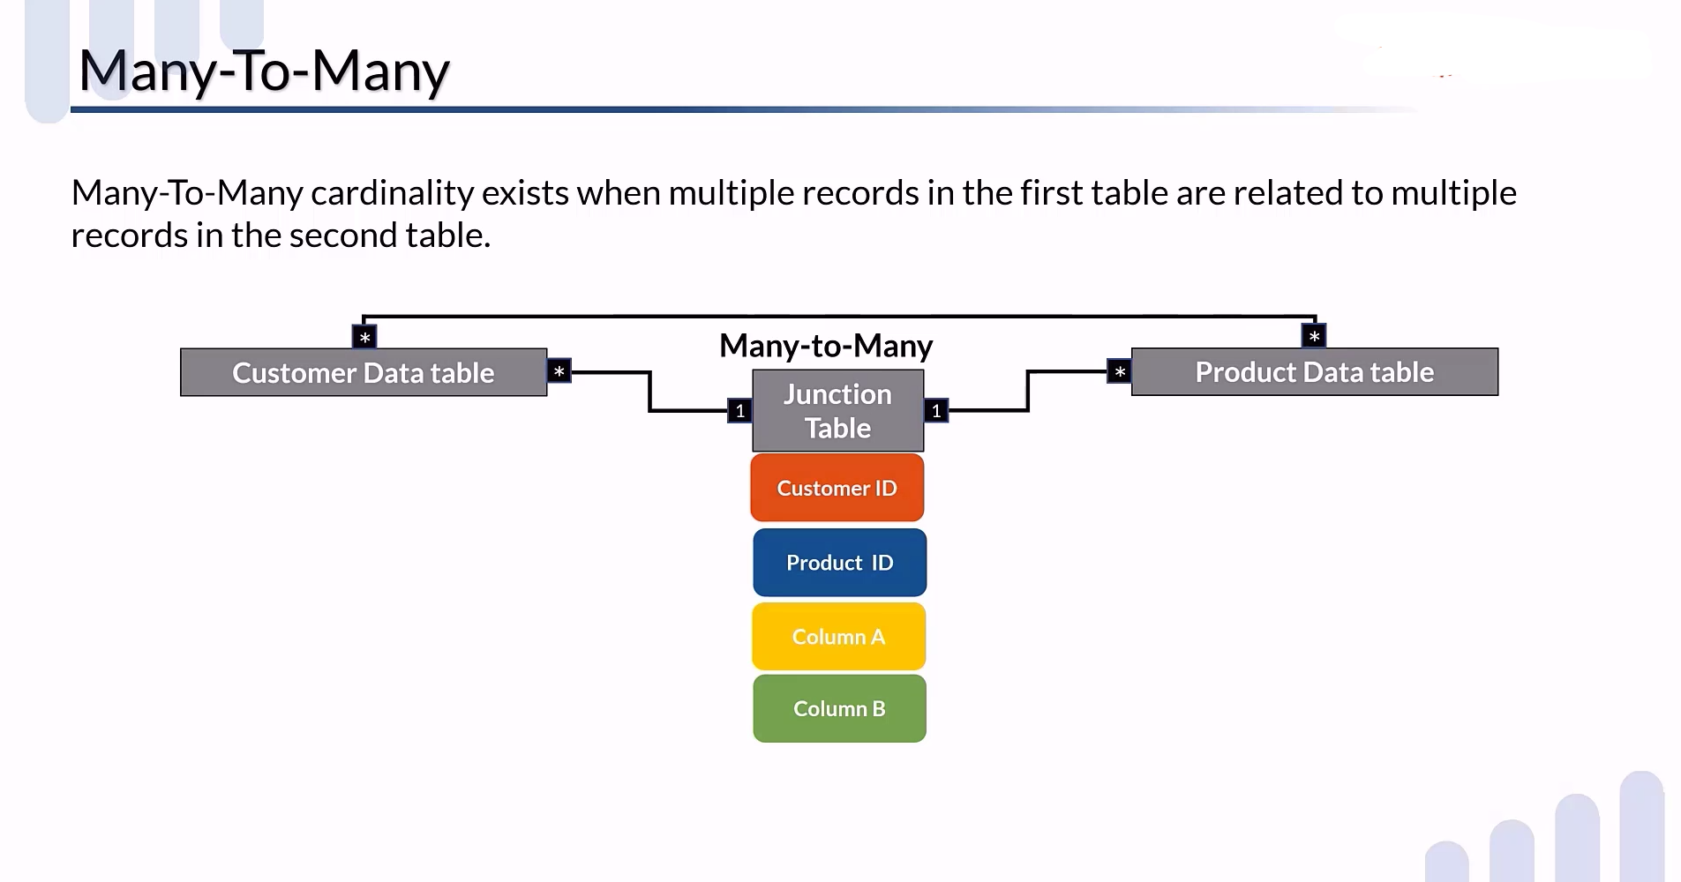

Slide 26
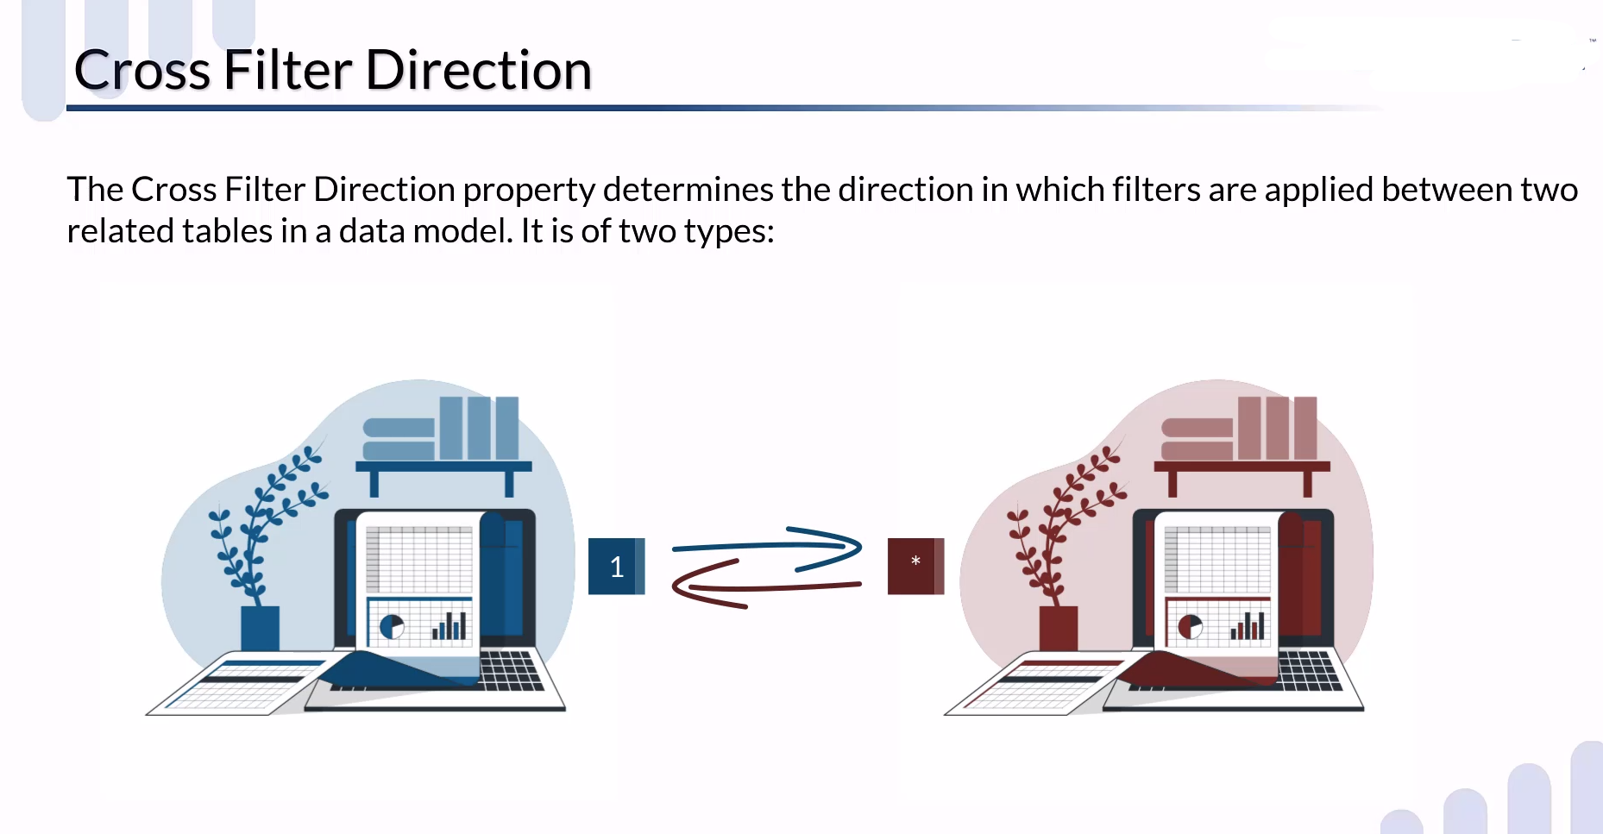

Slide 27
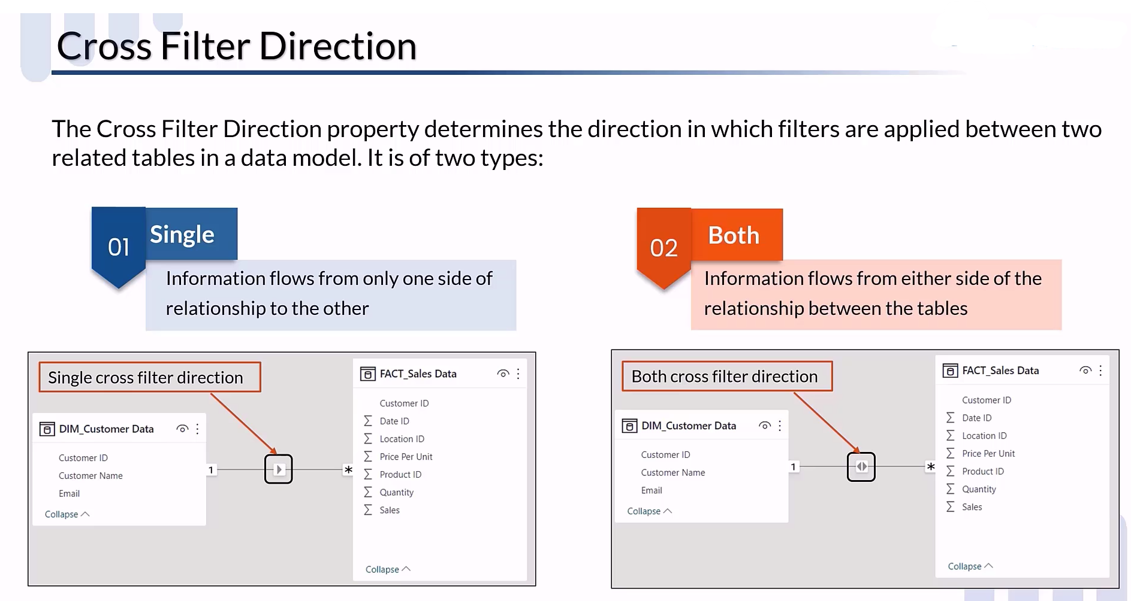

Slide 28
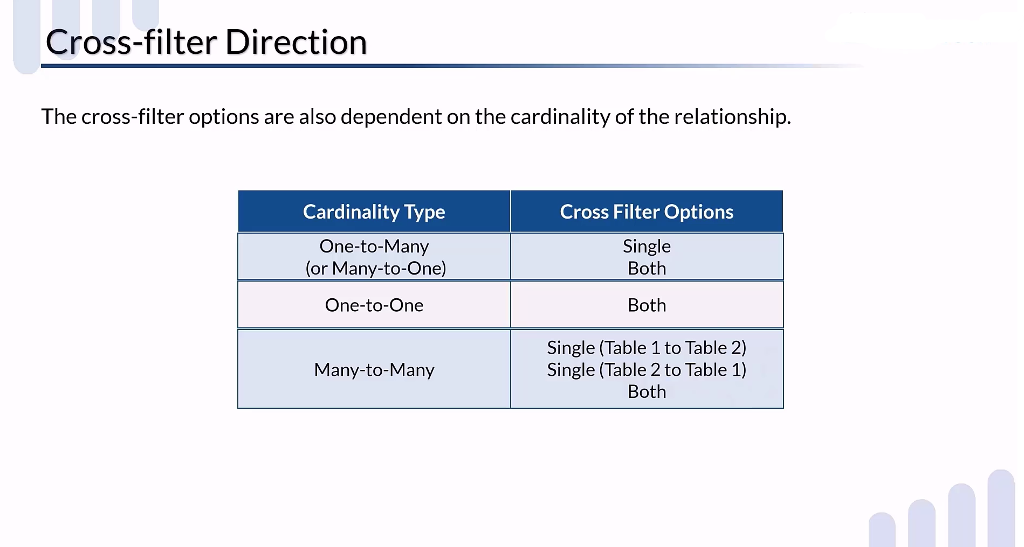

Slide 29


Slide 30
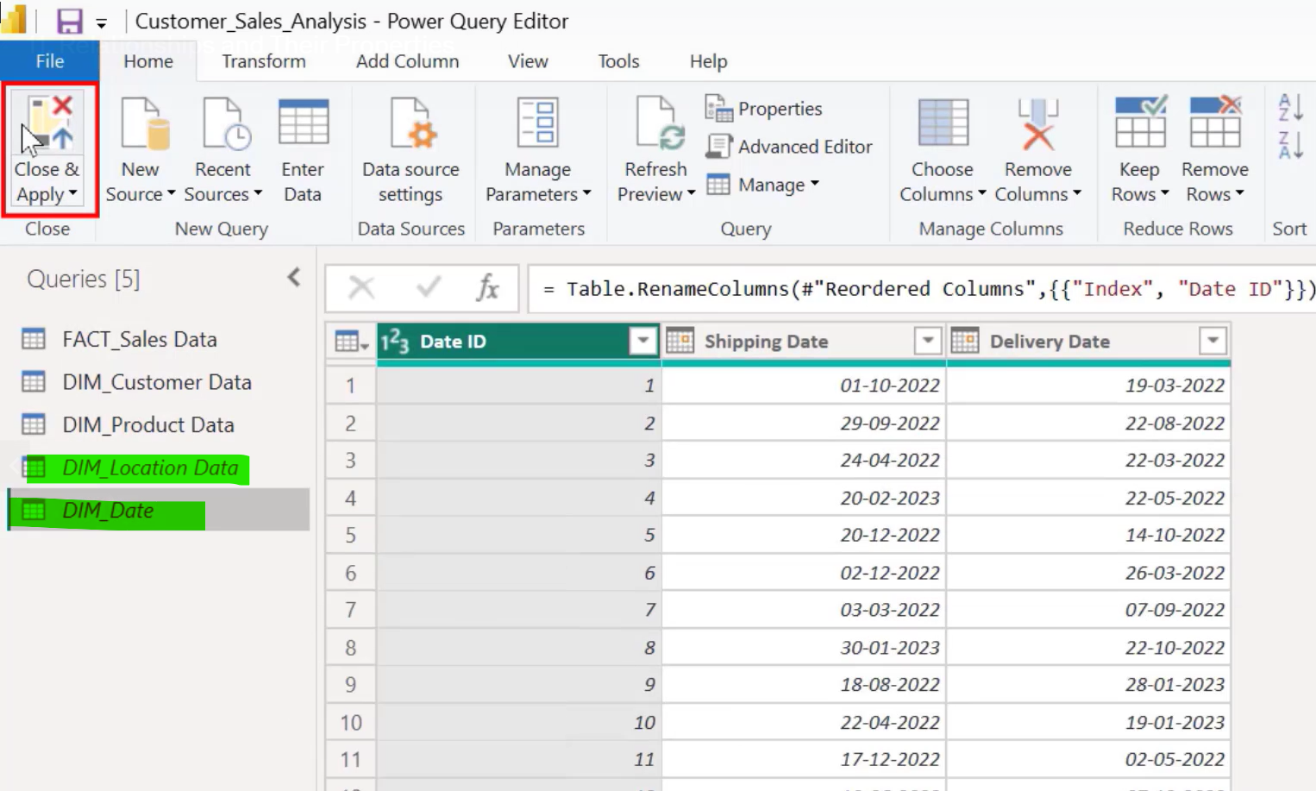
As you know there are five tables and we need only three tables
So unload the unnecessary table.
Close & apply

Slide 31
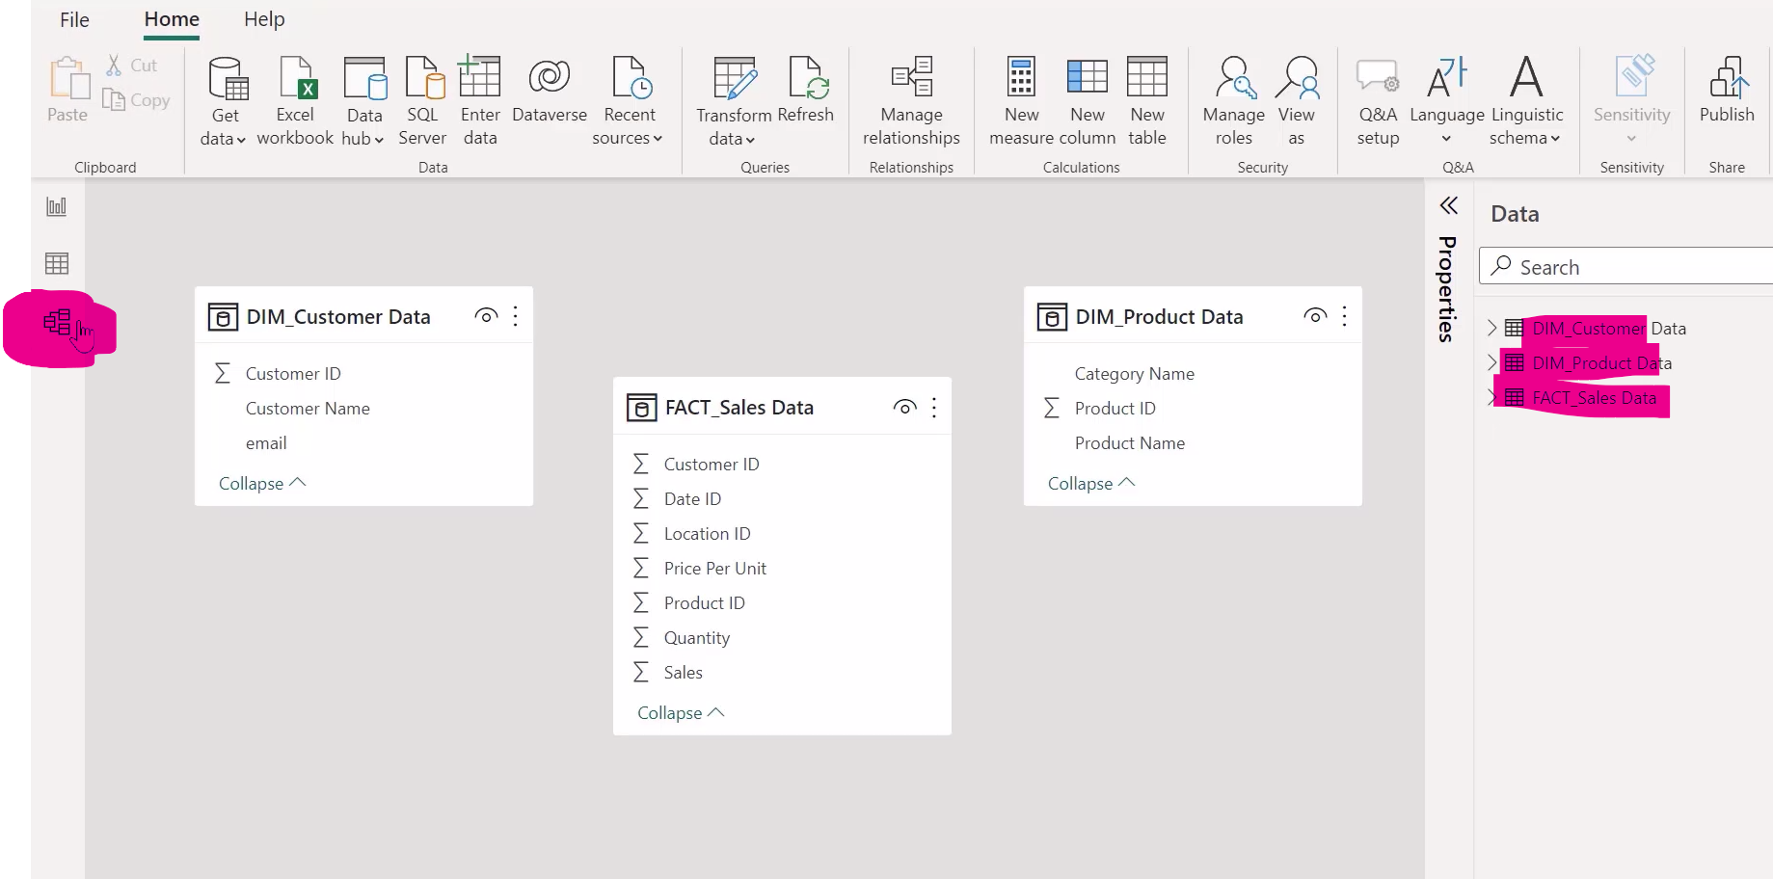
Let move to the home tab and load the table data
This will show three tables
Now click on the model view, this will show dataset with no relationship between them, its because automatic
table column relation table is disabled.

Slide 32
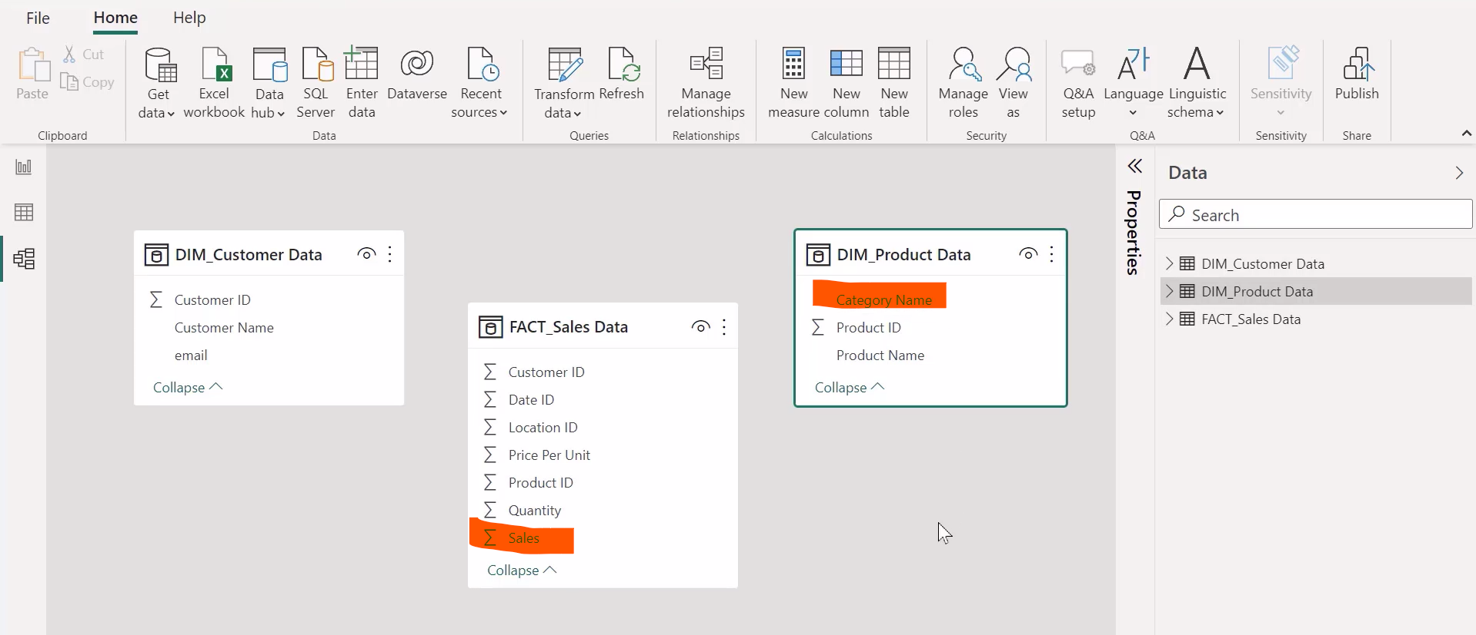
As you see there is no relationship between all the dataset,
now suppose we want to find out the sale category wise just follow the following steps.

Slide 33
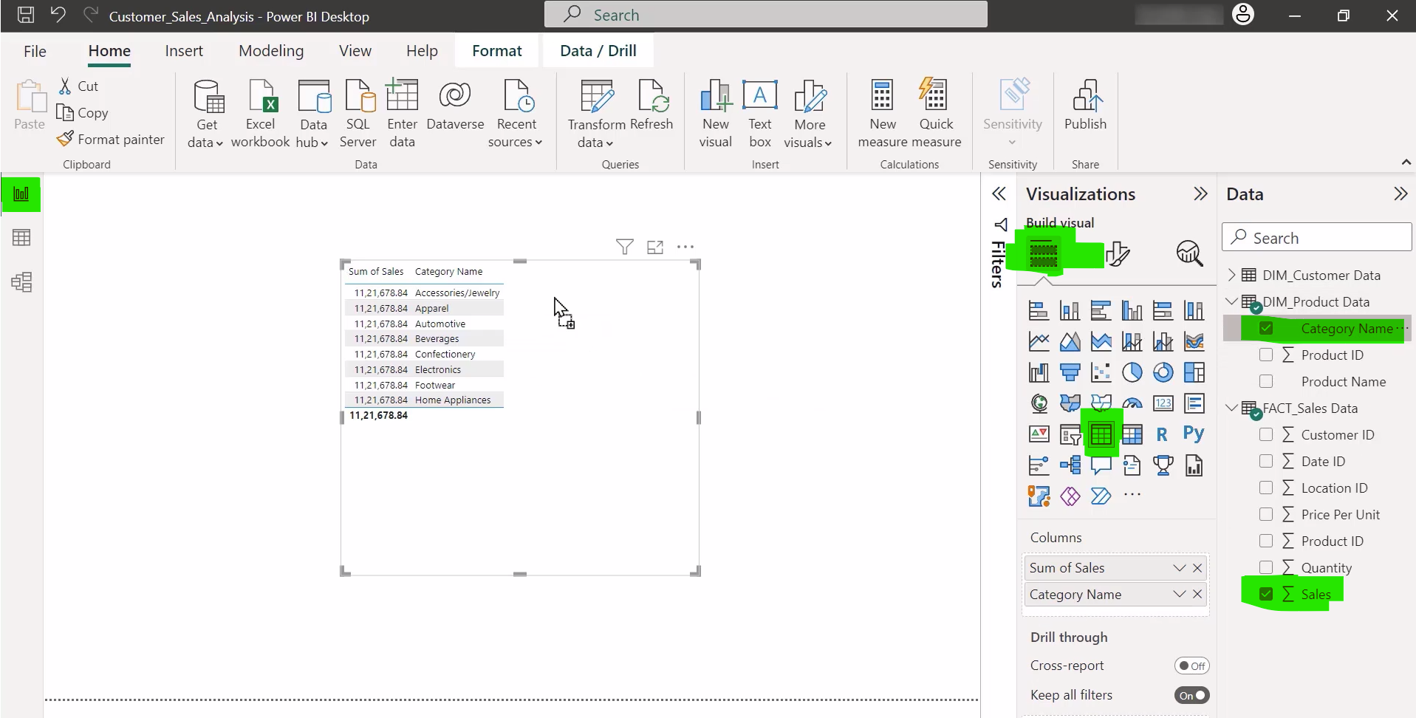

Now open the report view
Then select table
Choose table
Drag Sales field to report
Drag Company name field to report

Slide 34
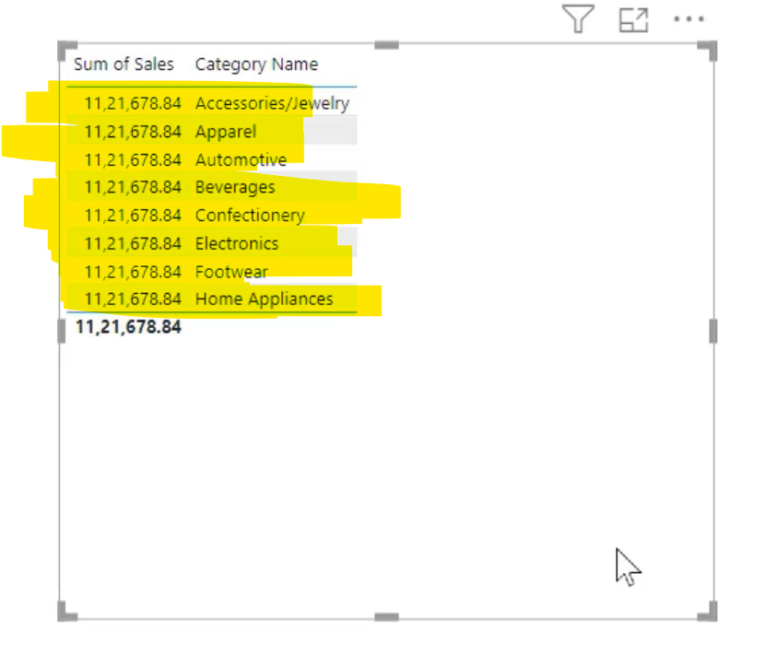
As u see each category shows same sum of sales which is incorrect
Which means that there is no relationship or correct relationship between tables

Slide 35
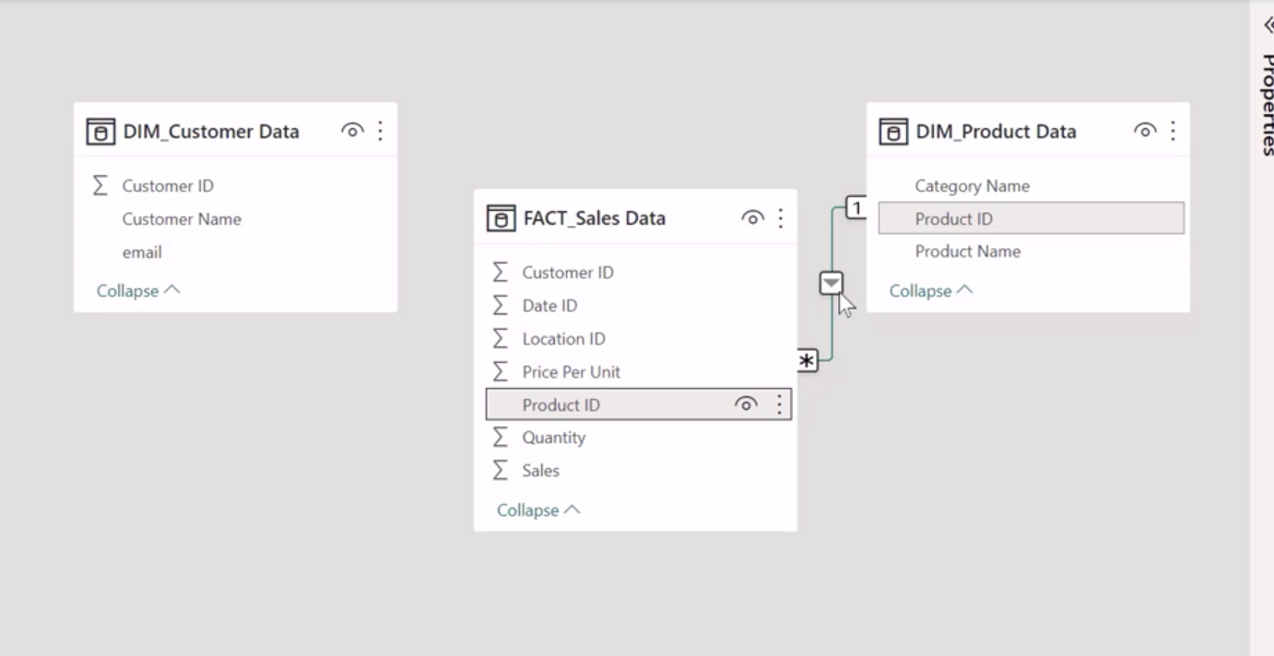
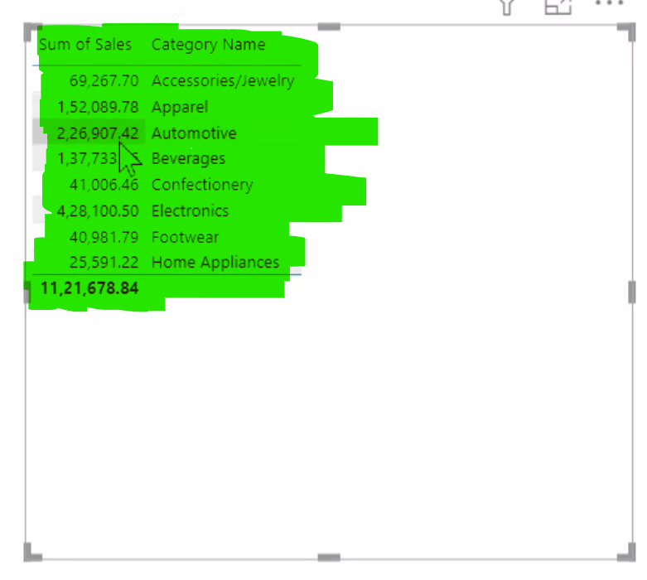
Now set the correct relationship between these two table
As u see after set the correct relationship it will show correct sum values
Just drag the ID to dim
Product data

Slide 36
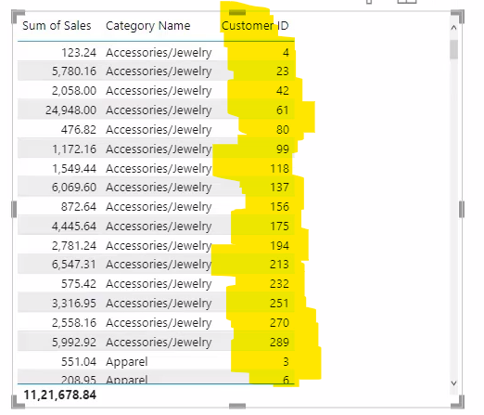
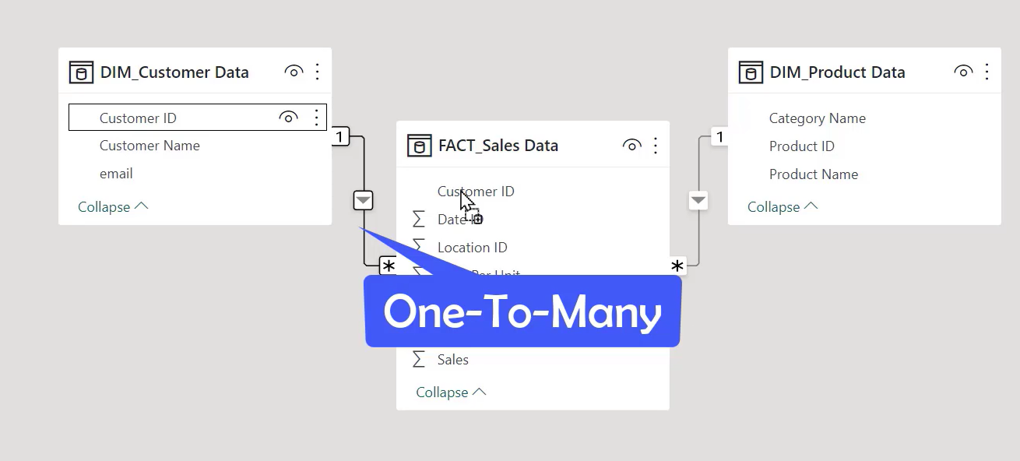
If u want to find out how many customer purchase same category, how may times
Then we have to set relationship with customer id also, just drag & drop the customer id
To set the relationship & open the report view.
After open the report view drag the customer id to report view
As u see in yellow highlighter category name shows many time that is the ISSUE

Slide 37
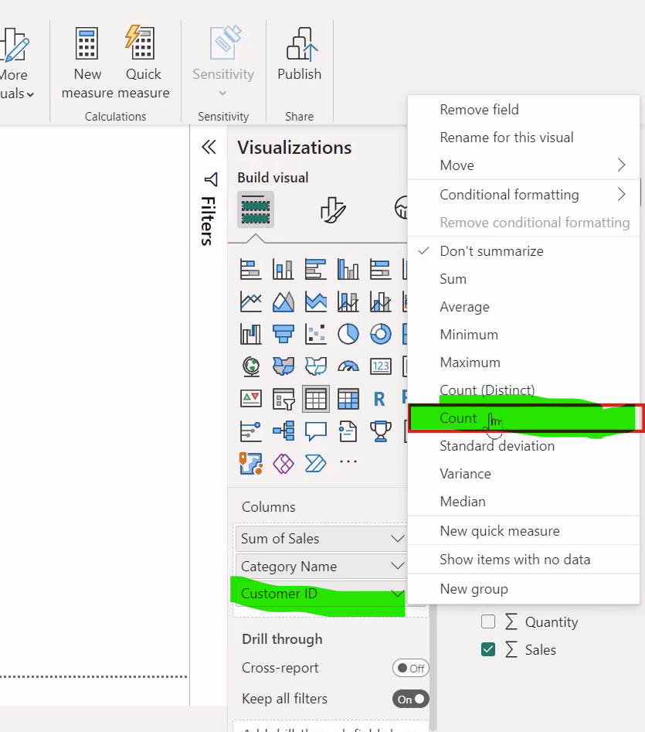
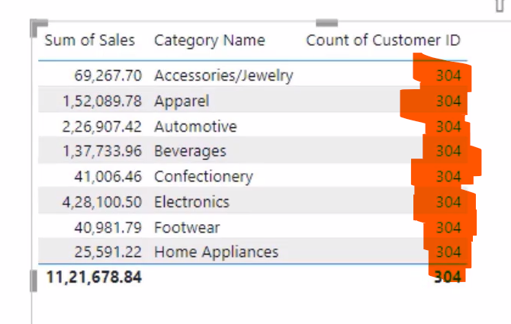
Because we need total count instead of customer id, just go to visualization pane
& select customerid & then choose count
This will show following output which is not correct
It will show total count in each category this is because of unidirectional relationship

Slide 38
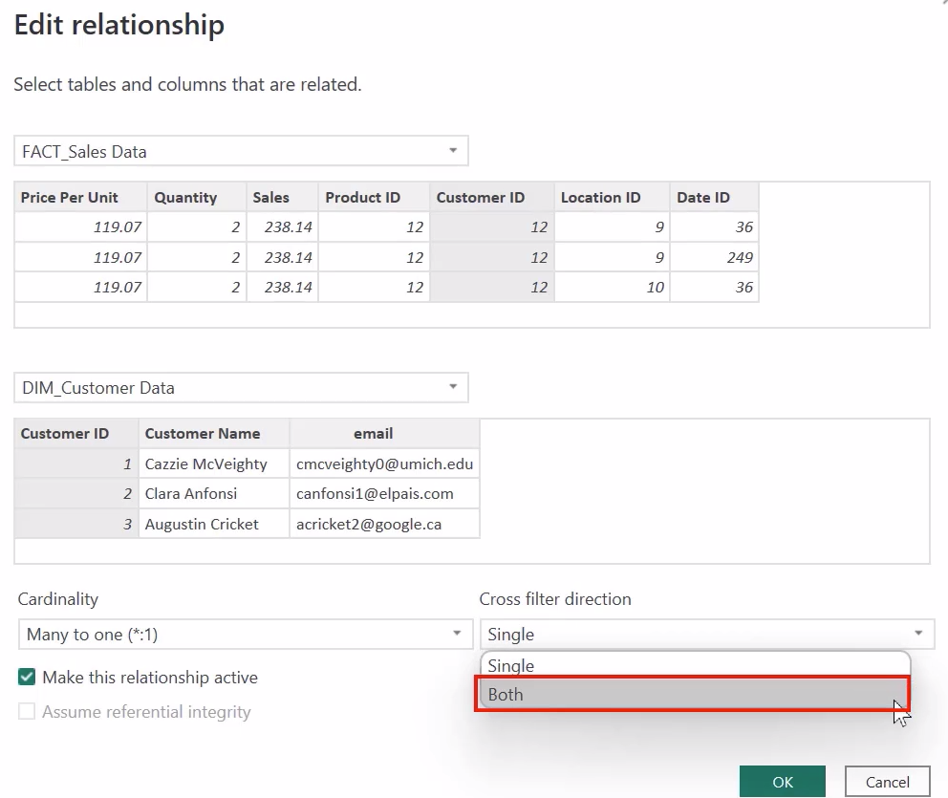

Change the relationship to unidirectional to both by double clicking on relationship line

Slide 39

Let move to the report view & see the correct visual

Slide 40



How to active or inactive the relationship
Just DoubleClick on the relationship line and check/uncheck the checkbox to active / inactive the relationship
As u see the inactive relationship shows in broken line & result shows incorrect data

Slide 41


Slide 42


Slide 43


Slide 44


