Slide 1


Slide 2
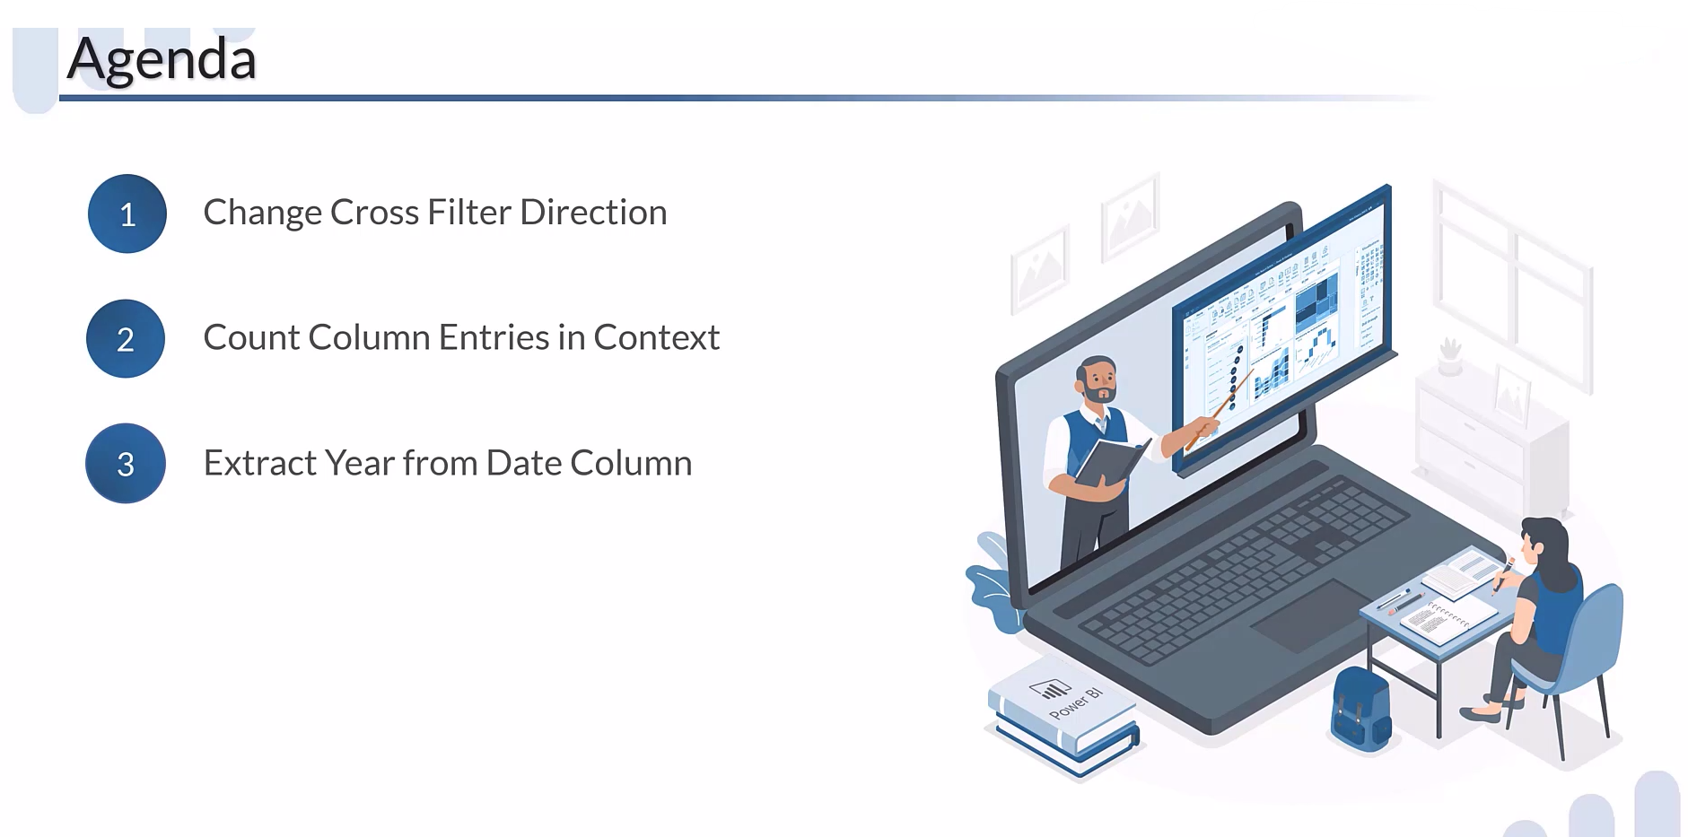

Slide 3
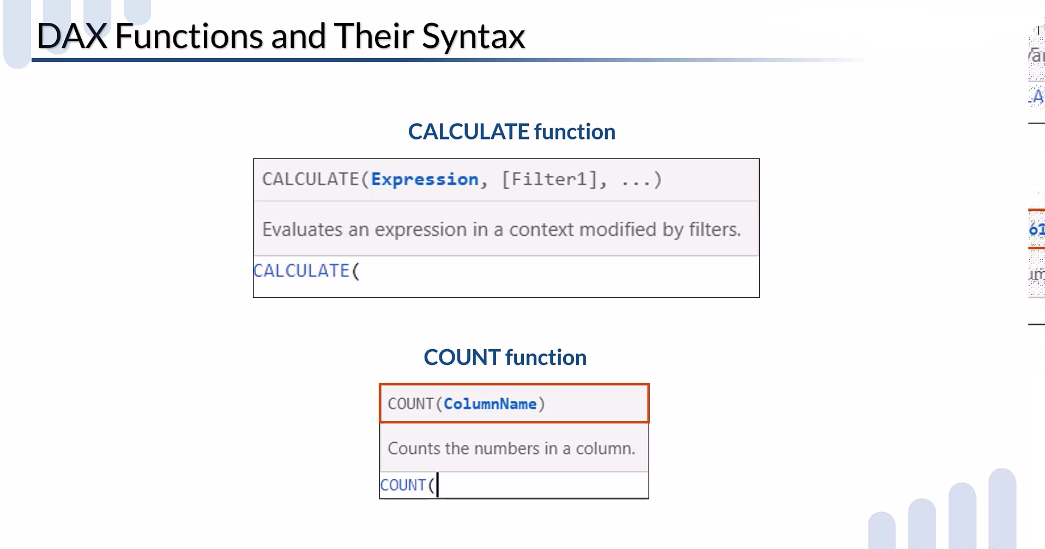

Slide 4
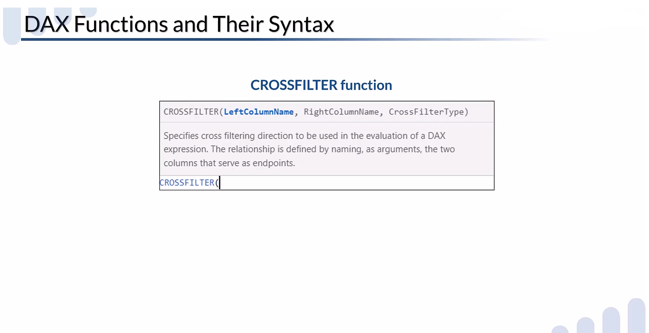

Slide 5
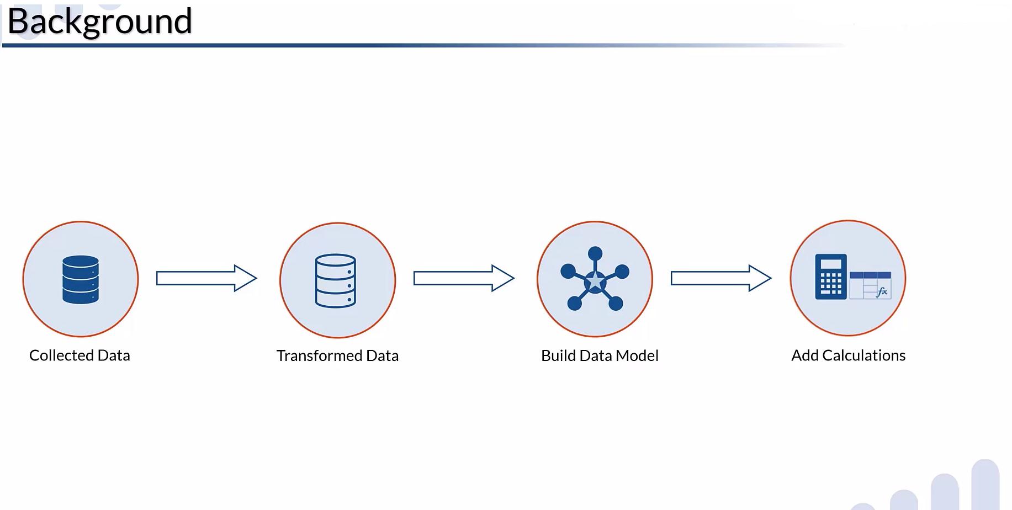

Slide 6
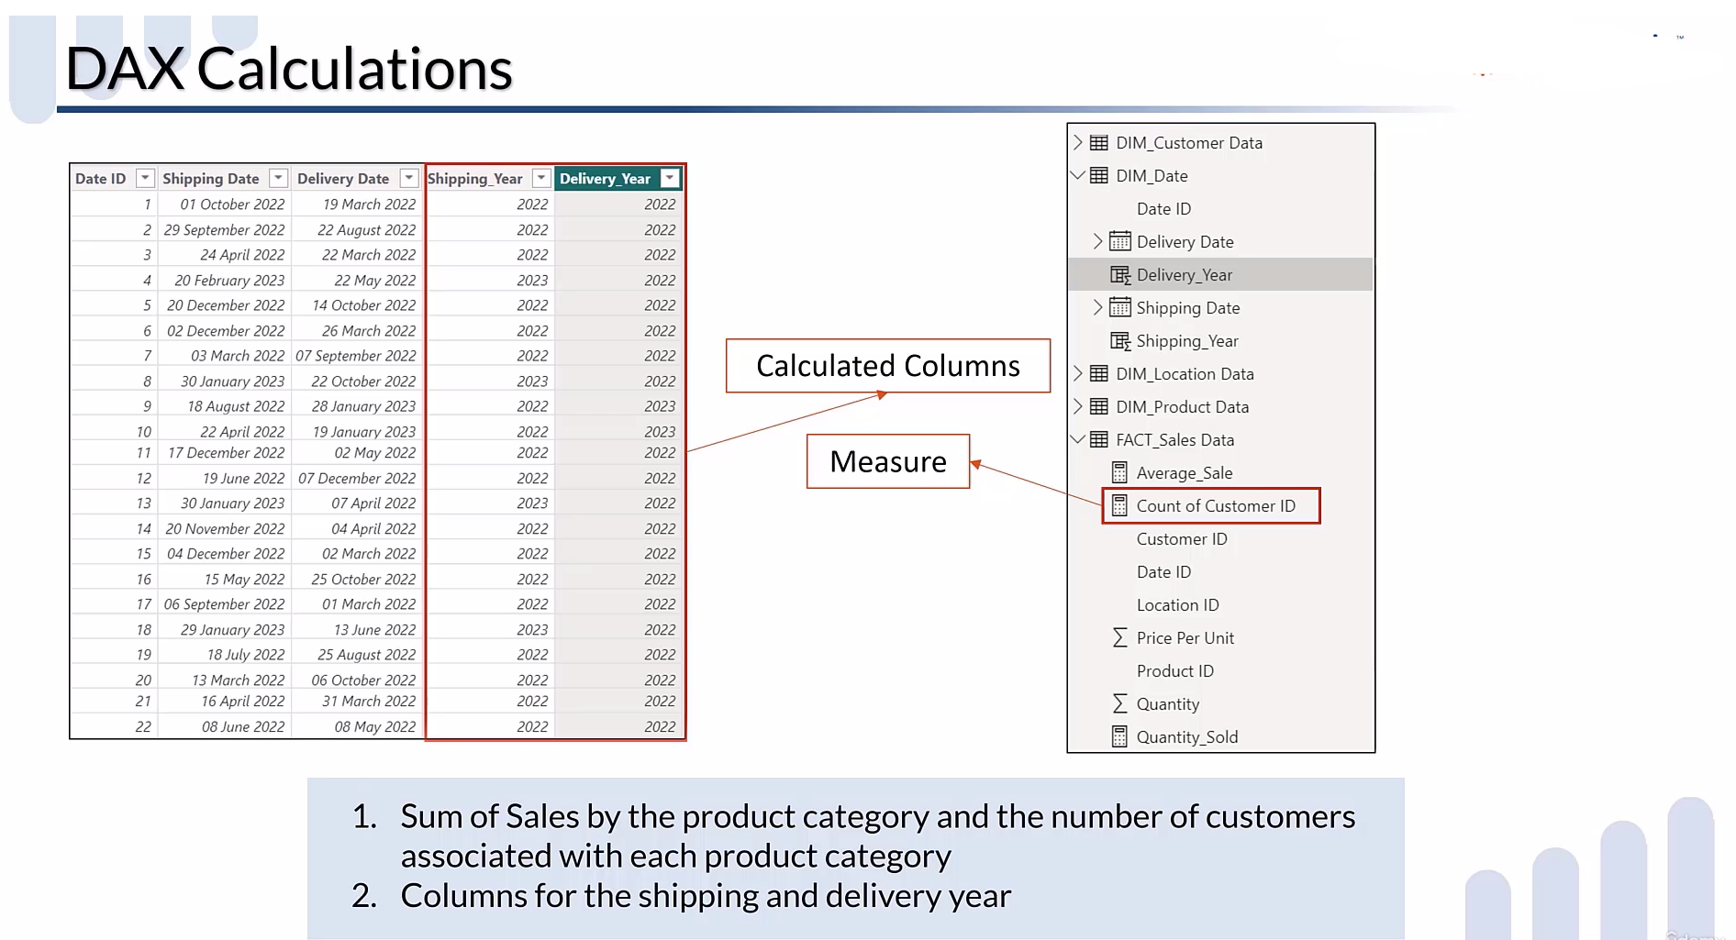

Slide 7
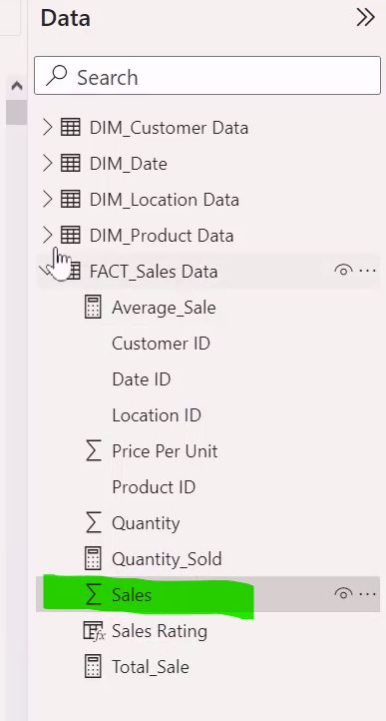
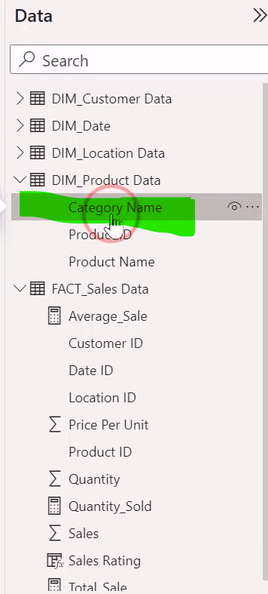
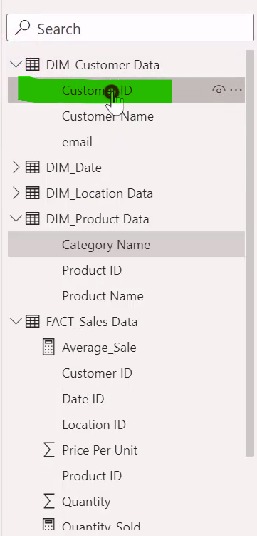
Let’s start with first calculation
Find out sales by the product category and number of customer associated with each product category.
For this calculation you have to categorize your sales data by the product category and the number of customer id
associated with each category
Now see all the fields are in different different tables

Slide 8
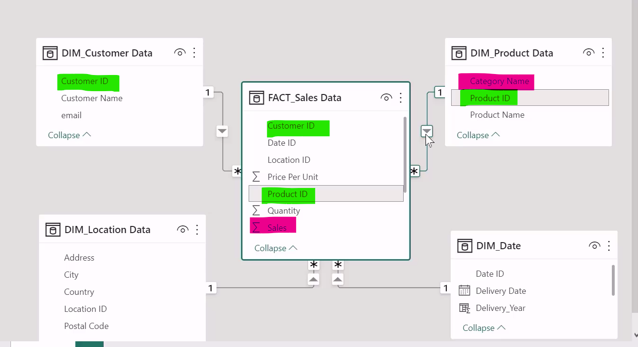
See the Relationship

Slide 9
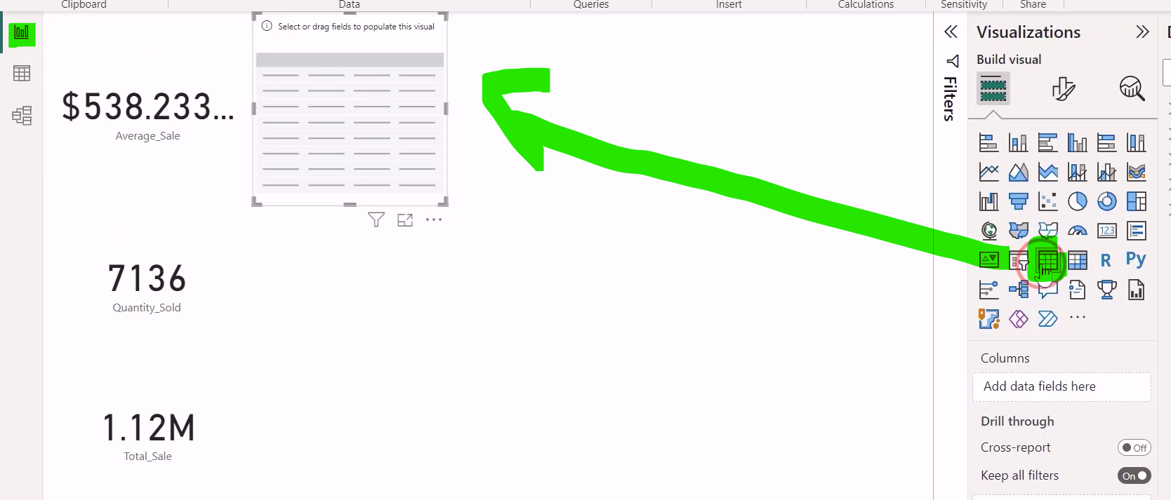
Drag Table view

Slide 10
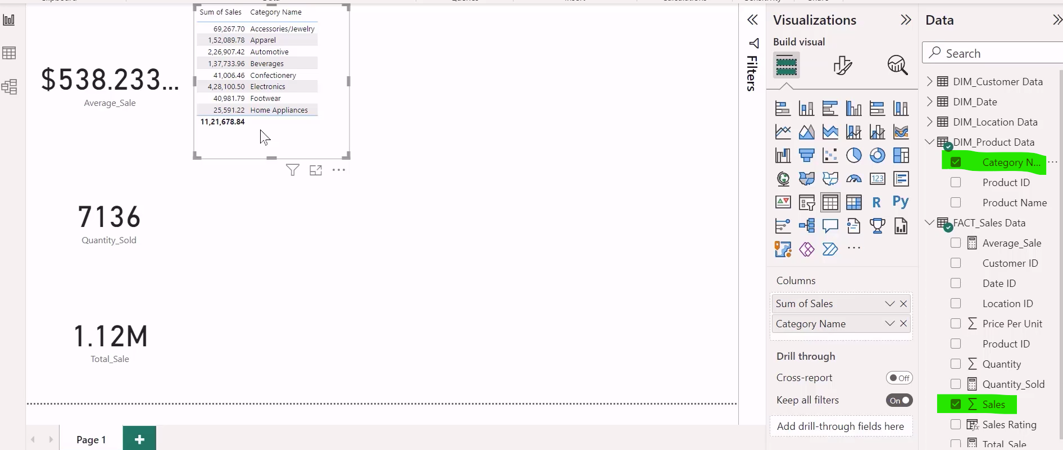
Drag sales and categoryname

Slide 11
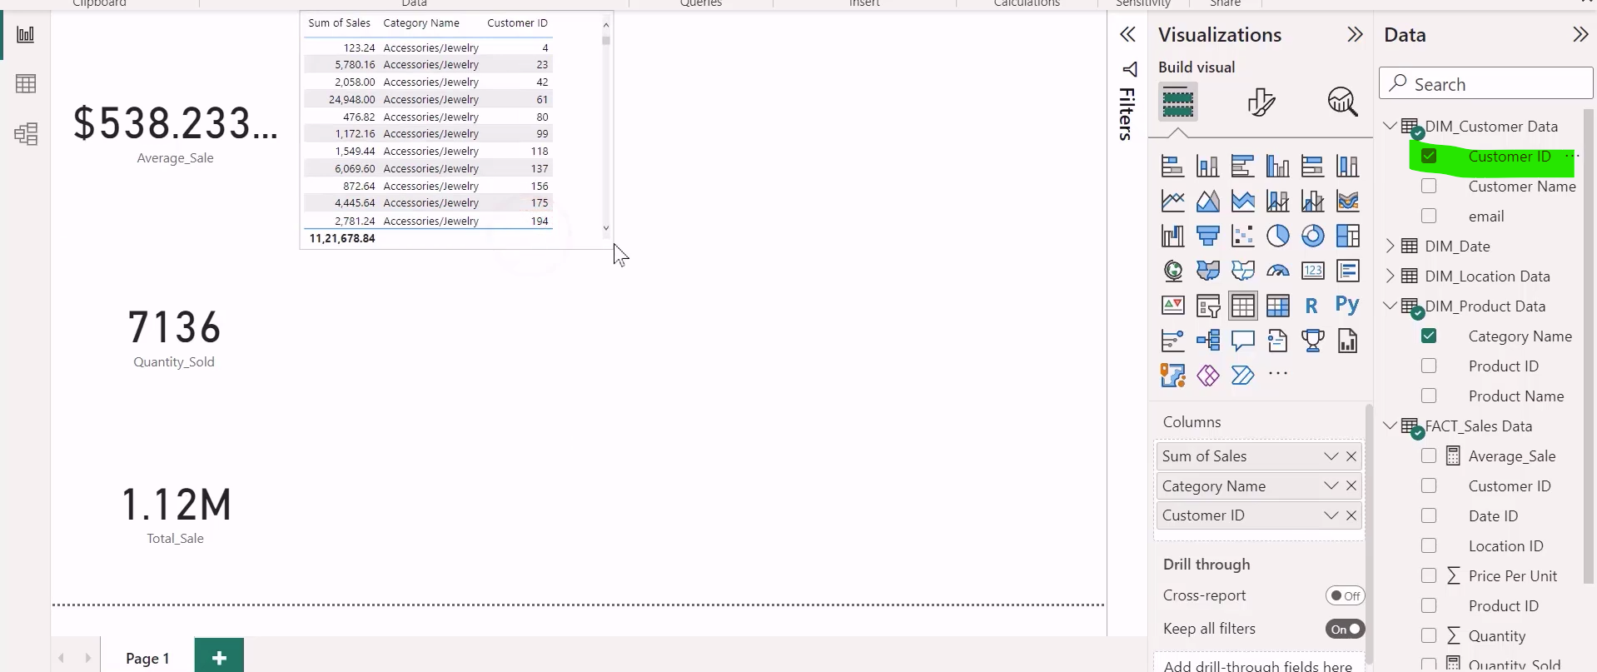
Drag Customer Id

Slide 12
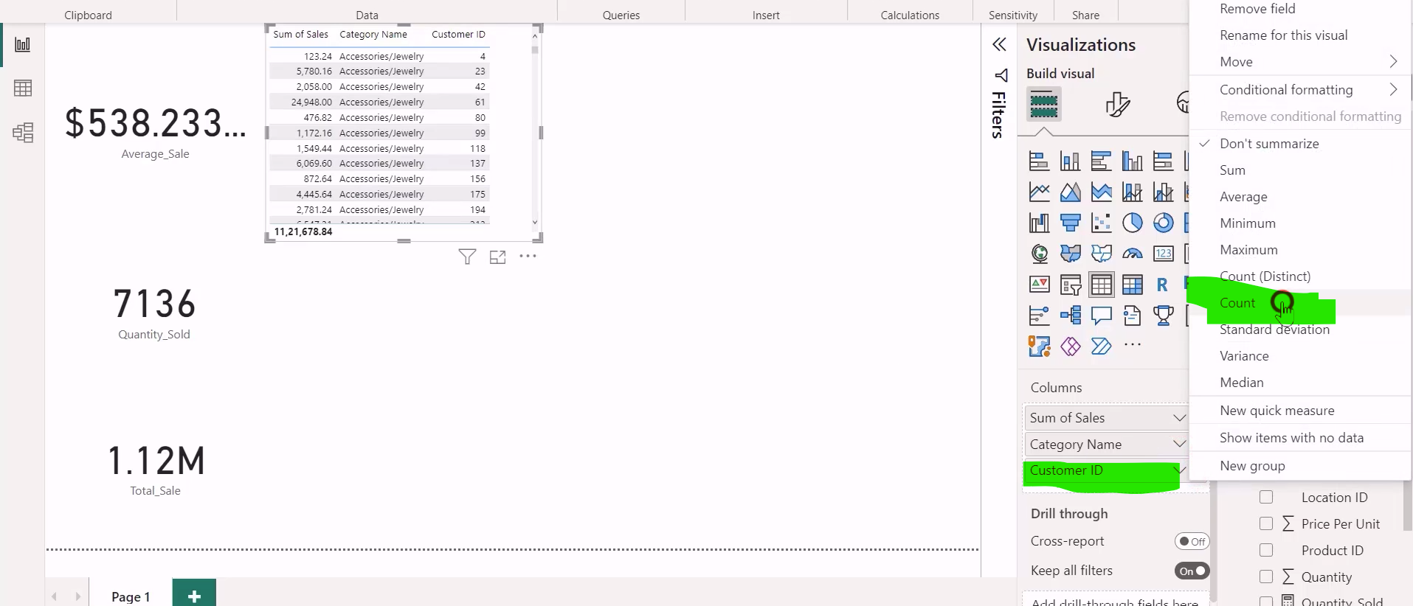
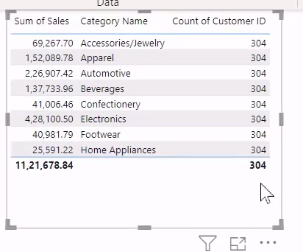

From the previous lecture on relationships in a data model, you know that this error occurs because the relationship between the dim customer data table and the fact sales data table is of one too many type, and the cross filter direction from the customer table to the sales table is set at single. Therefore, it cannot filter the information from the sales table to the customer table. To rectify this error, you can change the cross filter type direction to both from the relationship

Slide 13
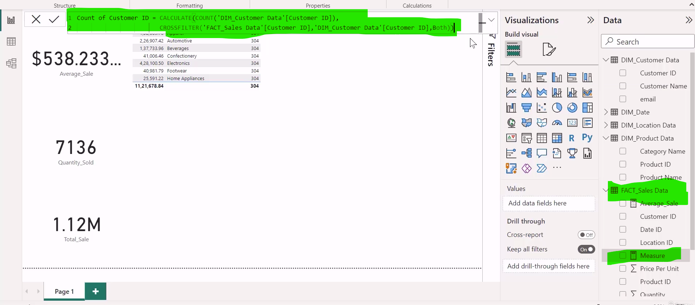
Create a new measure in fact_sales data
and write following dax expression

Slide 14
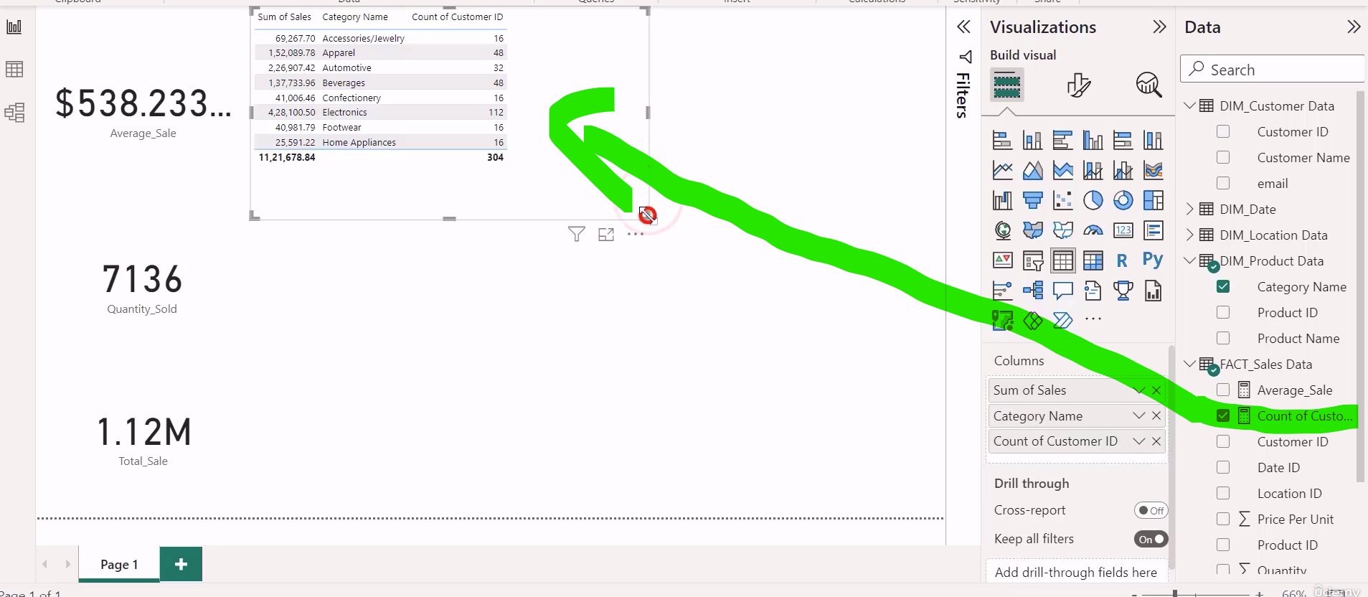
Drag the measure

Slide 15
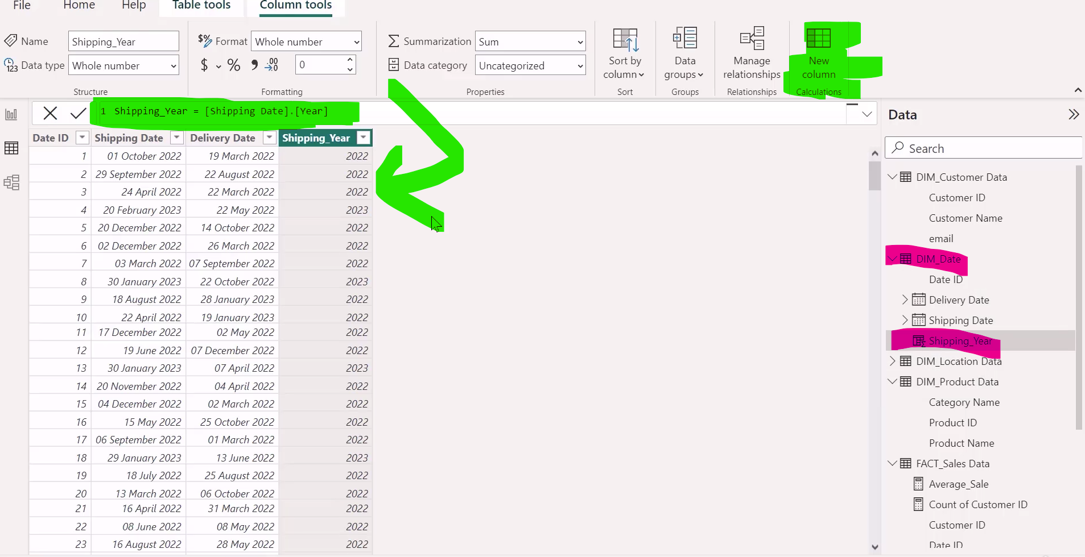

Insert new Column

Slide 16
