Slide 1
DMS-SCT
Vikas

Slide 2
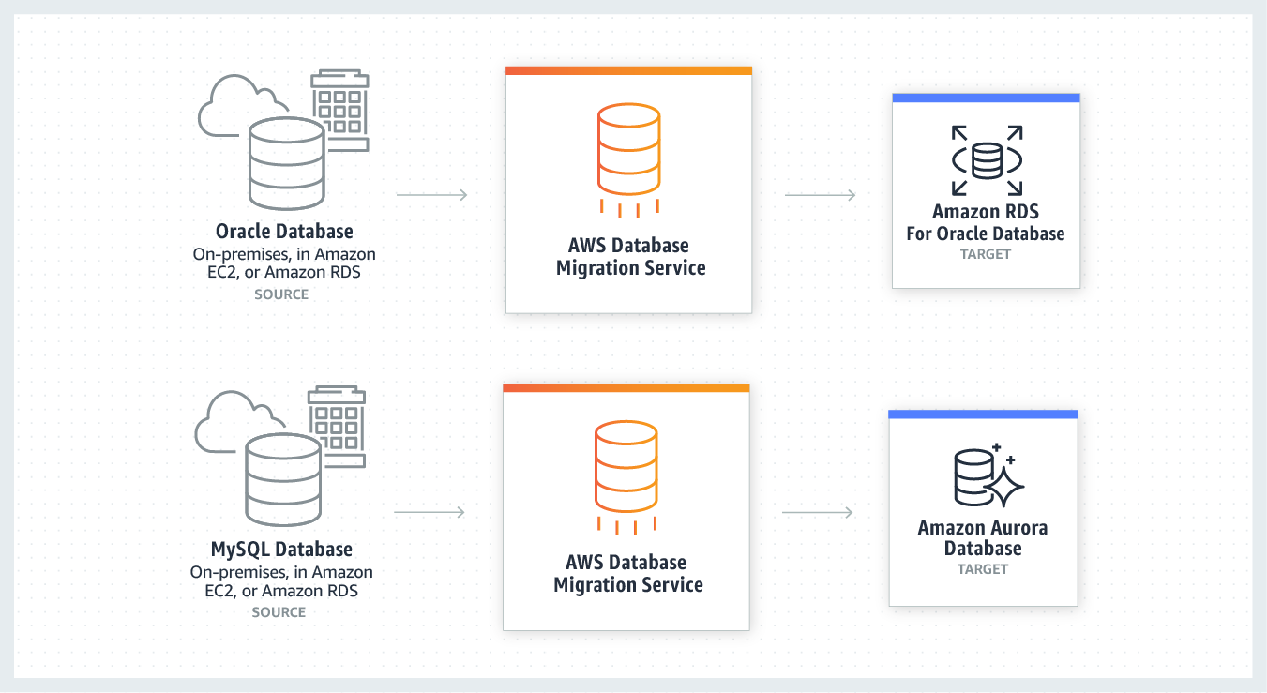
Notes:
DMS Migration Source :
Oracle, MySQL, PostgreSQL, MariaDB, MS-SQL Server
DMS Migration Destination :
Oracle, MySQL, PostgreSQL, MariaDB, MS-SQL Server, Aurora, Redshift, DynamoDB, S3

Slide 3
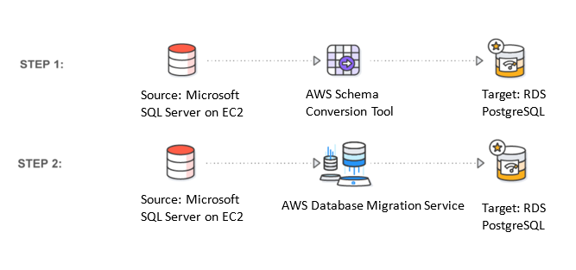
Notes:
Homogenous and heterogeneous migration possible

Slide 4
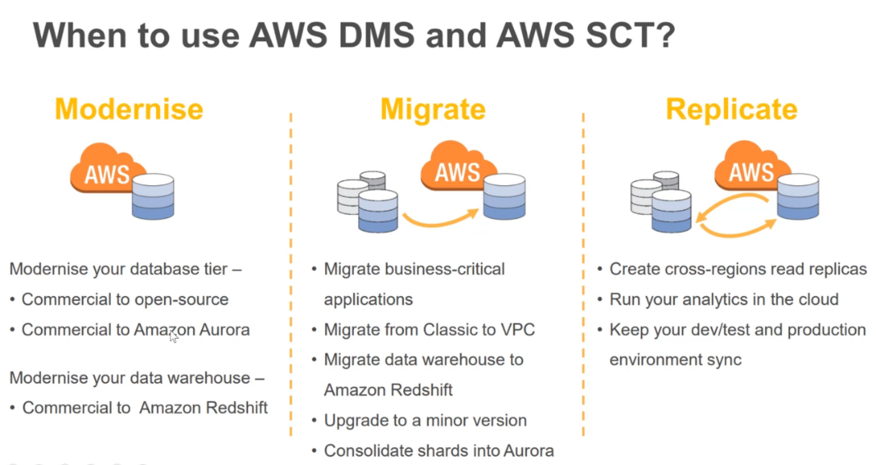
Notes:
https://docs.aws.amazon.com/dms/latest/userguide/CHAP_LargeDBs.html

Slide 5
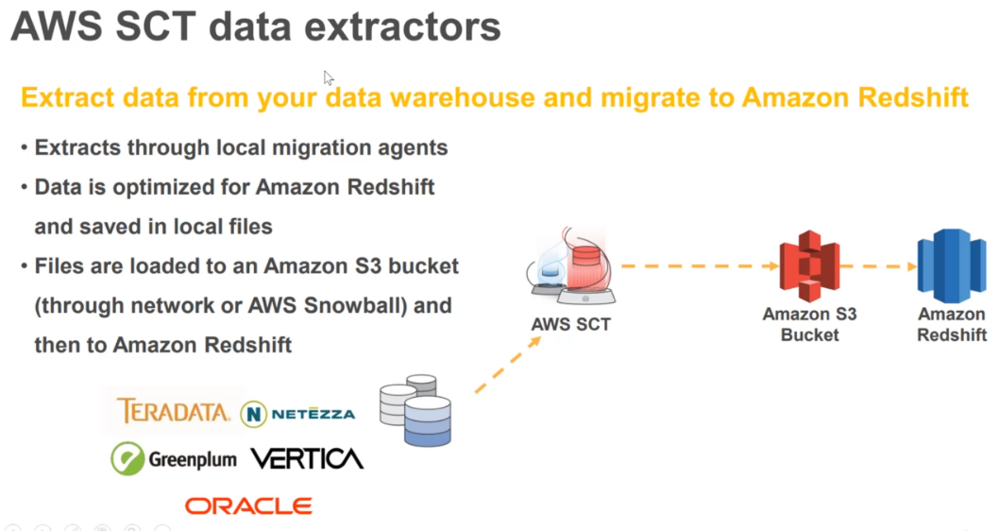

Slide 6
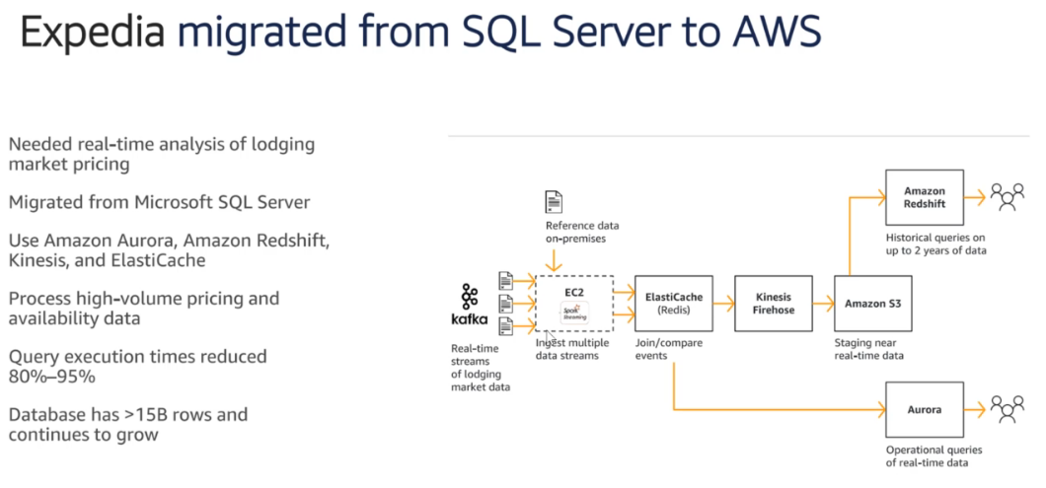
Notes:
AWS Schema Conversion Tool Download - https://docs.aws.amazon.com/SchemaConversionTool/latest/userguide/CHAP_Installing.html
Microsoft JDBC Driver 6.0 for SQL Server - https://www.microsoft.com/en-us/download/details.aspx?id=11774
Aginity Workbench for Redshift - https://www.aginity.com/main/workbench-for-amazon-redshift/
Migrating Large Data Stores using DMS and Snowball Edge - https://docs.aws.amazon.com/dms/latest/userguide/CHAP_LargeDBs.html
Expedia DMS Use-Case - https://aws.amazon.com/dms/testimonials/

Slide 7
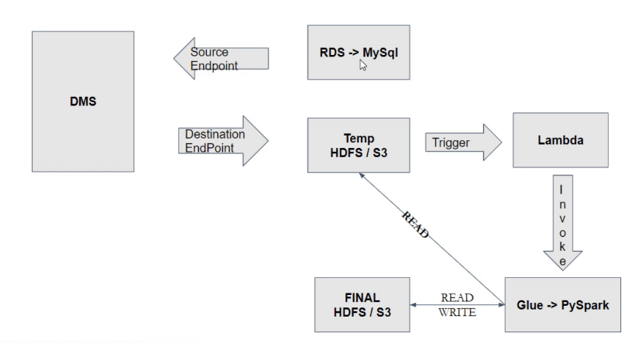
Notes:
Create a new DB MySQL instance with backup and public access. Also, have a custom param group(binlog_format=ROW).
Create DMS Source Endpoint:
Create DMS Destination Endpoint:

