Slide 1
Kinesis
vikas

Slide 2
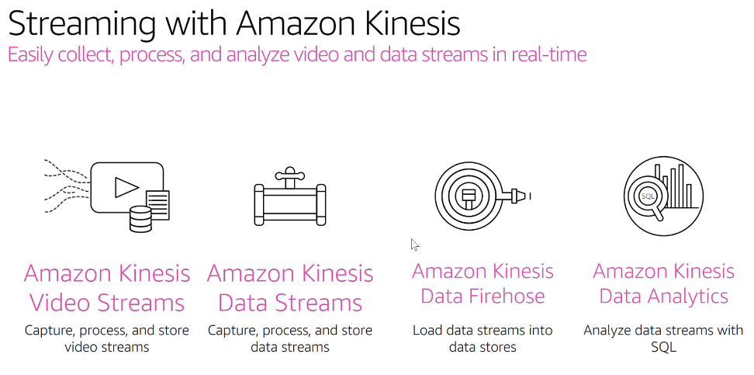
Notes:
Kinesis Streams Netflix Use-Case - https://aws.amazon.com/solutions/case-studies/netflix-kinesis-streams/
Kinesis Streams Hearst Data Analytics Use-Case - https://aws.amazon.com/solutions/case-studies/hearst-data-analytics/
AWS Simple Monthly Calculator - https://calculator.s3.amazonaws.com/index.html

Slide 3
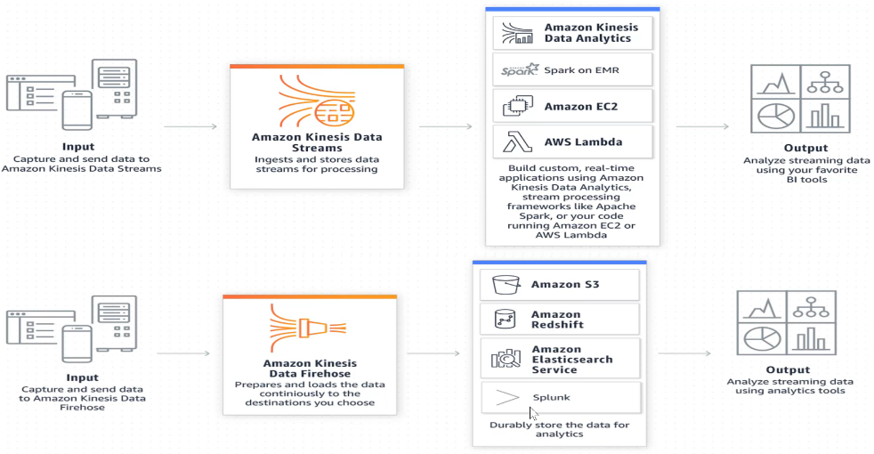

Slide 4
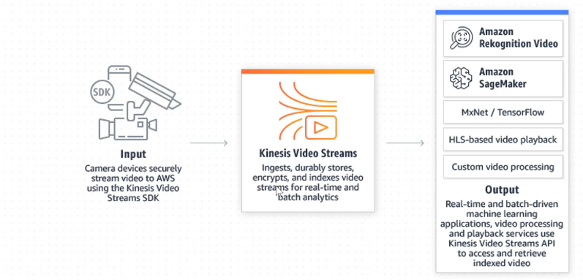

Slide 5
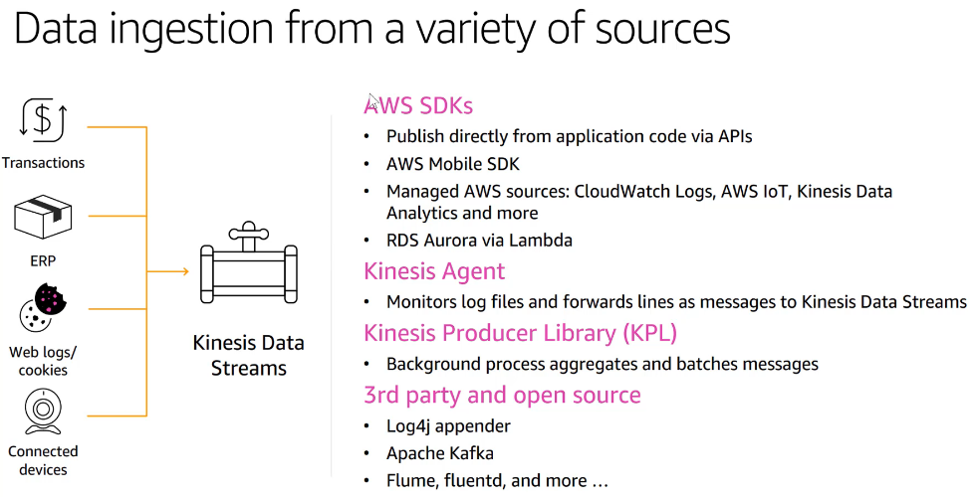

Slide 6
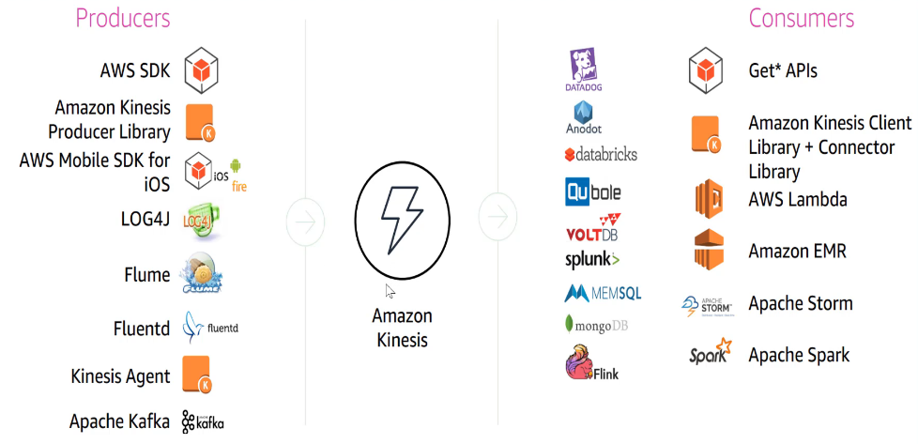
Notes:
Create delivery stream – Direct Put – Lambda – General Firehose processing –
Convert file format –nope
S3 bucket create and provide – create IAM
Create ec2 attach role – login – aws configure
aws kinesis list-streams
aws kinesis put-record –stream-name <> --partition-key 01 –data <msg>

Slide 7
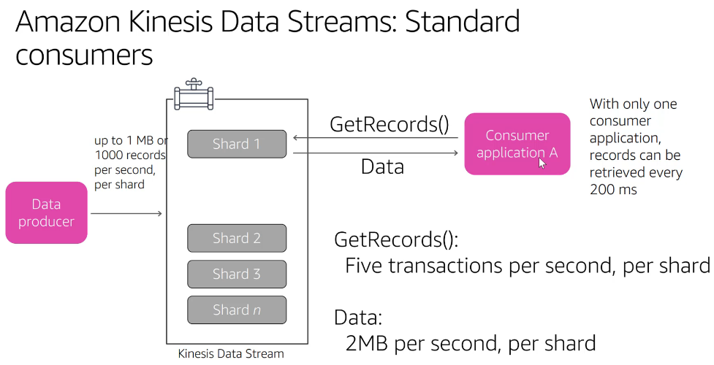
Notes:
As you increase the number of consumers propagation delay starts.
Consumers don’t poll, Messages are pushed to consumers when they arrive
Enhanced fan-out : gives 2MB per sec

