Slide 1
Highly Available, Scalable , Secure & HA AWS PROJECT
vikas
Notes:
Build a complete AWS stack using EC2, load balancer, Auto-scaling groups, EBS, S3, RDS, DynamoDB, CloudFront, IAM & VPC.

Slide 2
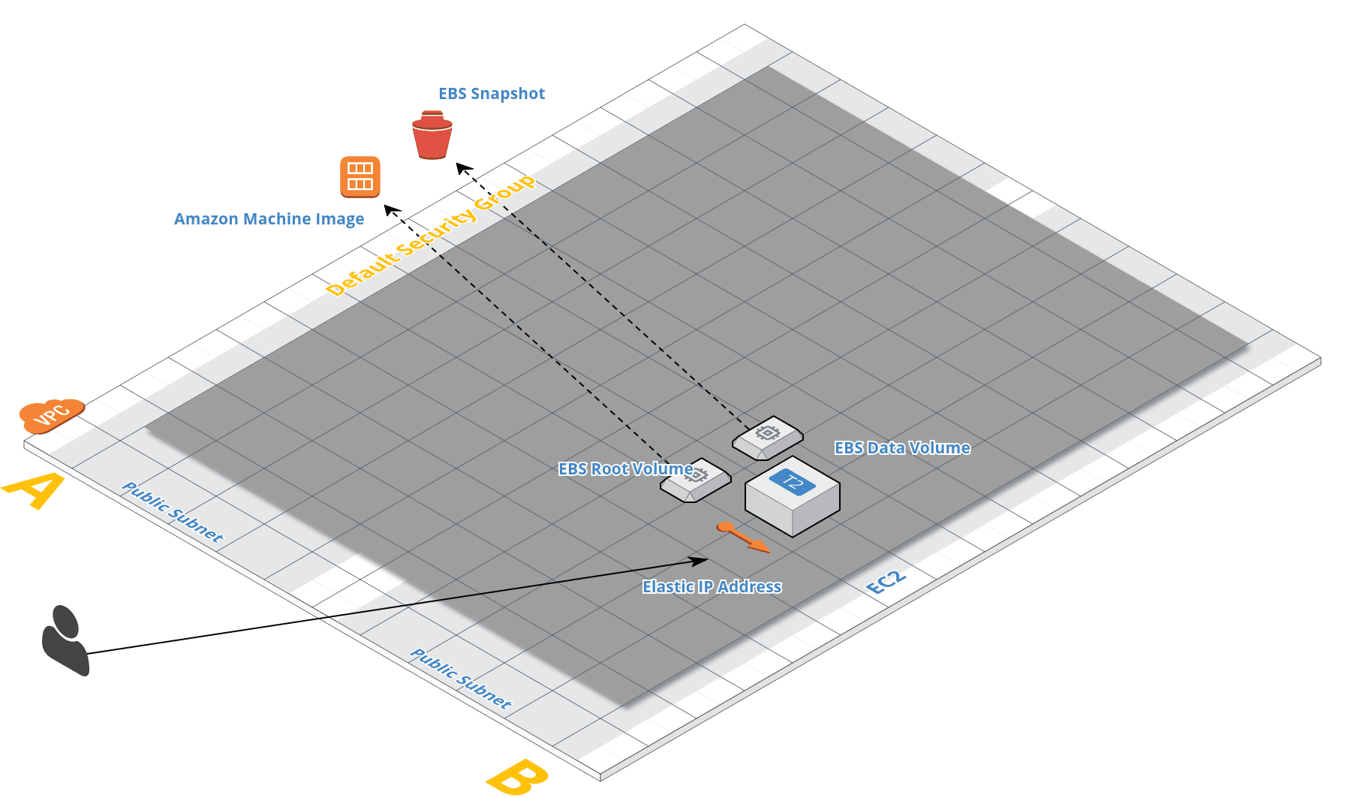
Notes:
## run these after you SSH into the server
# clone the app
git clone https://savitras@bitbucket.org/savitras/aws-course-php-app.git
# change to app folder
cd aws-course-php-app/
# install app dependencies
sh apt-get.sh
# install composer
curl -sS https://getcomposer.org/installer | php
# install AWS SDK
php composer.phar install
# deploy php pages to apache document root
sudo cp *.php /var/www/html/
# deploy vendor folder (contains AWS SDK) to the apache doc root
sudo cp -r vendor/ /var/www/html/
# deploy image to apache doc root
sudo cp aws-icon.png /var/www/html/

Slide 3
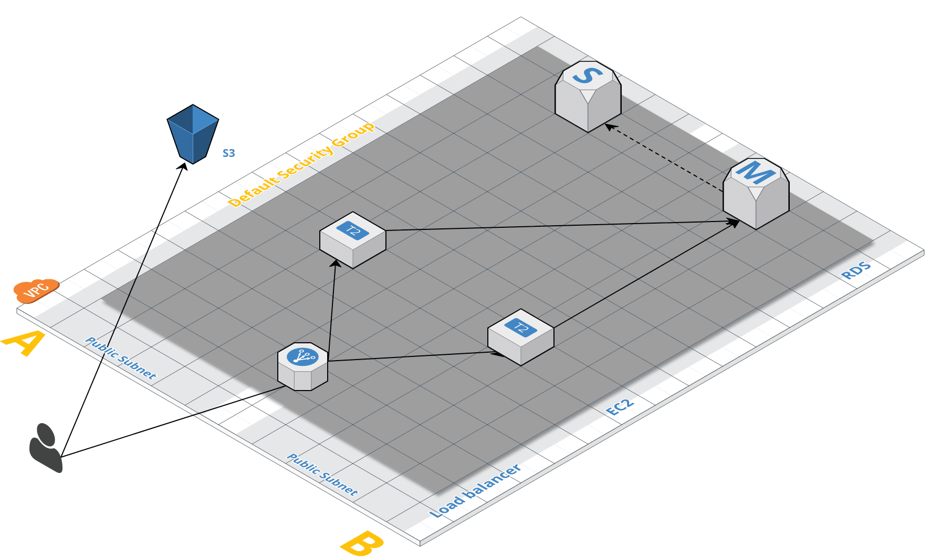
Notes:
DynamoDB : sessions – id
DynamoDB full access
Meme cache

Slide 4
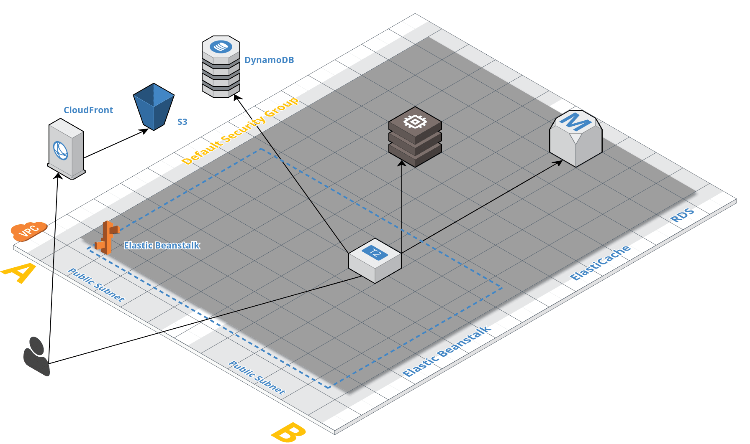
Notes:
# clone the beanstalk verion of the app on a local computer
git clone https://vikas99341@bitbucket.org/vikas99341/aws-course-php-app-beanstalk.git
# change into folder
cd aws-course-php-app-beanstalk/
# check git commits
git log --pretty=online
# Checkout the helloworld version of the app:
git checkout 9d5bdd3ee2f73342bcd483deb0a1a6605704660a
# Use git archive command to export the app into a zip file:
git archive --format=zip HEAD > aws-helloworld.zip
# Back to master
git checkout master
# checkout multi-tier version of the app:
git checkout 5ea9332a3df44446b6b9d96ed49e748a8d5b2f73
# Use git archive command to export the app into a zip file:
git archive --format=zip HEAD > aws-multi-tier.zip
RDS_HOSTNAME
RDS_USERNAME
RDS_PASSWORD
S3_IMAGE_URL
# Back to master
git checkout master
# checkout scalable version of the app:
git checkout fa72343d5f1a31b4cec1c472307d13fc5393fb9c
# Use git archive command to export the app into a zip file:
git archive --format=zip HEAD > aws-scalable.zip
DYN_REGION
RDS_RR_HOSTNAME
MEMCACHED_ENDPOINT
CLOUDFRONT_IMAGE_URL
Add role to the EBS
# Back to master
git checkout master
# checkout multi-tier version of the app:
git checkout a48cf5de263ea7f89812c8e8f74d0f9703083422
# edit privatekey configuration, add details of s3 location of private key
vi .ebextensions/privatekey.config
# Add name of s3 bucket where you have stored your private key below, e.g. eb-pvtkey-us-east-1-123456789012
buckets: ["S3_BUCKET_WITH_PRIVATE_KEY"]
# Specify the URL of the private key file in your s3 bucket, e.g https://s3.amazonaws.com/eb-pvtkey-us-east-1-123456789012/pk-APKAJ63NC4PRMDSDDWOI.pem
source: URL_OF_PRIVATE_KEY_IN_S3_BUCKET
# Commit private key config
git add .ebextensions/privatekey.config
git commit
# Use git archive command to export the app into a zip file:
git archive --format=zip HEAD > aws-course-php-app-secure.zip
CLOUDFRONT_KEY_PAIR_ID

Slide 5


