Slide 1
Experiential Learning :
CS235AI
Implementing Virtual Memory Management System
VIKAS J
RVCE23BCS404
WILSON
RVCE23BCS418

Slide 2
PRESENTATION CONTENTS
Problem Statement
Relevance Of the Project to the course
System Architecture
Tools/APIs used
Application
Implementation
Literature Survey

Slide 3
1. Problem Statement
Design and implement an efficient virtual memory management system for an operating system to address the challenges of optimizing page replacement policies, minimizing page faults, and enhancing overall system performance. The system should be capable of dynamically managing the allocation and deallocation of virtual memory space, ensuring seamless interaction between physical and virtual memory, and implementing effective page replacement strategies.

Slide 4
2. Relevance Of the Project to course
This project is highly relevant to the course as it delves into the core principles of operating systems, memory management, and system optimization. Has we will gain practical experience in designing and implementing a critical component of modern operating systems, deepening their understanding of virtual memory concepts, page replacement policies, and resource allocation strategies.

Slide 5
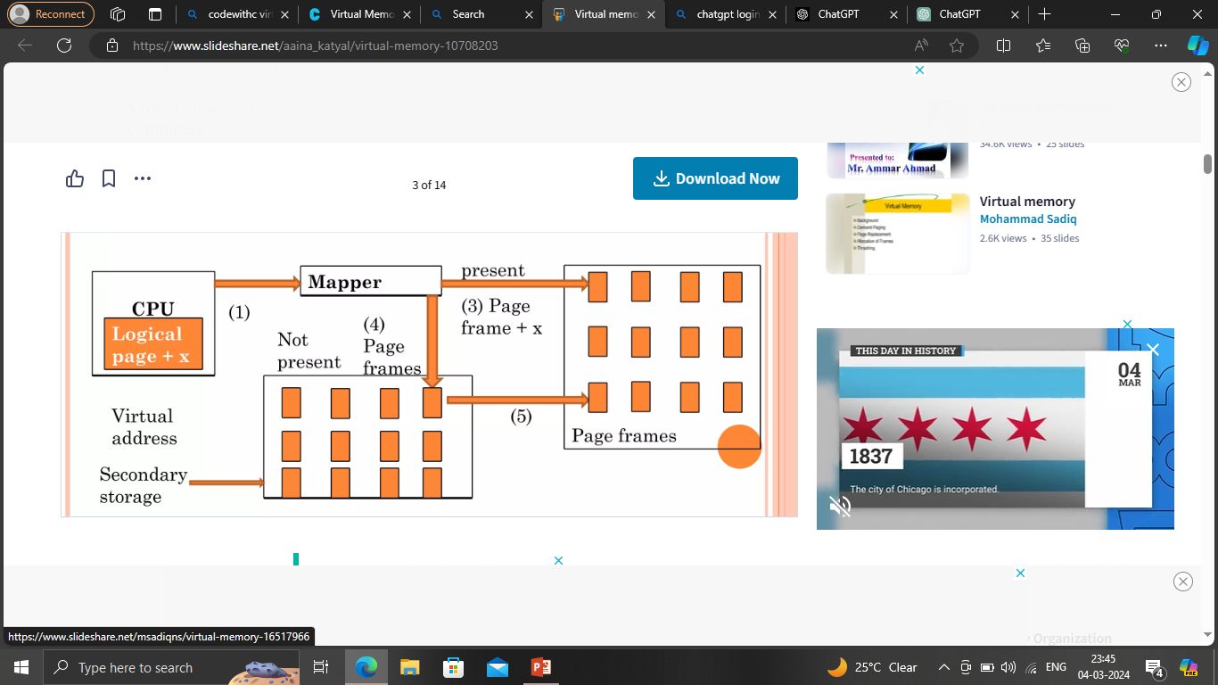
3. Architecture

Slide 6
5. OS Component
1. File I/O:
● The program reads input from a file using the `open()` function to open the file for reading (`'r'` mode) and then uses the `readlines()` method to read lines from the file.
2. Threading:
● The program utilizes threading to create concurrent execution flows. Threads are created using the `threading.Thread()` constructor and started using the `start()` method.
● Threading is used to simulate the concurrent execution of the memory management unit (MMU) and the OS scheduler.
3. Time-related functions:
● Time-related functions like `time.sleep()` are used to introduce delays or wait periods in the program execution. For example, in the `scheduler()` function, `time.sleep(5)` is used
to introduce a 5-second delay between scheduling iterations.
4. OS exit:
●The `os._exit(0)` call is used to exit the program and terminate the execution of theoperating system.
5. Signal Handling:
● The program defines a custom `SIGUSR1` signal using the `SignalUser1()` class. While not a traditional OS system call, signal handling is a mechanism provided by the operating system to notify processes of asynchronous events.

Slide 7
6. Application
VMM allows processes to access a larger address space than the physical memory available. Each process has its own virtual address space, which doesn't need to directly correspond to the physical RAM size.
Virtual memory enables memory protection by assigning different access permissions (read, write, execute) to different segments of memory. Unauthorized access attempts trigger memory protection faults, helping to enhance system security.
Virtual memory systems employ demand paging techniques to bring data into memory only when it is needed, reducing the amount of data that needs to be loaded into memory at any given time and improving overall system performance.

Slide 8
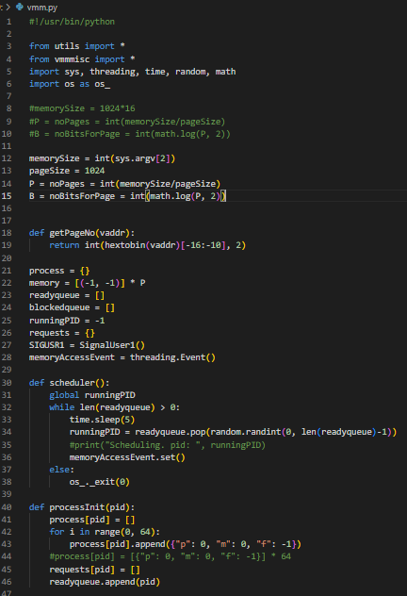
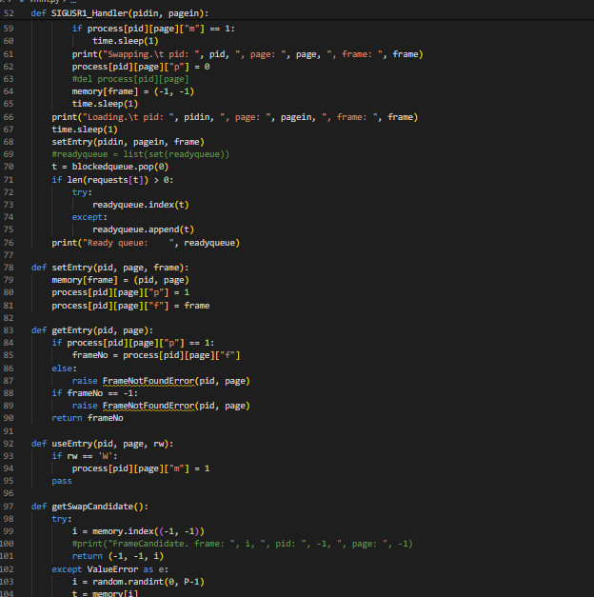
7. Implementation

Slide 9
1. Initialization:
● The program initializes necessary parameters such as memory size, page size, and calculates the number of pages and bits required for addressing.
● It sets up data structures for managing processes, memory, and handling memory requests.
2. Process Management:
● The `processInit()` function initializes a process with a given process ID (PID) and sets up data structures to track its memory usage.
● The `processExit()` function cleans up resources associated with a process upon termination.
3. Memory Management:
● Memory is represented as a list with each entry corresponding to a page frame. Initially, all frames are empty.
● The `setEntry()` function associates a page with a frame in physical memory.
● The `getEntry()` function retrieves the frame number corresponding to a given page of a process.
● The `getSwapCandidate()` function selects a frame for eviction when swapping is necessary.
4. Demand Paging:
● Memory pages are loaded into physical memory only when they are accessed (demand paging).
●When a page fault occurs, the `SIGUSR1_Handler()` function handles the page fault by selecting a page for eviction and loading the required page into memory.

Slide 10
5. Page Replacement:
● Page replacement occurs when physical memory is full, and a new page needs to be loaded.
● The program implements a basic page replacement strategy that selects a random page for eviction (`scheduler()` function).
6. Memory Access Handling:
● The `mmu()` function simulates memory access by processing memory requests from processes.
● It translates virtual addresses to physical addresses using the `v2p()` function and handles page faults if necessary.
7. Concurrency:
● The program uses multithreading to simulate concurrent execution of the memory management system and the operating system scheduler.
8. Input Processing & output Display:
● The program reads memory access requests from a file and initializes processes accordingly.
●The program prints information about memory accesses, page swaps, and the state of main memory for monitoring and debugging purposes.

Slide 11
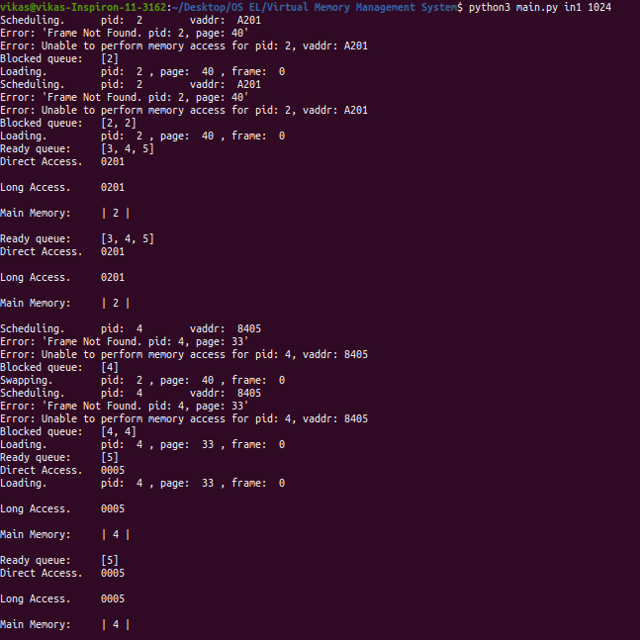
Result / Output
Simulation Flow:
The simulation starts with processes and their memory access requests. Initially, there are no
pages in memory. Processes encounter "Frame Not Found" errors and are added to the blocked
queue. The system loads requested pages into free frames, allowing processes to run.

Slide 12
8. Literature Survey
Articles | Summary
Memory management method in virtualization system Yoo Hyuck, Lee Chi Young, Yun Jong Hee | By implementing this memory management method, the virtualization system can effectively handle memory deficiencies and optimize memory usage, leading to improved performance and resource allocation The proposed method allows for efficient utilization of memory resources in a virtualization system by swapping out data from one virtual machine and storing it in the spare area of another virtual machine
Dixit, Shridhar S., “Study of Virtual Memory” (2020). Retrospective Theses and Dissertations. 619. https://stars.library.ucf.edu/rtd/619 | Discusses auxiliary memory, cache, CPU, demand paging, and dynamic allocation. Utilizes associative memory and compaction techniques for memory management.
Virtual Memory Pedro Mejia Alvarez, Marcelo Leon Ayala & Susana Ortega Cisneros | Virtual memory is a technique that allows the execution of the processes that may not be completely in memory. One major advantage of this scheme is that processes can be larger than the available physical memory. This technique abstracts main memory into a very large, uniform array of storage, separating logical memory as viewed by the user from physical memory. It frees programmers from taking care of main memory limitations. Virtual memory also allows processes to share files and address spaces. Virtual memory is not easy to implement, however, and may substantially decrease performance if it is used carelessly.

