Slide 1

Core Java Programming - 1
Sandeep Kulange
sandeepkulange@sunbeaminfo.com

Slide 2
Day 2: Agenda
Data Types
Wrapper Classes
Narrowing and widening
Boxing and Unboxing
Command line arguments
Comments
Console class

Slide 3
Data Types
Data type or simply type of a variable decides 4 things:
Memory
Nature
Operation
Range
Types
Primitive Type (also called as value type)
Non Primitive Type (also called as reference type)

Slide 4
Primitive Data Types
The Java programming language is statically-typed, which means that all variables must first be declared before they can be used.
The eight primitive data types supported by the Java programming language are:
The Java virtual machine works with one other primitive type that is unavailable to the Java programmer: the returnAddress type.

Slide 5
Primitive Data Types
Sr. No. | Primitive Type | Size | Default Value( For Fields ) | Wrapper Class
1 | boolean | Not Specified | false | Boolean
2 | byte | 1 byte | 0 | Byte
3 | char | 2 bytes | ‘\u0000’ | Character
4 | short | 2 bytes | 0 | Short
5 | int | 4 bytes | 0 | Integer
6 | long | 8 bytes | 0L | Long
7 | float | 4 bytes | 0.0f | Float
8 | double | 8 bytes | 0.0d | Double

Slide 6
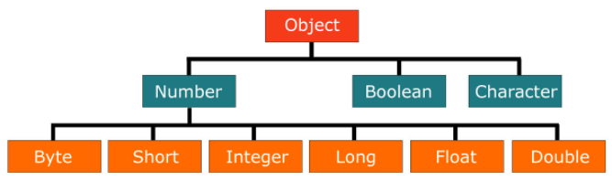
Wrapper Classes
In Java primitive types are not classes.
Wrapper class is a class associated with primitive type
Why Wrapper class?
To parse string into numeric type
int number = Integer.parseInt(“125”); //OK
To use primitive values into generic collection.
Stack<int> s1 = new Stack<int>(); //Not OK
Stack<Integer> s2 = new Stack<Integer>(); // OK

Slide 7
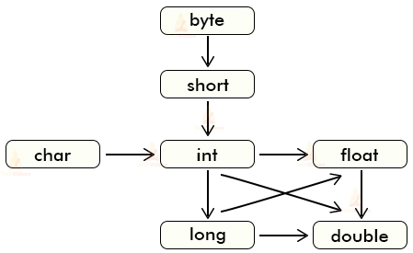
Widening
It is the process of converting state of variable of narrower type into wider type.
Consider example:
int num1 = 10;
double num2 = ( double )num1; //OK
double num3 = num1; //OK
In case of widening explicit typecasting is optional.

Slide 8
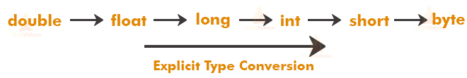
Narrowing
It is the process of converting state of variable of wider type into wider narrower.
Consider example:
double num1 = 10.5;
int num2 = ( int )num1; //OK
int num3 = num1; //Not OK
In case of narrowing explicit typecasting is mandatory.

Slide 9
Unboxing
It is the process of converting state of instance of reference type into value type.
Consider Example:
int num1 = Integer.parseInt(“10”); //UnBoxing
float num2 = Float.parseFloat(“10.5f”); //UnBoxing
double num3 = Double.parseDouble(“10.5d”); //UnBoxing

Slide 10
Boxing
It is the process of converting state of instance of value type into reference type.
Consider Example:
String s1 = Integer.toString( 10 );
String s2 = String.valueOf( 10 );

Slide 11
Command Line Arguments
class Program
{
public static void main( String[] args )
{
String name = args[ 0 ];
int empid = Integer.parseInt( args[ 1 ] );
float salary = Float.parseFloat( args[ 2 ] );
}
}
Compilation and execution steps
javac Program.java
java Program Sandeep 33 45000.50f

Slide 12
Comments
If we want to maintain documentation of source code then we should use comments.
Following types of comments, we can use in source code
Single line comment
//This is single line comment
Multi line comment
/*
This is multi line comment
*/
Java documentation/doc comment
/**
This is multi line comment
*/

Slide 13
User Input
Console is a class declared in java.io package.
“String readLine()” is a non method of java.io.Console class.
“static Console console()” is a method of java.lang.System class.
Consider following code:
Console console = System.console();
String name = console.readLine();
int empid = Integer.parseInt(console.readLine());
float salary = Float.parseFloat( console.readLine() );

Slide 14
Useful Link
https://docs.oracle.com/javase/tutorial/
https://www.artima.com/java/
http://tutorials.jenkov.com/

Slide 15
Thank You.

