Slide 1

Human vs Computer Ping Pong Game API Team Pong
Vikas Bhat

Slide 2
Human vs Computer Ping Pong Game API Description
Ping-pong also known as table tennis, is a sport in which two players hit a lightweight ball back and forth across a table using small rackets. In this project Team Pong is going to develop an API features two paddles and a ball, the goal is to defeat your opponent. A player gets a point once the opponent misses the ball. This game can be played with two human players, or one player against the computer-controlled player. Originally this game was developed by Atari.
This project will be made as interactive as possible for providing the player best user interface.

Slide 3
Measurement for Engagement
Team Pong will measure the improvement of the E that the team has selected by checking how much fun people are having while playing the game as well as being challenged and involved during the gameplay.
This can be measured by checking how long a user plays the game in one sitting. We can also add a feedback page to check how users are feeling about the game and can improve the gameplay on the basis of feedback provided by the users.
If a user only play this game for limited period of time, then we will consider it is not engaging.

Slide 4
Industry Research
According to David Smooke from HACKERnoon, Indie game industry should always use technologies that fit their skill level in department while also allowing them to target the platform and people.
We can understand what a user wants more clearly by doing a survey where users can let us know the environment, difficulty level, gameplay they enjoy the most. For example, ‘ Do users should be given an option decrease the ball speed to make the game easier’

Slide 5
Target Population
Team Pong target population will be young teens who are interested in playing a challenging and user-friendly ping pong game. They show many characteristics that would indicate their interest in our game.
They love to play indie games
As our game will be freely available, they don’t have to pay anything
They will not require any special console or high computer requirements to play our game
Our multiplayer feature will definitely interest them

Slide 6
Persona
Name: Shetty
Occupation: Student
Shetty is a high school student. He wants to get into a good university, so he stopped playing video games for some time to concentrate more on his studies. Although he wants to play some games as Shetty is playing video games since his childhood, but now he feels like he has an overwhelming amount of work to do. He is a big fan of arcade-based games. He works at a grocery store but is bored doing the same thing every day as he spends most of the time there using some app. His older brother Shenoy is an undergrad student, even he is a big fan of indie games. When Shetty got to know about a fun multiplayer game where you can manage the gameplay length and difficulty level which he can also play with his brother by taking microbrakes while studying, he became excited to play the game. Shetty spends most of his free time with his brother. They used to play lots of PlayStation video games together but now they don’t have enough time to use it.

Slide 7
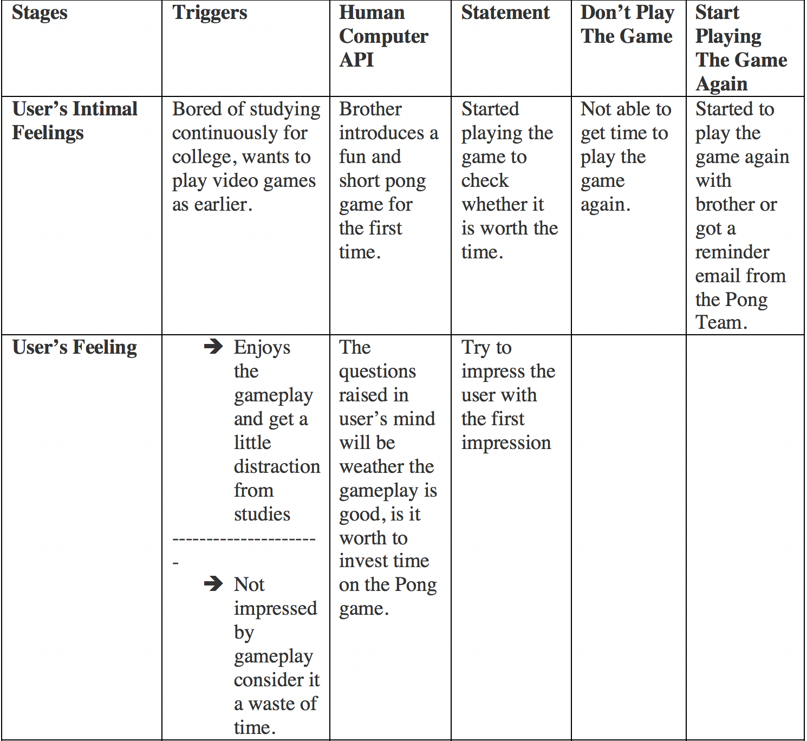
Experience Map to chart the way the user is feeling when engaging with the gameplay:

Slide 8
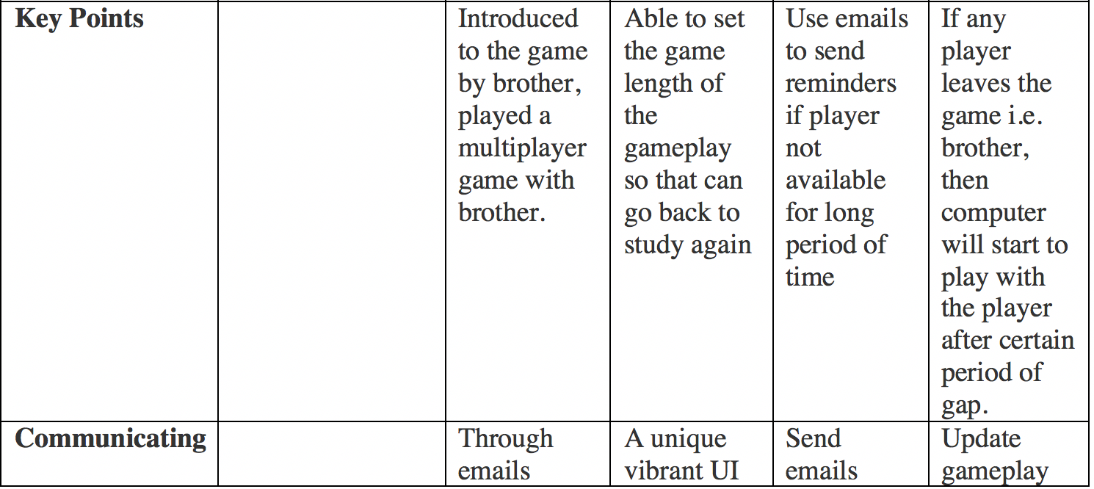
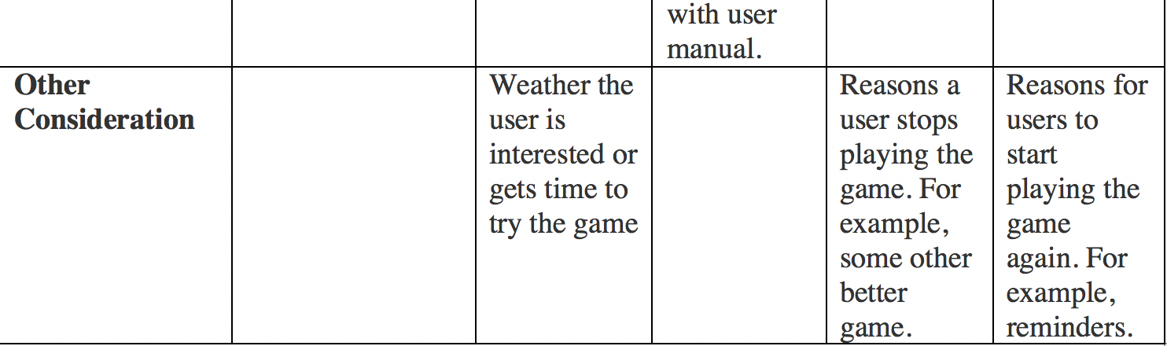

Slide 9
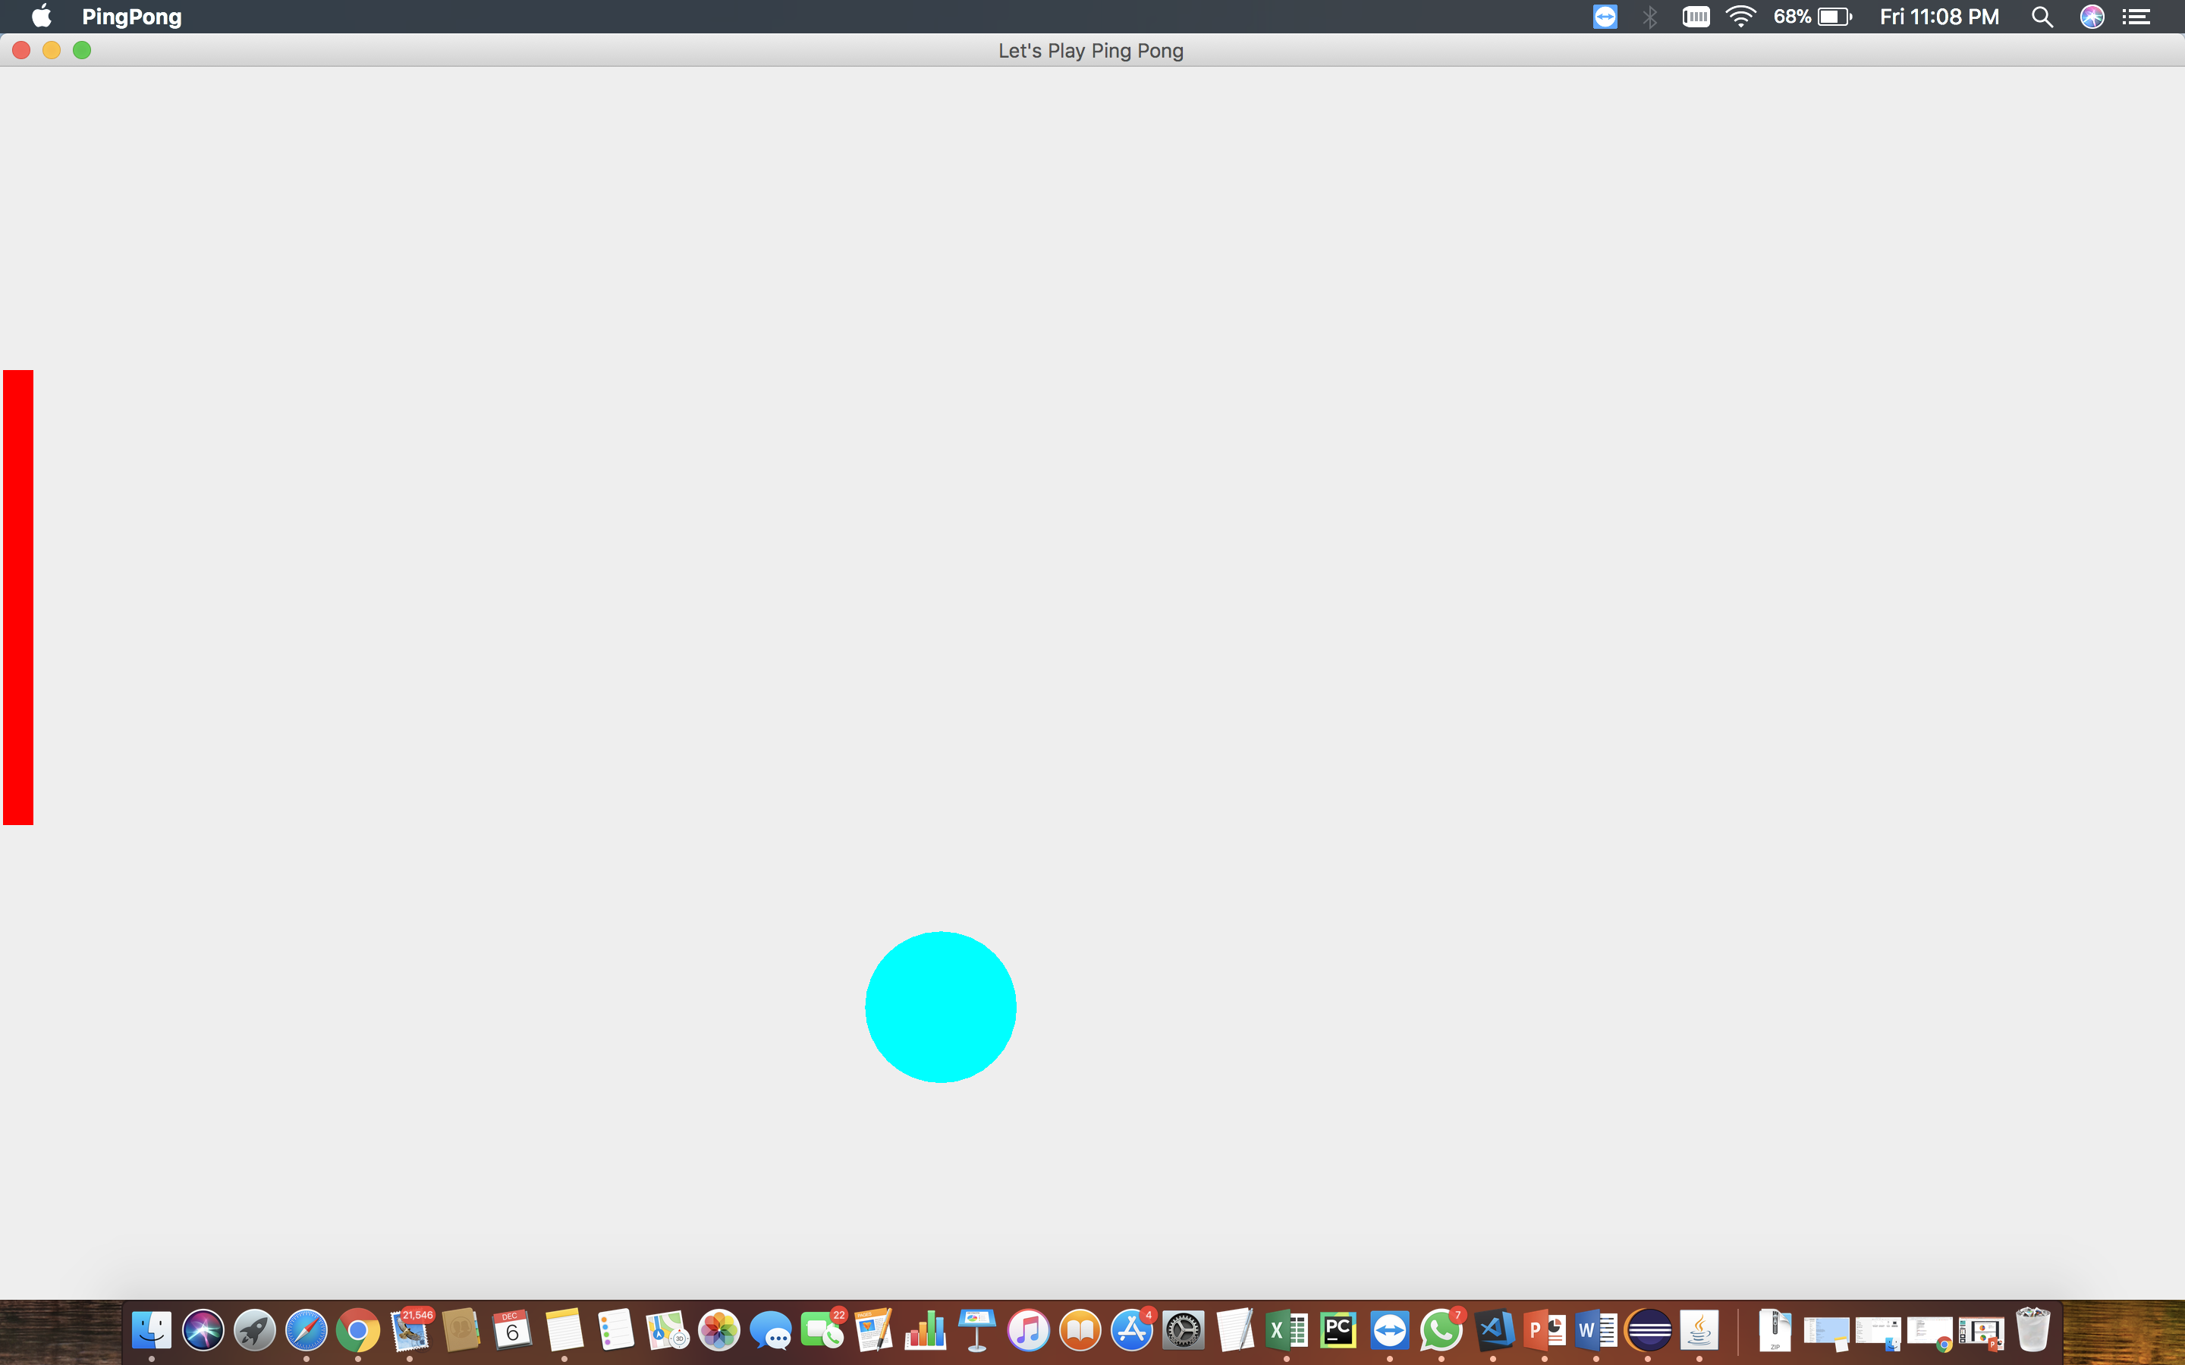
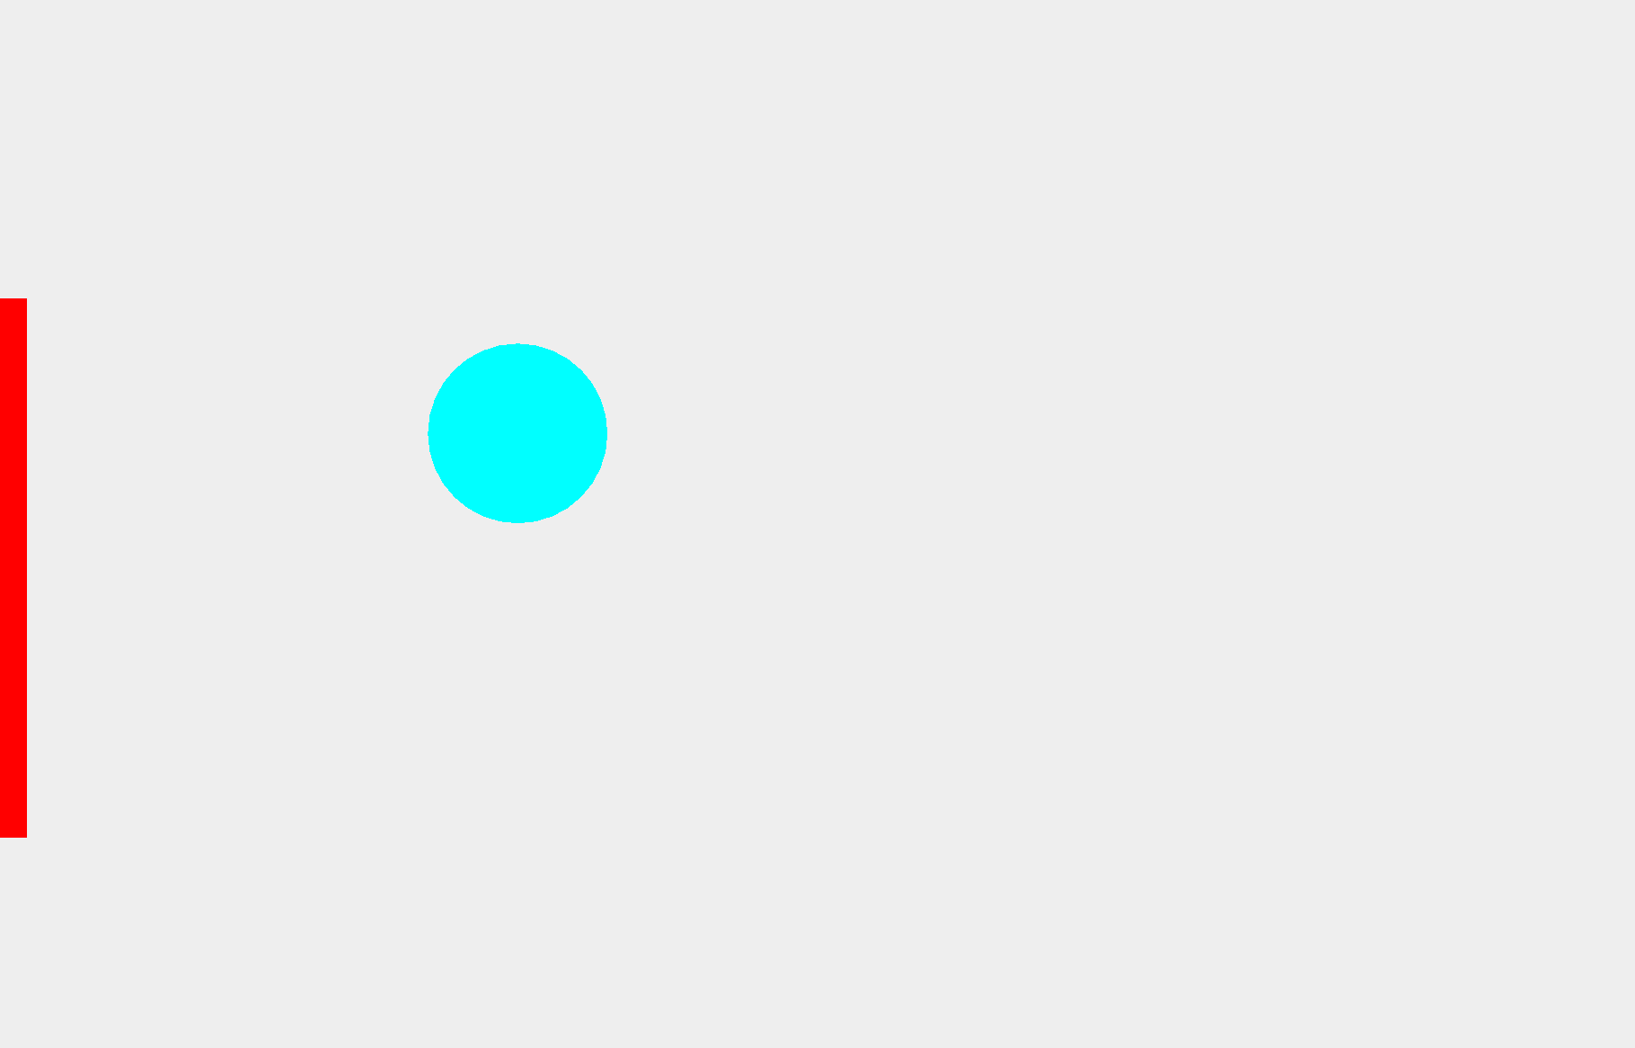
Low Fidelity Prototype
Our first prototype was a single player
Ping-pong game with basic rules, easy
Gameplay and least difficulty level
Need only a mouse to control the game.

Slide 10
User Feedback - First Prototype
Very basic, no special features to be considered worth the time
No competition, can play this game without getting defeated which makes it no fun
No instructions are provided
One user liked the fact that only mouse is required, which makes it very easily playable.
Our team did a survey after this iteration, we found that people want a game which is easy to understand but challenging
And we also found that almost 63% of users wants a user manual for the game.

Slide 11
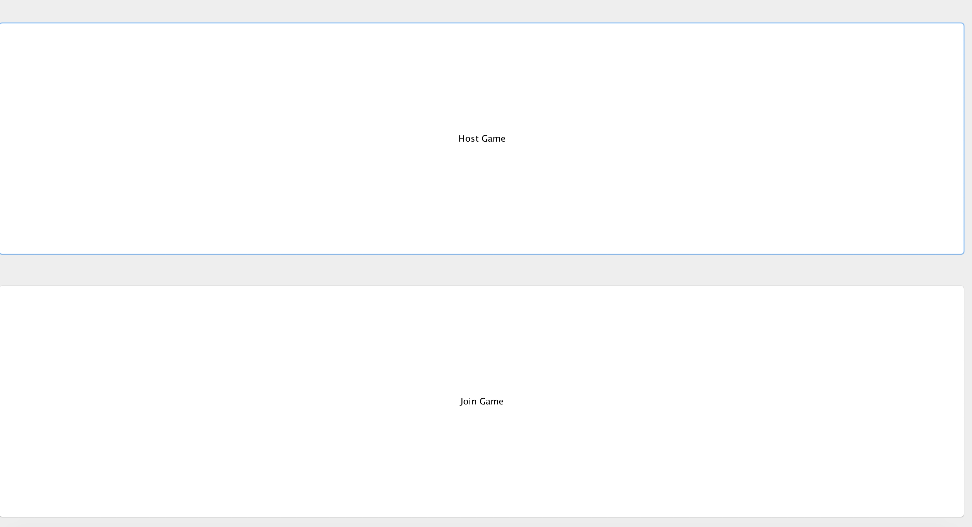
Medium Fidelity Prototype
This is our home page people can select if they want to host the game or join the game using the IP address

Slide 12
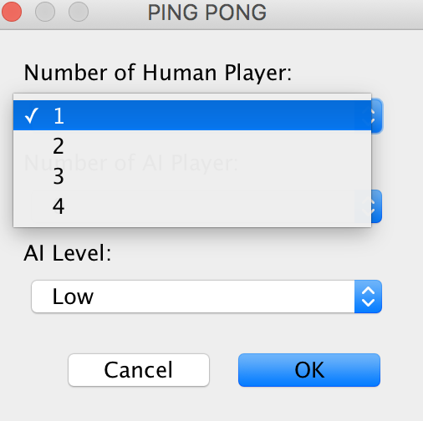
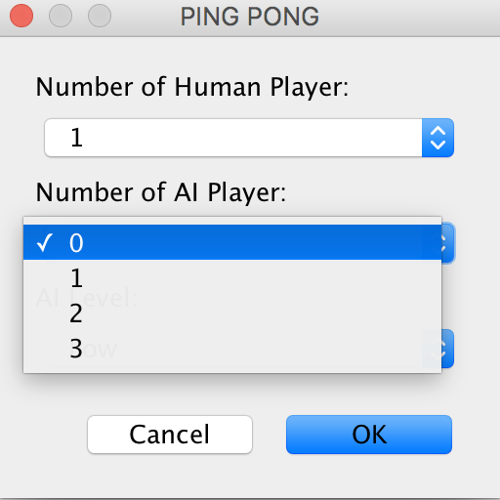
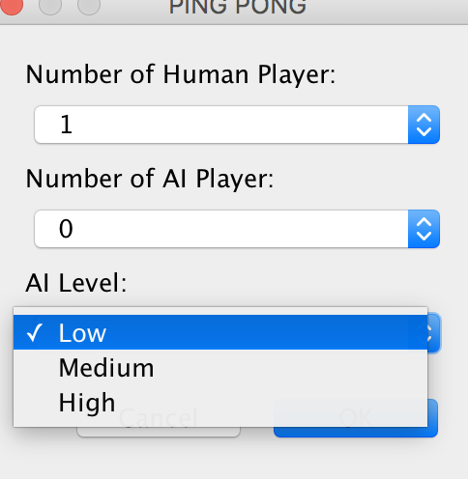
These are the different selection one can make which includes selecting number of players, difficulty level.

Slide 13
User Feedback - Second Prototype
Not enough vibrant to be interesting
Users found the gameplay easy to understand
Connection part is confusing
The difficulty levels are almost same, i.e. the hardest level is similar to lowest level

Slide 14

Additional Findings
Our survey showed that the majority (62%) thought the multiplayer part was the most engaging attribute. 53% said that a simplistic interface is critical. And x49% voted that the easy gameplay is critical component to engagement.

Slide 15
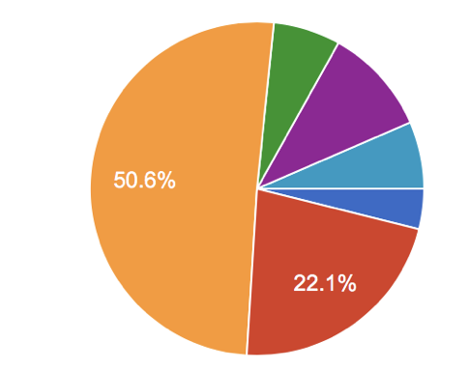
We also found that more than 50 % of users are not getting engaged in the game for more than 10 mins, only 15% users are playing the game for about 20 mins, our mission was to make a game which can be played between daily tasks, but we realized that we have to increase this time limit by at least 2x.

Slide 16
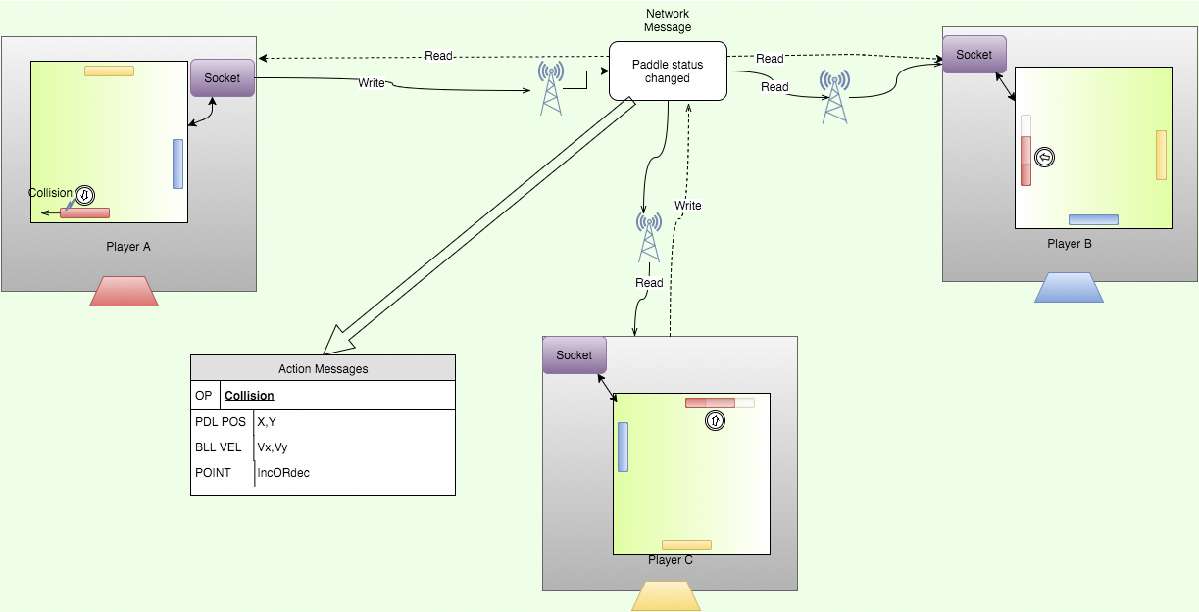
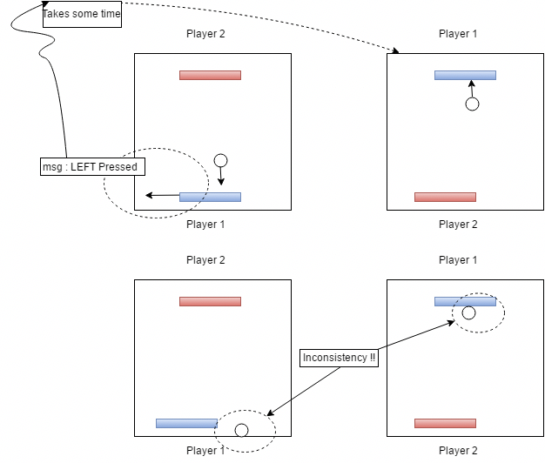
High Fidelity Prototype
Event Flow

Slide 17
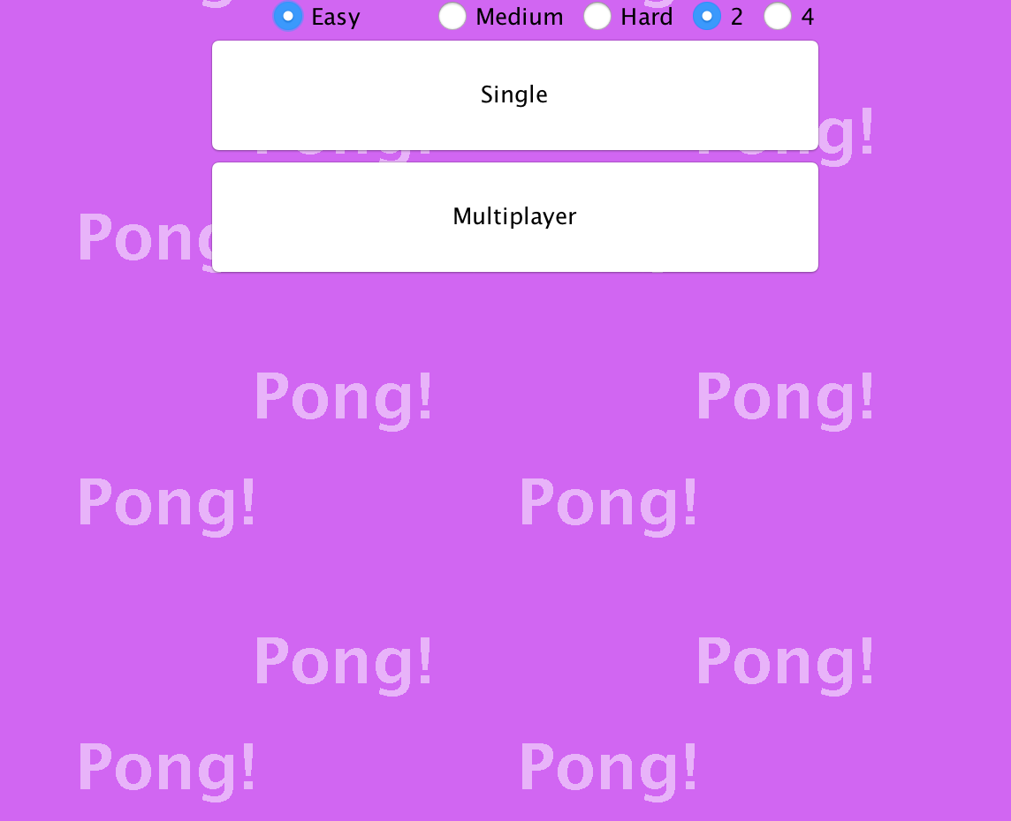
High Fidelity Prototype (1st Design)
This first iteration of final design, we heard all the reviews that the game is not vibrant enough to be engaging, our team made few changes in interface added more color to it and made it more happening.
But the major feedback we got in this iteration that the game is very hard to follow as the speed of ball is high the size of bats are small.

Slide 18
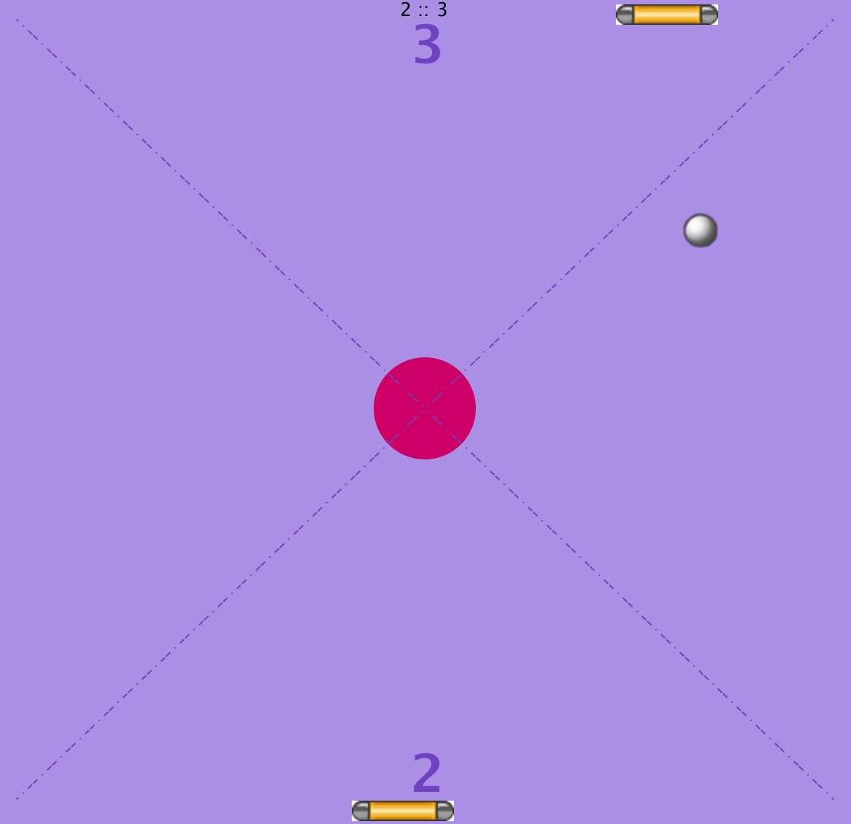
High Fidelity Prototype (2nd Design)
This second iteration of final design, we decided that we will reduce the difficulty of game as our game was based for young teens.
We also added an exit button here to make it look more user friendly. And In this iteration we made few changes in the network of the game to make it more multiplayer friendly
We also got feedback regarding player names, some users suggested that we should add player names when playing multiplayer

Slide 19
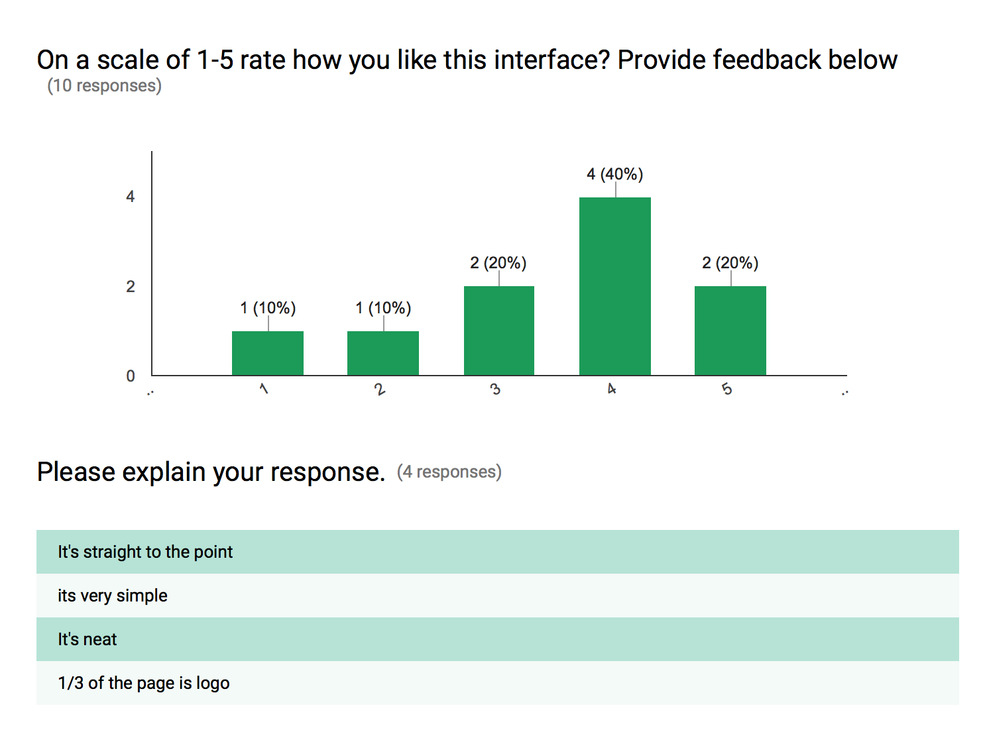
Our team received positive reviews on our interface with 60% of the respondents rating it as a 4 or 5

Slide 20
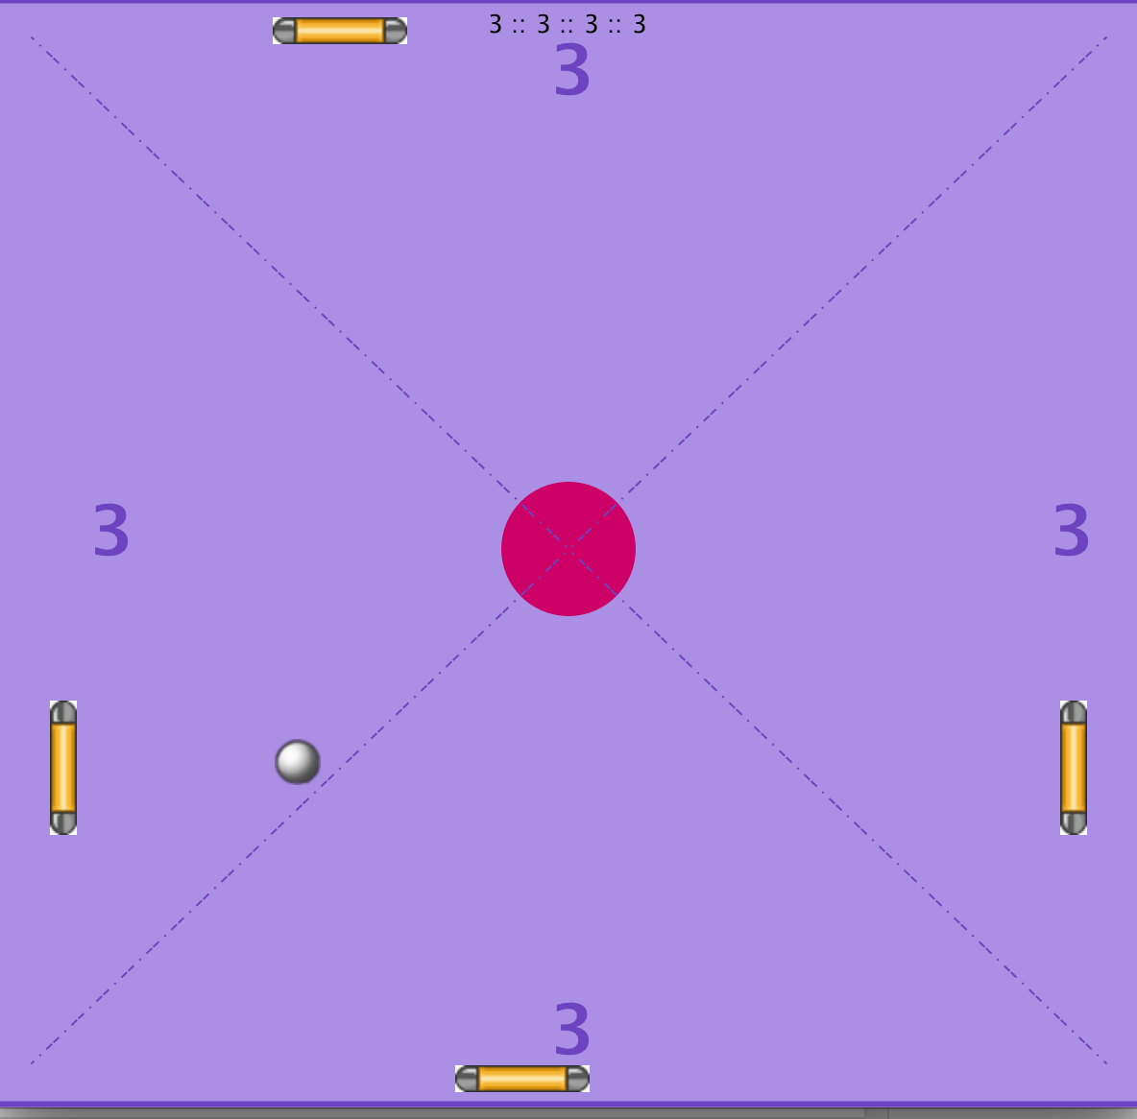
High Fidelity Prototype ( Design)
Two Players
Four Players

Slide 21
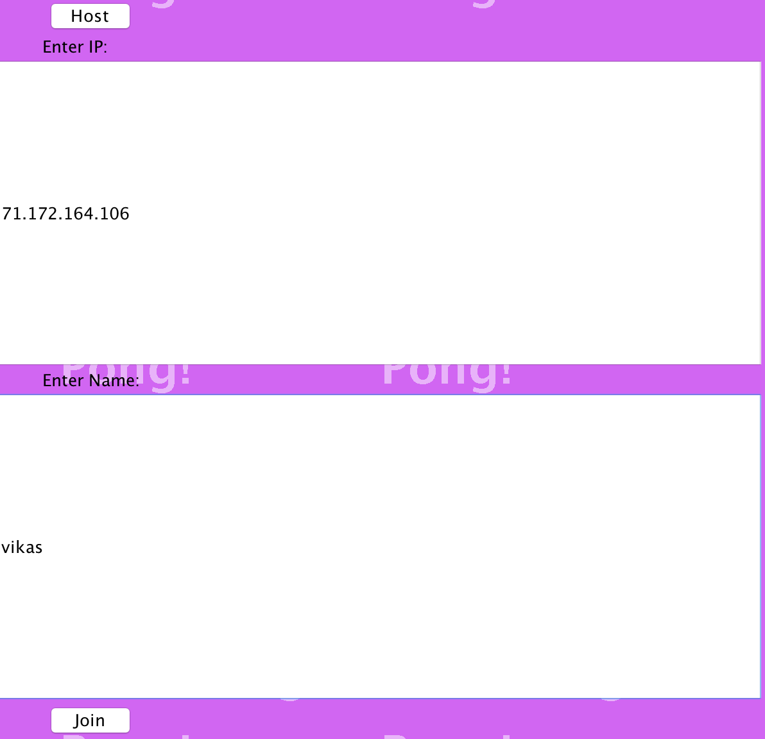
A player can host a game or can join the game by using the IP address and name.
As we received feedback in last iterations to allow players to enter their names, we implemented it.

Slide 22
PAR Review
PERCEPTION - We designed the system interface minimalistically so that users can easily perceive functions. The design of API is consistent and clean, there is no excess information being presented
ATTENTION - The API is vibrant and colorful, and the gameplay is challenging which gives keeps user engaged. And We believe that by giving users a challenging multiplayer environment and user will be more engaged
RETENTION – As our API is easy to use and fun, we are focusing on the microbreaks taken by high schoolers, they don’t need to memorize any control and they only need a keyboard and mouse for gameplay it will be perfect for them to play the game in those microbreaks.

Slide 23
Simplicity Review
One of the most important rules of simplicity for our project is “reduce” because we rely on reduction of controls and features involved. There are several Indie games which requires high specifications and sometimes consoles which can't be afforded by our target population. Our game needs minimal specifications, mouse and keyboard for gameplay, which will be perfect for our target population that is young teens who are not working and wants to have fun without any major expanses. We also tried to make our game with minimal controls which makes the game enjoyable and fun.

Slide 24
Accessibility Evaluation
As this game is a fun game it can be played by anyone, We also used Fitt’s Law by increasing the size of our buttons. We can also customize the ball size and paddle size if needed with some technical help. We

Slide 25
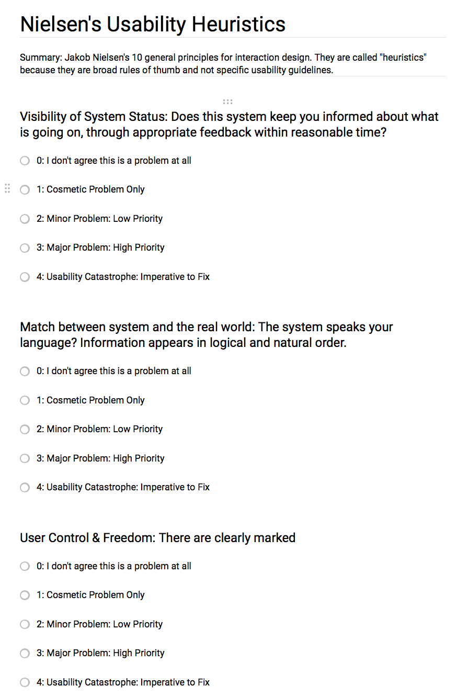
Heuristic Review
We had users fill out this heuristic evaluation after walking through the site.
We had a total of 6 respondents. While some of the users did report some problems but most of them were related to the interface, which we can understand as we have cost constraints here. Many users enjoyed the ease with which one can play the game and have fun without any prerequisite requirements.

Slide 26
User Quotes
The “menu” can be more interactive as It don’t have any specific manual attached with it.
The gameplay is very easy, I guess you can get bored easily.
This looks awesome I will introduce it to my brother so that we can play it together.
This gameplay is good but very repetitive.
I liked the gameplay but the interface can be better, you can do something with it as you cant play it in a full screen.
The interface can be better, you can do very cool stuff with the interface.

Slide 27
Microinteractions
One of the main details that mattered after testing was the feedback based on the users progress through the game. For this reason, we added feedback for users on their progress weather they find the gameplay interesting or not. Originally, we though we are going to provide feedback page in the game itself, but we found that this feedback was not salient enough. Our redesign is more based on how player is interacting with the game if they are having fun while playing it or not.

Slide 28
Targeted E - Revisited
We tried to make our gameplay as fun and engaging as possible for young adults as we are targeting those microbrakes they take in between, so we made various changes to make users feel more engaged, provide users the option to set the difficulty level as well as the number of players involved. We even made our game more vibrant to appeal the young teens.

Slide 29
Future scope
As our application is an extension to the existing classic arcade game Pong by Atari. It includes many features which the original game doesn’t have. But we can also add lot of features which can give it a universal appeal like using unity to make our game 3D. We can also add other minigames such as card games, tic tac toe to make it fun for users other than our target population.
We can also work on our interface to make it more realistic as well as increase the difficulty to make it more challenging.

Slide 30
References
https://en.wikipedia.org/wiki/Tic-tac-toe
http://library.iitd.ac.in/print-journals.php
https://stackoverflow.com/
https://docs.oracle.com/javase/7/docs/api/java/awt/Graphics.html
https://en.wikipedia.org/wiki/Pong
https://www.youtube.com/watch?v=xIqeK2hzx1I
https://www.ponggame.org/

