Slide 1
Lung Capacity Analysis
By Vikas Bansode
Post Graduate Diploma in Data Analytics 2019-2020

Slide 2
Content
Abstract
Introduction
Research Methodology
Result and discussion
Conclusion
References

Slide 3
OBJECTIVES
To analyze the volume of air in the lungs upon the maximum effort of inspiration.
To analyze the Lung capacity based on Age, Gender Height, Weight.
To analyze the factors affecting the different ranges of lung capacity among individuals.
The types of measurements employed for lung capacity.
To analyze if there is any difference in male and female lung capacity.

Slide 4
Research Methodology
It is showing Lung Capacity of smoker and non-smokers by their Age, Height, Gender and Caesarean.
I have employed following techniques to analysis the Lung Capacity Data.
Exploratory Data Analysis
Descriptive Statistics
Inferential Statistics
Probability Distribution
Simple and Multiple Linear Regression
• Collection of Data – Kaggle.com

Slide 5
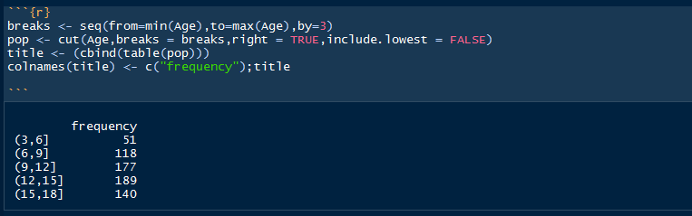
Calculated the Frequency Distribution of the data to examine the outliers and significant trends within dataset.

Slide 6

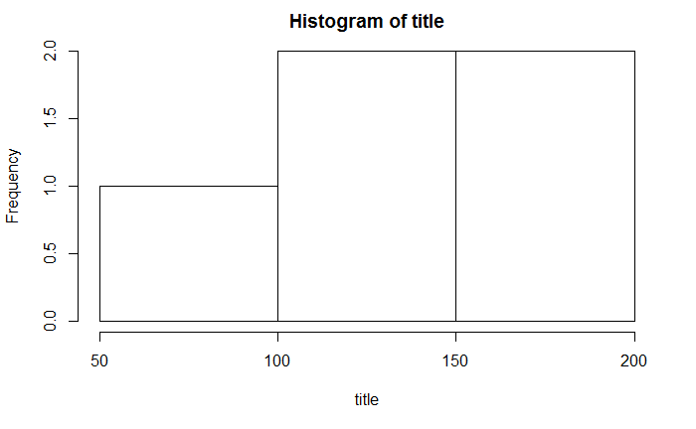

Slide 7
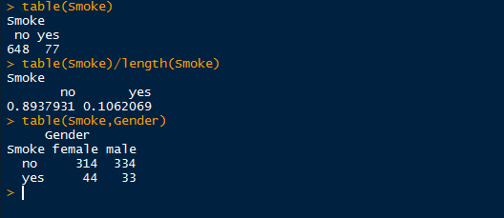
Table for proportion to examine the number of observations for a variables.

Slide 8
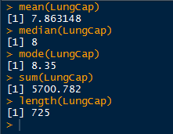
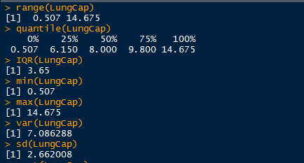
Descriptive Statistics
Measures of Central Tendency
Measures of Dispersion

Slide 9


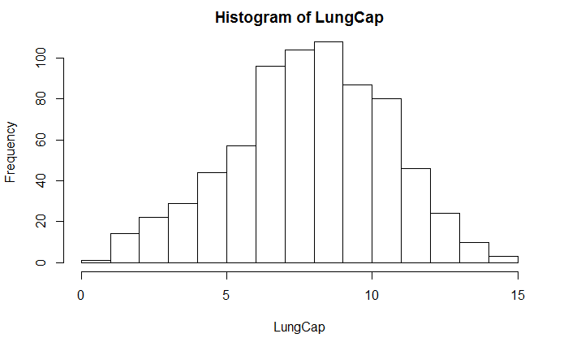
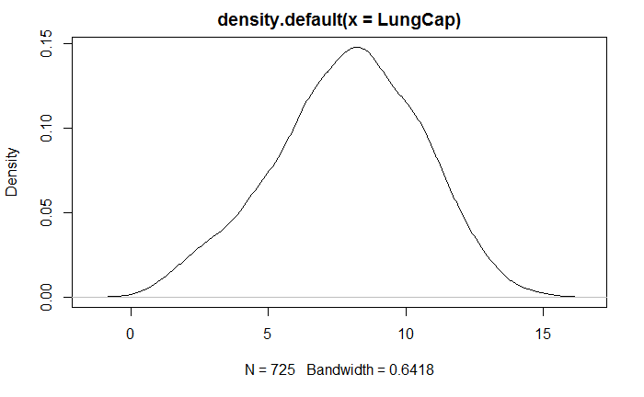
Measures of shapes
Skewness
Kurtosis

Slide 10


Bivariate Analysis
Correlation Analysis
The correlation coefficient of Lung cap and Age is 0.82. Since It is rather close to 1, we can conclude that the variables are positively linearly related.
Covariance Analysis
The Covariance of Lung cap and Age is about 9. It indicates a positive linear relationship between the two variables.

Slide 11
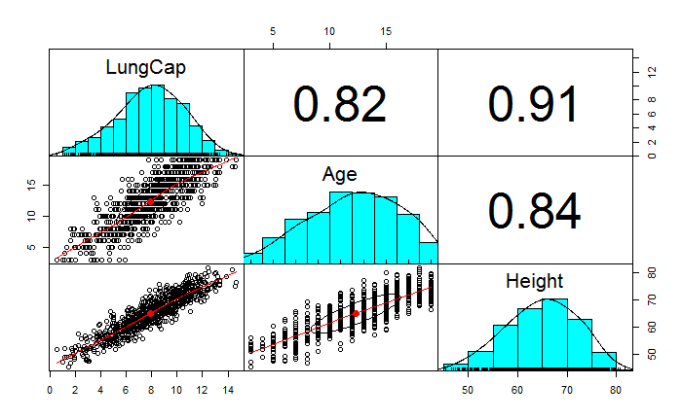
Correlation Pair Plot for All variables

Slide 12
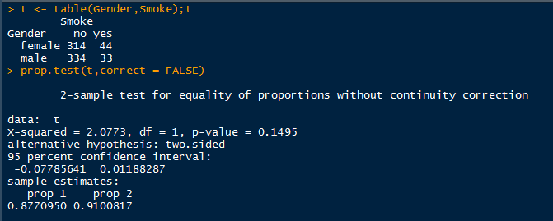
• Z-test two sided • H0 : female smoker is equal to male smoker • CI : 95%

Slide 13
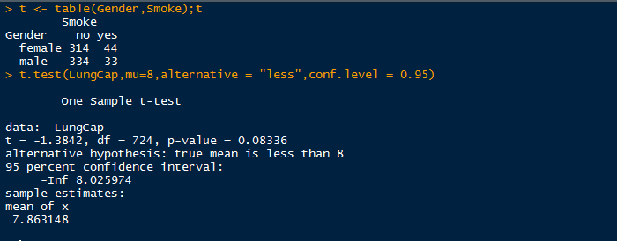
• T-test One sided • H0: mu < 8 • one sided 95 % CI for mu

Slide 14
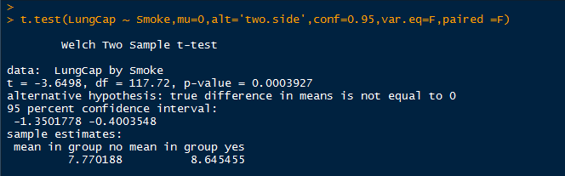
• t-test two sided • H0: mean lung capacity of smokers = of non-smokers • CI:95

Slide 15
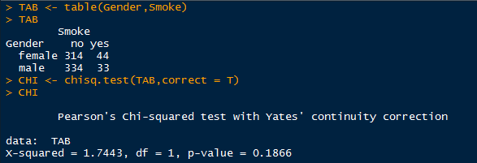
• Chi-Square Test • H0: male smokers = female smokers • Ha : male smokers not equal to female smokers

Slide 16
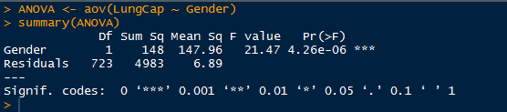
•ANOVA • H0: Male Lung capacity is equal to female Lung capacity • CI : 95%

Slide 17
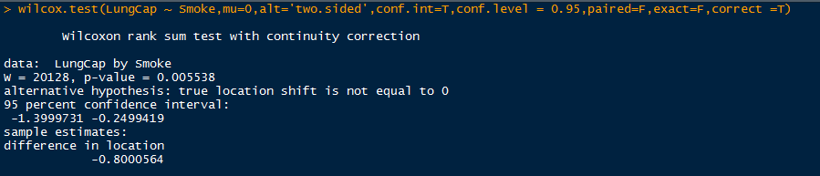
• Wilcoxon Non-parametric Test (two sided test) • H0 : Median Lung Capacity of smokers equal to non-smokers • CI : 95 %

Slide 18
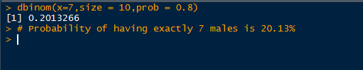
Probability Distribution • Binomial Distribution • suppose 80% adults are smoker and out of 10 are caesarean. what is the probability that they are male exactly seven. • Observations is n = 10 • success or events of male is x = 7 • p = 0.8

Slide 19
• POISSON DISTRIBUTION • Suppose there are 12 adults smoking per minute on an average. Find the probability of having seventeen or more adults smoking in a particular minutes.

Slide 20

• NORMAL DISTRIBUTION • The mean of Lung capacity is 7, and standard deviation is 2.66. what is the percentage of Lung capacity of female which has 9 or more lung capacity.

Slide 21
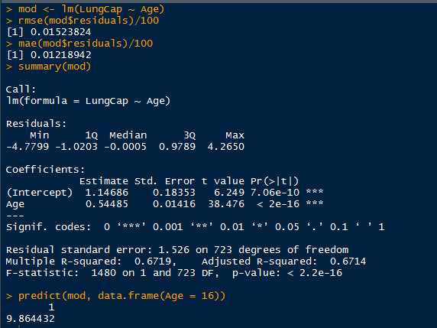
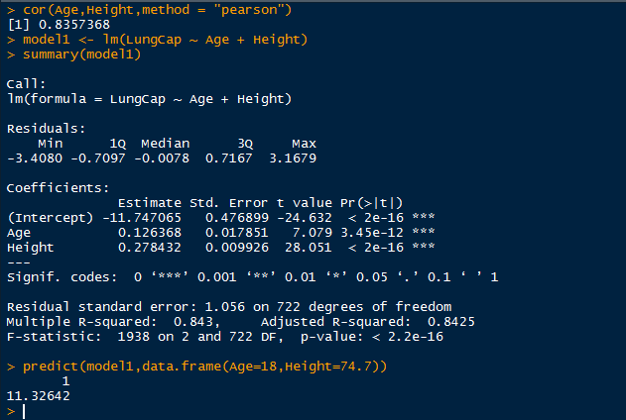
Modelling
Simple Linear Regression
Multiple Linear Regression

Slide 22
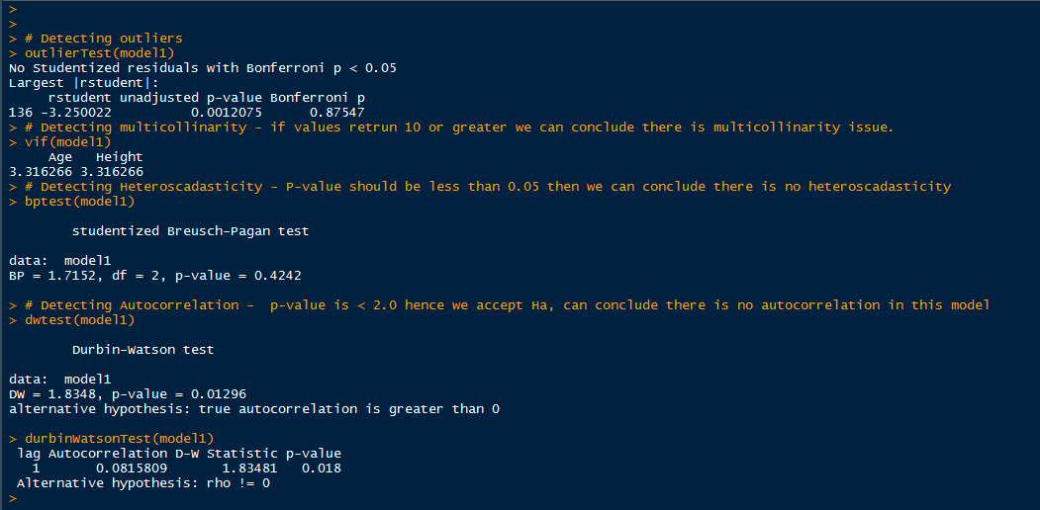
MODEL DIAGNOSTICS

Slide 23
CONCLUSION
With the help of R statistical Analysis and graphical presentation, I can easily analyze the Lung Capacity Data in the smokers and non-smokers by their age, gender, Height.

