Slide 1
B.Tech Project Presentation On Indian Bus
Submitted To: Submitted By:
Mr. Prateek Mishra Vikas Dhiman (8617111)
ASIA PACIFIC INSTITUTE OF INFORMATION TECHNOLOGY

Slide 2
Presentation Overview
Introduction of Project
Introduction of Angular, Spring Boot, Micro-service, MySQL
Connectivity of Angular with Spring Micro-service
System Requirements
E-R Diagram
Screen-short of the Project
References
Conclusion

Slide 3
Introduction of Project
For the college project, I would like to implement an Indian Bus Service based on Angular, Spring Boot, Micro-service and MySQL.
I try to Implement the Online sheet booking system.
The main objective of this project are to make a connectivity of Angular, Spring Boot, Micro-service with MySQL. In this project, I am trying to implement the higher validations.
In this project I will try to implement the micro-service, eureka, and zuul server or more.
In this project user can book our sheet.
Indian Bus Service project is a social project. Therefore user can book the sheet and payment gateway

Slide 4
Introduction of Angular, Spring Boot, Micro-service, MySQL
Angular
Angular is a TypeScript-based open source web application framework led by the angular team at Google and by a community of individuals and corporation.
Achieve the maximum speed possible on the Web Platform today, and take it further, via Web Workers and server-side rendering.
Build features quickly with simple, declarative templates. Extend the template language with your own components and use a wide array of existing components. Get immediate Angular-specific help and feedback with nearly every IDE and editor. All this comes together so you can focus on building amazing apps rather than trying to make the code work.
From prototype through global deployment, Angular delivers the productivity and scalable infrastructure that supports Google's largest applications.

Slide 5
Introduction of Angular, Spring Boot, Micro-service, MySQL
Spring Boot
Spring Boot is a open source Java-based framework used to create a micro-service. It is developed by Pivotal Team and is used to build stand-alone and production ready Spring application.
Micro Service is an architecture that allows the developers to develop and deploy services independently. Each service running has its own process and this achieves the lightweight model to support business applications.
Microservice
Microservices can be thought of as a form of service-oriented architecture (one of the most critical skills for Java developers) wherein applications are built as a collection of different smaller services rather than one whole app.
Java is great for writing microservices. Among other reasons, its annotation syntax is easy to read. Java annotations make writing microservices much easier, especially when powered by a framework like Spring Boot. There's a lot of value in readability, especially when it comes to working on complex systems.

Slide 6
Introduction of Angular, Spring Boot, Micro-service, MySQL
MySQL
MySQL is a open source relational database management system. Its name is a combination of “My”, the name of Co-founder Michael Widenius’s daughter and “SQL”, the abbreviation for Structured Query Language
MySQL Database Service is a fully managed database service to deploy cloud-native applications. HeatWave, an integrated, high-performance analytics engine accelerates MySQL performance by 400x.

Slide 7
Connectivity of Angular with Spring Micro-service
First, we are using the Npm package.
Therefore in angular will in inject the HTTP-client.
After you can create any URL (get, post, delete, put, patch).
In Spring Boot we create a API Gateway (Zuul). And this API Gateway we are adding the all filters in zuul project. After we add all information in application.properties.
In Spring Boot they inject the some dependency like Spring web, Spring Reactive, Spring JPA, etc.
In the Spring boot we set some annotations like @CrossOrigin, @RequestMapping, @RestController, @PostMapping, @GetMapping, @PutMapping, @DeleteMapping, etc.

Slide 8
System Requirements
Hardware requirement (Minimum Requirement)
Processer:- Pentinum IV Processer
Ram:- 1GB
Hard Disk:- 200GB
Softwere Requirements (Minimum Requirement)
Operating System:- Window 7/8/10
Package:- Npm
Framework:- Angular
Backend:- Spring Boot
Database:- MYSQL
Tools:- Visual Studio Code, Intellij IDEA Ultimate, MySQL Workbentch 8.0, Postman, Chrome

Slide 9
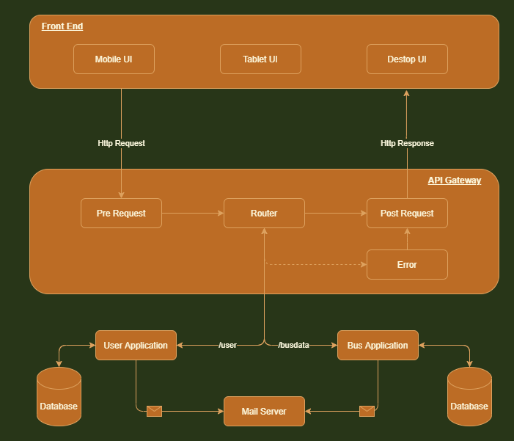
E-R Diagram
API Gateway

Slide 10
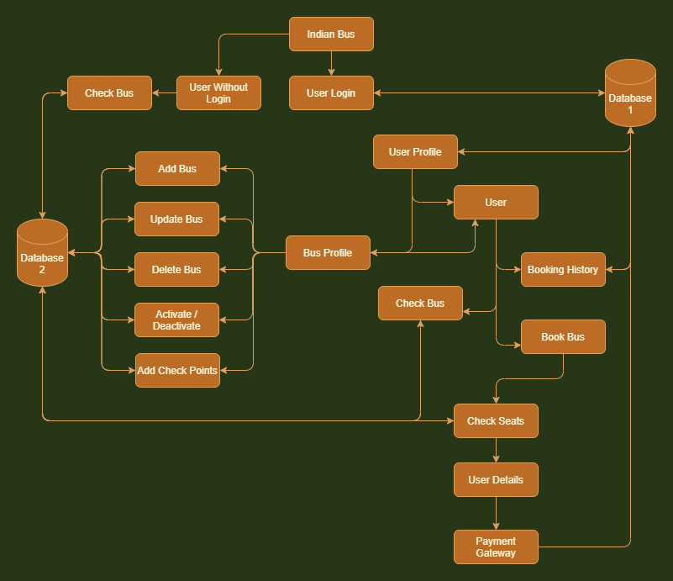
Project Data Structure

Slide 11
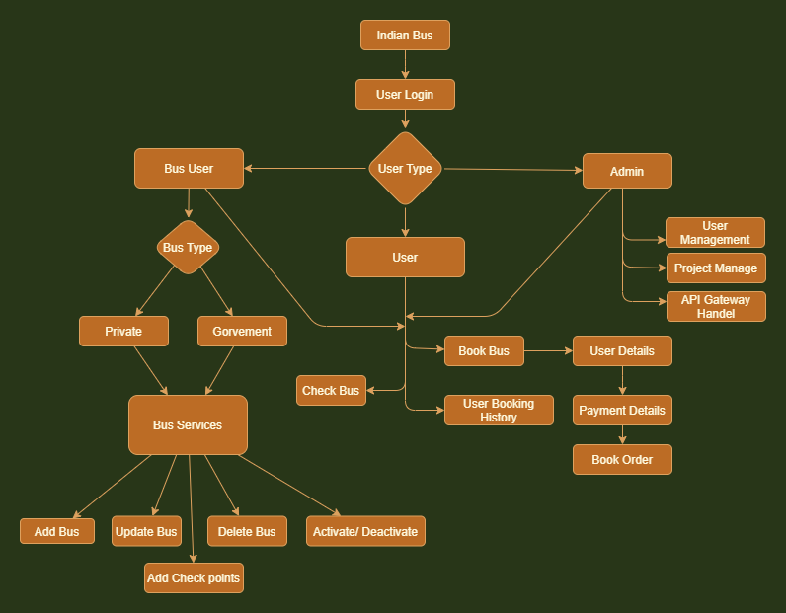
Project Management

Slide 12
Screen-short of the projects
Project URL

Slide 13
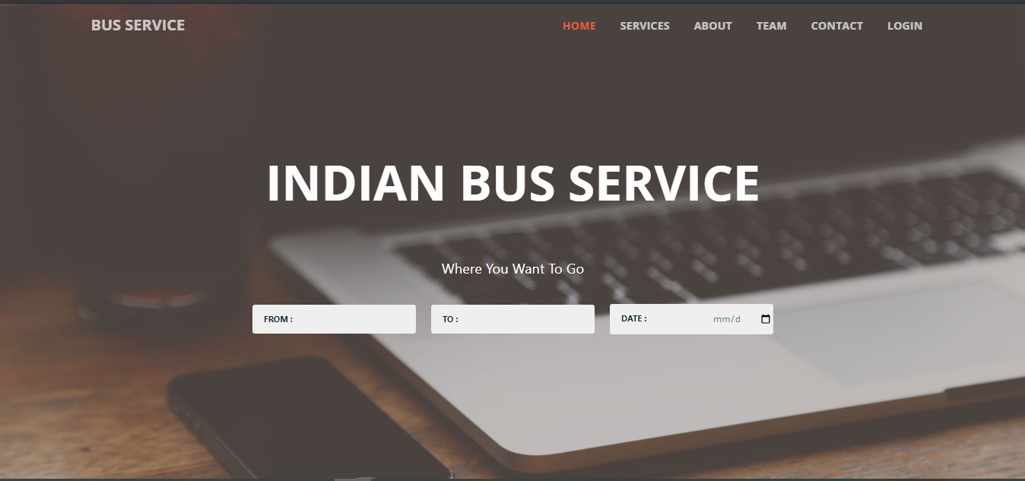
Home Page (Web View)

Slide 14
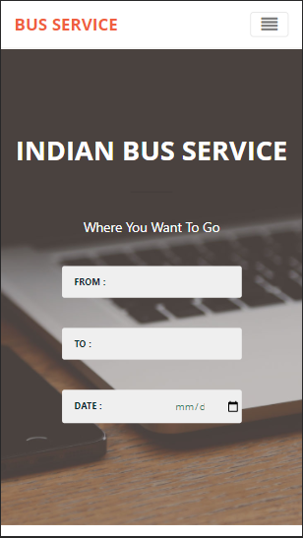
You can see this is the mobile of this project and also complete project are creating into the multiple platform hear
Home Page ( Mobile View )

Slide 15
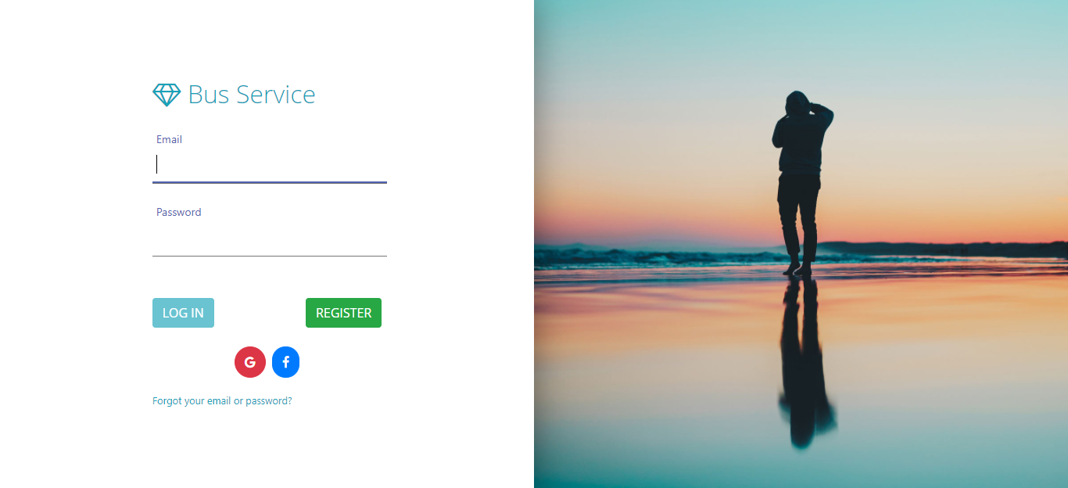
Login Page

Slide 16
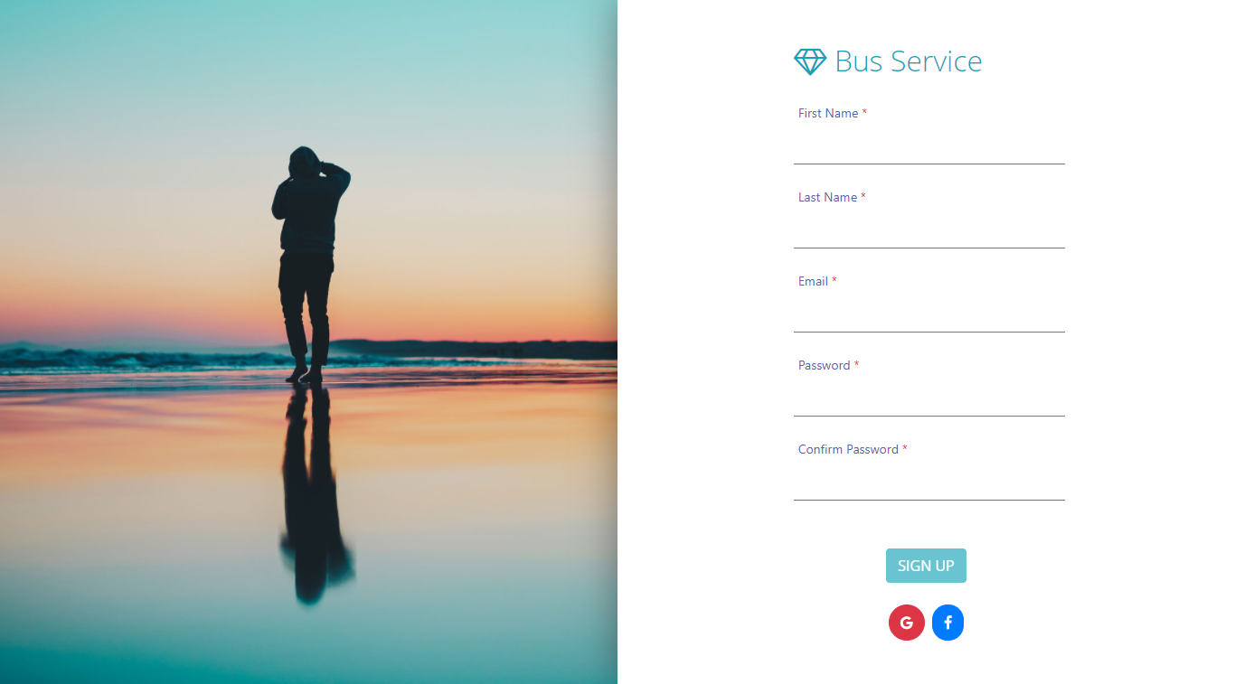
Registration Page

Slide 17
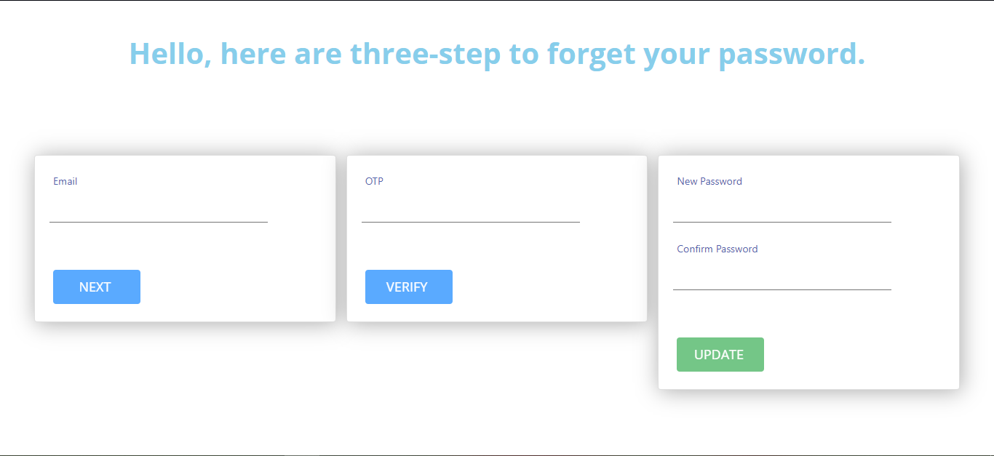
Forget Password

Slide 18
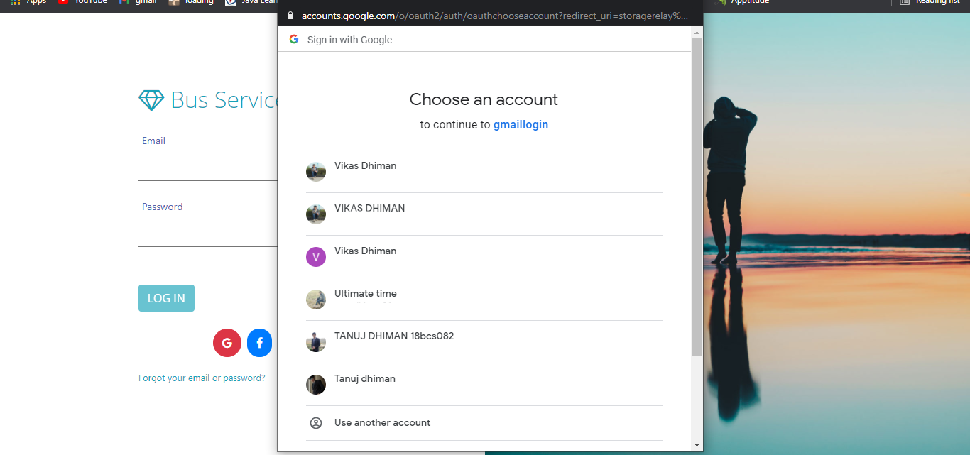
Login with Email and Facebook

Slide 19
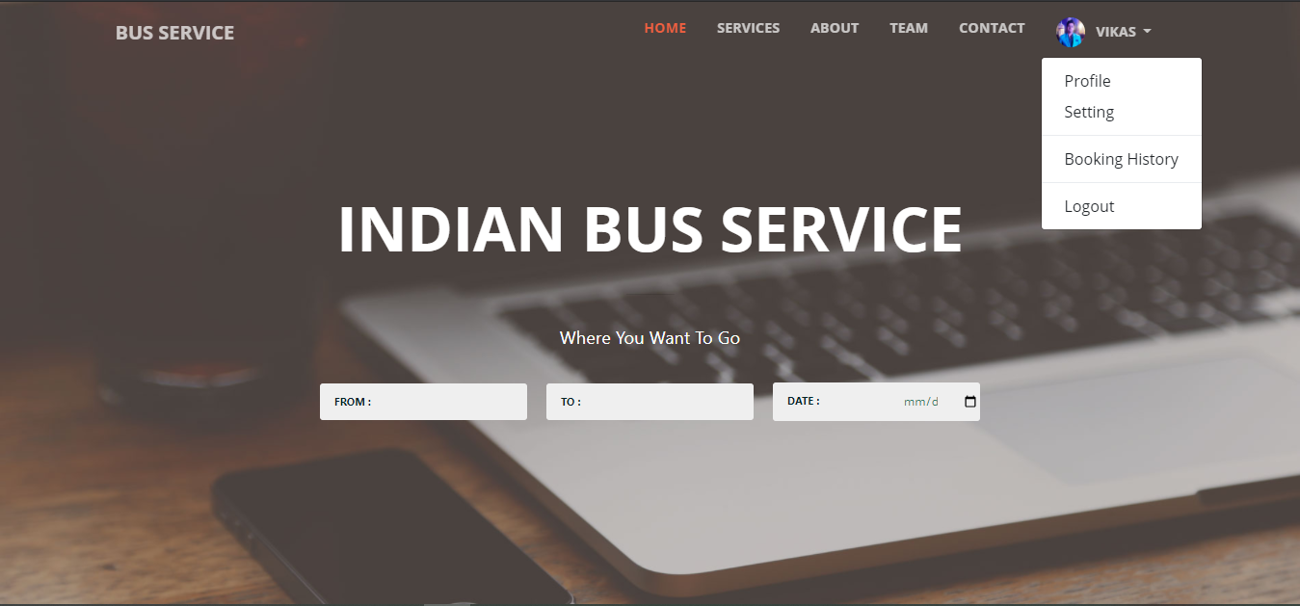
User Home Page

Slide 20
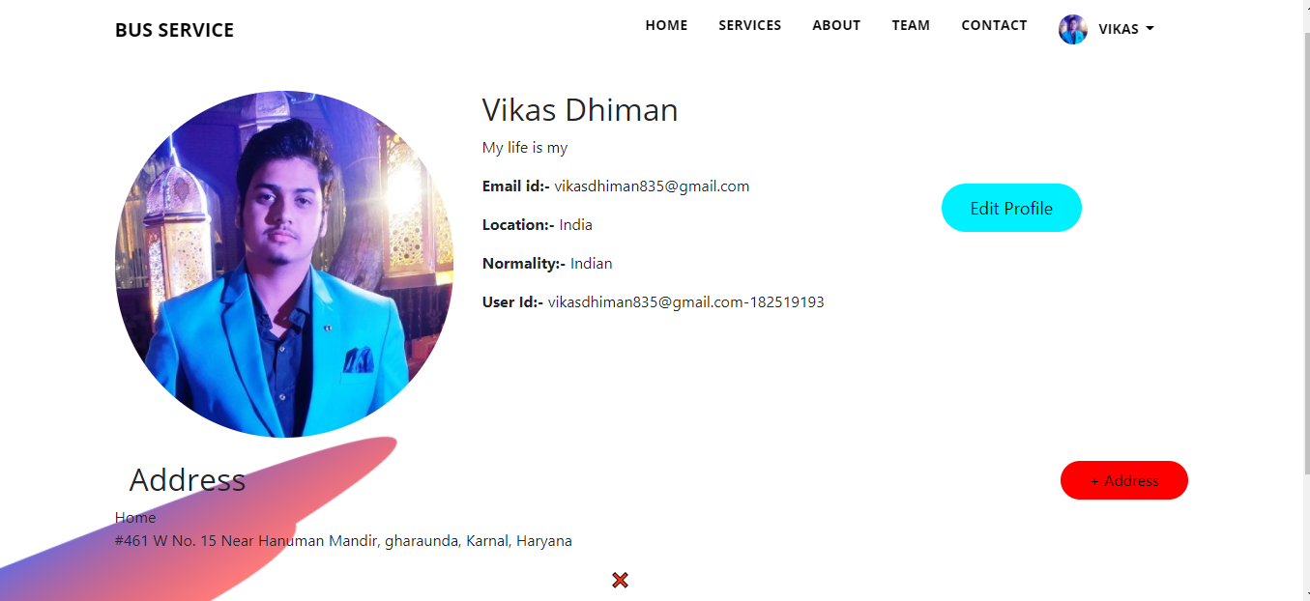
User Profile

Slide 21
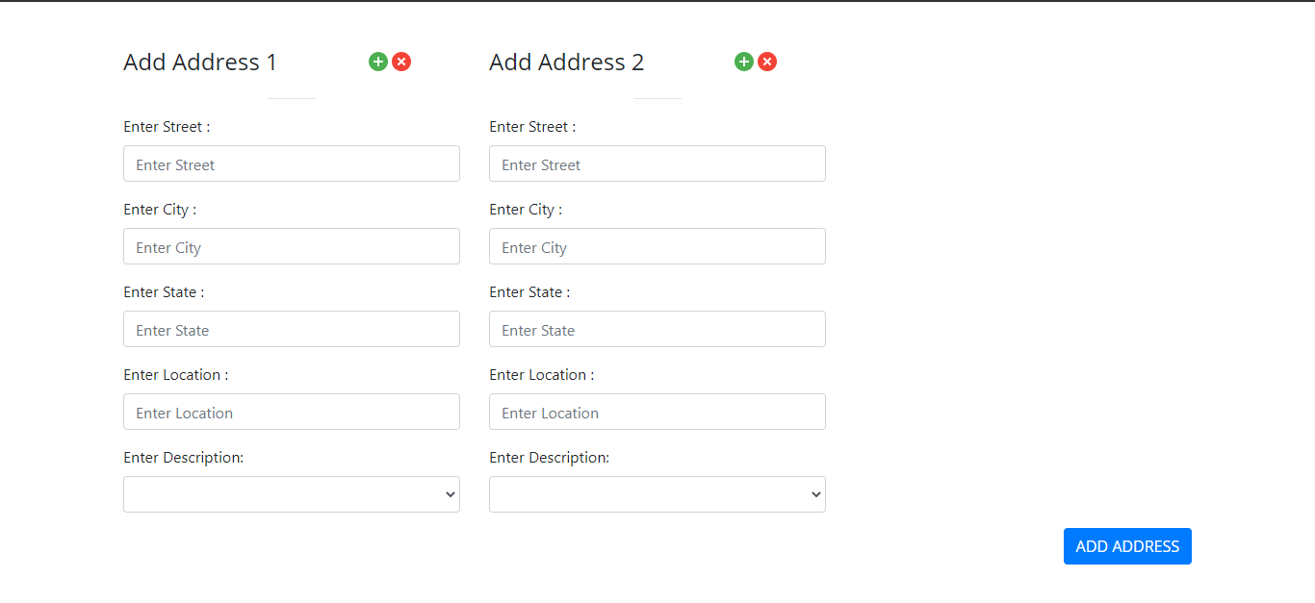
Add Multiple Address

Slide 22
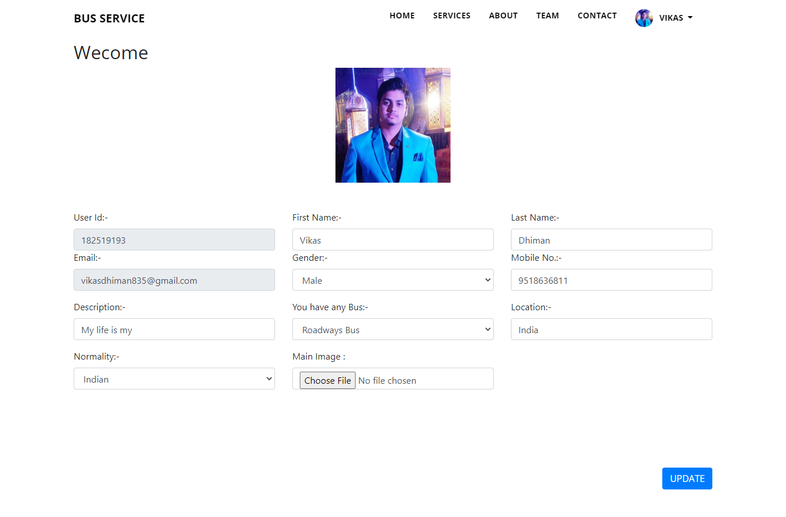
Update Profile

Slide 23
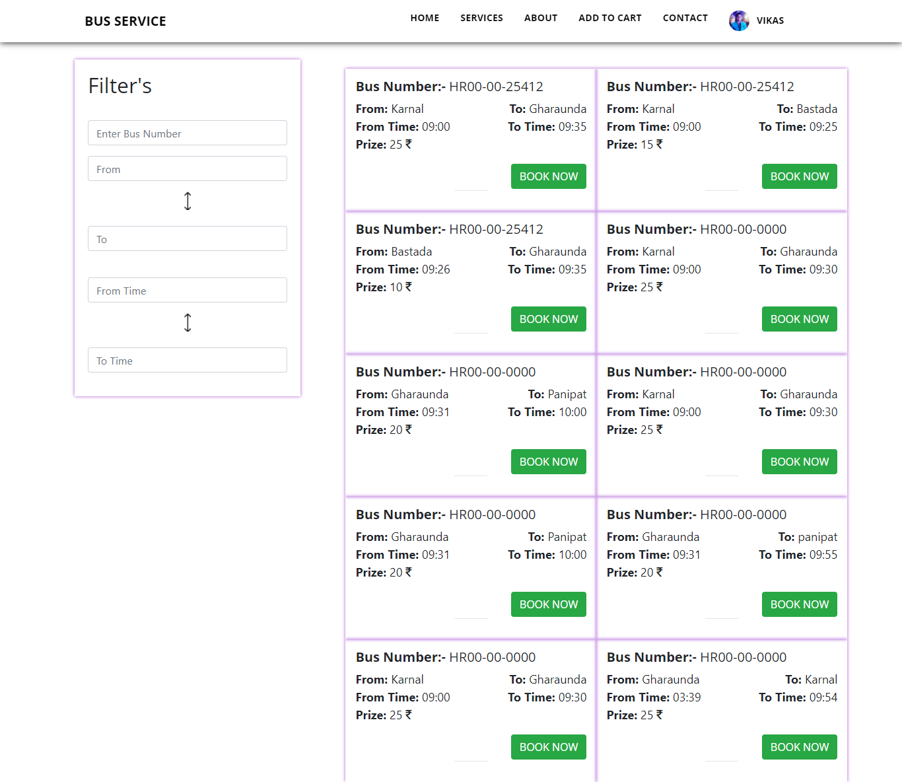
Check Bus

Slide 24
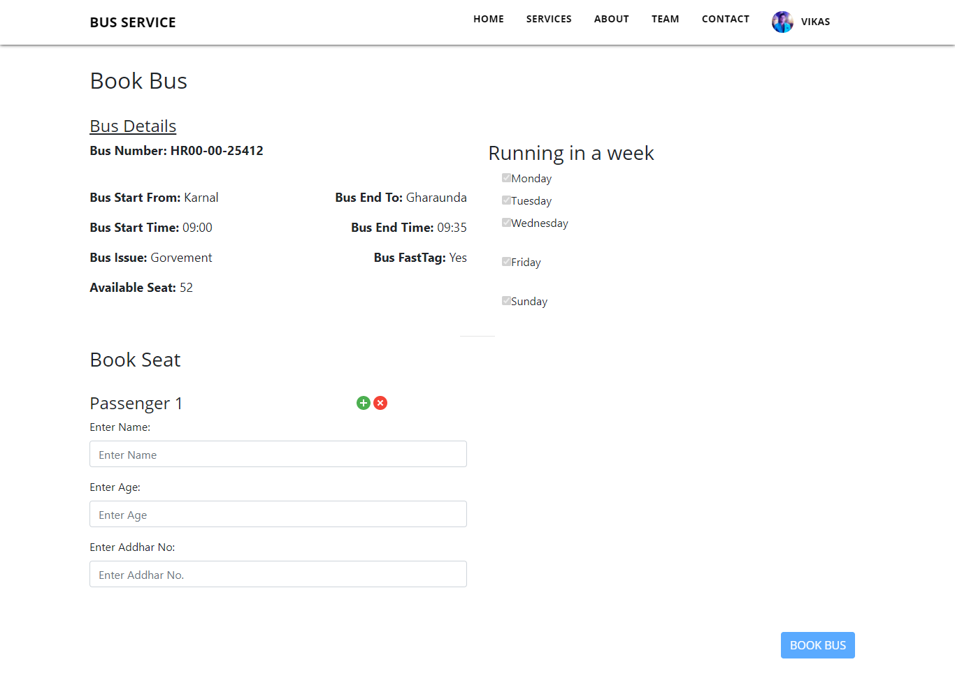
Book Bus

Slide 25
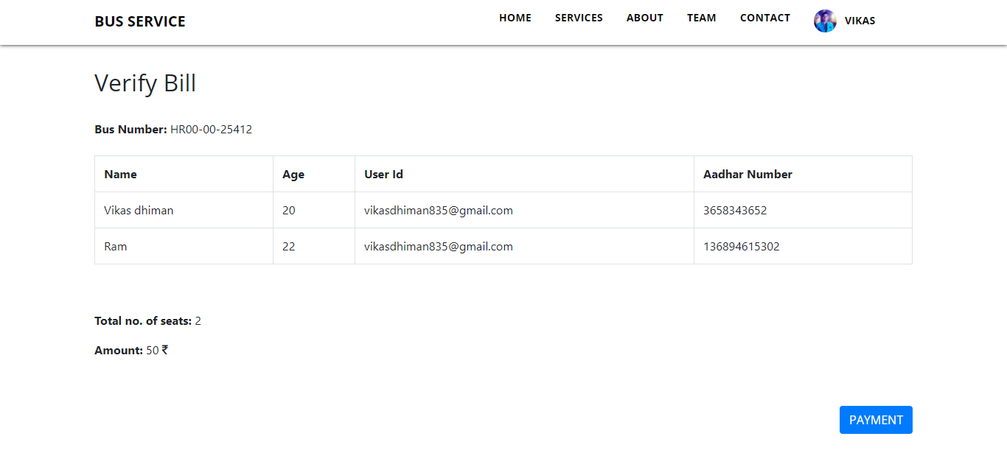
Verify Bill

Slide 26
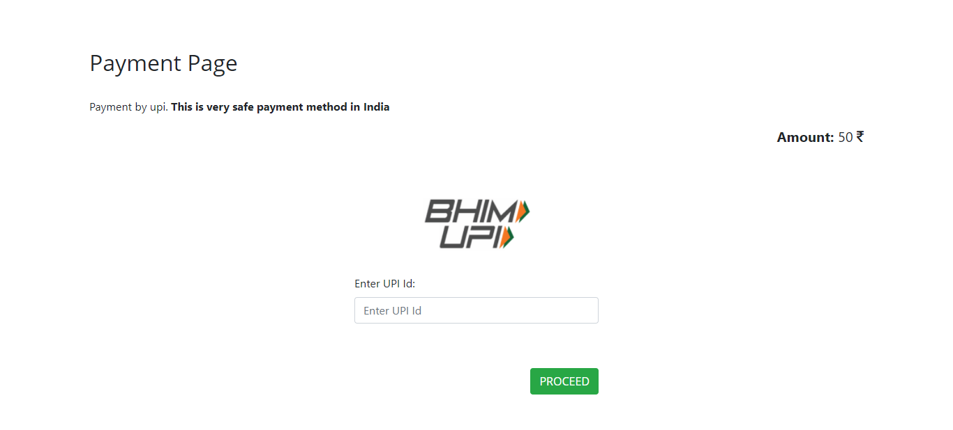
Payment Page

Slide 27
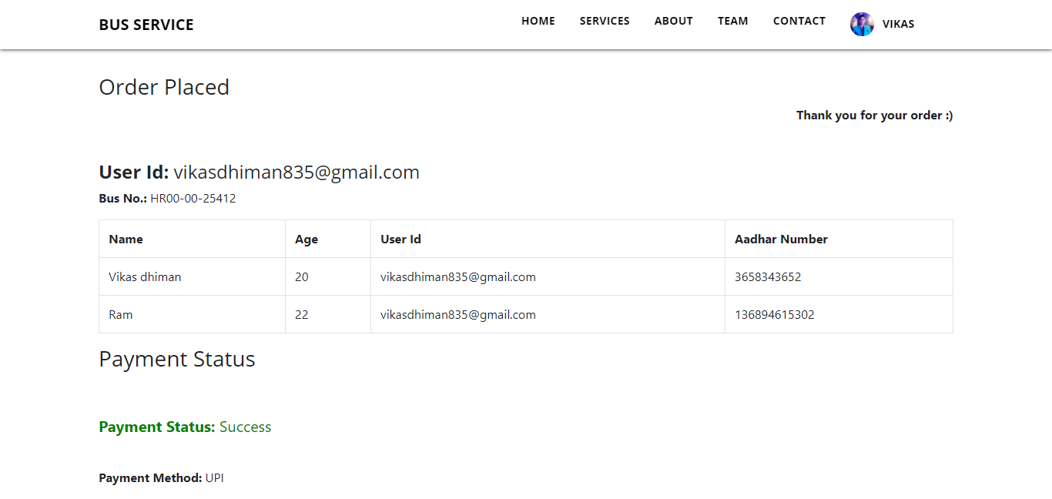
Order Placed

Slide 28
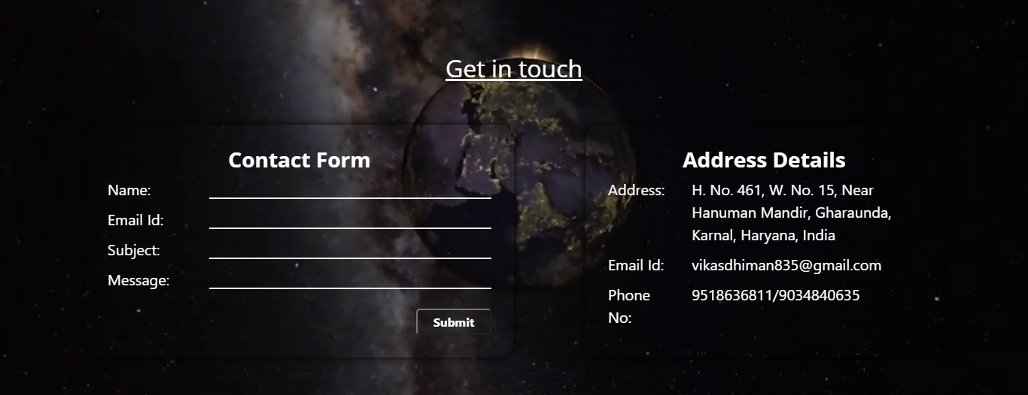
Contact Page

Slide 29
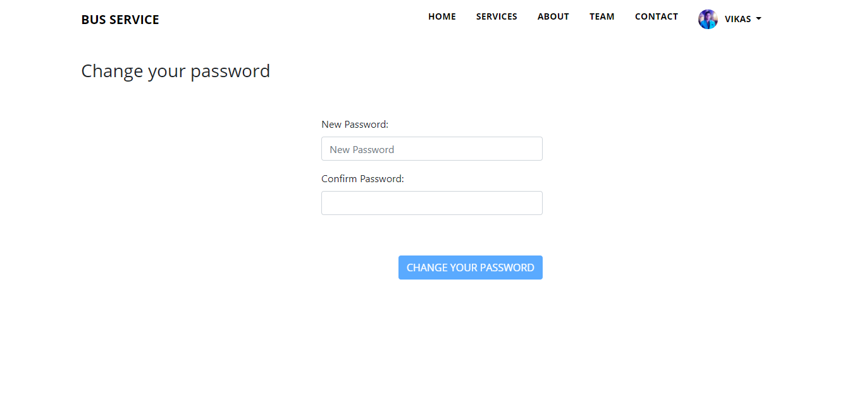
Change Password

Slide 30
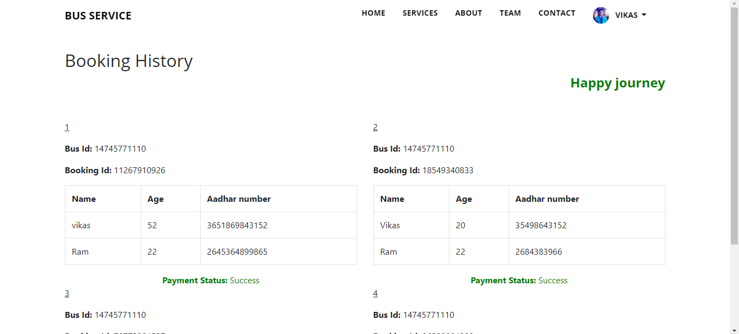
Booking History

Slide 31
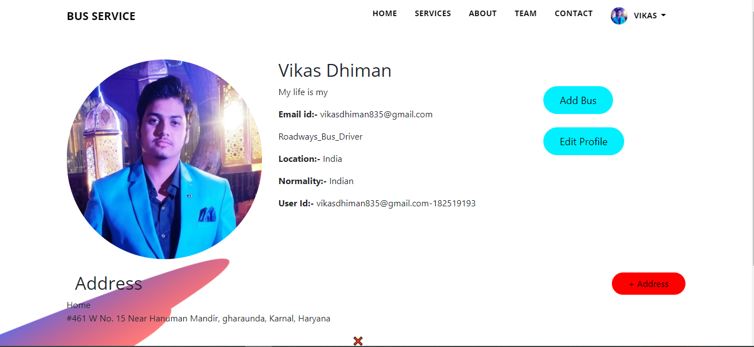
Bus Profile

Slide 32
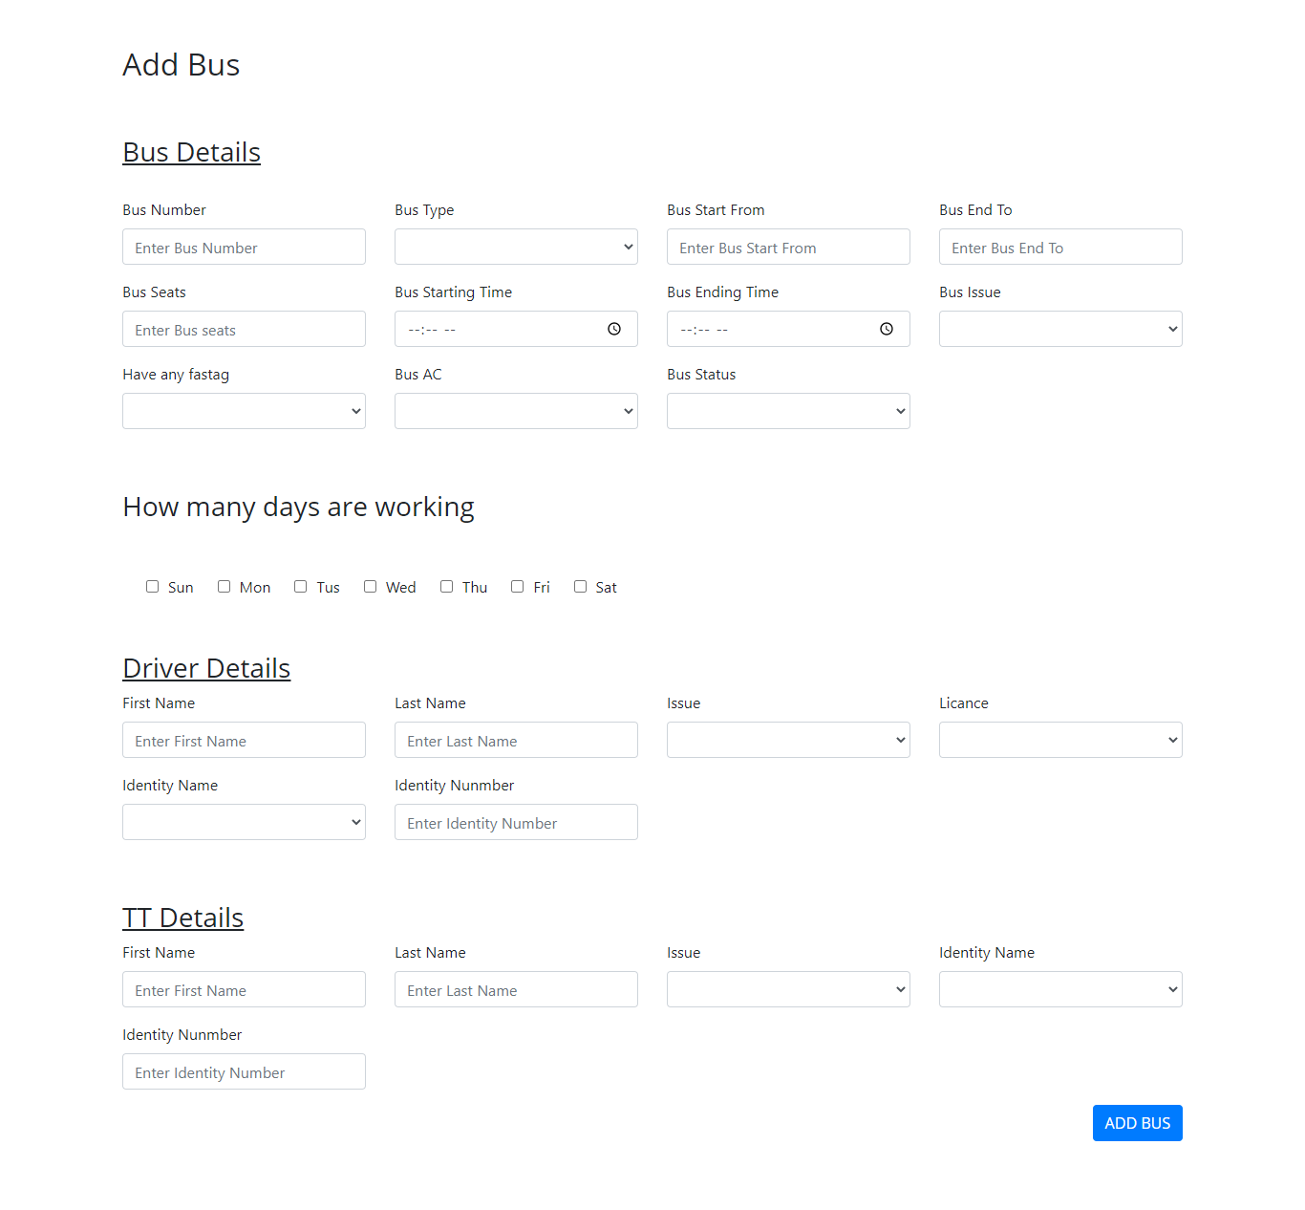
Add Bus

Slide 33
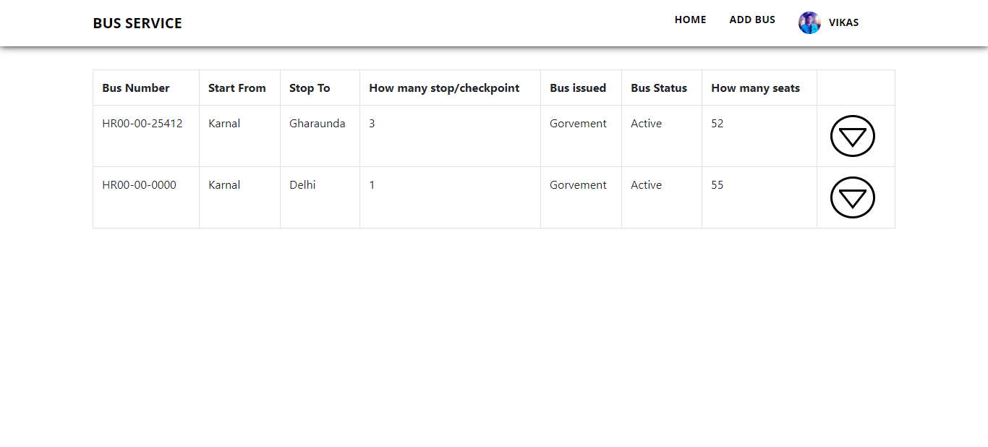
Bus List

Slide 34
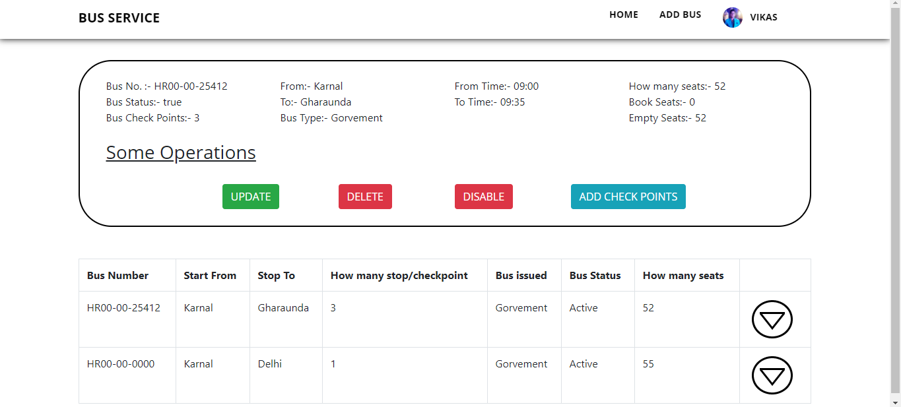
Bus Details

Slide 35
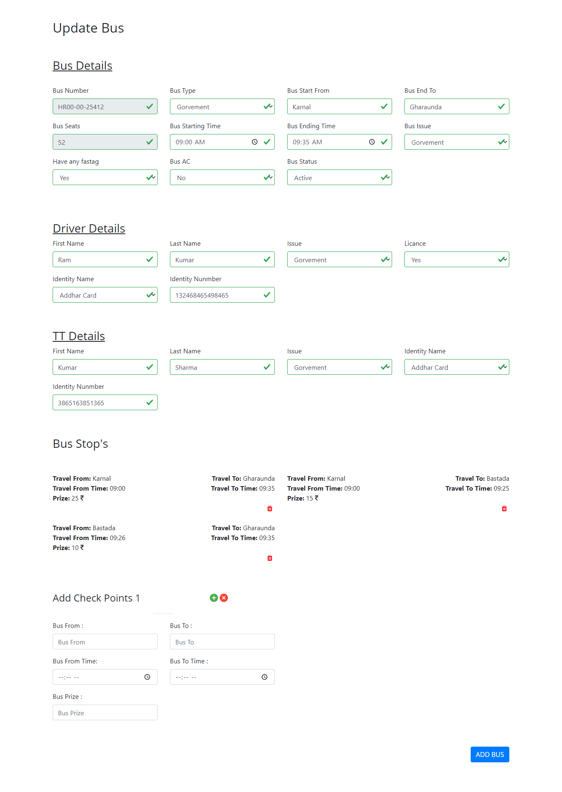
Update Bus

Slide 36
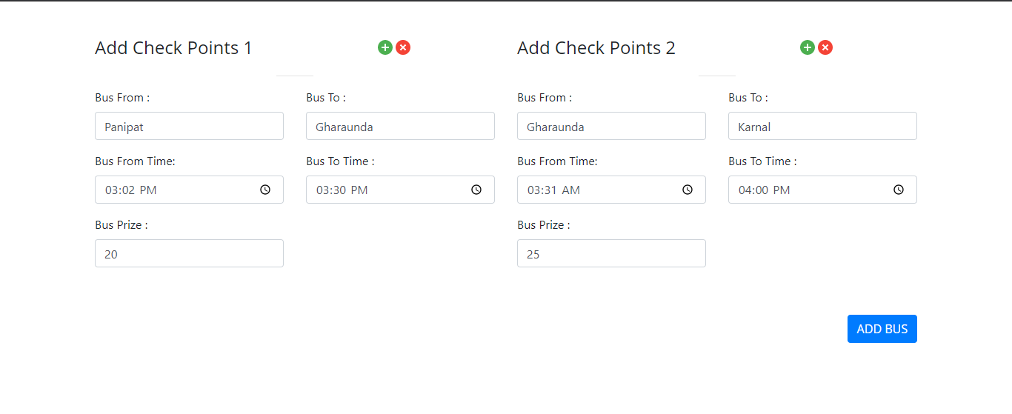
Add Check Points

Slide 37
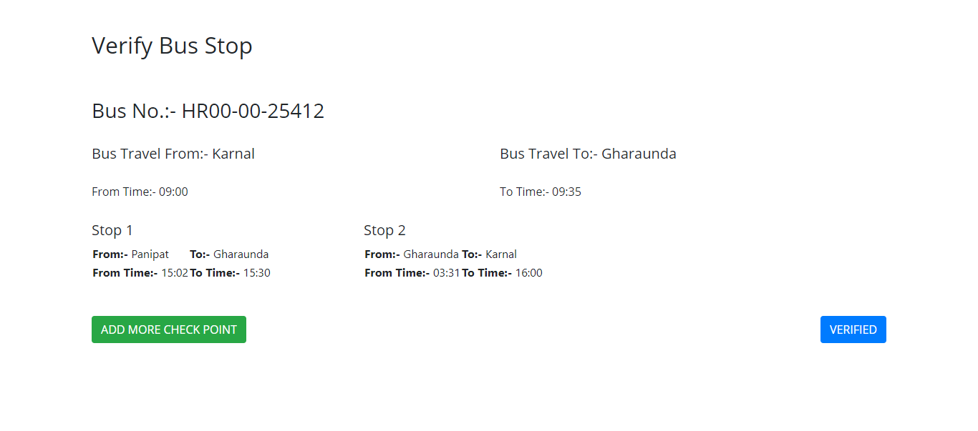
Verify Bus Stop’s

Slide 38
References
https://angular.io/
https://spring.io/projects/spring-boot
https://www.tutorialspoint.com/index.htm
https://www.javatpoint.com/
https://youtube.com/
https://www.tutorialspoint.com/spring_boot/spring_boot_eureka_server.htm#:~:text=Eureka%20Server%20is%20an%20application,also%20known%20as%20Discovery%20Server
https://spring.io/microservices
https://dzone.com/articles/service-discovery-with-eureka-and-zuul
https://spring.io/guides/gs/service-registration-and-discovery/

Slide 39
Conclusion
In this project I will learn about the following:-
Design the template using the multiple components in one html page shown in browser.
Connect Angular with Spring Boot using Rest API.
Learn micro-service.
Learn Eureka, and Zuul Server.
Create a maven dependency in Spring Boot.
Create a Payment Gateway.
Advance Spring Security.
Learn Hibernate validations.
Frontend Angular Validations.
Backend Security.
Social Login.
Spring Payment Gateway.
Multiple Sheet Booking

Slide 40
Thank you

