Slide 1


Source Code Management
Vikas Verma

Slide 2
Objectives
Version Control
Git, Git repository
Git vs Github
Setup git environment
Create a git repository ( adding file, adding folder)
Checkout different version/ignore files…
Git tools

Slide 3
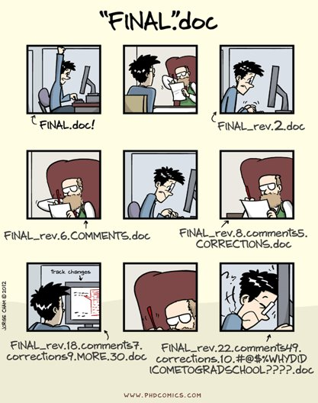

Slide 4
Why Version Control?
Collaboration
Versioning
Rolling Back
Understanding
Scenario : Multiple students are doing a project together
Question: Why not Google drive & One drive ????
source code management vs file storage management

Slide 5
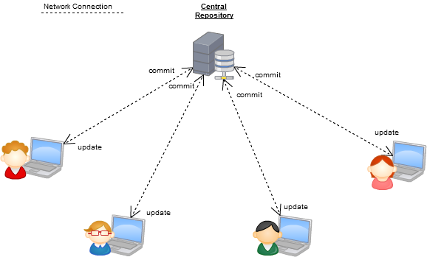
Version Control Systems
Some well-known version control systems are CVS, Subversion, Mercurial, and Git

Slide 6
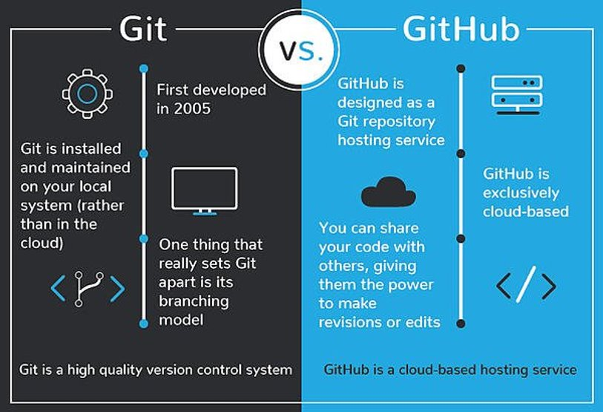

Slide 7
Download and install
yum install git
Configure
Generating a pair of ssh keys:
ssh-keygen -t rsa –C Vikas_Verma1@epam.com
Username and email settings:
git config --global user.name "Vikas Verma"
git config --global user.email "Vikas_Verma1@epam.com"

Slide 8
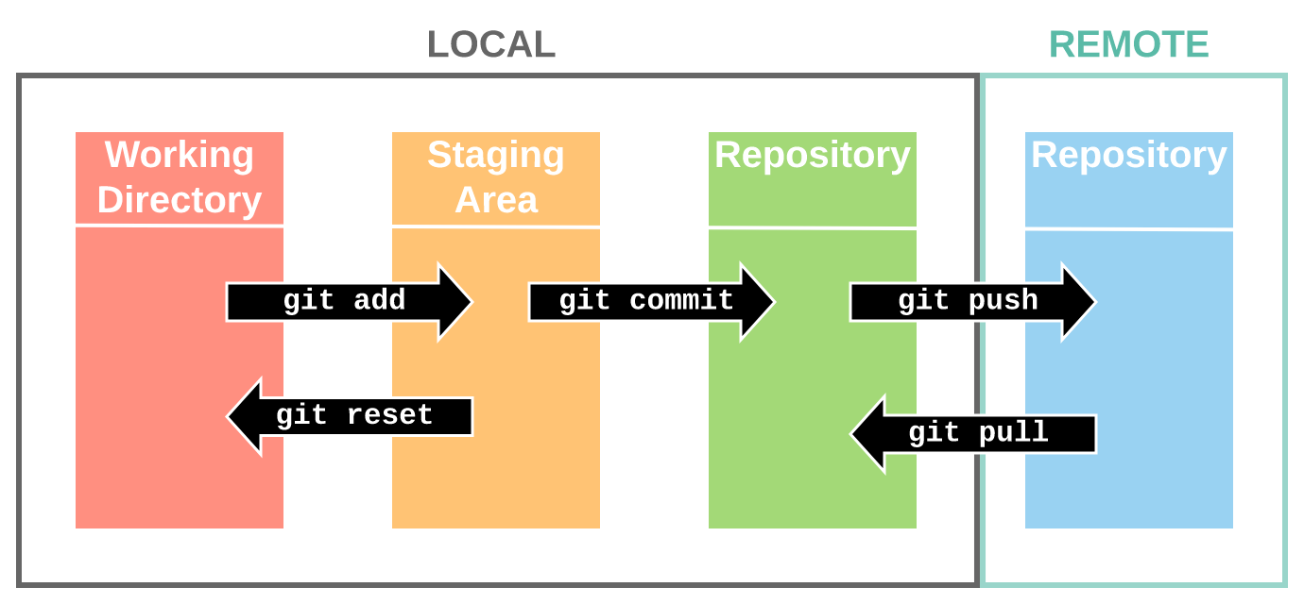

Slide 9
Commands
git clone
git init
git add
git commit
git push
git show -s commit {commitSHA1}
git ls-tree {treeSHA}
git show {blobSHA}

Slide 10
Commands
git remote set-url origin {ssh/https}
git checkout –b {branchname}
git pull
git checkout {branchname}

Slide 11


