Slide 1
Microservices
Microservice is an engineering approach focused on decomposing applications into single-function modules with well-defined interfaces which are independently deployed and operated by small teams who own the entire lifecycle of the service.
Microservices accelerate delivery by minimizing communication and coordination between people while reducing the scope and risk of change.

Slide 2
Monolithic Architecture
Monolithic applications are designed to handle multiple related tasks.
They’re typically complex applications that encompass several tightly coupled functions.
For example, consider a monolithic ecommerce SaaS application. It might contain a web server, a load balancer, a catalog service that services up product images, an ordering system, a payment function, and a shipping component.

Slide 3
Monolithic Architecture
As you can imagine, given their broad scope, monolithic tools tend to have huge code bases.
Making a small change in a single function can require compiling and testing the entire platform, which goes against the agile approach today’s developers favour.

Slide 4
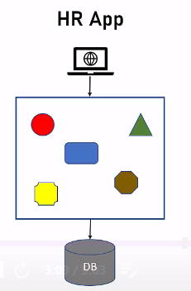
Monolithic Application

Slide 5
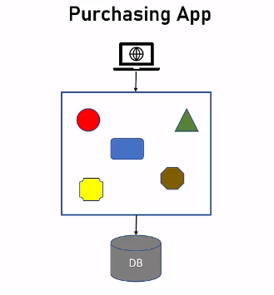
Monolithic Application

Slide 6
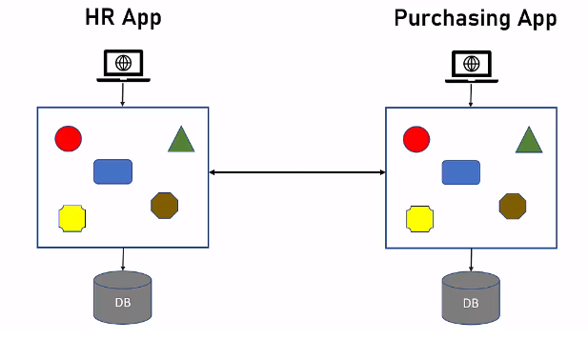
Communication between monothic Application

Slide 7
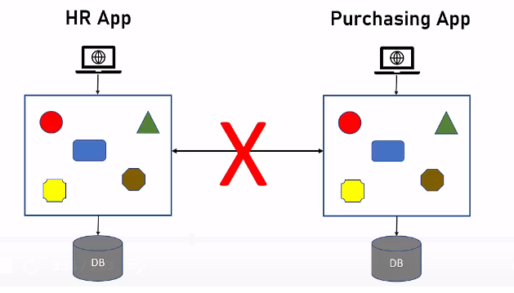

Slide 8
Advantages of Monolithic Applications
Easier to Design
Better Performance

Slide 9
Limitations of Monolithic Architecture
With monolith, all the components must be developed using the same development platform.
Can’t use specific platform for specific features
Future upgrade is a problem-------need to upgrade the whole app.

Slide 10
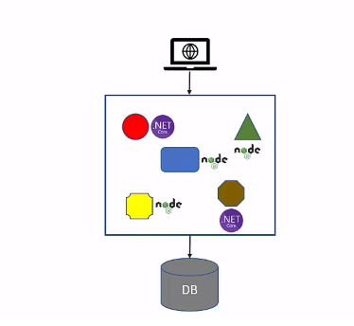
Single Technology Platform

Slide 11
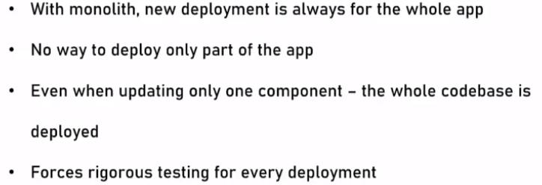
Inflexible Deployment

Slide 12
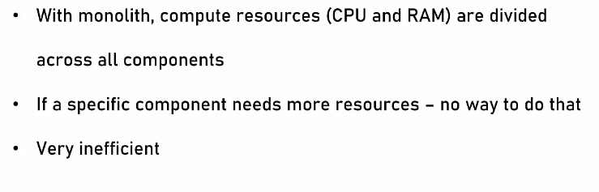
Inefficient Computing Resources

Slide 13
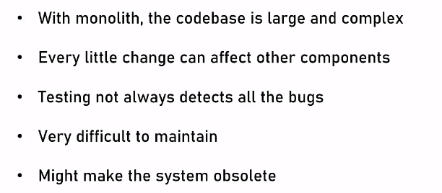
Large and Complex

Slide 14
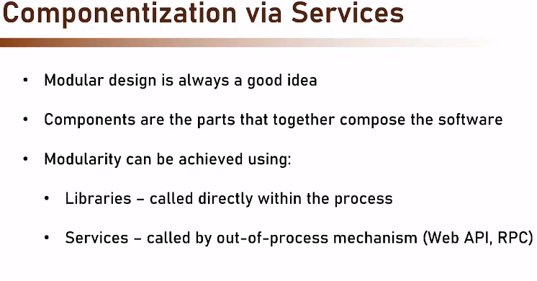
Microservices Architecture

Slide 15
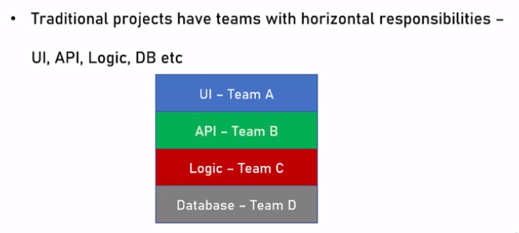
Organized around business capabilities

Slide 16
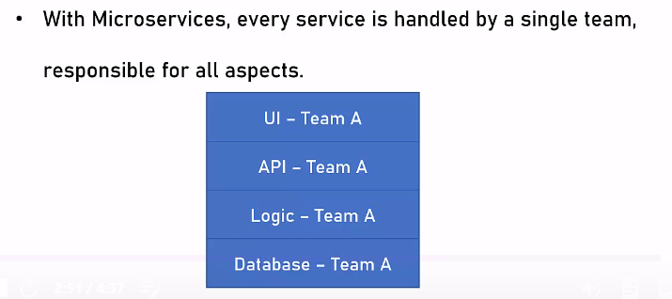
Organized around business capabilities

Slide 17
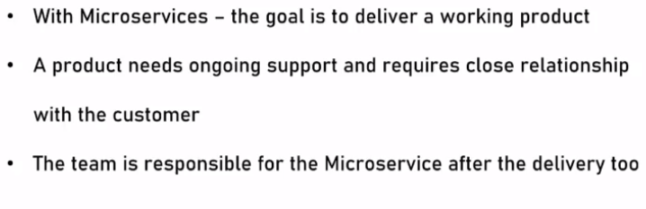
Products not projects

Slide 18
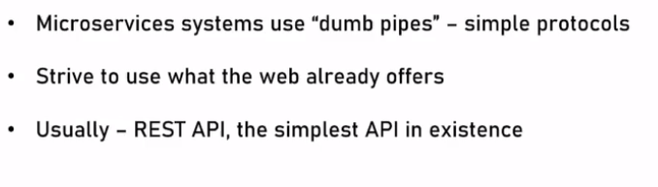
Smart End points

Slide 19
Decomposing
Instead of having one large application, we decompose it into separate, different, mini-applications (services).
Each service handles a specific business domain (logging, auth, orders, customers) and provides the implementation for the user interface, business logic, and connection to the database.

Slide 20
Single-function
Each and every service has a specific function or responsibility. A service can do many tasks, but all of them are nevertheless relevant to this single function.
Well-defined interfaces
Services must provide an interface that defines how can we communicate with it. This basically defines a list of methods, and their inputs and outputs.
Independent
Independent means services don’t know about each other implementation. They can get tested, deployed, and maintained independently.

Slide 21
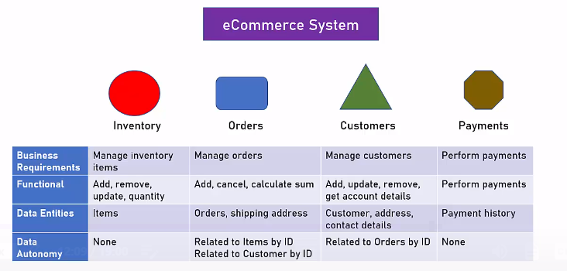
Mapping the components

Slide 22
Small Teams
Each team focuses on a specific service, they don’t need to know about the internal workings of other teams.
Those teams are can work efficiently, communicate easily, and each service can be deployed rapidly as soon as it’s ready.

Slide 23
Entire Lifecycle
The team is responsible for the entire lifecycle of the service; from coding, testing, staging, deploying, debugging, maintaining.
In a traditional application, we may have a team for coding, and another one for deployment. In microservices, that’s not the case.

Slide 24
Minimizing Communication
Minimizing communication doesn’t mean that the team members should ignore each other.
It means that the only essential cross-team communication should be through the interface that each service provides.
They all need to agree on the external interface so that communication between services is clearly defined.

Slide 25
The scope and risk of change
Services should be changed without breaking other services. And so long as we don’t change the external interface there will be no problem for other services.

Slide 26
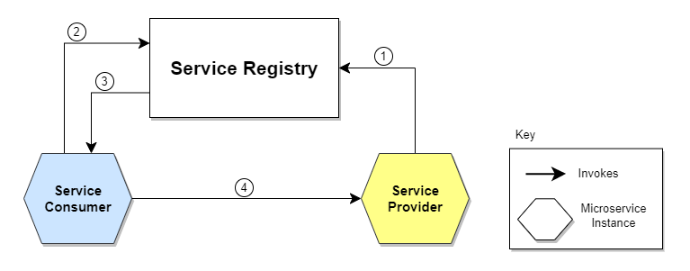
Patterns
Service Discovery

Slide 27
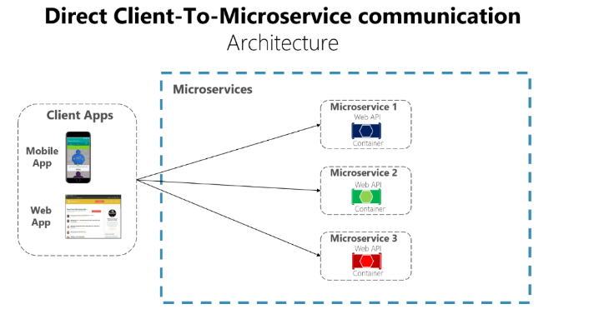
Api Gateway

Slide 28
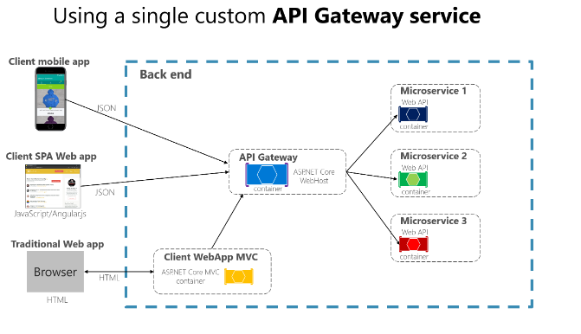
API Gateway

Slide 29
Circuit Breaker
The basic idea behind the circuit breaker is very simple. You wrap a protected function call in a circuit breaker object, which monitors for failures. Once the failures reach a certain threshold, the circuit breaker trips, and all further calls to the circuit breaker return with an error or with some alternative service or default message, without the protected call being made at all.

