Slide 1
OAuth2
OAuth 2 is an authorization framework that enables applications — such as Facebook, GitHub, and Google — to obtain limited access to user accounts on an HTTP service. It works by delegating user authentication to the service that hosts a user account and authorizing third-party applications to access that user account. OAuth 2 provides authorization flows for web and desktop applications, as well as mobile devices.

Slide 2
Oauth Roles
OAuth defines four roles:
Resource Owner: The resource owner is the user who authorizes an application to access their account. The application’s access to the user’s account is limited to the scope of the authorization granted (e.g. read or write access)
Client: The client is the application that wants to access the user’s account. Before it may do so, it must be authorized by the user, and the authorization must be validated by the API.
Resource Server: The resource server hosts the protected user accounts.
Authorization Server: The authorization server verifies the identity of the user then issues access tokens to the application.

Slide 3
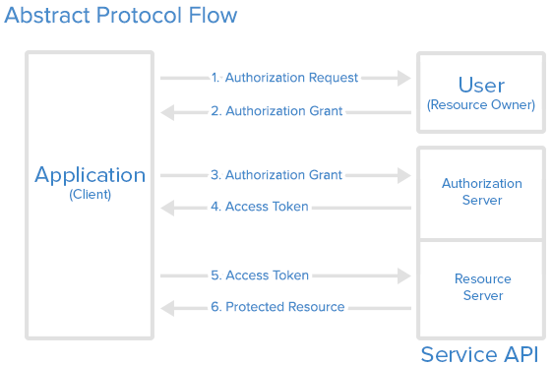
OAuth Flow

Slide 4
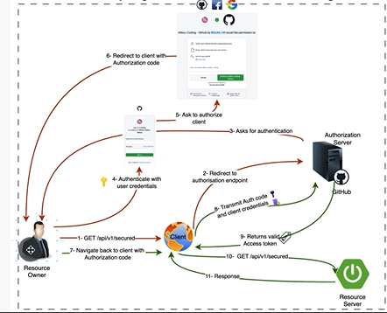

Slide 5
OAuth 2.0 is an open-standard authorization framework that allows services or servers to provide delegated and regulated access to their assets.

Slide 6
OAuth grant types are methods for getting tokens to make requests to a resource server. The grant type you choose depends on the security level, client application type, and other conditions. The most common grant type is the Authorization Code Grant. In this type, the authorization server returns a single-use authorization code to the client, which is then exchanged for an access token.

Slide 7
Authorization Code Grant
The authorization code grant is used to sign into applications by using third-party authentication providers like Google, Facebook, and GitHub. It is one of the most common methods used on the web to authorize and authenticate the Client to access protected data from the Resource Server.

Slide 8
Step 1
The Client redirects the user to the authorization endpoint on the Authorization Server with the following parameters in the query string:
response_type, with the value code.
client_id, with the Client’s Id.
redirect_uri, which is where the Client should be redirected after successful authentication at the Authorization Server. This parameter is optional, but without it, the user is redirected to a pre-registered redirect URI.
scope, a space-delimited list of scopes.
state, with a CSRF token. This is optional but recommended. Store the value of the CSRF token in the user’s session so that it can be validated when they return.

Slide 9
Step 2
These parameters are validated by the Authorization Server.

Slide 10
Step 3
The user is asked to log in to the Authorization Server and approve the Client. If there are scopes provided, those must be approved.

Slide 11
Step 4
If the user approves the Client, they are redirected from the Authorization Server back to the Client (specifically to the redirect URI) with the following parameters in the query string:
code, with the authorization code.
state, with the state parameter sent in the original request. The Client should compare this value with the one stored in the user’s session to make sure the authorization code obtained is in response to requests made by this Client and not another client application.

Slide 12
Step 5
The Client sends a POST request to the token endpoint on the Authorization Server. The Client also must include client credentials if it’s a confidential client or it was issued client credentials. The Authorization Server will authenticate the Client if client credentials are included and verify that the refresh token was issued to the authenticated client. The POST request must include the following parameters:
grant_type, with the value of authorization_code.
redirect_uri, with the same redirect URI the user was redirected back to.
code, with the authorization code from the query string.

Slide 13
Step 6
The Authorization Server responds with a JSON object containing these properties:
token_type, with the value Bearer.
expires_in, with an integer representing the TTL of the access token.
access_token, the access token itself.
scope and refresh_token may be returned as well.

Slide 14
Implicit Grant
The implicit grant type is used by user-agent-specific clients like web browsers or email readers. Generally, it’s used by single-page web applications that can’t store client secret credentials because their application code and storage are publicly accessible.

Slide 15
Resource Owner Password Credentials Grant
This grant is based on the functionality of the username and password credentials of a resource owner (user) to authorize and access protected data from a Resource Server.

Slide 16
Resource Owner Password Credentials Grant
1.The Client asks the user for authorization credentials (generally a username and password).
2.The Client sends a POST request with the following body parameters to the authorization endpoint on the Authorization Server:
grant_type, with the value password.
scope, with a space-delimited list of requested scope permissions.
username, with the user’s username.
password, with the user’s password.
3.Client credentials as described in the Authorization Code Grant section.
4.The Authorization Server responds with a JSON object containing these properties:
token_type, with any string value based on the application’s use case.
expires_in, with an integer representing the TTL of the access token.
access_token, which is the access token itself.
refresh_token, which is a refresh token used to get a new access token when the original expires (optional).

Slide 17
Client Credentials Grant
The Client Credentials grant type uses the Id and secret credentials of a Client to authorize and access protected data from a resource owner. This grant type is generally used for machine-to-machine authorization, in which a specific user’s permission to access data isn’t required. It can be used in a cron job that performs daily housekeeping tasks on the server.

Slide 18
Flow for Client Credentials Grant
1.The Client sends a POST request with the following body parameters to the authorization endpoint on the Authorization Server:
grant_type, with the value client_credentials.
scope, with a space-delimited list of requested scope permissions.
2.Client credentials as described in the above Authorization Code Grant section.
3.The Authorization Server will respond with a JSON object containing the following properties:
token_type, with any string value based on the application’s use case.
expires_in, with an integer representing the TTL of the access token.
access_token, the access token itself.

Slide 19
Refresh Token Grant
The Refresh Token grant type is used to gain a new access token from the Authorization Server by providing the refresh token to the token endpoint on the server.
Every access token expires after a specific period in time, and a refresh token is sent to the Authorization Server to get a new access token.

Slide 20
Flow for Refresh Token Grant
1.The Client sends a POST request with the following body parameters to the authorization endpoint on the Authorization Server:
grant_type, with the value refresh_token.
refresh_token, with the refresh token.
scope, with a space-delimited list of requested scope permissions. This is optional; if it isn’t sent, the original scopes will be used. You can request a reduced set of scopes instead.
2.The Authorization Server responds with a JSON object containing the following properties:
token_type, with the value Bearer.
expires_in, with an integer representing the TTL of the access token.
access_token, which is the access token itself.
refresh_token, which is a refresh token used to get a new access token when the original expires (optional).

