Slide 1


Supply Chain & Business Performance Analysis – January 2024
Executive Strategy Review
Prepared by: Vikas

Slide 2

OVERVIEW
Executive Summary: January Performance
Key Risks & Opportunities
Risks: Inventory imbalance (overstock/understock), discount-driven margin erosion, undifferentiated premium delivery.
Opportunities: Inter-warehouse stock optimisation, targeted discounting, loyalty-based priority shipping.
Business Snapshot
Net Revenue: ₹3.79 Billion
Total Orders: 1 Million
Customer Base: 200K
Average Discount: 7.5%
Average Delivery Time: 5 Days
These metrics provide a foundational understanding of our current operational scale and customer engagement.

Slide 3
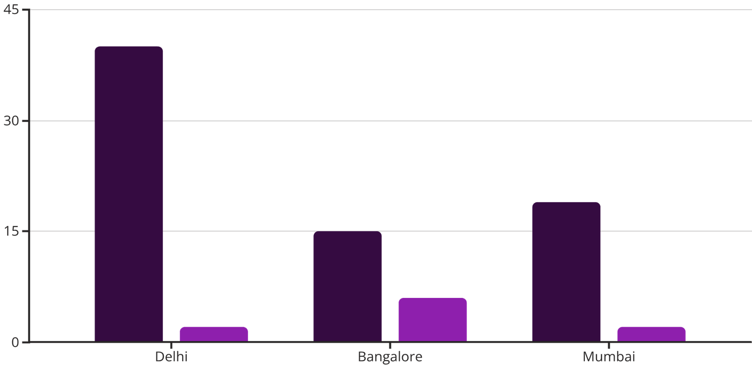
INVENTORY
Inventory Health & Warehouse Analysis
Our inventory analysis reveals critical imbalances across warehouses:
Understock SKUs: 10 critical SKUs are currently understocked, primarily in Bangalore, posing a risk of lost sales.
Overstock SKUs: A significant 74 SKUs are overstocked, with Delhi contributing the highest volume, leading to capital blockage.
"Inventory misalignment directly impacts both revenue potential and working capital efficiency. Optimising stock levels is paramount for financial health."
Overstock SKUs
Understock SKUs

Slide 4
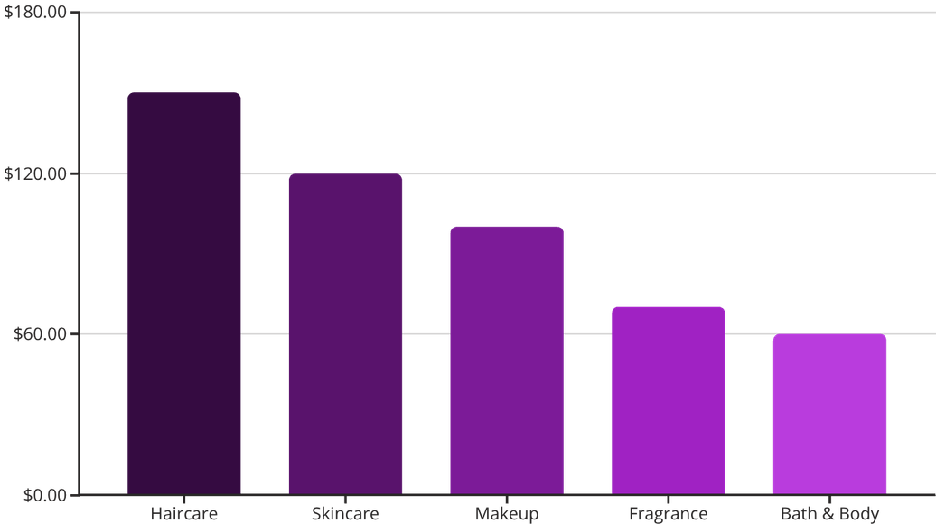


PRODUCTS
Product & Demand Analysis: High-Value SKUs
Top Revenue Products
Face Wash
Lipstick
Moisturizer
Serum
Foundation
Revenue by Category
The top 20% of products, including these, are revenue drivers and must adhere to a "Zero Stock-Out Strategy."

Slide 5
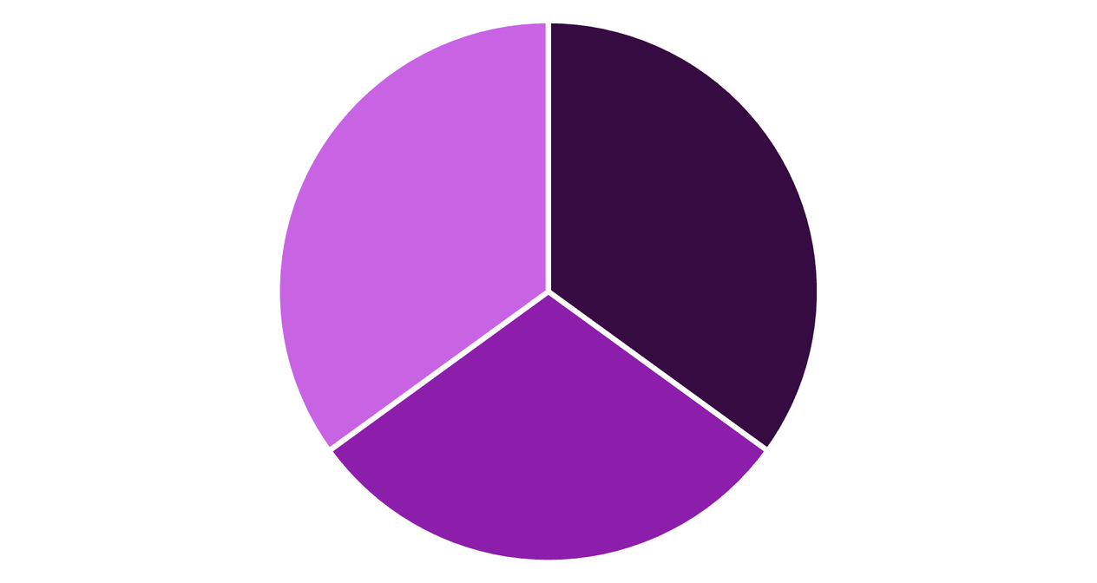
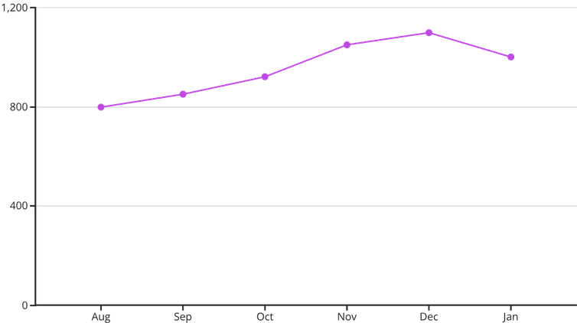
ORDERS
Orders & Channel Performance
Channel Distribution
Monthly Order Trend
The monthly order trend shows consistent growth, peaking in December, followed by a slight post-holiday normalisation.
Online
Retail Store
Marketplace
With 1 Million total orders, a balanced channel mix between Online, Retail Store, and Marketplace (near equal distribution) acts as a hedge against market volatility.

Slide 6
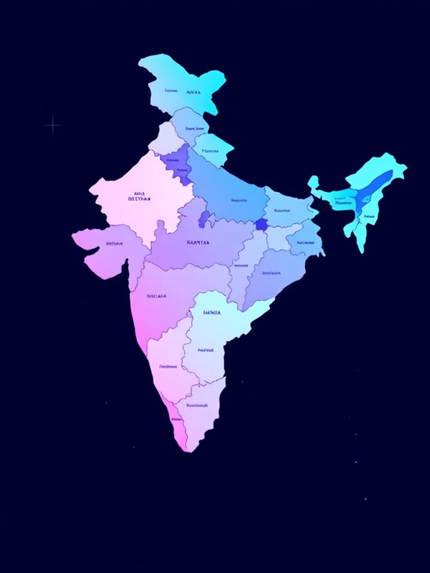
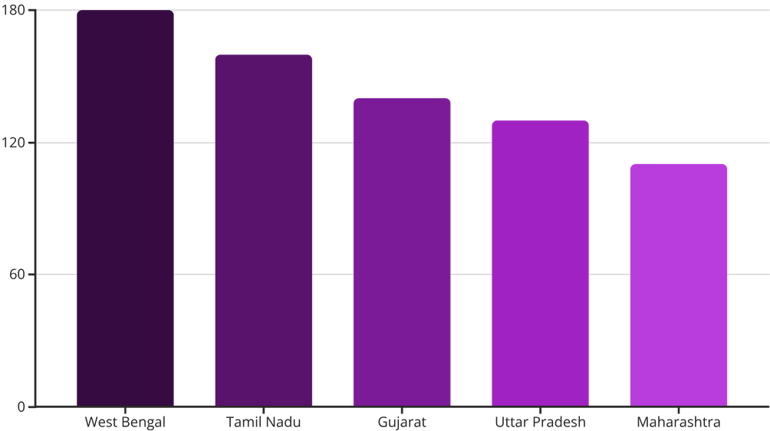
GEOGRAPHY
State-wise Demand Analysis
Our top-performing states – West Bengal, Tamil Nadu, Gujarat, and Uttar Pradesh – represent significant pockets of demand. These regions are strategically vital.
"Focusing on high-demand states offers a prime opportunity for micro-warehouse expansion, enhancing delivery speed and customer satisfaction."

Slide 7
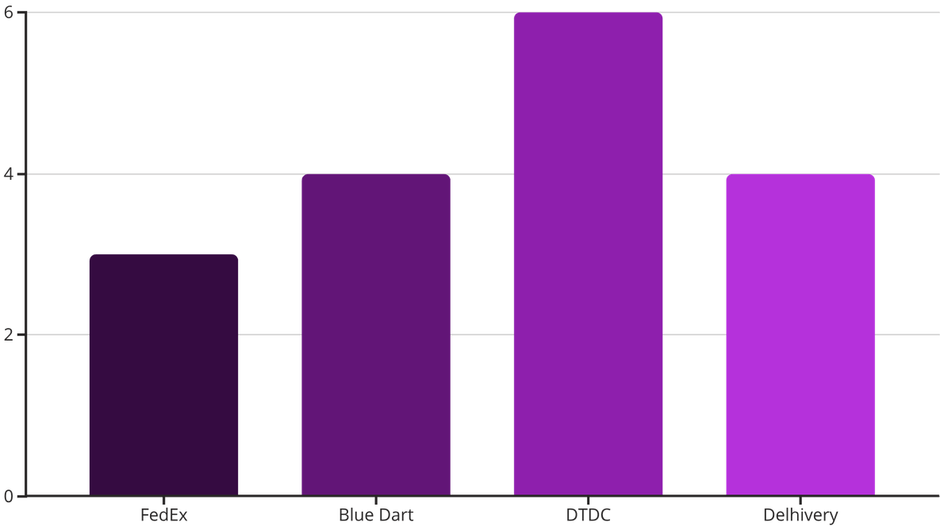
LOGISTICS
Logistics & Courier Performance
Courier Delay Comparison
Key Performance Insights
Average Delivery Time: Approximately 5 days across all couriers.
Courier Performance: DTDC exhibits a slightly higher delay percentage compared to other partners.
Regional Delays: Uttar Pradesh and Tamil Nadu show higher delay rates, impacting customer experience in key markets.
Recommendation: Implement a comprehensive courier performance scorecard and renegotiate Service Level Agreements (SLAs) with underperforming partners.

Slide 8

EFFICIENCY
Shipping Cost & Efficiency
Cost vs. Delivery Time
Total Shipping Cost: ₹174 Million
Average Shipping Cost per Order: ₹174
Our analysis indicates minimal cost differentiation among courier partners despite varying delivery times. This highlights that while cost is a factor, operational efficiency and reliability are paramount.
"The small cost difference between couriers suggests that optimising operational efficiency for speed and reliability, rather than solely focusing on marginal cost reductions, will yield greater strategic benefits."

Slide 9

CUSTOMERS
Discount Impact & Customer Insights
Customer Segmentation
Total Customers: 200,000
Premium Customers: 50% of our customer base, indicating significant high-value segments.
Average Revenue per Customer: ₹18,940
Crucially, our premium customers are not currently receiving a differentiated delivery experience, which presents a significant opportunity for enhanced loyalty and retention.
Discount Strategy Reassessment
Average Discount: Currently at 7.5%, this strategy is driving growth but impacting margins.
Sales Growth vs. Discount Trend: Our growth is heavily correlated with discount levels, suggesting a reliance on price sensitivity.
Insight: We must shift from blanket discounting to a targeted pricing strategy, coupled with superior service differentiation for our premium customer segments.

Slide 10




ROADMAP
Strategic Roadmap & Business Impact
Strategic Pillars
Expected Business Impact
Revenue Uplift
Margin Improvement
3-5% increase through better stock availability and pricing.
2-3% enhancement from reduced discounting and efficient operations.
Inventory Optimisation
Smart Pricing Strategy
Targeted discounting, value differentiation.
Balance stock, reduce capital lock.
Working Capital
Customer Retention
Reduced blockage, improving cash flow.
Improved premium customer loyalty and satisfaction.
Logistics Optimisation
Expansion in High-Demand States
Data-Driven Optimisation = Higher Revenue + Lower Cost + Superior Customer Experience.
Improve courier SLAs, regional efficiency.
Micro-warehouses for speed.

