Slide 1



Probabilistic Modeling and Reasoning with Python (PMP) : PROJECT
Project Title :- EDA of Suicides rate in India
objective :- Performing EDA on Suicides rate in India
importing all the standard libraries
[42]: import pandas as pd import numpy as np
# Data manipulation
# Numerical computations
import seaborn as sns # Data visualization (built on top of Matplotlib)
import matplotlib.pyplot as plt # General-purpose data visualization
5 Reading Data
[43]:
df = pd.read_csv("Suicides_in_India.csv")
[44]: | df
[44]: |  | State | Year | Type_code | \
 | 0 | A & N ISLANDS | 2001 | Causes
 | 1 | A & N ISLANDS | 2001 | Causes
 | 2 | A & N ISLANDS | 2001 | Causes
 | 3 | A & N ISLANDS | 2001 | Causes
 | 4 | A & N ISLANDS | 2001 | Causes
 | … | … … |  | …
 | 237514 | WEST BENGAL | 2012 | Professional_Profile
 | 237515 | WEST BENGAL | 2012 | Professional_Profile
 | 237516 | WEST BENGAL | 2012 | Professional_Profile
 | 237517 | WEST BENGAL | 2012 | Professional_Profile
 | 237518 | WEST BENGAL | 2012 | Social_Status
0
Type Gender Age_group Cancer Male 15-29

Slide 2
1 | Divorce | Male |  | 60-75
2 | Dowry Dispute | Female |  | 60-75
3 | Ideological Causes/Hero Worshipping | Female |  | 60-75
4 | Illness (Aids/STD) | Female |  | 0-14
… | … | … | …
237514 | Professional Activity | Male |  | 60-75
237515 | Self-employed (Business activity) | Male |  | 0-14
237516 | Service (Government) | Male |  | 15-29
237517 | Service (Government) | Male |  | 60-75
237518 | Never Married | Male |  | 75+
[237519 rows x 6 columns]
# changing the column name of columns
[45]:
df.rename(columns={'Type_code':'Professional_status'},inplace=True )
df.rename(columns={'Type':'Reasons'},inplace=True)
6 taking a random sample from the data
[46]:
df = df.sample(1000)
df
[46]: | State | Year | Professional_status | \
218909 | UTTAR PRADESH | 2004 | Causes
143460 | MANIPUR | 2007 | Professional_Profile
28271 | BIHAR | 2002 | Causes
96872 | JHARKHAND | 2001 | Professional_Profile
159288 … 128280 | MIZORAM … … MADHYA PRADESH | 2002 2001 | Professional_Profile … Causes
169496 | SIKKIM | 2001 | Professional_Profile
182675 | PUDUCHERRY | 2001 | Causes
9075 | ANDHRA PRADESH | 2001 | Means_adopted
165196 | PUDUCHERRY | 2012 | Causes
 |  |  | Reasons Gender Age_group
218909 | Divorce | Male |  | 45-59
143460 | Public Sector Undertaking | Female |  | 45-59
28271 | Insanity/Mental Illness | Female |  | 45-59
96872 | Student | Male |  | 60-75
159288 | Professional Activity | Female |  | 15-29
… | … | … | …
128280 | Illness (Aids/STD) | Male |  | 15-29
169496 | Public Sector Undertaking | Female |  | 45-59
182675 | Illegitimate Pregnancy | Male |  | 15-29

Slide 3
9075 By | Self Infliction of injury Female | 30-44
165196 | Illegitimate Pregnancy Male | 30-44
[1000 rows x 6 columns]
[47]:
professional_status = pd.DataFrame(df['Professional_status'].value_counts()) ␣
↪# counting the number of cases according to reasons
professional_status.reset_index(inplace = True) professional_status
[47]: | index | Professional_status
 | 0 Causes | 467
 | 1 Means_adopted | 276
 | 2 Professional_Profile | 198
 | 3 Education_Status | 38
 | 4 Social_Status | 21
7 pie chart of cases according to the profession
[48]:
plt.figure(figsize=(10,15))
professional_status.plot(kind='pie', y='Professional_status',␣
↪labels=professional_status['Professional_status'], autopct='%1.2f%%',␣
↪startangle=0)
plt.show()
<Figure size 1000x1500 with 0 Axes>

Slide 4
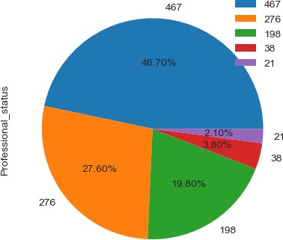
[49]:
professional_status.skew()
C:\Users\vikas\AppData\Local\Temp\ipykernel_18236\3567293245.py:1: FutureWarning: The default value of numeric_only in DataFrame.skew is deprecated. In a future version, it will default to False. In addition, specifying 'numeric_only=None' is deprecated. Select only valid columns or specify the value of numeric_only to silence this warning.
professional_status.skew()
[49]: Professional_status 0.634991 dtype: float64
[50]:
sns.kdeplot(professional_status['Professional_status'])
plt.xlabel('Number of cases')
[50]: Text(0.5, 0, 'Number of cases')

Slide 5
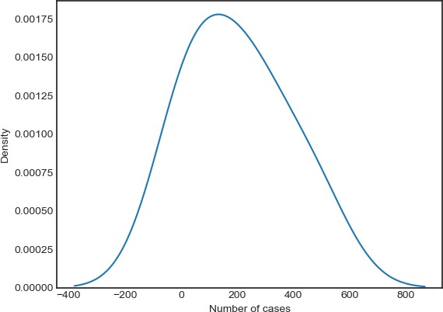
[51]:
age_group=pd.DataFrame(df['Age_group'].value_counts()) #number of cases␣
↪according to Age_Groups
age_group.reset_index(inplace= True) age_group
[51]: | index | Age_group
 | 0 15-29 | 202
 | 1 30-44 | 198
 | 2 45-59 | 187
 | 3 60-75 | 178
 | 4 0-14 | 176
 | 5 75+ | 59
# line graph showing the suicides cases according to age groups
[52]:
plt.figure(figsize = (8,8,))
plt.plot(age_group['index'],age_group['Age_group']) plt.title("Age Group oF People Who Commited Suicides") plt.xlabel("Age Group")
plt.ylabel("No Of People Who Commited Suicides") plt.style.use("seaborn-white")

Slide 6
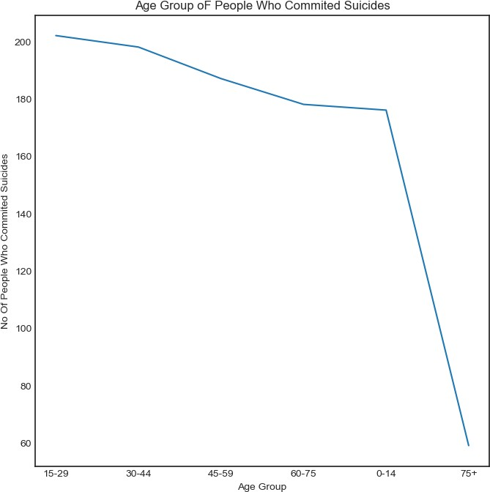
C:\Users\vikas\AppData\Local\Temp\ipykernel_18236\2729107350.py:6: MatplotlibDeprecationWarning: The seaborn styles shipped by Matplotlib are deprecated since 3.6, as they no longer correspond to the styles shipped by seaborn. However, they will remain available as 'seaborn-v0_8-<style>'.
Alternatively, directly use the seaborn API instead. plt.style.use("seaborn-white")
[53]:
age_group.skew()
C:\Users\vikas\AppData\Local\Temp\ipykernel_18236\3876976638.py:1: FutureWarning: The default value of numeric_only in DataFrame.skew is deprecated. In a future version, it will default to False. In addition, specifying 'numeric_only=None' is deprecated. Select only valid columns or

Slide 7
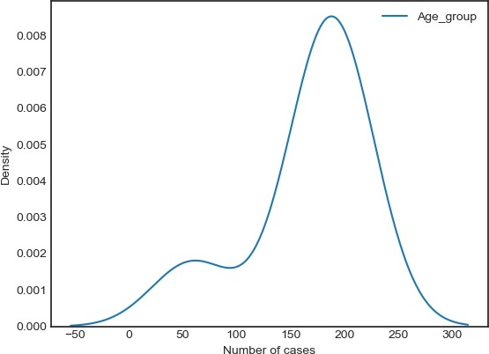
specify the value of numeric_only to silence this warning. age_group.skew()
[53]: Age_group -2.244503 dtype: float64
[54]:
sns.kdeplot(age_group)
plt.xlabel('Number of cases')
[54]: Text(0.5, 0, 'Number of cases')
8 number of cases according to reasons
[55]:
reasons = pd.DataFrame(df['Reasons'].value_counts())
reasons.reset_index(inplace=True) reasons
[55]: |  | index | Reasons
 | 0 | Others (Please Specify) | 27
 | 1 | Love Affairs | 23
 | 2 | By touching electric wires | 23

Slide 8
3 | Suspected/Illicit Relation |  | 22
4 | Student |  | 22
.. | … | …
63 | Diploma |  | 4
64 | Primary |  | 3
65 | Married |  | 3
66 Bankruptcy or | Sudden change in Economic Status |  | 2
67 | Post Graduate and Above |  | 1
[68 rows x 2 columns]
9 Bar plot showing the number of cases due to reasons
[56]:
plt.figure(figsize=(20,20,))
sns.barplot(x="Reasons",y="index",data=reasons) plt.xticks(rotation =90)
plt.xlabel("Number of cases") plt.ylabel("reasons")
[56]: Text(0, 0.5, 'reasons')

Slide 9
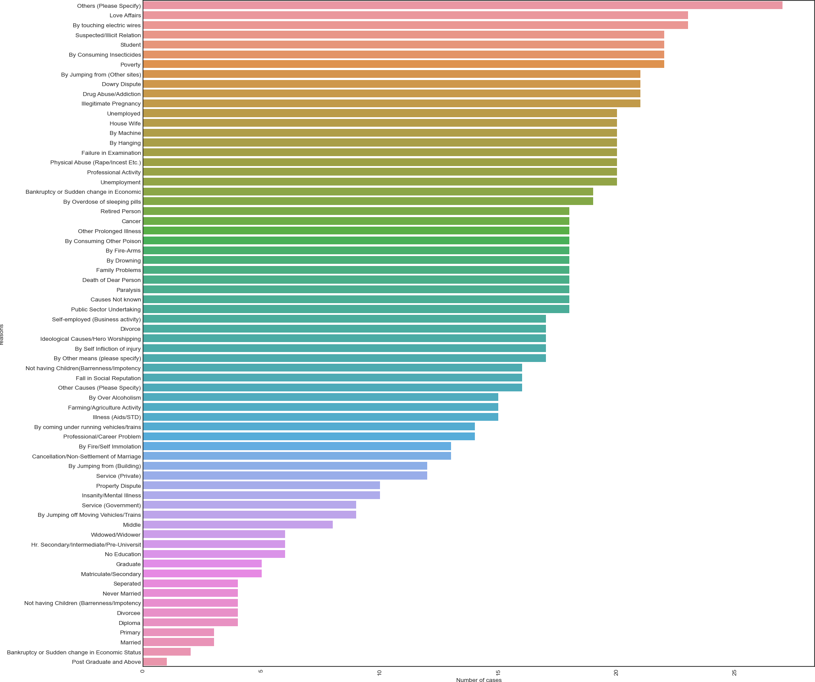
[57]:
reasons.skew()
C:\Users\vikas\AppData\Local\Temp\ipykernel_18236\3017534243.py:1: FutureWarning: The default value of numeric_only in DataFrame.skew is deprecated. In a future version, it will default to False. In addition, specifying 'numeric_only=None' is deprecated. Select only valid columns or specify the value of numeric_only to silence this warning.
reasons.skew()
[57]: Reasons -0.626037
dtype: float64
[58]:
sns.kdeplot(reasons['Reasons'])
plt.xlabel('Number of cases')
[58]: Text(0.5, 0, 'Number of cases')

Slide 10
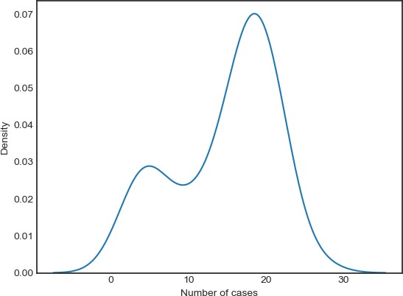
10 counting the number of males and females
[59]:
gender = pd.DataFrame(df['Gender'].value_counts())
gender
[59]:
Male Female
Gender
500
500
# Piechart showing the distributionn of suicides cases according to gender
[60]:
plt.figure(figsize=(100,120))
gender.plot(kind='pie', y='Gender', labels=gender['Gender'], autopct='%1.2f%%',␣
↪startangle=0,legend=False)
plt.show()
<Figure size 10000x12000 with 0 Axes>

Slide 11
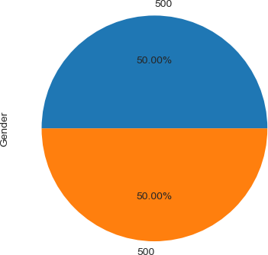
[61]:
sns.kdeplot(gender)
plt.xlabel("Number of cases")
C:\Users\vikas\AppData\Local\Temp\ipykernel_18236\1480453869.py:1: UserWarning: Dataset has 0 variance; skipping density estimate. Pass `warn_singular=False` to disable this warning.
sns.kdeplot(gender)
[61]: Text(0.5, 0, 'Number of cases')

Slide 12
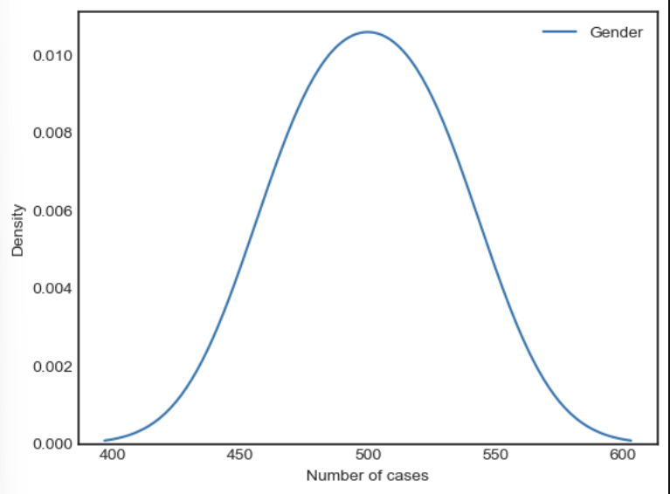
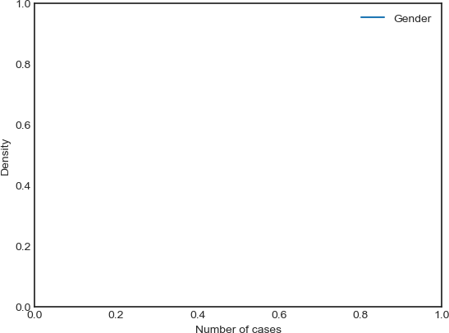
11 suicides rate per year indexing
[62]:
year = pd.DataFrame(df['Year'].value_counts())
year.reset_index(inplace =True) year
[62]: |  | index | Year
 | 0 | 2003 | 91
 | 1 | 2009 | 90
 | 2 | 2004 | 89
 | 3 | 2001 | 89
 | 4 | 2010 | 88
 | 5 | 2002 | 86
 | 6 | 2011 | 86
 | 7 | 2012 | 86
 | 8 | 2007 | 83
 | 9 | 2008 | 75
 | 10 | 2006 | 72
 | 11 | 2005 | 65

Slide 13
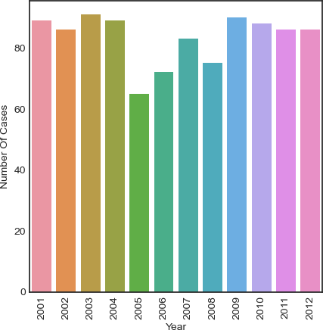
12 Barplot showing Number of cases per year
[63]:
plt.figure(figsize=(5,5,))
sns.barplot(x="index",y="Year",data=year) plt.xticks(rotation =90) plt.xlabel("Year")
plt.ylabel("Number Of Cases")
[63]: Text(0, 0.5, 'Number Of Cases')
13 year.skew()
[64]:
sns.kdeplot(year['Year'])
[64]: <Axes: xlabel='Year', ylabel='Density'>

Slide 14
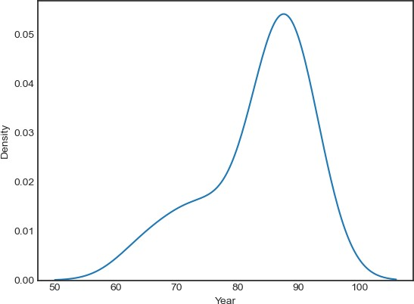
14 Number of cases according to states
[65]:
state = pd.DataFrame(df['State'].value_counts())
state.reset_index(inplace = True) state
[65]: |  | index | State
 | 0 | MEGHALAYA | 38
 | 1 | MIZORAM | 36
 | 2 | GUJARAT | 36
 | 3 | GOA | 35
 | 4 | KARNATAKA | 35
 | 5 | ODISHA | 34
 | 6 | SIKKIM | 32
 | 7 | TRIPURA | 32
 | 8 | NAGALAND | 32
 | 9 | BIHAR | 31
 | 10 | JHARKHAND | 31
 | 11 | UTTARAKHAND | 31
 | 12 | MAHARASHTRA | 31

Slide 15
13 HARYANA | 30
14 UTTAR PRADESH | 30
15 CHANDIGARH | 30
16 MADHYA PRADESH | 29
17 HIMACHAL PRADESH | 28
18 ARUNACHAL PRADESH | 27
19 LAKSHADWEEP | 27
20 WEST BENGAL | 27
21 DAMAN & DIU | 26
22 KERALA | 26
23 MANIPUR | 26
24 DELHI (UT) | 26
25 A & N ISLANDS | 26
26 RAJASTHAN | 25
27 JAMMU & KASHMIR | 24
28 PUNJAB | 24
29 TAMIL NADU | 23
30 PUDUCHERRY | 23
31 D & N HAVELI | 23
32 ANDHRA PRADESH | 23
33 CHHATTISGARH | 22
34 ASSAM | 20
35 TOTAL (UTs) | 1
# line graph showing the relationship between states and cases
[66]:
plt.figure(figsize=(10,10,))
plt.plot(state['index'],state['State']) plt.title('Number of suciedes in each states') plt.xlabel('States')
plt.ylabel('Number of cases') plt.xticks(rotation=90) plt.style.use("seaborn-white")
C:\Users\vikas\AppData\Local\Temp\ipykernel_18236\3945054002.py:7: MatplotlibDeprecationWarning: The seaborn styles shipped by Matplotlib are deprecated since 3.6, as they no longer correspond to the styles shipped by seaborn. However, they will remain available as 'seaborn-v0_8-<style>'.
Alternatively, directly use the seaborn API instead. plt.style.use("seaborn-white")

Slide 16
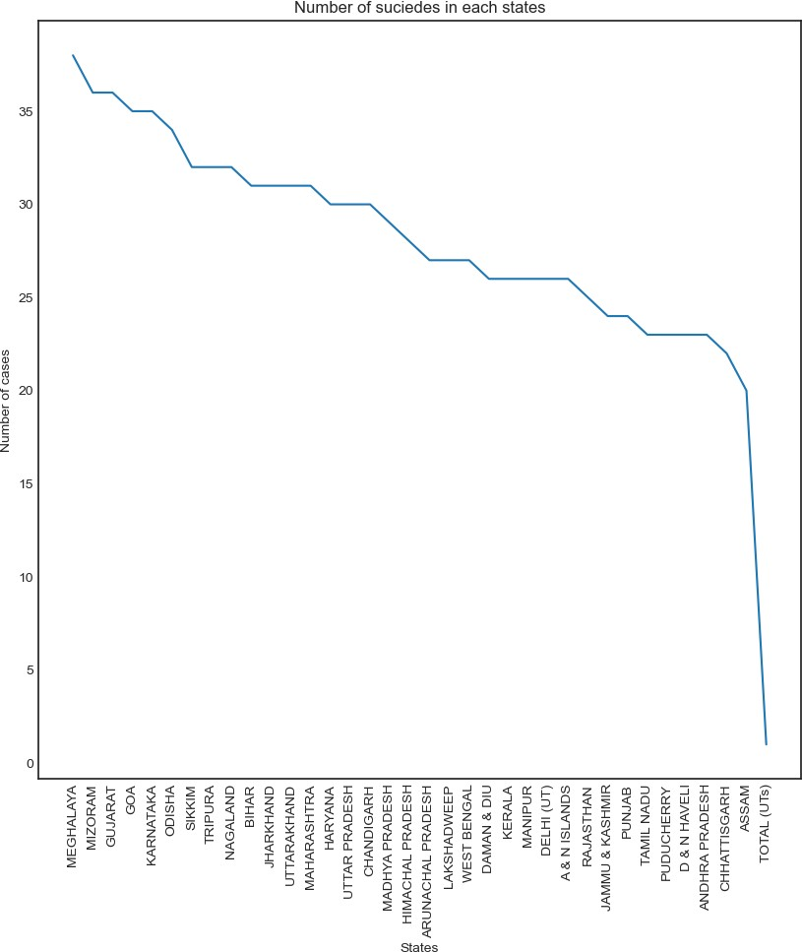
[67]:
state.skew()
C:\Users\vikas\AppData\Local\Temp\ipykernel_18236\1195401966.py:1: FutureWarning: The default value of numeric_only in DataFrame.skew is deprecated. In a future version, it will default to False. In addition, specifying 'numeric_only=None' is deprecated. Select only valid columns or specify the value of numeric_only to silence this warning.

Slide 17
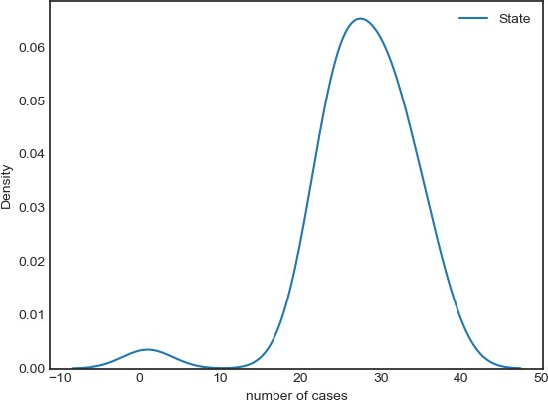
state.skew()
[67]: State -1.915825
dtype: float64
[68]:
sns.kdeplot(state)
plt.xlabel("number of cases")
[68]: Text(0.5, 0, 'number of cases')
.skew function is used to show where the graph is shifting
kde plot shows the density of the data in a given range and can also show where our data can shift
15 key Findings:-
[69]:
# We have analysed the dataset through -->
#Professional Status:- The key professional status categories were "Causes,"␣
↪"Means Adopted," "Professional Profile," "Education Status," and "Social␣
↪Status."
#The most significant category was "Causes" with 458 cases.

Slide 18
# Age Group Analysis:-The age groups "15-29," "30-44," and "60-75" had the␣
↪highest number of suicide cases.
# The age group "75+" had the lowest number of cases.
#Reasons Analysis:- The reasons behind suicides were explored, with categories␣
↪such as "Poverty," "Service (Private)," and "By Over Alcoholism."
# The top reason was "Others (Please Specify)" with 27 cases.
#Gender Analysis:- There were 504 cases of males and 496 cases of females,␣
↪indicating a nearly equal distribution.
#Yearly Analysis:- The year "2011" had the highest number of suicide cases,␣
↪followed closely by "2005."
#State-wise Analysis:- "Goa" had the highest number of suicide cases, followed␣
↪by "Madhya Pradesh" and "Chandigarh."
16 Conclusion:-
[70]:
#In summary, this EDA project revealed important patterns and trends in suicide␣
↪rates in India. It emphasized the importance of data-driven insights
#to address social and mental health challenges. Further research and␣
↪intervention efforts can be tailored based on the findings to reduce suicide␣
↪rates
#and provide support to vulnerable populations.
[ ]:
[ ]:
[ ]:
[ ]:
[ ]:
[ ]:

Slide 19
THANK YOU☺
:

