Slide 1
LOAN CASE STUDY SUBMISSION
Group Name:
Vivek Sachdeva
Vikash Sharma
Venkatesh Moorthi K
Rajashri Thakare

Slide 2
Goals
Identify factors impacting default leading to charged off
Factors leading to completion of Loan payment
Minimize risks of bank by reducing/cancellation of such members loan application
Increase and approve such candidates application resulting in better revenue and profit.

Slide 3
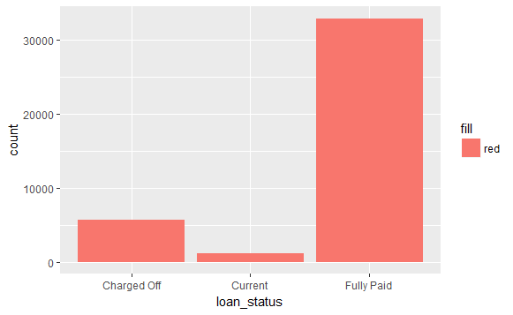
Loan Distribution count based on loan status

Slide 4
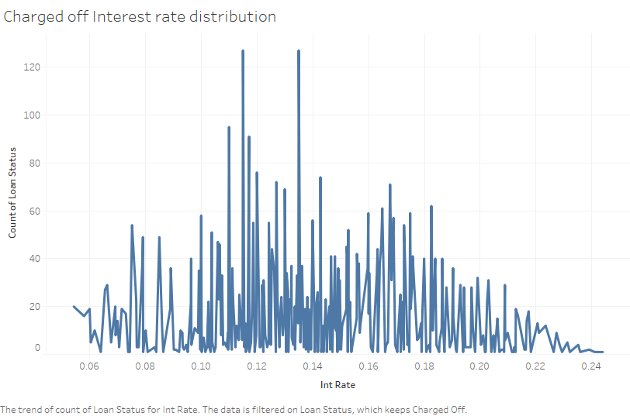
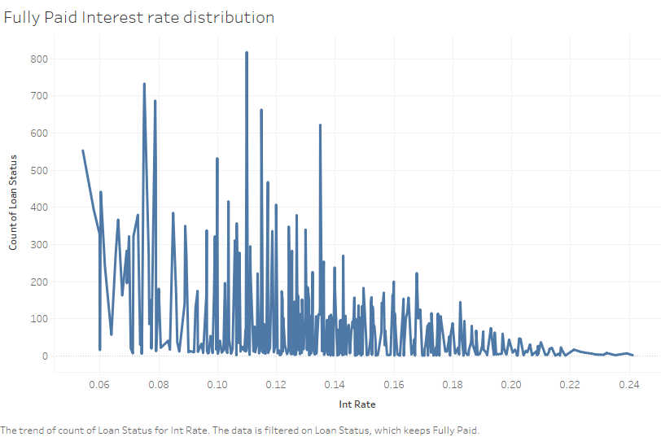
Interest Rates impact on Default
Interest rates are concentrated towards higher value for Charged off
Interest rates are concentrated towards lower value for Fully paid

Slide 5
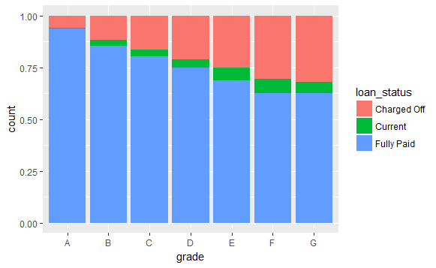
Loan issue analysis
Higher the Grade alphabetically, higher the chances of default.
Lower the Grade alphabetically, higher chances of being fully paid
This shows that the risk grading policy is structurally working in line with the pay-off profile.

Slide 6
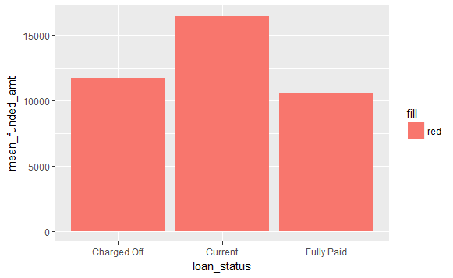
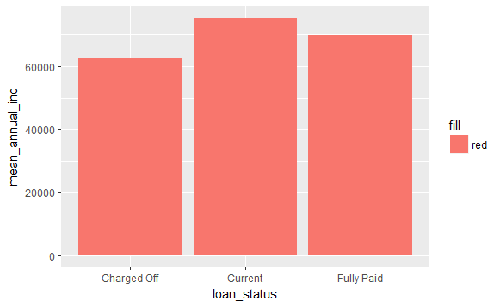
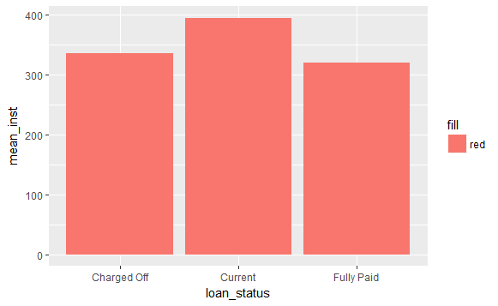
Mean values for different Loan Status
While mean funded amount for Charged Off is higher than that for Fully Paid, mean annual income for Charged Off is lower than that for Fully Paid.
This could mean that we could see some pattern in the DTI (debt to income) profile for these loan statuses. We will explore this in the later slides.

Slide 7
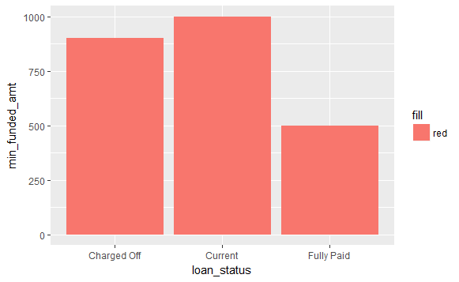
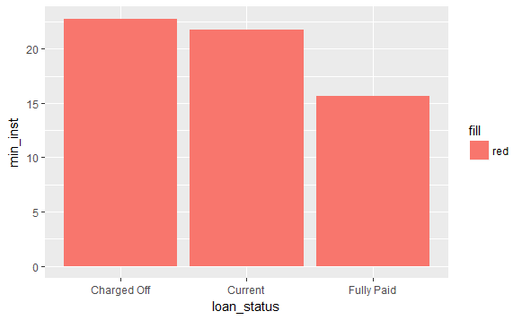
Min Values for different Loan Status
Above is a comparison of the minimum funded amount and minimum instalment amount for various loan statuses.
One of the conservative measures could be to limit the funding amount for the highest risk grades between the minimum and mean funding amount values seen for the fully paid customers.

Slide 8
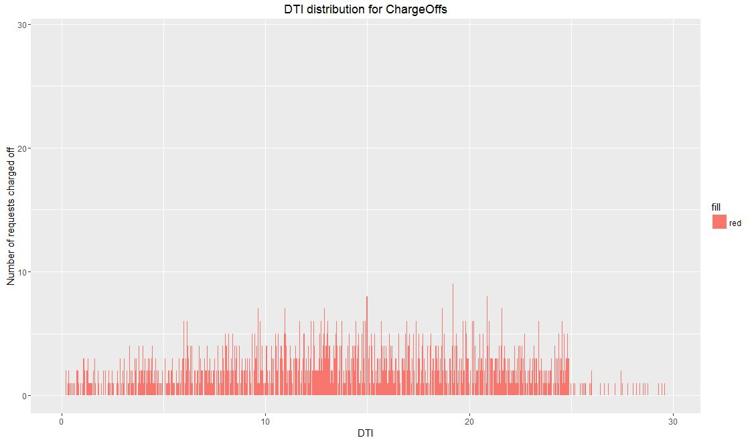
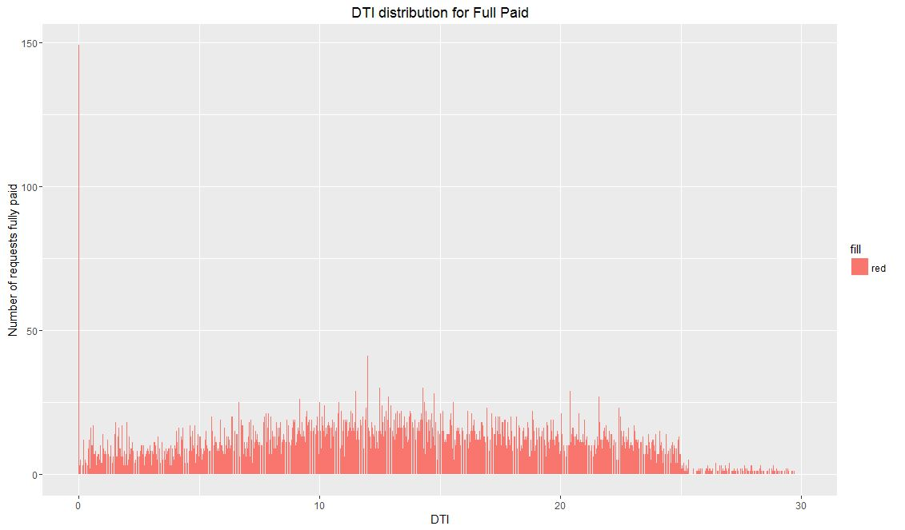
DTI (Debt to Income) Ratio for different Loan Status
The DTI (debt to income ratio) metric tells us about the (inverse of) repayment capacity of borrower and higher dti means the borrower has less capacity to repay than a lower dti borrower.
Above chart shows that the ChargeOffs see higher values of DTI (debt to income ratio) risk subgrade wise in comparison to that of Fully Paid customers.

Slide 9
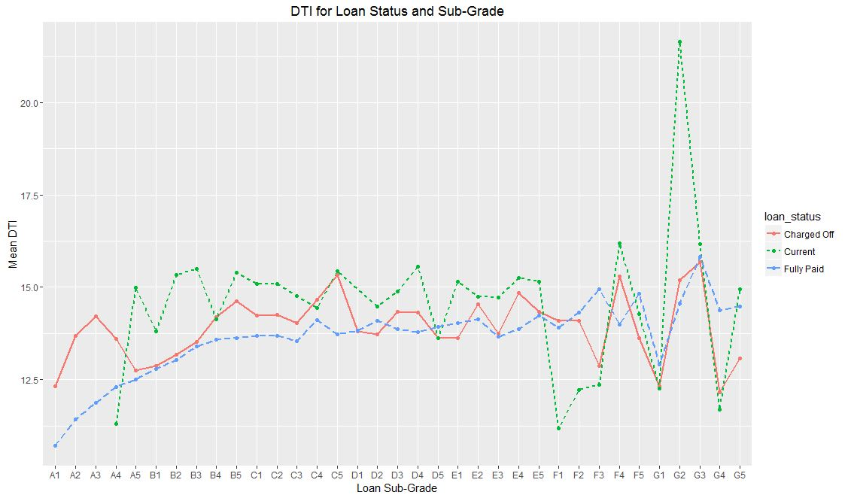
DTI Ratio for Loan Status & Sub-Grade
What we clearly see here that for most of the risk subgrades, there is higher dti for charged off borrowers than that for fully paid borrowers.
One of the actions we can take here is bring down the permissible dti values for sanctioning the loan to the historically approved dti values for the fully paid customers. This could reduce the charge-off cases.

Slide 10
Issues governing high default
Higher dti (debt to income ratio) values for charge-offs as compared to fully paid borrowers.
Higher income rates for charge-offs resulting in higher debt obligations. This is also partly due to higher concentration of charge-offs in the higher risk sub grades where income rates are higher.
Funding amount levels may be higher, especially for the higher risk sub grades.
Recommendations
Reducing the permissible dti values for sanctioning the loan to the historically approved dti values for the fully paid customers could possibly control the incidence of charge-offs.
Limiting the funding amount for the highest risk grades between the minimum and mean funding amount values seen for the fully paid customers could also help in lesser slippage through charge-off cases.
Apart from the risk grading, factoring in the dti and funding amount can be used arrive at a feasible interest rate for the borrower. If this feasible interest rate is lesser than the risk/sanctioning policy interest rate, then the loan should not be approved. This could improve the existing sanctioning/loan approval policy.

