Slide 1
HR ANALYTICS CASE STUDY SUBMISSION
Group Name:
Vivek Sachdeva
Vikash Sharma
Nilaksh Bajpai

Slide 2
Business Understanding
Problem Statement:
15% annual attrition is impacting XYZ company having employee strength of 4000
Management wants to understand:
What factors to focus on for curbing attrition
What changes they should make to their workplace
Which factors are most important and need to be addressed right away
Analysis Objectives:
Model the probability of attrition using a logistic regression
Use model results to understand what changes management should make to workplace
Identify the most important factors/variables

Slide 3
Analysis Approach
Data Understanding & Preparation
Model Creation
Model Evaluation & Deployment
Data Collection from multiple tables – Initial Cleaning and Merging
Logistic Regression on selected variables through stepwise and backward selection
Evaluate Model Output - Diagnostics on Accuracy, Specificity and Sensitivity
Data Cleaning – Treatment of missing and outlier values
Feature Selection through WOE and Information Value
Evaluation of Discriminative Power Measures to determine goodness of model prediction
Create Derived Metrics and Data Transformations
Split Data into Train and Test
Identify factors of importance and provide recommendations

Slide 4
Data Understanding
Response Variable: Attrition
ID/Label Variable: EmployeeID
Continuous Variables:
Age, Distance from Home, Monthly Income, NumCompanies Worked, PercentSalaryHike, TotalWorkingYears, YearsAtCompany, YearsSinceLastPromotion, YearswithCurrManager
Categorical Variables:
General Data - BusinessTravel, Department, Education, EducationField, Gender, JobLevel, JobRole, MaritalStatus, StockOptionLevel, TrainingTimesLastYear,
Employee Survey Data - EnvironmentSatisfaction, JobSatisfaction, WorkLifeBalance,
Manager Survey Data - JobInvolvement, Performance Rating
In-time and Out-time data:
Difference in these times can be used as an indicator of workload (i.e. how much of work stress for each employee)
Redundant Variables: (Since there is only one level throughout the data)
EmployeeCount, Over18, StandardHours (StandardHours is used in deriving metric for workload indicator)

Slide 5
Data Preparation
Data Cleaning, Merging & EDA
Check for missing and outlier values in all datasets
Check for unique and missing values of EmployeeID variable in all datasets
Merge datasets on EmployeeID since all tables have identical EmployeeID values
Comparison of Attrition with various attribute variables
Deriving New Metrics
Calculate difference between daily in-times and out-times to get daily working hours
Create workload indicator variable based on following rule:
If Median of daily working hours < Standard Hours – 1 then Workload=Low;
Else If Median of daily working hours within Standard Hours +/- 1 then Workload=Medium;
Else If Median of daily working hours > Standard Hours + 1 then Workload=High
Data Transformation
Scaling of Continuous Variables by dividing centered values of variables by their standard deviations
Convert Categorical Variables to factors
Convert Response/Target Variable (Attrition) to factor as 1 (Yes) and 0 (No)

Slide 6
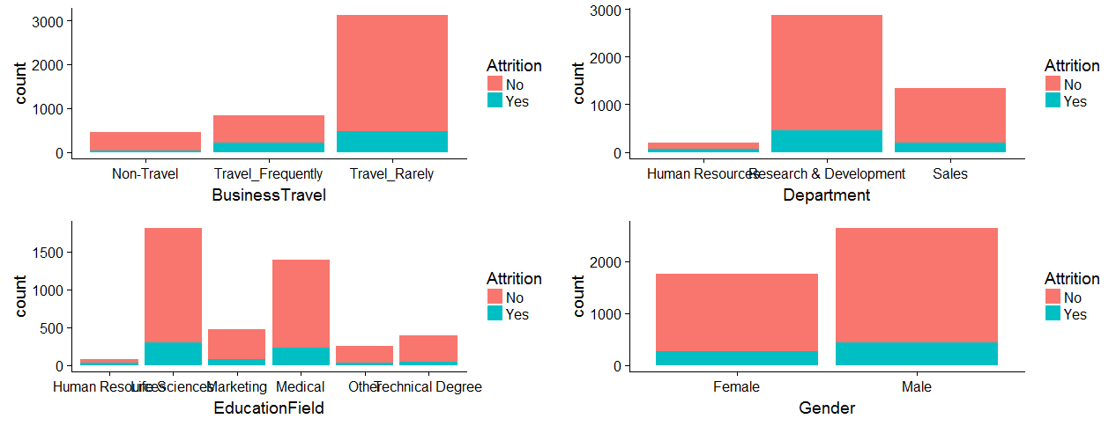
Comparison of attrition with different attributes - 1

Slide 7
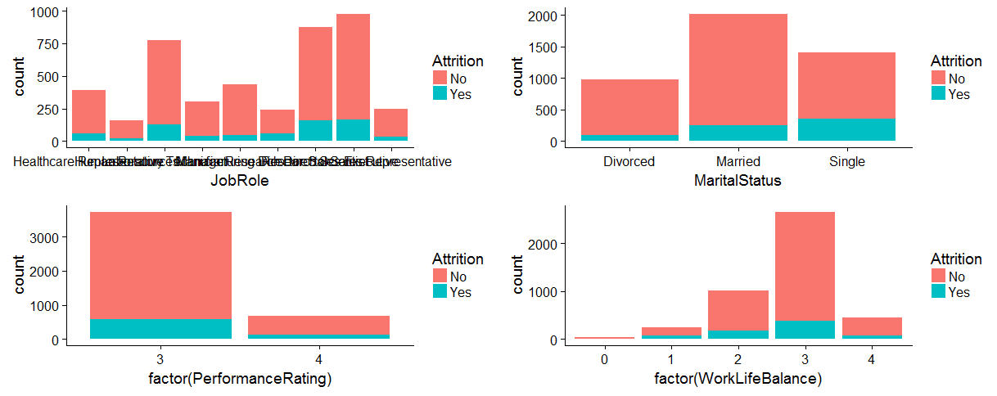
Comparison of attrition with different attributes - 2

Slide 8
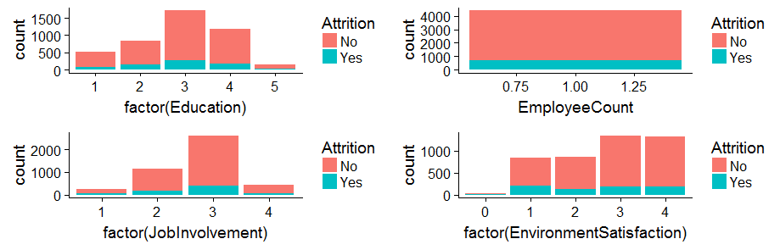
Comparison of attrition with different attributes - 3

Slide 9
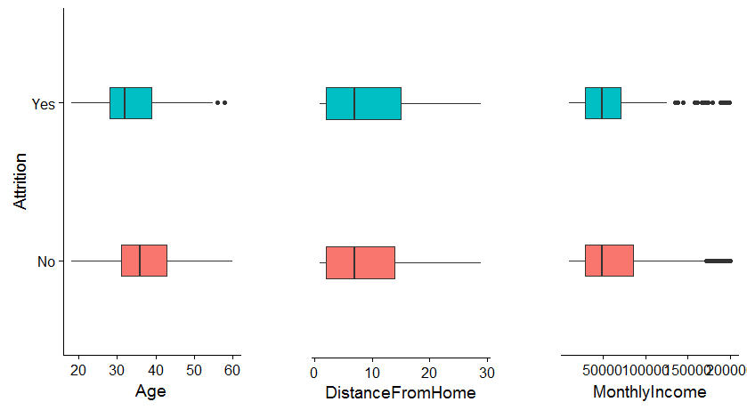
Attrition comparison with Numerical variables - 1
Monthly Income has few outliers here.

Slide 10
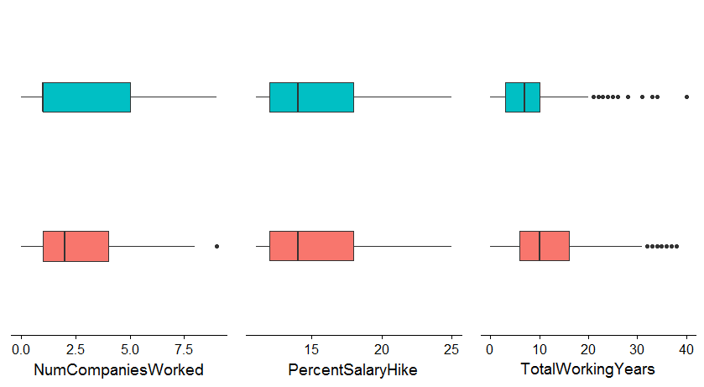
Attrition comparison with Numerical variables - 2
Total Working years is having few outliers

Slide 11
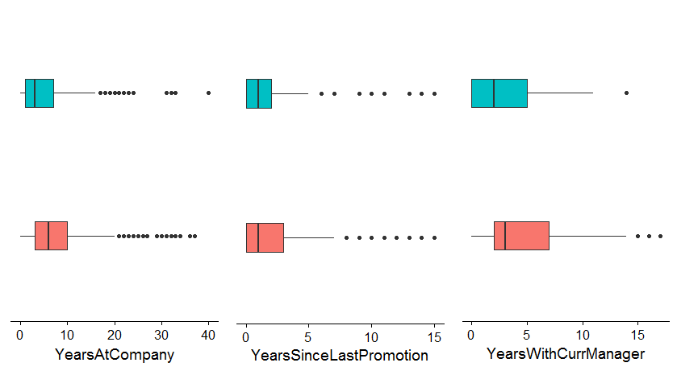
Attrition comparison with Numerical variables - 3
Here again we have outliers with
YearsAtCompany, YearsSinceLastPromotion, YearsWithCurrManager

Slide 12
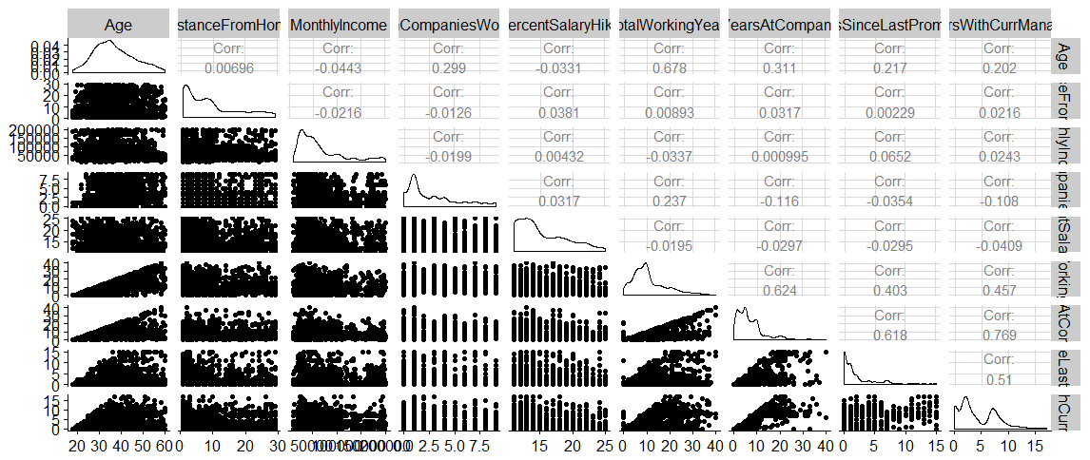
Correlation Matrix of Continuous Variables

Slide 13
Model Creation
Feature Selection
Split data into train and test in 70:30 ratio
Applying WOE and IV to select variables with better predictive power (i.e. IV > 0.02)
Variables Excluded:
PercentSalaryHike, PerformanceRating, JobInvolvement, Education, StockOptionLevel, Gender
Regression Modeling
Create dummy variables for categorical attributes and run logistic regression
Stepwise selection based on AIC criteria and backward selection based on VIF and p-value
Continue model selection until all predictor variables have 0.001 level of significance
Identifying Significant Variables
Final Model at 17th iteration with 24 significant variables
5 Categorical & 19 Continuous Variables are significant at 0.001 level
Workload-Low & Medium, YearsSinceLastPromotion & MaritalStatus-Single are key significant variables

Slide 14
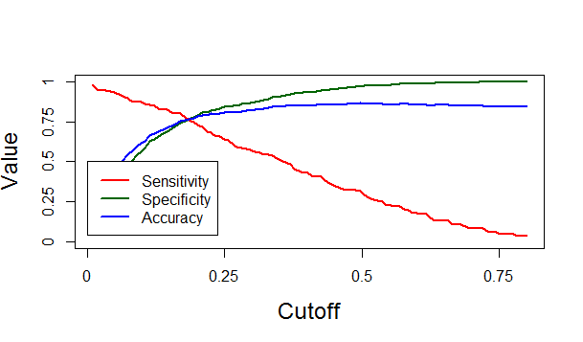
Model Evaluation
Accuracy, Sensitivity and Specificity
Confusion Matrix
Sensitivity = Probability of correctly predicting employee attrition when there is an actual attrition = 159/(159+50) = 0.7608;
Specificity = Probability of correctly predicting no employee attrition when there is no actual attrition = 829/(829+252) = 0.7669;
Accuracy = Probability of correctly predicting all instances of employee attrition and no attrition = (829+159)/(829+50+252+159) = 0.7659
As seen above, at a cutoff value of 0.1856 for model on test data, Accuracy = Sensitivity = Specificity ~ 0.76
This mean for any employee with P(attrition) >= 0.1856, model’s prediction is that the employee will churn in the near future. Even though the model says that there is a 19% probability of the employee attriting and a 81% probability of the customer not attriting, based on past experience however, even this much probability is generally enough to declare the employee as one likely to attrite.

Slide 15
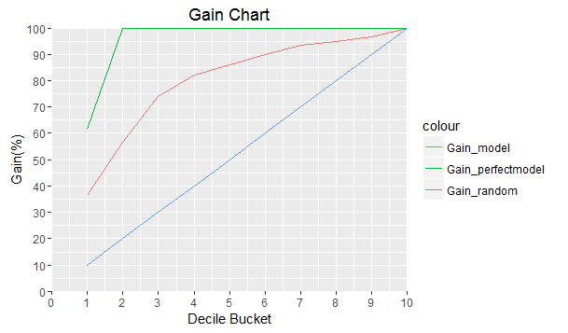
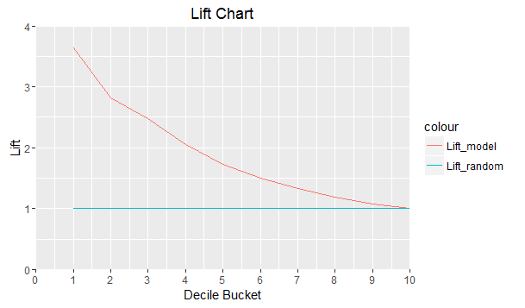
Model Discriminative Power Measures

Slide 16
Interpreting Gains and Lift Chart
In a worst case scenario, we assume a random model having equal distribution of attriting employees across all deciles, i.e. similar to a model-less situation. In the best case scenario, we assume a perfect model which is likely to correctly predict all the attriting employees in the top deciles ranked by probability of attrition, i.e. probability-ranking of employee attrition is 100% correct.
A good model is one whose gain chart is close to the perfect model, and far away from the random model.
The gain statistic is a clear indicator of the advantage offered by the model. As opposed to addressing 40% of the employees randomly, which would only result in identifying 40% of the attrition-likely employees, it is beneficial to use the model, sort all employees by probability, and then contact the top 40% employees in this sorted list, as that would result in contacting 82.3% of the employees that were likely to attrite.
The lift tells you the factor by which your model is outperforming a random model, i.e. a model-less situation. Lift of the model = (Gain for current model)/(Gain for random model)
With a model lift equal to 2.5 by the 3rd decile, it means that the attrition model’s gain by the end of the 3rd decile is 2.5 times that of a random model’s gain at the end of 3 deciles. In other words, the model catches 2.5 times more attritions than a random model would have caught.

Slide 17
KS-Statistic
The highest value of the term (%cumulative-attrition - %cumulative-non-attrition) is called the KS statistic. A high KS statistic means that not only does your model have all employee attritions at the top, but it also has all non-attritions at the bottom.
For a good model, KS statistic should be more than 40% and lie in the top few deciles (1st to 4th). In the current model, KS statistic is 52.7% and lies in the 3rd decile. This shows that the model is good in classifying the attritions and non-attritions as well.

Slide 18
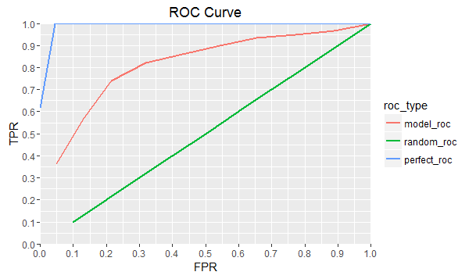
ROC Curve
ROC curve plots the %cumulative-attrition (TPR) and %cumulative-non-attrition (FPR) is called the ROC curve.
While the perfect model is almost a right triangle, the random model is a straight line. A model that rises steeply is a good model.
This also means that the model will cover a higher area under the curve. So, the Gini coefficient which represents the area under ROC curve should be high for a good model.
Gini Coefficient = (Area between ROC curve and diagonal line for random model)/(Area of the triangle above the diagonal line)
Gini coefficient = 0.6246
Since Gini above 60% is considered a good model, Gini of 62.46% shows that the model is good.

Slide 19
Model Deployment
Identifying Factors of Attrition Model (in order of relative importance):
ROC curve analysis is conducted on each predictor. After applying a series of cutoffs to the predictor data to predict the class, the sensitivity and specificity are computed for each cutoff and the ROC curve is computed. The trapezoidal rule is used to compute the area under the ROC curve. This area is used as the measure of variable importance.
Based on this method, we see that Workload, YearsSinceLastPromotion and MaritalStatus-Single are key significant variables.
We also see that employee survey parameters of Job Satisfaction, WorkLifeBalance & EnvironmentSatisfaction are significant variables.
Besides, some other variables representing tenure with current manager, business travel, number of companies worked and research based job roles also show significance.
Employees in Sales Executive & Research Scientist/Director roles show more likelihood to attrite than other job roles.

Slide 20
Model Deployment
Recommendations to Management:
Given our probability prediction model exhibits good accuracy, sensitivity, specificity and decent discriminative power in terms of significant advantage from random model as seen through gains & lift charts, KS-statistic, ROC curve, the management can use this model to predict likelihood of employee attrition in their company.
It appears that unmarried employees are more likely to attrite than others. Employees with workload but not promoted since long time are also a possible segment likely to attrite. The management needs to find ways how to involve such people in more important projects which can provide them visibility and opportunities of promotion.
Further, the management needs to take care of employees who have worked long years in multiple companies and/or with the same manager previously and who may have business travel. These people could be highly trained and in high impact important roles and their exits would have a strong impact on the company’s operations.
Management also needs to particularly address Sales Executive and Research Scientist/Director job role employees (through incentives or challenging projects) since these are more likely to attrite than other job roles.

Slide 21
THANK YOU

