Slide 1
Breast cancer – survival data and analysis
By Group 2
Advanced Analytics for Management

Slide 2
Project Team
Rajkul Fulzule – Team Lead
Shivank Kapur
Vikash Sharma
Praveen Sattarapu
Sameer Gupta
Chirag Jajoo
Ajay Dahiya
Tarun Arora

Slide 3
Case study – brief description
A study that was conducted between 1958 and 1970 at the University of Chicago's Billings Hospital on the survival of patients who had undergone surgery for breast cancer.
The dataset tracks the survival rate of patients with breast cancer
The data provided had four variables –
Age of patient at time of operation (numerical)
Patient's year of operation (year - 1900, numerical)
Number of positive axillary nodes detected (numerical)
Survival status (class attribute):
1 = the patient survived 5 years or longer
2 = the patient died within 5 year

Slide 4
Problem statement
Given age, number of axillary nodes and year of operation – Can we predict if the patient will survive for less than or more than 5 years?

Slide 5
Choice of method
Response | Predictors | Training Sample Present | Possible Model
Numerical | Numerical or Categorical | Yes | Linear Regression
Binary | Numerical or Categorical | Yes | Binary Logistic Regression
 | Numerical | No | K-means Clustering
Numerical or Categorical | Numerical or Categorical | Yes | Classification and Regression Trees (CART)
Numerical | Time | Yes | Time Series Forecasting Models

Slide 6
Choice of method - LOGISTIC
Response | Predictors | Training Sample Present | Possible Model
Numerical | Numerical or Categorical | Yes | Linear Regression
Binary - Survival | Numerical or Categorical – Age, Year of Operation, No of Auxiliary Nodes | Yes | Binary Logistic Regression
 | Numerical | No | K-means Clustering
Numerical or Categorical | Numerical or Categorical | Yes | Classification and Regression Trees (CART)
Numerical | Time | Yes | Time Series Forecasting Models

Slide 7
Descriptive statistics
Variable | Count | No of Missing | Mean | Standard Deviation | Minimum | Median | Maximum
Age of patients at time of operation | 306 | 0 | 52.5 | 10.8 | 30 | 52 | 83
Patients year of operation | 306 | 0 | 62.9 | 3.2 | 58 | 63 | 69
Number of positive axilliary nodes | 306 | 0 | 4.0 | 7.2 | 0 | 1 | 52
Survival Status | 306 | 0 | 1.3 | 0.4 | 1 | 1 | 2

Slide 8
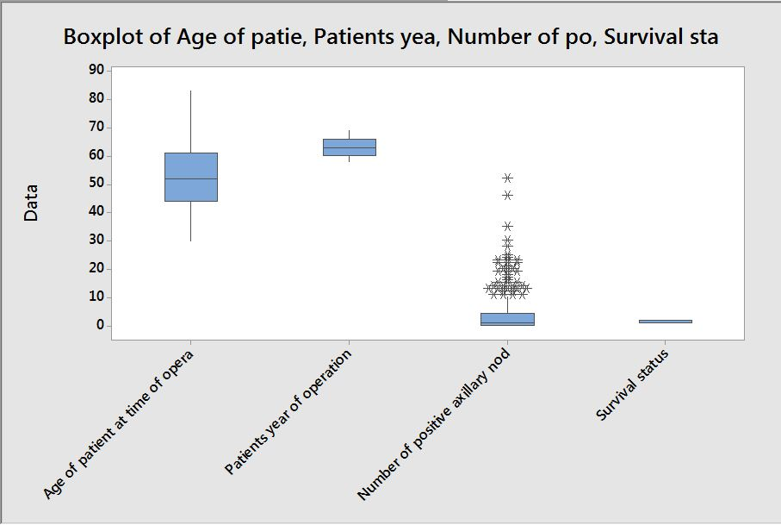
EDA - box plot

Slide 9
EDA - histograms

Slide 10
Approach
Data Preparation
Randomize ordering of observations to remove any bias
Choose split of 70-20-10 for Training-Validation-Test:
Total Observations = 306
Training Set = 214
Validation Set = 61
Test Set = 31
No Missing Values were found
Building the Model
Passed VIF Criteria (less than 4) for Multicollinearity
Removed 1 Unusual Observation for R-X error
Passed for p-value of Hosmer-Lemeshow Test (greater than 0.1)
Removed Year of Operation as predictor variable since p-value > 0.1
Repeated above checks for remaining variables
Model Equation
Derive logit regression equation
Y =3.451 - 0.0331*X1 - 1426*X2
Predictor Variables: X1=Age, X2=Number of Axillary Nodes
Dependent Variable: Y=Log[Odds(Survival)]
Response Event: 1=Patient surviving 5 years or longer
Interpretation: Keeping X2 constant, a unit change in X1 (Age) results in a change of odds ratio of survival by e^{-0.0331}.

Slide 11
Model Validation
Model Results
Validation Check
C-Statistic or AUC Value
Concordant = 71.3
Ties = 0.8
C-Statistics = (71.3 + 0.8/2)% = 0.717
Benchmark Criteria for Predictive Ability
0.5 < C-Stat < 0.7 => Poor
0.7 < C-Stat < 0.8 => Satisfactory
Model Performance
C-Stat of 0.717 signifies a satisfactory level of predictive ability.
Coefficient Confidence Interval Overlap
Set | Variables | Coeff-3*SE | Coeff+3*SE
Training | Age | -0.0805 | 0.0143
 | Nodes | -0.2371 | -0.0481
Validation | Age | -0.0831 | 0.0939
 | Nodes | -0.1418 | 0.0274
Benchmark Criteria for Validation
Coeff–3*SE to Coeff+3*SE intervals obtained using training and validation data should overlap for each variable
Model Performance
As shown here, the said intervals do overlap for each variable signifying that the model may be considered as validated.
Notes:
Why we choose 70:20:10
Professor’s opinion
- we tried multiple models and concluded this is the best

Slide 12
Best Threshold Choice
Threshold Scenarios as per Validation set results
*Specificity: Probability of correctly predicting death within 5 years when the survival observation also stated death within 5 years.
**Sensitivity: Probability of the model correctly predicting survival for 5 years or longer given that the actual observation also stated survival of 5 years or longer.
^Total Accuracy: Overall proportion of correct predictions for both survival events.
Threshold Choice Criteria: Maximize Total Accuracy, Specificity and Sensitivity.
However, since there is a tradeoff between specificity and sensitivity, we propose choosing 0.70 as the best threshold choice which helps us improve on the choice criteria as well as overall accuracy.
Threshold | 0.60 | 0.65 | 0.70 | 0.75 | 0.80
Specificity* | 0.57 | 0.50 | 0.56 | 0.50 | 0.39
Sensitivity** | 0.81 | 0.80 | 0.84 | 0.85 | 0.88
Total Accuracy^ | 0.75 | 0.72 | 0.75 | 0.72 | 0.59

Slide 13
Best Threshold Choice
Threshold Scenarios as per Validation set results
This means that all observations with a fitted probability above 0.70 predict survival of 5 years or longer and all observations with a fitted probability below 0.70 predict survival of less than 5 years.
Threshold Choice Criteria: Maximize Total Accuracy, Specificity and Sensitivity.
However, since there is a tradeoff between specificity and sensitivity, we propose choosing 0.70 as the best threshold choice which helps us improve on the choice criteria as well as overall accuracy.
Threshold | 0.60 | 0.65 | 0.70 | 0.75 | 0.80
Specificity* | 0.57 | 0.50 | 0.56 | 0.50 | 0.39
Sensitivity** | 0.81 | 0.80 | 0.84 | 0.85 | 0.88
Total Accuracy^ | 0.75 | 0.72 | 0.75 | 0.72 | 0.59

Slide 14
TEST set observations
The chosen threshold results in an overall prediction accuracy of 65% on the test data set. We are better able to predict survival of 5 years or longer with an accuracy of 83%. However, we are only able to predict survival of less than 5 years with an accuracy of 38%.
Threshold Performance
Misclassification Table
Threshold | 0.70
Specificity* | 0.38
Sensitivity** | 0.83
Total Accuracy^ | 0.65
 |  | Predicted
 |  | < 5 yrs | >= 5 yrs | Total
Actual | < 5 yrs | 5 | 8 | 13
 | >= 5 yrs | 3 | 15 | 18
 | Total | 8 | 23 | 31

Slide 15
Thank you

Slide 16
appendix

