Slide 1
Selenium –L2
Notes:
The below and following notes on the template slides are to guide you only. In your final presentation, you may delete these notes and add relevant notes if any.
Title slide:
Title – should not exceed beyond 3 lines, font size 30-34, Arial Bold
(Font size for the title of the PPT can vary between 30-34, Arial, Bold depending on the amount of text, however should not be smaller than 30 font size)
Name should not exceed beyond 1 line, Designation; font size to remain at 16, Arial normal
Please keep the title slide simple, just the logo, title and name and designation to appear. No other graphic elements or any design, photograph, image can be added to this slide, alignment to remain the same

Slide 2
Contents
1. Selenium Web-driver
1.1 Selenium- An introduction
1.2 Selenium Web-Driver
1.3 Selenium Server
1.4 Advantages of Webdriver over Selenium RC
1.5. Selenium-WebDriver’s Drivers
2. Webdriver API
2.1 Webdriver API
2.2 Webdriver Interface
2.3 By Class
2.4 WebElement Interface
2.5 Other Important APIs
2.6. Moving Between Windows and Frames
3. Selenium Locators
3.1. Introduction
3.2 Why TestNG Framework
4. Waits and Timeouts
4.1 Implicit Wait
4.2 Explicit Wait
4.3 TimeOuts
5. Remote Web Driver
6. TestNG framework
7. TestNG annotations
7.1 Annotations in TestNG
7.2 Attributes of TestNG Annotations
7.3 @DataProvider Annotation
7.4 @Test Annotation and Attributes
7.5 Test Groups
7.6 Parameterizing in TestNG
7.7 Dependencies
7.8 Failed Tests
7.9 TestNG Listeners
8. Build Tools
8.1 Introduction
8.2 Ant Build Tool
8.3 Maven Build Tool
9. Page Object Design Pattern
9.1 What is PODM
9.2 Creating Objects in PODM
9.3 Pros and Cons of PODM
10. Selenium Grid

Slide 3
1.2. Selenium Web-Driver
It is designed to providing an simpler, more concise programming interface.
It addresses some limitations in the Selenium-RC API.
It was developed to better support dynamic web pages where elements of a page may change without the page itself being reloaded.
It’s goal is to supply a well-designed object-oriented API that provides improved support for modern advanced web-app testing problems
Selenium-Web Driver makes direct calls to the browser using each browser’s native support for automation.

Slide 4
1.3 Selenium Server
Selenium Server replaces Selenium Remote Control. It can be used when tests and browser run on different machines. For example, you need to execute tests on a different version of browser installed on another machine.
It is also used to driver HtmlUnitDriver, when not using Java bindings
Can be configured as grid

Slide 5
1.4. Advantages of Webdriver over Selenium RC
Webdriver APIs are object oriented and offer better usage
Webdriver controls browsers natively from browser level
Unlike RC you don't have to start a server in webdriver.
Executions are faster in Webdriver
Interactions with web elements are more realistic. For example, Webdriver does not allow editing text in a disabled text field
You can find coordinates of any object using Webdriver

Slide 6
Contd…
Keyword driven framework is very easy to build in webdriver.
Smaller, compact API. Web Driver's API is more Object Oriented than the original Selenium RC API. This can make it easier to work with.
Support by browser vendors, like Opera, Mozilla and Chrome for the development of WD.

Slide 7
1.5. Selenium-Web Driver’s Drivers
Web Driver is the name of the key interface against which tests should be written, but there are several implementations. These include:
1) Html Unit Driver:
This is currently the fastest and most lightweight implementation of Web Driver. As the name suggests, this is based on Html Unit. Html Unit is a java based implementation of a Web Browser without a GUI. For any language binding (other than java) the Selenium Server is required to use this driver.

Slide 8
Contd…
2) Firefox Driver:
Controls the Firefox browser using a Firefox plug-in. The Firefox Profile that is used is stripped down from what is installed on the machine to only include the Selenium WebDriver.xpi (plug-in). Firefox Driver is capable of being run and is tested on Windows, Mac, Linux.
Runs in a real browser and supports JavaScript
Faster than the Internet Explorer Driver
Reference - https://github.com/SeleniumHQ/selenium/wiki/FirefoxDriver

Slide 9
Contd…
3) Internet Explorer Driver:
* This driver is controlled by a .dll and is thus only available on Windows OS. Each Selenium release has it’s core functionality tested against versions 6, 7 and 8 on XP, and 9 on Windows7.
Runs in a real browser and supports JavaScript with all the quirks your end users see.
Comparatively slow
Requires IEDriverServer.exe component and the path should be set in webdriver.ie.driver system variable
XPath is not natively supported in most versions. CSS is not natively supported in versions 6 and 7.
Reference - https://github.com/SeleniumHQ/selenium/wiki/InternetExplorerDriver

Slide 10
Contd…
4) Chrome Driver:
Chrome Driver is maintained / supported by the Chromium project itself. WebDriver works with Chrome through the chromedriver binary (found on the chromium project’s download page). You need to have both chromedriver and a version of chrome browser installed. chromedriver needs to be placed somewhere on your system’s path in order for WebDriver to automatically discover it.
Runs in a real browser and supports JavaScript
Slower than the HtmlUnit Driver
Requires a server component to be started. Path to the Chromedriver executable should be set in webdriver.chrome.driver variable.
Reference - https://github.com/SeleniumHQ/selenium/wiki/ChromeDriver

Slide 11
Contd…
4) Safari Driver:
Safari Driver is implemented as a Safari browser extension. The driver inverts the traditional client/server relationship and communicates with the Webdriver client using Websockets
Runs in a real browser and supports JavaScript
Slower than the HtmlUnit Driver
File upload is NOT supported

Slide 12
2. Webdriver API
Notes:
Section breaker slide:
Used for a section heading. You may add a sub heading not exceeding one line also here
Section heading – Arial, bold, 34 font size, should not exceed beyond 1 line
Sub Head – Arial, normal, 20 font size, should not exceed beyond 1 line

Slide 13
2.1 Webdriver API
Web driver is a platform and language neutral interface and associated wire protocol that allows programs or scripts to introspect into, and control the behavior of, a web browser
The API is defined by a wire protocol and a set of interfaces to discover and manipulate DOM elements on a web page, and to control the behavior of the containing browser
This specification also includes a normative reference serialization (to JSON over HTTP) of the interface's invocations and responses that are to be used by browser vendors to ensure interoperability
Selenium Web driver merges the open source projects Selenium and Web driver and is named as Selenium 2
Selenium Web driver client libraries are available in various languages like Java, C#, Ruby, Python, JavaScript etc.
The drivers implementing Web driver API are available for all major browsers like Internet Explorer, Firefox, Safari, Chrome, Opera and mobile platforms like Android, iOS, Windows Phone, Blackberry etc

Slide 14
2.2 Webdriver Interface
The main interface to use for testing, which represents an idealized web browser. The methods in this interface fall into three categories:-
Control of the browser itself – get(), navigate(), manage(), close(), quit(), switchTo()
Selection of web elements – findElement(), findElements()
Debugging aids – getCurrentUrl(), getPageSource(), getTitle(), getWindowHandle(), getWindowHandles()
Important methods
Reference - http://selenium.googlecode.com/git/docs/api/java/org/openqa/selenium/WebDriver.html
Method | Description
get() | Loads a new web page in the current browser window
findElement() | Find the first web element using a locator strategy like id, name, xpath
switchTo() | Sends future commands to a different frame or window
quit() | Quits driver, closing every associated window

Slide 15
Contd..
Webdriver.get() method mimics typing URL into address bar of web browser and hitting Enter key or clicking on Go button
Load a new web page in the current browser window.
Blocks until the load is complete
Follows redirects
Is synonym for Webdriver.Navigation.to() method
Webdriver.findElement() method finds the web element that is to be interacted with. It can be anything on a web page and is typically a button, textbox, radio button, check box, drop down, table, or simply some text. Further actions like click, typing text or simply reading text or done on these web elements.
Returns a reference to the web element
Accepts a “By” input which can be anything of class name, CSS, ID, Link text, Partial link text, Name, Tag name, XPath
Throws NoSuchElementException if no matching elements are found

Slide 16
2.3 By Class
By class is required to specify the mechanism used to locate the elements in a document by findElement() and findElements() methods
Reference - http://selenium.googlecode.com/git/docs/api/java/org/openqa/selenium/WebElement.html
Method | Description
By.ById() | Searches based on “id” attribute of web element
By.ByName() | Searches based on “name” attribute of web element
By.ByXPath() | Searches based on a XPath expression
By.ByCssSelector() | Searches based on a CSS expression
By.ByClassName() | Searches based on “class” attribute of web element. If an element has many classes, this will match against each of them
By.ByTagName() | Search by element’s tag name
By.ByLinkText() | Search for <a> element with matching text
By.ByPartialLinkText() | Search for <a> element with partially matching text

Slide 17
2.4 WebElement Interface
Represents a HTML element. All interactions with a web page will be performed through this interface. The methods in this interface fall into three categories:-
Interaction with the web element – sendKeys(), click(), clear(), submit()
Getting information on the web element – getText(), getAttribute(), getCssValue(), getLocation(), getSize(), getTagName(), isDisplayed(), isEnabled, isSelected()
Finding child elements within the current context – findElement(), findElements()
Important methods
Reference - http://selenium.googlecode.com/git/docs/api/java/org/openqa/selenium/WebElement.html
Method | Description
click() | Click on the web element
sendKeys() | Simulate typing into an element
getText() | Get the visible inner text of the element
isDisplayed() | Checks if the element is displayed

Slide 18
2.5 Other Important APIs
Select - http://selenium.googlecode.com/git/docs/api/java/org/openqa/selenium/support/ui/Select.html
JavascriptExecutor - http://selenium.googlecode.com/git/docs/api/java/org/openqa/selenium/JavascriptExecutor.html
Alert - http://selenium.googlecode.com/git/docs/api/java/org/openqa/selenium/Alert.html
Actions - http://selenium.googlecode.com/git/docs/api/java/org/openqa/selenium/interactions/Actions.html

Slide 19
2.6 Moving Between Windows and Frames
Some web applications have many frames or multiple windows. WebDriver supports moving between named windows using the “switchTo” method:
driver.switchTo().window("windowName");
You can also switch from frame to frame (or into iframes):
driver.switchTo().frame("frameName");

Slide 20
3. Selenium Locators
Notes:
Section breaker slide:
Used for a section heading. You may add a sub heading not exceeding one line also here
Section heading – Arial, bold, 34 font size, should not exceed beyond 1 line
Sub Head – Arial, normal, 20 font size, should not exceed beyond 1 line

Slide 21
Locating UI Elements (Web Elements)
Locating elements in WebDriver can be done on the WebDriver instance itself or on a WebElement. Each of the language bindings expose a “findElement()” and “findElements()” methods. The first returns a WebElement object otherwise it throws a NoSuchElementException exception. The latter returns a list of Web Elements, it can return an empty list if no DOM elements match the query.
The “Find” methods take a locator or query object called “By”. “By” strategies are listed below:-
ID
Class Name
Tag Name
Name
CSS
XPath
Link Text
Partial Link Text

Slide 22
3.1 Locating by ID
By ID
This is the most efficient and preferred way to locate an element. Common pitfalls that UI developers make is having non-unique id’s on a page or auto-generating the id, both should be avoided. A class on an html element is more appropriate than an auto-generated id.
Example of how to find an element that looks like this:
<div id="coolestWidgetEvah">...</div>
WebElement element = driver.findElement(By.id("coolestWidgetEvah"));

Slide 23
3.2 Locating by Class Name
By Class Name:
“Class” in this case refers to the attribute on the DOM element. Often in practical use there are many DOM elements with the same class name, thus finding multiple elements becomes the more practical option over finding the first element.
Example of how to find an element that looks like this:
<div class="cheese"><span>Cheddar</span></div><div class="cheese"><span>Gouda</span></div>
List<WebElement> cheeses = driver.findElements(By.className("cheese"));

Slide 24
3.3 Locating by Tag Name
By Tag Name:
The DOM Tag Name of the element.
Example of how to find an element that looks like this:
<iframe src="..."></iframe>
WebElement frame = driver.findElement(By.tagName("iframe"));

Slide 25
3.4 Locating by Name
By Name:
Find the input element with matching name attribute.
Example of how to find an element that looks like this:
<input name="cheese" type="text"/>
WebElement cheese = driver.findElement(By.name("cheese"));

Slide 26
3.5 Locating by ID
By CSS:
Like the name implies it is a locator strategy by css
Not all browsers were created equal, some css that might work in one version may not work in another.
Example to find the cheese below:
<div id="food"><span class="dairy">milk</span><span class="dairy aged">cheese</span></div>
WebElement cheese = driver.findElement(By.cssSelector("#food span.dairy.aged"));

Slide 27
Contd…
CSS (Cascading Style Sheets) is a language for describing the rendering of HTML and XML documents.
CSS uses Selectors for binding style properties to elements in the document.
These Selectors can be used by Selenium as another locating strategy.
“>” refers to child element. Example – “div > a” refers to “a” tag which is child of “div” tag
Whitespace refers to an element which is inside or one of it’s children of reference element. Example – “div a” refers to “a” tag which is inside of “div” tag
Id attribute is referred to with #. Example - <div id=‘example’> is referred as “div#example”
Class attribute is referred to with dot. Example - <div class=‘example’> is referred as “div.example”
Notes:
Horizontal Image slide – Horizontal image with bulleted text
Title – font size 20, Arial
Click on the icon to add image, the size of the image will be automatically determined once inserted, do not alter the size of the image
In the text box below the bulleted text should not be beyond one line
Font size should be 20, Arial normal and should not exceed beyond 4 bullet points

Slide 28
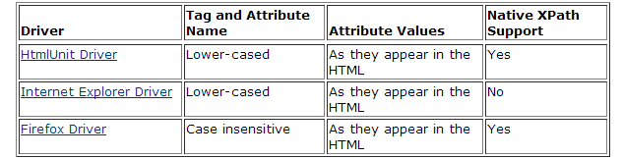
3.6 Locating by XPath
By XPATH:
At a high level, WebDriver uses a browser’s native XPath capabilities wherever possible. On those browsers that don’t have native XPath support, implementation is provided. This can lead to some unexpected behavior unless you are aware of the differences in the various xpath engines.

Slide 29
Contd…
XPath is the language used for locating nodes in an XML document using path expressions. It can also be written for HTML as HTML is also one form of XML.
XPath can be used to either locate the element in absolute terms (not advised), or relative to an element that does have an id or name attribute.
Absolute XPaths contain the location of all elements from the root (html) and as a result are likely to fail with only the slightest adjustment to the application.
Example - /html/body/form/input[@type=‘submit’]
‘/’ selects root node i.e. html
For instance, your page source could have structure as follows:
<html>
<body>
<form id="loginForm">
<input type="text" />
<input type="password" />
<input type="submit" value="Login" />
</form>
</body>
<html>
Notes:
Horizontal Image slide – Horizontal image with bulleted text
Title – font size 20, Arial
Click on the icon to add image, the size of the image will be automatically determined once inserted, do not alter the size of the image
In the text box below the bulleted text should not be beyond one line
Font size should be 20, Arial normal and should not exceed beyond 4 bullet points

Slide 30
Contd..
By finding a nearby element with an id or name attribute , you can locate your target element based on the relationship. This is much less likely to change and can make your tests more robust
Example - //form[@id=‘loginForm’]/input[@type=‘submit’]
‘//’ – selects any matching node, in this case a ‘form’
This is less likely to break in comparison with the absolute XPath
* wildcard refers to any node. For example, //*[@id=‘loginForm’]
@ refers to attribute name
Nodes can be referred by index. For example, //form[@id=‘loginForm’]/input[3] refers to third input element in the tree structure
Operators are supported. For example, //form[@id=‘loginForm’]/input[@type=‘submit’ and @value=‘Login’]
There are useful string functions like contains, starts-with. For example, //a[contains(text(), ‘account’)] matches <a>John’s account </a>
Notes:
Horizontal Image slide – Horizontal image with bulleted text
Title – font size 20, Arial
Click on the icon to add image, the size of the image will be automatically determined once inserted, do not alter the size of the image
In the text box below the bulleted text should not be beyond one line
Font size should be 20, Arial normal and should not exceed beyond 4 bullet points

Slide 31
Contd..
<html>
<body>
<form id="loginForm">
<input name="username" type="text" />
<input name="password" type="password" />
<input name="continue" type="submit" value="Login" />
<input name="continue" type="button" value="Clear" />
</form>
</body>
<html>
xpath=/html/body/form[1] - Absolute path (would break if the HTML was changed only slightly)
//form[1] - First form element in the HTML
xpath=//form[@id='loginForm'] - The form element with attribute named ‘id’ and the value ‘loginForm
Notes:
Horizontal Image slide – Horizontal image with bulleted text
Title – font size 20, Arial
Click on the icon to add image, the size of the image will be automatically determined once inserted, do not alter the size of the image
In the text box below the bulleted text should not be beyond one line
Font size should be 20, Arial normal and should not exceed beyond 4 bullet points

Slide 32
4. Waits and Timeouts

Slide 33
Why Wait?
Waiting is having the automated task execution elapse a certain amount of time before continuing with the next step
Waiting may be required for
A page to load
An action to complete, say Submit operation
An element to be available / clickable / visible
AJAX scripts to complete
Alert to be present
WebDriver provides 2 mechanisms for wait –
Implicit Wait
Explict Wait

Slide 34
4.1 Implicit Wait
An implicit wait is to tell WebDriver to poll the DOM for a certain amount of time when trying to find an element or elements if they are not immediately available.
The default setting is 0.
Sample Java Code
WebDriver will wait for maximum of 10 seconds for the element to be found. If found before 10 seconds, wait will cease.
WebDriver driver = new FirefoxDriver();
driver.manage().timeouts().implicitlyWait(10, TimeUnit.SECONDS);
driver.get("http://somedomain/url_that_delays_loading");
WebElement myDynamicElement = driver.findElement(By.id("myDynamicElement"));

Slide 35
4.2 Explicit Wait
An explicit wait is code to define to wait for a certain condition to occur before proceeding further in the code
Requires usage of 2 classes – WebDriverWait and ExpectedConditions
WebDriverWait defines maximum seconds to wait and polling interaval
ExpectedConditions defines what to wait for
Sample Java Code
WebDriver will wait for maximum of 10 seconds for the element to be found. If found before 10 seconds, wait will cease.
Throws TimeoutException if not found within 10 seonds
Default poll interaval is 500 milliseconds
WebDriver driver = new FirefoxDriver();
driver.get("http://somedomain/url_that_delays_loading");
WebElement myDynamicElement = (new WebDriverWait(driver, 10))
.until(ExpectedConditions.presenceOfElementLocated(By.id("myDynamicElement")));

Slide 36
Contd..
Possible Expected Conditions includes but is not restricted to
Element is present
Element is visible
Element is clickable
Element to be selected
Alert is present
Frame is available
Text is present
Expected Window title
Reference - http://selenium.googlecode.com/git/docs/api/java/org/openqa/selenium/support/ui/ExpectedConditions.html
Notes:
Horizontal Image slide – Horizontal image with bulleted text
Title – font size 20, Arial
Click on the icon to add image, the size of the image will be automatically determined once inserted, do not alter the size of the image
In the text box below the bulleted text should not be beyond one line
Font size should be 20, Arial normal and should not exceed beyond 4 bullet points

Slide 37
4.3 TimeOuts
Implicit Wait mechanism specifies the timeout for a web element to load in a Webdriver instance
The other 2 timeouts are
Method | Description
Webdriver.manage().timeouts().pageLoadTimeout() | Sets the amount of time to wait for a page load to complete before throwing an error
Webdriver.manage().timeouts().setScriptTimeout() | Sets the amount of time to wait for an asynchronous script to finish execution before throwing an error

Slide 38
5.Remote Web Driver

Slide 39
5.1. Remote Web Driver Introduction
The Remote WD is composed of two pieces: a client and a server. The client is your Web Driver test and the server is simply a Java servlet
The server can be started from the command line as:
java -jar selenium-server-standalone-{VERSION}.jar port.
The selenium-server keeps in-memory logs for each on-going session, which are cleared when Selenium#stop() or WebDriver#quit is called. If you forget to terminate these sessions your server may leak memory.

Slide 40
Contd…
Installing:
Copy "webdriver-all.jar" and all the associated JARs to your CLASSAPATH. This will give you the remote webdriver client.
Pro’s:
Separates where the tests are running from where the browser is.
Allows tests to be run with browsers not available on the current OS (because the browser can be elsewhere)

Slide 41
Contd…
Cons:
Requires an external servlet container to be running
You may find problems with line endings when getting text from the remote server
Introduces extra latency to tests, particularly when exceptions are thrown.

Slide 42
5.2. Remote Web Driver Modes
The remote webdriver comes in two flavours:
1) Client mode:
where the language bindings connect to the remote instance. This is the way that Firefox driver, Opera driver and remote Webdriver client normally work.
2) Server mode:
where the language bindings are responsible for setting up the server, which the driver running in the browser can connect to. The Chrome driver works in this way.

Slide 43
6.TestNG framework

Slide 44
6.1. Introduction
TestNG is a testing framework designed to simplify a broad range of testing needs, from unit testing to integration testing. Writing a test is typically a three-step process:
1) Write the business logic of your test and insert TestNG annotations in your code.
2) Add the information about your test (e.g. the class name, the groups you wish to run, etc...) in a testng.xml file or in build.xml.
3) Run TestNG.

Slide 45
Contd…
Some of the basic concepts are:
A suite is represented by one XML file. It can contain one or more tests and is defined by the <suite> tag.
A test is represented by <test> and can contain one or more TestNG classes.
A TestNG class is a Java class that contains at least one TestNG annotation. It is represented by the <class> tag and can contain one or more test methods.
A test method is a Java method annotated by @Test in your source.

Slide 46
6.2. Why TestNG?
TestNG handles dependency between test cases.
If one test case failure causes the failure of a group of test cases it skips that group and executes the rest of the test suite. The group that has dependency on the failed test cases is reported as skipped NOT failed.
In TestNG groups can be defined. Groups are specific subsets of the test suite. We can choose to run only specific subset of the test suite say database related test cases instead of running the entire test suite.
TestNG supports parameterization for objects

Slide 47
7.TestNG annotations

Slide 48
7.1. Annotations in TestNG
@BeforeSuite: The annotated method will be run before all tests in this suite have run.
@AfterSuite: The annotated method will be run after all tests in this suite have run.
@BeforeTest: The annotated method will be run before any test method belonging to the classes inside the <test> tag is run.
@AfterTest: The annotated method will be run after all the test methods belonging to the classes inside the <test> tag have run.

Slide 49
Contd…
@BeforeGroups: The list of groups that this configuration method will run before. This method is guaranteed to run shortly before the first test method that belongs to any of these groups is invoked.
@AfterGroups: The list of groups that this configuration method will run after. This method is guaranteed to run shortly after the last test method that belongs to any of these groups is invoked.
@BeforeClass: The annotated method will be run before the first test method in the current class is invoked.

Slide 50
Contd…
@AfterClass: The annotated method will be run after all the test methods in the current class have been run.
@BeforeMethod: The annotated method will be run before each test method.
@AfterMethod: The annotated method will be run after each test method.

Slide 51
7.2. Attributes of TestNG Annotations
alwaysrun:
For before methods (beforeSuite, beforeTest, beforeTestClass and beforeTestMethod, but not beforeGroups): If set to true, this configuration method will be run regardless of what groups it belongs to. For after methods (afterSuite, afterClass, ...): If set to true, this configuration method will be run even if one or more methods invoked previously failed or was skipped.
dependsOnGroups:
The list of groups this method depends on.

Slide 52
Contd…
dependsOnMethods:
The list of methods this method depends on.
Enabled:
Whether methods on this class/method are enabled.
inheritGroups:
If true, this method will belong to groups specified in the @Test annotation at the class level.

Slide 53
7.3 @DataProvider Annotation
@DataProvider
Marks a method as supplying data for a test method.
The annotated method must return an Object[][] where each Object[] can be assigned the parameter list of the test method.
The @Test method that wants to receive data from this DataProvider needs to use a dataProvider name equals to the name of this annotation.

Slide 54
7.3. Attributes of @DataProvider
Name:
The name of this data provider. If it's not supplied, the name of this data provider will automatically be set to the name of the method
Parallel:
.
If set to true, tests generated using this data provider are run in parallel. Default value is false.

Slide 55
Some other Annotations…
@Factory:
Marks a method as a factory that returns objects that will be used by TestNG as Test classes. The method must return Object[].
@Listeners:
Defines listeners on a test class. It has one attribute- value.
@Parameters:
Describes how to pass parameters to a @Test method. It has one attribute- value.

Slide 56
7.4. @Test Annotation and its attributes
Marks a class or a method as part of the test.
The attributes are:
alwaysRun:
If set to true, this test method will always be run even if it depends on a method that failed.
dataProvider:
The name of the data provider for this test method.

Slide 57
Contd…
dataProviderClass:
The class where to look for the data provider. If not specified, the data provider will be looked on the class of the current test method or one of its base classes. If this attribute is specified, the data provider method needs to be static on the specified class.
dependsOnGroups:
The list of groups this method depends on.

Slide 58
Contd…
dependsOnMethods:
The list of methods this method depends on.
Enabled:
Whether methods on this class/method are enabled.
Groups:
The list of groups this class/method belongs to.
Priority:
The priority for this test method. Lower priorities will be scheduled first.

Slide 59
Contd…
successPercentage:
The percentage of success expected from this method.
timeOut:
The maximum number of milliseconds this test should take.
singleThreaded:
If set to true, all the methods on this test class run in the same thread, even if the tests are currently being run with parallel="methods". This can only be used at the class level and it will be ignored if used at the method level).

Slide 60
7.5. Test groups
TestNG allows you to perform sophisticated groupings of test methods.
Not only can you declare that methods belong to groups, but you can also specify groups that contain other groups.
Then TestNG can be invoked and asked to include a certain set of groups (or regular expressions) while excluding another set.
This gives you maximum flexibility in how you partition your tests and doesn't require you to recompile anything if you want to run two different sets of tests back to back.

Slide 61
Contd…
Groups are specified in your testng.xml file and can be found either under the <test> or <suite> tag. Groups specified in the <suite> tag apply to all the <test> tags underneath. Note that groups are accumulative in these tags: if you specify group "a" in <suite> and "b" in <test>, then both "a" and "b" will be included.
For example, it is quite common to have at least two categories of tests
a) Check-in tests. These tests should be run before you submit new code. They should typically be fast and just make sure no basic functionality was broken.

Slide 62
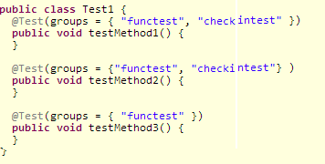
Contd…
b) Functional tests. These tests should cover all the functionalities of your software and be run at least once a day, although ideally you would want to run them continuously.
Example:

Slide 63
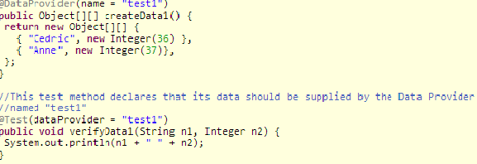
7.6. Parameterizing in TestNG
A Data Provider is used to supply the values you need to a test. A Data Provider is a method on your class that returns an array of array of objects. This method is annotated with @DataProvider:

Slide 64
7.7. Dependencies
Sometimes, you need your test methods to be invoked in a certain order. Here are a few examples:
To make sure a certain number of test methods have completed and succeeded before running more test methods.
To initialize your tests while wanting this initialization methods to be test methods as well (methods tagged with @Before/After will not be part of the final report).
TestNG allows you to specify dependencies either with annotations or in XML.

Slide 65
Contd…
There are two kinds of dependencies:
Hard dependencies. All the methods it depends on must have run and succeeded for it to run. If at least one failure occurred in your dependencies, it will not be invoked and marked as a SKIP in the report.
Soft dependencies. It will always be run after the methods it depends on, even if some of them have failed.. A soft dependency is obtained by adding "alwaysRun=true" in your @Test annotation.

Slide 66

Contd…
Example for HardDependency

Slide 67
7.8 Failed Tests
Every time tests fail in a suite, TestNG creates a file called testng-failed.xml in the output directory. This XML file contains the necessary information to rerun only these methods that failed, allowing you to quickly reproduce the failures without having to run the entirety of your tests. Therefore, a typical session would look like this:
java -classpath testng.jar;%CLASSPATH% org.testng.TestNG -d test-outputs testng.xml
java -classpath testng.jar;%CLASSPATH% org.testng.TestNG -d test-outputs test-outputs\testng-failed.xml

Slide 68
7.9. TestNG listeners
There are several interfaces that allow you to modify TestNG's behavior. These interfaces are broadly called "TestNG Listeners". Here are a few listeners: IAnnotationTransformer (doc, javadoc)
IAnnotationTransformer2 (doc, javadoc)
IHookable (doc, javadoc)
IInvokedMethodListener (doc, javadoc)
IMethodInterceptor (doc, javadoc)
IReporter (doc, javadoc)
ISuiteListener (doc, javadoc)
ITestListener (doc, javadoc)

Slide 69
8.Build Tools

Slide 70
8.2. Ant build tool
Apache Ant is a software tool for automating software build processes. It requires the Java platform,and is best suited to building Java projects.
Ant uses XML to describe the build process and its dependencies.
t is open source software,and is released under the Apache Software License.
Ant has limited fault handling rules, and no persistence of state, so it cannot be used as a workflow tool for any workflow other than classic build and test processes.

Slide 71
8.3. Maven build tool
Maven is a build automation tool used primarily for Java projects. Maven serves a similar purpose to the Apache Ant tool, but it is based on different concepts and works in a different manner.
It can also be used to build and manage projects written in C#, Ruby, and other languages.
Maven uses an XML file to describe the software project being built, its dependencies on other external modules and components, the build order, directories, and required plug-ins.
It comes with pre-defined targets for performing certain well-defined tasks such as compilation of code and its packaging.

Slide 72
9.Page Object Design Pattern

Slide 73
9.1 What is Page Object Design Pattern?
PageObject is a Design Pattern which has become popular in test automation for enhancing test maintenance and reducing code duplication.
A page object is an object-oriented class that serves as an interface to a page of your AUT.
The tests then use the methods of this page object class whenever they need to interact with that page of the UI.
The benefit is that if the UI changes for the page, the tests themselves don’t need to change, only the code within the page object needs to change.
Subsequently all changes to support that new UI are located in one place.
Page Objects are meant to encapsulate the messy internal state of a page.
In a simple form of Page Object Model, Create two packages – one will contain one java file which contains the objects of all the pages in an application and other package will contains all smoke test java files which will utilize those objects.

Slide 74
Page Factory
In order to support Page Object Design Pattern. Web Driver Supports a library that contains a factory class.
There is a Page Factory in the Support package that provides support for this pattern.
Using Page Factory under test file, we can access these page objects in other java file.
While creating any object, if you use the Page Factory , you can assume the fields are initialised, else NullPonterExceptions will be thrown.

Slide 75
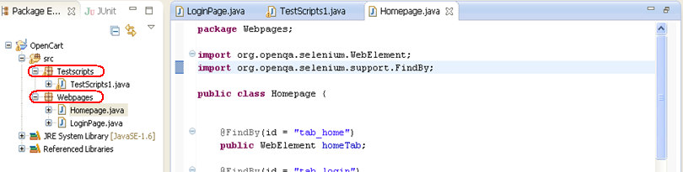
9.2 Creating Objects In Page Object Design Pattern
Create all the page objects in one java file (or create the objects on page level under one java folder )and then create the test file in other file (or under other java folder). There is a Page Factory in the support package that provides support for this pattern. Using Page Factory under test file, we can access these page objects in other java file.

Slide 76
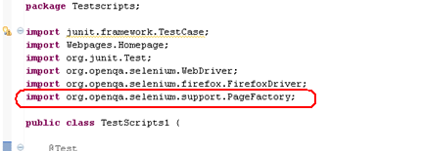
Contd..

Slide 77
@FindBy and @FindBys Annotation
Fields are decorated if and only if they have @FindBy or @FindBys annotation.
Default search strategy "by id or name" that works for WebElement fields is hardly suitable for lists because it is rare to have several elements with the same id or name on a page.
If you never use a WebElement field in a PageObject, there will never be a call to "findElement" for it.

Slide 78
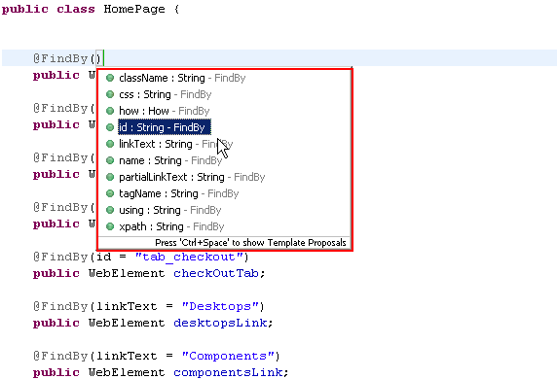
Contd…

Slide 79
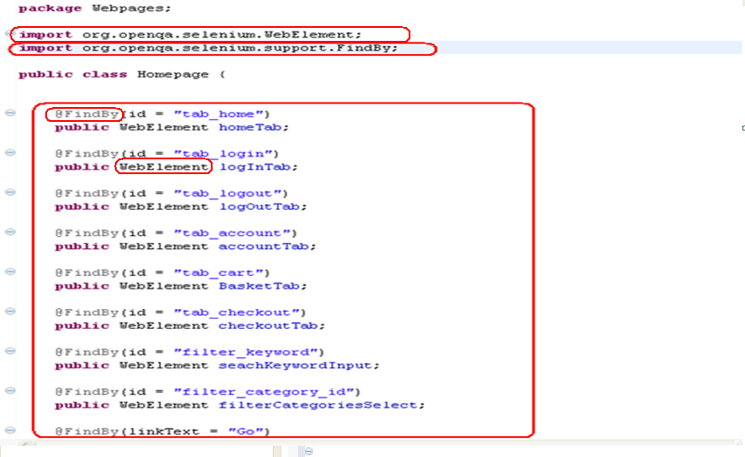
Contd…

Slide 80
InitElement Methods
Page Factory class provides four variations of InItElements methods which can be used based on the project requirement.
Based on the requirement, we can use one or all of them in a single framework so that we can attain the respective functionality.
ElementLocatorFactory:
InitElements method will contain an “ElementLocatorFactory”.
ElementLocatorFactory: is used for providing the mechanism for fniding elements.methods.
Syntax:
initElements(ElementLocatorFactory factory, java.lang.Object page)

Slide 81
InitElement Methods
2. FieldDecorator
InitElements method will contain an FieldDecorator.
FieldDecorator is used for decorating each of the fields.
Syntax:
initElements(FieldDecorator decorator, java.lang.Object page)

Slide 82
InitElement Methods
3 .Page Class
.InitElements method which will contain a page class.
Syntax:
initElements(WebDriver driver,java.lang.Class<T> pageClass)
Instantiate an instance of the given class, and set a proxy for each of the WebElement and List fields that have been declared, assuming that the field name is also the HTML element's "id" or "name". Means there will be an element that can be located using the xpath expression.

Slide 83
InitElement Methods
4.PageClass Variation
InitElements method will contain a page class similar to variation:
Syntax:
initElements(WebDriver driver, java.lang.Object page)
As initElements(org.openqa.selenium.WebDriver, Class) but will only replace the fields of an already instantiated Page Object.

Slide 84
9.3 Advantages of PODM
The following are the advantages of Page Object Design Pattern:
There is clean separation between test code and page specific code such as locators (or their use if you’re using a UI map) and layout.
There is single repository for the services or operations offered by the page rather than having these services scattered through out the tests.
In both cases this allows any modifications required due to UI changes to all be made in one place.

Slide 85
9.3 Dis Advantages of PODM
The following are the disadvantages of Page Object Design Pattern:
There is no separation between the test method and the AUTs locators (IDs in this example); both are intertwined in a single method. If the AUT’s UI changes its identifiers, layout, or how a login is input and processed, the test itself must change.
The id-locators would be spread in multiple tests, all tests that had to use this login page.

Slide 86
10.Selenium Grid

Slide 87
10.1 Selenium Grid Intro
Selenium-Grid allows you run your tests on different machines against different browsers in parallel.
Rrunning multiple tests at the same time against different machines running different browsers and operating systems.
Essentially, Selenium-Grid support distributed test execution. It allows for running your tests in a distributed test execution environment.

Slide 89
Reference
seleniumhq.org
Selenium Grid:
http://www.seleniumhq.org/docs/07_selenium_grid.jsp
Selenium Core:
http://lostechies.com/derickbailey/2009/08/27/how-to-get-started-with-selenium-core-and-asp-net-mvc/

Slide 91
Reference
Relevant topics in http://www.seleniumhq.org/docs/
HTML Tutorial at http://www.w3schools.com/html/default.asp
JavaScript Tutorial at http://www.w3schools.com/js/default.asp
CSS Tutorial at http://www.w3schools.com/css/default.asp
XPath Tutorial at http://www.w3schools.com/xpath/default.asp
CSS Selectors at https://saucelabs.com/resources/selenium/css-selectors
Relevant topics in http://testng.org/doc/documentation-main.html
Page Objects - http://www.guru99.com/page-object-model-pom-page-factory-in-selenium-ultimate-guide.html
Videos in CoE Repository
https://openconnect.wipro.com/community/262/wikis
RealSteel Project Executions in the CoE
WebDriver W3C http://www.w3.org/TR/webdriver/#navigation
Simon Stewart on Selenium http://www.aosabook.org/en/selenium.html
Webdriver Javadoc http://selenium.googlecode.com/git/docs/api/java/allclasses-noframe.html
(these must be referred mandatorily before appearing UCF)

Slide 92
Thank You
Notes:
Thank you slide with the customer logo:
Should have only the details shown here. Logo placement cannot be changed. Wipro logo to appear on the left as per our corporate guidelines.
Thank you– font size 30, Arial Bold
Name & Designation – font size 18, Arial normal, not to exceed beyond 2 lines
Your/contact email id – font size 18, Arial normal

