Slide 1
PERSONAL assistant
By(Vikash kumar gupta,18BCS6641)

Slide 2
What is voice assistant :-
A personal assistant is a computerized assistant that utilizations voice acknowledgment, natural combination, and regular language handling (NLP) to offer a support through a specific application.

Slide 3
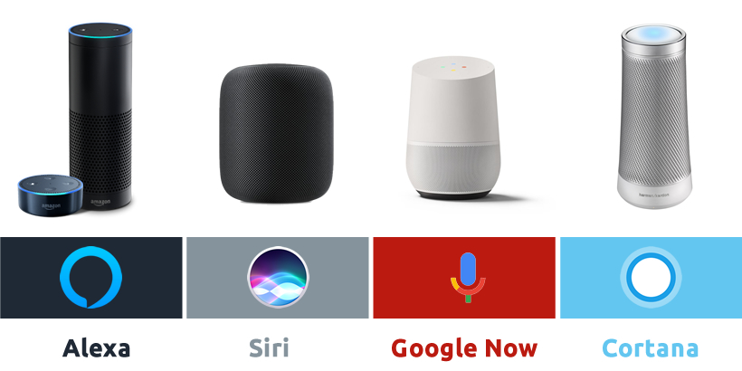
Example :-

Slide 4
Future of voice assistant :-
As AI becomes more advanced and voice technology becomes more accepted, not only will voice controlled digital assistants become more natural, they will also become more integrated into more daily devicesas it was estimated in early 2019 that 111.8 million people in the US will use a voice assistant at least monthly, up 9.5% from last year.

Slide 5
Services :-
Provide information such as weather, facts from e.g. Wikipedia or IMDb
Play videos, TV shows or movies on televisions, streaming
Assist public interactions with government

Slide 6
Requirements:
Hardware Requirements
A touch screen or any other pointing device is required by the user in order to interact with the system.
A microphone is required to implement speech to text.
Speakers are required to receive audio outputs
Software Requirements
Libraries such as numpy, pandas etc.
Python 3
PYTHON IDE such as spyder or Jupyter.
System Features

Slide 7
Drawback of voice assistant :-
Privacy
Accuracy
Snapshots Ahead:-

Slide 8
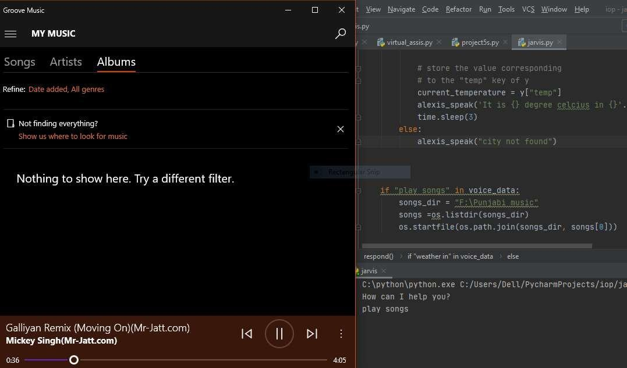

Slide 9
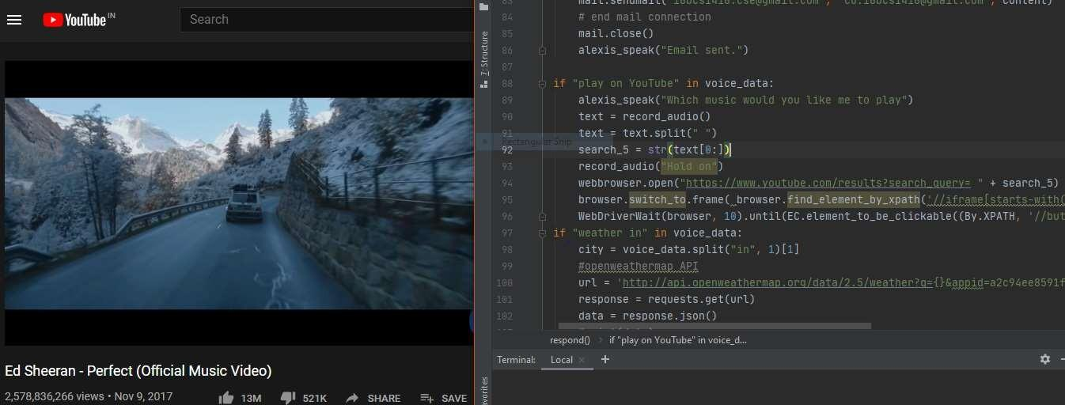

Slide 10
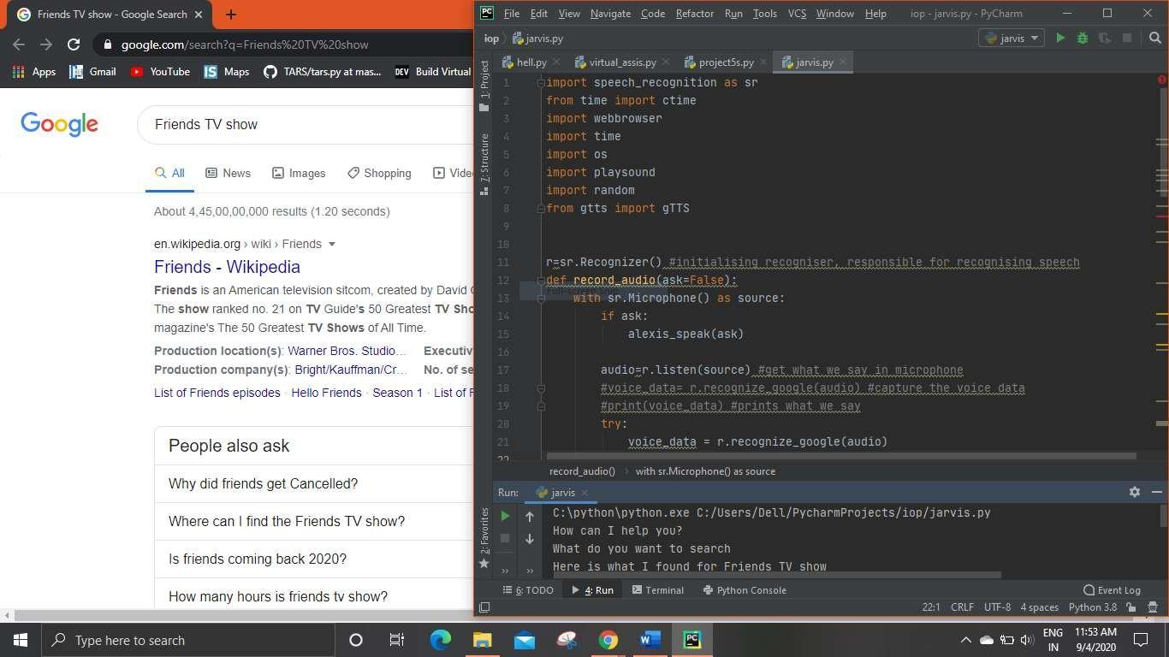

Slide 11
Thank you

