Slide 1

DROWSINESS DETECTION
BY BETA HACKERS
VIKASH,
BIBHUTI, SAHIN

Slide 2
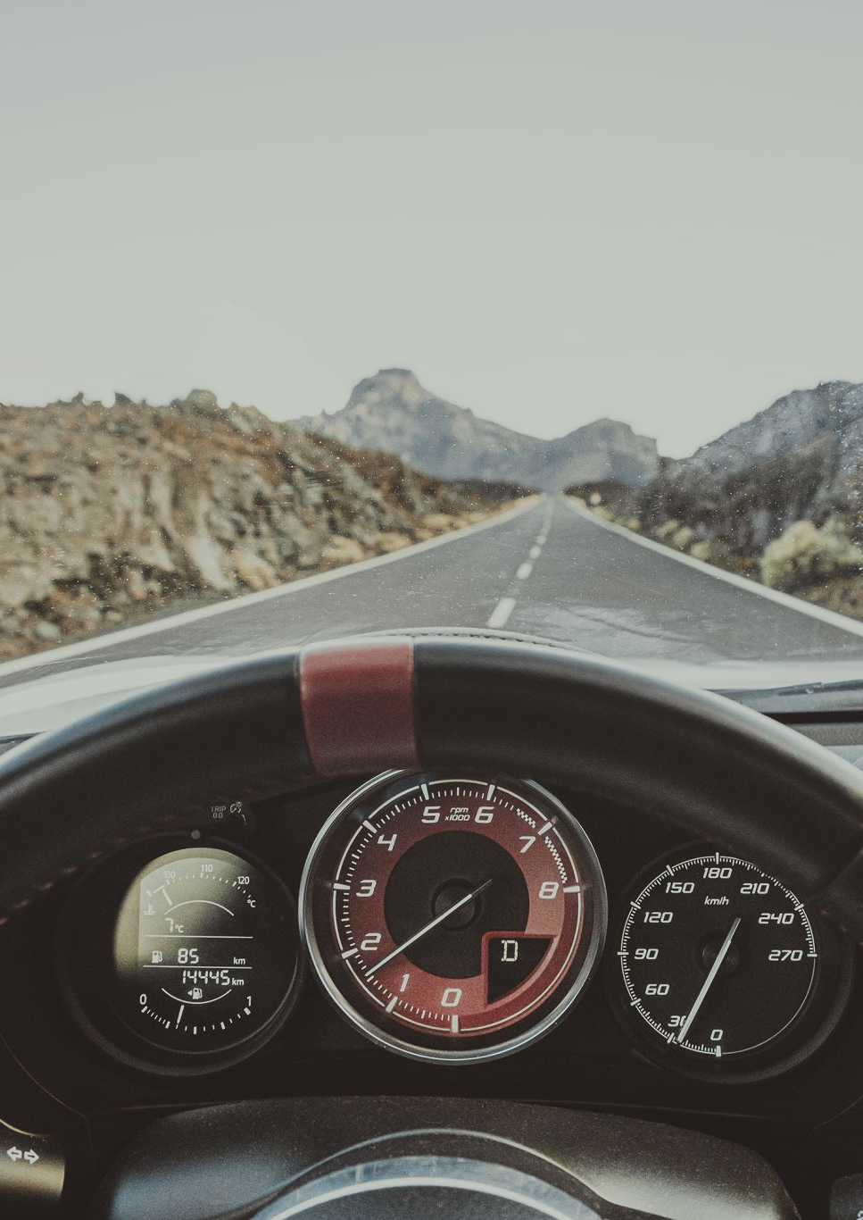
INTRODUCTION
This project is focused on detecting drowsiness based on images and alert them. Therefore, a model is built which can help achieve this with sufficient accuracy.

Slide 3
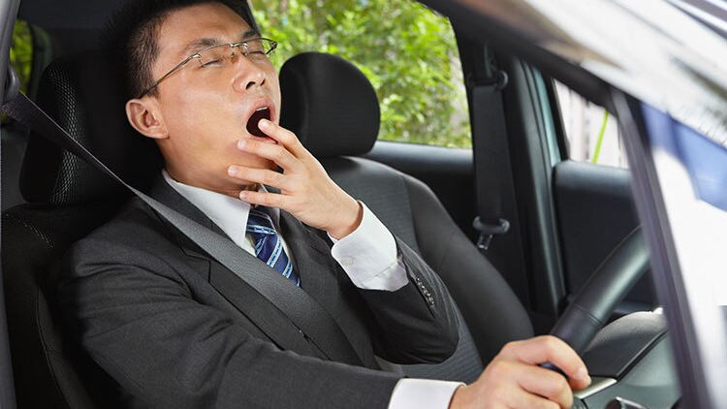
MOTIVATION
A lot of drivers feel lazy or sleepy sometimes which could lead to fatal accidents.
To reduce these accidents, a system should be developed which can identify the expressions and then alert the person in advance.
This could save a lot of lives. This project will be helpful in that case.

Slide 4
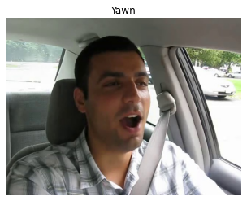
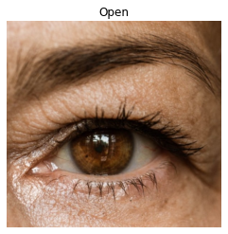
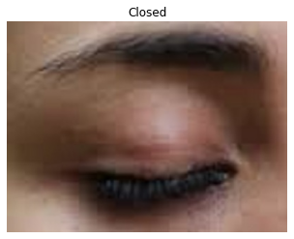
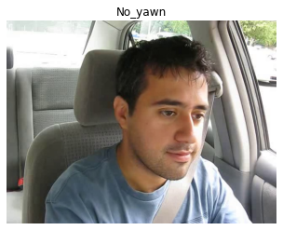
PROBLEM STATEMENT
TO PREDICT THE PHYSICAL CONDITION OF THE DRIVER BASED ON TRAINING IMAGES GIVEN WITH OPEN EYE,CLOSED EYE, YAWNING,NO YAWNING, WITH BETTER ACCURACY AND LESS TIME.

Slide 5
Project Scope
Proof Of Concept (POC)
Prototype
Minimum Viable Product (MVP)
collect data
Verify images
Build some baseline models
Test the models and analyse the results
Verify new unseen data to test the models
Visualize model activations to analyse what the model is seeing.
Create a demo app
Deploy one model to check the feasibility and performance.
Design the UI
Create App to detect drowsy drivers in a vehicle based on the images taken by a camera .
API Server for uploading images and predicting using best model.

Slide 6
Project Workflow and Timeline (updated)
POC(1 week)
Prototype(2 weeks
MVP(2 weeks)
Data Collection ✓
Setup Experiment Tracking
Build Baseline Models ✓
Build Better Models
Project, Containers, Deployment Setup
Build drowsiness detection app

Slide 7
Process Flow
Colab
Notebooks
- EDA
- Train model
- Evaluate
Google
Data Collection
Data / Model Store
App
- Collect relevent images
- Organize / Save image
- Verify images
- Images
- Labels
- Models
- Metrics
- Upload Image
- Make Prediction
- View Results

Slide 8
DATA
IMAGE CLASSES/LABELS: 'Closed','no_yawn', 'Open', 'yawn'
EACH CLASS HAS 617 IMAGES IN TRAIN SET
EACH CLASS HAS 109 IMAGES IN TEST SET

Slide 9
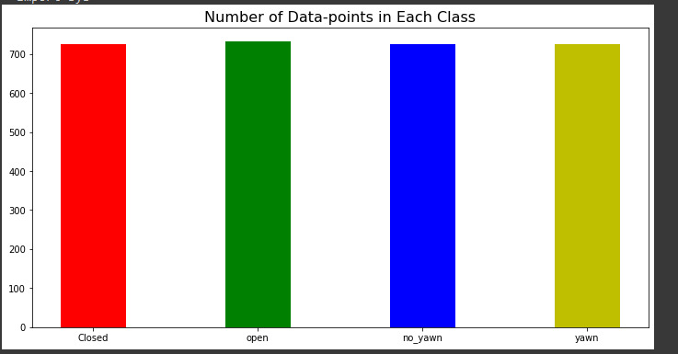
EDA
As evident from plot , we have a balanced dataset

Slide 10
Models
Computer Vision Task:
Baseline CNN model
Data augmentation
Transfer learning

Slide 11
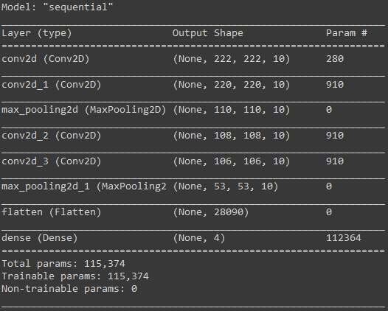
Base-line Model (Without Data Augmentation)

Slide 12
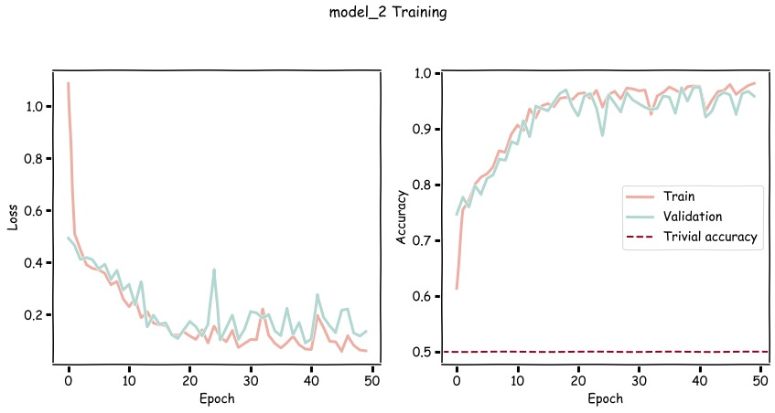
Model Assessment

Slide 13
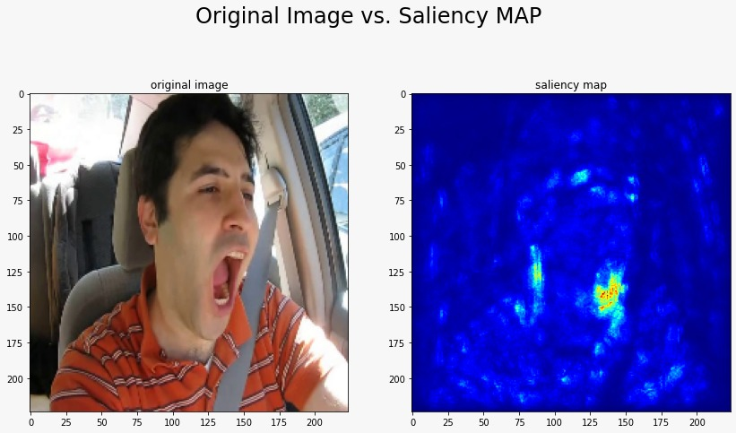
Model Assessment

Slide 14
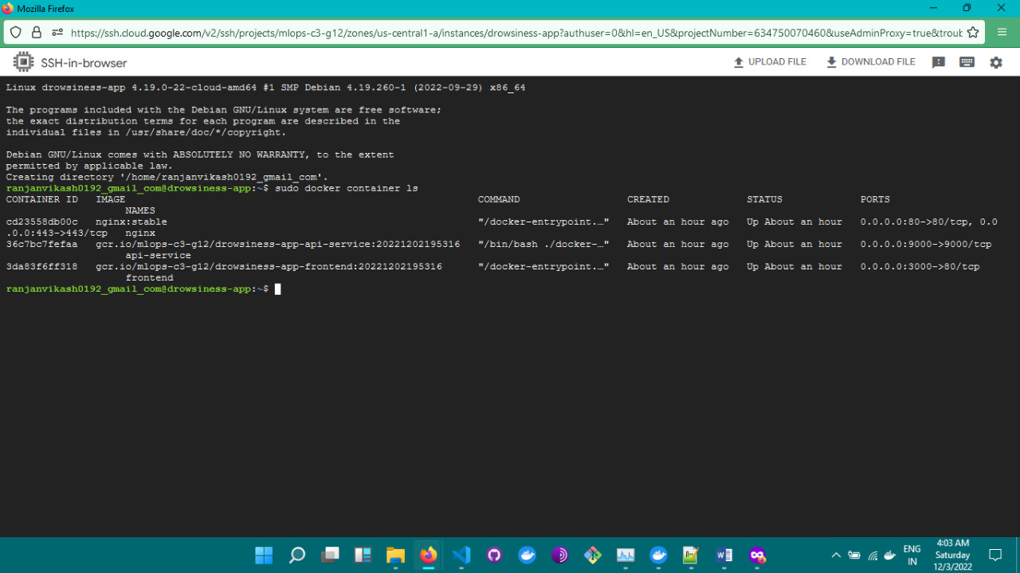
Model deployment

Slide 15
GCP
Container -1
Container -2
API Service
Frontend API
Run Model serving API
Run web app interface and provide the prediction

Slide 16
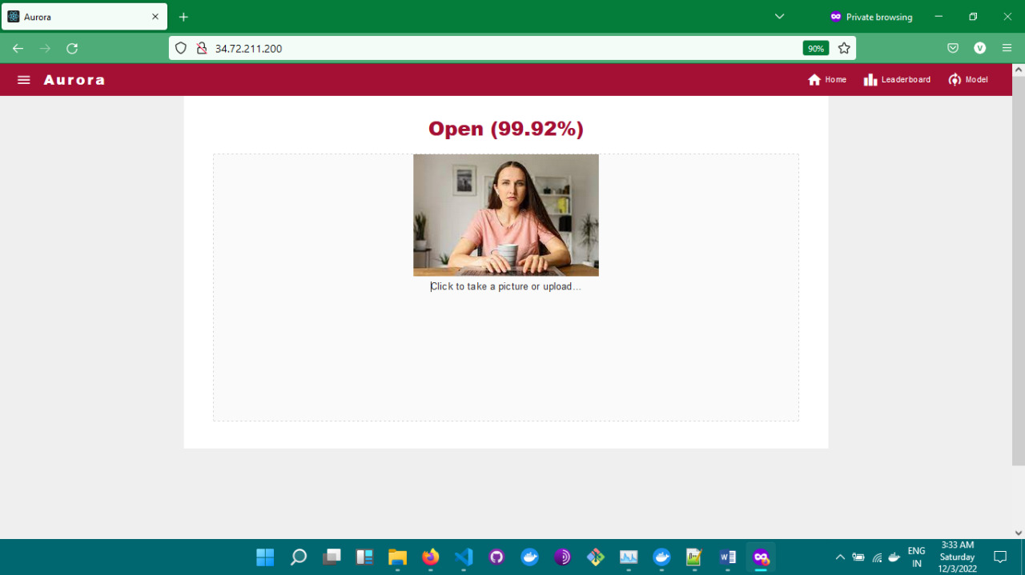
App sample predictions

Slide 17
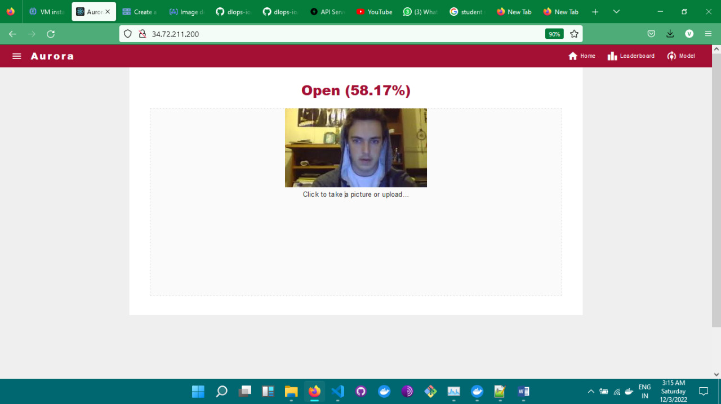

Slide 18
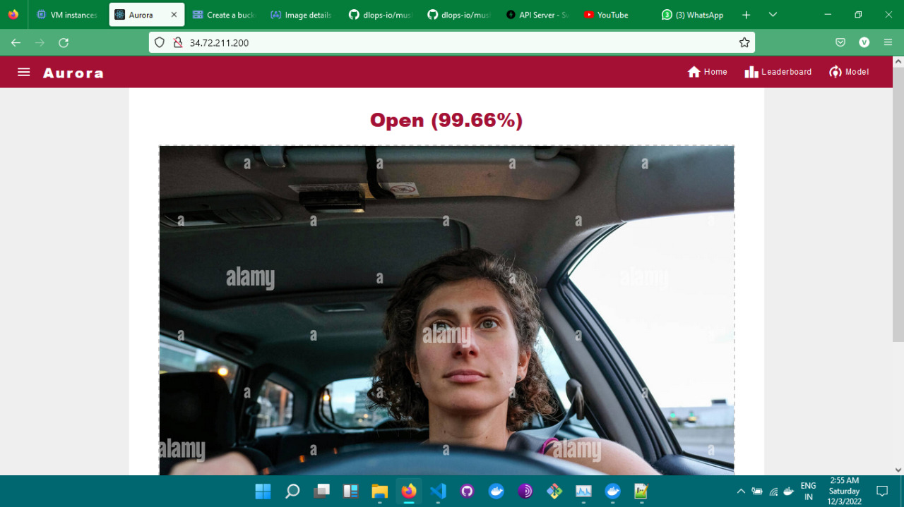

Slide 19
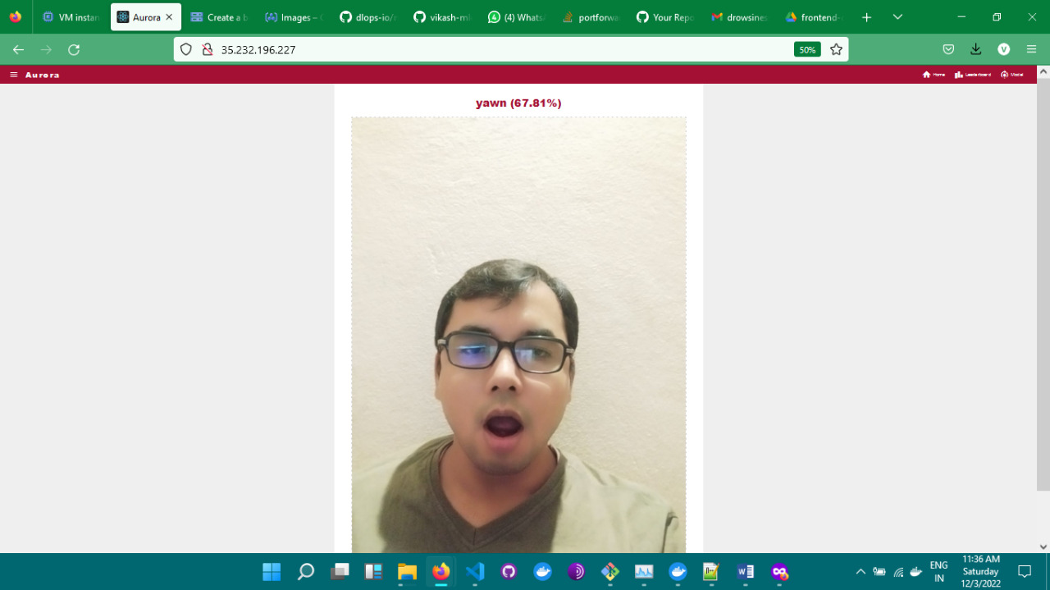

Slide 20
Web-app Demo
app.aurora.go

Slide 21
Thank You !!

