Slide 1


Build a self-checkout solution for a Retailer
Lowe’s Campus Hackathon
Vikash vishwakarma

Slide 2
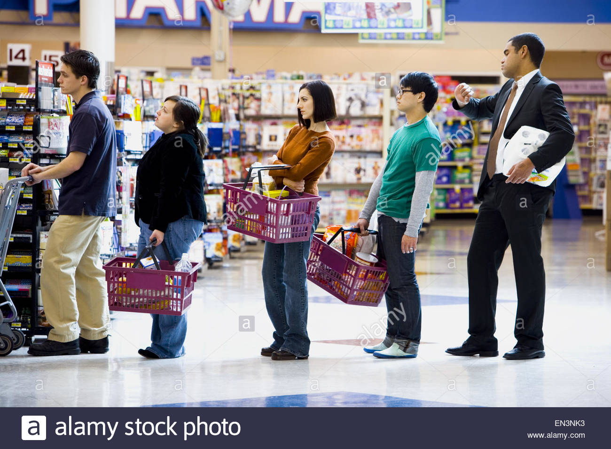
Let understand the problem
Why i am standing,
Why i can’t do payment directly
.
Solution
A simple mobile application
How ?

Slide 3
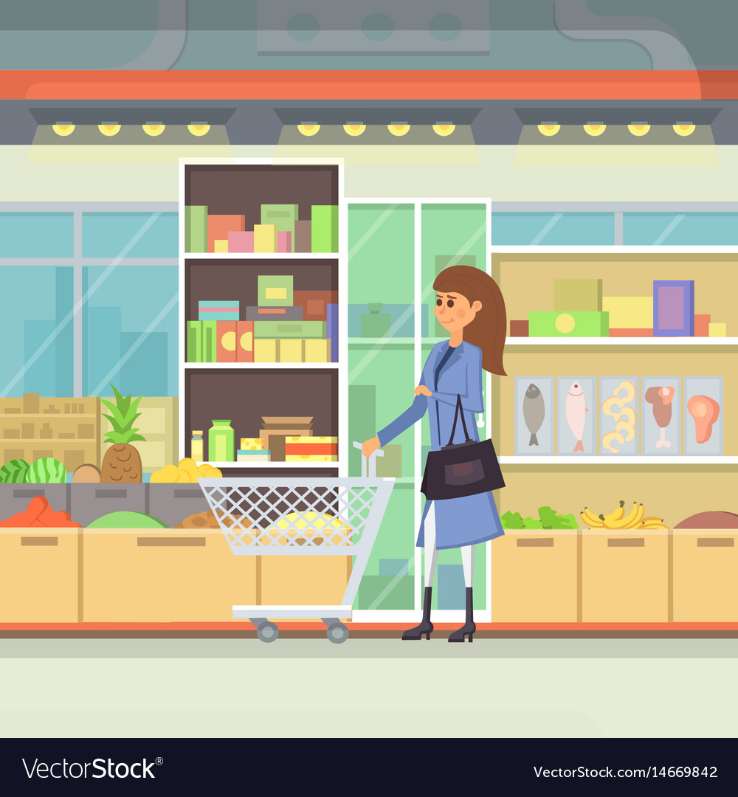

1. Instant payment
While product collections we can
Maintain product list
We can scann bar code with our
Phone . What ever price will be
listed
PName | Price | tax | discount | Total
maggi | 100 | 20 | 20 | 120

Slide 4
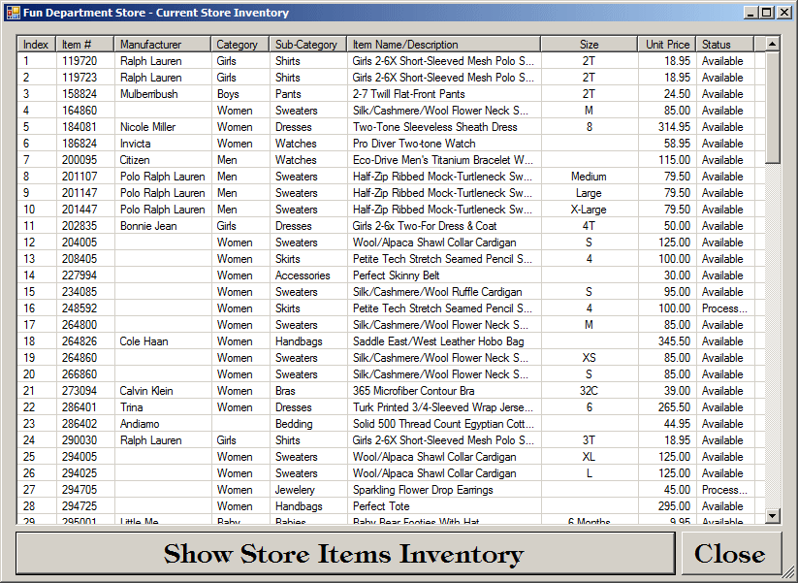
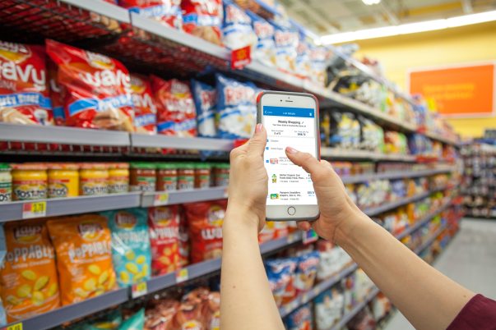
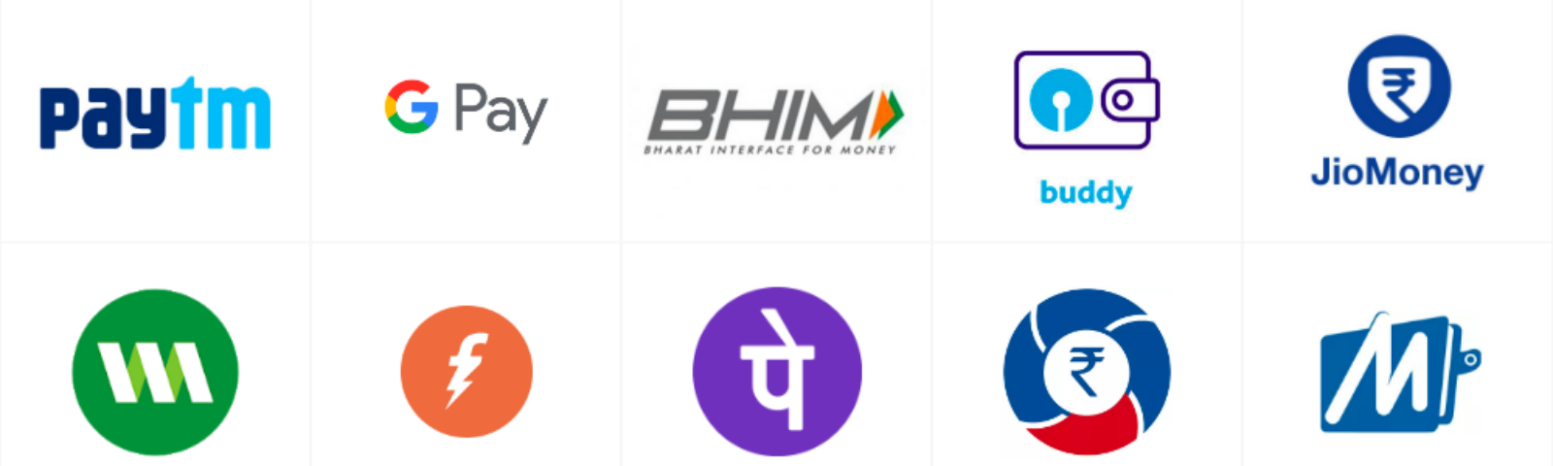
How it work
After payment
Qty.No will reduce
Total =10000 | Payment

Slide 5
Advantage
Save Resources like computer,barcode,cash....
Space matter for shop , will reduce
Empolyee cost reduction
Long Queue ??
Custumer friendly
People will divert from online to offline
Simple to impliment and use this application
Now It is more beneficial in covid-19 situation

