Slide 1
Cloud-Computing
By: Vikash Verma

Slide 2

Cloud Computing
Cloud computing is the on-demand delivery of compute power, databases, storage, application and other IT resources through a cloud services platform via internet with pay-as-you-go pricing model.
Cloud computing is the practice of using remote servers on the internet for carrying out a task, rather than using our computers/servers.

Slide 3
Advantages of Cloud Computing
Little or no investment
More focus on app development
Requires less Workforce
On demand self service
Board Network Access
Scalability
Resource pooling
Measured Services

Slide 4
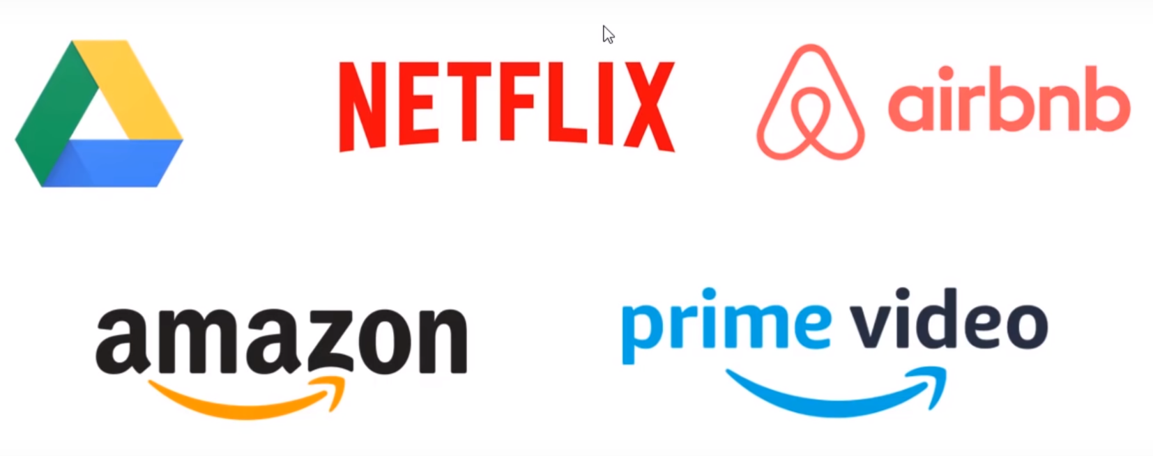
Cloud Products

Slide 5
Cloud Computing Models
There are two kinds of models in Cloud Computing:
Deployment Models
Pubic Cloud
Private Cloud
Hybrid Cloud
Service Models
Infrastructure as a service (IAAS)
Platform as a service (PAAS)
Software as a service (SAAS)

Slide 6
Cloud Computing Models-Deployment
Public Cloud : Public cloud is defined as computer services offered by third- party providers over the public Internet, making them available to anyone who wants to use or purchase them.
Private Cloud : Private cloud refers to a model of cloud computing where IT services are provisioned over private IT infrastructure for the dedicated use of single organisation.
Hybrid Cloud : Hybrid cloud computing environment that uses a mix of on-premises, private cloud and third-party, public cloud services with orchestration between the two platforms.

Slide 7
Cloud Computing Models-Services
Infrastructure as a Service: Infrastructure as a service refers to providing the complete access to the server’s OS. Typically, Iaas provides hardware, storage, servers and data centre space or network components. it may also include softwares.Ex.EC2
Platform as a Service : In platform as a Service, One does not get access to the whole Operating system. Rather access is given at a Dashboard level, where a user uploads the data, and the rest is taken care by the cloud provider Elastic Beanstalk
Software as a Service : Software as a Service refers to the practice of directly providing the software to the customer, without making any server or dashboard available to them. Ex. Facebook

Slide 8
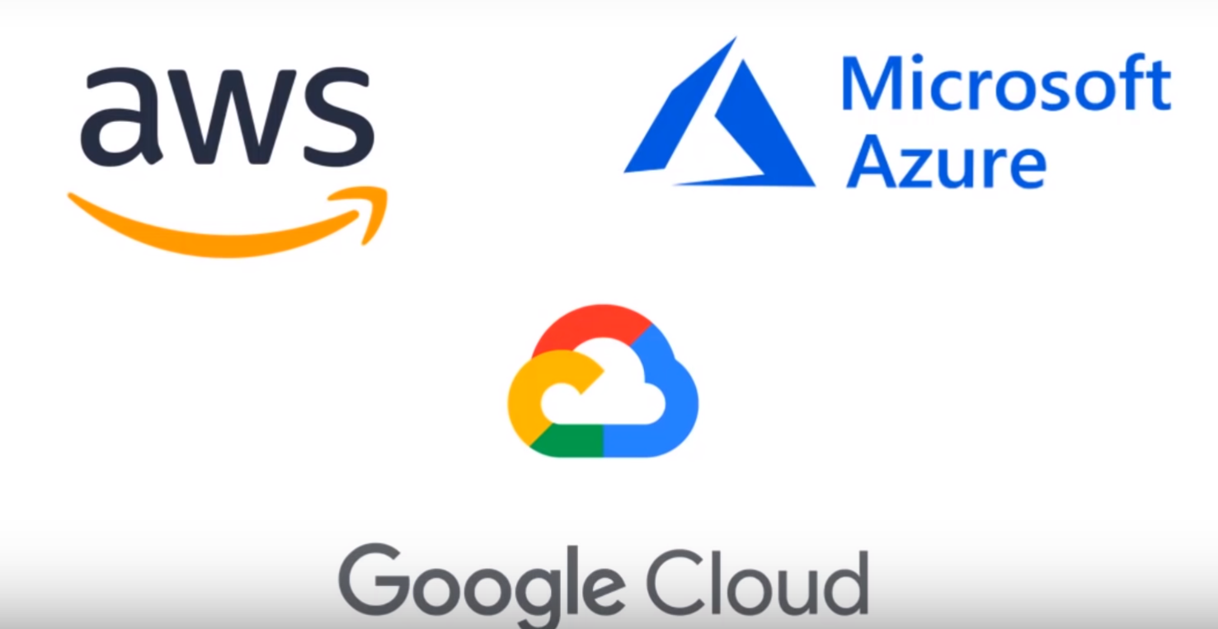
Top Cloud players
AWS
Microsoft Azure
GCP
Alibaba Cloud
IBM Cloud
VMware
Fujitsu
Oracle

