Slide 1
Docker
BY: Vikash Verma

Slide 2
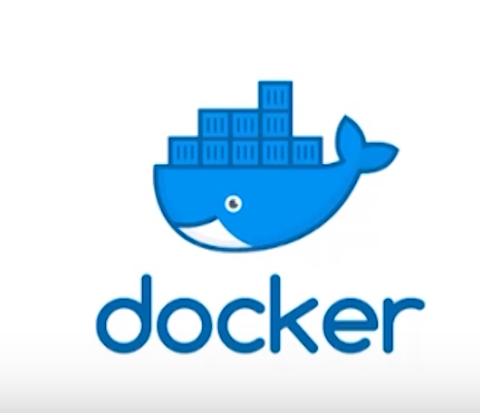
What is Docker?
Docker is a computer program that performs operating-system-level virtualization, also known as “Containerization". It was first released in 2013 and is developed by Docker. Inc. Docker is used to run software packages called “Containers”.

Slide 3
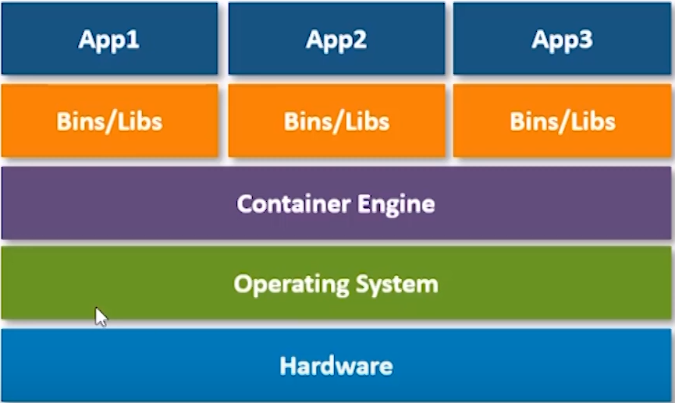
What is Docker?
Application containerization is an OS-level virtualization method used to deploy and run distributed applications without launching an entire virtual machine (VM) for each app.

Slide 4
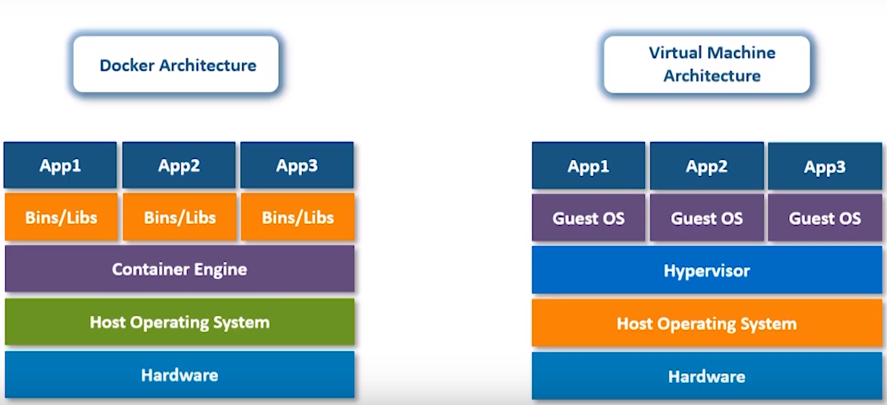
Docker vs Virtual Machines

