Slide 1
Orientation
Dev Environment • Git & CLI • Azure Setup • Collaboration Readiness

Slide 2
Kanban Fundamentals
Kanban Overview: Visual task management system using boards and cards
Kanban is a visual workflow management system to help teams track, limit, and improve flow of work (often using boards like Trello, Azure Boards, or Jira).
WIP(Work In Progress) Limits: Restrict number of tasks in progress to avoid context switching and improve flow
Collaboration Etiquette: Active listening, constructive feedback, respectful communication

Slide 3
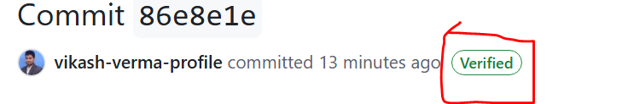
Git & Signed Commit Bootstrap
Install Git: Use official package manager or download binary installer
Initial Configuration: Set user.name and user.email
Signed Commits: Use GPG keys to sign commits – ensures authenticity and trust
Why Signed Commits: Detect tampering, validate authorship, enforce compliance

Slide 4
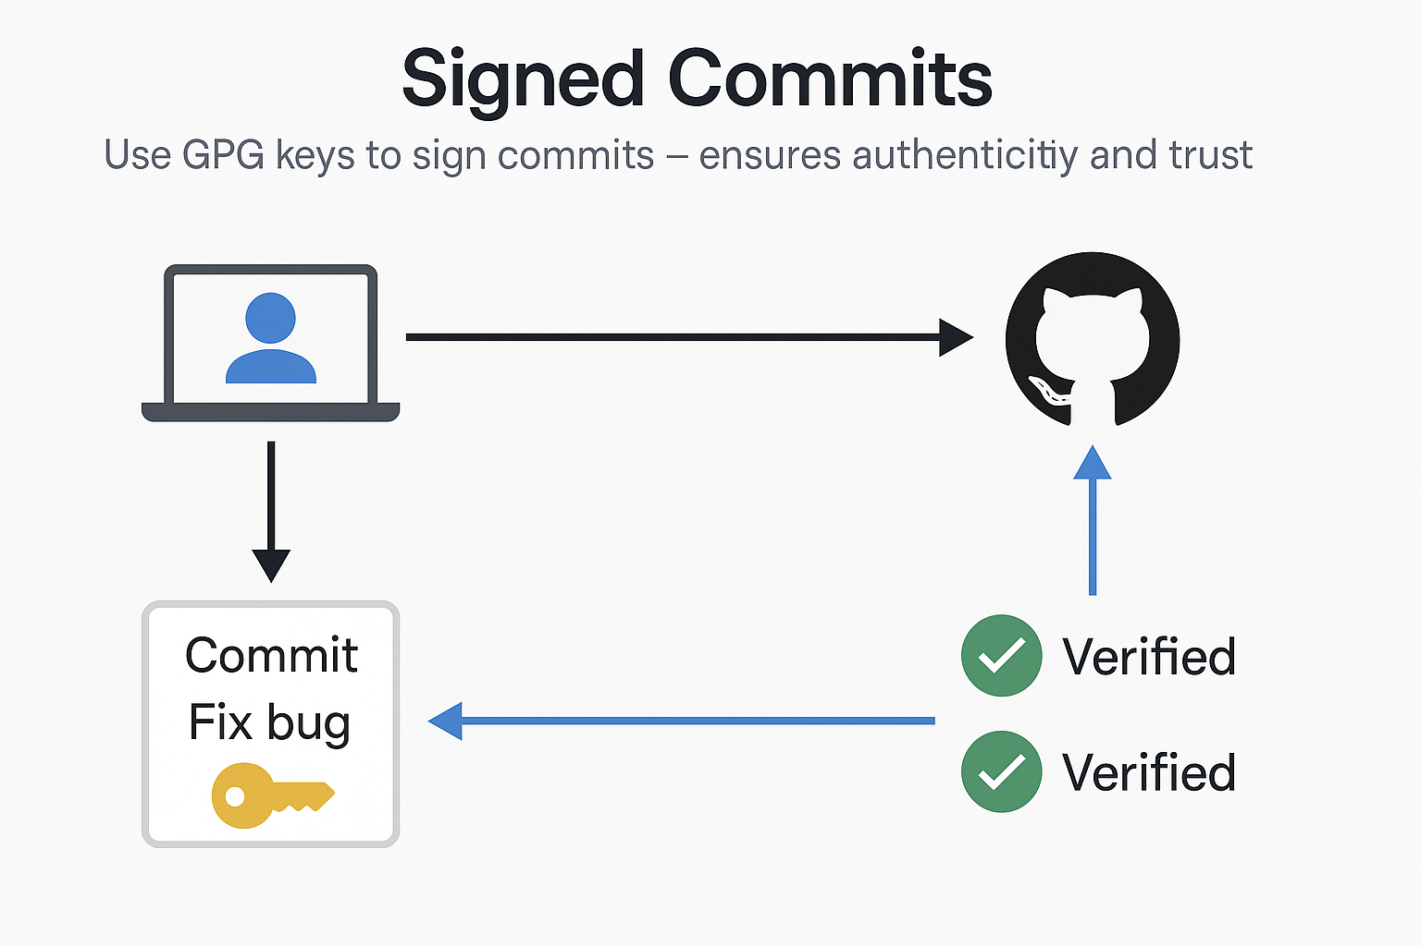
GPG+GIT

Slide 5
Linux CLI
Bash Basics: Navigating directories (cd, ls), creating files (touch, mkdir)
Pipes and Redirection: Use |, >, >>, and < for stream control
grep: Search patterns in files or streams using regular expressions
sed: Stream editor for transforming text, useful for replacements

Slide 6
Git Branching & VS Code Shortcuts
Git Branching: Create (git branch), switch (git checkout), merge (git merge), rebase basics
Merge Conflicts: Identify, resolve, and commit again
VS Code: Open terminal (Ctrl + `), search (Ctrl + P), format code (Shift + Alt + F)
Extensions: GitLens, Python, Prettier for enhanced dev experience

Slide 7
Azure Setup & Databricks Access
Azure RG: Create using Azure CLI `az group create --name <rg> --location <region>`
Databricks: Login via Azure portal, create workspace, spin up cluster
ADF Access: Validate Data Factory setup by launching Studio and viewing pipelines
Purview Access: Confirm account roles and scan lineage of test datasets

