Slide 1
Delta Lake: Concepts & Practices
Comprehensive Overview

Slide 2
Introduction to Delta Lakes
What is Delta Lake?
Open-source storage layer on top of data lakes
Brings reliability to data lakes
Built on Apache Parquet format
Delta Lake = Parquet + Transaction Log + ACID Guarantees + Streaming + Governance

Slide 3
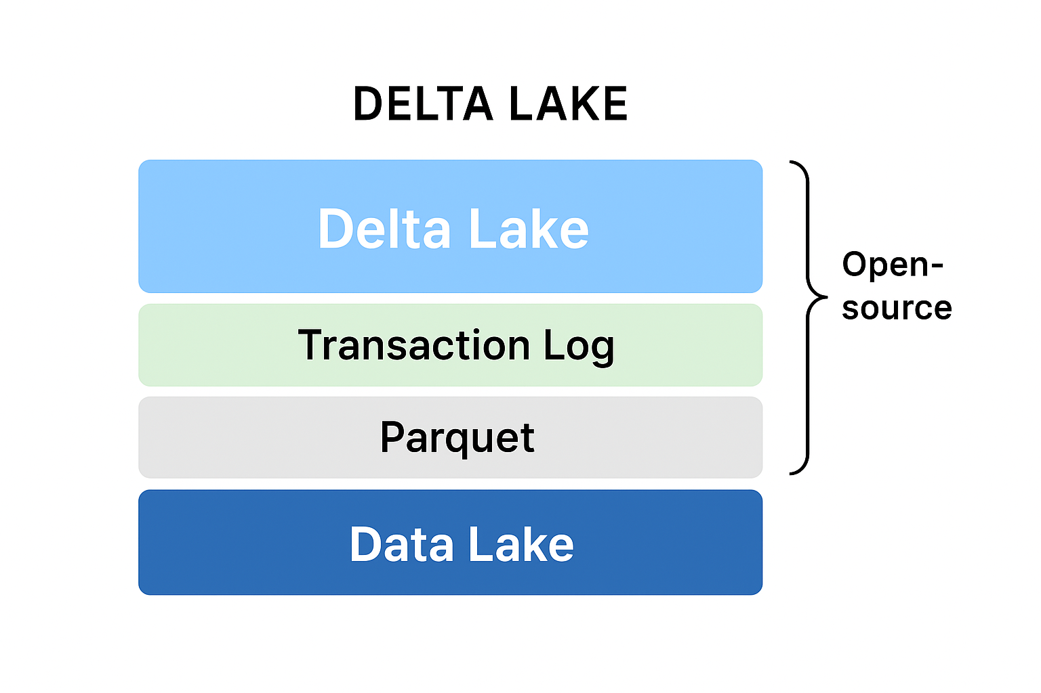
DELTA LAKE

Slide 4
Lakehouse vs Delte lake
Feature | Lakehouse (Architecture) | Delta Lake (Technology)
Definition | Unified data architecture (Lake + Warehouse) | Open-source storage layer/framework
Purpose | End-to-end platform for analytics + AI | Add ACID, reliability, governance to data lake
Scope | High-level architecture / vision | Low-level implementation
Supports | Any lakehouse implementation | Built on Spark & data lakes (S3, ADLS, etc.)
Example | Databricks Lakehouse | Delta Lake tables in Databricks/ADLS/S3

Slide 5
Delta Lake concepts: ACID transactions, schema enforcement, time travel
ACID Transactions: Ensures reliability and consistency
Bank transfers (money isn’t lost even if power fails mid-transfer).
Schema Enforcement: Prevents bad/mismatched data
Guard at the gate stopping invalid forms.
Time Travel: Query older versions of data
CCTV playback to see what happened yesterday.
Note:-
These features turn a raw data lake into a Lakehouse with database-like reliability.

Slide 6
Creating Delta tables from existing data
Convert existing Parquet/CSV to Delta
SQL: CREATE TABLE USING DELTA
Delta supports batch + streaming ingestion

Slide 7
Upserts and deletes with MERGE INTO
Delta Lake supports UPSERT (MERGE INTO)
Update existing rows, Insert new rows
Perform deletes efficiently
In plain SQL on Parquet, UPSERT isn’t possible directly (you’d need to rewrite entire files).
Delta Lake adds transaction logs + file management, so updates, inserts, and deletes become efficient and atomic.

Slide 8
Schema evolution: Adding/removing columns
Support for schema evolution
Add new columns automatically
Drop or rename columns with ALTER TABLE
Note:
In plain Parquet/CSV lakes, schema drift breaks pipelines.
In Delta Lake, schema evolution + enforcement means pipelines are resilient to changing business requirements.

Slide 9
Performance tuning: Z-Ordering, partitioning, caching
Z-Ordering: Optimizes data skipping
Z-Ordering works like putting similar values together in fewer files, so queries can skip irrelevant files quickly.
Think of Z-Ordering like sorting papers inside each drawer so you find them quicker.
Partitioning: Organize large datasets
Think of Partitioning like drawers in a filing cabinet (you only open the relevant drawer).
Caching: Improves query performance
keep hot data in memory for repeated queries.

Slide 10
Partitioning vs z-Order vs Caching
Feature | Partitioning | Z-Ordering | Caching
What it does | Organizes data into folders by column values | Reorganizes rows inside files to cluster similar values | Keeps frequently used data in memory (RAM)
Skips | Whole folders (partitions) | Irrelevant files within a partition | Skips disk I/O entirely (reads from memory)
Best for | Low-cardinality columns (year, region) | High-cardinality columns (customer_id, email) | Repeated queries on the same dataset
Storage Impact | Changes physical layout in storage (folders) | Rewrites data files (OPTIMIZE) | Uses cluster memory, not storage
When Applied | At table creation or ingestion | Anytime via OPTIMIZE ... ZORDER BY | At query/runtime via CACHE
Example Query | WHERE year=2025 → scans only year=2025/ folder | WHERE customer_id=12345 → scans only relevant files in 2025 | SELECT * multiple times → second run much faster

Slide 11
Streaming with Delta tables
Delta integrates with Structured Streaming
Supports real-time reads and writes
Exactly-once processing guarantees
NOTE:
Traditional streaming sinks (like Parquet/CSV) can only guarantee at-least-once (duplicates possible).
Delta Lake enables exactly-once semantics, making it reliable for real-time analytics, fraud detection, IoT ingestion, etc.

Slide 12
Managing Delta logs and vacuuming old data
Delta logs store metadata for versioning
version history & metadata
VACUUM removes old data files
garbage collection of old Parquet files
Retention policies for data cleanup
safety net for time travel & concurrent reads

Slide 13
Delta Lake Vs SQL
Feature | Delta Lake | SQL Databases (RDBMS)
Type | Data Lake + Storage Layer | Database + Query Language
Underlying Storage | Parquet files in object storage (S3, ADLS, GCS) | Database engine with storage + indexes
Transactions | ACID via Delta Log | ACID built into DB engine
Schema Handling | Schema enforcement & evolution | Schema enforcement, but strict changes
Scalability | Petabyte-scale, distributed (Spark/Databricks) | Limited by server capacity (scales up)
Workloads | Batch + Streaming + ML | Mostly OLTP, some OLAP (with warehouses)
Query Language | Uses Spark SQL / Delta SQL (SQL-like) | Standard SQL
Data Types | Structured + Semi-structured (JSON, Avro, Parquet) | Mostly structured tables
Use Case | Lakehouse, BI + ML pipelines, historical storage | Apps, transactional systems, smaller BI

Slide 14
Questions
Command | Scope | Delta Lake Behavior | Keeps History? | Use Case
DELETE | Conditional rows | Creates new version without those rows | Yes (until VACUUM) | Remove specific records
TRUNCATE | Entire table | Creates new empty version | Yes (until VACUUM) | Quickly empty table
VACUUM | Old unused files | Permanently deletes obsolete files from storage | No (files gone forever) | Free up storage, manage retention

Slide 15
OPTIMIZE vs Index
Feature | OPTIMIZE (Delta) | INDEX (SQL DB)
Scope | File-level compaction + clustering | Column-level data structure
How it works | Rewrites Parquet files, co-locates rows | Creates separate lookup structure
Storage Impact | Rewrites data files (same storage format) | Extra storage used for index structure
Performance | Reduces number of files scanned + data skipping | Allows direct row lookups, avoids scanning
Use Case | Big data lakes (Spark, Delta) | OLTP/OLAP relational databases
Maintenance | Needs periodic re-run as data lands | Auto-updated as rows change

