Slide 1
Snowflake Data Cloud Features and Architecture

Slide 2
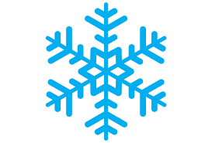
Introduction
Snowflake is a cloud-based advanced data platform system, provided as Software-as-a-Service (SaaS).
Snowflake provides features of data storage from AWS S3, Azure, and Google Cloud, processing complex queries and different analytic solutions.
The analytic solutions provided by Snowflake are faster, easy to use, and more flexible than traditional databases and their analytics features.
Snowflake stores and provide data near time not in actual real time.

Slide 3
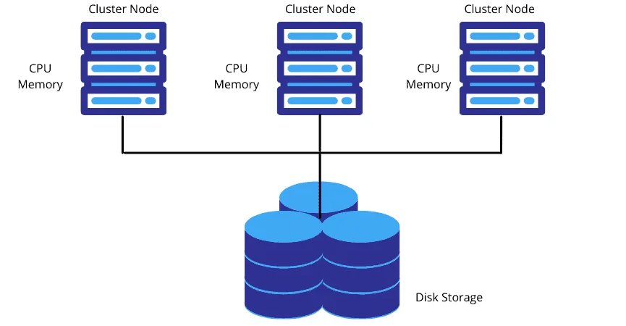
Overview of Shared-Disk Architecture
Used in traditional databases, Shared-Disk architecture is an architecture in which the cluster nodes share same storage device but each node has its own own CPU and Memory.
Any machine can read or write any portion of data into central data storage. Scalability and performance are limitations.

Slide 4
Snowflake Editions
Snowflake provides four different editions based on users'/company’s requirements.
Standard
Enterprise
Business Critical
Virtual Private Snowflake (VPS)

Slide 5
Standard Edition
It is the basic version of Snowflake. It provides the following features in this edition
Supports complete SQL Data Warehouse
Secure Data Sharing
Premier support for 24×365
Time travel of 1 day
Data Encryption
Dedicated virtual warehouses
Federated Authentication
Database Replication
External Functions support
Snowsight
Supporting user's own data exchange creation
Data Marketplace Access

Slide 6
Enterprise Edition
It is Standard+ edition i.e., all features of Standard edition plus the following additional features −
Multi-cluster warehouses
Time travel up to 90 days
Encryption key changes annually
Materialized Views
Search Optimization Services
Dynamic Data Masking
External Data Tokenization

Slide 7
Business Critical Edition
It is Enterprise+ edition, i.e., all features of Enterprise and Standard edition plus the following additional features.
HIPPA support
PCI compliance
Data Encryption everywhere
AWS Private Link Support
Azure Private Link Support
Database Failover and fallback
AD

Slide 8
Virtual Private Snowflake (VPS) Edition
It is the Business Critical+ edition and the most advanced version.
It supports all the offerings of Snowflake.
Customer-dedicated virtual servers where the encryption key is in memory.
Customer-dedicated metadata store.

Slide 9
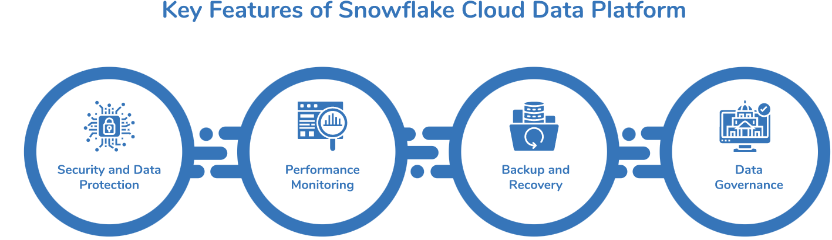
Overview of Key Features
Snowflake offers various features, which include
Security and Data Protection
Performance Monitoring
Backup and Recovery
Data Governance

Slide 10
Security and Data Protection
Data protection safeguards important information from corruption and/or loss and is considered an important concern for the modern data-driven organization.
It is designed to protect user data against attacks on different levels of data architecture, including the cloud platform.
Therefore, Snowflake implements two-factor authentication, (client-side) encrypted data import and export, secure data transfer and storage, and role-based access control for database objects.
It ensures that the data is always encrypted – even while at rest and in transit.

Slide 11
Performance Monitoring
Snowflake’s web interface provides a query load chart that contains concurrent queries processed by a warehouse over two weeks.
Warehouse query load measures the average number of queries that were running or queued within a specific interval.
You can customize the time period and time interval to evaluate warehouse performance by querying the Account Usage.
We can analyze and monitor account usage with the Snowsight dashboard or other reporting tools.

Slide 12
Backup and Recovery
Snowflake has amazing built-in backup functionality, called Time Travel that lets you access data for the specified date.
In addition, Snowflake protects your data in the event of a system failure or other catastrophic event with its fail-safe feature which allows Snowflake support to restore data for you during the fail-safe window.
The history of data is stored under time travel for up to 90 days.

Slide 13
Backup and Recovery
Snowflake data governance tool ensures sensitive data maintained by your organization is protected from inappropriate access and tampering.
It helps to achieve and maintain regulatory compliance.
These tools support a wide range of operations, such as risk assessment, intrusion detection/monitoring/notification, data masking, data cataloging, tasks scheduling, data lineage, and more.
Snowflake’s platform and its broad ecosystem of partners, including data governance experts, provide a strong foundation for improved data governance.

Slide 14
Virtual Warehouse
It is one or more clusters that is used to load data into Snowflake and execute queries.
Snowflake uses Snowflake Credits as a payment from customers.
The snowflake credit is calculated based on Warehouse size, number of clusters, and time spent to execute queries.
The size of a warehouse determines how fast a query will run.
When a virtual warehouse is not running and is in suspended mode, it doesn't spend any Snowflake credit.
Different sizes of warehouses spend Snowflake credits at different rates.

Slide 15
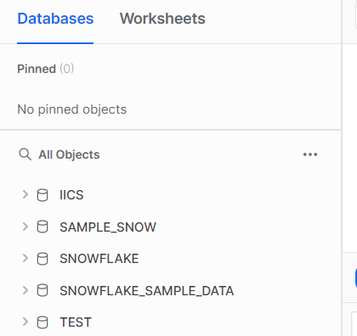
Databases
All data in Snowflake is maintained in databases.
Each database consists of one or more schemas, which are logical groupings of database objects, such as tables and views.
Snowflake does not restrict the limits on the number of databases, you can create schemas (within a database), or objects (within a schema).

Slide 16
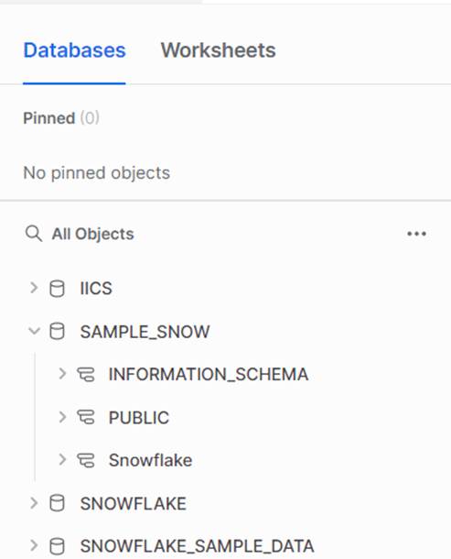
Schema
Schema is the grouping of database objects like tables, views, etc. Each schema belongs to a single database.
“Database. Schema” is the namespace in Snowflake.
While performing any operation, the namespace is required to provide either directly in a query or set up in Snowflake's UI.

Slide 17
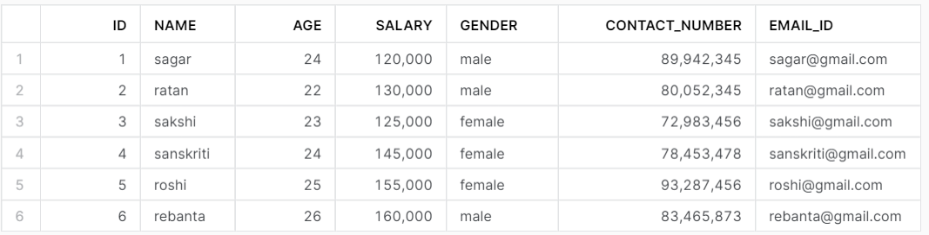
Table & Columns
In a database, Schemas are created which are logical grouping of tables. Tables contain columns.
Tables and columns are low-level and most important objects of a database.

Slide 18
Permanent Tables
Permanent tables in Snowflake are the standard type of table used for long-term storage of structured data.
They are designed to hold data indefinitely until explicitly dropped by the user.
Permanent tables are stored on Snowflake's highly durable storage infrastructure, ensuring data persistence and availability.
These tables are used for storing critical business data that needs to be retained and queried over long periods.

Slide 19
Transient Tables
Transient tables are similar to permanent tables but are designed for temporary data that does not require long-term retention or recovery.
Unlike permanent tables, transient tables do not have Fail-safe protection, meaning that data cannot be recovered after the Time Travel retention period (which can be set up to 1 day).
Transient tables are ideal for staging data, intermediate processing steps, and temporary datasets that do not need the durability guarantees provided by permanent tables.

Slide 20
Temporary Tables
Temporary tables in Snowflake are used for data that is only needed during the session in which it is created.
These tables are automatically dropped at the end of the session, making them suitable for short-lived operations like complex data transformations, intermediate calculations, and ad hoc analyses.
Temporary tables do not consume storage beyond the session duration, providing a cost-effective solution for transient data needs.

Slide 21
External Tables
External tables allow Snowflake to query data stored in external locations, such as Amazon S3, Google Cloud Storage, or Azure Blob Storage, without loading it into Snowflake.
This is achieved by defining a table that maps to the external data source.
External tables are used for integrating and querying large datasets that are stored outside Snowflake, enabling users to perform analytics on data across multiple storage systems.
They are particularly useful for scenarios where data is frequently updated or too large to be stored in Snowflake.

Slide 22
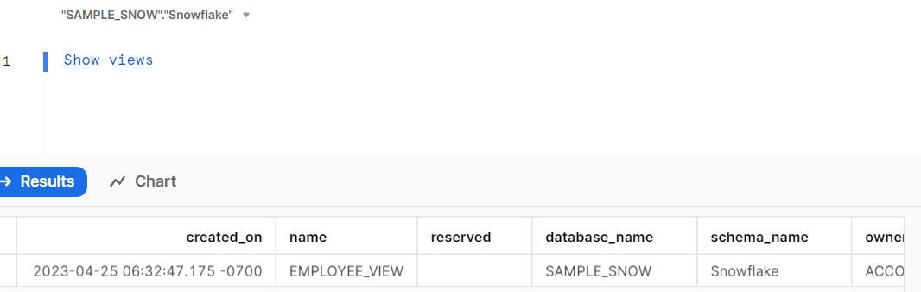
Views
A View can be considered as a virtual table and can be used almost anywhere that a table can be used (joins, subqueries, etc.).
Whenever you query a view, the underlying SQL query associated with the view gets executed dynamically and the results were displayed.

Slide 23
A View is nothing more than a saved SQL query associated with a name stored in your database.​
There are three broad categories of views in Snowflake.​
Non-Materialized views (Regular views)​
Materialized Views​
Secure Views​

Slide 24
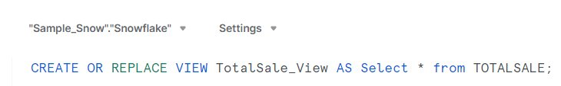
Non-Materialized Views​
A Non-Materialized view’s results are created by executing the query at the time that the view is referenced in a query. ​
The term “Views” generally refers to Non-Materialized views.​

Slide 25
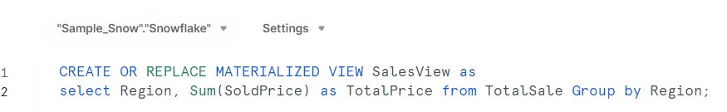
Materialized Views​
A Materialized view is a database object that stores the pre-computed results of a query definition of a view.​
While simple views allow us to save complicated queries for future use, materialized views store a copy of the query results.​

Slide 26
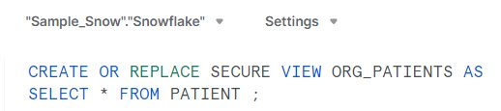
Secure Views​
A Secure View limit access to the data definition of the view so that the sensitive data that should not be exposed to all users of the underlying table(s) stays hidden.​

Slide 27
Data Types
In Snowflake, data types define the kind of data that can be stored in a table's column.
Snowflake supports a variety of data types including numeric (e.g., INTEGER, FLOAT), string (e.g., VARCHAR, STRING), date and time (e.g., DATE, TIMESTAMP), and boolean (BOOLEAN).
Additionally, Snowflake supports semi-structured data types like VARIANT, OBJECT, and ARRAY, which are essential for handling JSON, Avro, ORC, Parquet, and XML data.
These versatile data types enable Snowflake to efficiently store and query both structured and semi-structured data, ensuring compatibility with a wide range of applications and data sources.

Slide 28
User-Defined Functions (UDFs)
UDFs in Snowflake allow users to create custom functions using SQL or JavaScript.
These functions can be scalar, returning a single value, or tabular, returning a set of rows (though tabular functions are technically UDTFs).
UDFs are used to encapsulate complex business logic, perform specialized calculations, or manipulate data in ways that are not possible with built-in functions.
By enabling custom logic execution within the database, UDFs help optimize performance by reducing the need to transfer data between Snowflake and external applications.

Slide 29
User Defined Table Functions (UDTFs)
UDTFs return a set of rows rather than a single value, making them ideal for tasks that require generating multiple output rows from a single input.
Written in SQL or JavaScript, UDTFs can perform operations like expanding arrays into individual rows, generating series of numbers, or unpivoting tables.
They are particularly useful for ETL processes and data transformations where intermediate datasets need to be generated and processed further.

