Slide 1
Domain 2

Slide 2
Network Security in Snowflake
Encryption:
Data Encryption: Snowflake uses AES-256 encryption for data at rest and TLS (Transport Layer Security) for data in transit.
End-to-end Encryption: All data, including backups, is encrypted end-to-end.
Network Policies:
IP Whitelisting: Snowflake allows administrators to define IP whitelists to restrict access to specific IP ranges.
Virtual Private Snowflake (VPS): For enhanced security, Snowflake can be deployed in a customer’s virtual private cloud (VPC) using a VPS.
This isolates the Snowflake deployment from the public internet.

Slide 3
PrivateLink:
Snowflake supports AWS PrivateLink, Azure Private Link, and Google Cloud Private Service Connect, enabling private connectivity between Snowflake and other services within the same cloud provider.
Network Access Controls:
Firewall Rules: Snowflake employs network firewall rules to control incoming and outgoing traffic.
Service Endpoints: Dedicated endpoints are used to manage network traffic securely.

Slide 4
Security Policies in Snowflake
User Authentication and Authorization:
Multi-Factor Authentication (MFA): Snowflake supports MFA for an additional layer of security during user login.
Single Sign-On (SSO): Integration with SSO providers (e.g., SAML 2.0) allows centralized user authentication.
Role-Based Access Control (RBAC):
Granular Permissions: Snowflake implements RBAC to control access to objects within the account.
Permissions can be assigned at the level of warehouses, databases, schemas, tables, and views.
Custom Roles: Administrators can define custom roles and assign specific privileges to them.

Slide 5
Data Masking:
Dynamic Data Masking: Snowflake allows dynamic data masking to obfuscate sensitive data based on user roles.
Object Tagging:
Tagging resources with metadata for easier tracking, auditing, and policy enforcement.
Resource Monitoring and Quotas:
Resource Monitors: To prevent runaway queries and resource overutilization, Snowflake offers resource monitors that can enforce usage quotas and limits.

Slide 6
Security Best Practices in Snowflake
Regularly Review Access Controls: Regularly review and update roles and permissions to ensure the principle of least privilege.
Implement Strong Password Policies: Enforce strong password policies and use MFA to protect user accounts.
Monitor and Audit: Continuously monitor usage patterns and audit logs for unusual activities.
Data Encryption: Ensure all sensitive data is encrypted both at rest and in transit.
Network Policies: Use network policies and IP whitelisting to restrict access to trusted networks only.
Regular Updates and Patching: Keep Snowflake and any integrated tools up to date with the latest security patches and updates.

Slide 7
Multi-Factor Authentication (MFA)
Multi-Factor Authentication (MFA) in Snowflake enhances security by requiring users to provide two or more verification factors to access their accounts, significantly reducing the risk of unauthorized access.
In Snowflake, MFA typically involves a combination of something the user knows (password) and something the user has (a time-based one-time password (TOTP) generated by an authenticator app or sent via SMS).
Administrators can enforce MFA at the account level, ensuring that all users adhere to the enhanced security protocol.
This additional layer of security is crucial for protecting sensitive data within the Snowflake platform, providing peace of mind for organizations handling critical information.

Slide 8
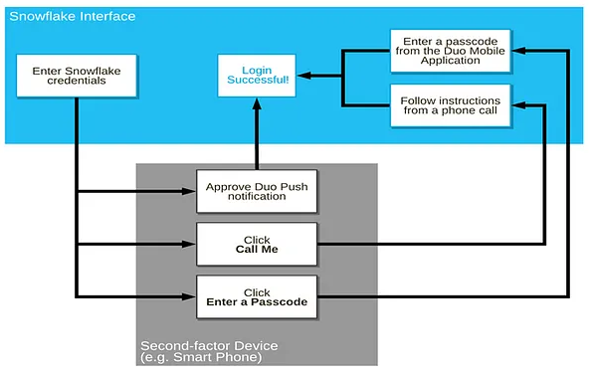
Multi-factor Authentication (MFA) provides an additional layer of security for users connecting to Snowflake.
MFA is a built-in feature of Snowflake editions and is supported by an external company called Duo, although the actual process is managed by the internal Snowflake team.
MFA is widely used across various sectors to secure sensitive data, such as banking applications.
It is enabled on a per-user basis; however, currently, users are not automatically enrolled in MFA. To utilize MFA, users must enroll themselves.

Slide 9
Federated Authentication
Federated authentication in Snowflake enables seamless and secure user access by leveraging an external identity provider (IdP) to authenticate users.
This process allows Snowflake to delegate the authentication responsibility to the IdP, which supports single sign-on (SSO) and multifactor authentication (MFA), enhancing security and user convenience.
Users log in to Snowflake using their enterprise credentials, which are verified by the IdP.
Once authenticated, the IdP issues a security token to Snowflake, granting access without the need for additional passwords.
This integration simplifies user management and aligns with organizational security policies, ensuring consistent and secure access control across platforms.

Slide 10
Key Pair Authentication
Key pair authentication in Snowflake involves using a public-private key pair to securely connect to Snowflake without a password.
In this method, the private key is stored securely on the client side, and the corresponding public key is uploaded to Snowflake.
When a user attempts to authenticate, Snowflake uses the public key to validate the signature created with the private key.
This process ensures that only clients possessing the private key can authenticate, enhancing security by eliminating the need to transmit or store passwords.
This method is particularly useful for automated processes and integrations where password management can be cumbersome and less secure.

Slide 11
Single Sign-On (SSO)
Single Sign-On (SSO) in Snowflake allows users to authenticate using their existing enterprise credentials, streamlining access and enhancing security by integrating with identity providers (IdPs) such as Okta, Azure AD, or ADFS.
By leveraging SAML 2.0 or OAuth standards, SSO facilitates a seamless and secure login experience, reducing the need for multiple passwords and enabling centralized user management.
This integration not only improves user convenience but also supports compliance with organizational security policies, ensuring that access to Snowflake's data warehouse services is tightly controlled and monitored.

Slide 12
Access Control Frameworks
Snowflake's access control framework is built on a robust and flexible model that integrates role-based access control (RBAC) with a hierarchical role structure.
This allows organizations to manage permissions and access to data effectively.
In Snowflake, roles are created to represent different levels of access and responsibilities, and these roles can be assigned to users or other roles, forming a role hierarchy.
Privileges are granted to roles rather than individual users, which simplifies the management of access rights.
Additionally, Snowflake supports object-level access control, enabling granular control over databases, schemas, tables, and other objects within the system.
This framework ensures that users have the appropriate access necessary for their roles while maintaining security and compliance.

Slide 13
Role
It is an entity to which privileges can be granted.
Roles are used to manage and control access to securable objects in Snowflake.
Roles are assigned to users, and a user can have multiple roles.
Roles can also be assigned to other roles, creating a role hierarchy that enables more granular level control.
Securable object
It is an entity that can be secured and to which access can be granted.
Access to a securable object is, by default, denied unless allowed by a grant.
Examples of securable objects are databases, schemas, tables, views, and functions in Snowflake.

Slide 14
Understanding Access Control and its Relationships in Snowflake
Access to securable objects is allowed via privileges assigned to roles
Roles can be assigned to other roles or individual users
Each securable object in Snowflake has an owner who can grant access to other roles.
Snowflake model differs from a user-based access control model, where rights and privileges are assigned to each user or group of users.

Slide 15
Access control privileges
In Snowflake, access control privileges are managed through a role-based access control (RBAC) system, which assigns permissions to roles rather than individual users.
Users are then assigned to these roles, enabling flexible and scalable permission management.
Privileges in Snowflake can be granted on various objects like databases, schemas, tables, and views, encompassing operations such as SELECT, INSERT, UPDATE, and DELETE.
Administrative privileges include roles for creating and managing users, roles, and other system objects.
This hierarchical model supports inheritance, where roles can be nested, allowing a role to inherit the privileges of other roles, thereby streamlining the management of complex permission sets and ensuring secure, efficient access control across the platform.

Slide 16
Outline how privileges can be granted and revoked
In Snowflake, privileges can be granted and revoked using the GRANT and REVOKE SQL commands, respectively.
Privileges can be assigned to various database objects such as tables, views, schemas, and databases, and can be given to roles or directly to users.
To grant a privilege, the syntax is GRANT privilege ON object TO role_or_user;, and to revoke a privilege, the syntax is REVOKE privilege ON object FROM role_or_user;.
Additionally, roles can be granted to other roles or users, enabling hierarchical privilege management.
For example, GRANT ROLE role_name TO USER user_name; assigns a role to a user.
Snowflake's role-based access control (RBAC) allows for fine-grained control and flexibility in managing user permissions, ensuring security and adherence to the principle of least privilege.

Slide 17
Role Hierarchy
In Snowflake, the role hierarchy is a structured way of organizing roles to manage and control access to data and resources effectively.
It operates on a parent-child model where roles can be nested, meaning a parent role can have one or more child roles.
This hierarchical arrangement allows for granular control over permissions, enabling an efficient delegation of privileges.
When a higher-level role (parent) is granted specific privileges, all roles beneath it (children) inherit these privileges.
This simplifies the management of user access by allowing administrators to assign permissions at the top level, which then propagate down the hierarchy, ensuring consistent and streamlined access control.

Slide 18
Privilege Inheritance
Privilege inheritance in Snowflake refers to the mechanism where roles in a hierarchical structure automatically receive the permissions granted to their parent roles.
When a privilege is assigned to a parent role, all descendant roles in the hierarchy inherit this privilege, facilitating efficient and scalable access management.
This inheritance model helps avoid redundancy and reduces the administrative burden by allowing permissions to be managed at higher levels rather than individually at every role level.
It ensures that users with roles deeper in the hierarchy maintain necessary access rights without manual reassignments, thus promoting a consistent and secure approach to managing permissions across the organization.

Slide 19
System-defined roles
System-defined roles in Snowflake are predefined roles that are automatically created when a Snowflake account is provisioned.
These kinds of roles are designed to provide built-in access controls and permissions for Snowflake objects and resources.
ORGADMIN (Organization Administrator):
This role manages the operations at the organizational level.
It has the ability to create accounts at the organization level.
It can view all accounts in the organization as well as all regions enabled for the organization.
It can also view usage information across the organization.

Slide 20
ACCOUNTADMIN (Account Administrator):
This role combines the power of SYSADMIN and SECURITYADMIN roles.
It Is considered as the top-level role in the Snowflake.
It should only be granted to a limited/controlled number of users in the account.
SECURITYADMIN (Security Administrator):
This role can manage any object grant globally.
It has the ability to create, monitor, and manage users and roles.
It is granted the MANAGE GRANTS security privilege to be able to modify any grant, including revoking it.
It inherits the privileges of the USERADMIN role via the system role hierarchy.

Slide 21
USERADMIN (User and Role Administrator):
This particular role is dedicated to user and role management only.
It is granted the CREATE USER and CREATE ROLE security privileges.
It can create users and roles in the account.
It can manage users and roles that it owns.
SYSADMIN (System Administrator):
This role has privileges to create warehouses, databases, and various other objects in the account.
It can grant privileges on warehouses, databases, and other objects to other roles if all custom roles are ultimately assigned to the SYSADMIN role.

Slide 22
PUBLIC:
This role is automatically granted to every user and every role in the account.
It can own securable objects, but the objects are available to every other user and role in the account.
It is typically used when explicit access control is not needed.

Slide 23
Custom Roles
Custom role in Snowflake is a role that is created by users with appropriate privileges to grant the role and user ownership on specific securable objects.
Custom roles can be created using the USERADMIN role or higher, as well as by any role that has been granted the CREATE ROLE privilege.
It is recommended to create a hierarchy of custom roles with the top-most custom role assigned to the system role SYSADMIN when creating roles that will serve as the owners of securable objects, which allows SYSADMIN to manage all objects in the account while restricting management of users and roles to the USERADMIN role.
If a custom role is not assigned to SYSADMIN through a role hierarchy, then the SYSADMIN role cannot manage the objects owned by that role.

Slide 24
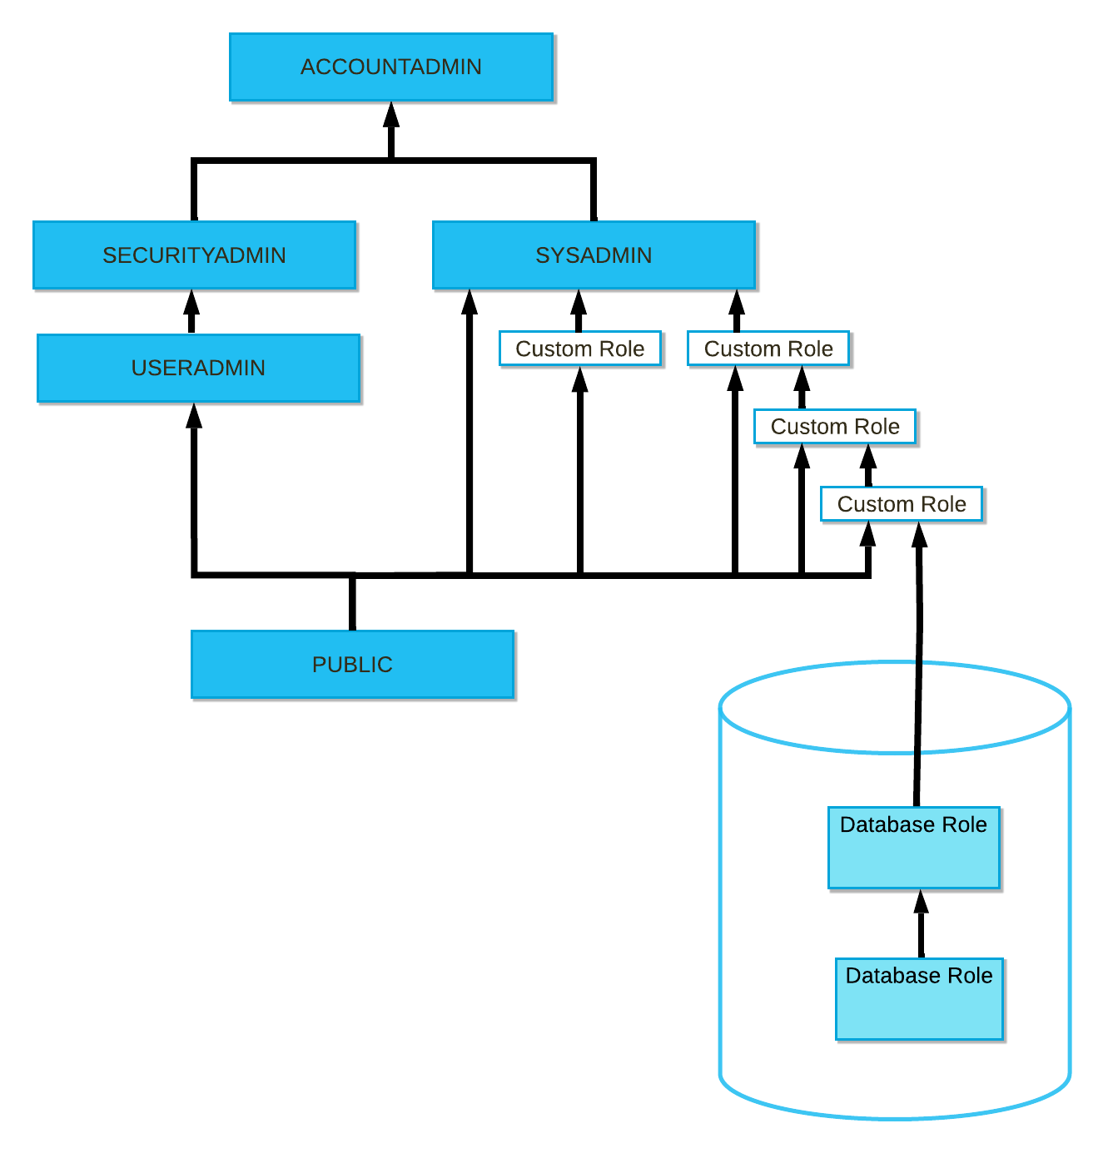
As you can see in the diagram below, which shows the full structure of system-defined and user-defined roles in Snowflake, the highest-level role is given to a custom account role, which is then granted to another custom role, allowing the SYSADMIN role to inherit all their privileges.

Slide 25
Accounts
Snowflake is a cloud-based data warehousing platform that revolutionizes data management and analytics by decoupling storage and computing, offering a scalable and efficient solution for handling large volumes of data.
In Snowflake, data is stored in virtual warehouses, which are computational clusters responsible for executing queries.
Each Snowflake account can have multiple virtual warehouses tailored to different workloads, allowing users to scale compute resources independently based on demand.
Snowflake's architecture ensures data consistency and performance by separating compute from storage, enabling seamless concurrency and efficient query processing.
This flexibility, combined with its ability to handle semi-structured and structured data types, makes Snowflake a versatile choice for modern data analytics and warehousing needs.

Slide 26
Organizations
Snowflake is a cloud-based data warehousing platform that revolutionizes how organizations manage and analyze their data.
Organizations using Snowflake benefit from its unique architecture that separates compute from storage, allowing them to scale each independently based on their needs.
This scalability, combined with its ability to handle diverse data types including structured, semi-structured, and unstructured data, makes Snowflake exceptionally versatile for modern enterprises.
Its architecture also supports concurrent workloads, enabling multiple teams to query and analyze data simultaneously without performance degradation.
Snowflake's built-in security features, such as data encryption and role-based access controls, ensure that data remains protected at all times.

Slide 27
Secure views
In Snowflake, secure views can be implemented to control access and protect sensitive data within an organization.
Views in Snowflake allow users to create virtual representations of data stored in tables while maintaining security through access controls.
To ensure secure views, administrators can define permissions at both the object level (view) and underlying data level (tables or other views).
This includes granting SELECT privileges on the view itself and ensuring that users have appropriate access to the underlying data.
Additionally, Snowflake supports column-level security, allowing views to limit exposure of specific columns based on user roles or privileges.

Slide 28
Secure Functions
In Snowflake, secure functions play a critical role in ensuring data protection and access control within the platform.
These functions are designed to adhere to Snowflake's security standards, providing robust mechanisms for encryption, authentication, and authorization.
For encryption, Snowflake supports various methods including client-side encryption, enabling sensitive data to be encrypted before it reaches the platform.
Authentication mechanisms such as multi-factor authentication (MFA) and OAuth enhance user verification and secure access.
Additionally, Snowflake's access controls are granular, allowing administrators to define fine-grained permissions at the level of databases, schemas, tables, and even specific columns.
This ensures that only authorized users and applications can access sensitive data, mitigating risks associated with unauthorized access or data breaches.

Slide 29
Information Schemas
In Snowflake, information schemas play a crucial role in organizing and accessing metadata about databases, tables, and other objects within the data warehouse.
There are two primary types of information schemas: Metadata and Account Usage.
The Metadata schema stores details about databases, schemas, tables, views, columns, and other objects.
It helps users understand the structure and relationships between different data components stored in Snowflake.
The Account Usage schema, on the other hand, contains information related to account-level activities such as query history, warehouse usage, and access logs.
Both schemas are pivotal for administrators, developers, and analysts to efficiently manage, query, and optimize their data workflows within Snowflake, ensuring transparency and control over data operations.

Slide 30
Access history
In Snowflake, access history refers to the records and logs of user activities and interactions within the data platform.
It includes detailed information about who accessed which data or objects, when the access occurred, and what actions were performed.
Snowflake maintains a comprehensive access history through its built-in metadata and logging capabilities, capturing details such as SQL queries executed, data modifications made, and system operations performed by users or automated processes.
This access history is crucial for auditing, compliance, and security purposes, enabling administrators to track and review user behavior, detect anomalies, and ensure data governance and regulatory requirements are met.
Snowflake's access history supports transparency and accountability in data usage, helping organizations maintain trust and integrity in their data environments.

Slide 31
Tracking read/write operations
Account Usage Views
These views offer insights into historical data consumption, query execution times, and data transfer volumes.
They include tables like QUERY_HISTORY, LOGIN_HISTORY, and WAREHOUSE_METERING_HISTORY which track queries, user logins, and warehouse usage respectively.
Resource Monitors
Resource monitors allow administrators to allocate and monitor warehouse credits, which helps in tracking and managing compute resource usage across different workloads.

Slide 32
Tracking read/write operations
Query Profile
Each query in Snowflake generates a query profile that contains detailed information about its execution, including the number of rows processed, execution time, and stages involved.
This can be used to track individual query performance and resource consumption.
Snowflake Information Schema
Snowflake’s Information Schema provides metadata about databases, tables, and other objects, allowing users to monitor schema changes and access patterns.

Slide 33
Row-Level Security (RLS)
Row-level security in Snowflake allows you to control which rows of data a user has access to based on specific conditions.
This feature is particularly useful in scenarios where different users or roles need to see different subsets of data from the same table. Key aspects of row-level security in Snowflake include:
Security Policies: These are defined on tables to specify conditions that filter rows accessible to users. Security policies can be based on simple filters or complex logical expressions involving multiple columns.
Policy Evaluation: Security policies are automatically enforced by Snowflake at runtime. When a user queries a table with an associated security policy, Snowflake dynamically applies the policy's conditions to filter out rows that the user is not authorized to see.
Usage: Row-level security is typically used in multi-tenant environments, regulatory compliance scenarios, or any situation requiring data segregation based on user roles or attributes.

Slide 34
Column-Level Security (CLS)
Column-level security in Snowflake allows you to restrict access to specific columns within a table. This is useful when certain columns contain sensitive information that should only be accessible to authorized users or roles. Key aspects of column-level security include:
Column-Level Grants: Snowflake allows administrators to grant or restrict access to individual columns using the GRANT and REVOKE commands. This ensures that only authorized users or roles can view specific columns while accessing the rest of the table.
Dynamic Masking: Snowflake also supports dynamic data masking, where sensitive column values can be masked or obfuscated based on predefined masking policies. This ensures that unauthorized users see masked values while authorized users see the actual data.
Usage: Column-level security is commonly employed in scenarios where certain columns contain personally identifiable information (PII), financial data, or other sensitive information that requires strict access control.

Slide 35
Object tags
In Snowflake, object tags provide a flexible way to organize and categorize database objects such as databases, schemas, tables, and views with custom metadata.
These tags are user-defined key-value pairs that can be attached to objects, allowing for easier management, classification, and querying of metadata.
Object tags can be particularly useful for labeling objects by environment (e.g., development, staging, production), ownership (e.g., team responsible), or any other relevant categorization (e.g., data sensitivity level).
They enhance governance by enabling consistent labeling practices and simplify administrative tasks like access control and auditing across complex data environments.
Overall, object tags in Snowflake contribute to better organization, clarity, and control over data assets within the platform.

