Slide 1
Introduction to Data Engineering & Azure Fundamentals
Vikash Verma

Slide 2
Introduction to Data Engineering
Definition: Discipline focused on building systems for collecting, storing, and analyzing data.
Roles: Data Engineer, ETL Developer, Cloud Engineer, Pipeline Architect.
Responsibilities: Data ingestion, transformation, orchestration, governance, performance optimization.

Slide 3
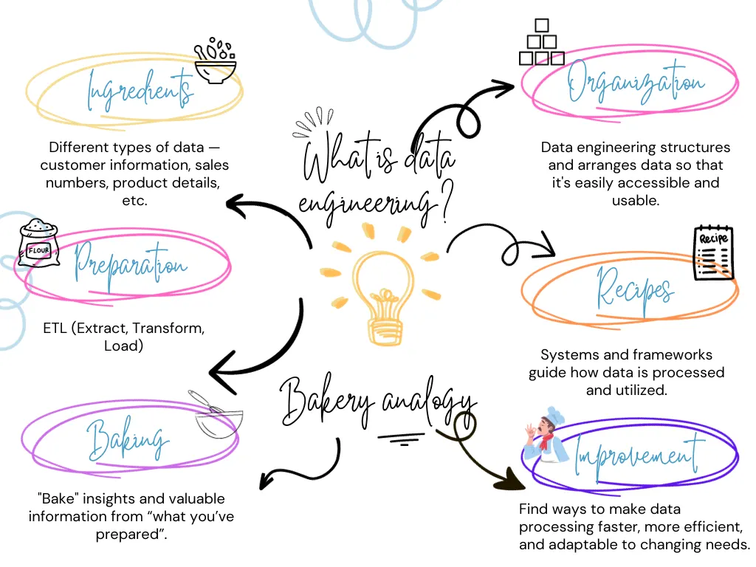

Slide 4
Types of Data
Structured Data: Relational databases (SQL).
Semi-Structured Data: JSON, XML, CSV, Parquet.
Unstructured Data: Images, videos, free text, sensor logs.
Examples: POS transactions (structured), IoT sensor feeds (semi-structured), product images (unstructured).

Slide 5
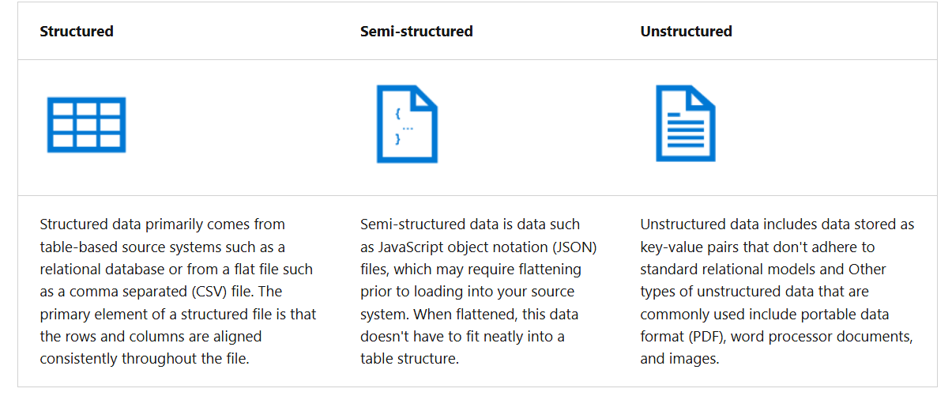

Slide 6
Batch vs Real-Time Processing
Batch Processing: Processes large volumes at scheduled intervals.
Real-Time Processing: Processes streaming data instantly.
Use Cases: Batch – End-of-day sales reports; Real-Time – Fraud detection in payments.
Pros & Cons: Batch – reliable, cost-effective; Real-Time – immediate insights, higher infra cost.

Slide 7
data engineering concepts
Operational and analytical data
Streaming data
Data pipelines
Data lakes
Data warehouses
Apache Spark

Slide 8
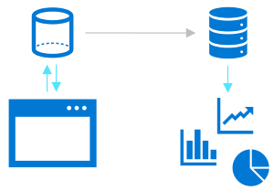
Operational and analytical data
Operational data is usually transactional data that is generated and stored by applications, often in a relational or non-relational database. Analytical data is data that has been optimized for analysis and reporting, often in a data warehouse.
One of the core responsibilities of a data engineer is to design, implement, and manage solutions that integrate operational and analytical data sources or extract operational data from multiple systems, transform it into appropriate structures for analytics, and load it into an analytical data store (usually referred to as ETL solutions).

Slide 9

Streaming data
Streaming data refers to perpetual sources of data that generate data values in real-time, often relating to specific events. Common sources of streaming data include internet-of-things (IoT) devices and social media feeds.
Data engineers often need to implement solutions that capture real-time stream of data and ingest them into analytical data systems, often combining the real-time data with other application data that is processed in batches.

Slide 10

Data pipelines
Data pipelines are used to orchestrate activities that transfer and transform data. Pipelines are the primary way in which data engineers implement repeatable extract, transform, and load (ETL) solutions that can be triggered based on a schedule or in response to events.

Slide 11

Data lakes
A data lake is a storage repository that holds large amounts of data in native, raw formats. Data lake stores are optimized for scaling to massive volumes (terabytes or petabytes) of data. The data typically comes from multiple heterogeneous sources, and may be structured, semi-structured, or unstructured.
The idea with a data lake is to store everything in its original, untransformed state. This approach differs from a traditional data warehouse, which transforms and processes the data at the time of ingestion.

Slide 12
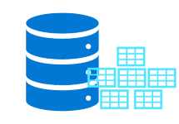
Data warehouses
A data warehouse is a centralized repository of integrated data from one or more disparate sources. Data warehouses store current and historical data in relational tables that are organized into a schema that optimizes performance for analytical queries.
Data engineers are responsible for designing and implementing relational data warehouses, and managing regular data loads into tables.

Slide 13

Apache Spark
Apache Spark is a parallel processing framework that takes advantage of in-memory processing and a distributed file storage. It's a common open-source software (OSS) tool for big data scenarios.
Data engineers need to be proficient with Spark, using notebooks and other code artifacts to process data in a data lake and prepare it for modeling and analysis.

Slide 14
Cloud Computing Basics
IaaS (Infrastructure as a Service): VMs, Networking, Storage (Azure VMs).
PaaS (Platform as a Service): Managed platforms for apps (Azure App Service, Databricks).
SaaS (Software as a Service): End-user applications (Microsoft 365, Power BI).

Slide 15
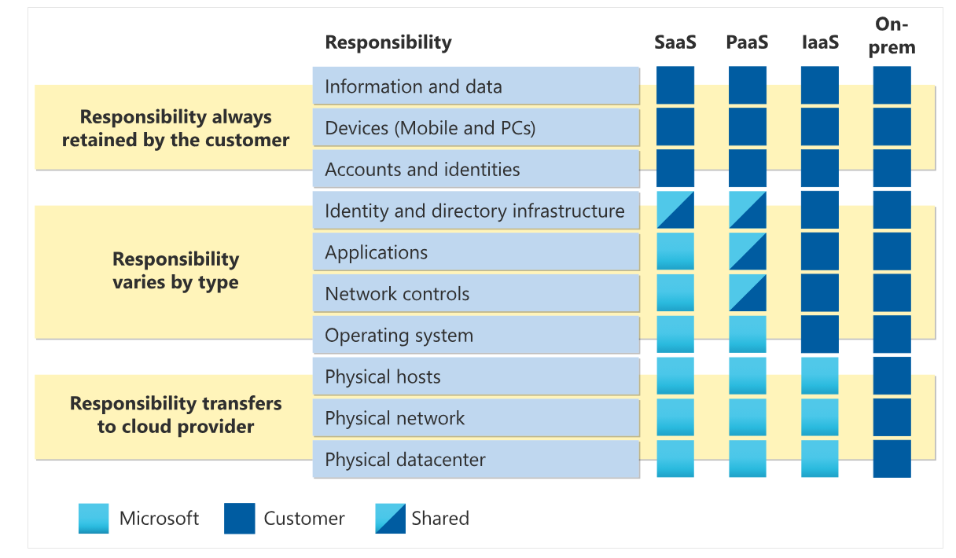
Shared Responsibility Model

Slide 16
Azure Global Infrastructure
Regions: Geographically separated datacenters worldwide.
Availability Zones: Physically isolated locations within a region.
Benefit: High availability, disaster recovery, global reach.

Slide 17
Azure Resource Hierarchy
Subscriptions → Resource Groups → Resources.
Subscriptions: Billing + access boundary.
Resource Groups: Logical grouping for resources.
Resources: VMs, Databases, Storage Accounts.

Slide 18
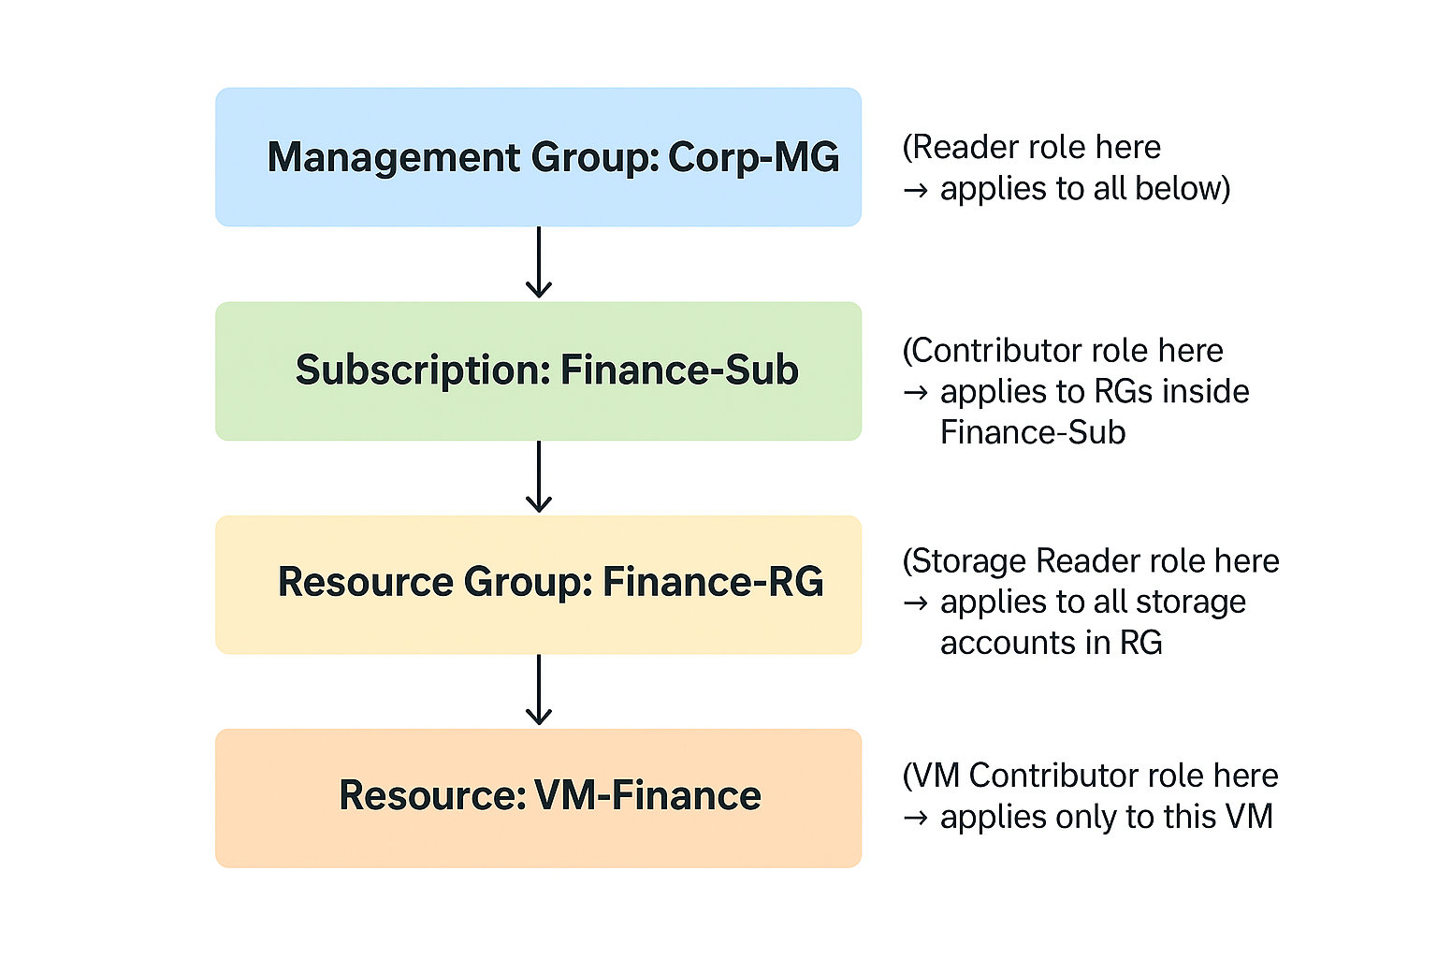
Azure Resource Hierarchy(Example)

Slide 19
Navigating Azure Portal
Dashboard customization for frequently used services.
Resource search and filtering options.
Monitoring tools: Metrics, Logs, Alerts.
Azure Advisor for optimization recommendations.

Slide 20
Azure CLI & PowerShell Basics
Azure CLI: Cross-platform command-line tool (az commands).
PowerShell: Windows-centric scripting with Az module.
Common tasks: Deploy resources, manage users, configure networking.
Automation: Scripting and Infrastructure as Code (IaC).

Slide 21
Cost Management in Azure
Azure Pricing Calculator for estimation.
Cost analysis and budgets in Azure Portal.
Resource tagging for cost allocation.
Best Practices: Shut down unused VMs, right-size resources, use Reserved Instances.

Slide 22
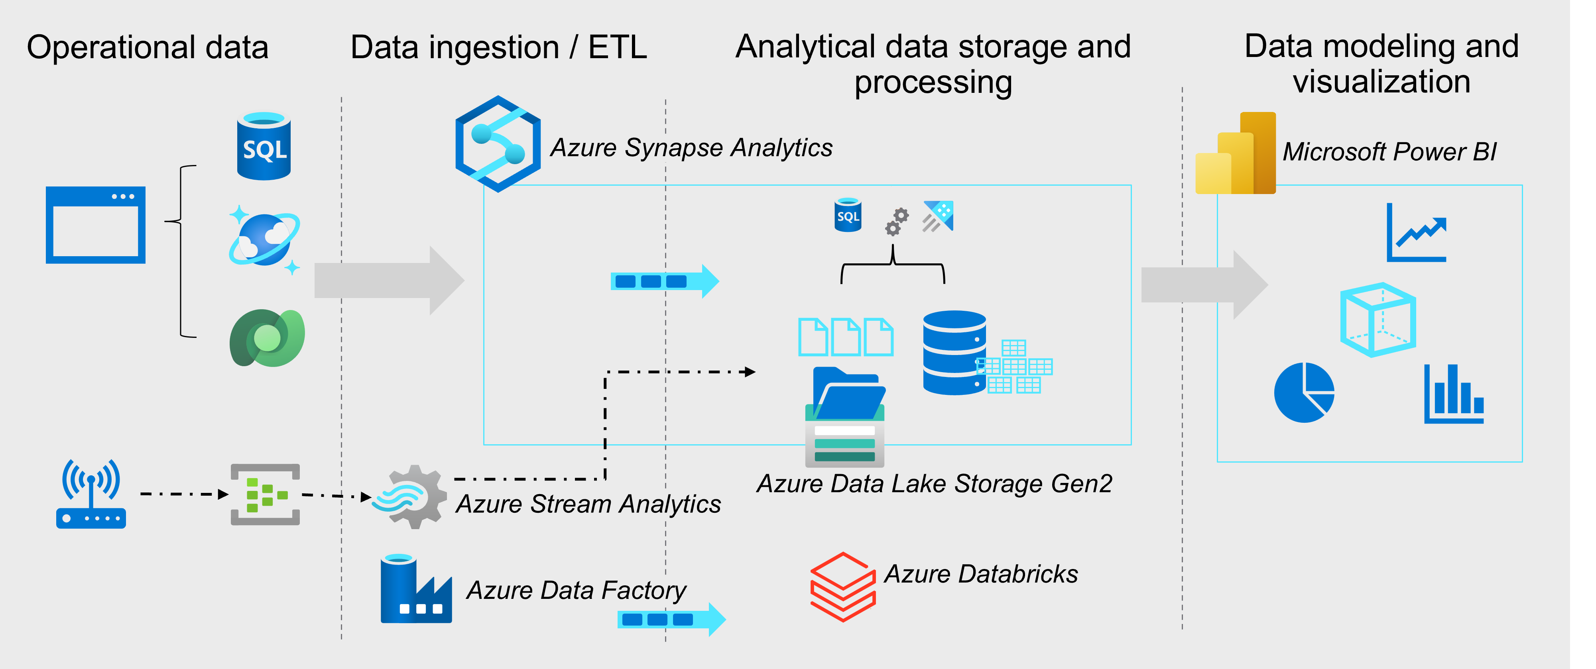
DE in Azure

