Slide 1

Module 8 — Azure Streaming
Overview of Azure streaming services and architecture

Slide 2
Azure Event Hub
High-throughput data ingestion service
Supports Kafka protocol
Used for real-time analytics pipelines

Slide 3
IoT Hub (Concept)
Device-to-cloud and cloud-to-device communication
Secure and scalable IoT ingestion
Built on Event Hub

Slide 4
Azure Stream Analytics
Real-time stream processing engine
SQL-like query language
Integrates with Event Hub, IoT Hub

Slide 5
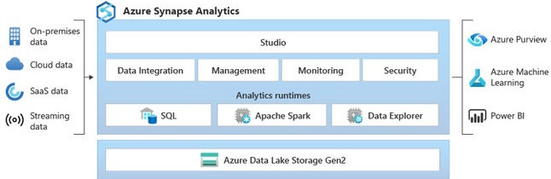
Azure Synapse Analytics

Slide 6
Windowing Functions
Tumbling Window
Hopping Window
Sliding Window
Session Window
Used for time-based aggregations

Slide 7
Window Type | Overlap | Trigger Type | Best For
Tumbling | No | Time-based | Simple aggregation
Hopping | Yes | Time-based | Moving averages
Sliding | Yes | Event-based | Real-time analytics
Session | Dynamic | Activity-based | User/session tracking

Slide 8
Stream to ADLS / Synapse
Store processed data in ADLS Gen2
Load into Synapse for analytics
Supports batch + real-time hybrid architecture

Slide 9
Monitoring Streaming Jobs
Metrics: throughput, latency
Azure Monitor integration
Alerts and diagnostics logs

Slide 10
Module 9 — Azure Synapse Analytics
Unified analytics platform
Combines data warehousing + big data analytics

Slide 11
Dedicated SQL Pool
Provisioned resources
Best for predictable workloads
Supports MPP architecture

Slide 12
Single system (SMP) → 1 chef cooking for 100 people
MPP system → 10 chefs cooking different dishes simultaneously
Result → Much faster processing

Slide 13
SMP vs MPP
Feature | MPP | SMP (Single Node)
Processing | Parallel | Sequential
Scalability | High | Limited
Performance | Very fast (big data) | Slower
Example | Synapse, Redshift | SQL Server

Slide 14
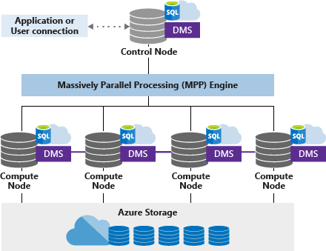
MPP Architecture

Slide 15
MPP Architecture
MPP is a database architecture where multiple nodes (machines) work in parallel to process large queries.
Instead of one server doing all the work:
Data is split across nodes
Each node processes a portion of data
Results are combined (aggregated)

Slide 16
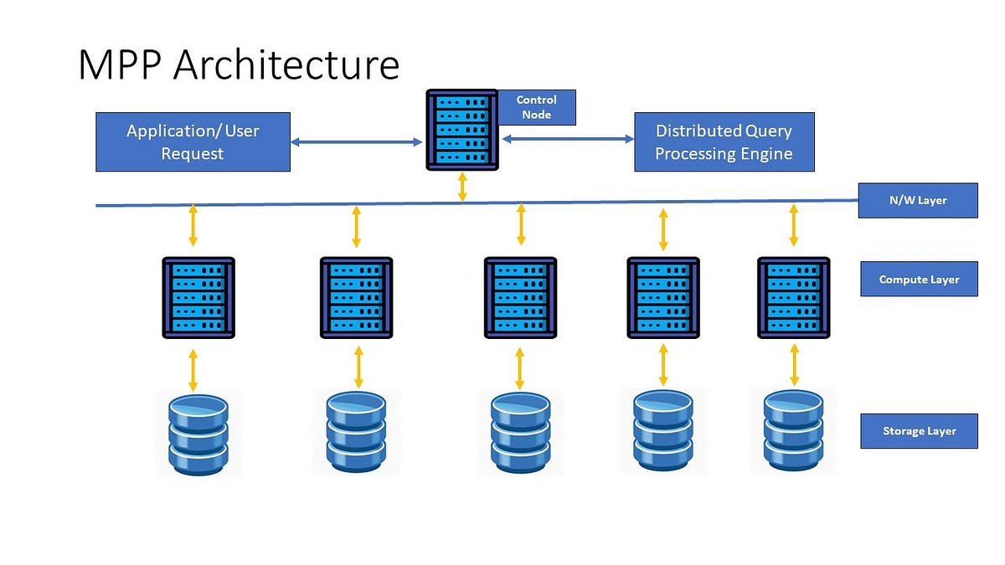
MPP Architecture

Slide 17
Components
Components:
Control Node
Receives SQL query
Breaks it into smaller tasks
Compute Nodes
Execute queries in parallel
Each node has its own data slice
Distributed Storage
Data is distributed across nodes

Slide 18
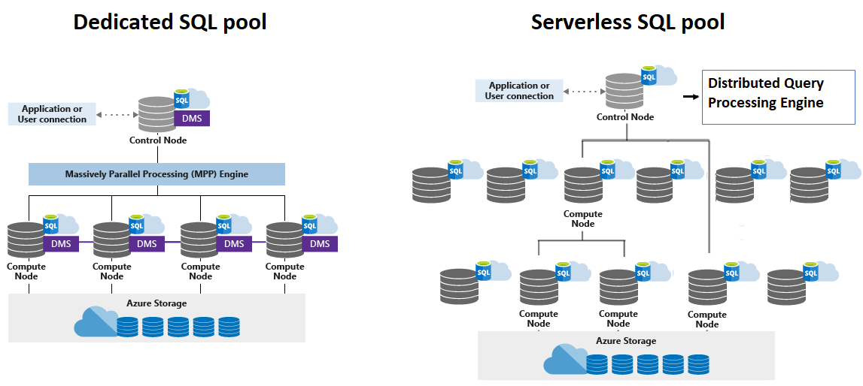

Slide 19
Distribution Strategies
Hash Distribution
Round Robin
Replicated Tables
Optimize query performance

Slide 20
Partitioning
Divide large tables
Improve query performance
Manage data efficiently

Slide 21
Loading Data
COPY INTO
PolyBase
Bulk insert
Best practices for large datasets

Slide 22
Synapse vs Databricks
Synapse: SQL-first analytics
Databricks: Spark-based data engineering
Synapse for BI, Databricks for ML/ETL

Slide 23
Synapse vs Redshift
Synapse: tightly integrated with Azure
Redshift: AWS-based warehouse
Differences in pricing, scaling, ecosystem

Slide 24
Synapse vs Redshift
Feature | Synapse | Redshift
Cloud | Azure | AWS
Storage | ADLS integration | S3
Compute | MPP | MPP
Ecosystem | Azure-native | AWS-native

Slide 25
SQL Pool vs Spark Pool
Feature | SQL Pool | Spark Pool
Engine Type | SQL Engine | Distributed Compute Engine
Language | T-SQL | Python, Scala, Spark SQL
Use Case | Reporting, BI | Data processing, ML
Data Type | Structured | Structured + Unstructured
Schema | Schema-on-write | Schema-on-read
Performance | Optimized for queries | Optimized for transformations
Storage | Tables (DW) or external | Data Lake files
Scaling | DWUs (Dedicated) | Auto-scale clusters

