Slide 1
Azure Data Engineering - Foundations
Modules 1 to 3 Overview

Slide 2
Module 1: Azure Cloud Foundations
Overview of Azure architecture, hierarchy, ARM, pricing

Slide 3
Azure Global Architecture
Regions: Geographic locations
Availability Zones: Fault isolation
Paired regions for DR

Slide 4
Region
Region
A Region is a geographical area (e.g., East US, Central India)
Contains multiple datacenters
Example:
Central India
East US
West Europe
Real-world analogy: Region = City where your data lives

Slide 5
Availability Zone
Availability Zone (AZ)
Physically separate datacenters inside a region
Each zone has:
Independent power
Independent network
Independent cooling
Example:
Central India → Zone 1, Zone 2, Zone 3

Slide 6
Availability Set
Logical grouping inside a datacenter
Protects against:
Hardware failures
Maintenance downtime

Slide 7
Architecture
Component | Purpose
Region | Geographic deployment
Availability Zone | High availability
Availability Set | Fault domain protection
Edge Location | Fast content delivery

Slide 8
Subscriptions & Resource Groups
Subscription: Billing & access boundary
Resource Group: Logical grouping of resources

Slide 9
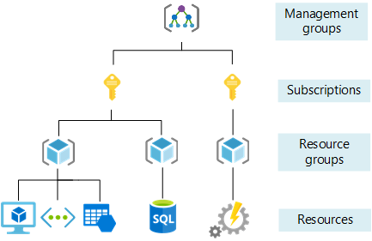
Azure Resource Hierarchy
Management Groups
Subscriptions
Resource Groups
Resources

Slide 10
ARM Concepts
Azure Resource Manager
Declarative templates
Infrastructure as Code (IaC)

Slide 11
Azure Resource Manager (ARM)
What is ARM?
Azure Resource Manager
ARM is the central management layer (control plane) of Azure.
It handles:
Creating resources
Updating resources
Deleting resources
Applying security (RBAC)
Enforcing policies

Slide 12
Azure Pricing & Cost Management
Pay-as-you-go
Reserved instances
Cost analysis
Budgets & alerts

Slide 13
Module 2: Identity & Governance
Security, access control, and compliance

Slide 14
Microsoft Entra ID
Identity provider
Users, Groups, Service Principals
Authentication & SSO

Slide 15
RBAC Model
Role-based access control
Least privilege principle
Built-in & custom roles

Slide 16
Managed Identity
Eliminates secrets
System & User assigned identities
Used for secure service access

Slide 17
Azure Policies
Governance enforcement
Compliance rules
Audit & deny actions

Slide 18
Budgets & Alerts
Cost tracking
Threshold alerts
Prevent overspending

Slide 19
Module 3: Networking for Data Platforms
Secure networking concepts

Slide 20
Virtual Network (VNet)
Private network in Azure
IP addressing
Isolation

Slide 21
Subnets
Segment VNet
Control traffic flow
Used for service isolation

Slide 22
Network Security Groups
Traffic filtering
Allow/Deny rules
Inbound & outbound security

Slide 23
Private Endpoints
Private access to PaaS
No public exposure
Secure connectivity

Slide 24
Service Endpoints
Secure access over Azure backbone
Extend VNet to PaaS

Slide 25
Key Vault Integration
Store secrets & keys
Secure access via Managed Identity

Slide 26
Secure Access to Storage & Databricks
Private endpoints
NSG rules
Identity-based access
Data exfiltration protection

