Slide 1
GCP - Getting started

Slide 2
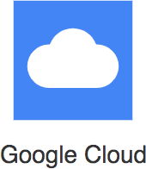
Google Cloud Platform (GCP)
One of the Top 3 cloud service providers Provides a number of services (200+)
Reliable, secure and highly-performant:
Infrastructure that powers 8 services with over 1 Billion Users: Gmail, Google Search, YouTube etc
One thing I love : "cleanest cloud"
Net carbon-neutral cloud (electricity used matched 100% with renewable energy)

Slide 3
Regions and Zones

Slide 4
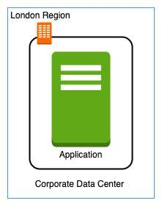
Regions and Zones
Imagine that your application is deployed in a data center in London What would be the challenges?
Challenge 1 : Slow access for users from other parts of the world (high latency)
Challenge 2 : What if the data center crashes?
Your application goes down (low availability)

Slide 5
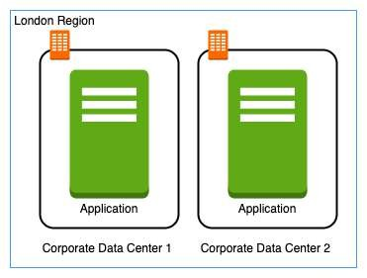
Multiple data centers
Let's add in one more data center in London What would be the challenges?
Challenge 1 : Slow access for users from other parts of the world
Challenge 2 (SOLVED) : What if one data center crashes?
Your application is still available from the other data center
Challenge 3 : What if entire region of London is unavailable?
Your application goes down

Slide 6
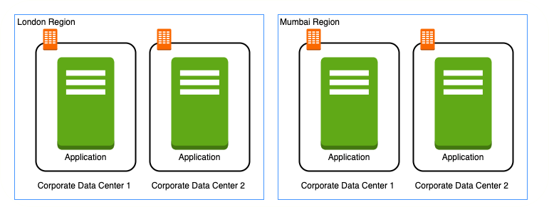
Multiple regions
Let's add a new region : Mumbai What would be the challenges?
Challenge 1 (PARTLY SOLVED) : Slow access for users from other parts of the world
You can solve this by adding deployments for your applications in other regions
Challenge 2 (SOLVED) : What if one data center crashes?
Your application is still live from the other data centers
Challenge 3 (SOLVED) : What if entire region of London is unavailable?
Your application is served from Mumbai

Slide 7
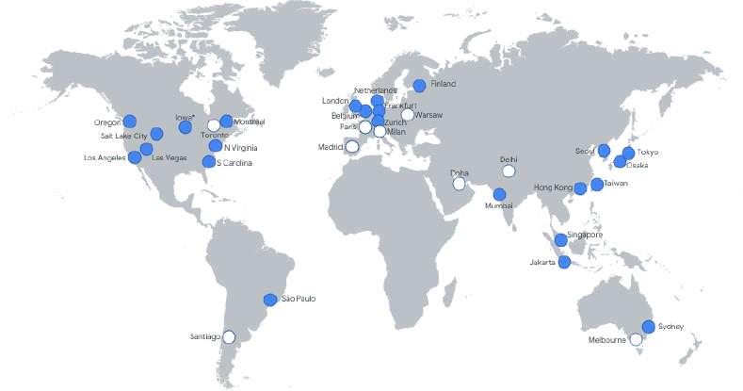
Regions
Imagine setting up data centers in different regions around the world
Would that be easy?
(Solution) Google provides 20+ regions around the world
Expanding every year
Region : Specific geographical location to host your resources
Advantages:
High Availability
Low Latency Global Footprint
Adhere to government regulations

Slide 8
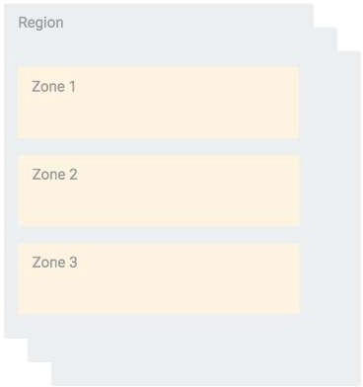
Zones
How to achieve high availability in the same region (or geographic location)?
Enter Zones
Each Region has three or more zones
(Advantage) Increased availability and fault tolerance within same region
(Remember) Each Zone has one or more discrete clusters
Cluster : distinct physical infrastructure that is housed in a data center
(Remember) Zones in a region are connected through low-latency links

Slide 9
Regions and Zones examples
New Regions and Zones are constantly added
Region Code | Region | Zones | Zones List
us-west1 | The Dalles, Oregon, North America | 3 | us-west1-a us-west1-b
 |  |  | us-west1-c
europe- north1 | Hamina, Finland, Europe | 3 | europe-north1-a, europe- north1-b europe-north1-c
asia-south1 | Mumbai, India APAC | 3 | asia-south1-a, asia-south1-b asia-south1-c

Slide 10
Compute Engine Fundamentals

Slide 11

Google Compute Engine (GCE)
In corporate data centers, applications are deployed to physical servers
Where do you deploy applications in the cloud?
Rent virtual servers
Virtual Machines - Virtual servers in GCP
Google Compute Engine (GCE) - Provision & Manage Virtual Machines

Slide 12


Compute Engine - Features
Create and manage lifecycle of Virtual Machine (VM) instances
Load balancing and auto scaling for multiple VM instances
Attach storage (& network storage) to your VM instances
Manage network connectivity and configuration for your VM instances
Our Goal:
Setup VM instances as HTTP (Web) Server
Distribute load with Load Balancers

Slide 13
Compute Engine Hands-on
Let's create a few VM instances and play with them
Let's check out the lifecycle of VM instances Let's use SSH to connect to VM instances

Slide 14
Compute Engine Machine Family
What type of hardware do you want to run your workloads on? Different Machine Families for Different Workloads:
General Purpose (E2, N2, N2D, N1) : Best price-performance ratio
Web and application servers, Small-medium databases, Dev environments
Memory Optimized (M2, M1): Ultra high memory workloads
Large in-memory databases and In-memory analytics
Compute Optimized (C2): Compute intensive workloads
Gaming applications

Slide 15
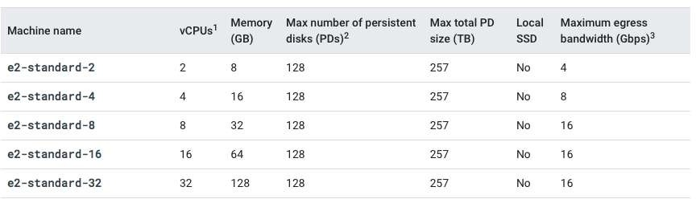
Compute Engine Machine Types
How much CPU, memory or disk do you want?
Variety of machine types are available for each machine family
Let's take an example : e2-standard-2:
e2 - Machine Type Family
standard - Type of workload
2 - Number of CPUs
Memory, disk and networking capabilities increase along with vCPUs

Slide 16


Image
What operating system and what software do you want on the instance?
Type of Images:
Public Images: Provided & maintained by communities or third party vendors
Custom Images: Created by you for your projects
Google or Open source

Slide 17
Compute Engine Hands-on : Setting up a HTTP server
#! /bin/bash sudo su
apt update
apt -y install apache2 sudo service apache2 start
sudo update-rc.d apache2 enable
echo "Hello World" > /var/www/html/index.html
echo "Hello world from $(hostname) $(hostname -I)" > /var/www/html/index.html
Commands:
sudo su - execute commands as a root user
apt update - Update package index - pull the latest changes from the APT repositories
apt -y install apache2 - Install apache 2 web server
sudo service apache2 start - Start apache 2 web server
echo "Hello World" > /var/www/html/index.html - Write to index.html
$(hostname) - Get host name
$(hostname -I) - Get host internal IP address

Slide 18
Internal and External IP Addresses
External (Public) IP addresses are Internet addressable.
Internal (Private) IP addresses are internal to a corporate network You CANNOT have two resources with same public (External) IP address.
HOWEVER, two different corporate networks CAN have resources with same Internal (private) IP address
All VM instances are assigned at least one Internal IP address
Creation of External IP addresses can be enabled for VM instances
(Remember) When you stop an VM instance, External IP address is lost
DEMO: VM instances - Internal and External IPs

Slide 19
Static IP Addresses
Scenario : How do you get a constant External IP address for a VM instance?
Quick and dirty way is to assign an Static IP Address to the VM!
DEMO: Using Static IP Address with an VM instance

Slide 20
Static IP Addresses - Remember
Static IP can be switched to another VM instance in same project
Static IP remains attached even if you stop the instance. You have to manually detach it.
Remember : You are billed for an Static IP when you are NOT using it!
Make sure that you explicitly release an Static IP when you are not using it.

Slide 21
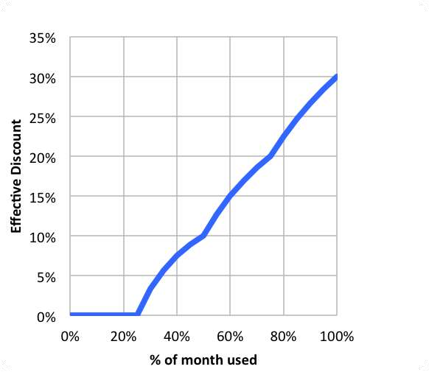
Sustained use discounts
Automatic discounts for running VM instances for significant portion of the billing month
Example: If you use N1, N2 machine types for more than 25% of a month, you get a 20% to 50% discount on every incremental minute.
Discount increases with usage (graph) No action required on your part!
Applicable for instances created by Google Kubernetes Engine and Compute Engine
RESTRICTION: Does NOT apply on certain machine types (example: E2 and A2)
RESTRICTION: Does NOT apply to VMs created by App Engine flexible and Dataflow
Source: https://cloud.google.com

Slide 22
Committed use discounts
For workloads with predictable resource needs
Commit for 1 year or 3 years
Up to 70% discount based on machine type and GPUs
Applicable for instances created by Google Kubernetes Engine and Compute Engine RESTRICTION: Does NOT apply to VMs created by App Engine flexible and Dataflow

Slide 23
Preemptible VM
Short-lived cheaper (upto 80%) compute instances
Can be stopped by GCP any time (preempted) within 24 hours
Instances get 30 second warning (to save anything they want to save)
Use Preempt VM's if:
Your applications are fault tolerant
You are very cost sensitive
Your workload is NOT immediate
Example: Non immediate batch processing jobs
RESTRICTIONS:
NOT always available
NO SLA and CANNOT be migrated to regular VMs NO Automatic Restarts
Free Tier credits not applicable

Slide 24
Spot VMs
Spot VMs: Latest version of preemptible VMs
Key Difference: Does not have a maximum runtime
Compared to traditional preemptible VMs which have a maximum runtime of 24 hours
Other features similar to traditional preemptible VMs
May be reclaimed at any time with 30-second notice
NOT always available
Dynamic Pricing: 60 - 91% discount compared to on-demand VMs Free Tier credits not applicable

Slide 25
Google Compute Engine - Billing
You are billed by the second (after a minimum of 1 minute)
You are NOT billed for compute when a compute instance is stopped
However, you will be billed for any storage attached with it!
(RECOMMENDATION) Always create Budget alerts and make use of Budget exports to stay on top of billing!
What are the ways you can save money?
Choose the right machine type and image for your workload
Be aware of the discounts available:
Sustained use discounts
Committed use discounts
Discounts for preemptible VM instances

Slide 26
Compute Engine : Live Migration & Availability Policy
How do you keep your VM instances running when a host system needs to be updated (a software or a hardware update needs to be performed)?
Live Migration
Your running instance is migrated to another host in the same zone
Does NOT change any attributes or properties of the VM SUPPORTED for instances with local SSDs
NOT SUPPORTED for GPUs and preemptible instances
Important Configuration - Availability Policy:
On host maintenance: What should happen during periodic infrastructure maintenance?
Migrate (default): Migrate VM instance to other hardware
Terminate: Stop the VM instance
Automatic restart - Restart VM instances if they are terminated due to non-user-initiated reasons (maintenance event, hardware failure etc.)

Slide 27
Compute Engine Features: Custom Machine Types
What do you do when predefined VM options are NOT appropriate for your workload?
Create a machine type customized to your needs (a Custom Machine Type)
Custom Machine Type: Adjust vCPUs, memory and GPUs
Choose between E2, N2, or N1 machine types
Supports a wide variety of Operating Systems: CentOS, CoreOS, Debian, Red Hat, Ubuntu, Windows etc
Billed per vCPUs, memory provisioned to each instance
Example Hourly Price: $0.033174 / vCPU + $0.004446 / GB

Slide 28

Compute Engine Features: GPUs
How do you accelerate math intensive and graphics-intensive workloads for AI/ML etc?
Add a GPU to your virtual machine:
High performance for math intensive and graphics-intensive workloads
Higher Cost
(REMEMBER) Use images with GPU libraries (Deep Learning) installed
OTHERWISE, GPU will not be used
GPU restrictions:
NOT supported on all machine types (For example, not supported on shared-core or memory-optimized machine types)
On host maintenance can only have the value "Terminate VM instance"
Recommended Availability policy for GPUs
Automatic restart - on

Slide 29
Virtual Machine - Remember
Associated with a project
Machine type availability can vary from region to regions
You can only change the machine type (adjust the number of vCPUs and memory) of a stopped instance
You CANNOT change the machine type of a running instance
VM's can be filtered by various properties
Name, Zone, Machine Type, Internal/External IP, Network, Labels etc
Instances are Zonal (Run in a specific zone (in a specific region))
Images are global (You can provide access to other projects - if needed)
Instance templates are global (Unless you use zonal resources in your templates)
Automatic Basic Monitoring is enabled
Default Metrics: CPU utilization, Network Bytes (in/out), Disk Throughput/IOPS
For Memory Utilization & Disk Space Utilization - Cloud Monitoring agent is needed

Slide 30
Virtual Machine - Best Practices
Choose Zone and Region based on:
Cost, Regulations, Availability Needs, Latency and Specific Hardware needs
Distribute instances in multiple zones and regions for high availability
Choose right machine type for you needs:
Play with them to find out the right machine type
Use GPUs for Math and Graphic intensive applications
Reserve for "committed use discounts" for constant workloads
Use preemptible instances for fault-tolerant, NON time critical workloads
Use labels to indicate environment, team, business unit etc

Slide 31
Compute Engine Scenarios
Scenario
What are the pre-requisites to be able to create a VM instance?
Solution
Project
Billing Account
Compute Engines APIs should be enabled
Sole-tenant nodes
Use "VM Manager"
You want dedicated hardware for your compliance, licensing, and management needs
I have 1000s of VM and I want to automate OS patch management, OS inventory management and OS configuration management (manage software installed)
You want to login to your VM instance to install software You do not want to expose a VM to internet
You want to allow HTTP traffic to your VM
You can SSH into it
Do NOT assign an external IP Address
Configure Firewall Rules

Slide 32
Quick Review
Image
What operating system and what software do you want on the VM instance? Reduce boot time and improve security by creating custom hardened Images.
You can share an Image with other projects
Machine Types
Optimized combination of compute(CPU, GPU), memory, disk (storage) and networking for specific workloads.
You can create your own Custom Machine Types when existing ones don't fit your needs

Slide 33
Quick Review
Static IP Addresses: Get a constant IP addresses for VM instances
Instance Templates: Pre-configured templates simplifying the creation of VM instances
Sustained use discounts: Automatic discounts for running VM instances for significant portion of the billing month
Committed use discounts: 1 year or 3 year reservations for workloads with
predictable resource needs
Preemptible VM: Short-lived cheaper (upto 80%) compute instances for non- time-critical fault-tolerant workloads

Slide 34
Gcloud

Slide 35

Gcloud
Command line interface to interact with Google Cloud Resources Most GCP services can be managed from CLI using Gcloud:
Compute Engine Virtual Machines
Managed Instance Groups Databases
and ... many more
You can create/delete/update/read existing resources and perform actions like deployments as well!
(REMEMBER) SOME GCP services have specific CLI tools:
Cloud Storage - gsutil
Cloud BigQuery - bq Cloud Bigtable - cbt
Kubernetes - kubectl (in addition to Gcloud which is used to manage clusters)

Slide 36
Gcloud - Getting Started
Installation
Gcloud is part of Google Cloud SDK
Cloud SDK requires Python
Instructions to install Cloud SDK (and Gcloud) => https://cloud.google.com/sdk/docs/install
You can also use Gcloud on Cloud Shell
Connecting to GCP
gcloud init - initialize or reinitialize gcloud
Authorize gcloud to use your user account credentials
Setup configuration
Includes current project, default zone etc
gcloud config list - lists all properties of the active configuration

Slide 37
gcloud config set
Sets the specified property in your active configuration
gcloud | config | set | core/project VALUE
gcloud | config | set | compute/region VALUE
gcloud | config | set | compute/zone VALUE
gcloud | config | set | core/verbosity VALUE(debug)
Syntax - gcloud config set SECTION/PROPERTY VALUE
core, compute - SECTIONS
project, region, zone - PROPERTIES
Specifying core is optional as it is the default SECTION!
gcloud config set project VALUE
gcloud config set verbosity VALUE(debug)
Get more details with gcloud config set --help
Look for AVAILABLE PROPERTIES in the content
Opposite - gcloud config unset

Slide 38
Playing with gcloud config set
gcloud config set compute/region us-east2 gcloud config set compute/zone us-east1-b gcloud config list
testing@cloudshell:~ (useful-device-303710)$ gcloud config list [component_manager]
disable_update_check = True [compute]
gce_metadata_read_timeout_sec = 30 region = us-east1
zone = us-east1-b [core]
account = testing@gmail.com disable_usage_reporting = True
project = useful-device-303710 verbosity = info
[metrics]
environment = devshell

Slide 39
Gcloud - Managing Multiple Configurations
Scenario: You are working on multiple projects from the same machine. You would want to be able to execute commands using different configurations.
How do you simplify this?
gcloud config configurations create/delete/describe/activate/list
Create new configuration: gcloud config configurations create NAME(dev)
Activate specific configuration: gcloud config configurations activate NAME(dev)
List Configurations: gcloud config configurations list

Slide 40
gcloud command structure - Playing with Services
gcloud GROUP SUBGROUP ACTION ...
GROUP - config or compute or container or dataflow or functions or iam or ..
Which service group are you playing with?
SUBGROUP - instances or images or instance-templates or machine-types or regions or zones
Which sub group of the service do you want to play with?
ACTION - create or list or start or stop or describe or ...
What do you want to do?
Examples:
gcloud compute instances list
gcloud compute zones list gcloud compute regions list
gcloud compute machine-types list
gcloud compute machine-types list --filter="zone:us-central1-b"
gcloud compute machine-types list --filter="zone:( us-central1-b europe-west1-d )"

Slide 41
gcloud compute instances create
Creating Compute Instances
gcloud compute instances create [NAME]
Options:
--machine-type (default type is n1-standard-1 - gcloud compute machine-types list)
--custom-cpu --custom-memory --custom-vm-type(n1/n2) (Custom Machine)
--custom-cpu 6 --custom-memory 3072MB --custom-vm-type n2
--image or --image-family or --source-snapshot or --source-instance-template or --source-machine-image (beta)
--service-account or --no-service-account
--zone=us-central1-b
--tags (List of tags - Allow network firewall rules and routes to be applied to VM instances)
--preemptible
--restart-on-failure(default) --no-restart-on-failure --maintenance-policy(MIGRATE(default)/TERMINATE)
--boot-disk-size, --boot-disk-type --boot-disk-auto-delete(default) --no-boot-disk-auto-delete
--deletion-protection --no-deletion-protection(default)
--metadata/metadata-from-file startup-script/startup-script-url
--metadata-from-file startup-script=/local/path/to/script/startup OR --metadata startup-script="echo 'hello world'"
shutdown-script
--network --subnet --network-tier (PREMIUM (default), STANDARD)
--accelerator="type=nvidia-tesla-v100,count=8" --metadata="install-nvidia-driver=True" (GPU)

Slide 42
Compute Instances - Default Region and Zone
Three Options:
Option 1 (Centralized Configuration): gcloud compute project-info add-metadata
--metadata=[google-compute-default-region=REGION | google-compute-default-zone=ZONE]
Option 2 (Local gcloud configuration): gcloud config set compute/region REGION Option 3 (Command Specific): --zone or --region in the command
Priority: Option 3 (if exists) overrides Option 2 (if exists) overrides Option 1

Slide 43
List and Describe commands
Typically list commands are used to list a set of resources
gcloud compute RESOURCES list
gcloud compute images/regions/zones/disk-types list
gcloud compute instances/disks/snapshots list
Most list commands support a few common options
--filter="zone:VALUE"
--sort-by (NAME, ~NAME)
--uri (https://www.googleapis.com/compute/v1/projects/windows-sql-cloud/global/images/sql-2019-web- windows-2019-dc-v20210112)
gcloud compute images list --sort-by NAME --filter "PROJECT:(windows-cloud ubuntu-os-cloud)"
Typically describe commands are used to describe a specific resource gcloud compute images describe ubuntu-1604-xenial- v20210203 --project ubuntu- os-cloud
gcloud compute regions describe us-central1

Slide 44
Playing with Compute Instances - gcloud
Playing with compute instances
gcloud compute instances list/start/stop/delete/reset/describe/move
gcloud compute instances start example-instance
gcloud compute instances stop example-instance-1 example-instance-2 gcloud compute instances delete example-instance
--delete-disks=VALUE (all or data or boot)
--keep-disks=VALUE (all or data or boot)
gcloud compute instances move example-instance-1 --zone us-central1-b --destination-zone us- central1-f
Move a VM from one zone to another

Slide 45
Playing with Instance Templates
gcloud compute instance-templates create/delete/describe/list
gcloud compute instance-templates create INSTANCE-TEMPLATE
--source-instance=SOURCE_INSTANCE --source-instance-zone (Which instance to create a template from?)
Supports almost all options supported by gcloud compute instances create [NAME]
--image or --image-family or --source-snapshot or --source-instance-template
--service-account or --no-service-account
--tags
--preemptible
--restart-on-failure(default) --no-restart-on-failure --maintenance-policy(MIGRATE(default)/TERMINATE)
--boot-disk-size, --boot-disk-type --boot-disk-auto-delete(default) --no-boot-disk-auto-delete
--deletion-protection --no-deletion-protection(default)
--metadata/metadata-from-file startup-script/startup-script-url
--network --subnet --network-tier (PREMIUM (default), STANDARD)
--accelerator="type=nvidia-tesla-v100,count=8" --metadata="install-nvidia-driver=True" (GPU)
Using Instance Tempate to create an instance
gcloud compute instances create my-test-vm --sourc e-instance-template=my-instance-template- with-custom-image

Slide 46
Managed Services

Slide 47

Managed Services
Do you want to continue running applications in the cloud, the same way you run them in your data center?
OR are there OTHER approaches?
You should understand some terminology used with cloud services:
IaaS (Infrastructure as a Service)
PaaS (Platform as a Service) FaaS (Function as a Service) CaaS (Container as a Service) Serverless
Let's get on a quick journey to understand these!

Slide 48
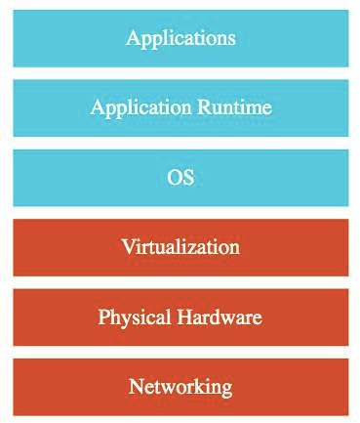
IAAS (Infrastructure as a Service)
Use only infrastructure from cloud provider
Example: Using VM to deploy your applications or databases
You are responsible for:
Application Code and Runtime
Configuring load balancing Auto scaling
OS upgrades and patches Availability
etc.. ( and a lot of things!)

Slide 49
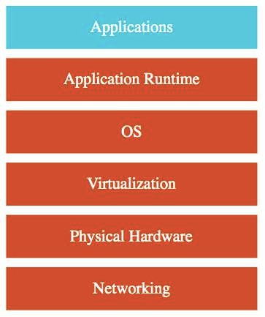
PAAS (Platform as a Service)
Use a platform provided by cloud
Cloud provider is responsible for:
OS (incl. upgrades and patches)
Application Runtime
Auto scaling, Availability & Load balancing etc..
You are responsible for:
Configuration (of Application and Services)
Application code (if needed)
Varieties:
CAAS (Container as a Service): Containers instead of Apps
FAAS (Function as a Service): Functions instead of Apps
Databases - Relational & NoSQL (Amazon RDS, Google Cloud SQL, Azure SQL Database etc), Queues, AI, ML, Operations etc!

Slide 50
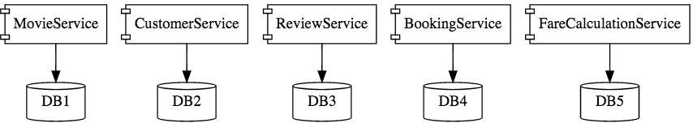
Microservices
Enterprises are heading towards microservices architectures
Build small focused microservices
Flexibility to innovate and build applications in different programming languages (Go, Java, Python, JavaScript, etc)
BUT deployments become complex!
How can we have one way of deploying Go, Java, Python or JavaScript .. microservices?
Enter containers!

Slide 51
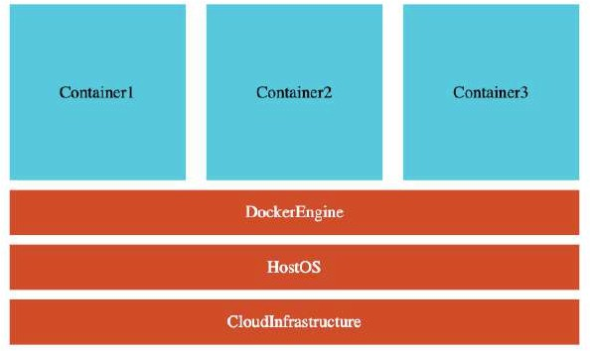
Containers - Docker
Create Docker images for each microservice
Docker image has all needs of a microservice:
Application Runtime (JDK or Python or NodeJS)
Application code and Dependencies
Runs the same way on any infrastructure:
Your local machine
Corporate data center Cloud
Advantages
Docker containers are light weight
Compared to Virtual Machines as they do not have a Guest OS
Docker provides isolation for containers Docker is cloud neutral

Slide 52
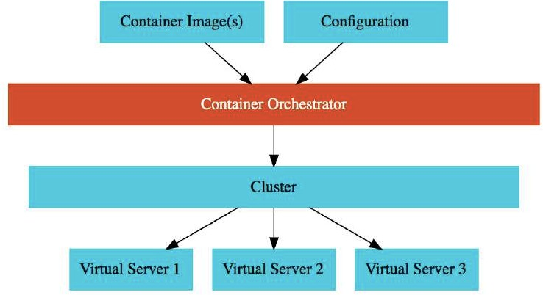
Container Orchestration
Requirement : I want 10 instances of Microservice A container, 15 instances of Microservice B container and ....
Typical Features:
Auto Scaling - Scale containers based on demand
Service Discovery - Help microservices find one another
Load Balancer - Distribute load among multiple instances of a microservice
Self Healing - Do health checks and replace failing instances
Zero Downtime Deployments - Release new versions without downtime

Slide 53
Serverless
What do we think about when we develop an application?
Where to deploy? What kind of server? What OS?
How do we take care of scaling and availability of the application?
What if you don't need to worry about servers and focus on your code?
Enter Serverless
Remember: Serverless does NOT mean "No Servers"
Serverless for me:
You don't worry about infrastructure (ZERO visibility into infrastructure)
Flexible scaling and automated high availability
Most Important: Pay for use
Ideally ZERO REQUESTS => ZERO COST
You focus on code and the cloud managed service takes care of all that is needed to scale your code to serve millions of requests!
And you pay for requests and NOT servers!

Slide 54



GCP Managed Services for Compute
Service | Details | Category
Compute Engine | High-performance and general purpose VMs that scale globally | IaaS
Google Kubernetes Engine | Orchestrate containerized microservices on Kubernetes Needs advanced cluster configuration and monitoring | CaaS
App Engine | Build highly scalable applications on a fully managed platform using open and familiar languages and tools | PaaS (CaaS, Serverless)
Cloud Functions | Build event driven applications using simple, single- purpose functions | FaaS, Serverless
Cloud Run | Develop and deploy highly scalable containerized applications. Does NOT need a cluster! | CaaS (Serverless)

Slide 55
Storage

Slide 56
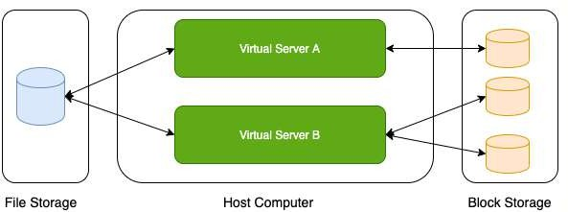
Storage Types - Block Storage and File Storage
What is the type of storage of your hard disk?
Block Storage
You've created a file share to share a set of files with your colleagues in a enterprise. What type of storage are you using?
File Storage

Slide 57
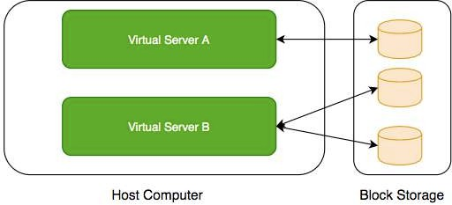
Block Storage
Use case: Harddisks computers
attached to your
Typically, ONE Block Storage device can be connected to ONE virtual server
(EXCEPTIONS) You can attach read only block devices with multiple virtual servers and certain cloud providers are exploring multi-writer disks as well!
HOWEVER, you can connect multiple different block storage devices to one virtual server
Used as:
Direct-attached storage (DAS) - Similar to a hard disk
Storage Area Network (SAN) - High-speed network connecting a pool of storage devices

Slide 58
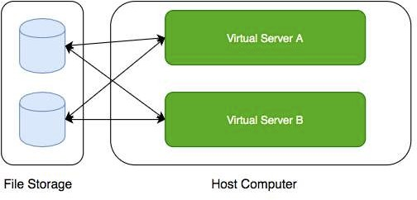
File Storage
Media workflows need huge shared storage for supporting processes like video editing
Enterprise users need a quick way to share files in a secure and organized way
These file shares are shared by several virtual servers

Slide 59

GCP - Block Storage and File Storage
Block Storage:
Persistent Disks: Network Block Storage
Zonal: Data replicated in one zone
Regional: Data replicated in multiple zone
Local SSDs: Local Block Storage
File Storage:
Filestore: High performance file storage

Slide 60
GCP - Block Storage
Two popular types of block storage can be attached to VM instances:
Local SSDs
Persistent Disks
Local SSDs are physically attached to the host of the VM instance
Temporary data
Lifecycle tied to VM instance
Persistent Disks are network storage
More durable
Lifecycle NOT tied to VM instance

Slide 61
Local SSDs
Physically attached to the host of VM instance:
Provide very high (IOPS) and very low latency
(BUT) Ephemeral storage - Temporary data (Data persists only until instance is running)
Enable live migration for data to survive maintenance events
Data automatically encrypted
HOWEVER, you CANNOT configure encryption keys!
Lifecycle tied to VM instance
ONLY some machine types support Local SSDs Supports SCSI and NVMe interfaces
Remember:
Choose NVMe-enabled and multi-queue SCSI images for best performance
Larger Local SSDs (more storage), More vCPUs (attached to VM) => Even Better Performance

Slide 62
Local SSDs - Advantages and Disadvantages
Advantages
Very Fast I/O (~ 10-100X compared to PDs)
Higher throughput and lower latency
Ideal for use cases needing high IOPs while storing temporary information
Examples: Caches, temporary data, scratch files etc
Disadvantages
Ephemeral storage
Lower durability, lower availability, lower flexibility compared to PDs
You CANNOT detach and attach it to another VM instance

Slide 63


Persistent Disks (PD)
Network block storage attached to your VM instance
Provisioned capacity
Very Flexible:
Increase size when you need it - when attached to VM instance
Performance scales with size
For higher performance, resize or add more PDs
Independent lifecycle from VM instance
Attach/Detach from one VM instance to another
Options: Regional and Zonal
Zonal PDs replicated in single zone. Regional PDs replicated in 2 zones in same Region.
Typically Regional PDs are 2X the cost of Zonal PDs
Use case : Run your custom database

Slide 64
Persistent Disks vs Local SSDs
Feature | Persistent Disks | Local SSDs
Attachment to VM instance | As a network drive | Physically attached
Lifecycle | Separate from VM instance | Tied with VM instance
I/O Speed | Lower (network latency) | 10-100X of PDs
Snapshots | Supported | Not Supported
Use case | Permanent storage | Ephemeral storage

Slide 65
Persistent Disks - Standard vs Balanced vs SSD
Feature | Standard | Balanced | SSD
Underlying Storage | Hard Disk Drive | Solid State Drive | Solid State Drive
Referred to as | pd-standard | pd-balanced | pd-ssd
Performance - Sequential IOPS (Big Data/Batch) | Good | Good | Very Good
Performance - Random IOPS (Transactional Apps) | Bad | Good | Very Good
Cost | Cheapest | In Between | Expensive
Use cases | Big Data (cost efficient) | Balance between cost and performance | High Performance

Slide 66


Persistent Disks - Snapshots
Take point-in-time snapshots of your Persistent Disks You can also schedule snapshots (configure a schedule):
You can also auto-delete snapshots after X days
Snapshots can be Multi-regional and Regional You can share snapshots across projects
You can create new disks and instances from snapshots Snapshots are incremental:
Deleting a snapshot only deletes data which is NOT needed by other snapshots
Keep similar data together on a Persistent Disk:
Separate your operating system, volatile data and permanent data
Attach multiple disks if needed
This helps to better organize your snapshots and images

Slide 67
Persistent Disks - Snapshots - Recommendations
Avoid taking snapshots more often than once an hour
Disk volume is available for use but Snapshots reduce performance
(RECOMMENDED) Schedule snapshots during off-peak hours
Creating snapshots from disk is faster than creating from images:
But creating disks from image is faster than creating from snapshots
(RECOMMENDED) If you are repeatedly creating disks from a snapshot:
Create an image from snapshot and use the image to create disks
Snapshots are incremental:
BUT you don't lose data by deleting older snapshots
Deleting a snapshot only deletes data which is NOT needed by other snapshots (RECOMMENDED) Do not hesitate to delete unnecessary snapshots

Slide 68

Playing with Machine Images
(Remember) Machine Image is different from Image
Multiple disks can be attached with a VM:
One Boot Disk (Your OS runs from Boot Disk)
Multiple Data Disks
An image is created from the boot Persistent Disk HOWEVER, a Machine Image is created from a VM instance:
Machine Image contains everything you need to create a VM instance:
Configuration
Metadata Permissions
Data from one or more disks
Recommended for disk backups, instance cloning and replication

Slide 69
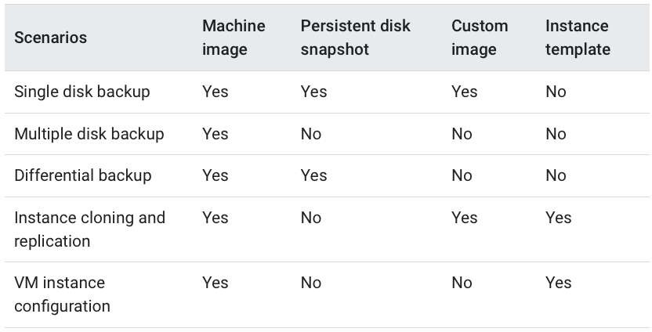
Let's Compare
https://cloud.google.com/compute/docs/machine-images

Slide 70
Playing with Disks - Command Line
gcloud compute disks list/create/delete/resize/snapshot
gcloud compute disks create my-disk-1 --zone=us-east1-a
What should be the size and type?
--size=SIZE (1GB or 2TB)
--type=TYPE (default - pd-standard) (gcloud compute disk-types list)
What should be on the disk?
--image --image-family --source-disk --source-snapshot
How should data on disk be encrypted?
--kms-key --kms-project
gcloud compute disks resize example-disk-1 --size=6TB
Only increasing disk size is supported
gcloud compute disks snapshot test names=snapshot-test
You can also play with the snapshots which are created:
gcloud compute snapshots list/describe/delete
--zone=us-central1-a
--snapshot-

Slide 71
Playing with Images - Command Line
gcloud compute images
Actions: create/delete/deprecate/describe/export/import/list/update
Creating Images
gcloud compute images create my-image
From a Disk - --source-disk=my-disk --source-disk-zone=us-east1-a
From a Snapshot - --source-snapshot=source-snapshot
From another image - --source-image=source-image --source-image-project=source-image-project
From latest non deprecated image from a family - --source-image-family=source-image-family --source-image- project=source-image-project
Deprecate Image
gcloud compute images deprecate IMAGE --state=DEPRECATED
Exports virtual disk images
gcloud compute images export --image=my-image --destination-uri=gs://my-bucket/my-image.vmdk -
-export-format=vmdk --project=my-project
Other Examples:
gcloud compute images delete my-image1 my-image2

Slide 72
Playing with Machine Images - Command Line
(Remember) gcloud commands for machine images are IN BETA Commands:
Create Machine Image:
gcloud beta compute machine-images create SOURCE_INSTANCE_NAME
Create an Instance from the Machine Image:
MACHINE_IMAGE_NAME --source-instance
gcloud beta compute instances create VM_NAME --zone ZONE --source-machine-image SOURCE_MACHINE_IMAGE_NAME

Slide 73
Storage - Scenarios - Persistent Disks
Scenario Solution
You want to improve performance of Persistent Disks (PD)
Increase size of PD or Add more PDs. Increase vCPUs in your VM.
You want to increase durability of Persistent Disks (PD)
Go for Regional PDs (2X cost but replicated in 2 zones)
You want to take hourly backup of Persistent Disks (PD) for disaster recovery
Schedule hourly snapshots!
You want to delete old snapshots created by scheduled snapshots
Configure it as part of your snapshot scheduling!

Slide 74
Cloud Filestore
Shared cloud file storage:
Supports NFSv3 protocol
Provisioned Capacity
Suitable for high performance workloads:
Up to 320 TB with throughput of 16 GB/s and 480K IOPS
Supports HDD (general purpose) and SSD (performance-critical workloads)
Use cases : file share, media workflows and content management

Slide 75
Review - Global, Regional and Zonal Resources
Global
Images
Snapshots
Instance templates (Unless you use zonal resources in your templates)
Regional
Regional managed instance groups
Regional persistent disks
Zonal
Zonal managed instance groups
Instances
Persistent disks
You can attach a disk only to instances in the same zone as the disk

Slide 76
Storage - Scenarios
Scenario
Solution
You want Very High IOPS but your data can be lost without a problem
Local SSDs
You want to create a high perfomance file sharing system in GCP which can be attached with multiple VMs
Filestore
You want to backup your VM configuration along with all its attached Persistent Disks
Create a Machine Image
You want to make it easy to launch VMs with hardened OS and customized software
Create a Custom Image

Slide 77
Object Storage - Cloud Storage

Slide 78

Cloud Storage
Most popular, very flexible & inexpensive storage service
Serverless: Autoscaling and infinite scale
Store large objects using a key-value approach:
Treats entire object as a unit (Partial updates not allowed)
Recommended when you operate on entire object most of the time
Access Control at Object level
Also called Object Storage
Provides REST API to access and modify objects
Also provides CLI (gsutil) & Client Libraries (C++, C#, Java, Node.js, PHP, Python & Ruby)
Store all file types - text, binary, backup & archives:
Media files and archives, Application packages and logs
Backups of your databases or storage devices
Staging data during on-premise to cloud database migration

Slide 79
Cloud Storage - Objects and Buckets
Objects are stored in buckets
Bucket names are globally unique
Bucket names are used as part of object URLs => Can contain ONLY lower case letters, numbers, hyphens, underscores and periods.
3-63 characters max. Can't start with goog prefix or should not contain
google (even misspelled)
Unlimited objects in a bucket
Each bucket is associated with a project
Each object is identified by a unique key
Key is unique in a bucket
Max object size is 5 TB
BUT you can store unlimited number of such objects

Slide 80
Cloud Storage - Storage Classes - Introduction
Different kinds of data can be stored in Cloud Storage
Media files and archives
Application packages and logs
Backups of your databases or storage devices Long term archives
Huge variations in access patterns
Can I pay a cheaper price for objects I access less frequently?
Storage classes help to optimize your costs based on your access needs
Designed for durability of 99.999999999%(11 9’s)

Slide 81
Cloud Storage - Storage Classes - Comparison
Storage Class | Name | Minimum Storage duration | Typical Monthly availability | Use case
Standard | STANDARD | None | > 99.99% in multi region and dual region, 99.99% in regions | Frequently used data/Short period of time
Nearline storage | NEARLINE | 30 days | 99.95% in multi region and dual region, 99.9% in regions | Read or modify once a month on average
Coldline storage | COLDLINE | 90 days | 99.95% in multi region and dual region, 99.9% in regions | Read or modify at most once a quarter
Archive storage | ARCHIVE | 365 days | 99.95% in multi region and dual region, 99.9% in regions | Less than once a year

Slide 82
Features across Storage Classes
High durability (99.999999999% annual durability) Low latency (first byte typically in tens of milliseconds) Unlimited storage
Autoscaling (No configuration needed)
NO minimum object size
Same APIs across storage classes
Committed SLA is 99.95% for multi region and 99.9% for single region for Standard, Nearline and Coldline storage classes
No committed SLA for Archive storage

Slide 83
Cloud Storage - Uploading and Downloading Objects
Option Recommended for Scenarios
Simple Upload Small files (that can be re uploaded in case of failures) + NO object metadata
Multipart upload Small files (that can be re uploaded in case of failures) + object metadata
Resumable upload
Larger files. RECOMMENDED for most usecases
(even for small files - costs one additional HTTP request)
Streaming transfers
Upload an object of unknown size
Parallel composite uploads
File divided up to 32 chunks and uploaded in parallel.
Significantly faster if network and disk speed are not limiting factors.
Simple download
Downloading objects to a destination
Streaming download
Downloading data to a process
Sliced object download
Slice and download large objects

Slide 84
Object Versioning
Prevents accidental deletion & provides history
Enabled at bucket level
Can be turned on/off at any time
Live version is the latest version
If you delete live object, it becomes noncurrent object version
If you delete noncurrent object version, it is deleted
Older versions are uniquely identified by (object key + a generation number)
Reduce costs by deleting older (noncurrent) versions!

Slide 85
Object Lifecycle Management
Files are frequently accessed when they are created
Generally usage reduces with time
How do you save costs by moving files automatically between storage classes?
Solution: Object Lifecycle Management
Identify objects using conditions based on:
Age, CreatedBefore, IsLive, MatchesStorageClass, NumberOfNewerVersions etc
Set multiple conditions: all conditions must be satisfied for action to happen
Two kinds of actions:
SetStorageClass actions (change from one storage class to another)
Deletion actions (delete objects)
Allowed Transitions:
(Standard or Multi-Regional or Regional) to (Nearline or Coldline or Archive)
Nearline to (Coldline or Archive)

Slide 86
Object Lifecycle Management - Example Rule
{
"lifecycle": {
"rule": [
{
"action": {"type": "Delete"}, "condition": {
"age": 30, "isLive": true
}
},
{
"action": {
"type": "SetStorageClass", "storageClass": "NEARLINE"
},
"condition": {
"age": 365,
"matchesStorageClass": ["STANDARD"]
}
}
]
}
}

Slide 87


Cloud Storage - Encryption
Cloud Storage always encrypts data on the server side!
Configure Server-side encryption: Encryption performed by Cloud Storage
Google-managed encryption key - Default (No configuration required)
Customer-managed encryption keys - Created using Cloud Key Management Service (KMS). Managed by customer in KMS.
Cloud Storage Service Account should have access to keys in KMS for encrypting and decrypting using the Customer-Managed encryption key
(OPTIONAL) Client-side encryption - Encryption performed by customer before upload
GCP does NOT know about the keys used

Slide 88
Cloud Storage - Scenarios
Scenario
How do you speed up large uploads (example: 100 GB) to Cloud Storage?
You want to permanently store application logs for regulatory reasons. You don't expect to access them at all.
Log files stored in Cloud storage. You expect to access them once in quarter.
How do you change storage class of an existing bucket in Cloud Storage?
Description
Use Parallel composite uploads (File is broken in to small chunks and uploaded)
Cloud storage - Archive
Cold Line
Step 1: Change Default Storage Class of the bucket.
Step 2: Update the Storage Class of the objects in the bucket.

Slide 89
Cloud Storage - Command Line - gsutil - 1
(REMEMBER) gsutil is the CLI for Cloud Storage (NOT gcloud) Cloud Storage (gsutil)
gsutil mb gs://BKT_NAME (Create Cloud Storage bucket)
gsutil ls -a gs://BKT_NAME (List current and non-current object versions)
gsutil cp gs://SRC_BKT/SRC_OBJ gs://DESTN_BKT/NAME_COPY (Copy objects)
-o 'GSUtil:encryption_key=ENCRYPTION_KEY' - Encrypt Object
gsutil mv (Rename/Move objects)
gsutil mv gs://BKT_NAME/OLD_OBJ_NAME gs://BKT_NAME/NEW_OBJ_NAME
gsutil mv gs://OLD_BUCKET_NAME/OLD_OBJECT_NAME gs://NEW_BKT_NAME/NEW_OBJ_NAME
gsutil rewrite -s STORAGE_CLASS gs://BKT_NAME/OBJ_PATH (Ex: Change Storage Class for objects)
gsutil cp : Upload and Download Objects
gsutil cp LOCAL_LOCATION gs://DESTINATION_BKT_NAME/ (Upload)
gsutil cp gs://BKT_NAME/OBJ_PATH LOCAL_LOCATION (Download)

Slide 90
Cloud Storage - Command Line - gsutil - 2
Cloud Storage (gsutil)
gsutil versioning set on/off gs://BKT_NAME (Enable/Disable Versioning)
gsutil uniformbucketlevelaccess set on/off gs://BKT_NAME gsutil acl ch (Set Access Permissions for Specific Objects)
gsutil acl ch -u AllUsers:R gs://BKT_NAME/OBJ_PATH (Make specific object public)
gsutil acl ch -u john.doe@example.com:WRITE gs://BKT_NAME/OBJ_PATH
Permissions - READ (R), WRITE (W), OWNER (O)
Scope - User, allAuthenticatedUsers, allUsers(-u), Group (-g), Project (-p) etc
gsutil acl set JSON_FILE gs://BKT_NAME
gsutil iam ch MBR_TYPE:MBR_NAME:IAM_ROLE gs://BKT_NAME (Setup IAM role)
gsutil iam ch user:me@myemail.com:objectCreator gs://BKT_NAME
gsutil iam ch allUsers:objectViewer gs://BKT_NAME (make the entire bucket readable)
gsutil signurl -d 10m YOUR_KEY gs://BUCKET_NAME/OBJECT_PATH (Signed URL for temporary access)

Slide 91
Cloud Storage - Command Line - gcloud storage
Earlier, gsutil was the recommended CLI for Cloud Storage
GCLOUD STORAGE is now the recommended CLI for Cloud Storage
Advantages:
Upto 94% faster storage transfers
Better parallel processing
Do NOT worry about options/parameters/flags
gcloud storage will decide the optimal storage transfer approach for you Provides very simple to remember commands (consistent with gcloud):
gcloud storage buckets create gs://BKT_NAME (Create Cloud Storage bucket)
options: --default-encryption-key, --default-storage-class
gcloud storage buckets delete gs://BKT_NAME gcloud storage buckets list gs://B*
gcloud storage buckets describe gs://BKT_NAME gcloud storage buckets update gs://BKT_NAME
options: --default-encryption-key, --default-storage-class, --[no-]versioning
If you have existing scripts that make use of gsutil commands AND
You do NOT want to change the scripts AND
You want the performance benefits offered by new features in gcloud storage
Check out shim (In boto configuration file, configure use_gcloud_storage=True under GSUtil section)

Slide 92
IAM

Slide 93

Typical identity management in the cloud
You have resources in the cloud (examples - a virtual server, a database etc)
You have identities (human and non-human) that need to access those resources and perform actions
For example: launch (stop, start or terminate) a virtual server
How do you identify users in the cloud?
How do you configure resources they can access?
How can you configure what actions to allow?
In GCP: Identity and Access Management (Cloud IAM) provides this service

Slide 94
Cloud Identity and Access Management (IAM)
Authentication (is it the right user?) and Authorization (do they have the right access?) Identities can be
A GCP User (Google Account or Externally Authenticated User)
A Group of GCP Users
An Application running in GCP
An Application running in your data center Unauthenticated users
Provides very granular control
Limit a single user:
to perform single action
on a specific cloud resource from a specific IP address

Slide 95
Cloud IAM Example
I want to provide access to manage a specific cloud storage bucket to a colleague of mine:
Important Generic Concepts:
Member: My colleague
Resource: Specific cloud storage bucket
Action: Upload/Delete Objects
In Google Cloud IAM:
Roles: A set of permissions (to perform specific actions on specific resources)
Roles do NOT know about members. It is all about permissions!
How do you assign permissions to a member?
Policy: You assign (or bind) a role to a member
1: Choose a Role with right permissions (Ex: Storage Object Admin)
2: Create Policy binding member (your friend) with role (permissions) IAM in AWS is very different from GCP (Forget AWS IAM & Start FRESH!)
Example: Role in AWS is NOT the same as Role in GCP

Slide 96
IAM - Roles
Roles are Permissions:
Perform some set of actions on some set of resources
Three Types:
Basic Roles (or Primitive roles) - Owner/Editor/Viewer
Viewer(roles.viewer) - Read-only actions
Editor(roles.editor) - Viewer + Edit actions
Owner(roles.owner) - Editor + Manage Roles and Permissions + Billing EARLIEST VERSION: Created before IAM
NOT RECOMMENDED: Don't use in production
Predefined Roles - Fine grained roles predefined and managed by Google
Different roles for different purposes
Examples: Storage Admin, Storage Object Admin, Storage Object Viewer, Storage Object Creator
Custom Roles - When predefined roles are NOT sufficient, you can create your own custom roles

Slide 97
IAM - Predefined Roles - Example Permissions
Important Cloud Storage Roles:
Storage Admin (roles/storage.admin)
storage.buckets.*
storage.objects.*
Storage Object Admin (roles/storage.objectAdmin)
storage.objects.*
Storage Object Creator (roles/storage.objectCreator)
storage.objects.create
Storage Object Viewer (roles/storage.objectViewer)
storage.objects.get
storage.objects.list
All four roles have these permissions:
resourcemanager.projects.get
resourcemanager.projects.list

Slide 98
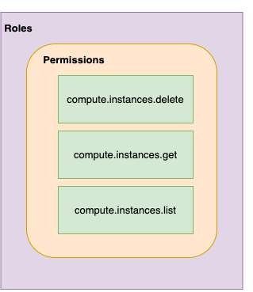
IAM - Most Important Concepts - A Review
Member : Who?
Roles : Permissions (What Actions? What Resources?)
Policy : Assign Permissions to Members
Map Roles (What?) , Members (Who?) and Conditions (Which Resources?, When?, From Where?)
Remember: Permissions are NOT directly assigned to Member
Permissions are represented by a Role
Member gets permissions through Role!
A Role can have multiple permissions
You can assign multiple roles to a Member

Slide 99
IAM policy
Roles are assigned to users through IAM Policy documents Represented by a policy object
Policy object has list of bindings
A binding, binds a role to list of members
Member type is identified by prefix:
Example: user, serviceaccount, group or domain

Slide 100
IAM policy - Example
{
"bindings": [
{
"role": "roles/storage.objectAdmin", "members": [
"user:you@in28minutes.com",
"serviceAccount:myAppName@appspot.gserviceaccount.com", "group:administrators@in28minutes.com", "domain:google.com"
]
},
{
"role": "roles/storage.objectViewer", "members": [
"user:you@in28minutes.com"
],
"condition": {
"title": "Limited time access", "description": "Only upto Feb 2022",
"expression": "request.time < timestamp('2022-02-01T00:00:00.000Z')",
}
}
]
}

Slide 101
Playing With IAM
gcloud: Playing with IAM
gcloud compute project-info describe - Describe current project
gcloud auth login - Access the Cloud Platform with Google user credentials gcloud auth revoke - Revoke access credentials for an account
gcloud auth list - List active accounts
gcloud projects
gcloud projects add-iam-policy-binding - Add IAM policy binding
gcloud projects get-iam-policy - Get IAM policy for a project
gcloud projects remove-iam-policy-binding - Remove IAM policy binding gcloud projects set-iam-policy - Set the IAM policy
gcloud projects delete - Delete a project
gcloud iam
gcloud iam roles describe - Describe an IAM role
gcloud iam roles create - create an iam role(--project, --permissions, --stage) gcloud iam roles copy - Copy IAM Roles

Slide 102
Service Accounts
Scenario: An Application on a VM needs access to cloud storage
You DONT want to use personal credentials to allow access
(RECOMMENDED) Use Service Accounts
Identified by an email address (Ex: id-compute@developer.gserviceaccount.com)
Does NOT have password
Has a private/public RSA key-pairs
Can't login via browsers or cookies
Service account types:
Default service account - Automatically created when some services are used
(NOT RECOMMENDED) Has Editor role by default
User Managed - User created
(RECOMMENDED) Provides fine grained access control
Google-managed service accounts - Created and managed by Google
Used by GCP to perform operations on user's behalf
In general, we DO NOT need to worry about them

Slide 103
Use case 1 : VM <-> Cloud Storage
1: Create a Service Account Role with the right permissions
2: Assign Service Account role to VM instance
Uses Google Cloud-managed keys:
Key generation and use are automatically handled by IAM when we assign a service account to the instance
Automatically rotated
No need to store credentials in config files
Do NOT delete service accounts used by running instances:
Applications running on those instances will lose access!

Slide 104
Use case 2 : On Prem <-> Cloud Storage (Long Lived)
You CANNOT assign Service Account directly to an On Prem App 1: Create a Service Account with right permissions
2: Create a Service Account User Managed Key
gcloud iam service-accounts keys create
Download the service account key file
Keep it secure (It can be used to impersonate service account)!
3: Make the service account key file accessible to your application
Set environment variable GOOGLE_APPLICATION_CREDENTIALS
export GOOGLE_APPLICATION_CREDENTIALS="/PATH_TO_KEY_FILE"
4: Use Google Cloud Client Libraries
Google Cloud Client Libraries use a library - Application Default Credentials (ADC)
ADC uses the service account key file if env var GOOGLE_APPLICATION_CREDENTIALS exists!

Slide 105
Use case 3 : On Prem <-> Google Cloud APIs (Short Lived)
Make calls from outside GCP to Google Cloud APIs with short lived permissions
Few hours or shorter
Less risk compared to sharing service account keys!
Credential Types:
OAuth 2.0 access tokens
OpenID Connect ID tokens
Self-signed JSON Web Tokens (JWTs)
Examples:
When a member needs elevated permissions, he can assume the service account role (Create OAuth 2.0 access token for service account)
OpenID Connect ID tokens is recommended for service to service authentications:
A service in GCP needs to authenticate itself to a service in other cloud

Slide 106
Service Account Use case Scenarios
Scenario Solution
Application on a VM wants to talk to a Cloud Storage bucket
Configure the VM to use a Service Account with right permissions
Application on a VM wants to put a message on a Pub Sub Topic
Configure the VM to use a Service Account with right permissions
Is Service Account an identity or a resource?
It is both. You can attach roles with Service Account (identity). You can let other members access a SA by granting them a role on the Service Account (resource).
VM instance with default service account in Project A needs to access Cloud Storage bucket in Project B
In project B, add the service account from Project A and assign Storage Object Viewer Permission on the bucket

Slide 107
ACL (Access Control Lists)
ACL: Define who has access to your buckets and objects, as well as what level of access they have
How is this different from IAM?
IAM permissions apply to all objects within a bucket
ACLs can be used to customized specific accesses to different objects
User gets access if he is allowed by either IAM or ACL! (Remember) Use IAM for common permissions to all objects in a bucket
(Remember) Use ACLs if you need to customize access to individual objects

Slide 108
Access Control - Overview
How do you control access to objects in a Cloud Storage bucket?
Two types of access controls:
Uniform (Recommended) - Uniform bucket level access using IAM
Fine-grained - Use IAM and ACLs to control access:
Both bucket level and individual object level permissions
Use Uniform access when all users have same level of access across all objects in a bucket
Fine grained access with ACLs can be used when you need to customize the access at an object level
Give a user specific access to edit specific objects in a bucket

Slide 109
Cloud Storage - Signed URL
You would want to allow a user limited time access to your objects:
Users do NOT need Google accounts
Use Signed URL functionality
A URL that gives permissions for limited time duration to perform specific actions
To create a Signed URL:
1: Create a key (YOUR_KEY) for the Service Account/User with the desired permissions
2: Create Signed URL with the key:
gsutil signurl -d 10m YOUR_KEY gs://BUCKET_NAME/OBJECT_PATH

Slide 110
Cloud Storage - Static website
1: Create a bucket with the same name as website name (Name of bucket should match DNS name of the website)
Verify that the domain is owned by you
2: Copy the files to the bucket
Add index and error html files for better user experience
3: Add member allUsers and grant Storage Object Viewer option
Select Allow Public Access

Slide 111
Database Fundamentals

Slide 112
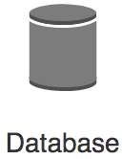
Databases Primer
Databases provide organized and persistent storage for your data
To choose between different database types, we would need to understand:
Availability
Durability RTO
RPO
Consistency Transactions etc
Let's get started on a simple journey to understand these

Slide 113
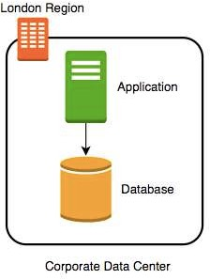
Database - Getting Started
Imagine a database deployed in a data center in London
Let's consider some challenges:
Challenge 1: Your database will go down if the data center crashes or the server storage fails
Challenge 2: You will lose data if the database crashes

Slide 114
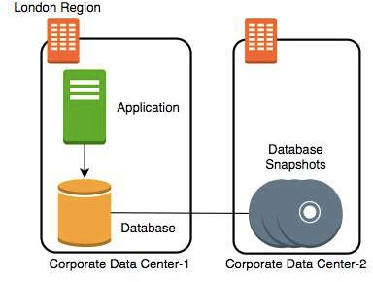
Database - Snapshots
Let's automate taking copy of the database (take a snapshot) every hour to another data center in London
Let's consider some challenges:
Challenge 1: Your database will go down if the data center crashes
Challenge 2 (PARTIALLY SOLVED): You will lose data if the database crashes
You can setup database from latest snapshot. But depending on when failure occurs you can lose up to an hour of data
Challenge 3(NEW): Database will be slow when you take snapshots

Slide 115
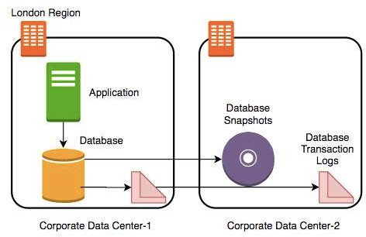
Database - Transaction Logs
Let's add transaction logs to database and create a process to copy it over to the second data center
Let's consider some challenges:
Challenge 1: Your database will go down if the data center crashes
Challenge 2 (SOLVED): You will lose data if the database crashes
You can setup database from latest snapshot and apply transaction logs
Challenge 3: Database will be slow when you take snapshots

Slide 116
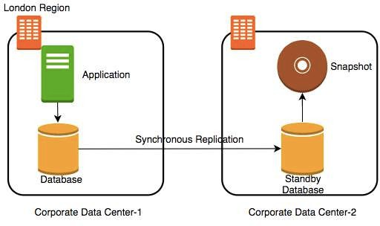
Database - Add a Standby
Let's add a standby database in the second data center with replication
Let's consider some challenges:
Challenge 1 (SOLVED): Your database will go down if the data center crashes
You can switch to the standby database
Challenge 2 (SOLVED): You will lose data if the database crashes
Challenge 3 (SOLVED): Database will be slow when you take snapshots
Take snapshots from standby.
Applications connecting to master will get good performance always

Slide 117
Availability and Durability
Availability
Will I be able to access my data now and when I need it?
Percentage of time an application provides the operations expected of it
Durability
Will my data be available after 10 or 100 or 1000 years?
Examples of measuring availability and durability:
4 9's - 99.99
11 9's - 99.999999999
Typically, an availability of four 9's is considered very good Typically, a durability of eleven 9's is considered very good

Slide 118
Availability
Availability | Downtime (in a month) | Comment
99.95% | 22 minutes
99.99% (4 9's) | 4 and 1/2 minutes | Typically online apps aim for 99.99% (4 9's) availability
99.999% (5 9's) | 26 seconds | Achieving 5 9's availability is tough

Slide 119
Durability
What does a durability of 11 9's
mean?
If you store one million files for ten million years, you would expect to lose one file
Why should durability be high?
Because we hate losing data
Once we lose data, it is gone

Slide 120
Increasing Availability and Durability of Databases
Increasing Availability:
Have multiple standbys distribute the database
in multiple Zones
in multiple Regions
available OR
Increasing Durability:
Multiple copies of data (standbys, snapshots, transaction logs and replicas)
in multiple Zones
in multiple Regions
Replicating data comes with its own challenges!
We will talk about them a little later

Slide 121
Database Terminology : RTO and RPO
Imagine a financial transaction being lost
Imagine a trade being lost
Imagine a stock exchange going down for an hour
Typically businesses are fine with some downtime but they hate losing data
Availability and Durability are technical measures
How do we measure how quickly we can recover from failure?
RPO (Recovery Point Objective): Maximum acceptable period of data loss
RTO (Recovery Time Objective): Maximum acceptable downtime
Achieving minimum RTO and RPO is expensive Trade-off based on the criticality of the data

Slide 122
Question - RTO and RPO
You are running an application in VM instance storing its data on a persistent data storage. You are taking snapshots every 48 hours. If the VM instance crashes, you can manually bring it back up in 45 minutes from the snapshot. What is your RTO and RPO?
RTO - 45 minutes
RPO - 48 hours

Slide 123
Achieving RTO and RPO - Failover Examples
Scenario Solution
Very small data loss (RPO - 1 minute) Very small downtime (RTO - 5 minutes)
Hot standby - Automatically synchronize data Have a standby ready to pick up load
Use automatic failover from master to standby
Very small data loss (RPO - 1 minute)
BUT I can tolerate some downtimes (RTO - 15 minutes)
Warm standby - Automatically synchronize data Have a standby with minimum infrastructure Scale it up when a failure happens
Data is critical (RPO - 1 minute) but I can tolerate downtime of a few hours (RTO - few hours)
Create regular data snapshots and transaction logs
Create database from snapshots and transactions logs when a failure happens
Data can be lost without a problem (for example: cached data)
Failover to a completely new server

Slide 124
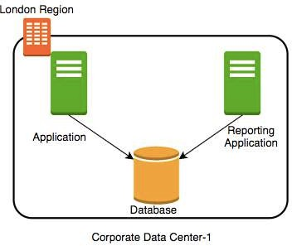
(New Scenario) Reporting and Analytics Applications
New reporting and analytics applications are being launched using the same database
These applications will ONLY read data
Within a few days you see that the database performance is impacted
How can we fix the problem?
Vertically scale the database - increase CPU and memory
Create a database cluster (Distribute the database) - Typically database clusters are expensive to setup
Create read replicas - Run read only applications against read replicas

Slide 125
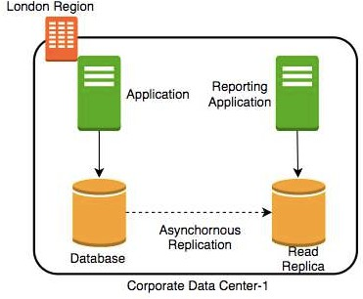
Database - Read Replicas
Add read replica
Connect reporting and analytics applications to read replica
Reduces load on the master databases
Upgrade read replica to master database (supported by some databases)
Create read replicas in multiple regions Take snapshots from read replicas

Slide 126
Consistency
How do you ensure that data in multiple database instances (standbys and replicas) is updated simultaneously?
Strong consistency - Synchronous replication to all replicas
Will be slow if you have multiple replicas or standbys
Eventual consistency - Asynchronous replication. A little lag - few seconds - before the change is available in all replicas
In the intermediate period, different replicas might return different values
Used when scalability is more important than data integrity
Examples : Social Media Posts - Facebook status messages, Twitter tweets, Linked in posts etc
Read-after-Write consistency - Inserts are available
However, updates would have eventual consistency
immediately

Slide 127

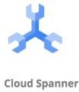


Database Categories
There are several categories of databases:
Relational (OLTP and OLAP), Document, Key Value, Graph, In Memory among others
Choosing type of database for your use case is not easy. A few factors:
Do you want a fixed schema?
Do you want flexibility in defining and changing your schema? (schemaless)
What level of transaction properties do you need? (atomicity and consistency) What kind of latency do you want? (seconds, milliseconds or microseconds)
How many transactions do you expect? (hundreds or thousands or millions of transactions per second)
How much data will be stored? (MBs or GBs or TBs or PBs) and a lot more...

Slide 128
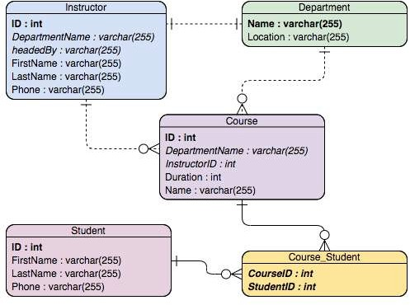
Relational Databases
This was the only option until a decade back!
Most popular (or unpopular) type of databases
Predefined schema with tables and relationships
Very strong transactional capabilities Used for
OLTP (Online Transaction Processing) use cases and
OLAP (Online Analytics Processing) use cases

Slide 129
Relational Database - OLTP (Online Transaction Processing)
Applications where large number of users make large number of small transactions
small data reads, updates and deletes
Use cases:
Most traditional applications, ERP, CRM, e-commerce, banking applications
Popular databases:
MySQL, Oracle, SQL Server etc
Recommended Google Managed Services:
Cloud SQL : Supports PostgreSQL, MySQL, and SQL Server for regional relational databases (upto a few TBs)
Cloud Spanner: Unlimited scale (multiple PBs) and 99.999% availability for global applications with horizontal scaling

Slide 130
Relational Database - OLAP (Online Analytics Processing)
Applications allowing users to analyze petabytes of data Examples : Reporting applications, Data ware houses, Business intelligence applications, Analytics systems
Sample application : Decide insurance premiums analyzing data from last hundred years
Data is consolidated from multiple (transactional) databases
Recommended GCP Managed Service
BigQuery: Petabyte-scale distributed data ware house

Slide 131
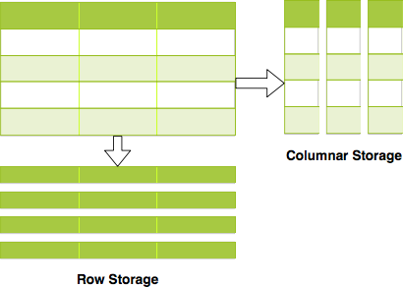
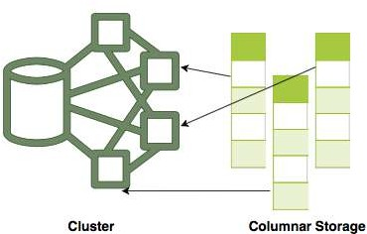
Relational Databases - OLAP vs OLTP
OLAP and OLTP use similar data structures
BUT very different approach in how data is stored
OLTP databases use row storage
Each table row is stored together
Efficient for processing small transactions
OLAP databases use columnar storage
Each table column is stored together
High compression - store petabytes of data efficiently
Distribute data - one table in multiple cluster nodes
Execute single query across multiple nodes - Complex queries can be executed efficiently

Slide 132
NoSQL Databases
New approach (actually NOT so new!) to building your databases
NoSQL = not only SQL
Flexible schema
Structure data the way your application needs it
Let the schema evolve with time
Horizontally scale to petabytes of data with millions of TPS
NOT a 100% accurate generalization but a great starting point:
Typical NoSQL databases trade-off "Strong consistency and SQL features" to achieve "scalability and high-performance"
Google Managed Services:
Cloud Firestore (Datastore)
Cloud BigTable

Slide 133

Cloud BigTable
Petabyte scale, wide column NoSQL DB (HBase API compatible)
Designed for huge volumes of analytical and operational data
IOT Streams, Analytics, Time Series Data etc
Handle millions of read/write TPS at very low latency
Single row transactions (multi row transactions NOT supported)
NOT serverless: You need to create a server instance (Use SSD or HDD)
Scale horizontally with multiple nodes (No downtime for cluster resizing)
CANNOT export data using cloud console or gcloud:
Either use a Java application (java -jar JAR export\import) OR
Use HBase commands
Use cbt command line tool to work with BigTable (NOT gcloud)
Ex: cbt createtable my-table

Slide 134
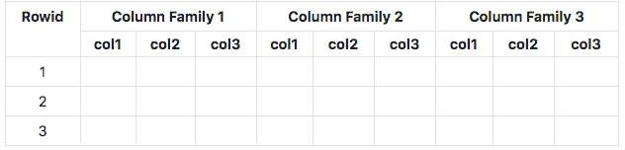
Cloud BigTable - Wide Column Database
At the most basic level, each table is a sorted key/value map
Each value in a row is indexed using a key - row key
Related columns are grouped into column families
Each column is identified by using column-family:column-qualifer(or name)
This structure supports high read and write throughput at low latency
Advantages : Scalable to petabytes of data with millisecond responses upto millions of TPS
Use cases : IOT streams, graph data and real time analytics (time-series data, financial data - transaction histories, stock prices etc)
Cloud Dataflow : Used to export data from BigTable to CloudStorage

Slide 135

Memorystore
In-memory datastore service: Reduce access times
Fully managed (Provisioning, Replication, Failover and Patching)
Highly available with 99.9% availability SLA
Monitoring can be easily setup using Cloud Monitoring
Support for Redis and Memcached:
Use Memcached for Caching
Reference data, database query caching, session store etc
Use Redis for low latency access with persistence and high availability
Gaming Leader Boards, Player Profiles, In memory Stream Processing etc

Slide 136
BigQuery - Datawarehouse
Exabyte scale modern Datawarehousing solution from GCP
Relational database (SQL, schema, consistency etc)
Use SQL-like commands to query massive datasets
Traditional (Storage + Compute) + Modern (Realtime + Serverless)
When we are talking about a Datawarehouse, importing and exporting data (and formats) becomes very important:
Load data from a variety of sources, incl. streaming data
Variety of import formats - CSV/JSON/Avro/Parquet/ORC/Datastore backup
Export to Cloud Storage (long term storage) & Data Studio (visualization)
Formats - CSV/JSON (with Gzip compression), Avro (with deflate or snappy compression)
Automatically expire data (Configurable Table Expiration)
Query external data sources without storing data in BigQuery
Cloud Storage, Cloud SQL, BigTable, Google Drive
Use Permanent or Temporary external tables

Slide 137
BigQuery - Accessing and Querying Data
Access databases using:
Cloud Console
bq command-line tool (NOT gcloud) BigQuery Rest API OR
HBase API based libraries (Java, .NET & Python)
(Remember) BigQuery queries can be expensive as you are running them on large data sets!
(BEST PRACTICE) Estimate BigQuery queries before running:
1: Use UI(console)/bq(--dry-run) - Get scanned data volume (estimate)
2: Use Pricing Calculator: Find price for scanning 1 MB data. Calculate cost.

Slide 138
Relational Database - Import and Export
Cloud SQL : to/from Cloud Storage (gcloud sql export/import csv/sql)
From Console/gcloud/REST API
SQL and CSV formats
For large databases, use serverless mode
Reduces performance impact of export on the live database
Cloud Spanner: to/from Cloud Storage
From Console (uses Cloud Data Flow)
BigQuery: to/from Cloud Storage and Others (bq extract/load)
From Console/bq
Formats - CSV/JSON (with Gzip compression), Avro (with deflate or snappy compression)
Variety of options to import data:
Load data from Cloud Storage
Example Use Case: Data Store > Cloud Storage > Big Query
Batch Loading with BigQuery Data Transfer Service Use Dataflow to setup streaming pipeline

Slide 139
BigQuery - Command Line
BigQuery (bq)
bq show bigquery-public-data:samples.shakespeare
bq query 'QUERY-STRING'
--dry-run - To estimate the bytes scanned by a query
bq extract (export data)
bq load (load data)
(Remember) Use the standard way to set the project
gcloud config set project my-project

Slide 140
cbt tool - Cloud Bigtable - CommandLine
cbt - CLI for Cloud Bigtable (NOT gcloud)
Installing - gcloud components install cbt
Verify Installation - cbt listinstances
Create .cbtrc file with the configuration
echo project = project-id > ~/.cbtrc
echo instance = quickstart-instance >> ~/.cbtrc
Commands (cbt):
cbt createinstance - Create an instance
cbt createcluster - Create a cluster within configured instance! cbt createtable/deleteinstance/deletecluster/deletetable
cbt listinstances/listclusters
cbt ls - list tables and column families
(Remember) You can configure your project with cbt in .cbtrc file

Slide 141
Databases - Remember
(Remember) BigQuery, Datastore, Firebase does NOT need VM configuration
whereas Cloud SQL and BigTable need VM configuration
Relational Databases
Small Local Databases - Cloud SQL
Highly scalable global databases - Cloud Spanner Datawarehouse - BigQuery
NoSQL Databases
Transactional database for a few Terabytes of data - Cloud Datastore
Huge volumes of IOT or streaming analytics data - Cloud BigTable

Slide 142
Decoupling Applications with Pub/Sub

Slide 143
Need for Asynchronous Communication
Why do we need asynchronous communication?

Slide 144
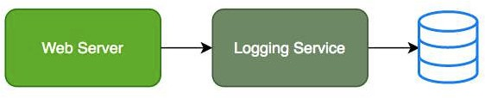
Synchronous Communication
Applications on your web server make synchronous calls to the logging service
What if your logging service goes down?
Will you applications go down too?
What if all of sudden, there is high load and there are lot of logs coming in?
Log Service is not able to handle the load and goes down very often

Slide 145

Asynchronous Communication - Decoupled
Create a topic and have your applications put log messages on the topic Logging service picks them up for processing when ready
Advantages:
Decoupling: Publisher (Apps) don't care about who is listening
Availability: Publisher (Apps) up even if a subscriber (Logging Service) is down Scalability: Scale consumer instances (Logging Service) under high load Durability: Message is not lost even if subscriber (Logging Service) is down

Slide 146

Pub/Sub
Reliable, scalable, messaging service
fully-managed asynchronous
Backbone for Highly Available and Highly Scalable
Solutions
Auto scale to process billions of messages per day
Low cost (Pay for use)
Usecases: Event ingestion and delivery for streaming analytics pipelines
Supports push and pull message deliveries

Slide 147
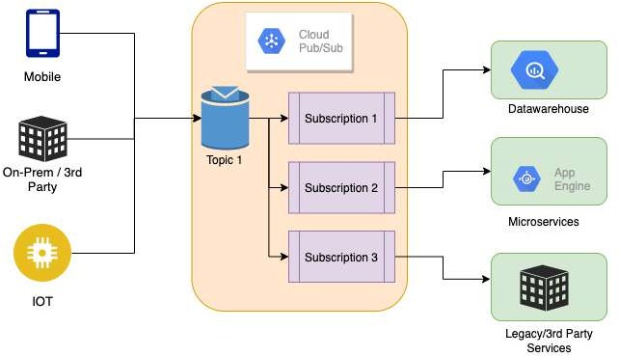
Pub/Sub - How does it work?
Publisher - Sender of a message Publishers send messages by making HTTPS requests to pubsub.googleapis.com
Subscriber - Receiver of the message
Pull - Subscriber pulls messages when ready Subscriber makes HTTPS requests to pubsub.googleapis.com
Push - Messages are sent to subscribers Subscribers provide a web hook endpoint at the time of registration
When a message is received on the topic, A HTTPS POST request is sent to the web hook endpoints
Very Flexible Publisher(s) and Subscriber(s) Relationships: One to Many, Many to One, Many to Many

Slide 148
Pub/Sub - Getting Ready with Topic and Subscriptions
Step 1 : Topic is created
Step 2 : Subscription(s) are created
Subscribers register to the topic
Each Subscription represents discrete pull of messages from a topic:
Multiple clients pull same subscription
=> messages split between clients
Multiple clients create a subscription each => each client will get every message

Slide 149
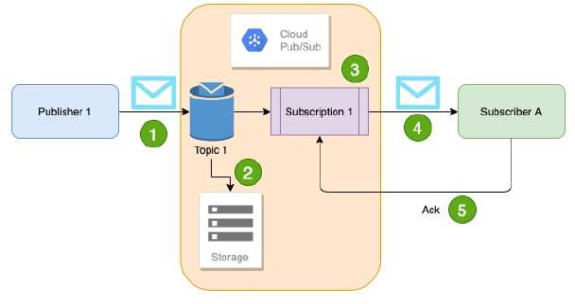
Pub/Sub - Sending and Receiving a Message
Publisher sends a message to Topic
Message individually delivered to each and every subscription
Subscribers can receive message either by:
Push: Pub/Sub sends the message to Subscriber
Pull: Subscribers poll for messages
Subscribers send acknowledgement(s)
Message(s) are removed from subscriptions message queue
Pub/Sub ensures the message is retained per subscription until it is acknowledged

Slide 150
Managing Pub/Sub
Pub/Sub pubsub
gcloud pubsub topics create my-topic
gcloud pubsub subscriptions create my-subscription --topic=my-topic
--enable-message-ordering - ordered message delivery
--ack-deadline - how long to wait for acknowledgment?
--message-filter - criteria to filter messages
gcloud pubsub subscriptions pull my-subscription
--auto-ack --limit
gcloud pubsub subscriptions ack my-subscription --ack-ids=[ACK_ID,…]
Topic: gcloud pubsub topics
gcloud pubsub topics delete my-topic
gcloud pubsub topics list
gcloud pubsub topics list-subscriptions my-topic

Slide 151
Networking

Slide 152
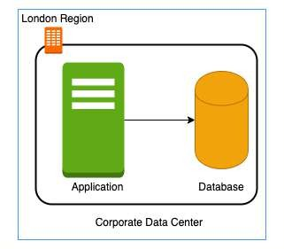
Need for Google Cloud VPC
In a corporate network or an on-premises data center: Can anyone on the internet see the data exchange between the application and the database?
No
Can anyone from internet directly connect to your database?
Typically NO.
You need to connect to your corporate network and then access your applications or databases.
Corporate network provides a secure internal network protecting your resources, data and communication from external users
How do you do create your own private network in the cloud?
Enter Virtual Private Cloud (VPC)

Slide 153

Google Cloud VPC (Virtual Private Cloud)
Your own isolated network in GCP cloud
Network traffic within a VPC is isolated (not visible) from all other Google Cloud VPCs
You control all the traffic coming in and going outside a VPC
(Best Practice) Create all your GCP resources (compute, storage, databases etc) within a VPC
Secure resources from unauthorized access AND
Enable secure communication between your cloud resources
VPC is a global resource & contains subnets in one or more region
(REMEMBER) NOT tied to a region or a zone. VPC resources can be in any region or zone!

Slide 154


Need for VPC Subnets
Different types of resources are created on cloud - databases, compute etc
Each type of resource has its own access needs
Load Balancers are accessible from internet (public resources) Databases or VM instances should NOT be accessible from internet
ONLY applications within your network (VPC) should be able to access them(private resources)
How do you separate public resources from private resources inside a VPC?
Create separate Subnets!
(Additional Reason) You want to distribute resources across multiple regions for high availability

Slide 155
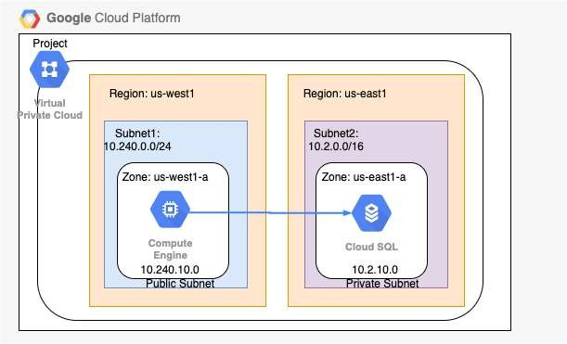
VPC Subnets
(Solution) Create different subnets for public and private resources
Resources in a public subnet CAN be accessed from internet
Resources in a private subnet CANNOT be accessed from internet
BUT resources in public subnet can talk to resources in private subnet
Each Subnet is created in a region
Example : VPC - demo-vpc => Subnets - region us-central1, europe-west1 or us-west1 or ..

Slide 156
Creating VPCs and Subnets
By default, every project has a default VPC You can create YOUR own VPCs:
OPTION 1: Auto mode VPC network:
Subnets are automatically created in each region
Default VPC created automatically in the project uses auto mode!
OPTION 2: Custom mode VPC network:
No subnets are automatically created
You have complete control over subnets and their IP ranges Recommended for Production
Options when you create a subnet:
Enable Private Google Access - Allows VM's to connect to Google API's using private IP's
Enable FlowLogs - To troubleshoot any VPC related network issues

Slide 157
CIDR (Classless Inter-Domain Routing) Blocks
Resources in a network use continuous IP addresses to make routing easy: Example: Resources inside a specific network can use IP addresses from 69.208.0.0 to 69.208.0.15
How do you express a range of addresses that resources in a network can have?
CIDR block
A CIDR block consists of a starting IP address(69.208.0.0) and a range(/28) Example: CIDR block 69.208.0.0/28 represents addresses from 69.208.0.0 to 69.208.0.15 - a total of 16 addresses
Quick Tip: 69.208.0.0/28 indicates that the first 28 bits (out of 32) are fixed.
Last 4 bits can change => 2 to the power 4 = 16 addresses

Slide 158
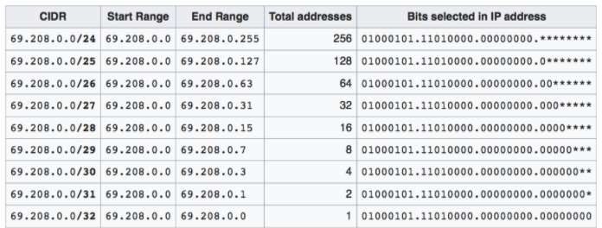
CIDR Exercises
Exercise : How many addresses does 69.208.0.0/26 represent?
2 to the power (32-26 = 6) = 64 addresses from 69.208.0.0 to 69.208.0.63
Exercise : How many addresses does 69.208.0.0/30 represent?
2 to the power (32-30 = 2) = 4 addresses from 69.208.0.0 to 69.208.0.3
Exercise : What is the difference between 0.0.0.0/0 and 0.0.0.0/32?
0.0.0.0/0 represent all IP addresses. 0.0.0.0/32 represents just one IP address 0.0.0.0.

Slide 159
Examples of Recommended CIDR Blocks - VPC Subnets
Recommended CIDR Blocks
Private IP addresses RFC 1918: 10.0.0.0/8, 172.16.0.0/12, 192.168.0.0/16
Shared address space RFC 6598: 100.64.0.0/10 IETF protocol assignments RFC 6890: 192.0.0.0/24
Restricted Range Examples
You CANNOT use these as CIDR for VPC Subnets
Private Google Access-specific virtual IP addresses: 199.36.153.4/30, 199.36.153.8/30
Current (local) network RFC 1122: 0.0.0.0/8 Local host RFC 1122: 127.0.0.0/8
(REMEMBER) You CAN EXTEND the CIDR Block Range of a Subnet (Secondary CIDR Block)

Slide 160
Firewall Rules
Configure Firewall Rules to control traffic going in or out of the network:
Stateful
Each firewall rule has priority (0-65535) assigned to it
0 has highest priority. 65535 has least priority Default implied rule with lowest priority (65535)
Allow all egress
Deny all ingress
Default rules can't be deleted
You can override default rules by defining new rules with priority 0-65534
Default VPC has 4 additional rules with priority 65534
Allow incoming traffic from VM instances in same network (default-allow-internal)
Allow Incoming TCP traffic on port 22 (SSH) default-allow-ssh
Allow Incoming TCP traffic on port 3389 (RDP) default-allow-rdp
Allow Incoming ICMP from any source on the network default-allow-icmp

Slide 161
Firewall Rules - Ingress and Egress Rules
Ingress Rules: Incoming traffic from outside to GCP targets
Target (defines the destination): All instances or instances with TAG/SA
Source (defines where the traffic is coming from): CIDR or All instances or instances with TAG/SA
Egress Rules: Outgoing traffic to destination from GCP targets
Target (defines the source): All instances or instances with TAG/SA
Destination: CIDR Block
Along with each rule, you can also define:
Priority - Lower the number, higher the priority
Action on match - Allow or Deny traffic
Protocol - ex. TCP or UDP or ICMP
Port - Which port?
Enforcement status - Enable or Disable the rule

Slide 162
Shared VPC
Scenario: Your organization has multiple projects. You want resources in different projects to talk to each other?
How to allow resources in different projects to talk with internal IPs securely and efficiently?
Enter Shared VPC
Created at organization or shared folder level (Access Needed: Shared VPC Admin)
Allows VPC network to be shared between projects in same organization Shared VPC contains one host project and multiple service projects:
Host Project - Contains shared VPC network
Service Projects - Attached to host projects
Helps you achieve separation of concerns:
Network administrators responsible for Host projects and Resource users use Service Project

Slide 163
VPC Peering
Scenario: How to connect VPC networks across different organizations?
Enter VPC Peering
Networks in same project, different projects and across projects in different organizations can be peered
All communication happens using internal IP addresses
Highly efficient because all communication happens inside Google network
Highly secure because not accessible from Internet
No data transfer charges for data transfer between services
(REMEMBER) Network administration is NOT changed:
Admin of one VPC do not get the role automatically in a peered network

Slide 164
Hybrid Cloud

Slide 165

Cloud VPN
Cloud VPN - Connect on-premise network to the GCP network
Implemented using IPSec VPN Tunnel
Traffic through internet (public)
Traffic encrypted using Internet Key Exchange protocol
Two types of Cloud VPN solutions:
HA VPN (SLA of 99.99% service availability with two external IP addresses)
Only dynamic routing (BGP) supported
Classic VPN (SLA of 99.9% service availability, a single external IP address)
Supports Static routing (policy-based, route-based) and dynamic routing using BGP

Slide 166

Cloud Interconnect
High speed physical connection between on-premise and VPC networks:
Highly available and high throughput
Two types of connections possible
Dedicated Interconnect - 10 Gbps or 100 Gpbs configurations
Partner Interconnect - 50 Mbps to 10 Gbps configurations
Data exchange happens through a private network:
Communicate using VPC network's internal IP addresses from on-premise network
Reduces egress costs
As public internet is NOT used
(Feature) Supported Google API's and services can be privately accessed from on-premise
Use only for high bandwidth needs:
For low bandwidth, Cloud VPN is recommended

Slide 167
Direct Peering
Connect customer network to google network using network peering
Direct path from on-premises network to Google services
Not a GCP Service
Lower level network connection outside of GCP
NOT RECOMMENDED:
Use Cloud Interconnect and Cloud VPN

Slide 168
Cloud Operations

Slide 169

Cloud Monitoring
To operate cloud applications effectively, you should know:
Is my application healthy?
Are the users experiencing any issues? Does my database has enough space?
Are my servers running in an optimum capacity?
Cloud Monitoring - Tools to monitor your infrastructure
Measures key aspects of services (Metrics)
Create visualizations (Graphs and Dashboard) Configure Alerts (when metrics are NOT healthy)
Define Alerting Policies:
Condition
Notifications - Multiple channels Documentation

Slide 170
Cloud Monitoring - Workspace
You can use Cloud Monitoring to monitor one or more GCP projects and one or more AWS accounts
How do you group all the information from multiple GCP projects or AWS Accounts?
Create a Workspace
Workspaces are needed to organize monitoring information
A workspace allows you to see monitoring information from multiple projects
Step I: Create workspace in a specific project (Host Project)
Step II: Add other GCP projects (or AWS accounts) to the workspace

Slide 171

Cloud Monitoring - Virtual Machines
Default metrics monitored include:
CPU utilization
Some disk traffic metrics
Network traffic, and Uptime information
Install Cloud Monitoring agent on the VM to get more disk, CPU, network, and process metrics:
collectd-based daemon
Gathers metrics from VM and sends them to Cloud Monitoring

Slide 172

Cloud Logging
Real time log management and analysis tool
Allows to store, search, analyze and alert on massive volume of data
Exabyte scale, fully managed service
No server provisioning, patching etc
Ingest Log data from any source Key Features:
Logs Explorer - Search, sort & analyze using flexible queries
Logs Dashboard - Rich visualization
Logs Metrics - Capture metrics from logs (using queries/matching strings) Logs Router - Route different log entries to different destinations

Slide 173

Cloud Logging - Collection
Most GCP Managed services automatically send logs to Cloud Logging:
GKE
App Engine Cloud Run
Ingest logs from GCE VMs:
Install Logging Agent (based on fluentd)
(Recommended) Run Logging Agent on all VM instances
Ingest logs from on-premises:
(Recommended) Use the BindPlane tool from Blue Medora
Use the Cloud Logging API

Slide 174
Cloud Logging - Audit and Security Logs
Access Transparency Log: Captures Actions performed by GCP team on your content (NOT supported by all services):
ONLY for organizations with Gold support level & above
Cloud Audit Logs: Answers who did what, when and where:
Admin activity Logs
Data Access Logs
System Event Audit Logs Policy Denied Audit Logs

Slide 175
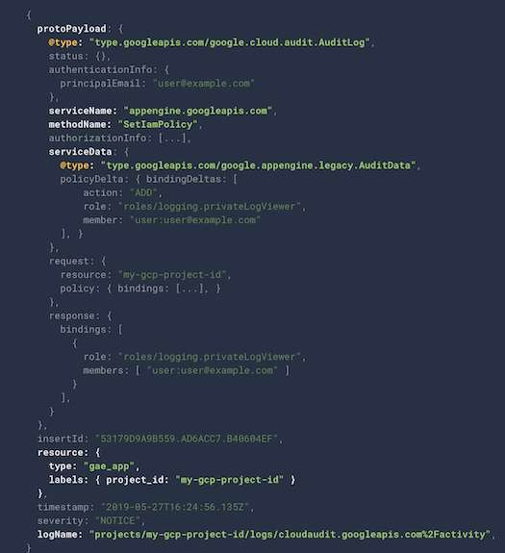
Cloud Logging - Audit Logs
Which service?
protoPayload.serviceName
Which operation?
protoPayload.methodName
What resource is audited?
resource.Type
Who is making the call?
authenticationInfo.principalEmail

Slide 176
Cloud Audit Logs
Feature | Admin Activity Logs | Data Access Logs | System Event Logs | Policy Denied Logs
Logs for | API calls or other | Reading | Google Cloud | When user or
 | actions that modify | configuration of | administrative | service account is
 | the configuration of | resources | actions | denied access
 | resources
Default | ✓ | X | ✓ | ✓
Enabled
VM Examples | VM Creation, Patching | Listing resources | On host | Security policy
 | resources, Change in | (vms, images etc) | maintenance, | violation logs
 | IAM permissions |  | Instance preemption,
 |  |  | Automatic restart
Cloud Storage | Modify bucket or | Modify/Read bucket
 | object | or object
Recommended | Logging/Logs Viewer | Logging/Private | Logging/Logs Viewer | Logging/Logs

Slide 177
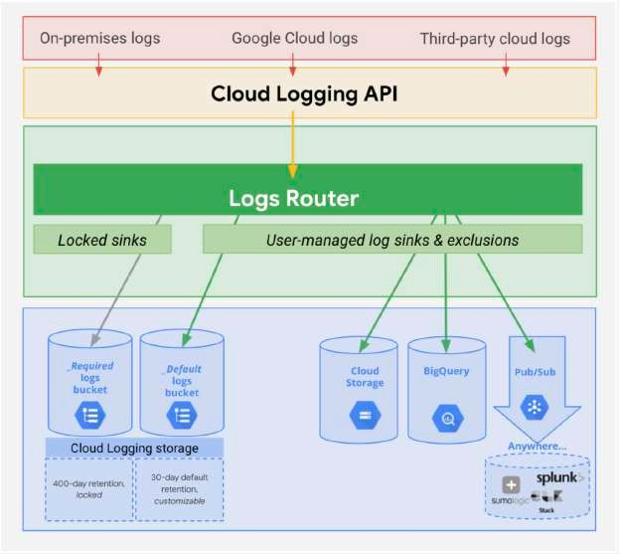
Cloud Logging - Controlling & Routing
How do you manage your logs?
Logs from various sources reaches Log Router
Log Router checks against configured rules
What to ingest? what to discard?
Where to route?
Two types of Logs buckets:
_Required: Holds Admin activity, System Events & Access Transparency Logs (retained for 400 days)
ZERO charge
You cannot delete the bucket
You cannot change retention period
_Default: All other logs (retained for 30 days)
You are billed based on Cloud Logging pricing
You cannot delete the bucket:
But you can disable the _Default log sink route to disable ingestion!
You can edit retention settings (1 to 3650 days (10 years))
source: (https://cloud.google.com)

Slide 178
Cloud Logging - Export
Logs are ideally stored in Cloud Logging for limited period
For long term retention (Compliance, Audit) logs can be exported to:
Cloud Storage bucket (ex: bucket/syslog/2025/05/05)
Big Query dataset (ex: tables syslog_20250505 > log)
Cloud Pub/Sub topic (base64 encoded log entries)
How do you export logs?
Create sinks to these destinations using Log Router:
You can create include or exclude filters to limit the logs
columns timestamp,

Slide 179
Cloud Logging - Export - Use Cases
Use Case 1: Troubleshoot using VM Logs:
Install Cloud logging agent in all VM's and send logs to Cloud Logging
Search for logs in Cloud Logging
Use Case 2: Export VM logs to BigQuery for querying using SQL like queries:
Install Cloud logging agent in all VM's and send logs to Cloud Logging
Create a BigQuery dataset for storing the logs
Create an export sink in Cloud Logging with BigQuery dataset as sink destination
Use Case 3: You want to retain audit logs for external auditors at minimum cost
Create an export sink in Cloud Logging with Cloud Storage bucket as sink destination
Provide auditors with Storage Object Viewer role on the bucket You can use Google Data Studio also (for visualization)

Slide 180

Cloud Trace
Distributed tracing system for GCP: Collect latency data from:
Supported Google Cloud Services
Instrumented applications (using tracing libraries) using Cloud Trace API
Find out:
How long does a service take to handle requests?
What is the average latency of requests?
How are we doing over time? (increasing/decreasing trend)
Supported for:
Compute Engine, GKE, App Engine (Flexible/Standard) etc
Trace client libraries available for:
C#, Go, Java, Node.js, PHP, Python & Ruby

Slide 181

Cloud Debugger
How to debug issues that are happening only in test or production environments?
Cloud Debugger: Capture state of a running application
Inspect the state of the application directly in the GCP environment
Take snapshots of variables and call stack No need to add logging statements
No need to redeploy
Very lightweight => Very little impact to users
Can be used in any environment: Test, Acceptance, Production

Slide 182

Cloud Profiler
How do you identify performance bottlenecks in production?
Cloud Profiler - Statistical, low-overhead profiler
Continuously gathers CPU and Memory usage from production systems
Connect profiling data with application source code
Easily identify performance bottlenecks
Two major components:
Profiling agent (collects profiling information)
Profiler interface (visualization)

Slide 183

Error Reporting
How do you identify production problems in real time? Real-time exception monitoring:
Aggregates and displays errors reported from cloud services (using stack traces)
Centralized Error Management console:
Identify & manage top errors or recent errors
Use Firebase Crash Reporting for errors from Android & iOS client applications
Supported for Go, Java, .NET, Node.js, PHP, Python, and Ruby
Errors can be reported by:
Sending them to Cloud Logging OR
By calling Error Reporting API
Error Reporting can be accessed from desktop
Also available in the Cloud Console mobile app for iOS and Android

Slide 184
Cloud Operations Scenarios
Scenario
You would like to record all operations/requests on all objects in a bucket (for auditing)
You want to trace a request across multiple microservices
You want to identify prominent exceptions (or errors) for a specific microservice
You want to debug a problem in production by executing step by step
You want to look at the logs for a specific request
Solution
Turn on data access audit logging for the bucket
Cloud Trace
Error Reporting
Cloud Debugger Cloud Logging

Slide 185
Organizing GCP Resources

Slide 186
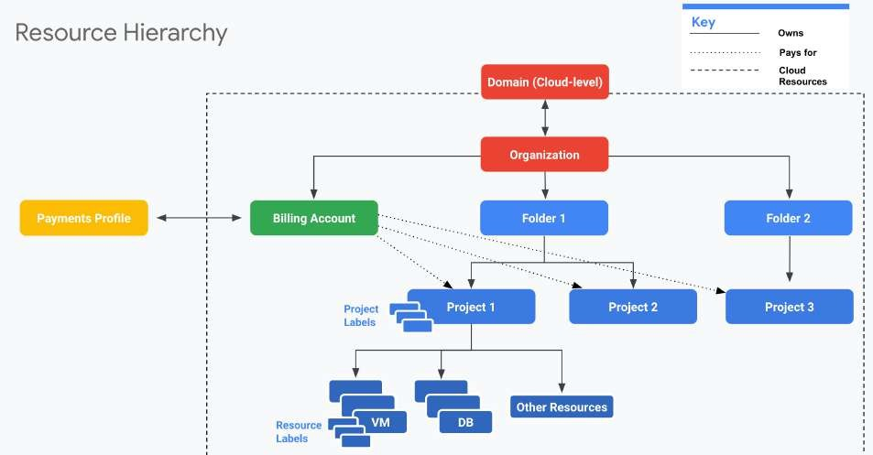
Resource Hierarchy in GCP
Well defined hierarchy: Organization > Folder > Project > Resources
Resources are created in projects
A Folder can contain multiple projects
Organization can contain multiple Folders
source: (https://cloud.google.com)

Slide 187
Resource Hierarchy - Recommendations for Enterprises
Create separate projects for different environments:
Complete isolation between test and production environments
Create separate folders for each department:
Isolate production applications of one department from another
We can create a shared folder for shared resources
One project per application per environment:
Let's consider two apps: "A1" and "A2"
Let's assume we need two environments: "DEV" and "PROD"
In the ideal world you will create four projects: A1-DEV, A1-PROD, A2-DEV, A2-PROD:
Isolates environments from each other
DEV changes will NOT break PROD
Grant all developers complete access (create, delete, deploy) to DEV Projects Provide production access to operations teams only!

Slide 188
Billing Accounts
Billing Account is mandatory for creating resources in a project:
Billing Account contains the payment details
Every Project with active resources should be associated with a Billing Account
Billing Account can be associated with one or more projects You can have multiple billing accounts in an Organization
(RECOMMENDATION) Create Billing Accounts representing your organization structure:
A startup can have just one Billing account
A large enterprise can have a separate billing account for each department
Two Types:
Self Serve : Billed directly to Credit Card or Bank Account
Invoiced : Generate invoices (Used by large enterprises)

Slide 189
Managing Billing - Budget, Alerts and Exports
Setup a Cloud Billing Budget to avoid surprises:
(RECOMMENDED) Configure Alerts
Default alert thresholds set at 50%, 90% & 100%
Send alerts to Pub Sub (Optional)
Billing admins and Billing Account users are alerted by e-mail
Billing data can be exported (on a schedule) to:
Big Query (if you want to query information or visualize it)
Cloud Storage (for history/archiving)

Slide 190
IAM Best Practices
Principle of Least Privilege - Give least possible privilege needed for a role!
Basic Roles are NOT recommended
Prefer predefined roles when possible
Use Service Accounts with minimum privileges
Use different Service Accounts for different apps/purposes
Separation of Duties - Involve atleast 2 people in sensitive tasks:
Example: Have separate deployer and traffic migrator roles
AppEngine provides App Engine Deployer and App Engine Service Admin roles
App Engine Deployer can deploy new version but cannot shift traffic
App Engine Service Admin can shift traffic but cannot deploy new version!
Constant Monitoring: Review Cloud Audit Logs to audit changes to IAM policies and access to Service Account keys
Archive Cloud Audit Logs in Cloud Storage buckets for long term retention
Use Groups when possible
Makes it easy to manage users and permissions

Slide 191
User Identity Management in Google Cloud
Email used to create free trial account => "Super Admin"
Access to everything in your GCP organization, folders and projects
Manage access to other users using their Gmail accounts
However, this is NOT recommended for enterprises
Option 1: Your Enterprise is using Google Workspace
Use Google Workspace to manage users (groups etc)
Link Google Cloud Organization with Google Workspace
Option 2: Your Enterprise uses an Identity Provider of its own
Federate Google Cloud with your Identity Provider

Slide 192
Corporate Directory Federation
Federate Cloud Identity or Google Workspace with your external identity provider (IdP) such as Active Directory or Azure Active Directory.
Enable Single Sign On:
1: Users are redirected to an external IdP to authenticate
2: When users are authenticated, SAML assertion is sent to Google Sign-In
Examples:
Federate Active Directory with Cloud Identity by using Google Cloud Directory Sync (GCDS) and Active Directory Federation Services (AD FS)
Federating Azure AD with Cloud Identity

Slide 193
IAM Members/Identities
Google Account - Represents a person (an email address)
Service account - Represents an application account (Not person)
Google group - Collection - Google & Service Accounts
Has an unique email address
Helps to apply access policy to a group
Google Workspace domain: Google Workspace (formerly G Suite) provides collaboration services for enterprises:
Tools like Gmail, Calendar, Meet, Chat, Drive, Docs etc are included
If your enterprise is using Google Workspace, you can manage permissions using your Google Workspace domain
Cloud Identity domain - Cloud Identity is an Identity as a Service (IDaaS) solution that centrally manages users and groups.
You can use IAM to manage access to resources for each Cloud Identity account

Slide 194
IAM Members/Identities - Use Cases
Scenario Solution
All members in your team have G Suite accounts. You are creating a new production project and would want to provide access to your operations team
Create a Group with all your operations team. Provide access to production project to the Group.
All members in your team have G Suite accounts. You are setting up a new project. You want to provide a one time quick access to a team member.
Assign the necessary role directly to G Suite email address of your team member
If it is not a one time quick access, the recommended approach would be to create a Group
You want to provide an external auditor access to view all resources in your project BUT he should NOT be able to make any changes
Give them roles/viewer role (Generally basic roles are NOT recommended BUT it is the simplest way to provide view only access to all resources!)
Your application deployed on a GCE VM (Project A) needs to access cloud storage bucket from a different project (Project B)
In Project B, assign the right role to GCE VM service account from Project A

Slide 195
Organization Policy Service
How to enable centralized constraints on all resources created in an Organization?
Configure Organization Policy
Example: Disable creation of Service Accounts
Example: Allow/Deny creation of resources in specific regions Needs a Role - Organization Policy Administrator (Remember) IAM focuses on Who
Who can take specific actions on resources?
(Remember) Organization Policy focuses on What
What can be done on specific resources?

Slide 196
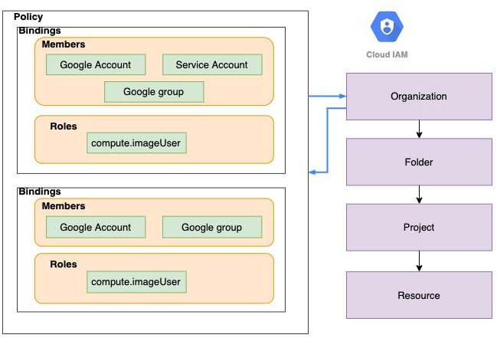
Resource Hierarchy & IAM Policy
IAM Policy can be set at any level of the hierarchy
Resources inherit the policies of All parents
The effective policy for a resource is
the union of the policy on resource and its parents
Policy inheritance is transitive:
For example: Organization policies are applied at resource level
that
You can't restrict policy at lower level if permission is given at an higher

Slide 197
Organization, Billing and Project Roles
Organization Administrator
Define Resource Hierarchy
Define Access Management Policies Manage other users and roles
Billing Account Creator - Create Billing Accounts
Billing Account Administrator - Manage Billing Accounts (payment instruments, billing exports, link and unlink projects, manage roles on billing account)
CANNOT create a Billing Account
Billing Account User - Associate Projects with Billing Accounts
Typically used in combination with Project Creator
These two roles allow user to create new project and link it with billing account
Billing Account Viewer - See all Billing Account details

Slide 198
Billing Roles - Quick Review
Roles | Description | Use Case
Billing Account Creator | Permissions to create new billing accounts | Finance Team
Billing Account Administrator | Manages billing account but can't create them | Finance Team
Billing Account User | Assigns projects to billing accounts | Project Owner
Billing Account Viewer | View only access to billing account | Auditor

Slide 199
Organization, Billing and Project Roles - Scenarios
Scenario 1: I'm creating a project and I want to associate an existing billing account with the project
Roles needed : Project Creator and Billing Account User (link project to billing account)
Scenario 2: I'm a billing auditor
Roles needed : Billing Account Viewer role

Slide 200
Compute Engine Roles
Compute Engine IAM Roles
Compute Engine Admin - Complete control of compute - Instances, Images, Load Balancers, Network, Firewalls etc...
Compute Instance Admin - Create, modify, and delete virtual machine instances and disks
Compute Engine Network Admin - Complete access to networking resources (routes, networks, health checks, VPN, Gateways etc) and READ ONLY access to (firewall rules and SSL certificates)
Compute Engine Security Admin - Complete access to firewall rules and SSL certificates
Compute Storage Admin - Complete access to disks, images, snapshots
Compute Engine Viewer - Read ONLY access to everything in compute
Compute OS Admin Login - Log in to a Compute Engine instance as an administrator user
Compute OS Login - Log in to a Compute Engine instance as a standard user

Slide 201
App Engine Roles
App Engine Roles (CRUD - Create, Read (get/list), Update, Delete)
App Engine Creator - applications(CD) (Responsible for creating an application)
App Engine Admin - applications(RU), services/instances/versions(CRUD), operations
App Engine Viewer - applications/services/instances/versions(R), operations
App Engine Code Viewer - appengine.versions.getFileContents (ONLY role that can view code)
App Engine Deployer - versions(CRD), applications/services/versions(R)
Deploy a new version of an app (if you also grant the Service Account User role)
App Engine Service Admin - versions(RUD), applications(R), services/instances(CRUD), operations: Split or migrate traffic, Start and stop a version
App Engine Roles DO NOT allow you to
View and download application logs
View Monitoring charts in the Cloud Console Enable and Disable billing
Access configuration or data stored in other services

Slide 202
Compute Engine and App Engine Roles - Few Scenarios
Scenario 1: What is the difference between Compute Engine Admin vs Compute Instance Admin?
Compute Instance Admin can do everything with instances and disks ONLY. Compute Engine Admin is admin for everything in compute - instances, disks, images, network, firewalls etc.
Scenario 2: What is a secure way of setting up application deployment?
Application Deployer - Roles: App Engine Deployer + Service Account User
Limited to deploying new versions and deleting old versions that are not serving traffic
Will NOT be able to configure traffic
Operations - Role: App Engine Service Admin
CANNOT deploy a new version of an app
Change traffic between versions

Slide 203
Google Kubernetes Engine (GKE) IAM Roles
Kubernetes Engine Admin (roles/container.admin) - Complete Access to Clusters and Kubernetes API objects
Kubernetes Engine Cluster Admin - Provides access to management of clusters (Cannot access Kubernetes API objects - Deployments, Pods etc)
Kubernetes Engine Developer - Manage Kubernetes API objects (and read cluster info)
Kubernetes Engine Viewer - get/list cluster and kubernetes api objects

Slide 204
Cloud Storage - Roles
Storage Admin - storage.buckets.*, storage.objects.* Storage Object Admin - storage.objects.* (DOES NOT storage.buckets.*)
HAVE
Storage Object Creator - storage.objects.create
Storage Object Viewer - storage.objects.get, storage.objects.list
(REMEMBER) Container Registry stores container images in Cloud Storage buckets
Control access to images in Container Registry using Cloud Storage permissions!
(REMEMBER) Storage Admin vs Storage Object Admin
Storage Admin can create buckets and play with objects
Storage Object Admin CANNOT create buckets but can play with objects in a bucket!

Slide 205
Cloud BigQuery Roles
Cloud BigQuery IAM Roles
BigQuery Admin - bigquery.*
BigQuery Data Owner -
bigquery.datasets.*, bigquery.models.*, bigquery.routines.*,
bigquery.tables.* (Does NOT have access to Jobs!)
BigQuery Data Editor - bigquery.tables.(create/delete/export/get/getData/getIamPolicy/ list/update/updateData/updateTag), bigquery.models.*, bigquery.routines.*, bigquery.datasets.(create/get/getIamPolicy/updateTag)
BigQuery Data Viewer - get/list bigquery.(datasets/models/routines/tables)
BigQuery Job User - bigquery.jobs.create
BigQuery User - BigQuery Data Viewer + get/list (jobs, capacityCommitments, reservations etc)
To see data, you need either BigQuery User or BigQuery Data Viewer roles
You CANNOT see data with BigQuery Job User roles
BigQuery Data Owner or Data Viewer roles do NOT have access to jobs!

Slide 206
Logging IAM Roles and Service Account Roles
Logging and Audit Logging:
roles/logging.viewer (Logs Viewer): Read all Logs except Access Transparency logs and Data Access audit logs.
roles/logging.privateLogViewer (Private Logs Viewer): Logs Viewer + Read Access Transparency logs and Data Access audit logs
roles/logging.admin (Logging Admin): All permissions related to Logging
Service Accounts:
roles/iam.serviceAccountAdmin: Create and manage service accounts
roles/iam.serviceAccountUser: Run operations as the service account roles/iam.serviceAccountUser => create and manage instances that use a service account. This needs to be added to Admin roles if you want them to attach service accounts with instances.
roles/iam.serviceAccountTokenCreator - Impersonate service accounts (create OAuth2 access tokens, sign blobs or JWTs, etc).
roles/iam.serviceAccountKeyAdmin - Create and manage (and rotate) service account keys.

Slide 207
Other Important IAM Roles
roles/iam.securityAdmin - Get and set any IAM policy
roles/iam.securityReviewer - List all resources & IAM policies
roles/iam.organizationRoleAdmin - Administer all custom roles in the organization and the projects below it
roles/iam.organizationRoleViewer - Read all custom roles in the organization and the projects below it
roles/iam.roleAdmin - Provides access to all custom roles in the project roles/iam.roleViewer - Provides read access to all custom roles in the project
roles/browser - Read access to browse the hierarchy for a project, including the folder, organization, and IAM policy
This role doesn't include permission to view resources in the project

Slide 208
SSHing into Linux VMs - Options
Compute Engine Linux VMs uses key-based SSH authentication
Two Options:
Metadata managed: Manually create and configure individual SSH keys
OS Login: Manage SSH access without managing individual SSH keys!
Recommended for managing multiple users across instances or projects
Your Linux user account is linked to your Google identity To enable: Set enable-oslogin to true in metadata
gcloud compute project-info/instances add-metadata --metadata enable-oslogin=TRUE
(Advantage) Ability to import existing Linux accounts from on premises AD and LDAP Users need to have roles : roles/compute.osLogin or roles/compute.osAdminLogin
(Windows) Windows instances use password
authentication(username and password)
Generate using console or gcloud (gcloud compute reset-windows-password)

Slide 209
SSHing into Linux VMs - Details
Option 1: Console - SSH Button
Ephemeral SSH key pair is created by Compute Engine
Option 2: Gcloud - gcloud compute ssh
A username and persistent SSH key pair are created by Compute Engine
SSH key pair reused for future interactions
Option 3: Use customized SSH keys
(Metadata managed): Upload the public key to project metadata OR
(OS Login): Upload your public SSH key to your OS Login profile
gcloud compute os-login ssh-keys add OR
Use OS Login API : POST https://oslogin.googleapis.com/v1/users/ACCOUNT_EMAIL:importSshPublicKey
You can disable Project wide SSH keys on a specific compute instance gcloud compute instances add-metadata [INSTANCE_NAME] --metadata block- project-ssh-keys=TRUE

Slide 210
IAM - Scenarios
Scenario
You want to give permanent access to a sub set of objects in a Cloud Storage bucket
You want to give permanent access to the entire bucket in a Cloud Storage bucket
You want to provide time limited access to a specific object in a Cloud Storage bucket
You want to give access to a set of resources to your development team
Which Role? Upload objects to Cloud Storage Which Role? Manage Kubernetes API objects Which Role? Manage service accounts
Which Role? View Data in BigQuery
Description
Use ACLs
Use IAM
Create a Signed URL
Create a Group with your development team as member. Bind the right Predefined Roles to your Group.
Storage Object Creator
Kubernetes Engine Developer
Service Account Admin
BigQuery Data Viewer

