Slide 1
GCP Foundations
Overview of Google Cloud Platform fundamentals

Slide 2
Introduction to GCP
- Cloud platform by Google
- Compute, Storage, Networking
- Global scale infrastructure
- Pay-as-you-go model

Slide 3
GCP Global Infrastructure
- Regions & Zones
- Multi-region deployments
- High availability design
- Low latency networking

Slide 4
Regions & Zones
What is a Region?
A geographic area containing multiple data centers
Examples: East US, West Europe, Central India
What is an Availability Zone?
Isolated data center within a region
Independent power, cooling, networking
Key Benefits
Fault isolation
Disaster resilience
Improved uptime

Slide 5
Multi-Region Deployments
Deploying applications across multiple regions
Types
Active-Active - Both are live and serving traffic simultaneously.
Active-Passive - One region is active (serving traffic), the other is standby (idle or minimal activity).
Benefits
Disaster recovery
Global availability
Load distribution
Challenges
Data consistency
Higher cost
Complex architecture

Slide 6
GCP Console Walkthrough
- Web-based UI
- Resource management
- Monitoring & logs
- Billing dashboard

Slide 7
IAM Overview
- Identity & Access Management
- Controls access to resources
- Role-based access control

Slide 8
IAM Components
- Users
- Roles (Primitive, Predefined, Custom)
- Service Accounts
- Permissions

Slide 9
Principle of Least Privilege
- Grant minimum access
- Reduce security risks
- Regular access review

Slide 10
IAM Hierarchy
- Organization level
- Folder level
- Project level
- Inheritance of permissions

Slide 11
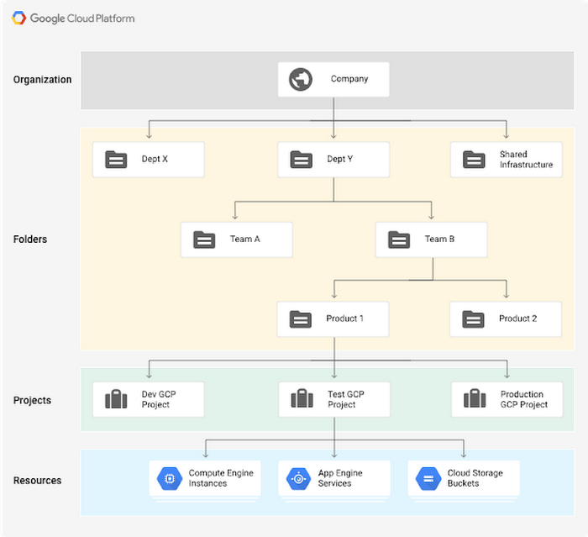

Slide 12
GCP Resource Hierarchy
- Organization → Folder → Project
- Logical grouping
- Policy inheritance

Slide 13
Project Isolation
- Separate environments
- Dev/Test/Prod isolation
- Billing separation

Slide 14
Project Best Practices
- Naming conventions
- Separate workloads
- Use folders effectively

Slide 15
GCP Networking Foundations
- VPC networks
- Subnets
- Firewall rules
- Private connectivity

Slide 16
VPC & Subnets
- Global VPC
- Regional subnets
- CIDR ranges
- Auto vs Custom mode

Slide 17
Firewall Rules
- Allow/Deny traffic
- Stateful rules
- Tags and service accounts

Slide 18
Private Service Connect & Peering
- Private access to services
- VPC Peering
- Hybrid connectivity

Slide 19
Billing & Cost Management
- Pricing models
- Budgets
- Cost alerts
- Optimization strategies

Slide 20
Cloud Shell & gcloud CLI
- Browser-based terminal
- Pre-installed tools
- Access to GCP resources

Slide 21
gcloud Commands
- gcloud init
- gcloud compute instances create
- gcloud storage buckets create

Slide 22
Deploy via CLI
- Automate deployments
- Script infrastructure
- Infrastructure as Code

Slide 23
Cloud Storage
Foundation for Data Engineering in GCP

Slide 24
Cloud Storage (GCS)
- Object storage service
- Highly durable
- Scalable storage

Slide 25
Bucket Structure
- Global namespace
- Unique names
- Objects inside buckets

Slide 26
Storage Classes
- Standard
- Nearline
- Coldline
- Archive
- Based on access frequency

Slide 27
Lifecycle Rules
- Automate data movement
- Transition between classes
- Delete old data

Slide 28
Object Versioning
- Maintain object history
- Recover deleted data
- Enable/disable per bucket

Slide 29
GCS in Data Engineering
- Raw data ingestion
- Landing zone
- Data lake storage

Slide 30
Data Lake Patterns
- Bronze (Raw)
- Silver (Cleaned)
- Gold (Aggregated)
- Partitioning strategies

