Slide 1
Introduction to .NET
By : Vikash Verma
Content :
  Introduction to .NET Technology
  Introduction to Web Based Applications
  Introduction to ASP.NET

Slide 2
Introduction to .NET Technology
Notes:
© Accenture 2006
Course Code Z16828
ATS Application Programming: C# .Net Programming
2.1 Introduction to .NET Technology

Slide 3
What is .NET ?
Microsoft.NET is a Framework
  Microsoft .NET is a Framework which provides a common platform to Execute or, Run the applications developed in various programming languages.
  Microsoft announced the .NET initiative in July 2000.
  The main intention was to bridge the gap in interoperability between services of various programming languages.
Notes:
© Accenture 2006
Course Code Z16828

Slide 4
.NET Framework Objectives
The .NET Framework is designed to fulfill the following objectives:
  Provide object-oriented programming environment
  Provide environment for developing various types of applications, such as Windows-based applications and Web-based applications
  To ensure that code based on the .NET Framework can integrate with any other code
Notes:
© Accenture 2006
Course Code Z16828
ATS Application Programming: C# .Net Programming
2.1 Introduction to .NET Technology
Faculty Notes:

Slide 5
.NET Framework
VB
C++
C#
JScript
…
Visual Studio 2008
Common Language Specification
ASP.NET
Windows
Forms
ADO.NET
Base Class Library
(CLR) Common Language Runtime
Operating System
Notes:
© Accenture 2006
Course Code Z16828
ATS Application Programming: C# .Net Programming
2.1 Introduction to .NET Technology
Faculty Notes:
Figure above illustrates the Microsoft .NET Framework. All .NET languages are built on a Common Language Specification. While designed specifically to support the .NET versions of Visual Basic, C++, C# and JScript, .NET also supports other languages that can be modified to this specification. These include Perl, Python, COBOL, Eiffel, Pascal, Fortran, SmallTalk, Java, RPG, Ada, APL, J# and others.
The .NET Framework is designed to unify programming models to enable cross-language integration.
The Microsoft Active Server Page (ASP) technology has been enhanced as ASP.NET and is designed to allow the easy development of Web services and Web forms see figure above. The development of Windows forms has also been improved with .NET, and ADO.NET provides full support for data and XML. Visual Studio 2005 supports and integrates all of these development environments, automating many development tasks that previously required manual integration.
Each of the languages in the figure is supported by Visual Studio 2005, which is an enhanced IDE. The other languages discussed earlier can also be added to Visual Studio 2005. The strategy behind Visual Studio 2005 is to enable applications to be developed within Windows for later execution in a .NET environment on any platform.

Slide 6
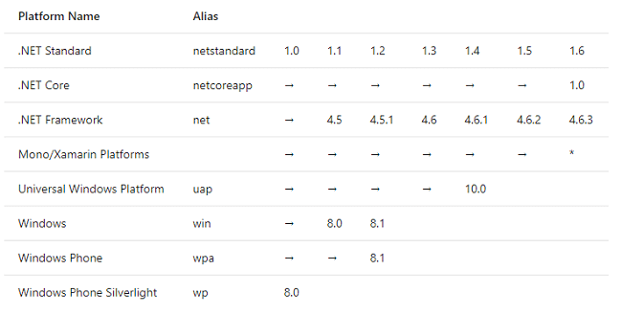
.Net Versions

Slide 7
The .NET Framework consists of:
  The Common Language Specification (CLS)
  It contains guidelines, that language should follow so that they can communicate with other .NET languages. It is also responsible for Type matching.
  The Framework Base Class Libraries (BCL)
  A consistent, object-oriented library of prepackaged functionality and Applications.
  The Common Language Runtime (CLR)
  A language-neutral development & execution environment that provides common runtime for application execution .
Notes:
© Accenture 2006
Course Code Z16828
ATS Application Programming: C# .Net Programming
2.1 Introduction to .NET Technology
Faculty Notes:
Just read out the slide the sub point are explained in next slide

Slide 8
Common Language Specification
  CLS performs the following functions:
  Establishes a framework that helps enable cross-language integration, type safety, and high performance code execution
  Provides an object-oriented model that supports the complete implementation of many programming languages
  Defines rules that languages must follow, which helps ensure that objects written in different languages can interact with each other

Slide 9
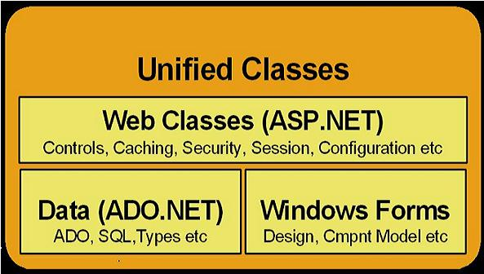
.NET Framework Base Class Library
The Class Library is a comprehensive, object-oriented collection of reusable types
These class library can be used to develop applications that include:
  Traditional command-line applications
  Graphical user interface (GUI) applications
  Applications based on the latest innovations provided by ASP.NET
    Web Forms
    XML Web services
Notes:
© Accenture 2006
Course Code Z16828
ATS Application Programming: C# .Net Programming
2.1 Introduction to .NET Technology

Slide 10
Common Language Runtime (CLR)
CLR ensures:
  A common runtime environment for all .NET languages
  Uses Common Type System (strict-type & code-verification)
  Memory allocation and garbage collection
  Intermediate Language (IL) to native code compiler. Which Compiles MSIL code into native executable code
  Security and interoperability of the code with other languages
Over 36 languages supported today
  C#, VB, Jscript, Visual C++ from Microsoft
  Perl, Python, Smalltalk, Cobol, Haskell, Mercury, Eiffel, Oberon, Oz, Pascal, APL, CAML, Scheme, etc.
Notes:
© Accenture 2006
Course Code Z16828
ATS Application Programming: C# .Net Programming
2.1 Introduction to .NET Technology

Slide 11
Execution in CLR
Source code
VB
C#
C++
Compiler
Compiler
Compiler
Managed
code
Assembly
IL Code
Assembly
IL Code
Assembly
IL Code
Common Language Runtime
JIT Compiler
Native Code
Operating System Services
Notes:
© Accenture 2006
Course Code Z16828
ATS Application Programming: C# .Net Programming
2.1 Introduction to .NET Technology
Faculty Notes:
We already know that an assembly does NOT contain native binary code, but instead MSIL code. Obviously before the MSIL code can be executed it must be converted into native binary instructions. Converted? Does this mean interpreted? NO! The MSIL code is compiled and not thrown away. This means that the next time the code is requested it is already in the form of machine instructions and thus this mechanism in the log run is far more efficient than an interpreter for example.
The compilation is carried out by a JIT (Just In Time) compiler. Does the compiler compile all of the code in one go? The answer to this question is NO. If this approach was taken there would be a long delay during the applications initialization, and realistically not all the code within the module will be required in one go. Instead, when the code is loaded a ‘stub’ is connected to each method. When a method is called via the stub the compiler generates the binary native code. This mechanism goes a long way to describing why the compiler is called a ‘JIT’ compiler.
Compiled code is only saved in the same process (run) of an application. And even then it's not guaranteed. We do what's called "code-pitching" which means we through away cold (or little used) JITed code if memory pressure requires it. We do persisted JITed code in the install time scenario.
The benefit to this system is obviously portability. A couple of things to think about -
Let’s imagine you’ve built a managed component for the Intel Pentium III platform. It works fine. Later in the year Intel released a super new chip. When Microsoft released a new version of the JIT, it’s possible that this brand spanking new version of the JIT will have learned a few new tricks e.g. to make use of the new improved instruction set of the new Intel chip or new CPU registers!
And finally, Microsoft plans to offer a tool called PREJIT. This tool will compile your assemblies into native code and save the resultant binary executable code to disk. When the assemblies are next loaded the binary code is already available thus improving startup time and execution speeds.

Slide 12
Memory Management
Cleaning Up Unmanaged Resources
Garbage Collection

Slide 13
Clear Unmanaged Resources
Implementing Dispose Pattern
Using Objects that Implement Idisposable(By using USING )

Slide 14
C# (C Sharp)
Microsoft C# (pronounced C Sharp) developed by Microsoft Corporation, USA
New programming language that runs on the .NET Framework
C# is simple, modern, type safe, and object oriented
C# code is compiled as managed code
Combines the best features of Visual Basic, C++ and Java
Notes:
© Accenture 2006
Course Code Z16828
ATS Application Programming: C# .Net Programming
2.1 Introduction to .NET Technology
Faculty Notes:
C# code is compiled as managed code, which means it benefits from the services of the common language runtime. These services include language interoperability, garbage collection, enhanced security, and improved versioning support.

Slide 15
C# Features
Simple
Modern
Object-Oriented
Type-safe
Versionable
Compatible
Secure
Notes:
© Accenture 2006
Course Code Z16828
ATS Application Programming: C# .Net Programming
2.1 Introduction to .NET Technology
Faculty Notes:
Simple – It simplifies the use of operators such as -> :: and pointers. It treats integers and boolean data types as two different types.
Modern – because it supports:
Automatic garbage collection
Rich model for Error handling
Decimal Data type for Financial applications
Robust Security model
Object –Oriented:
Supports all the tenets of an object-oriented system
Encapsulation
Inheritance
Polymorphism
Type-Safe:
Dynamically allocated objects and arrays are initialized to zero
Access to arrays are range bound and warned if it goes out of bounds
C# enforces overflow checking in arithmetic operations
Reference parameters that are passed are type-safe
Versionable:
New versions of software's work with existing applications this is known as versioning
Compatible:
Enforces .NET common language specifications and there fore allows inter-operation with other .NET languages

Slide 16
Datatypes
Primitive types
  These are types representing the basic types we are familiar with – integers, floats, characters etc
  In C# they are part of the FCL so they are treated as Objects (unlike in Java!) but are used in the same way as normal primitive types
    So, for example, we can apply the normal arithmetic operators to them

Slide 17
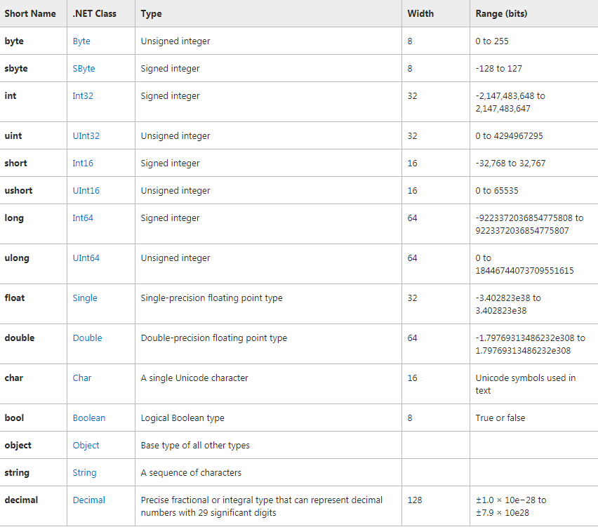

Slide 18
Reference Types Vs Value Types
Reference Types and Value Types
  When we declare a variable in a C# program it is either a reference or a value type
  All non-primitive types are reference types
    Essentially the variable name is a reference to the memory occupied by the variable
  But primitive types can be either
    Even though all primitive types are treated as objects (unlike in Java)!!

Slide 19
For example String and Int32 are both primitive types
  BUT
    String is a reference type
    Int32 is a value type
  String variable s is a reference (memory address) of some memory which stores the string (which defaults to null)
  Int32 variable x is the actual value of the integer (which defaults to zero)

Slide 20
Implicit and Explicit Casting
Implicit conversions: No special syntax is required because the conversion is type safe and no data will be lost. Examples include conversions from smaller to larger integral types.
int num = 2147483647;
long bigNum = num;

Slide 21
Explicit conversions (casts): Explicit conversions require a cast operator. Casting is required when information might be lost in the conversion, or when the conversion might not succeed for other reasons. Typical examples include numeric conversion to a type that has less precision or a smaller range, and conversion of a base-class instance to a derived class.
double x = 1234.7; int a; // Cast double to int. a = (int)x;

Slide 22
Boxing and Unboxing
Boxing is used to store value types in the garbage-collected heap. Boxing is an implicit conversion of a value type to the type object or to any interface type implemented by this value type.
int i = 123;object o = i; (Implicit)
int i = 123; object o = (object)i;(explicit )

Slide 23
Unboxing
Unboxing is an explicit conversion from the type object to a value type or from an interface type to a value type that implements the interface
int i = 123; object o = i; int j = (int)o;

Slide 24
Control Statements
Control flow statements in C# are the same as for C++ and Java
  if {} else{}
  for {}
  do{} while()
  While()
  Switch
  Break
  Foreach

Slide 25
foreach simplifies the code for iterating through an array
  There is no loop counter
    If the loop counter variable is required in the loop, then a for construct must be used
  The type must match the type of elements in the array
  The array cannot be updated inside the loop

Slide 26
Working with Arrays
Arrays
  Array declaration and initialization is similar to other languages
// A one dimensional array of 10 Bytes
Byte[] bytes = new Byte[10];
// A two dimensional array of 4 Int32s
Int32[,] ints = new Int32[5,5];
// A one dimensional array of references to Strings
String[] strings = new String[10];

Slide 27
The array itself is an object
  The array is automatically derived from the Array class in the FCL
  This enables a number of useful methods of the Array class to be used
    Finding the length of an array
    Finding the number of dimensions of an array
Arrays themselves are reference types although their elements can be value types, or reference types

Slide 28
OOPs-Concept
Class
Object
Abstraction
Encapsulation
Inheritance
Polymorphism
Object Creation and Instantiation.

Slide 29
Classes & Objects
Classes are the most fundamental of C#’s types. A class is a data structure that combines state (fields) and actions (methods and other function members) in a single unit. A class provides a definition for dynamically created instances of the class, also known as objects.

Slide 30
Abstraction
Data Abstraction may also be defined as the process of identifying only the required characteristics of an object ignoring the irrelevant details. The properties and behaviors of an object differentiate it from other objects of similar type and also help in classifying/grouping the objects.
Eg RGB

Slide 31
Encapsulation
Encapsulation is defined 'as the process of enclosing one or more items within a physical or logical package'. Encapsulation, in object oriented programming methodology, prevents access to implementation details.

Slide 32
Encapsulation is implemented by using access specifiers. An access specifier defines the scope and visibility of a class member. C# supports the following access specifiers −
Public
Private :Only functions of the same class can access its private members
Protected: Protected access specifier allows a child class to access the member variables and member functions of its base class.

Slide 33
Internal: any member with internal access specifier can be accessed from any class or method defined within the application in which the member is defined.
Protected internal:The protected internal access specifier allows a class to hide its member variables and member functions from other class objects and functions, except a child class within the same application

Slide 34
Inheritance
Inheritance is one of the fundamental attributes of object-oriented programming. It allows you to define a child class that reuses (inherits), extends, or modifies the behavior of a parent class. The class whose members are inherited is called the base class. The class that inherits the members of the base class is called the derived class.

Slide 35
Polymorphism
The word polymorphism means having many forms. In object-oriented programming paradigm, polymorphism is often expressed as 'one interface, multiple functions’.
Static Polymorphism
Dynamic Polymorphism

Slide 36
Static Polymorphism
The mechanism of linking a function with an object during compile time is called early binding. It is also called static binding. C# provides two techniques to implement static polymorphism. They are −
Function overloading
Operator overloading

Slide 37
Function Overloading
You can have multiple definitions for the same function name in the same scope. The definition of the function must differ from each other by the types and/or the number of arguments in the argument list. You cannot overload function declarations that differ only by return type.

Slide 38
Dynamic Polymorphism
C# allows you to create abstract classes that are used to provide partial class implementation of an interface. Implementation is completed when a derived class inherits from it. Abstract classes contain abstract methods, which are implemented by the derived class. The derived classes have more specialized functionality.

Slide 39
Operator Overloading
You can redefine or overload most of the built-in operators available in C#. Thus a programmer can use operators with user-defined types as well. Overloaded operators are functions with special names the keyword operator

Slide 40
Example
public static Box operator+ (Box b, Box c) {
Box box = new Box();
box.length = b.length + c.length;
box.breadth = b.breadth + c.breadth;
box.height = b.height + c.height;
return box;
}

Slide 41
Collections and Generics
Generics provides the type safe code with re-usability like as algorithm. In algorithms such as sorting, searching, comparing etc. you don’t specify what data type(s) the algorithm operates on. The algorithm can be operates with any types of data. In the same way Generics operate, you can provide different data type to Generics.

Slide 42
How to do it using Collections
//Overloaded sort methods
private int[] Sort(int[] inputArray)
{//Sort array and return sorted array
return inputArray;
}
private float[] Sort(float[] inputArray)
{//Sort array and return sorted array
return inputArray;
}

Slide 43
How to do it using Generics
private T[] Sort(T[] inputArray)
{
//Sort array
//and return sorted array
return inputArray;
}

Slide 44
Problem with Collections
Suppose by mistake you have added a string value to ArrayList like as
studentList.Add("Generics"); //Fooling the compiler
Since ArrayList is a loosely typed collection and it never ensure compile-time type checking. Hence above statement will compile without error but it will throw an InvalidCastException at run time when you try to cast it to Student Type.

Slide 45
How to do it using Generics
In generics we can use generic List to store a list of Student objects like as:
List<Student> lstStudents = new List<Student>();
Student objStudent = new Student();
objStudent.Name = "Rajat";
objStudent.RollNo = 1;
lstStudents.Add(objStudent);
objStudent = new Student();
objStudent.Name = "Sam";
objStudent.RollNo = 2;
lstStudents.Add(objStudent);
//Looping through the list of students
foreach (Student currentSt in lstStudents)
{
//no need to type cast since compiler already knows that everything inside
//this list is a Student
Console.WriteLine("Roll # " + currentSt.RollNo + " " + currentSt.Name);
}

Slide 46
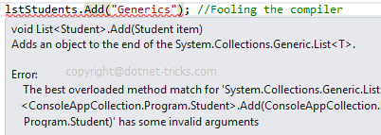
Advantage with Generics
In case of collections you can make fool to compiler but in case of generics you can't make fool to compiler as shown below. Hence Generics provide Type Safety.

Slide 47
Advantages
Cleaner Code with Generics
Better Performance with Generics

Slide 48
Exception Handling
Exception handling in C# and .NET framework, supported by the try catch and finally block is a mechanism to detect and handle run-time errors in code. The .NET framework provides built-in classes for common exceptions. The exceptions are anomalies that occur during the execution of a program. They can be because of user, logic or system errors.

Slide 49
C# provides three keywords try, catch and finally to implement exception handling. The try encloses the statements that might throw an exception whereas catch handles an exception if one exists. The finally can be used for any cleanup work that needs to be done.

Slide 50
try
{
// Statement which can cause an exception.
}
catch(Type x)
{
// Statements for handling the exception
}
finally
{//Any cleanup code
}

Slide 51
IO Streams
System.IO.Stream is an abstract class that provides standard methods to transfer bytes (read, write, etc.) to the source. It is like a wrapper class to transfer bytes. Classes that need to read/write bytes from a particular source must implement the Stream class.

Slide 52
FileStream reads or writes bytes from/to a physical file whether it is a .txt, .exe, .jpg or any other file. FileStream is derived from the Stream class.
MemoryStream: MemoryStream reads or writes bytes that are stored in memory.
BufferedStream: BufferedStream reads or writes bytes from other Streams to improve the performance of certain I/O operations.

Slide 53
NetworkStream: NetworkStream reads or writes bytes from a network socket.
PipeStream: PipeStream reads or writes bytes from different processes.
CryptoStream: CryptoStream is for linking data streams to cryptographic transformations.

Slide 54
Introduction to Web Based Applications
Notes:
© Accenture 2006
Course Code Z16828
ATS Application Programming: C# .Net Programming
2.1 Introduction to .NET Technology

Slide 55
Introducing Web Applications
Web Page
Static web page
This type of web page consists of HTML code typed directly into text or a web page editor
It is saved as an .htm or .html file
Static
Dynamic
The content (text, images, hyperlinks, and so on) and appearance of a static web page is always the same.
These web pages do not utilize any database or any other technology that dynamically builds up pages or content at runtime based on their visitors input.
Notes:
.NET: Software Engineering II
4.1 Introduction to ASP.NET
© Accenture 2006 All Rights Reserved
http://www.visualbuilder.com/aspnet/tutorial/pageorder/2/

Slide 56


How Are Static Web Pages Served ?
WEB SERVER
3. Web Server locates .html file
Author writes
HTML
4. HTML stream( from the .html page) returned to the browser
2. Client requests the web page
5. Browser processes
HTML and displays
page
CLIENT
Notes:
.NET: Software Engineering II
4.1 Introduction to ASP.NET
© Accenture 2006 All Rights Reserved
1. Author writes HTML.
2. The Web browser sends a request for a particular Web page of a Web site to the Web server hosting that site.
3. The Web server searches for the page in directory containing Web pages for the Web site.
4. On finding the requested page, the Web server collects the HTML of the Web page.
5. The Web server sends the HTML to the requesting browser which then parses it to develop the visual presentation of the page.

Slide 57
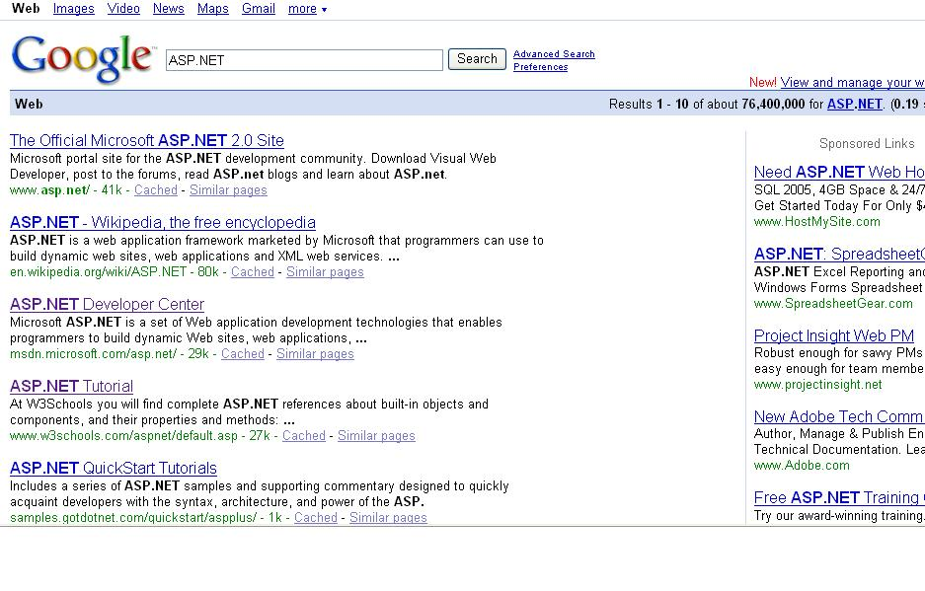
Dynamic web page
Dynamic Web sites provide its visitors to modify the content of the web page based on their input.
They utilize databases and other mechanisms that enable to
  identify their visitors
  present them with customized greeting messages
  restructure the content according to user input etc..
Examples:
  Online shopping stores,
  search engines
  email
  chat, community portals etc.

Slide 58
Dynamic web page
Dynamic Web sites make use of “server-side technology”.
Server-side technologies add an extra layer to the static web page that enables the Web Server to generate HTML on the fly.
The web server will first
  interpret the server-side code present in web pages,
  generate the appropriate HTML and then
  send the response to the web browser.
Notes:
.NET: Software Engineering II
4.1 Introduction to ASP.NET
© Accenture 2006 All Rights Reserved
Web servers are software that manage Web pages and make them available to client browsers – via a local
network or over the Internet. In the case of the Internet, the Web server and browser are usually on two
different machines, possibly many miles apart. However, in a local situation you can set up a machine
that runs the Web server software, and then use a browser on the same machine to look at its Web pages.

Slide 59
How Are Dynamic Web Pages Served?
Web Server collects the contents (code + HTML) of the web page and parses the contents to produce HTML.
WEB SERVER
2. The Web Server searches for the requested page
4. The HTML stream is sent back to the requesting browser
1. The Web browser sends a request
5. Browser processes
HTML and displays
page
CLIENT
Notes:
.NET: Software Engineering II
4.1 Introduction to ASP.NET
© Accenture 2006 All Rights Reserved
1. The Web browser sends a request for a particular Web page of a Web site to the Web server hosting that site.
2. The Web server searches for the page in directory containing Web pages for the Web site.
3. On finding the requested page, the Web server collects the content (code + HTML) of the Web page.
4. The Web server then parses the content to produce HTML.
5. The HTML stream is sent back to the requesting browser which then parses it to develop the visual presentation of the page.

Slide 60

Introduction to ASP.NET
Notes:
© Accenture 2006
Course Code Z16828
ATS Application Programming: C# .Net Programming
2.1 Introduction to .NET Technology

Slide 61
Introduction to ASP.NET
ASP.NET is part of the Microsoft .NET framework
ASP.NET is an effective and flexible technology for creating interactive and dynamic web pages.
It is a convergence of two major Microsoft technologies:
  Active Server Pages (ASP)
    Active Server Pages is Microsoft’s server side scripting technology for building dynamic web pages.
  .NET Framework
    The .NET Framework is a suite of technologies designed by Microsoft where program development takes place.
Notes:
.NET: Software Engineering II
4.1 Introduction to ASP.NET
© Accenture 2006 All Rights Reserved
Faculty Notes
ASP.NET applications can be written in any .NET compatible language like Visual Basic .NET, C#, and JScript .NET.

Slide 62
Introduction to ASP.NET
It is built on .NET Common Language Runtime
ASP.NET :
  Provides better user authentication
  Has better language support.
  Has a large set of new controls (web controls)
  Uses compiled code, which increases the performance of the applications
It is programmable using any of the .NET languages (VB.NET, C#, VJ# etc).
The ASP.NET pages are saved with the .aspx extension.

Slide 63
Working of an ASP.NET Application
To execute an ASP.NET file, the following steps are followed:
A web browser sends a request for an ASP.NET file to the web server by using a URL.
The web server receives the request and retrieves the appropriate ASP.NET file from the disk or memory.
The web server forwards the file to the ASP.NET script engine for processing.
ASP.NET
Script
Engine
WEB SERVER
CLIENT

Slide 64
Working of an ASP.NET Application
4. The ASP.NET script engine reads the file from top to bottom and executes it.
5. The processed ASP.NET file is generated as an HTML document and the ASP.NET script engine sends the HTML page to the Web server.
6. The Web server then sends the HTML code to the client which interprets the output and displays it.
ASP.NET
Script
Engine
WEB SERVER
CLIENT

Slide 65
Advantages of ASP.NET
Easy Programming Model
Flexible Language Options
Compiled Execution
Rich Output Caching
Web-Farm Session State
Enhanced Reliability
Master Pages
Themes
Improved Security
Web Services
Improved Performance and Scalability
Notes:
.NET: Software Engineering II
4.1 Introduction to ASP.NET
© Accenture 2006 All Rights Reserved
Faculty Notes
Review the points on the slide, and provide the following elaboration to each point:
Easy Programming Model: HTML-like style of declarative programming of Server controls lets you build great pages with very less code than with classic ASP. All Web browsers support ASP.NET page -- including Netscape, Opera, AOL, and Internet Explorer
Flexible Language Options: More than 25 .NET languages are supported by ASP.NET. This gives flexibility in choice of language
Rich Class Framework: Over 4500 classes and more that encapsulate rich functionality like XML, data access, file uploading, regular expressions, image generation, performance monitoring and logging, transactions, message queuing, SMTP mail are available in .NET Framework
Compiled Execution: ASP.NET application is up to date due to dynamic compilation, and this compiled execution makes the application fast
Rich Output Caching: Rendering of controls to XHTML is improved by output caching. Database caching enables the application to be notified when the underlying database changes, eliminating unnecessary queries
Web-Farm Session State: In a Web farm, ASP.NET session state lets you share session data and user-specific state values across all machines. A Web Farm comprises of multiple Web servers situated on different machines having the same Web Application running on them.
It is used for scaling up to increasing number of users and provide satisfactory response times.
Enhanced Reliability:
Master Pages - Using Master Pages, ASP.NET makes it easy to create and apply a common look-and-feel to your Web site. It ensures that the application is always available to users by automatically detecting and recovering from errors like deadlocks and memory leaks.
Themes: Using Themes, Web pages can be given a consistent appearance with the built-in support.
XHTML ComplianceUsing ASP.NET, XHTML-compliant pages can be easily created.
Improved Security ASP.NET helps you protect your data and users.
Built-in Protection ASP.NET has built-in protection from many common forms of hacker attacks, including cross-site scripting and more.
XML Web Services: ASP.NET makes exposing and calling XML Web Services simple. XML Web services allow applications to share data and communicate with other application over the Internet, irrespective of the type of operating system or programming language.
Improved Performance and Scalability: ASP.NET lets you use serve more users with the same hardware.

Slide 66
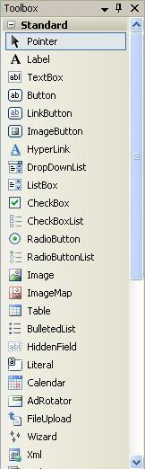
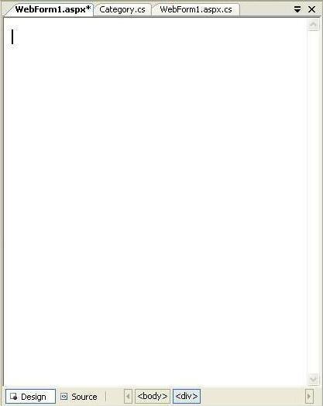
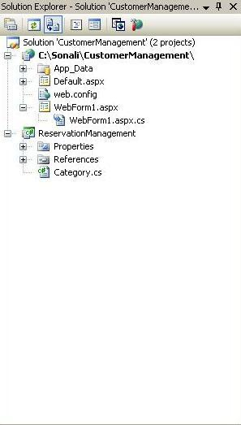
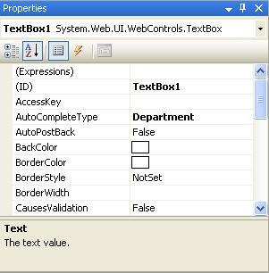
Visual Studio 2008 IDE
Title Bar
Menu Bar
Tool Box
Document window
Solution Explorer
Properties Window
Status Bar
Notes:
.NET: Software Engineering II
4.1 Introduction to ASP.NET
© Accenture 2006 All Rights Reserved
Faculty Notes:
Run this slide

Slide 67
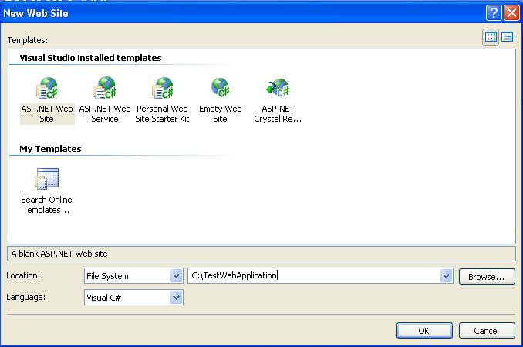
Creating a New Web Application
To start a new Web Application in VS 2008, Click the Create Web Site button on the Start page or Select File > New > Web Site
The New Web Site allows
you to choose:
  Templates
  Language for creating an
  application
  Location where the application
  will be created
Notes:
.NET: Software Engineering II
4.1 Introduction to ASP.NET
© Accenture 2006 All Rights Reserved
Faculty Notes:
This slide demonstrates how to create a new Web Application in VS 2008.
You can also create other projects such as a Windows Application, Class Library, Console Application etc;
by selecting File > New > Project and then selecting the required project.

Slide 68
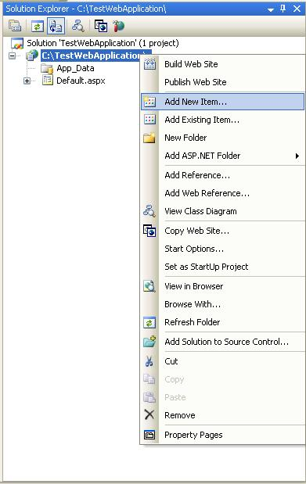
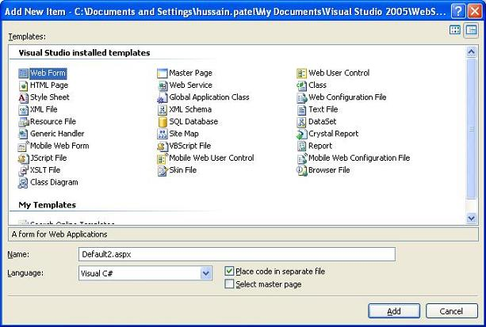
Creating a New Application (Continued)
After you create a new Web Application, Default.aspx page is added to this Website. To Rename this page, Select the page from the Website node in the Solution Explorer > Right Click > Rename.
Files can be added to the Project, using Solution Explorer:
  Right click on the project node, in the Solution Explorer, and select the option Add New Item.
  The Add New Item window will popup.
  Select the type of file (item) to be added and click on Add.
Notes:
.NET: Software Engineering II
4.1 Introduction to ASP.NET
© Accenture 2006 All Rights Reserved
Faculty Notes:
Read the content in the slide (Self-explanatory)

Slide 69
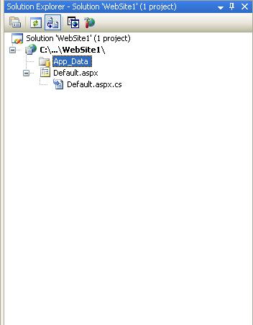
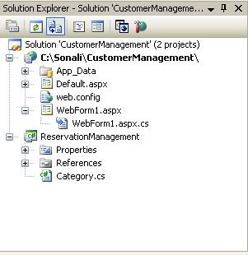
Solution Explorer
Presents a tree view structure of files present in the project.
  By default a New Website will contain:
    An App_Data folder
    A Default.aspx page (including Default.aspx.cs)
To view Solution Explorer:
Select View > Solution Explorer
OR
Press buttons Ctrl+W,S
Notes:
.NET: Software Engineering II
4.1 Introduction to ASP.NET
© Accenture 2006 All Rights Reserved
Faculty Notes
Read the content in the slide (Self-explanatory)
Note: You can add multiple projects in a single Solution Explorer.

Slide 70

Solution Explorer (Continued)
The Toolbar at the top of Solution Explorer enables various tasks.
Code
Refresh
Copy Website
Properties
View Designer
Nest Related Files
ASP.NET Configuration
Notes:
.NET: Software Engineering II
4.1 Introduction to ASP.NET
© Accenture 2006 All Rights Reserved
Faculty Notes
Explain the following tasks:
Properties – Displays the properties window for the selected file
Refresh - Refreshes the Solution Explorer
Nest Related Files - Undoes the nesting found in
ASP.NET files developed by
using code-behind files
Code - Displays the code behind file/s
View Designer - Displays the document window
Copy Website – Enable you to copy your application from one point to another (on the same server or on a different server) by opening a new dialog in the document window
ASP.NET Configuration – Displays the ASP.NET configuration page within the document window

Slide 71
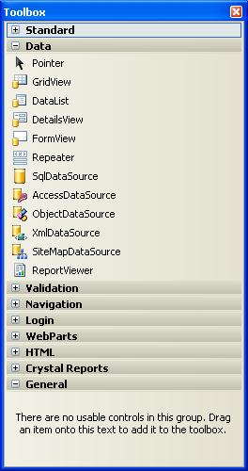
Toolbox
To add controls in the Design Window use Toolbox.
There are various tool tabs available in the Toolbox.
  The controls in the IDE are presented in a hierarchical manner (e.g., Standard Tab, Data Tab, Validation, Navigation, WebParts etc.).
  Depending on the type of project (application) the toolbox tabs will vary.
To view the tool box:
  Select menu View > Toolbox
  OR
  Press buttons Ctrl+Alt+X or Ctrl+W, X
You can also view the controls as icons by right-clicking on the toolbox you want to change and deselecting the List View.
Notes:
.NET: Software Engineering II
4.1 Introduction to ASP.NET
© Accenture 2006 All Rights Reserved
Faculty Notes
Read the content in the slide (Self-explanatory)
Use ToolBox to add controls in the Design Window.
Just drag and drop the required controls in the design window and the control gets added to your application.

Slide 72
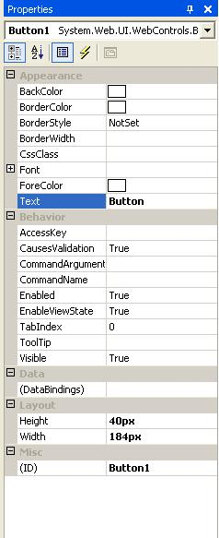
Properties Window
To view or change the properties and events of a selected control during design use the Properties Window
To configure a control:
  Click once to select it
  Press F4 or Select menu View > Properties window
  Modify the appropriate properties in the window
There are various options provided for viewing the properties of the selected control, such as:
  Categorized view
  Alphabetical view
  Properties view (default)
  Events View
  Property pages
Notes:
.NET: Software Engineering II
4.1 Introduction to ASP.NET
© Accenture 2006 All Rights Reserved
Faculty Notes:
Properties shown in grey are read-only
The default view for the Selected control properties view is displayed. Use:
Categorized View (to view the properties by category)
Alphabetical View (to view the properties in alphabetical order)
Events View (to view the events associated with the control)
Property Pages (to view the property page of an option)

Slide 73
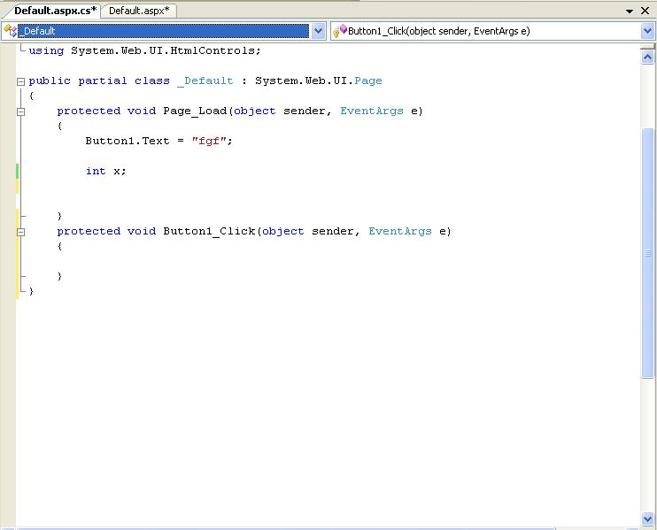
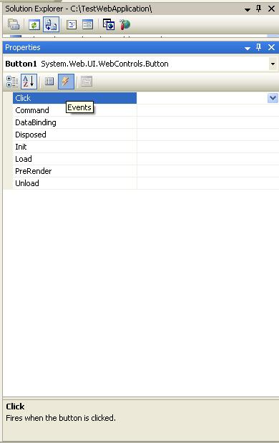
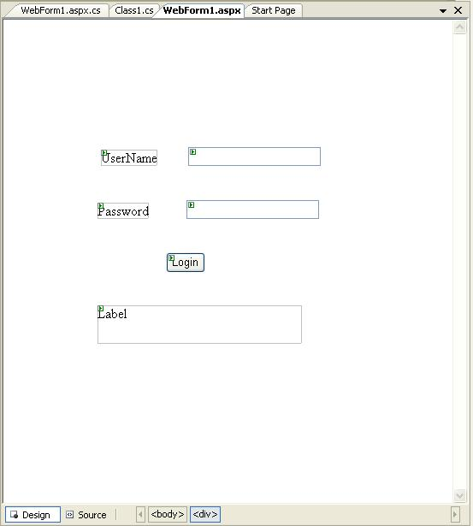
Adding an Event
Events can be added to the code in one of three ways:
  Double clicking a control in design view
  Typing the code manually
  Selecting the Events Icon and double clicking the required event from the Properties Window
Event Handler For Button
Notes:
.NET: Software Engineering II
4.1 Introduction to ASP.NET
© Accenture 2006 All Rights Reserved
Faculty Notes:
Type it in manually
You must specify the appropriate parameters and the handles clause
Double-click on a control in the design view
For example, double-click on the page, it will create a Page.Load event handler.
Double-click on a button or input control, it will create the required click or change event handler.
Choose the event from the drop-down list:
Once you double-click the control, the events get added to the drop-down list on the top of the code view.
You can choose the required event from this list.

Slide 74
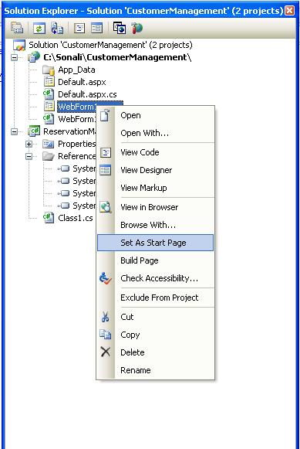
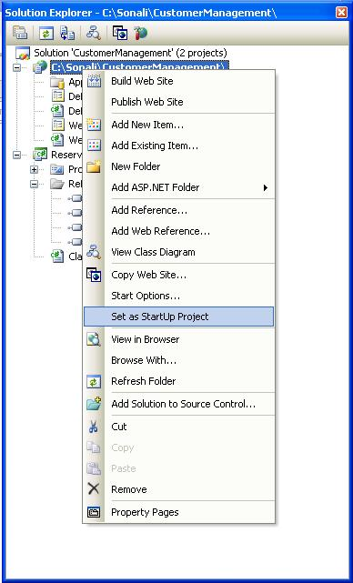
Project Settings
Project Settings can be adjusted using various options in the Project Properties menu or by using the Solution Explorer window.
  These settings change based on the type of application developed.
Setting Startup Page:
  Right Click on the form you want set as the startup page in the Solution Explorer.
  Select option Set As Start Page.
Startup Project (In case of multiple projects):
  Right Click on Project to set as startup project in the Solution Explorer.
  Select Option Set As StartUp Project.
Notes:
.NET: Software Engineering II
4.1 Introduction to ASP.NET
© Accenture 2006 All Rights Reserved

Slide 75
Validation Controls
RequiredFieldValidator
RangeValidator
CompareValidator
RegularExpressionValidator
CustomValidator
ValidationSummary

Slide 76
Members | Description
ControlToValidate | Indicates the input control to validate.
Display | Indicates how the error message is shown.
EnableClientScript | Indicates whether client side validation will take.
Enabled | Enables or disables the validator.
ErrorMessage | Indicates error string.
Text | Error text to be shown if validation fails.
IsValid | Indicates whether the value of the control is valid.
SetFocusOnError | It indicates whether in case of an invalid control, the focus should switch to the related input control.
ValidationGroup | The logical group of multiple validators, where this control belongs.
Validate() | This method revalidates the control and updates the IsValid property.

Slide 77
BaseValidator Class
The validation control classes are inherited from the BaseValidator class hence they inherit its properties and methods. Therefore, it would help to take a look at the properties and the methods of this base class, which are common for all the validation controls

Slide 78
RequiredFieldValidator Control
The RequiredFieldValidator control ensures that the required field is not empty. It is generally tied to a text box to force input into the text box.
The syntax of the control is as given:
<asp:RequiredFieldValidator ID="rfvcandidate"
runat="server"ControlToValidate="ddlcandidate"ErrorMessage="Please choose a candidate"
InitialValue="Please choose a candidate">
</asp:RequiredFieldValidator>

Slide 79
RangeValidator Control
The RangeValidator control verifies that the input value falls within a predetermined range.
Properties | Description
Type | It defines the type of the data. The available values are: Currency, Date, Double, Integer, and String.
MinimumValue | It specifies the minimum value of the range.
MaximumValue | It specifies the maximum value of the range.
<asp:RangeValidator ID="rvclass" runat="server" ControlToValidate="txtclass" ErrorMessage="Enter your class (6 - 12)" MaximumValue="12" MinimumValue="6" Type="Integer"> </asp:RangeValidator>

Slide 80
CompareValidator Control
The CompareValidator control compares a value in one control with a fixed value or a value in another control.
Properties | Description
Type | It specifies the data type.
ControlToCompare | It specifies the value of the input control to compare with.
ValueToCompare | It specifies the constant value to compare with.
Operator | It specifies the comparison operator, the available values are: Equal, NotEqual, GreaterThan, GreaterThanEqual, LessThan, LessThanEqual, and DataTypeCheck.
<asp:CompareValidator ID="CompareValidator1" runat="server" ErrorMessage="CompareValidator"> </asp:CompareValidator>

Slide 81
RegularExpressionValidator
The RegularExpressionValidator allows validating the input text by matching against a pattern of a regular expression. The regular expression is set in the ValidationExpression property.
<asp:RegularExpressionValidator ID="string" runat="server" ErrorMessage="string" ValidationExpression="string" ValidationGroup="string"> </asp:RegularExpressionValidator>

Slide 82
Resources
Visual Studio 2008 Website
http://msdn.microsoft.com/vstudio/
Notes:
.NET: Software Engineering II
4.1 Introduction to ASP.NET
© Accenture 2006 All Rights Reserved

Slide 83
Questions and Comments
???
Notes:
.NET: Software Engineering II
4.1 Introduction to ASP.NET
© Accenture 2006 All Rights Reserved
Faculty Notes:
Ask participants if they have any questions about the content covered in this presentation.

