Slide 1
Azure
By: Vikash Verma

Slide 2
Why Microsoft Azure
Microsoft Azure is 5 times cheaper than aws when using Microsoft products
Sayings though existing Microsoft licences
More than 95% of Fortune 500 companies use Microsoft Azure.

Slide 3

What is Microsoft Azure
Microsoft azure is a cloud service provider owned and managed by Microsoft. It offers various services such as compute, Storage, database and various other domains. It has a pay-as you go model, and is the second largest cloud provider in the market right now.

Slide 4
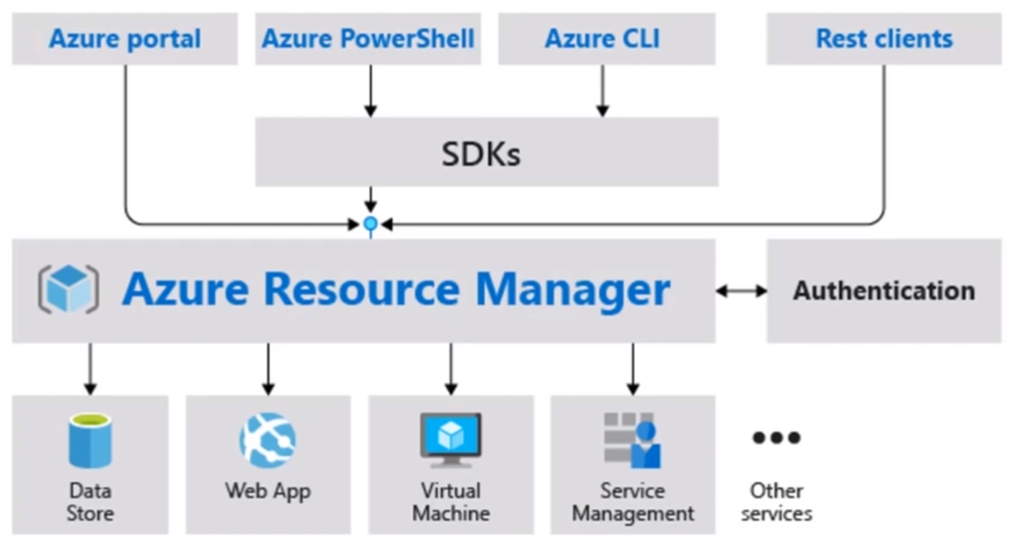
Azure Core Architecture

Slide 5
Azure Core Architecture
The Azure Architecture can be divided into 3 components :
Front End
Middle Ware
Services

Slide 6
Azure Core Architecture Components
Azure Portal is the GUI dashboard provided to us by Azure, through which we can deploy or previous resources.
Azure PowerShell makes use of windows PowerShell to give command line access to Azure Resources
Azure CLI is a command line tool providing a great experience for managing azure resources. The CLI is designed to make scripting easy, query data, support long-running operations and more.
Rest Clients are nothing but APIs which can used in application’s code to initiate an action on Azure cloud.

Slide 7
Azure Resource Manager
Azure resource manager ,plays a key deploying and managing the resources.
It helps you organise your resources in one group, this group is called a resource group.
It helps you deploy, manage, and monitor all the resources for your solution as a group, rather than handling these resources individually.

Slide 8
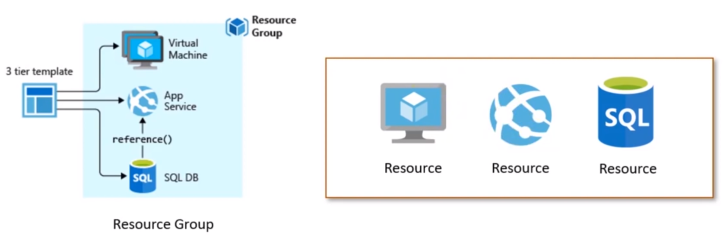
Azure Resource Manager

Slide 9
Azure Core Services-Domains
Compute
Networking
File Storage
Database Analytics
AI+Machine learning
Identity
Management

Slide 10
Azure Core Services-Compute
Azure Virtual Machines are images service instances that provide on-demand and scalable computing resources with usage-based pricing.
Function Apps is a solution for easily running small pieces of code or functions in the cloud. You can write just the code you need for the problem at hand, without worrying about a whole application or the infrastructure to run it.
Azure App service is a fully managed “Platform as a Service”(Paas) that integrates Microsoft Azure Websites, Mobile Services, and Biztalk Services into a single service.
Azure Kubernetes Services (AKS) is managed container orchestration services, base on the open source Kubernetes system, which is available on the Microsoft Azure Public Cloud.

