Slide 1
AI-Assisted SQL, dbt & Data Modelling
Vikash Verma

Slide 2
Agenda
NL2SQL deep dive
SQL optimization using AI
Dimensional modelling
dbt automation
Hands-on use case

Slide 3
What is NL2SQL?
Convert natural language to SQL
Used in BI tools and GenAI
Reduces dependency on SQL experts

Slide 4
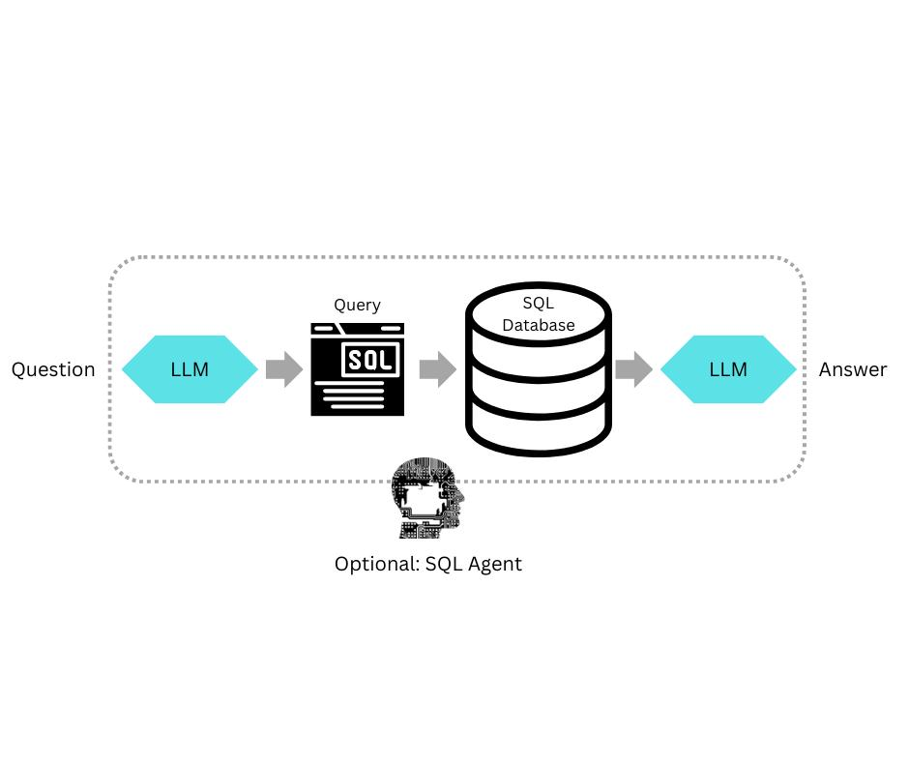
How NL2Sql WOrks

Slide 5
Step By STEP
1. User Input
User provides a natural language question Example:
“Top 5 customers by revenue last quarter”
2. Schema Understanding
AI reads:
Table names (customers, orders)
Columns (revenue, date)
Relationships (joins)

Slide 6
ContD
3. Query Generation
AI generates SQL:
SELECT c.customer_name, SUM(o.amount) AS total_revenue FROM customers c JOIN orders o ON c.customer_id = o.customer_id WHERE o.order_date >= DATE_TRUNC('quarter', CURRENT_DATE) - INTERVAL '1 quarter' GROUP BY c.customer_name ORDER BY total_revenue DESC LIMIT 5;
4. Execution
Query runs on database (Snowflake, Postgres, etc.)
5. Output
Returns table / chart / insight

Slide 7
Key Components
LLM (Large Language Model) → understands language
Schema Context → database structure
Prompt Engineering → instructions to guide SQL generation
Execution Engine → runs SQL

Slide 8
NL2SQL Patterns
Aggregation queries
Filtering conditions
Joins across tables
Group by and ordering

Slide 9
Examples
1. Aggregation
“Total sales by region”
GROUP BY region
2. Filtering
“Sales in 2023”
WHERE year = 2023
3. Joins
“Customer orders with product names”
JOIN customers, orders, products
4. Ranking / Top-N
“Top 10 products”
ORDER BY revenue DESC LIMIT 10

Slide 10
NL2SQL Challenges
Ambiguity in language
“Top customers” → by revenue? by orders?
Schema understanding
Many tables
Unclear relationships
Complex joins
AI may generate wrong join conditions
Performance issues
Null handling
Date logic
Nested queries
Edge Cases
Inefficient queries
Missing indexes

Slide 11
SQL Optimization Concepts
Avoid SELECT *
Use proper joins
Index usage
Query refactoring

Slide 12
AI for SQL Optimization
Claude Code suggestions
Copilot inline improvements
Explain query plans
Auto rewrite queries

Slide 13
Dimensional Modelling
Fact tables
Contains quantitative data used for analysis
Examples:
Sales amount
Quantity sold
Revenue
Dimension tables
Provide context to facts
Examples:
Customer details
Product info
Time (date, month, year)
Location

Slide 14
CONTD
Star schema
Fact table at center
Dimension tables around it
Direct joins (simple)
Snowflake schema
Dimensions are further normalized
More tables, less redundancy
Trade-off:
Cleaner data model
But slower queries (more joins)

Slide 15
AI-Assisted Modelling
AI-Assisted Modelling uses LLMs (like Claude, GPT, Copilot) to automatically design and generate data models (tables, relationships, dbt models) from natural language prompts.
Generate schema from prompt
What AI does:
Identifies entities
Separates facts vs dimensions
Defines columns
Suggests keys
Suggest relationships
AI can:
Detect primary/foreign keys
Suggest join conditions
Avoid incorrect joins
Optimize relationship structure

Slide 16
CONTD
Auto documentation
AI generates documentation
Benefits:
Saves time
Improves data understanding
Helps business users
End-to-End Flow
User gives prompt
AI reads schema (if available)
Generates:
Tables
Relationships
SQL / dbt models
Adds:
Tests
Documentation
Ready for deployment

Slide 17
Tools Used in AI-Assisted Modelling
dbt Cloud → model + docs + tests
Claude Code → SQL + explanation + optimization
GitHub Copilot → inline suggestions
Snowflake Cortex Analyst → schema-aware query generation

Slide 18
dbt Overview
dbt (data build tool) is a tool that lets you transform raw data in your warehouse using SQL, while also providing:
Testing
Documentation
Version control
Data lineage
Transformation tool
SQL-based modelling
Version controlled pipelines
dbt is like software engineering for data :-write SQL, version it, test it, and deploy it

Slide 19
Where dbt Fits
Ingestion → (ADF, NiFi, Fivetran)
Storage → (Snowflake, BigQuery, Databricks)
Transformation (dbt) ← THIS is where dbt works
BI / Analytics → (Power BI, Tableau)
➔ dbt does T in ELT (Transform)

Slide 20
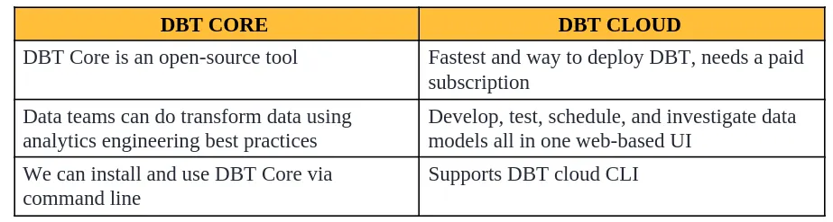
Different DBT options /DBT products
We can access DBT using DBT Core or DBT Cloud. DBT Cloud is built around DBT Core
DBT core (CLI)
DBT cloud

Slide 21
Core Concepts in dbt
1. Models (Main Concept)
A model = SQL file
Example:
-- models/fact_sales.sql SELECT customer_id, SUM(amount) AS total_sales FROM raw_orders GROUP BY customer_id
dbt turns this into a table or view in your warehouse.

Slide 22
2. Sources
Define raw data tables
sources: - name: raw tables: - name: orders
3. Tests (Data Quality)
Example:
columns: - name: customer_id tests: - not_null - unique
Ensures:
No nulls
No duplicates

Slide 23
4. Documentation
dbt auto-generates:
Table descriptions
Column meanings
Data lineage graph
5. Lineage (DAG)
Shows how data flows:
raw_orders → stg_orders → fact_sales → dashboard

Slide 24
Types of Models
View → virtual (fast, no storage)
Table → stored physically
Incremental → loads only new data (very important for big data)
Why dbt is Powerful
Uses pure SQL (no new language)
Built-in testing
Easy collaboration (Git)
Automatic documentation
Works directly on warehouse (no data movement)

Slide 25
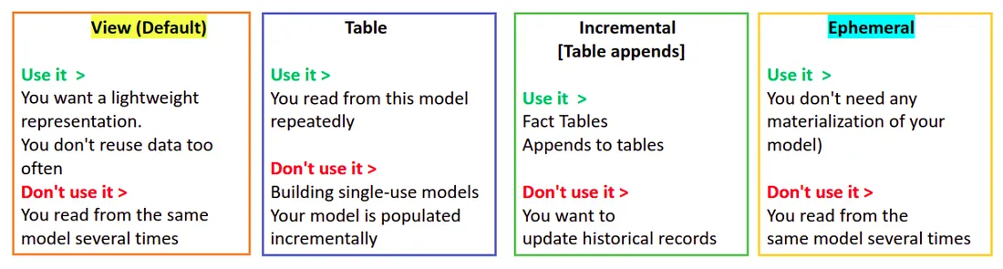
Models

Slide 26
Tools Around dbt
dbt Cloud → UI + scheduling
dbt Core → CLI-based
Snowflake → common backend
GitHub → version control

Slide 27
dbt Model Generation
dbt model generation is the process of creating SQL-based transformation models (tables/views) in dbt either:
Manually (writing SQL files), or
Automatically using AI from a prompt
A dbt model = one SQL file that transforms data.
Generate models using AI
Auto-create sources
Create exposures

Slide 28
Traditional vs AI-Based Model Generation
Traditional Way
Write SQL manually
Define joins, filters, aggregations
Create multiple files
AI-Assisted Way
You just give a prompt:
“Create a customer revenue model from orders table grouped by region”
AI generates:
SQL model
File name
Dependencies
Tests

Slide 29
Example
Prompt
“Build a sales fact model with total revenue per customer”
Generated dbt Model
-- models/fact_sales.sql SELECT customer_id, SUM(amount) AS total_revenue FROM {{ ref('stg_orders') }} GROUP BY customer_id

Slide 30
dbt Testing
dbt testing ensures that your data is correct, clean, and reliable by running checks on your models.
Instead of trusting data blindly, dbt lets you define rules (tests) like:
No nulls
No duplicates
Valid relationships

Slide 31
Types of dbt Tests
Generic Tests (Built-in)
Singular Tests (Custom SQL)

Slide 32
Generic Tests (Built-in)
These are pre-defined tests you configure in YAML.
a. not_null
Checks if a column has no null values
columns: - name: customer_id tests: - not_null
b. unique
Ensures values are not duplicated
columns: - name: order_id tests: - unique

Slide 33
CONTD
c. accepted_values
Ensures values are within a list
columns: - name: status tests: - accepted_values: values: ['completed', 'pending']
d. relationships
Ensures referential integrity (joins are valid)
columns: - name: customer_id tests: - relationships: to: ref('dim_customer') field: customer_id

Slide 34
Singular Tests (Custom SQL)
You write your own SQL test.
Example:
-- tests/no_negative_revenue.sql SELECT * FROM {{ ref('fact_sales') }} WHERE revenue < 0
If this query returns rows → test FAILS

Slide 35
How dbt Tests Work
How dbt Tests Work Internally
dbt converts tests into SQL queries
Runs them on your warehouse
If rows are returned → FAIL
If zero rows → PASS

Slide 36
Snowflake Cortex Analyst
Snowflake Cortex Analyst is an AI-powered feature inside Snowflake that allows users to:
Ask questions in natural language (English)
Automatically generate SQL queries
Get results directly from the data warehouse
NL to SQL in warehouse
Business-friendly analytics
Self-service BI

Slide 37
How It Works (Step-by-Step)
1. User Input (Natural Language)
Example:
“Show total revenue by region for last quarter”
2. AI Understanding
Understands intent (aggregation, grouping)
Reads schema (tables, columns, relationships)
3. SQL Generation
Cortex converts it into SQL:
SELECT region, SUM(revenue) FROM sales WHERE order_date >= DATEADD(quarter, -1, CURRENT_DATE) GROUP BY region;
4. Execution in Snowflake
Query runs directly in Snowflake warehouse
Uses existing data (no movement)
5. Output
Table / chart / insights returned instantly

Slide 38
Key Features
1. NL → SQL
Converts business questions to SQL
Handles joins, filters, aggregations
2. Schema Awareness
Understands:
Tables
Columns
Relationships
Reduces wrong queries
3. Self-Service Analytics
Business users don’t need SQL knowledge
Reduces dependency on data teams
4. Works Inside Snowflake
No external tools required
Secure (data never leaves Snowflake)

Slide 39
Architecture
User Question → Cortex Analyst → SQL Generation → Snowflake Engine → Results
Business Question
“Top 5 products by revenue this month”
Cortex Output
SQL query generated
Results displayed
Optional visualization

Slide 40
SQL Code Review Agent
A SQL Code Review Agent is an AI-powered assistant that automatically reviews SQL queries to ensure they are:
Correct
Efficient
Secure
Readable
It acts like a senior data engineer reviewing your SQL, but instantly.
Security checks
Performance tuning
Code readability

Slide 41
What Does It Actually Do?
1. Syntax & Logic Validation
Detects missing joins
Identifies wrong aggregations
Flags incorrect filters
2. Performance Optimization
Example (Bad Query):
SELECT * FROM orders o JOIN customers c ON o.customer_id = c.customer_id
Issues:
SELECT * (unnecessary columns)
No filtering → full table scan
Optimized Version:
SELECT o.order_id, c.customer_name, o.amount FROM orders o JOIN customers c ON o.customer_id = c.customer_id WHERE o.order_date >= CURRENT_DATE - INTERVAL '30 days'

Slide 42
3. Security Checks
Detects:
SQL injection risks
Unsafe dynamic queries
Exposure of sensitive columns
4. Readability & Formatting
Before:
select * from orders o join customers c on o.customer_id=c.customer_id
After:
SELECT o.order_id, c.customer_name FROM orders o JOIN customers c ON o.customer_id = c.customer_id;
5. Best Practices Enforcement
Avoid SELECT *
Use proper aliases
Use indexed columns
Reduce unnecessary joins

Slide 43
How It Works
SQL Query → AI Agent → Analysis → Suggestions → Improved SQL
Tools That Act as SQL Review Agents
SQLFluff → linting + formatting
Claude Code → optimization + explanation
GitHub Copilot → inline suggestions
ChatDB → query validation

Slide 44
Tools Ecosystem
Claude Code
GitHub Copilot
dbt Cloud
SQLFluff
ChatDB

Slide 45
dbt Project Structure
models/
sources.yml
schema.yml
tests/

Slide 46
Optimization Report
Before vs After query
Execution time
Cost improvement

Slide 47
Best Practices
Always validate AI output
Use version control
Monitor performance

Slide 48
DBT vs AirFLow dbt = Chef (cooks the data) Airflow = Manager (decides when cooking happens)
Feature | dbt | Airflow
Purpose | Data transformation | Workflow orchestration
Language | SQL | Python
Runs Where | Data warehouse | External scheduler
DAG Type | Data lineage DAG | Task DAG
Testing | Built-in | No (manual)
Use Case | Transform data | Schedule & automate

Slide 49
Summary
AI accelerates SQL development
dbt + AI = faster pipelines
Automation improves quality

