Slide 1
GenAI & LLM Landscape
Overview of Generative AI, LLMs, and Applications

Slide 2
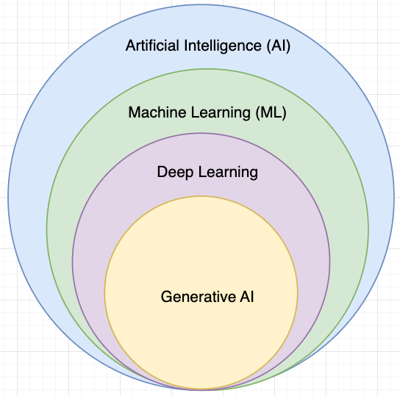

Slide 3
What is Generative AI?
AI that generates text, code, images
Examples: ChatGPT, Claude, Gemini
Based on deep learning models

Slide 4
GEN AI
Generative AI refers to systems that create new content from learned patterns, not just analyze or classify data.
Traditional systems:
Detect fraud
Classify emails (spam / not spam)
Generative AI:
Writes emails
Generates code
Creates images
Produces insights

Slide 5
How it actually works
At its core, Generative AI:
Takes input (prompt)
Converts it into tokens
Uses a trained neural network
Predicts the most probable next token repeatedly
Produces output

Slide 6
Types of Content It Can Generate
Text
Blogs, emails, documentation
SQL queries, explanations
Chat conversations
Code
Python, Java, SQL
Debugging and optimization
API generation

Slide 7
Images
Text-to-image generation
Design mockups
Synthetic data creation
Audio / Video (advanced)
Speech synthesis
Video generation (emerging area)

Slide 8
What powers Generative AI?
Generative AI is built on deep learning models, specifically:
Neural Networks
Inspired by the human brain
Learn patterns from data
Transformers
Backbone of modern LLMs
Handle context better than older models
Training Data
Massive datasets (text, code, images)
Model learns grammar, logic, patterns

Slide 9
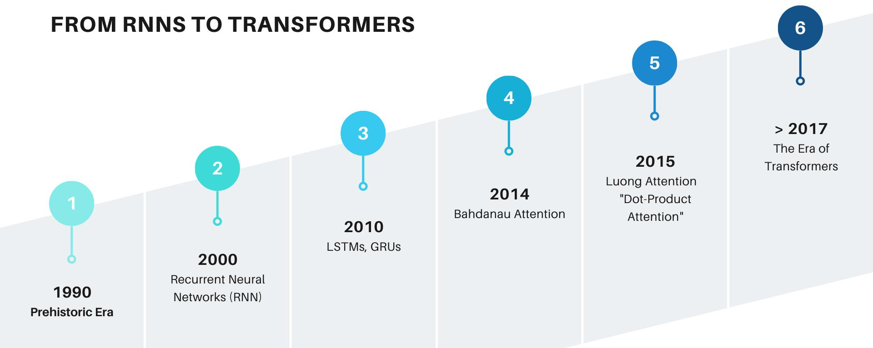
Evolutions

Slide 10
History of GenAI
Pre-2017: RNNs(Recurrent Neural Networks), LSTMs(Long Short-Term Memory)
How they worked
Process data sequentially (one word at a time)
Maintain memory of previous inputs
Limitations
Slow (no parallel processing)
Struggled with long sentences (vanishing gradient problem)
Poor long-range context understanding
2017: Transformers introduced
2022+: Explosion of LLMs
2024-25: Multimodal & agentic AI

Slide 11
LLM Architecture
Transformer architecture:
attention-based architecture for sequence modeling
Self-attention mechanism
each word understands context from all other words
Tokenization process
text → tokens (model input units)
Parallel processing
faster, scalable computation

Slide 12
Attention Mechanism
Captures relationships in data
Attention heads focus on different patterns
Improves contextual understanding

Slide 13
Tokens Explained
Text split into tokens
Model processes tokens, not words
Token limits impact performance

Slide 14
Model Comparison
GPT-4o: strong reasoning
Claude 4: safety + long context
Llama 3: open-source
Gemini: multimodal

Slide 15
Embeddings
Vector representation of text
Used in search, similarity, RAG
Power modern AI systems

Slide 16
Hallucinations
LLMs can generate incorrect info
Mitigation: grounding, RAG, validation

Slide 17
Bias & Responsible AI
Bias from training data
Need fairness, explainability
Use guardrails

Slide 18
GenAI in Data Engineering
Use cases: data quality, pipelines, SQL generation
Automation opportunities

Slide 19
Tools Overview
Claude.ai
ChatGPT
Hugging Face
OpenAI Tokenizer

Slide 20
Model Compare
Feature / Capability | GPT-4o | Claude 4 | Llama 3 | Gemini
Model Type | Closed-source | Closed-source | Open-source | Closed-source
Core Strength | Reasoning + coding | Safety + long context | Customization | Multimodal + ecosystem
Reasoning Ability | Very strong | Strong (sometimes better in logic) | Moderate–High | Strong (especially scientific)
Coding Capability | Excellent | Excellent (often strong in structured logic) | Good | Good
Context Window | Medium–High | Very high (long documents) | Medium | Very high
Multimodal Support | Yes (text, image, audio) | Limited (mostly text-focused) | Limited (depends on setup) | Strong (native multimodal)
Speed / Latency | Fast | Fast | Depends on infra | Moderate
Cost | Medium–High | Medium | Low (self-hosted) | Medium (often cost-efficient)
Customization | Limited | Limited | Very high (fine-tuning possible) | Limited
Deployment | API / Cloud | API / Cloud | Local / Cloud / On-prem | API / Google Cloud
Data Privacy | Vendor-controlled | Vendor-controlled | Full control (self-hosted) | Vendor-controlled
Ecosystem | Strong (OpenAI, Azure, tools) | Growing ecosystem | Open ecosystem (Hugging Face) | Strong (Google ecosystem)
Best for Data Engineering | Code generation, pipelines | Documentation, analysis | Custom pipelines, private AI | Multimodal data workflows
Hallucination Risk | Medium | Lower (more cautious) | Medium–High | Medium
Safety / Alignment | Good | Very strong | Depends on tuning | Good
Enterprise Adoption | Very high | High | Growing | High
Open Source Availability | No | No | Yes | No

Slide 21
Hands-on Lab
Prompt: detect schema drift in DataFrames
Compare outputs across 3 LLMs

Slide 22
Evaluation Criteria
Accuracy
Code quality
Approach
Performance

Slide 23
Deliverable
Create comparison table
Document findings
Insights on best model

