Slide 1
Prompt Engineering for Data Engineers
Practical guide to GenAI for SQL, pipelines, and data quality

Slide 2
Prompt Engineering for Data Engineers
Zero-shot → Few-shot prompting
Reasoning patterns (CoT, ReAct)
NL ↔ SQL transformations
Structured outputs (JSON/YAML)
Context engineering
Prompt templates & libraries

Slide 3
Why It Matters
LLMs help generate SQL, docs, and pipelines but require good prompts
LLMs are probabilistic, not deterministic
Same input → different outputs depending on prompt quality
Prompt = your API contract with AI
For Data Engineers:
Query generation (SQL, PySpark)
Pipeline debugging
Documentation automation
Data validation logic

Slide 4
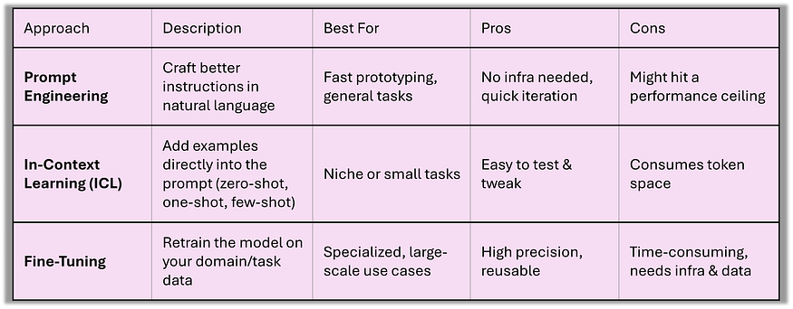
Approaches

Slide 5
Core Concepts
Prompt = Instruction + Context + Constraints
Prompt Design Principles
Be clear and explicit
Provide context
Define output format
Use examples when needed
Constrain the model
Bad Prompt: "Write SQL"
Good Prompt: "Generate Snowflake SQL to join orders and customers using order_id with filters on last 30 days"

Slide 6
Prompting Types
Zero-shot prompting is ideal for quick, low-risk tasks where context is minimal. Think: “Summarize this paragraph.”
Few-shot prompting helps LLMs match tone and structure by showing a few examples commonly used for report generation or templated emails.
Chain of Thought (CoT) prompts guide the model through step-by-step reasoning valuable for analytical breakdowns in audits or financial reconciliation.
Role-based prompting aligns the model’s response tone and depth with a specified persona such as a legal advisor, HR rep, or data analyst.
Instruction-based prompting excels in structured environments like business reporting, where clear formatting and output control are key.
Iterative prompting supports complex tasks that require accuracy and refinement, especially when initial outputs fall short.
Contextual prompting integrates background knowledge or recent updates to improve precision essential in compliance-heavy sectors.
Constraint-based prompting enforces limits like word count, tone, or schema, ensuring outputs meet formatting and policy expectations.

Slide 7
Zero-shot Prompting
No examples, fast but less reliable
Example:
Generate a SQL query to find top 5 customers by revenue.
Use When:
Task is simple
Model already understands pattern
Pros:
Fast
Minimal tokens
Cons:
Less control
Can hallucinate

Slide 8
One-shot Prompting
Single example improves structure
*Provide one example
Example:
Input: Find total sales per region Output: SELECT region, SUM(sales) FROM table GROUP BY region; Now: Input: Find total revenue per product Output:
Use When:
Pattern needs slight guidance

Slide 9
Few-shot Prompting
Multiple examples improve consistency
*Provide multiple examples
Example:
Input: Count users Output: SELECT COUNT(*) FROM users; Input: Average salary Output: SELECT AVG(salary) FROM employees; Input: Max order value Output:
Benefits:
Improves accuracy
Reduces ambiguity
Tradeoff:
Higher token cost

Slide 10
When to Use Which
Type | Use Case
Zero-shot | Simple queries
One-shot | Slight pattern
Few-shot | Complex transformations

Slide 11
Take Away
Zero-shot is fine for easy tasks but unreliable in nuanced scenarios.
One-shot gives structure and helps shape output tone.
Few-shot is ideal for production use where consistency, formatting, and control matter.
Model behavior differs:
- GPT-4o: Balanced and well-structured output with clear formatting. - Claude 3.7 Sonnet: Clean, concise, and schema-consistent responses. - Gemini 2.0 Flash: More conversational; includes helpful explanations alongside the output.

Slide 12
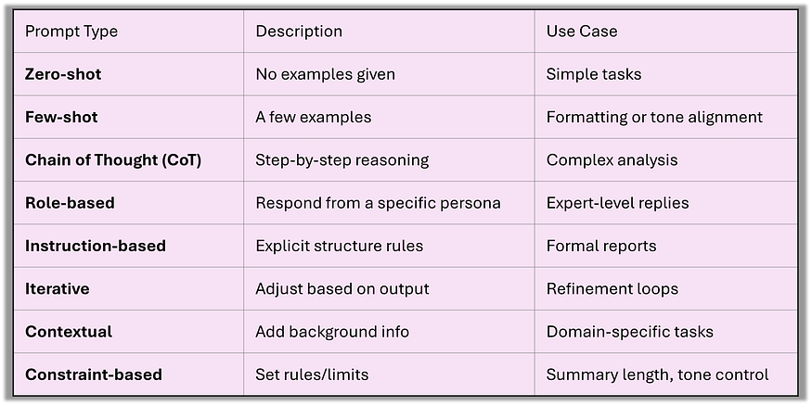
Prompt TYPES VS

Slide 13
Chain-of-Thought
Step-by-step reasoning for complex queries
*Encourage step-by-step reasoning
Example:
Explain step by step how to derive this SQL query.
Output:
Step 1: Identify tables
Step 2: Apply filters
Step 3: Aggregate
Use Cases:
Debugging pipelines
Complex joins
Data transformations

Slide 14
Why CoT Works
Forces model to reason explicitly
Reduces hallucination
Improves correctness
Best for:
Multi-step logic
Business rules

Slide 15
ReAct Prompting
Reason + Act pattern for debugging
Pattern:
Thought → Action → Observation → Final Answer
Example:
Thought: Need schema Action: Fetch schema Observation: columns available Answer: Generate SQL
Use Case:
Agents
Tool-based workflows

Slide 16
Role Prompting
Assign role like 'Senior Data Engineer’
Example:
Act as a senior Data Engineer. Generate optimized PySpark code.
Impact:
Changes tone
Changes depth
Improves domain relevance

Slide 17
Role Prompting Variants
Act as a Data Architect
Act as a Snowflake expert
Act as a Data Quality analyst
Pro Tip: Combine with constraints:
Act as a senior DE. Follow best practices and optimize for performance.

Slide 18
Tree-of-Thought (ToT) Prompting
Simulates multiple reasoning branches before reaching a decision - much like weighing trade-offs or options.
Best for: Strategic analysis, evaluations, planning, or choices involving pros and cons.
Think: “Option A: Pros & Cons. Option B: Pros & Cons. Now compare and decide.”

Slide 19
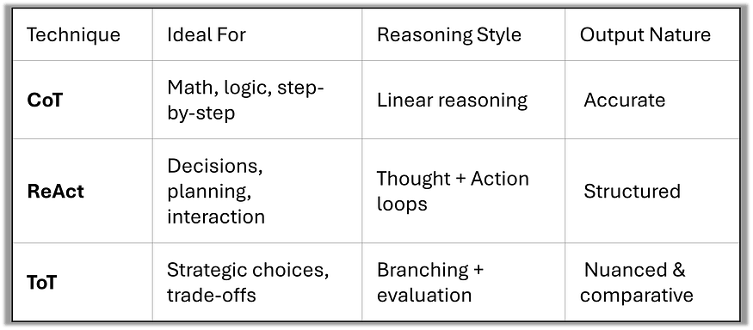
COT vS REACT VS TOT

Slide 20
ConCLUSION
Chain-of-Thought improves clarity in multi-step logic.
ReAct adds tool-like thinking and verification.
Tree-of-Thought helps in structured decision-making with pros/cons exploration.
Each is not just a prompting style — it’s a thinking framework for LLMs.

Slide 21
NL to SQL
Convert business questions into SQL queries
*Convert natural language into SQL
Example:
Find top 10 products by sales in last 7 days
Output:
SELECT product, SUM(sales) FROM orders WHERE date >= CURRENT_DATE - 7 GROUP BY product ORDER BY SUM(sales) DESC LIMIT 10;

Slide 22
Improving NL → SQL Accuracy
Include:
Schema
Table relationships
Constraints
Better Prompt:
Schema: orders(order_id, product_id, sales, date) Generate SQL for: Top 10 products by sales

Slide 23
SQL to NL
Explain SQL queries in simple language
*Explain SQL in plain English
Example:
SELECT region, SUM(sales) FROM orders GROUP BY region;
Output: "Total sales grouped by region"
Use Cases:
Documentation
Data governance
Training

Slide 24
Structured Output
Use JSON/YAML for machine-readable outputs
Force output format
Example:
Return output in JSON: { "query": "", "explanation": "" }

Slide 25
JSON Output Example
{ "query": "SELECT * FROM orders", "explanation": "Fetches all records" }
Benefits:
API integration
Automation
Consistency

Slide 26
YAML Output Example
query: SELECT * FROM orders explanation: Fetch all records
Use When:
Config-driven systems
Pipelines

Slide 27
Context Engineering
Manage tokens and relevant schema
Managing what the model sees
Includes:
System prompt
User prompt
Conversation history

Slide 28
Token Management
LLM has context window limit
Tokens = words + subwords
Strategies:
Trim history
Summarize context
Use embeddings (RAG)

Slide 29
Context vs Noise
Context = Useful Information
Schema
Business rules
Constraints
Noise = Irrelevant Information
Extra text
Unused columns
Long descriptions

Slide 30
Example(Bad Prompt - Noise)
Generate SQL. Here is company history... We started in 1990... We have many products... orders table exists... Also marketing data...
Problem:
Too much noise
Model confused

Slide 31
Example (Good Prompt -Clean Context)
Act as a Data Engineer. Schema: orders(order_id, customer_id, amount) Task: Find total revenue
Result:
Clear
Focused
Accurate

Slide 32
Context Engineering Principle
“More data ≠ better results Right data = better results”

Slide 33
Conversation State
Problem:
Model forgets earlier context
Solution:
Pass history explicitly
Maintain state externally

Slide 34
Problem with Conversation State
Context can get:
Too long
Irrelevant
Confusing
Issues:
Wrong answers
Lost instructions
Token overflow

Slide 35
Managing Conversation State
Best Practices:
Reset when needed
Pass only relevant history
Summarize previous steps
Avoid unnecessary back-and-forth

Slide 36
Context Engineering Example
Bad:
Generate SQL
Good:
Schema: orders(order_id, customer_id, amount) Task: Find top customers

Slide 37
Prompt Templates
Reusable templates using frameworks
Reusable prompt structure
Example Template:
Act as a Data Engineer. Schema: {schema} Task: {task} Output format: JSON

Slide 38
Benefits of Templates
Standardization
Reusability
Scalability
Reduced errors

Slide 39
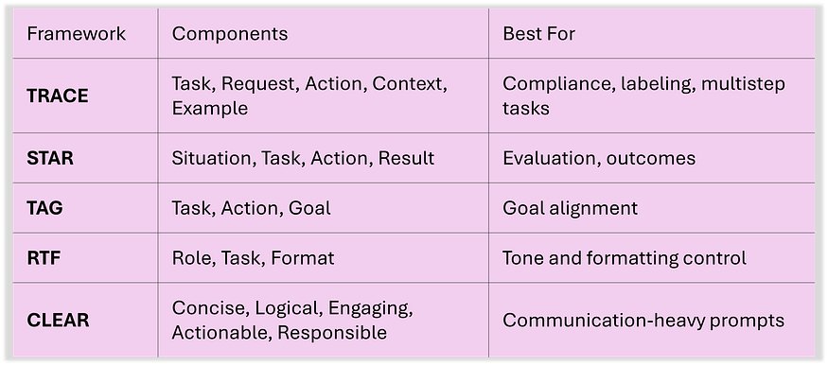
Framework's

Slide 40
Prompt Library
Centralized reusable prompts
Store prompts for:
SQL generation
Data validation
Schema explanation
Pipeline debugging

Slide 41
Example Prompt Library Entry
Name: SQL Generator Input: Natural language Output: SQL + explanation Constraints: Use Snowflake syntax

Slide 42
Best Practices
Always define output format
Provide schema for SQL tasks
Use few-shot for complex logic
Combine role + constraints
Test prompts iteratively

Slide 43
Common Mistakes
Vague prompts
No output structure
Ignoring schema
Overloading context
Not validating output

Slide 44
End-to-End Example
Act as a senior Data Engineer.
Schema:
orders(order_id, amount, date)
Task:
Top 5 days by revenue
Output JSON:
{
"query": "",
"explanation": ""
}

Slide 45
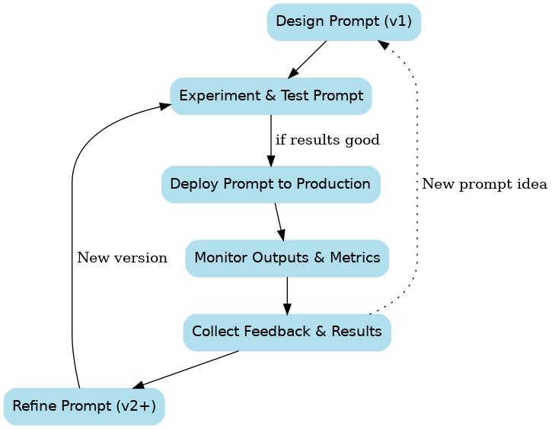
FLOW

Slide 46
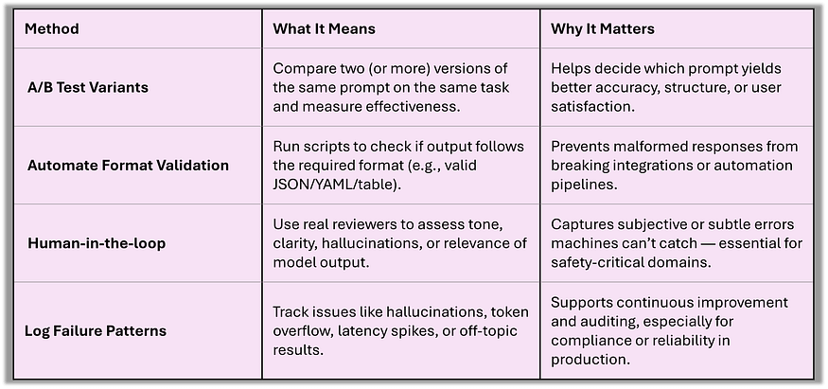
Testing Methods

Slide 47
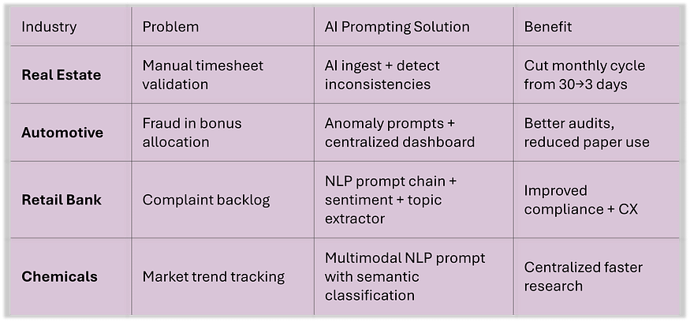
Use Cases

Slide 48
Summary
Prompt = control mechanism
Use:
Zero/One/Few-shot
CoT & ReAct
Role prompting
Structured output
Context engineering
Build reusable prompt libraries

