Slide 1
Complete Modern C++
C++98/11/14/17

Slide 2
Instructor
C++, STL, Java, C#, Android, Unity, Design Patterns, Win32 API, MFC, COM, ATL, Boost, Linux…
B.E. Civil
Poash Technologies

Slide 3
Who is this course for
College grads or software developers
Software developers working in Java, C# or other language
Software developers working in C++
refresh concepts
migrate to modern C++

Slide 4
Prerequisites
Basic programming knowledge
C, Java, C#, Python or any other language
Visual Studio 2015/2017 Community Edition

Slide 5
Course Objectives
Object Oriented Programming in C++
Reference, qualifiers, pointers, memory management
Classes, operator overloading, exception handling
Inheritance, composition & polymorphism
Generic programming through templates
Overview of the standard template library (new containers, chrono, threads, filesystem)

Slide 6
Salient Features
Tons of examples
Source code
Short video length
Exercises & quizzes
Understand C++ as an object oriented language
Learn modern C++ (key C++11 features)
Develop applications in modern C++

Slide 7
What is C++
General purpose programming language
Object-oriented, imperative, generic
Created by Bjarne Stroustrup
Emphasis on system programming
Low-level like C, but feature-rich

Slide 8
New Features
Rvalue References
Move Semantics
Non-static data member initializers
Initializer lists
Delegating constructors
Automatic type inference
Null pointer constant
Range-base for
Raw string literals
nullptr
Lambda expressions
Concurrency
Variadic templates
Type aliases
Strongly-typed enums
Deleted functions
Explicit virtual overrides
8

Slide 9
What is Modern C++
Encompasses features of C++11
Move semantics
Smart pointers
Automatic type inference
Threading
Lambda functions

Slide 10
ISO Standard Committee
Responsible for adding new features to C++
Has members from all over the world
Some are representatives of their companies (Microsoft, Google, IBM, etc)
Published first standard in 1998, followed by a minor revision in 2003
Major change in 2011, with lots of new features
2014 added a minor change, mostly enhancements

Slide 11
Where is C++ used
All major software companies, in different domains
Majorly chosen for creating high performance software(Facebook, Google, Microsoft, CERN, etc.)
All operating systems, popular software, games

Slide 12
Why is C++ used
Used for performance, stability & portability
Available on almost all operating systems
No dependency on separate runtime
Smaller memory footprint
Can run in constrained environment (e.g. limited memory, slow CPU)
Standard C++ code can be easily ported to multiple platforms

Slide 13
First C++ Program

Slide 14
Visual Studio Project Structure
Project
Project
Project
Project
Solution
C++ Source Files
Visual Studio C++ Project
Contains one or multiple projects

Slide 15
C++ Build Steps
Preprocessing
statements beginning with # are expanded or replaced
macros are expanded
Compilation
code is checked for correct syntax
converted into object code
Linking
the object code is linked with the standard libraries
The output of linking is the executable file

Slide 16
Primitive Types
Arithmetic & void
Arithmetic -> Integral & floating point
Integral types -> bool, char, wchar_t, char16_t, char32_t, short, int, long
Floating point -> float & double
void is a special type used with pointers & functions

Slide 17
Modifiers
Some of these can be modified using modifiers – signed, unsigned, short, long
All types can be qualified with qualifiers – const, volatile, static
All types occupy memory and can hold a range of values
memory requirements may change with platform
Prepared by

Slide 18
Datatype Size
Size in bytes
0
1
2
4
8
bool
char
wchar_t
short
int
long
float
long long
double
long double
- Floating Point Types

Slide 19
Range Of Fundamental Types
Type | Typical Byte Width | Typical Range
char | 1 byte | -127 to 127
unsigned char | 1 byte | 0 to 255
int | 4 bytes | -2147483648 to 2147483647
unsigned int | 4 bytes | 0 to 4294967295
signed int | 4 bytes | -2147483648 to 2147483647
short int | 2 bytes | -32768 to 32767
unsigned short int | 2 bytes | 0 to 65,535
signed short int | 2 bytes | -32768 to 32767
long int | 4 bytes | -2,147,483,648 to 2,147,483,647
unsigned long int | 4 bytes | 0 to 4,294,967,295
float | 4 bytes | +/- 3.4e +/- 38 (~7 digits)
double | 8 bytes | +/- 1.7e +/- 308 (~15 digits)
long double | 8 bytes | +/- 1.7e +/- 308 (~15 digits)
wchar_t | 2 or 4 bytes | 1 wide character
Prepared by

Slide 20
<climits> (or <limits.h>
#define | CHAR_BIT | 8 | // | number of bits in a char
#define | SCHAR_MIN | (-128) | // | minimum signed char value
#define | SCHAR_MAX | 127 | // | maximum signed char value
#define | UCHAR_MAX | 0xff | // | maximum unsigned char value
#ifndef _CHAR_UNSIGNED #define CHAR_MIN #define CHAR_MAX
#else
#define CHAR_MIN #define CHAR_MAX
#endif
SCHAR_MIN SCHAR_MAX
// mimimum char value
// maximum char value
0
UCHAR_MAX
#define MB_LEN_MAX #define SHRT_MIN #define SHRT_MAX #define USHRT_MAX #define INT_MIN #define INT_MAX #define UINT_MAX #define LONG_MIN #define LONG_MAX #define ULONG_MAX #define LLONG_MAX #define LLONG_MIN #define ULLONG_MAX
5
(-32768)
32767
0xffff
// max. # bytes in multibyte char
// minimum (signed) short value
// maximum (signed) short value
// maximum unsigned short value
(-2147483647 - 1) // minimum (signed) int value
2147483647
0xffffffff
// maximum (signed) int value
// maximum unsigned int value
(-2147483647L - 1) // minimum (signed) long value 2147483647L // maximum (signed) long value 0xffffffffUL // maximum unsigned long value
9223372036854775807i64
(-9223372036854775807i64 - 1)
0xffffffffffffffffui64
// maximum signed long long int value
// minimum signed long long int value
// maximum unsigned long long int value

Slide 21
<cfloat> (or float.h)
#define DBL_DECIMAL_DIG 17
#define DBL_DIG 15 #define DBL_EPSILON #define DBL_HAS_SUBNORM 1
#define DBL_MANT_DIG 53 #define DBL_MAX
#define DBL_MAX_10_EXP 308
#define DBL_MAX_EXP 1024 #define DBL_MIN
#define DBL_MIN_10_EXP #define DBL_MIN_EXP #define _DBL_RADIX #define DBL_TRUE_MIN
// # of decimal digits of rounding precision
// # of decimal digits of precision
2.2204460492503131e-016 // smallest such that 1.0+DBL_EPSILON != 1.0
// type does support subnormal numbers
// # of bits in mantissa
1.7976931348623158e+308 // max value
// max decimal exponent
// max binary exponent
2.2250738585072014e-308 // min positive value
(-307)
(-1021)
2
// min decimal exponent
// min binary exponent
// exponent radix
4.9406564584124654e-324 // min positive value
#define FLT_DECIMAL_DIG | 9 | // # of decimal digits of rounding precision
#define FLT_DIG | 6 | // # of decimal digits of precision
#define FLT_EPSILON | 1.192092896e-07F | // smallest such that 1.0+FLT_EPSILON != 1.0
#define FLT_HAS_SUBNORM | 1 | // type does support subnormal numbers
#define FLT_GUARD | 0
#define FLT_MANT_DIG | 24 | // # of bits in mantissa
#define FLT_MAX | 3.402823466e+38F | // max value
#define FLT_MAX_10_EXP | 38 | // max decimal exponent
#define FLT_MAX_EXP | 128 | // max binary exponent
#define FLT_MIN | 1.175494351e-38F | // min normalized positive value
#define FLT_MIN_10_EXP | (-37) | // min decimal exponent
#define FLT_MIN_EXP | (-125) | // min binary exponent
#define FLT_NORMALIZE | 0
#define FLT_RADIX | 2 | // exponent radix
#define FLT_TRUE_MIN | 1.401298464e-45F | // min positive value

Slide 22
Variable Declaration
A variable is declared by specifying a type followed by a variable name e.g. int i or float x
The variable is also called identifier
Multiple variables can be declared with the same type e.g. int a, b, c
May or may not be initialized with an initializer
Better to initialize variables during declaration to avoid bugs
Some compilers don’t allow read operation from an uninitialized variable

Slide 23
Functions
A function is a set of statements enclosed within a pair of { }
Called as body of the function
These statements define what the function does
Every function has a unique name
This name is used to invoke or call the function
Functions are basic building blocks of C/C++ programs

Slide 24
Why Functions
Help avoid writing repetitive logic/code in a program
Same code can be reused in different parts of the program through a function
There’s no limit to the number of times a function can be called
Makes the code modular as the program is divided can be divided into cohesive modules
Reduces complexity of the code

Slide 25
Structure
A function can accept values through parameters
These can be used as input for some processing inside the function
Afterwards, a function can return the result of processing as the return value
Only one value can be returned
Parameters and return value are optional
<return type> <name> (<parameters>){<body>}
int Add(int,int){} void Print(char ch){} void Clear(){}

Slide 26
Structure
To use a function, you’ve to call or invoke it
If a function has parameters, you’ve to supply the corresponding
arguments
Function Definition
Function Call
int Add(int x, int y){ return x + y ;
}
Add(3,5) ;

Slide 27
Console I/O
std::basic_ostream & std::basic_istream
std::ostream & std::istream
std::cout & std::cin
std::cout for console output through operator <<
std::cin for keyboard input through operator >>
<iostream> header

Slide 28
Uniform Initialization
C++98 provided different ways to initialize types
Scalar types can be initialized with = or ()
Array types have to be initialized with {}
C++11 introduced uniform initialization
Use {} to initialize all types

Slide 29
Advantages
Uniform syntax to initialize all types
Forces initialization of both scalar and array types
Prevents bugs when initializing incompatible types through compiler warnings/errors

Slide 30
auto Keyword
Indicates storage class of a variable in C & pre-C++11
Remnant of B language (which largely influenced C)
Meaning has been changed in C++11
Allows the compiler to automatically infer the type from the initializer
The initializer is important
auto <identifier> = <initializer>
<initializer> could be an expression that returns some value e.g. a literal, mathematical expression or a function call that returns a value

Slide 31
Pointer Type

Slide 32
Pointer
Points to another type
Holds the memory address of another variable
Used for indirect access to other variables
Need not be initialized during declaration
Declared with * operator
int * ptr ;
int *p1, *p2, *p3 , p4 ;

Slide 33
Address Of Operator
& is the address of operator
When applied to any variable, we get the address of that variable (the location where it is stored in the memory)
int x = 10 ;
cout << &x ; //prints the address of x

Slide 34
Pointer Type
0x100
0x200
int x = 10 ;
int *ptr = &x ;
10
Memory address of x
The pointer p type should be exactly same as the source, except when creating a void pointer
Memory address of ptr
0x100
void *ptr = &var ;
RAM

Slide 35
Dereference Operator
To access the value at the address in the pointer, use the * operator
Also called dereference operator
Allows indirect read or write operation on the variable through the pointer
int x = 10 ;
int *ptr = &x ;
*ptr = 5 ; //Assign 5 to address of x
int y = *ptr ; //Read a value from address of x

Slide 36
Null Pointer
NULL is a macro in C & pre-C++11
It is defined as 0 in most compilers
Used to initialize pointer types
C++11 introduced a new type of null called nullptr
This is type safe and better than NULL macro
Always use nullptr to initialize a pointer, instead of NULL macro

Slide 37
Reference Type
Defines an alternative name for a variable (an alias)
It is created with the & operator during declaration
Always needs an initializer (called referent)
The referent should be a variable
It is bound to its referent
It can be used to modify a variable indirectly (like a pointer)
A reference is NOT a new variable; it is just another name

Slide 38
Reference Type
int x = 10 ;
int &ref = x ; //x is the referent
0x100
x
ref
10
Memory address of x
RAM

Slide 39
Reference Vs Pointer
Reference
Always needs an initializer
Initializer should be l-value
Cannot be nullptr
Bound to its referent
No storage required, so has same address as that of referent
Dereference not required
Pointer
Initializer is optional
Initializer need not be lvalue
Can be nullptr
Can point to other variables
Has its own storage, so will have a different address
Requires dereference operator to access the value

Slide 40
const Qualifier
Creates a variable that is constant
Value cannot be modified
Attempt to modify will cause compilation error
Qualified to a declaration, but always needs an initializer
Replaces C macros
Commonly used with references
const <type> <variable> { initializer } const float PI { 3.141f };

Slide 41
Range-based for loop
Allows iteration over arrays and containers
Doesn’t need index variable
Each iteration returns an element
Can be used with any object that behaves like a range
for(variable declaration : range){ statement ;
}
int arr[] = {1,2,3} ; for(int x : arr){

Slide 42
For vs Range-Based For
For
Index based iteration
Requires end condition
Index variable needs to be incremented or decremented
Error-prone e.g. wrong end condition, overflow, underflow, incorrect iteration expression
More control over iteration
Use for finer control
Range-Based For
Does not use index to iterate
End condition is provided by the range
No need to increment or decrement
Lesser chances of errors
No control over iteration
Use with ranges

Slide 43
Function Overloading
Two or more functions declared with the same name
Arguments should differ in type and/or number
For pointers & reference arguments, qualifiers participate in overload
Return type is ignored
For member functions, qualifiers participate in overload
Different implementations of the same behaviour
The correct implementation is chosen based on the arguments
This is resolved at compile-time
static polymorphism
Convenience for the caller

Slide 44
Name Mangling
Unique names generated by the compiler for functions
Allows linker to link the call with the correct overloaded function
Name mangling algorithm varies from compiler to compiler
Depends on the type & number of function arguments
Consequently, C++ functions are not callable from C code

Slide 45
extern “C”
Compiler directive applied on global functions and variables
Suppresses name mangling of the type on which it is applied
Can be applied only to one function in a set of overloaded functions
Allows C++ functions to be called from C or other languages
//Apply to both declaration & definition extern “C” void Print(const char *message) ;

Slide 46
Default Function Arguments
Allows some or all function arguments to have a default value
It becomes optional to pass values to those arguments
Compiler automatically assigns default value if no explicit value is provided
Explicit value is preferred over default value
Default arguments should begin from the right side in the list of function arguments
Simplifies the invocation for the caller

Slide 47
Inline Function
A function that is marked with inline keyword
Such functions are defined in a header file
Requests the compiler to replace the call with the function body
The overhead of the function call is avoided
Stack memory for arguments not required
No need to save the return address
May improve the performance of the code
inline void Function(arguments){
//Implementation
}

Slide 48
Points
Only a request to the compiler
Certain functions may not be inlined
large functions
functions having too many conditional statements
recursive functions
functions invoked through pointers
etc
Different compilers have different rules
Modern compilers may automatically inline even non-inline functions
Excessive inlining may increase binary size

Slide 49
Macros Vs Inline Functions
Macro
Works through text substitution
Error prone dues to substitution nature
Does not have an address
Difficult to use with multiple lines of code
Cannot be used for member functions of a class
Inline function
The call is replaced with body
Safe to use as it has function semantics
Has an address
Can have multiple lines of code
Class member functions can be inline

Slide 50
Function Pointer
Pointer that holds the address of the function
The type is same as the signature of the function (return type & arguments)
Can be used to indirectly invoke the function even if the function name is not known
Used by algorithms and classes for customization
<ret> (*fnptr)(args) = &Function
int (*PtrAdd)(int,int) = &Add //int Add(int,int)

Slide 51
Namespace
Named declarative region used for declaring types
The types are not visible outside the namespace
Standard library is in std namespace
Prevents name clashes
Helps modularize code
namespace <name> {
(namespace, class, structure, function, variable, etc)
}

Slide 52
Namespace Access
Types inside a namespace have a scope
Cannot be accessed outside the namespace
Either open the namespace or the type
use the global using declarative and open the entire namespace
using namespace std ;
use the using declarative and open a specific type
using std::cout ;
using the full qualified name
std::cout << “C++” << std::endl;

Slide 53
Memory Management
C/C++ programs are provided with different types of memory areas
stack – allocated automatically for local variables
data section – allocated for global and static data
heap – allocated at runtime
All the memory is taken from the process address space
C/C++ programs provide support for memory allocation at runtime (also called dynamic memory)
Allocations on the heap have to be managed by the programmer
Stack and data section allocations are managed by the runtime

Slide 54
Dynamic Memory Allocation in C
C provides various functions for allocating memory from the heap
malloc : allocate raw memory on the heap
calloc : allocates memory on the heap and initializes it to zero
realloc : allocates larger chunk of memory for an existing allocation
free : deallocates/releases the memory allocated through the above functions

Slide 55
Dynamic Memory Allocation in C++
C++ provides two operators for dynamic memory allocation
new : allocates memory on the heap
delete : deallocates memory
Memory that is allocated through new has to be released with delete
<type> *<variable> = new <type> (optional args) ; delete <variable> ;
int *p = new int(value); delete p ;

Slide 56
malloc vs new
malloc
Function
Requires size during allocation
Cannot initialize memory
Cannot call constructors
Returns void pointer that needs to be type casted
Cannot be customized
malloc, calloc & realloc
Return NULL on failure
new
Operator
Size is ascertained from the type
Can initialize memory
Can call constructors
Returns correct type of pointer
Can be customized through overloading
Has different forms
Throws exception on failure

Slide 57
new For Arrays
Another form of new
Used for allocating dynamic arrays
Written as new[]
Subsequently, use delete [] for releasing the memory
<type> *<variable> = new <type>[size] ;
delete [] <variable> ;
int *p = new int[5] ;//Allocate memory for 5 integers
delete []p ; //Note the usage of [] with delete

Slide 58
Important Points
Always use as a pair
Not calling delete causes a memory leak
Responsibility of the programmer to release the memory
Do not mix malloc and new in same code

Slide 59
Object Oriented Programming
Uses objects as fundamental building blocks, rather algorithms
Program is created as a collection of objects
Every object is an instance of some class
Classes are united via inheritance relationship
59

Slide 60
Object Oriented Programming
Simulate interactions of objects in real-world systems
Allows representation of objects in problem domain as software objects
Decreases complexity of software systems
Make code reusable, extensible and maintainable
60

Slide 61
Object Model
Basic principles that help us write OO programs
Abstraction
Encapsulation
Inheritance
Polymorphism

Slide 62
Abstraction
Abstraction focuses on important & necessary details
Unwanted features are left out
e.g. name of a person without other details (age, weight, etc)
Helps focus on important characteristics
Used to represent real-life objects in software, but without the associated complexity
Represented through a class, struct, interface, union or enum

Slide 63
Encapsulation
Next step after abstraction
Hides the implementation details of a class
The class provides behaviour without revealing the implementation
Objects of such classes are easy to use
The internal implementation can be changed without the users’ knowledge
Implemented through access modifiers in OO languages

Slide 64
Inheritance
Represents a hierarchy of classes
The classes are related through “is-a” relationship
The relation is due to same behaviour of classes
e.g. a dog is an animal
The behaviour & its implementation is inherited by the children from the parent
The child classes may then reuse the behaviour with the same implementation or provide a different implementation
Promotes reuse & extensibility

Slide 65
Composition
Signifies relationship between objects
Represented as “has-a” or “part-of” relationship
Promotes reuse of objects
e.g. car has an engine

Slide 66
Polymorphism
Means different forms
Represents common behaviour with different implementations
Response will be different for each object, either based on its class or the arguments
e.g. car, cycle, person, etc. can move differently
Implemented through function overloading, templates & virtual functions
Used in conjunction with inheritance & composition
Promotes reuse, scalability & extensibility

Slide 67
class
Blueprint/template/recipe
Represents an abstraction
Every object is instantiated
Instance of a class
Can have multiple instances
Objects are independent

Slide 68
Syntax
class <name> {
//Members are private by default
<modifiers>:
<member variables>
<member functions>
} ;

Slide 69
Example
class Car { private:
float fuel ; float speed ;
int passengers ; public:
void FillFuel(float amount) ; void Accelerate() ;

Slide 70
Structure
Creates a user-defined type through keyword struct
Similar to a class
Default access is public
Frequently used
to represent simple abstract types such as point, vector3D, etc.
for implementing function objects
70

Slide 71
Non-Static Data Member Initializers
Convenient way of initializing class members with values during declaration
class Class{
<type1> <var1> {<initializer> };
<type2> <var2> = <initializer> ;
Ensures the members are initialized with valid values
Can be used to initialize any type
Compiler automatically generates initialization code
Initialization in a user-defined constructor takes precedence

Slide 72
Constructor
Invoked automatically during instantiation
Used for initialization
Doesn’t have any return type
Can be overloaded
Default
Parameterized
Copy
Delegating
Inheriting

Slide 73
Default Constructor
Constructor with no arguments
Car c ;//Invokes default constructor
Automatically synthesized by the compiler
if no other user-defined constructor exist

Slide 74
Parameterized Constructor
Constructor that accepts one or more arguments
Used to initialize the object with user-defined values
Never synthesized by the compiler
Blocks auto generation of default constructor

Slide 75
Destructor
Function that is invoked automatically when an object is destroyed
Used for releasing resources that may have been allocated in the constructor
Cannot be overloaded
No arguments
Compiler synthesizes one if required

Slide 76
this Pointer
A hidden pointer passed to member function
Points to the object that invoked the member function
Provided as a keyword that is meaningful only in member functions
Can be used to access members inside the member functions

Slide 77
Static Member Variables
Member variables qualified with static keyword
Not part of the object
Belong to the class
Only one copy exists
Shared between objects

Slide 78
Static Member Variables
Cannot be initialized inside the class
Have to be defined outside the class for initialization
Default initialization assigns default value of the type
//Car.h class Car{
static int totalCars ;
//Car.cpp
int Car::totalCars ; //Default init to 0

Slide 79
Static Member Functions
Functions qualified with static keyword
Required only in declaration
Belong to class and not objects
Do not receive this pointer
Cannot access non-static members of the class
Can be invoked directly through the class name

Slide 80
Constant Member Functions
Member functions qualified with const keyword
Both declaration and definition is qualified
Such functions cannot change value of any member variables
Useful for creating read-only functions
Constant objects can invoke only constant member functions
80

Slide 81
struct
Similar to a class
Supports everything that a class does
Members are public by default
Used for creating abstract data types & function objects

Slide 82
Delegating Constructor
Allows a constructor to invoke another constructor
Replacement for common initialization
Reduces duplicate initialization code in multiple constructors
class Class{
Class():Class(val1, val2){ Class(arg1, arg2){
//Initialization code

Slide 83
Copy Constructor
Creates copy of the object’s state in another object
Synthesized automatically
Default implementation copies values
User-defined implementation required for pointer members

Slide 84
Rule Of 3
All should be defined if a user implements any of them
Destructor
Copy constructor
Copy assignment operator
This will be due to allocation of some resource in a constructor
Destructor will free the resource
Copy constructor will perform a deep copy
Copy assignment operation will also perform a deep copy
Not implementing user defined operations can lead to memory leak or shallow copy

Slide 85
L-value & R-value
L-value
Has a name
All variables are l-values
Can be assigned values
Some expressions return l-value
L-value persists beyond the expression
Functions that return by reference return l-value
Reference to l-value (called l-value reference)
R-value
Does not have a name
R-value is a temporary value
Cannot be assigned values
Some expressions return r-value
Does not persist beyond the expression
Functions that return by value return r-value
R-value reference to r-value (called r-value reference)

Slide 86
R-Value References
A reference created to a temporary
Represents a temporary
Created with && operator
Cannot point to l-values
R-value references always bind to temporaries
L-value references always bind to l-values
int &&r1 = 10 ;
int &&r2 = Add(5,8); int &&r3 = 7+2 ;
//R-value reference
//Add returns by value (temporary)
//Expression return a temporary

Slide 87
Copy & Move Semantics
Copy is implemented through copy constructor
Copy of the object state is created
Wasteful in case copy is created from a temporary
Instead, the state can be moved from the source object
Implemented through move semantics

Slide 88
Copy Semantics
obj1
v
ptr
0x100 | …
0x104 | 5
obj2
v
ptr
0x200 | …
0x204 | 5

Slide 89
Move Semantics
0x0
…
. . . .
obj1
v
ptr
0x100 | …
0x104 | 5
obj2
v
ptr

Slide 90
Rule Of 5
All should be defined if a user implements any of the following
Destructor
Copy constructor
Copy assignment operator
Move constructor
Move assignment operator
90

Slide 91
Rule of 0
If a class does not have ownership semantics, then do not provide any user defined function from the rule of 5
This is called the “rule of 0”
This way the compiler will automatically synthesize the necessary functions
Providing user-defined implementation of some functions will prevent the compiler from synthesizing others

Slide 92
Automatic Synthesis of Functions
Compiler will synthesize the five functions only if no other user-defined implementation exists
If any of the five functions is implemented by the user, then the move operations will become deleted
If any of the move operations are implemented by the user, then the copy operations & other move operation will be deleted

Slide 93

Custom | Copy Constructor | Copy Assignment | Move Constructor | Move Assignment | Destructor
Copy constructor | Custom | =default | =delete | =delete | =default
Copy assignment | =default | Custom | =delete | =delete | =default
Move constructor | =delete | =delete | Custom | =delete | =default
Move assignment | =delete | =delete | =delete | Custom | =default
Destructor | =default | =default | =delete | =delete | Custom
None | =default | =default | =default | =default | =default

Slide 94
Operator Overloading
Custom implementation for primitive operators
Allows usage of user-defined objects in mathematical expressions
Overloaded as functions but provide a convenient notation
Implemented as member or global functions
Require usage of the operator keyword
<ret> operator <#> (<arguments>)

Slide 95
Operator Overloading
As global functions, require same no. of arguments as the operands
As member functions, one operand is passed as argument through this pointer
binary operator will require only one explicit argument
unary operator will not require any explicit argument
Integer operator +(const Integer &, const Integer &) Integer Integer::operator +(const Integer &)

Slide 96
Rules
Associativity, precedence & arity (operand count) does not change
Operator functions should be non-static
except for new & delete
One argument should be user defined type
Global overload if first operand is primitive type
Not all operators can be overloaded
. ?: .* sizeof
Cannot define new operators
Overloaded for conventional behaviour only

Slide 97
Type Conversions
Conversion between types
Performed through casts
Ordered by compiler (implicit) or user(explicit)
Explicit conversion uses casting operators
Conversion between
basic & basic
basic & user-defined
user-defined & basic
user-defined & user-defined

Slide 98
Type Conversion Operator
operator <type>()
No arguments No return type
operator int()

Slide 99
Enumerated Type
Type created through enum keyword
Created with restricted range of values, called symbolic constants or enumerators
Enumerators are internally represented as undefined integral types
Can implicitly convert to an integer, but not the other way round
Default value starts from 0, but users can assign any value
Enumerators are visible in the scope in which they’re defined
enum Color(Red, Green, Blue) ; Color c = Red ;
c = 1 ; //Compiler error, use static_cast to convert int x = Green ;//x will contain 1

Slide 100
constexpr
Represents an expression that is constant
Such expressions are possibly evaluated at compile time
Can be applied to variable declarations or functions
May increase the performance of the code as computation is done at compile time
100

Slide 101
const vs constexpr
Initialization of a const variable can be deferred until runtime
However, a constexpr variable must be initialized at compile time
All constexpr variables are const, but not the other way round
Use const keyword to indicate the value cannot be modified
Use constexpr to create expressions that can be evaluated at compile time

Slide 102
std::initializer_list
Lightweight proxy object that represents an array of objects
Constructed automatically from a braced list of elements
auto
ranged for loop
constructor
function
Not a true container, but has similar behaviour
Provides access to its elements through iterators
Defined in <initializer_list> header

Slide 103
std::weak_ptr
Memory Address
shared_ptr
5
std::shared_ptr<int> p{new int{5}} ; std::weak_ptr<int> wk = p ; p.reset() ;
10
Control block
weak_ptr

Slide 104


Circular Reference
emp
prj
12
21
Employee*
m_prj
m_emp
Project*

Slide 105

Circular Reference
emp
prj
201
10
Employee*
m_prj
m_emp
Project*

Slide 106
Object Oriented Programming
System is made up of objects
Object is instance of a class
Classes & objects are related
Collaboration between objects
Define the behaviour of the system

Slide 107


Composition
Object composed in another object
Represents “has-a” relation
Reuse behavior
Car has an engine and uses its implementation to move
class Car{
Engine m_Engine ; public:
void Accelerate(){ m_Engine.Intake() ;
//etc

Slide 108



Inheritance
Class inherits the features of another class
Reuse & inherit behaviour
Represents “is-a” relationship
Animal
Eat Speak Run

Slide 109
Syntax
class <child class> : <access modifier> <base class>
class Dog : public Animal

Slide 110
Access Modifiers
class Base{ private:
MemberA public :
MemberB protected:
MemberC
} ;
Inaccessible
Accessible
Accessible only to child classes
110

Slide 111
Access Modifiers
class Base{ private:
MemberA public :
MemberB protected:
MemberC
class Child : pruiobvtaleictcetBeBadasesBe{a{se{ private:
MemberA pruiobvtaleictcet::ed:
MemberB priovtaetcet:ed:
MemberC

Slide 112
Object Construction
Constructors execute from base to child
Destructors execute from child to base
Base data members will be part of child object
class A{ private:
int x ; float y ;
//Member functions
class B : public A{ private:
double d ;
//Member functions
x
y
d
A
B

Slide 113
Banking Application
Manage accounts
Customers can perform common operations
Bank can perform administrative tasks
Represent account through Account class
Common implementation for all account types

Slide 114
Banking Application
Account
name accno balance
...
Withdraw Deposit GetBalance
AccumulateInterest GetInterestRate
...
Savings
Checking

Slide 115
Polymorphism
Different forms of the function are provided
The call is resolved at compile time or runtime
Runtime polymorphism or dynamic binding
Implemented through virtual mechanism
Compiler inserts code to invoke the correct function at runtime
Automatically generated through the virtual keyword
Such functions are called polymorphic functions
Should be invoked only through a pointer or reference

Slide 116
Vtable & Vptr
Account Virtual Table
Account
&Account::AccumulateInterest
&Account::Withdraw
&Account::GetInterestRate
virtual pointer
GetBalance AccumulateInterest Withdraw
Deposit GetInterestRate
Savings Virtual Table
Savings
&Savings::AccumulateInterest
&Account::Withdraw
&Savings::GetInterestRate
AccumulateInterest GetInterestRate

Slide 117

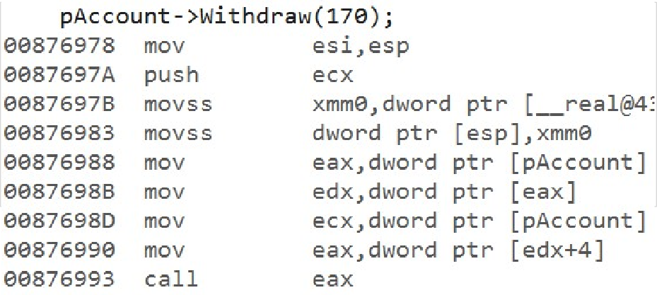
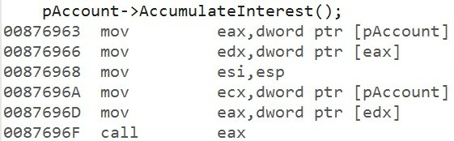
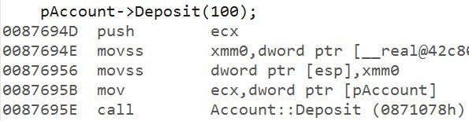
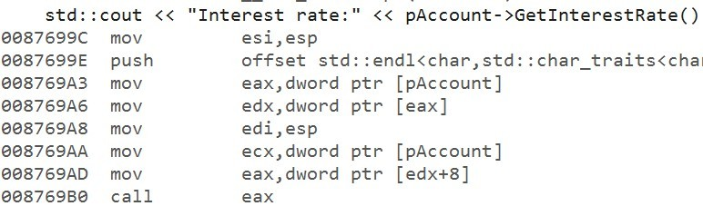
Virtual Mechanism
Get the object address
Get the virtual pointer
Find the position of the function in vtable
Get the address of the function
Invoke the function

Slide 118
Abstract Class
At least one pure virtual function
Can contain other members (data, non-virtual functions, etc.)
Cannot be instantiated, but used through a pointer or reference
Establishes a contract with clients
Used for creating interface

Slide 119
Pure Virtual Function
Virtual function marked with =0
Does not have an implementation (optional)
Cannot be invoked (except by derived classes if defined)
No entry in the vtable
Must be overridden by the derived classes

Slide 120
Multiple Inheritance
C++ allows inheritance from more than one class simultaneously
Known as multiple inheritance
Allows a class to reuse/override behaviours from multiple classes
Multiple inheritance can lead to diamond inheritance
Classes inherit from a common parent (form a diamond shape)
120

Slide 121
Diamond Inheritance
Stream
stream
stream
instream
InputStream
OutputStream
outstream
stream
outstream
stream
instream
iostream
IOStream
IOStream object

Slide 122
Diamond Inheritance
Stream
virtual
virtual
stream
stream
instream
vptr
InputStream
OutputStream
outstream
vptr
IOStream
stream
outstream
vptr
IOStream object
instream
vptr
iostream

Slide 123
Exception Handling
Mechanism to handle errors in programs that occur at runtime
These errors are called exceptions
Exist outside the normal functioning of the program
Require immediate handling by the program
If not handled, the program crashes
Cannot be ignored, unlike C error handling

Slide 124
Mechanism
try
creates a scope/block & exception causing code appears here
can contain other try-catch statements
throw
throws an exception from the try block
exception is object that is constructed in throw statement
catch
handler that catches the exception object
should appear just after the try block
multiple catch blocks can exist

Slide 125
noexcept
Applied to functions (both in declaration & definition)
Indicates the function does not throw exceptions
Compiler can optimize the function code
no need to generate stack unwinding code
An exception from such function terminates the program
stack may or may not be unwinded
Not all functions should use noexcept specifier
especially functions calling other functions (in library)
such functions will be exception-neutral

Slide 126
Raw String Literals
Raw string that does not process special characters
Begins with R”( and ends with )”
Useful while representing HTML, XML, file system path, etc

Slide 127

<filesystem>
Contains the filesystem support library with following classes
Exist under std::experimental::filesystem namespace
Class | Purpose
path | represents a path
filesystem_error | exception representing file system errors
directory_iterator | iterator to the contents of a directory
file_status | represents file type and permissions

Slide 128
File I/O
C++ provides support for file I/O through following classes
ofstream – write to an output stream
ifstream – read from an input stream
fstream – write/read stream
Include <fstream> header
All classes can be used for both text & binary I/O
Additionally, they support modes that decide how the file is opened and operated
is_open() function returns a boolean indicating if a stream is open

Slide 129
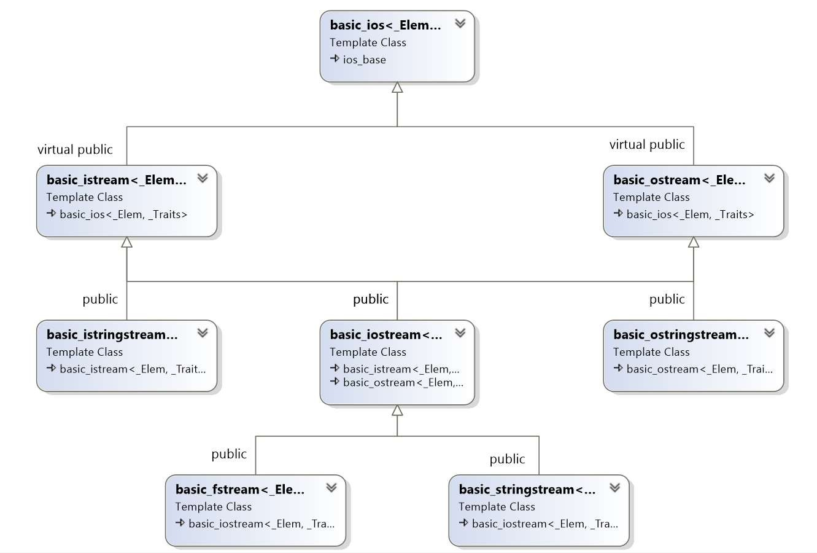
Stream Classes

Slide 130
Stream Class Typedefs
ios
istream
ostream
ifstream
istringstream
iostream
ofstream
ostringstream
fstream |  |  | stringstream
130

Slide 131

File Open Modes
The following modes can be used while opening a file
These are constants defined in std::ios_base class
Some modes can be combined e.g. std::ios::in | std::ios:: out, etc
Mode | Meaning
app | seek to the end before each write operation
binary | open in binary mode
in | open for reading (default for ifstream)
out | open for writing (default for ofstream)
trunc | discard file contents before opening
ate | seek to end after open

Slide 132
Stream State Flags
Flag | Meaning | Function
goodbit | no error | bool good()
badbit | irrecoverable stream error | bool bad()
failbit | I/O operation failed | bool fail() [operator !]
eofbit | end of file reached during input | bool eof()

Slide 133
Templates
Generalizes software components
Such components can be reused in different situations
Operate of any kind of data
High performance algorithms & classes
Compile time; no runtime costs are involved
Libraries such as ATL, WTL, Boost, POCO, ACE, etc. use templates for implementation

Slide 134
Function Templates
Function that accepts template type arguments
Always begins with template keyword
Template type argument is called type name
Type name is a placeholder for the actual type
Can accept any type
The template type can be used as return type
Template parameter list
template<typename T> T Function(T arg){
//Implementation
}

Slide 135
Template Argument Deduction
Process of deducing the types
Each function argument is examined
The corresponding type argument is deduced from the argument
The type argument deduction should lead to same type
Type conversions are not performed
After deduction, the template is instantiated
Override deduction by specifying types in template argument list
Max<int>(3,5) ;

Slide 136
Template Instantiation
A template function or class only acts as a blueprint
The compiler generates code from the blueprint at compile time
Known as template instantiation
Occurs implicitly when
a function template is invoked
taking address of a function template
using explicit instantiation
creating explicit specialization
Full definition of template should be available
Define in header file

Slide 137
Explicit Specialization
Template specialized for a particular type
Provides correct semantics for some datatype
Or implement an algorithm optimally for a specific type
Explicitly specialized functions must be defined in a .cpp file
Primary template definition should occur before specialization

Slide 138
Nontype Template Arguments
Expression that is computed at compile time within a template argument list
Must be a constant expression (addresses, references, integrals, nullptr, enums)
Part of the template type
Used by std::begin & std::end functions

Slide 139
Type Definition (typedef)
Introduces a name for an existing type
This name becomes a synonym of that type
Useful to construct shorter or more meaningful names for existing types
Simplifies declaration of some types (e.g. function pointers & templates)
Implementation details that may change can be encapsulated
Does not introduce a new type; only introduces a new name for existing type

Slide 140
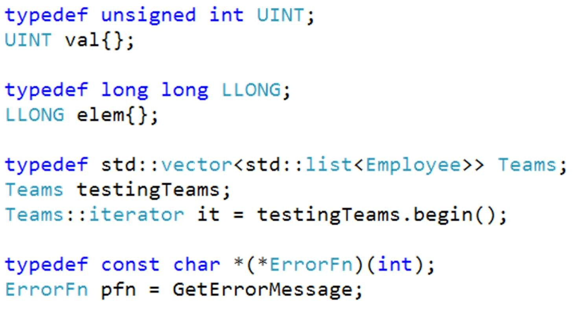

Example
140

Slide 141
Type Alias
Creates a name that is a synonym of existing type
Does not introduce a new type
Same as a typedef declaration
Created through the using keyword
using identifier = type ;

Slide 142
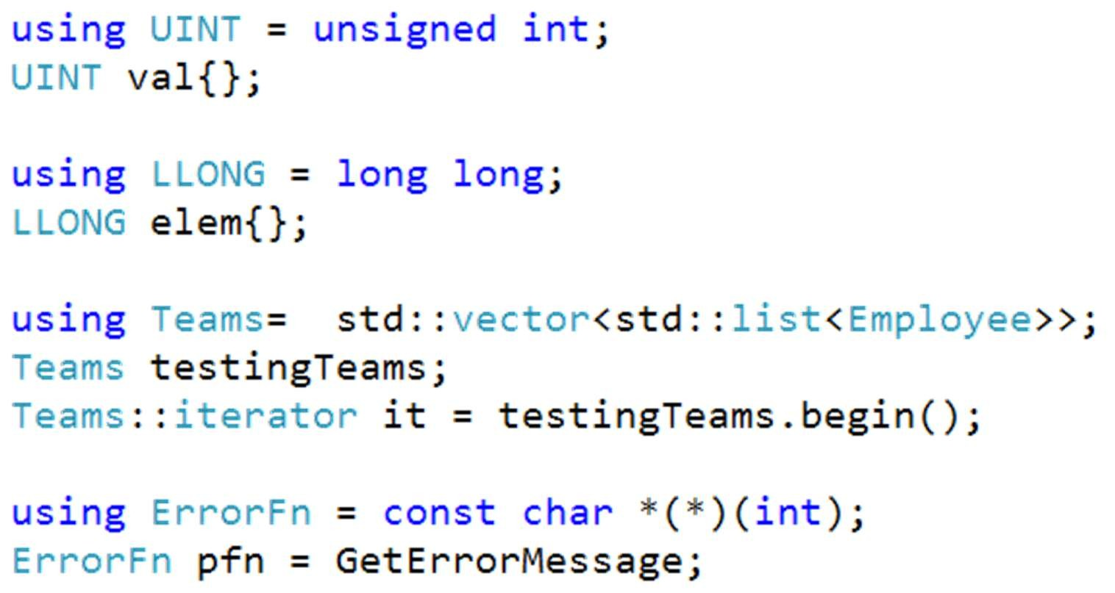
Example

Slide 143
Function Object
Object with overloaded function call operator
Call to overloaded function call operator resembles a global function call
Can be used as a callback instead of function pointers
More efficient than function pointers
Usually implemented as structs

Slide 144
Function Pointer Vs Function Object
Function Pointer
Invoked through a pointer
Dynamic in nature
Can be specified at runtime
Difficult to optimize
Slow
Cannot store state
Function Object
Invoked through an object
Static in nature
Must be specified at compile time
Easy to optimize
Fast
Can store state

Slide 145
Lambda Expressions
Defines an anonymous function object
Syntactic shortcut for a function object
Can be passed as an argument
Can accept parameters and return values

Slide 146
Lambda Expressions
Typically, encapsulates a few lines of code
Behaves like a normal function when invoked
Replaces function objects
Internally, implemented as a nameless function object
Use auto to provide an explicit name

Slide 147
Syntax
Arguments
Mutable Specification Exception Specification
Trailing Return type
Lambda Introducer
[](
{
<args>
)
<mutable> <excp specification> -> <return type>
Lambda
Body
}

Slide 148

Capture List Modes
Capture Mode | Explanation
[var] | Capture var by value
[=] | Capture all enclosing scope variables by value
[&var] | Capture var by reference
[&] | Capture all enclosing scope variables by reference
[&, var] | Capture var by value & other variables by reference
[=, &var] | Capture var by reference & other variables by value
[this] | Capture this (captures all member variables)

Slide 149
Generalized Capture (C++14)
This feature allows creation of new variables in the capture clause
The type of these variables is deduced from the type produced by the expression
Consequently, these variables must always be initialized
If the initializer expression is a variable, the new variable can have the same or different name
To create a reference, you have to use operator & before the variable name
[var=expression](args) [&var=expression](args)

Slide 150
Standard Template Library
Heart of the standard library for C++
Developed by Alexander Stepenov & Meng Lee at Hewlett Packard
Provides fast & reusable containers and algorithms
Relies heavily on templates; almost every component in the STL is a template
150

Slide 151
Core Components
Container classes, algorithms & iterators form the core components of the STL
Container classes represent data & algorithms represent operations on the data
Iterators serve as the glue between containers and algorithms
Also includes classes for concurrency, random numbers, regular expressions, utilities, etc.

Slide 152
Why use the STL?
Quicker development
Reliable
Portable
Efficient & fast
Accurate
Readable code
Lower maintenance cost

Slide 153

Container Types
Sequence | Header
array | <array>
vector | <vector>
list | <list>
deque | <deque>
forward_list | <forward_list>
Associative | Header
set, multiset | <set>
map, multimap | <map>
Unordered | Header
unordered_set, unordered_multiset | <unordered_set>
unordered_map, unordered_multimap | <unordered_map>
Common functions
default constructor
uniform initialization constructor
copy constructor
iterator constructor
size()
clear()
begin()
end()
default allocator

Slide 154
Iterators
Pointer like objects
Used to access elements by their position
Provide overloaded operators, such as ++, --, *, etc
Created through begin() & end() functions in all containers
begin
end

Slide 155
std::array
Thin wrapper over C-style static array
Supports iterators
Knows about its size
Provides random access
Can be used with C functions
Cannot grow

Slide 156
std::vector
Behaves like a dynamic array
Grows automatically
Efficient for addition/removal at the end
Provides random access
Not good for insertion/deletion

Slide 157
std::deque
Efficient for addition/removal at the both ends
Grows automatically
Provides random access
Not good for insertion/deletion

Slide 158
std::list
Implemented as a two-way linked list
Efficient for insertion/deletion anywhere
Does not provide random access

Slide 159
std::forward_list
Implemented as a one-way linked list
Small memory footprint
Efficient for insertion/deletion
Does not provide support for size
Elements are added at the front

Slide 160
std::set/std::multi_set
Implemented as a binary tree
Elements are stored in sorted order (< & >)
Value acts as key
Fast search
No random access
Elements cannot be modified directly
160

Slide 161
std::map/std::multi_map
Implemented as a binary tree
Stores a pair that contains a key and value
Elements are stored in sorted order based on a key
Fast search
No random access
Key
Value
Keys cannot be modified directly
161

Slide 162
Unordered Containers
Associative containers implemented as hash tables
Values are hashed and stored in undefined order
Fast search, insertion/deletion, but may degrade over a period of time
std::unordered_set stores values that act as keys for hashing
std::unordered_map stores pairs (first is used to compute hash)
Iterators are constant
Unordered set/multiset
Unordered map/multimap
162

Slide 163
Implementation
Buckets
Entries
Insert Element
Hash
Function
Load factor = entries/capacity

Slide 164
Complexity
Amount of time taken by an algorithm to run for input of size
n
Commonly, represented through Big-O notation e.g.
O(1) represents constant time
O(n) represents linear time
Gives a rough idea about the performance of an algorithm
Useful for large input size

Slide 165
Container Changes
All member functions that create an iterator are noexcept
New member functions, such as emplace(), emplace_back(), emplace_front() in containers, support for brace list initialization
Containers are move aware and will prefer move over copy
In std::vector, new functions were added - data(), shrink_to_fit()
std::erase added for sequence containers
Associative containers got new functions – emplace_hint(), extract(), contains()

Slide 166

Complexity of Operations
Container | [ ] | push_back | pop_back | insert | erase | find | sort
array | O(1) |  |  |  |  | O(n) | O(n log n)
vector | O(1) | O(1) | O(1) | O(n) | O(n) | O(n) | O(n log n)
deque | O(1) | O(1)* | O(1)* | O(n) | O(n) | O(n) | O(n log n)
list | NA | O(1) | O(1) | O(1) | O(1) | O(n) | O(n log n)
forward_list | NA | NA* | NA* | O(1) | O(1) | O(n) | NA
set/multiset | NA | NA | NA | O(log n) | O(log n) | O(log n) | NA
map/multimap | NA | NA | NA | O(log n) | O(log n) | O(log n) | NA
unordered_set/ unordered_multiset | NA | NA | NA | O(1) | O(1) | O(1) | NA
unordered_map/ unordered_multimap | NA | NA | NA | O(1) | O(1) | O(1) | NA

Slide 167
Summary
Use vector for random access, but not insertion & deletion
deque is preferable when elements need to be inserted and removed from both the ends
Use list if frequent insertions & deletions are required
Use forward_list for memory constrained systems
Use associative containers if lookup/search is important
Favour unordered containers if elements need not be ordered, else use set/map

Slide 168
User Objects & Containers
Compilers may define certain rules for user defined objects if they have to be stored in containers
These are mostly about certain operators that have to be overloaded for the user objects
Generally, your objects should have the following operators overloaded : < > != ==
These operators are used by various containers for sorting & searching
Not always required

Slide 169
Algorithms
STL provides algorithms for common tasks
Sorting, removing, searching, numeric, etc
More optimized than handwritten loops
Work with all containers regardless of the data type
Several algorithms can be customized through user-defined operations
Some containers provide specialized versions of algorithms
list provides sort & remove
associative containers provide lower_bound, upper_bound, find, etc
Most algorithms reside in <algorithm> header

Slide 170
C++ Concurrency
Large applications have multiple components
Some components may have to execute concurrently
This allows efficient usage of the CPU
C++11 added support for concurrency
Includes utilities for starting and managing threads
170

Slide 171
std::thread
Accepts a callable as constructor argument
The callable is executed in a separate thread
The constructor does not wait for the thread to start; it returns immediately
Resides in <thread> header

Slide 172
Joined & Detached Threads
A thread can be joined or detached
Call join() to wait for the thread to return
The thread object should be destroyed after calling join()
destroying the thread object without calling join() will terminate the program
A detached thread can be created by calling detach() on thread object
Detached threads are not joinable

Slide 173
std::async
Part of high-level concurrency
Executes a callable object or a function in a separate thread (if possible)
Returns a std::future object that provides access to the result of the callable
Include the header <future>

Slide 174
std::future
Used for communication between threads
Created through std::promise
created by std::async, that directly returns a future object
represents an input channel
std::future is the output channel
Promise/future pair allow safe data sharing between threads

Slide 175
Removed Features
register keyword
Exception specifications
operator++(bool)
Trigraphs
auto_ptr
Library Functions

Slide 176
register Keyword
A hint that specifies the variable should be stored in a register
This storage class is now removed in C++17
It has no effect on the semantics of the program
void RegisterKeyword() { register int x ;
x = 5 ;
}

Slide 177
operator++(bool)
Increment operator on a bool type is removed
Decrement operators were never allowed
int main() {
bool x{} ; x++ ;
}

Slide 178
Trigraphs
Special character sequences used when a system does not support 7- bit ASCII
E.g. ??- produced ~
These have been removed to speed up the compilation process

Slide 179
Exception Specifications
Feature that allowed a function to advertise what exceptions it throws
Not implemented by many compilers
Replaced by noexcept
void Check(int a) throw (int) { if(a > 1000)
throw 1 ;
}

Slide 180
std::auto_ptr
Smart pointer in C++98
No ownership semantics
Could lead to bugs
Replaced with std::unique_ptr & std::shared_ptr

Slide 181
Library Functions
std::random_shuffle
std::unary_function
std::ptr_fun
std::bind1st….
https://isocpp.org/files/papers/p0636r0.html

Slide 182
Changes
Direct list initialization with auto
static_assert
Different begin & end types on range-based for loop

Slide 183
Direct List Initialization
Using auto with list initialization containing one element would deduce the type of variable as std::initializer_list
In C++17, there are two rules for direct list initialization
for one element, auto deduces from that element
for multiple elements, it will be ill-formed
For copy initialization, the type is always std::initializer_list
auto a{ 1 };
auto b{ 1,2 };
//int
//Ill-formed
//std::initializer_list
auto c = { 1 }; auto d
= { 1,2 }; //std::initializer_list

Slide 184
Range-Based For Loop
Range-based for loop allows easy iteration over a range
It automatically expands to a loop that uses iterators to iterate over the range
Relies on presence of iterators
begin & end iterators must be same until C++14
C++17 removes this limitation; they can be of different types, but must provide operator != for comparison

Slide 185
Expansion
std::array<int, 5> values{ 1,2,3,4,5 };
for (auto v
//Use v
}
: values) {
//Pseudo code
auto | && range | = | values ;
auto | begin | = | std::begin(range);
auto | end | = | std::end(range); | //Can | be of a different type in C++17
for (; begin != end ; ++begin) { auto v = *begin ;
//Use v
}

Slide 186
Type Traits
Type traits give the ability to introspect
find the characteristics of types at compile time
transform the properties of the type
Useful in template metaprogramming
Will either return a boolean or a type when inspecting types
Provides template-based interface and defined in header
<type_traits>
Some traits require support from the compiler
compiler provides intrinsics for such traits
186

Slide 187
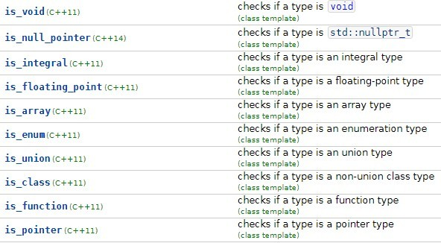
Type Traits

Slide 188
static_assert
In C++17, static_assert can have a condition without a message
error C2607: static assertion failed error C2338: Only pointer types allowed
template<typename T>
void CheckPointer(T args) {
static_assert(std::is_pointer_v<T> ) ; static_assert(std::is_pointer_v<T>, "Only pointer types allowed" ) ;
}
int main() {
int x {} ; CheckPointer(x)
; //Causes assertion
CheckPointer(&x) ;
}

Slide 189
Evaluation Order
In previous standards, the evaluation order of sub-expressions in function parameters was unpredictable
In the following statement, it is unspecified in which order the functions will be invoked
using namespace std ;
cout << a() << b() << c() ;
cout.operator<<(a()).operator<<(b()).operator<<(c());
1
2
3
4
5
6

Slide 190

Evaluation Order
void F(
std::unique_ptr<int> p1,
std::unique_ptr<int> p2) {
//Implementation
}
int main() {
F(
std::unique_ptr<int>
{new int},
std::unique_ptr<int>
{new int}
) ;
}
//1
//2
//3
//4
Pre-C++17 | C++17
2, 4, 1, 3 | 2, 1, 4, 3
4, 2, 3, 1 | 4, 3, 2, 1

Slide 191
Exception Specification
Exception specification for a function was not part of the function signature/type
In C++17, it is part of the function’s type

Slide 192
Structured Bindings
Allows initialization of multiple variables with the elements or members of an object
The object could be object of a class/struct or an array
For objects of classes, the members should be public
The number of variables should match with the number of elements in the object
auto [variables] = object ;
<cv qualifiers> auto &[variables] = object ;

Slide 193
Structured Bindings
Creates an anonymous entity which is a copy of the object
This anonymous entity cannot be accessed directly
We can only access the members through the structured binding
Useful when you want to read the data of each member to separate variables (or assign)
Makes the code more readable by binding the value directly to a name that conveys the real purpose of the data

Slide 194
Example
Person p ;
auto [n, a] = p ; //Creates an alias(copy) of p
//Use as separate variables
if(a < 18) {
std::cout << "Child:" << n << std::endl;
}
//Create a reference
auto &[n1, a1] = p ;
//Apply qualifiers
const auto &[n2, a2] = p ;

Slide 195
if-switch Initialization
C++17 added the ability to initialize and compare variables in if &
switch statements
These statements have an initialization clause in addition to conditional or select clause
Avoids creation of local variables that leak to the entire scope
if(initialization clause; condition clause){
}
switch(initialization clause; select clause){
}
195

Slide 196
Global Variables
In C++, a global name can be defined only once (ODR)
E.g. you should avoid defining a global variable in a header file
If the header file is included in multiple .cpp files, it would cause linker errors (violates ODR)
To avoid this, the global variable is defined in one of the .cpp files and declared extern in others
This satisfies ODR
In C++17, you can now define a variable in a header file without ODR errors through the inline keyword

Slide 197
Inline Variables
inline on a global variable implies it can have multiple definitions
The linker will treat it as only on variable even if it is encountered in multiple .cpp files
However, all the definitions must be exactly same
The definition of an inline variable should be accessible by the compiler before it can be used
All the instances of the inline variable will have the same address

Slide 198
Inline Static Variables
C++11 introduced non-static data member initialization
Allows initialized of non-static data members in the class
C++17 allows initialization of static data members through the inline
keyword
No need to initialize the static variable outside the class
This allows creation of header-only libraries
constexpr static member variables are implicitly inline

Slide 199
Nested Namespace
Namespaces can be nested with a simple syntax in C++17
Instead of using the namespace keyword on each nested namespace, you can now use scope resolution operator
namespace A { namespace B {
namespace C {
}
}
}
namespace A::B::C {
}
C++14
C++17

Slide 200
Attributes
Attributes used to be compiler-specific commands that give additional information to the compiler
They might be utilised for optimization or checks
Before C++11, different compiler vendors used keywords for attributes e.g. MSVC uses declspec, GCC uses attribute, etc
C++11 introduced some standardized attributes that work with all standard-compliant compilers
C++14 & C++17 introduced more attributes that you can use in your code
You cannot create custom attributes

Slide 201
Common Attributes
Attribute | Meaning | Use
[[noreturn]] | Indicates the function does not return (C++11) | Function
[[deprecated(””)]] | The entity is deprecated but can be used (C++14) | variables, classes, typedefs, functions, namespaces
[[nodiscard]] | The return value should not be discarded (C++17) | function, class, enum, variable declaration
[[maybe_unused]] | Prevents compiler for issuing warnings on non- used entities (C++17) | class, variables, enum declarations & functions
[[fall_through]] | Indicates deliberate fall through in a case statement (C++17) | switch-case
201

Slide 202
Lambdas
Two additions were made in C++17 in regards to lambda expressions
they can be constexpr (although the specifier is not required)
capture of *this

Slide 203
Feature Test Macro (C++17)
C++17 introduced a new macro - has_include
Can be used to check if a header is available for inclusion or not
Helps track the progress of partial implementations of new C++ standards
Can be used with #if & #elif expressions only
Modern C++

Slide 204
Class Template Argument Deduction
Template argument deduction is a process by which a compiler deduces the types
Until C++14, this worked only with functions and not classes
Consequently, to create instances of classes with multiple template arguments, we had to resort to make_ functions e.g. make_pair
With C++17, the deduction works with class templates as well
This feature is called class template argument deduction or CTAD
There are two types – compiler generated and user-defined
Works with direct or copy initialization of objects or objects on heap

Slide 205
Folding
It is process that applies a binary operator to a list of values recursively
The results are combined recursively, that builds up the final result
This process is called as folding
Variadic templates can perform folds over a template parameter pack
However, it requires overloads with recursion
needs to unpack the parameters for processing

Slide 206
Fold Expressions
C++17 offers a new way to unpack variadic parameters with binary operators
This is call fold expression
A fold expression reduces(folds) a parameter pack over a binary operator
This is a compact syntax for applying binary operations to the elements of a parameter pack
Simplifies implementation of variadic templates that have to apply binary operators on a parameter pack

Slide 207
Fold Expressions
The following syntax is provided for fold expressions
(pack op …)
(… op pack)
(pack op … op init)
(init op … op pack)
:unary right fold
:unary left fold
:binary right fold
:binary left fold
pack is unexpanded parameter pack
op is operator – can be any of the 32 binary operators
init is a value
207

Slide 208
Fold Expressions
The following syntax is provided for fold expressions
(pack op …)
(… op pack)
(pack op … op init)
(init op … op pack)
:unary right fold
:unary left fold
:binary right fold
:binary left fold
pack is unexpanded parameter pack
op is operator – can be any of the 32 binary operators
init is a value
208

Slide 209
Compile-Time if
This feature allows the condition of an if statement to be evaluated at compile time
It also discards branches of an if statement at compile-time
if constexpr(condition)
The expression condition must be a constant condition and it should be possible to be evaluate it at compile-time
Can be used in template & non-template functions

Slide 210
Compile-Time if
Only the block that follows the true condition is evaluated; the else blocks become discarded statements
Note that the discarded statements must be still valid statements
It also work with initialization inside if constexpr and runtime if
statements
if constexpr can be used only inside functions, not outside

Slide 211
std::optional
A new library type that can be used when a function may or may not return a value
If it does not return a value, a common way is to compare with a predefined value such as 0, nullptr, true/false, etc
This leads to different kinds of checks for different types
std::optional<T> can represent a type that may or may not contain a value
often called a nullable type

Slide 212
Properties
No value is represented by std::nullopt
std::optional is a value type – so, it can be copied through deep copy
Does not need to allocate any memory on heap
You cannot store references inside std::optional
Provides several overloaded operators and functions to access the value inside safely
May throw std::bad_optional_access

Slide 213
Unions in C++
Gives the ability to represent all the members in the same memory
Saves space
However, it has several disadvantages
no way to know which type it holds
nested types with non-default constructors deletes the default constructor of the union
cannot assign objects of user-defined types directly to a union member
user-defined types are not destroyed implicitly
cannot have a base class
cannot derive from a union

Slide 214
std::variant
std::variant is a type-safe replacement for union type
Just like union, it uses the storage of the largest member
The first member is always default initialized if variant is default constructed
Alternatively, you can initialize any member of the variant during construction
Members are destroyed properly
Throws bad_variant_access on invalid access

Slide 215
std::variant
Type of the current value is always known
It can hold values of any specified type
Always holds a value (except in some rare situations)
You can derive from it
Doesn’t require heap memory
Easily initialize or assign a new value to a member
Members are automatically destroyed

Slide 216
Type Safety
C++ is a strongly typed language
Object are declared with a specific type and that cannot be changed later
In some cases, we may require an object that should hold values of different types
This is difficult to achieve in C++, except through void *
However, such pointers have certain disadvantages
Not typesafe
No way to know the type
Cannot access the value in a type-safe way
Need to manage the object lifetime

Slide 217
std::any
C++17 introduced std::any
A wrapper that can hold value of any arbitrary type in a type-safe way
Replacement for void *
Contains both the value & its type
The value is accessed through any_cast<>
May allocate memory on the heap
Throws exception of type bad_any_cast on wrong type access

Slide 218
std::string_view
Allows us to deal with character sequences without allocating memory
Can be considered as a kind of reference to a character sequence
Can be used where ever a non-modifiable string is required
It simply stores a pointer to the character array along with its length
It is fast and cheap to copy
However, it should be used carefully as it can lead to bugs
length data
– 4
– 0x123
std::string_view
a |  | s | t | r | i | n | g |  | i | n

Slide 219
Properties
Underlying sequence is read-only
It can be accessed through data() method
may return a nullptr
a character sequence without null terminator
You can only assign a new value, swap values and shrink it to a subset of character sequence
Character sequence is not guaranteed to be null-terminated
consequently, may not work with C string functions
No allocator support

Slide 220
When to use std::string_view
Don’t pass in functions that accept a C-style string because it might not have a null terminator
Do not return string view to string from a function
Do not assign temporary strings to string views
Avoid as class members
Avoid using as constructor argument to initialize a string member

Slide 221
Filesystem
C++17 added support for working with filesystem components
Adopted from Boost.Filesystem, it was adjusted to new language standards and made consistent with other parts of the library
Provides facilities for performing following operations
manipulation of filesystem paths
create, move, rename, delete directories
list contents of a given directory
get information about path, file permissions, etc
To create, read & write files, you’ll still use the stream library classes

Slide 222
Filesystem
The facilities are provided in <filesystem> header under std::filesystem
namespace
path – allows manipulation of paths that represent existing files or directories
directory_entry – represents a path with additional information such as file size, file times, etc
directory_iterator – an iterator that iterates over the contents of a directory
functions for working with directories
and much more
Many functions will throw std::filesystem_error exception on failure

Slide 223
Parallel STL Algorithms
May STL algorithms by default execute serially
C++17 provides overloads to these algorithms that can now execute parallelly
Algorithms that can be parallelized accept a new template parameter called execution policy
used to disambiguate the calls to overloads of the algorithm
This can be used to inform the algorithm if it should execute serially or parallelly
The internal implementation details are hidden to the user

Slide 224
Syntax
Parallel versions of STL algorithms have a simple interface
They are provided as overloaded functions with the first parameter signifying the execution policy
Execution policy defines how the algorithm should execute
std::algorithm(execution_policy, /*begin, end, other args*/) ;

Slide 225
Execution Policies
All execution policies existing in <execution> header and in std::execution
namespace
Each of the policy is an individual type
sequenced_policy - seq
the algorithm’s execution will not be parallelized and will perform operations sequentially element by element
same as invoking the algorithms from C++14
parallel_policy - par
indicates the algorithm should execute parallelly
might use threads from a thread pool for execution along with the calling thread
parallel_unsequenced_policy – par_unseq
indicates the execution may be parallelized, vectorized or migrated across threads

Slide 226
Parallelized Algorithms
std::adjacent_difference std::adjacent_find std::all_of
std::any_of std::copy std::copy_if std::copy_n std::count std::count_if std::equal std::fill std::fill_n std::find std::find_end std::find_first_of std::find_if std::find_if_not std::generate std::generate_n std::includes std::inner_product std::inplace_merge std::is_heap std::is_heap_until
std::is_partitioned std::is_sorted std::is_sorted_until std::lexicographical_compare std::max_element
std::merge std::min_element
std::minmax_element std::mismatch std::move std::none_of std::nth_element std::partial_sort
std::partial_sort_copy std::partition
std::partition_copy std::remove std::remove_copy std::remove_copy_if std::remove_if std::replace std::replace_copy std::replace_copy_if std::replace_if
std::reverse std::reverse_copy std::rotate std::rotate_copy std::search std::search_n std::set_difference std::set_intersection
std::set_symmetric_difference std::set_union
std::sort
std::stable_partition std::stable_sort std::swap_ranges std::transform std::uninitialized_copy std::uninitialized_copy_n std::uninitialized_fill std::uninitialized_fill_n std::unique std::unique_copy

Slide 227
New Algorithms
for_each for_each_n reduce exclusive_scan inclusive_scan transform_reduce
transform_exclusive_scan transform_inclusive_scan

Slide 228
Exception Handling
If an element access function throws an exception which is not handled, all parallel algorithms call std::terminate
This also applies if sequential execution policy is chosen
If you want to handle exceptions, use the standard algorithms instead
Parallel algorithms themselves may throw std::bad_alloc if they fail to acquire memory during execution

Slide 229
Parallel Algorithms Everywhere?
Backward compatibility
Can use both input & output iterators
Synchronization is expensive
Parallelized algorithms terminate on exceptions, sequenced do not
Do not give good performance for operations on small number of elements due to overhead

